Slide 1
The Need for Approximations:
We can prove it's impossible, yet we do it anyway!
Gary T. Leavens
Leavens@ucf.edu
Professor of Computer Science, January 9, 2024
Notes:
Please ask questions!

Slide 2
Background: Problems
A problem is a specification of a procedure’s desired relation between inputs and outputs
(possibly with some resource constraints)
E.g.,
Given two positive integers n and m, produce the remainder, r, of n divided by m,
i.e., such that 0 ≤ r and there is some integer k such that k∙m+r = n.
Notes:
Specifying problems (gathering requirements) is part of software engineering, what software engineers do. The view here is somewhat limited, as it’s batch processing.

Slide 3
Background: Algorithms
Inputs: integers n, m. Assume n ≥ 0 and m > 0.
If n < m, then halt, returning n.
if n ≥ m, then set n to be n-m and go to step 1.
Notes:
An unambiguous method for accomplishing something. This is what computer programmers do.
Q: Does this algorithm always halt?

Slide 4
Effective Procedure
“a set of rules which tell us, from moment to moment, precisely how to behave.”
        -- M. Minsky, Computation: Finite and Infinite Machines (p. 106)
Practical definition:
a program written in a computer programming language
that always gives an answer
Notes:
The practical definition embodies “Church’s thesis”. Note that programming languages are VERY precise.

Slide 5
Example Program
define Rem(n, m) = if n < m then return n
else return Rem(n-m, m)

Slide 6
An Interesting Program
define H(x) = if odd(x) then return ((3*x)+1)/2
else return x/2;
define Steps(n) = if n == 1 then return 0
else return 1+Steps(H(n))
E.g., Steps(1) == 0
Steps(2) == 1
Steps(3) == 5
note: H(3)=5, H(5)=8, H(8)=4, H(4)=2, H(2)=1
Steps(7) == 11
Steps(27) == 70
Notes:
This is called the 3x+1 problem.

Slide 7
Can Programs do Everything?
Program = effective procedure,
note: must always give an answer
But if
Some problems can’t be solved by programs!
Then:
all problems ≠ what programs can do
Notes:
Problem = specification.

Slide 8
What does “impossible” mean?
Mathematical meaning is not:
  Socially unacceptable
    No, you can’t wear that!
  Illegal
    No, you can’t murder your brother!
  Very hard
    No, you can’t eat 100 hamburgers before 5pm!
  Against physical laws
    You can’t travel faster than the speed of light.

Slide 9
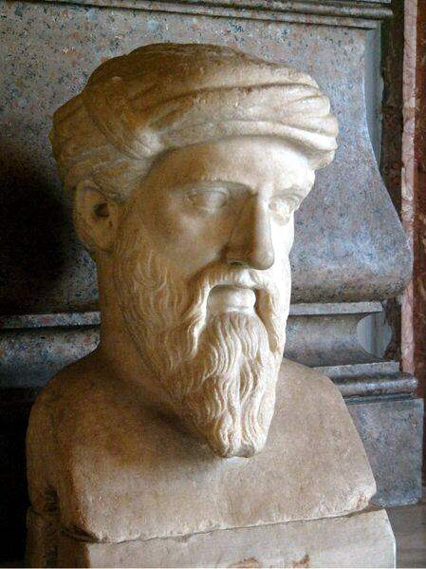
Mathematical meaning of
Impossible
Inconsistent with the accepted axioms
  2 = 3 ?
Famous examples:
  no fraction equal to square root of 2
  no solving the “halting problem”
from Livius.org, by permission
Notes:
The picture is a sculpture of Pythagoras (supposedly), who was really upset by the square root of 2 being irrational.

Slide 10

Impossibility,
What Computers Can’t Do
Notes:
Although this picture was created with a computer, of course!

Slide 11
The Halting Problem
Write a program, Halts(P,I), that takes
a program P, and input string I, and:
  Halts(P, I) = true, if P halts on input I,
  Halts(P, I) = false, if P does not halt on input I,
  Halts always returns true or false in a finite amount of time.
Notes:
Halts = finish. The program P can be written as a string (as can the input I). This would be very practical! Emphasize that we want to do this in *general*.

Slide 12
We care if programs halt
define H(x) = if odd(x) then return ((3*x)+1)/2
else return x/2;
define Steps(n) = if n == 1 then return 1
else return 1+Steps(H(n))
A student may say: “I tried Steps(703),
and it seems to run for a long time, does it stop?”
So, this is a practical, important problem.
Notes:
Steps(703) does halt, but we don’t know about Steps(n) for n>0 in general!

Slide 13
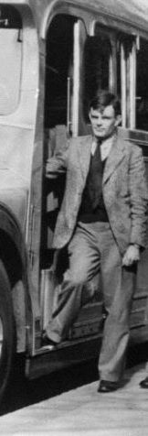
Work of Alan Turing (1936)
“Turing was a quite brilliant mathematician,
most famous for his work on breaking the
German Enigma codes.
It is no exaggeration to say that,
without his outstanding contribution,
the history of World War Two
could well have been very different.”
-- Gordon Brown’s statement Sept 10, 2009

Slide 14
Solving the Halting Problem is Impossible!
Proof by contradiction:
Suppose Stops solves the halting problem.
Let T be as in the program below:
define loop() = return loop(); % loops forever!
define T(P) = if Stops(P,P) then return loop()
else return false end
Consider T(T)
  By definition, T must either loop forever or return false.
  If it returns false,
  If it loops forever,
Notes:
T is constructed using Cantor’s diagonalization process.

Slide 15
Solving the Halting Problem is Impossible!
Proof by contradiction:
Suppose Stops solves the halting problem.
Let T be as in the program below:
define loop() = return loop(); % loops forever!
define T(P) = if Stops(P,P) then return loop()
else return false end
Consider T(T)
  By definition, T must either loop forever or return false.
  If it returns false, then Stops said T wouldn’t halt on input T,
  but it did halt!
  If it loops forever

Slide 16
Solving the Halting Problem is Impossible!
Proof by contradiction:
Suppose Stops solves the halting problem.
Let T be as in the program below:
define loop() = return loop(); % loops forever!
define T(P) = if Stops(P,P) then return loop()
else return false end
Consider T(T)
  By definition, T must either loop forever or return false.
  If it returns false, then Stops said T wouldn’t halt on input T,
  but it did halt!
  If it loops forever, then Stops said T must have halted on input T,
  but it didn’t (since it is looping forever)!
Notes:
Questions about that? Is this convincing?

Slide 17
Other Unsolvable Problems
Write AlwaysHalts(P) to decide if P halts on all inputs
  Unsolvable, since it includes the halting problem as a special case!
Write HaltsOnEmpty(P) to decide if P halts on “” as input
  Unsolvable, since can construct from HaltsOnEmtpy a procedure Stops that would solve the halting problem!
  define Stops(P,I) =
  define N(E) = return P(I); % ignore E and run P on I
  return HaltsOnEmpty(N)
Notes:
These decision procedures must never loop! Here a program always takes one argument (which might be a pair) as an input, so we can apply P to I.

Slide 18
Rice’s Theorem
There is no program that can decide any
non-trivial property of programs.
Notes:
Named after Henry Gordon Rice. It’s a theorem if we accept the Church-Turing thesis.

Slide 19
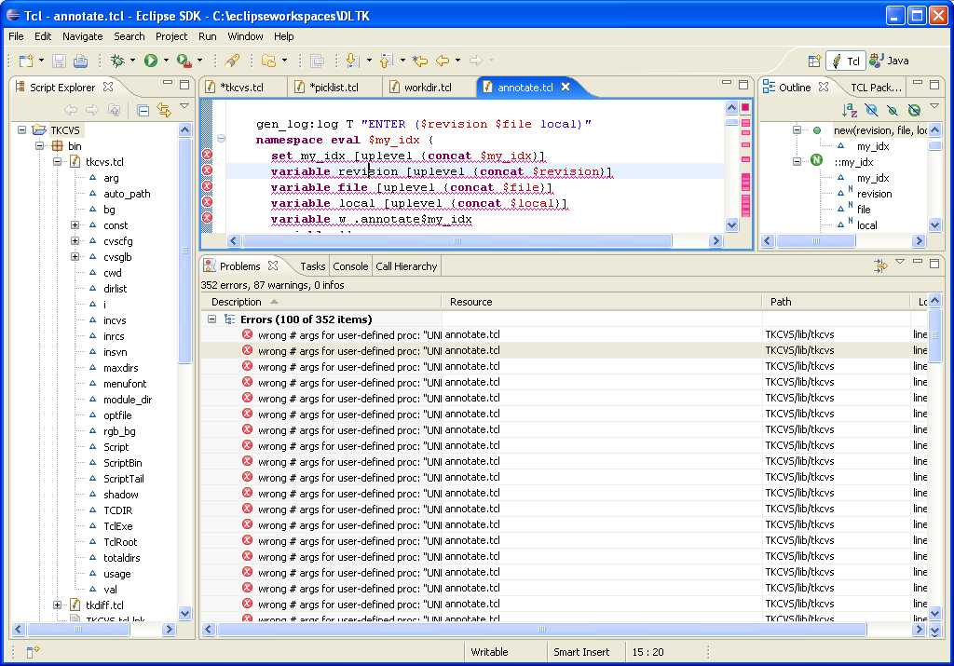
Can Programs Help Programmers?
Notes:
We’d still like to be able to check programs by programs.

Slide 20
What we’d like to Decide About a Program
Could the program encounter any type errors?
Could the program ever crash?
Will the program produce the correct output?
Are these impossible?
Yes, programs can’t decide these precisely,
must change the problem!
Notes:
Precisely means to answer “yes” or “no” and always halt, and get that 100% right.
All of these are easily shown to be undecidable. But we still want to do something with them…

Slide 21

Changing the Problem:
What should this (web) program do?
from umbrellatoday.com, by permission
Notes:
This web site has gone out of business…

Slide 22
What Should umbrellatoday.com do?
Need Umbrella? | It rains | No rain
“YES” | Good ☺ | OK 😐
“NO” | Bad ☹ | Good ☺
Safety (conservatism) means:
when in doubt say “bring umbrella”!
Notes:
We assume that no one wants to get wet.
Note: weather.com seems to add 20% to rain probabilities compared to weather.gov; that is similarly being conservative.

Slide 23
Example: Type Checking
A type error is an attempt to apply an operation
to arguments that are not appropriate
e.g., 3 + 4 % ok
true + 4 % type error!
Problematic cases:
if read() then return 3 + 4 else return true + 4 end
define A(I) = return I + 4;
define B() = return A(true);
Notes:
What to do if you don’t know which way the branch will go (as in the if)? Conservatively assume the worst.
What to do if you don’t know if B will be called? Assume it will be.

Slide 24
Specifications for Type Checking
What it says | Has Error in Run | No Error in Run
“type error” | Good ☺ | OK 😐
“no error” | Bad ☹ | Good ☺
Safety (conservatism) means:
when in doubt say “type error”!

Slide 25
Sound, Conservative
Type Checking
If tool says:
“type error”, then might be a type error at runtime
“no errors”, then won’t be any errors at runtime
Soundness means “no errors” is valid
Examples of where sound checker says “type error”:
if read() then return 3 + 4 else return true + 4 end
define A(I) = return I + 4;
define B() = return A(true);

Slide 26
Some Rules for Conservative
Type Checking
if E1 then E2 else E3 end : T
if E1: bool, E2: T, and E3: T
P(E): T if P: (S) -> T and E: S
P(x) = E remember P: (S) -> T
if assuming x: S then E: T
true: bool
false: bool
0: int, 1:int, 2:int, …
x: T if we are remembering x:T
E1 op E2: T if E1: S1, E2: S2, and op: (S1,S2) -> T
Notes:
These aren’t very precise and are simplified…

Slide 27
What a Sound Checker Does
Programs
Checker says
“no errors”
Programs without
runtime type errors
Undecidable
boundary
Checker says
“type error”
Programs with
runtime type errors
Notes:
The picture shows a sound checker, but it’s not complete. Talk about the game of making the green area get bigger without crossing the red line.

Slide 28
Sound but Not Very Useful
Programs
Checker says
“no errors”
Programs without
runtime type errors
Undecidable
boundary
Checker says
“type error”
Programs with
runtime type errors
Notes:
The picture shows a sound checker, but it’s less complete.

Slide 29
Apparently more Useful,
But Unsound
Programs
Checker says
“no errors”
Programs without
runtime type errors
Undecidable
boundary
Checker says
“type error”
Programs with
runtime type errors
Notes:
The picture shows a more complete checker, but it’s unsound! For some programs it says no errors when it’s not true!

Slide 30
Making better checkers
Work Without End!
Programs
Checker says
“no errors”
Programs without
runtime type errors
Undecidable
boundary
Checker says
“type error”
Programs with
runtime type errors
Notes:
The picture shows a more sound checker.

Slide 31
Other Workarounds
Accept “I don’t know”, written ┴, as an answer
Approximate by combining knowledge:
  e.g.,
  read() : ┴
  if B then read()+4 else 5+7 end : ┴
Notes:
This leads to a lot of static analysis work

Slide 32
What has been Accomplished (1)
Standard compiler techniques
  Type checking before running program
  Static analysis:
    No aliases for this object?
    Variables read before written?
Notes:
Standard compiler technology now.

Slide 33

What has been Accomplished (2)
ASTRḖE static analyzer (CNRS, ENS, INRIA, France)
  Checks embedded flight control software
  Used on Airbus control programs
  Proves absence of certain runtime errors
    Undefined behavior (e.g., division by 0)
    Non-portable code
    Violation of assertions

Slide 34
What has been Accomplished (3)
Terminator (Byron Cook, et al., MSR, Cambridge)
  Proves program fragments (in C) terminate
    What can it answer?
    Used on Windows device drivers
  Iterative search for potential counterexamples to termination
    The counterexamples demonstrate loops!
Notes:
Q: Can answer: “proved”, “here’s a loop”, or “don’t know”
Q: What would this program do when run on itself? “don’t know”

Slide 35
Conclusions
Some tasks are impossible, i.e., “undecidable”
Undecidable tasks give work without end!
It is possible to partly automate these tasks
  Intellectually interesting work

Slide 36
Impossible Problems give
Unlimited Potential for Advances
leavens@cs.ucf.edu

