Slide 1
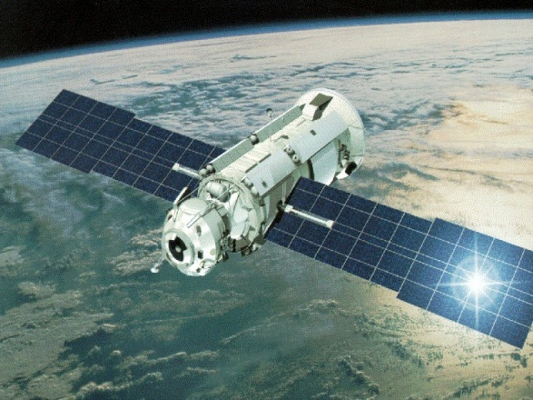
Introduction To Localization Techniques (GPS)
By: Linda Mohaisen
02/8/2010

Slide 2
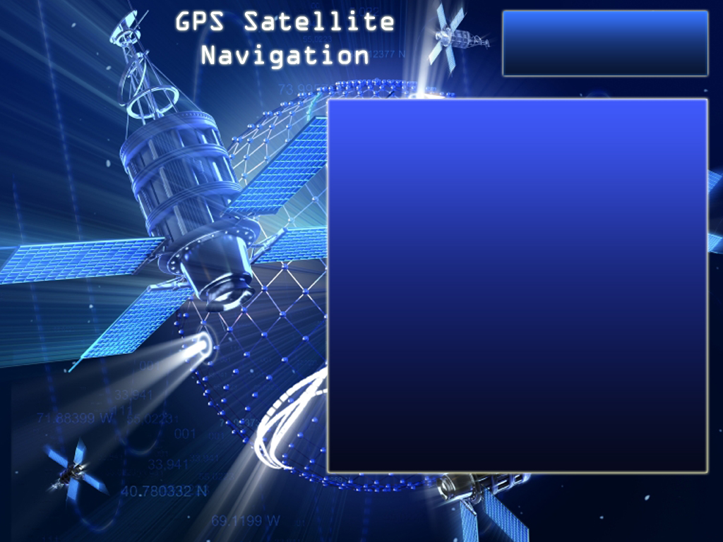
Outline
Introduction to the GPS
GPS Enhancement
Mapping Issues
Mobile Mapping Technology
Questions
references

Slide 3
1
Introduction to the GPS
  History
  GPS Architecture
  Common uses for GPS
  How the system works
  Measuring GPS Distance
  SV and GPS Receiver Clocks
  Measuring GPS Accuracy

Slide 4
What is GPS
GPS (Global Position System) is a satellite-based navigation system that sends and receives radio signals and provides the user with information.
Using the GPS technology, you can determine location, velocity, and time, 24 hours a day, in any weather condition.
GPS, formally known as NAVSTAR (Navigation Satellite Timing and Ranging) Global Position System which designed, financed, deployed, and operated by the U.S. Department of Defense (DOD).

Slide 5
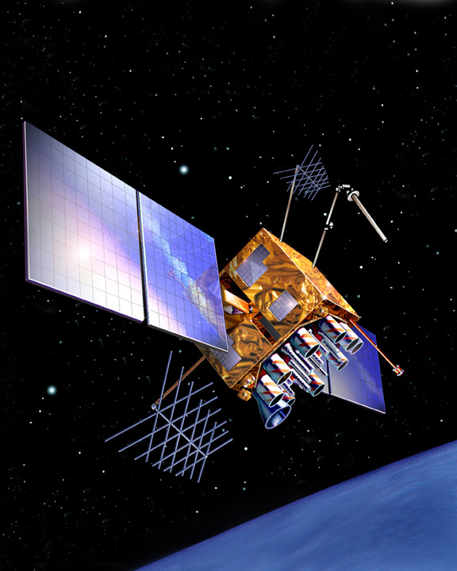
GPS Satellites Vehicles (SVs)
First GPS satellite launched in 1978.
Full constellation achieved in 1994.
Approximately 2,000 pounds, 17 feet across .
Transmitter power is only 50 watts or less .

Slide 6
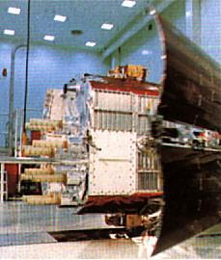
GPS Timeline
Phase 1: 1978
First Launch of Block 1 SV.
Phase 2: 1979-1985
Full Development and Tests.
Phase 3: 1985-Present
Production And Deployment.

Slide 7

Precise Positioning System (PPS)
Authorized users ONLY and U. S. and Allied military.
Requires cryptographic equipment, specially equipped receivers.
Accurate to 22 meters horizontal and 27.7 meters vertical and 200 nanosecond time.

Slide 8
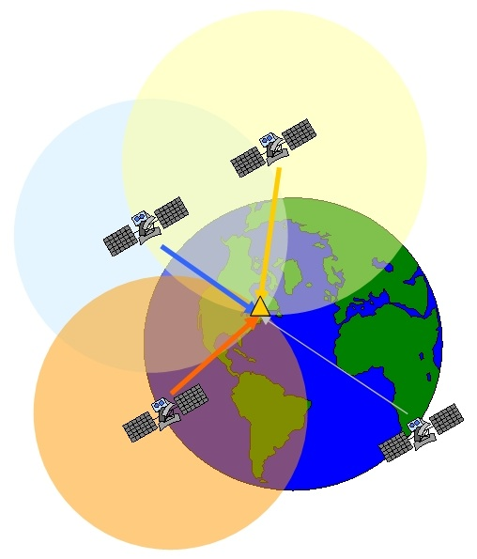
Standard Positioning Service (SPS)
Civil users worldwide use the SPS without charge or restrictions.
Accurate to 100 meters horizontal and 156 meters vertical and 340 nanosecond time.

Slide 9
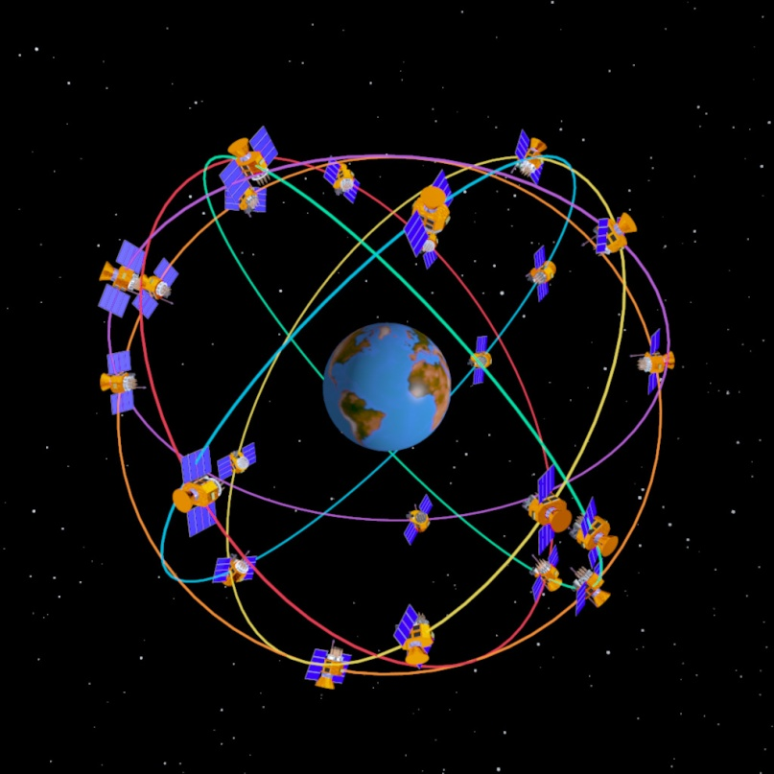
GPS System Architecture
GPS consists of three major segments:
User Segment
Control Segment
Space Segment

Slide 10
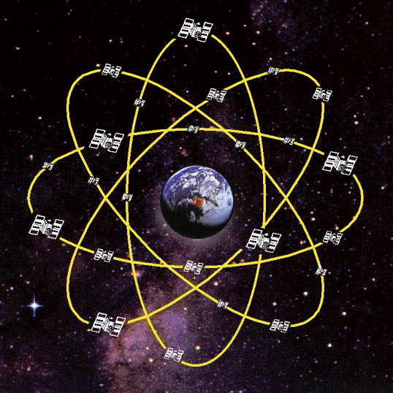
Space Segment
24 satellites
  6 planes and 55° to the equator.
  4 satellites per each orbital plane.
  24 operational satellites.
  Satellites orbit every 12 hours.
  Orbital trace repeated two times a day.

Slide 11
Space Segment
Considerations:
  Accuracy
  Survivability
  Coverage

Slide 12
Control Segment
5 stations are monitor stations, equipped with GPS and send the tracking data to the Master Control Station.
The tracking data are processed in Colorado Springs Master Control Station (MCS).
The three stations (Ascension Is., Diego Garcia, and Kwajalein) are Upload Stations. The data includes the orbit and clock correction information transmitted from MCS.

Slide 13
Control Segment
Colorado
Springs
Hawaii
Ascension
Islands
Kwajalein
Diego
Garcia
Master Control Station
Monitor Station
Ground Antenna

Slide 14
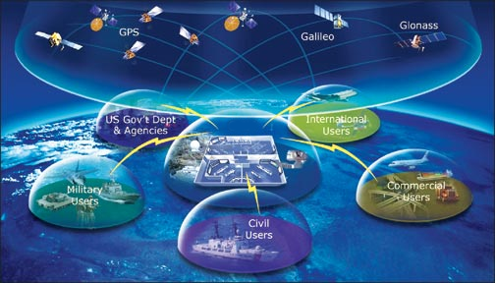
User Segment
Is composed of
  hundreds of thousands of U.S. and allied military users of the secure GPS Precise Positioning Service, and
  tens of millions of civil, commercial and scientific users of the Standard Positioning Service.
DoD/DoT Executive Board sets GPS policy.

Slide 15
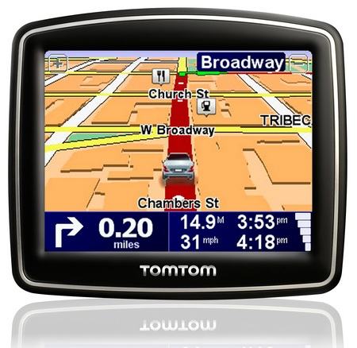
User Segment
In general, GPS receiver is a user segment, which is composed of an antenna, a highly reliable local clock (often a crystal oscillator,) processor’s and I/O interfaces.

Slide 16

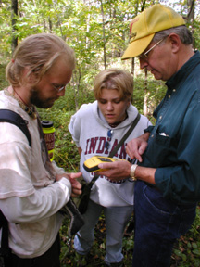
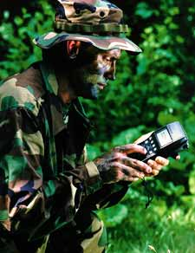
Common Uses for GPS
Land, Sea and Air Navigation and Tracking.
Military Applications.
Surveying/ Mapping.
Recreational Uses.

Slide 17
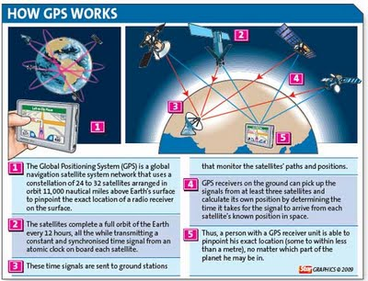
How the system works

Slide 18
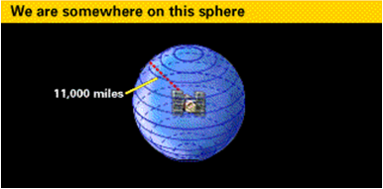
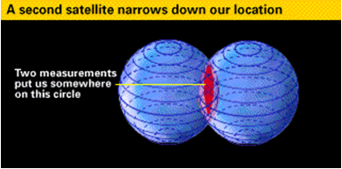
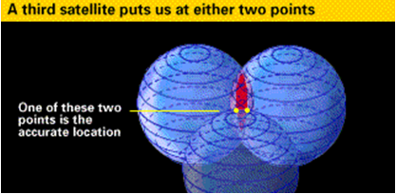
Triangulation

Slide 19
Measuring GPS Distance
Speed = 186,000 miles per second (speed of light).
Time = amount of time it takes for the signal to travel from SV to GPS receiver.
To measure the travel time:
  Receiver generates the same codes as the satellite (PRN codes).
  Measure delay between incoming codes and self generated codes.
Distance = Speed x Time Delay

Slide 20
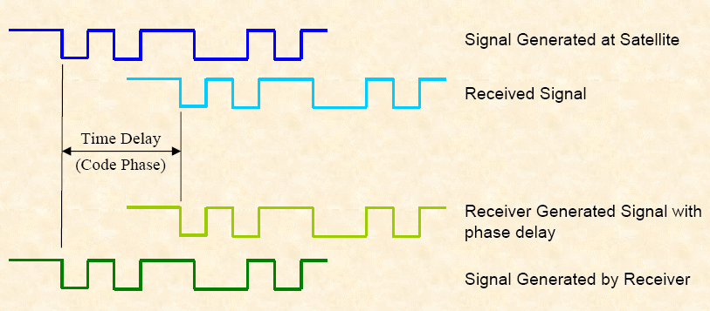
Measuring GPS Distance

Slide 21
SV and GPS Receiver Clocks
SV Clocks:
  GPS satellites carry very accurate atomic clocks and follow very precise orbits.
  Use the oscillation of 2 cesium & 2 rubidium atoms to measure time.
Receiver Clocks:
  GPS receiver has a built- in clock that can have a small timing error .
  Always an error between SV and GPS receiver clocks ( Δ t).
  SV Time is converted to GPS Time in the receiver using the SV clock correction parameters.

Slide 22
Measuring GPS Accuracy
The major factors that affect the accuracy of the GPS signal:
  Alignment, or geometry of the group of satellites (constellation).
  GPS Errors.

Slide 23
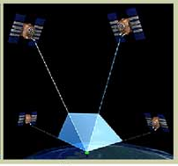
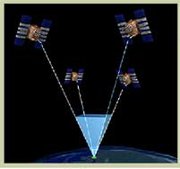
Geometric of Satellite Constellation
It is called Dilution Of Precision(DOP)
the geometry will be poor and the computed DOP value will be high when all satellites confined in one part of the sky or blocked by buildings, mountains, etc.
Good
Poor

Slide 24
Geometric of Satellite Constellation
The better the geometry (satellites properly spread in the sky), the lower the DOP value.
Good
QUALITY DOP
Very Good 1-3
Good 4-5
Fair 6
Suspect >6
Poor

Slide 25
The GPS Error Sources
Ionosphere and Troposphere Delay:
  The satellite signal slows down through the atmosphere.
  It uses the built-in model to calculate the average delay.
Ephemeris Errors/Clock Drift/Measurement Noise:
  The disparity in ephemeris data can introduce 1-5 meters of positional error.
  clock drift disparity can introduce 0-1.5 meters of positional error, and
  measurement noise can introduce 0-10 meters of positional error.

Slide 26
2
GPS Enhancement
  Differential GPS
  Wide Area Augmentation System

Slide 27
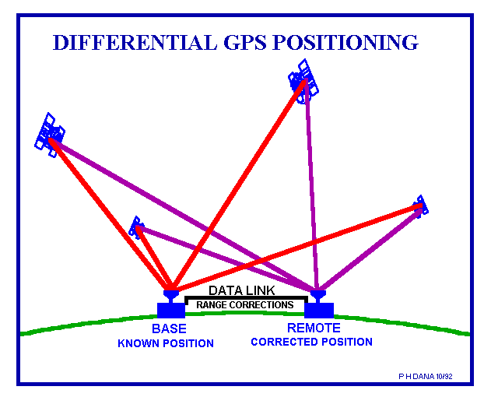
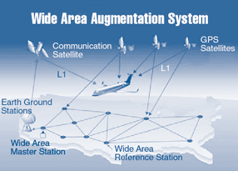
GPS Enhancement

Slide 28
Differential GPS
A technique to get accuracies within 1 -5 meters, or even better.
Differential correction eliminates most of the errors listed in the GPS Error Budget .
Differential correction requires:
  A second GPS receiver.
  a base station.
  collecting data at a stationary position on a precisely known point .

Slide 29
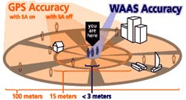
Wide Area Augmentation System
WAAS is a combination of ground- and space-based equipment to augment the standard positioning service of the GPS.
25 ground reference stations (Currently only in the US) receiving a standard GPS signal.
WAAS provides the functions for :
  differential corrections (to improve accuracy).
  integrity monitoring (to ensure that errors are within tolerable limits to ensure safety).
  ranging (to improve availability).
5 Times the accuracy (3m) 95% of time.

Slide 30
3
Mapping Issues
  Datum and Coordinate Systems

Slide 31
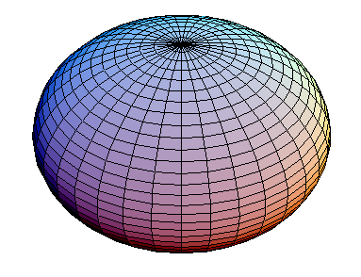
Datum and Coordinate Systems
Geodetic datum defines reference points on the Earth's surface against which position measurements are made.
The central to this concept is an associated model of the shape of the Earth to define a coordinate system.

Slide 32
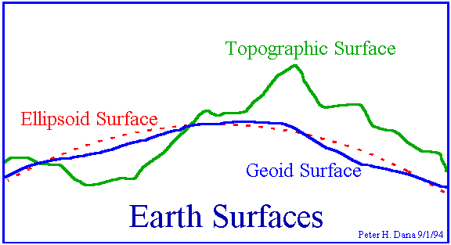
Datum and Coordinate Systems
Variety of models:
  Flat earth
  Spherical
  Ellipsoidal
Incorrect referencing of coordinates to the wrong datum can result in position errors of hundreds of meters

Slide 33
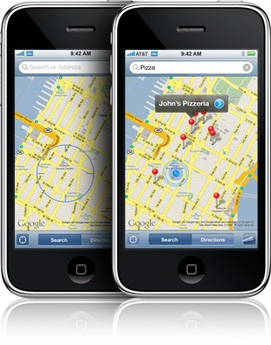
Mobile Mapping
Integrates GPS technology and GIS software .
Makes GIS data directly accessible in the field.
Can be augmented with wireless technology.

Slide 34

Questions

Slide 35
References
Corvallis Microtechnology, Inc. “Introduction to the Global Positioning System for GIS and TRAVERSE.” www.cmtinc.co . June, 1996.
  http://www.cmtinc.com/gpsbook/
The University of New South Wales. Sydney. Australia. “Notes on Basic GPS Positioning and Geodetic Concepts.” www.gmat.unsw.edu.au . June, 1999.
  http://www.gmat.unsw.edu.au/snap/gps/gps_notes.htm#chapter1

