Slide 1
Chapter 5: CPU Scheduling

Slide 2
Types of schedulers
Long term scheduler
selects process and loads it into ready queue (memory) for execution
Medium term scheduler
Memory manager
Swap in, Swap out from main memory non-active processes
Short term scheduler
Deals with processes among ready processes
Very fast, similar to action at every clock interrupt
if a process requires a resource (or input) that it does not have, it is removed from the ready list (and enters the WAITING state)

Slide 3
Basic Concepts (CPU Burst)
CPU–I/O Burst Cycle
Process execution begins with a CPU burst
Process execution consists of a cycle of CPU execution and I/O wait
CPU burst distribution
Long bursts – CPU bound
Shorts bursts – I/O bound

Slide 4
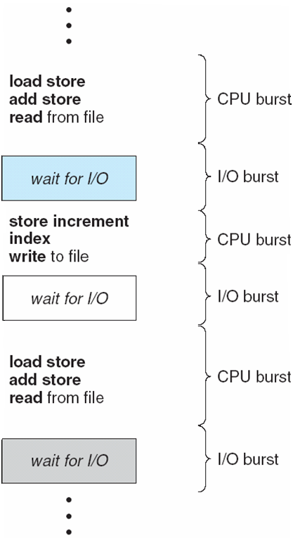
Alternating Sequence of CPU And I/O Bursts

Slide 5
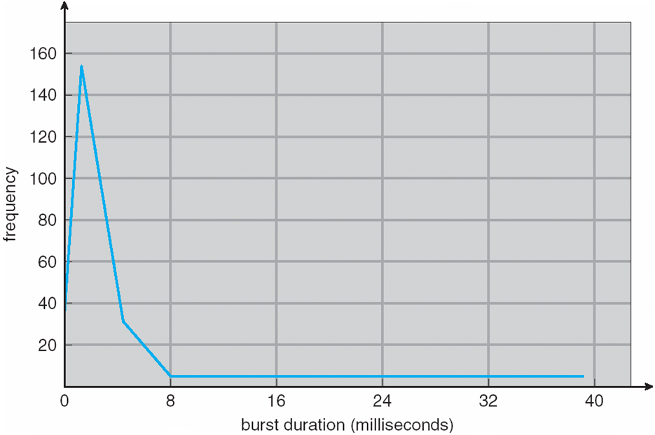
Histogram of CPU-burst Times
This can vary from OS to OS, and deployment to deployment
If you are doing scientific computing, the bursts will be long

Slide 6
CPU Scheduler
Selects from among the processes in memory that are ready to execute, and allocates the CPU to one of them
CPU scheduling decisions may take place when a process:
1. Switches from running to waiting state
Switches from running to ready state
-Normally, this happens at timer interrupts
Switches from waiting to ready
-Normally, this happens when an interrupt arrives as a result of an I/O being finished
4. Terminates
Scheduling under 1 and 4 is nonpreemptive
If you only schedule at these opportunities, you have a non-preemptive multi-tasking system.
Examples: Windows before XP, early MacOS
Requires collaboration from processes (e.g. call to yield())
All other scheduling is preemptive

Slide 7
Dispatcher
Dispatcher module gives control of the CPU to the process selected by the short-term scheduler; this involves:
switching context – reloading the appropriate registers with the ones expected by the new program
switching to user mode
jumping to the proper location in the user program to restart that program
Dispatch latency – time it takes for the dispatcher to stop one process and start another running
Overheads:
Dispatch latency
Cache flush: does the new process find the required memory items in the cache?

Slide 8
Scheduling Criteria
How do we choose a schedules? What constitutes a good one?
Several metrics we might be interested in
CPU utilization – keep the CPU as busy as possible
We want to maximize it
Throughput – # of processes that complete their execution per time unit
We want to maximize it
Turnaround time – amount of time to execute a particular process from beginning to end
Important for batch systems.
Waiting time – amount of time a process has been waiting in the ready queue
Fairness
Response time – amount of time it takes from when a request was submitted until the first response is produced
Important for interactive operating systems
Some of these are at odds with each other: we cannot simultaneously optimize all of them, only find a suitable balance.

Slide 9
First-Come, First-Served (FCFS) Scheduling
Process Burst Time
P₁ 24
P₂ 3
P₃ 3
Suppose that the processes arrive in the order: P₁ , P₂ , P₃ The Gantt Chart for the schedule is:
Waiting time for P₁ = 0; P₂ = 24; P₃ = 27
Average waiting time: (0 + 24 + 27)/3 = 17
No pre-emption, let the CPU burst run until it gives up the processor.
P₁
P₂
P₃
0
24
27
30

Slide 10
FCFS Scheduling (Cont)
Suppose that the processes arrive in the order
P₂ , P₃ , P₁
The Gantt chart for the schedule is:
Waiting time for P₁ = 6; P₂ = 0; P₃ = 3
Average waiting time: (6 + 0 + 3)/3 = 3
Much better than previous case
Example; one CPU bound and many I/O bound processes
Convoy effect short process behind long process
P₂
P₃
P₁
0
3
6
30

Slide 11
Shortest-Job-First (SJF) Scheduling
Shortest next cpu burst algorithm
Associate with each process the length of its next CPU burst. Use these lengths to schedule the process with the shortest time
SJF is optimal for the average waiting time – gives minimum average waiting time for a given set of processes
The difficulty is knowing the length of the next CPU request

Slide 12
Shortest-Job-First (SJF) Scheduling
SJF can be preemptive or non-preemptive
Choice arises when a new process arrives at ready queue
Non-preemptive
Always make a choice based on the current queue
Let the burst finish, regardless of what happens
Preemptive:
If a new process enters the queue, re-consider based on the remaining time for all processes
It might happen that a shorter process arrives and displaces the currently running one.

Slide 13
Example of SJF
Process Burst Time
P₁ 6
P₂ 8
P₃ 7
P₄ 3
SJF scheduling chart
Average waiting time = (3 + 16 + 9 + 0) / 4 = 7
P₄
P₁
P₃
P₂
0
3
9
16
24

Slide 14
Example of Pre-emptive SJF
Process Arrival Time Burst Time
P₁ 0.0 8
P₂ 1.0 4
P₃ 2.0 9
P₄ 3.0 5
SJF scheduling chart
Average waiting time = (10-1) + (1-1) + (17-2) + (5-3) / 4 = 6.5ms
P₁
P₂
P₄
P₁
P₃
0
1
5
10
17
26

Slide 15
Determining Length of Next CPU Burst
Can only estimate the length
Can be done by using the length of previous CPU bursts, using exponential averaging

Slide 16
Examples of Exponential Averaging
α =0
τ_{n+1} = τ_{n}
Recent history does not count
α =1
τ_{n+1} = α t_{n}
Only the actual last CPU burst counts
If we expand the formula, we get:
τ_{n+1} = α t_{n}+(1 - α)α t_{n} -1 + …
+(1 - α )^{j} α t_{n} _{-j} + …
+(1 - α )^{n +1} τ₀
Since both α and (1 - α) are less than or equal to 1, each successive term has less weight than its predecessor

Slide 17
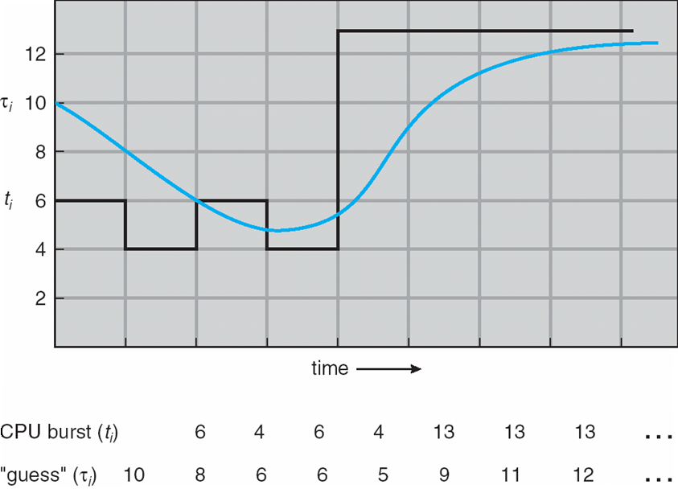
Prediction of the Length of the Next CPU Burst

Slide 18
Priority Scheduling
A priority number (integer) is associated with each process
The CPU is allocated to the process with the highest priority (smallest integer ≡ highest priority)
Preemptive
nonpreemptive
SJF is a priority scheduling where priority is the predicted next CPU burst time (priority inverse of prediction)
Problem ≡ Starvation – low priority processes may never execute
Solution ≡ Aging – as time progresses increase the priority of the process

Slide 19
Round Robin (RR)
Each process gets a small unit of CPU time (time quantum), usually 10-100 milliseconds. After this time has elapsed, the process is preempted and added to the end of the ready queue.
If there are n processes in the ready queue and the time quantum is q, then each process gets 1/n of the CPU time in chunks of at most q time units at once. No process waits more than (n-1)q time units.
Performance
q large ⇒ FIFO
q small ⇒ q must be large with respect to context switch, otherwise overhead is too high

Slide 20
Example of RR with Time Quantum = 4
Process Burst Time
P₁ 24
P₂ 3
P₃ 3
The Gantt chart is:
Typically, higher average turnaround than SJF, but better response
P₁
P₂
P₃
P₁
P₁
P₁
P₁
P₁
0
4
7
10
14
18
22
26
30

Slide 21
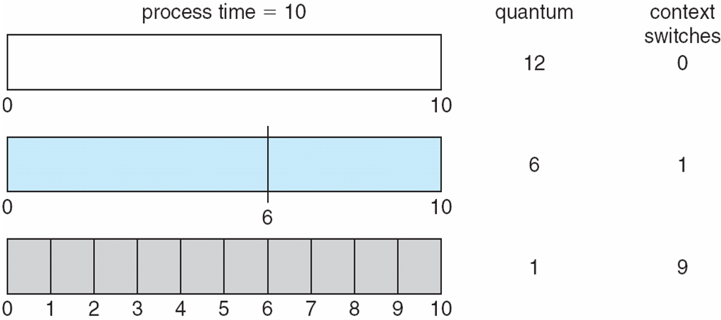
Time Quantum and Context Switch Time

Slide 22
Multilevel Queue
Ready queue is partitioned into separate queues. One possible choice is:
foreground (interactive)
background (batch)
Each queue has its own scheduling algorithm. For instance:
foreground – RR
background – FCFS
Scheduling must be done between the queues
Fixed priority scheduling; (i.e., serve all from foreground then from background). Possibility of starvation.
Time slice – each queue gets a certain amount of CPU time which it can schedule amongst its processes. For instance:
80% to foreground in RR
20% to background in FCFS

Slide 23
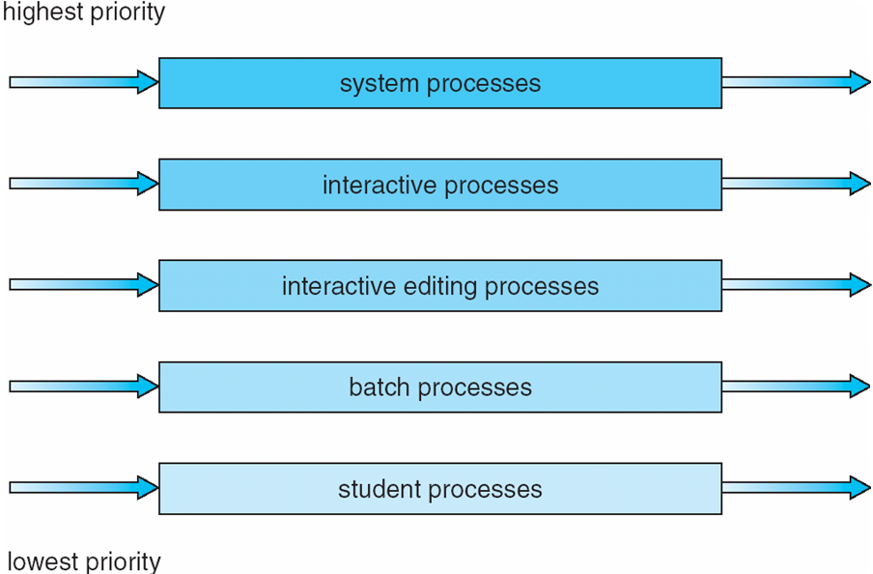
Multilevel Queue Scheduling

Slide 24
Multilevel feedback queue
Problem we want to solve:
Optimize for turn-around time (like Shortest Job First)
Optimize for response time (like Round Robin)
What about multi-level queue?
Every process wants to run on a highest priority!
How do we decide on the priority levels?
But we don’t know anything about the processes!
Multilevel feedback queue
Have multiple queues
Move processes between the queues
Based on the history of the processes in the queue

Slide 25
Multilevel Feedback Queue (continued)
The original idea had been around since 1962 (F.J. Corbato et al).
Many variations possible
Some of the possible choices of variations in MLFQs:
number of queues
scheduling algorithms for each queue
method used to determine when to upgrade a process
method used to determine when to demote a process
method used to determine which queue a process will enter when that process needs service

Slide 26
Intellectual exercise: building an MLFQ algorithm
Let us try to go through building an MLFQ step by step and see what it entails
Rule 1: If priority(A) > priority(B), A runs, B doesn’t
Rule 2: If priority(A)=priority(B), A and B run in round robin
Thoughts:
We only use RR
Cheap to implement
It will obviously have starvation
We need to decide on who goes into what queue

Slide 27
Building an MLFQ variant (2)
Rule 3: Jobs enter the system at the highest priority
Rule 4a: If a job uses up an entire time slice while running, its priority is reduced (i.e., it moves down one queue).
Rule 4b: If a job gives up the CPU before the time slice is up, it stays at the same priority level.
Thoughts:
Jobs with short bursts stay on top (typically interactive)
Jobs with long bursts sink to bottom
No way to move up – if the behavior changes, the process with the long bursts stay at the bottom
No immediate starvation, if there are few interactive jobs. But if they are many, they will starve the lower levels.
Can be gamed by a process (how?)

Slide 28
MLFQ variant – priority boost (3)
How to solve some of these problems? Idea: periodic priority boost.
Rule 5: After some time period S, move all the jobs in the system to the topmost queue → avoids starvation
What does it solve?
Starvation
Behavior change: you can get back to fast queues
New problems:
New parameter S: how are we going to choose it?

Slide 29
MLFQ variant – accounting (4)
Another variation of MLFQ uses a detailed accounting of the time used by a process to move it up and down. Keep track how much time the process spent at each level.
Rule 4: Once a job uses up its allotments at a given level, its priority is reduced. → accounting
What did we gain?
Cannot be gamed due to exact accounting of time.
Resistant to unusual bursts (e.g. a particularly long one).
Can make variations for upgrading them as well…
Problems:
More parameters to set… “voodoo constants”

Slide 30
MultiPROCESSOR scheduling

Slide 31
Multiple-Processor Scheduling
CPU scheduling more complex when multiple CPUs are available
Some issues:
Multiple cores, we want them to be used efficiently
A single operating system!
Usually, we want it to be transparent to the user.
Problem of cache affinity: not all caches are shared across all processors.
So, we want processes to be scheduled on the same core it was running before.

Slide 32
Single queue scheduling
Adapt the known framework of an existing scheduler for multiprocessor scheduling.
Single ready queue
Multiple run processes
When a core is available: pick the next process to run from the ready queue
Discussion:
Easy to implement
You need to find some way to lock the scheduler against parallel execution with itself – limits scalability.
Does not handle affinities by itself (but such a logic can be added)

Slide 33
Multi-queue multiprocessor scheduling
Multiple scheduling queues
Normally, one per core or processor
Entering processes are put onto one queue
E.g. the shortest, or one picked at random.
Scheduling happens independently.
Discussion:
More scalable!
Problem: load balancing.
Can be solved through migration of processes between queues.

