Slide 1
Chapter 4: Threads

Slide 2
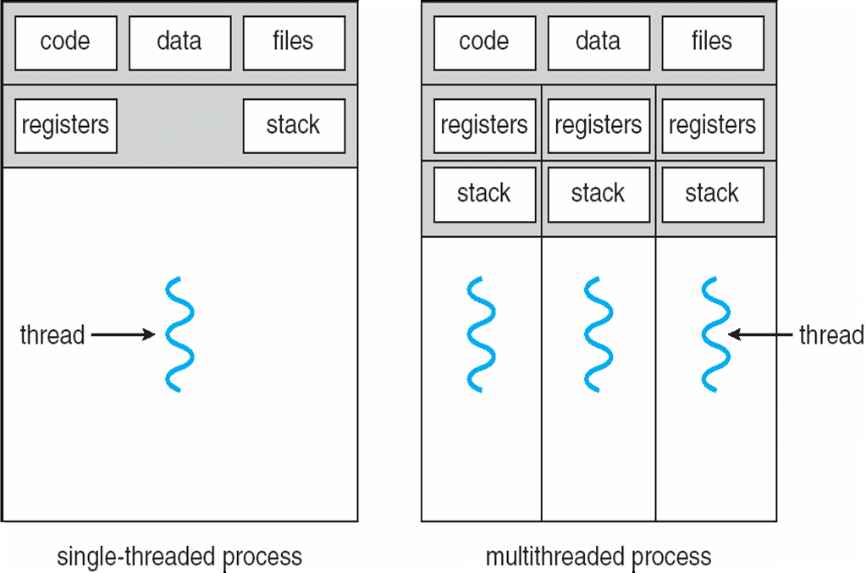
Single and Multithreaded Processes

Slide 3
Benefits
Responsiveness
  A program can continue running even if part of it is blocked or waiting for long I/O
  Important for user interfaces
Resource Sharing
  Easier to share resources between threads (shared memory) compared to between processes
Economy
  Allocating a new process is costlier (in general) than allocating a new thread.
  Context switching can also be faster.
Scalability
  A single process can take advantage of multiple processes

Slide 4
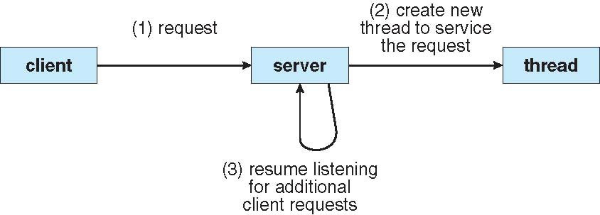
Example: Multithreaded Server Architecture
Every new request is handled in a new thread
Avoids blocking
Particularly useful if the service request is then sent further down (e.g. to the database)

Slide 5
Threads, concurrency and parallelism

Slide 6
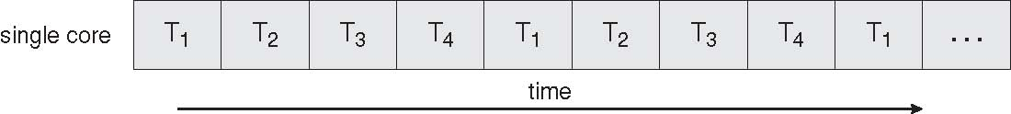
Concurrent Execution on a Single-core System

Slide 7
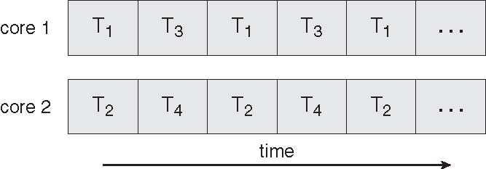
Parallel Execution on a Multicore System

Slide 8
Limits to parallelism – Amdahl’s law
S – is the portion of the application which must be performed serially
Example
  S = 20%
  N = 100
  Speedup = 4.8 times!!!

Slide 9
Implementation details: user threads, kernel threads, mapping models

Slide 10
User Threads
Thread management done by user-level threads library
Three primary thread libraries:
  POSIX Pthreads
  Win32 threads
  Java threads

Slide 11
Kernel Threads
Supported by the Kernel
Examples
  Windows XP/2000
  Solaris
  Linux
  Tru64 UNIX
  Mac OS X

Slide 12
Multithreading Models
Many-to-One
One-to-One
Many-to-Many

Slide 13
Many-to-One
Many user-level threads mapped to single kernel thread
Examples:
  Solaris Green Threads
  GNU Portable Threads

Slide 14
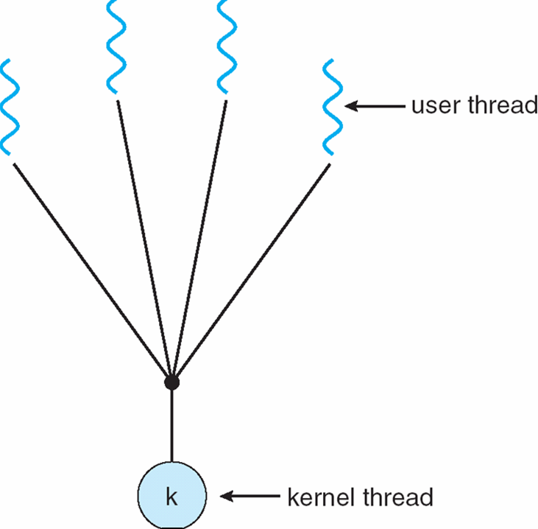
Many-to-One Model

Slide 15
One-to-One
Each user-level thread maps to kernel thread
Examples
  Windows NT/XP/2000
  Linux
  Solaris 9 and later

Slide 16
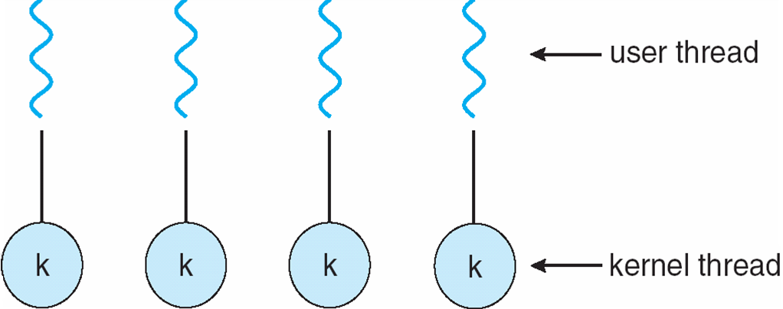
One-to-one Model

Slide 17
Many-to-Many Model
Allows many user level threads to be mapped to many kernel threads
Allows the operating system to create a sufficient number of kernel threads
Solaris prior to version 9
Windows NT/2000 with the ThreadFiber package

Slide 18
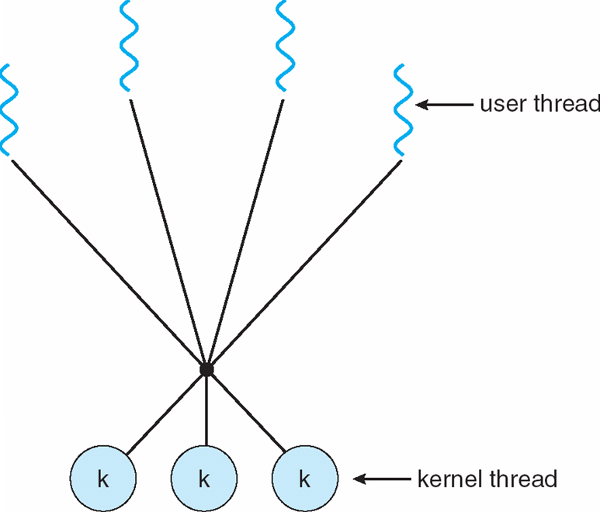
Many-to-Many Model

Slide 19
Two-level Model
Similar to M:M, except that it allows a user thread to be bound to kernel thread
Examples
  IRIX
  HP-UX
  Tru64 UNIX
  Solaris 8 and earlier

Slide 20
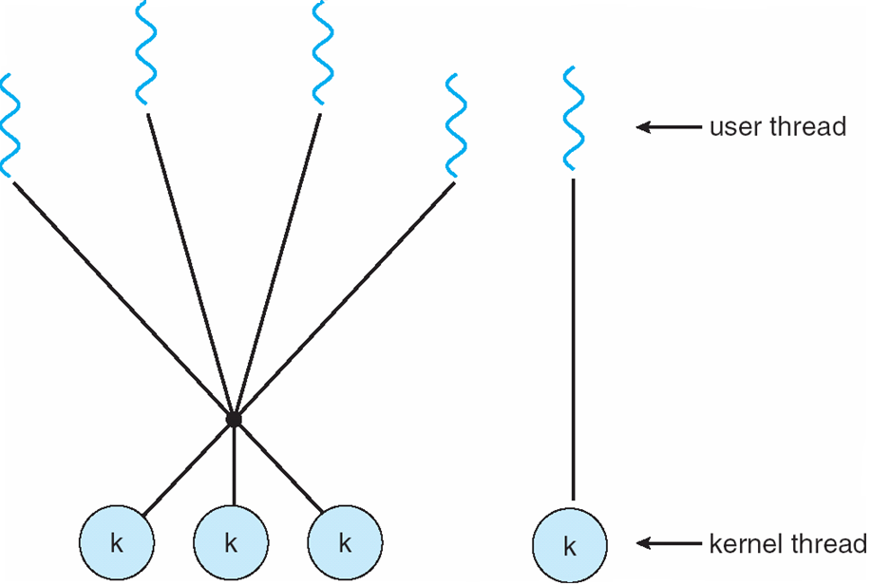
Two-level Model

Slide 21
Thread Libraries
Thread library provides programmer with API for creating and managing threads
Two primary ways of implementing
  Library entirely in user space
  Kernel-level library supported by the OS

Slide 22
Pthreads
May be provided either as user-level or kernel-level
A POSIX standard (IEEE 1003.1c) API for thread creation and synchronization
API specifies behavior of the thread library, implementation is up to development of the library
Common in UNIX operating systems (Solaris, Linux, Mac OS X)

Slide 23
Threading in Linux
History
  Initially: weak threading support, userland threading implementations
  “LinuxThreads” – a partial POSIX thread implementation (until Linux 2.6 – current is 4.2)
    Used processes to implement
    Clone system call: create a process sharing the parent’s address space
Current model: NTPL – Native POSIX Thread Library (part of Linux kernel since 2003 – 2.6)
  Compatible with the POSIX thread model
  Primary abstraction in the Kernel is still the process.
  1-1 threads library: 1 thread matches 1 kernel task
  Still uses the clone() call, but called from NTPL

Slide 24
Windows XP Threads
Implements the one-to-one mapping, kernel-level
Each thread contains
  A thread id
  Register set
  Separate user and kernel stacks
  Private data storage area
The register set, stacks, and private storage area are known as the context of the threads
The primary data structures of a thread include:
  ETHREAD (executive thread block)
  KTHREAD (kernel thread block)
  TEB (thread environment block)

Slide 25
Java Threads
Java threads are managed by the JVM
Typically implemented using the threads model provided by underlying OS
Java threads may be created by:
  Extending Thread class
  Implementing the Runnable interface

Slide 26
Miscellaneous issues in threading

Slide 27
Threading Issues
Semantics of fork() and exec() system calls
Thread cancellation of target thread
  Asynchronous or deferred
Signal handling
Thread pools
Thread-specific data
Scheduler activations

Slide 28
Semantics of fork() and exec()
Does fork() duplicate only the calling thread or all threads?

Slide 29
Thread Cancellation
Terminating a thread before it has finished
Two general approaches:
  Asynchronous cancellation terminates the target thread immediately
  Deferred cancellation allows the target thread to periodically check if it should be cancelled

Slide 30
Signal Handling
Signals are used in UNIX systems to notify a process that a particular event has occurred
A signal handler is used to process signals
  Signal is generated by particular event
  Signal is delivered to a process
  Signal is handled
Options:
  Deliver the signal to the thread to which the signal applies
  Deliver the signal to every thread in the process
  Deliver the signal to certain threads in the process
  Assign a specific threa to receive all signals for the process

Slide 31
Thread Pools
Create a number of threads in a pool where they await work
Advantages:
  Usually slightly faster to service a request with an existing thread than create a new thread
  Allows the number of threads in the application(s) to be bound to the size of the pool

Slide 32
Thread Specific Data
Allows each thread to have its own copy of data
Useful when you do not have control over the thread creation process (i.e., when using a thread pool)

Slide 33
Scheduler Activations
Both M:M and Two-level models require communication to maintain the appropriate number of kernel threads allocated to the application
Scheduler activations provide upcalls - a communication mechanism from the kernel to the thread library
This communication allows an application to maintain the correct number kernel threads

