Slide 1
Chapter 2
Instructions: Language of the Computer

Slide 2
Instruction Set
§2.1 Introduction
The repertoire of instructions of a computer
Different computers have different instruction sets
But with many aspects in common
Early computers had very simple instruction sets
Simplified implementation
Many modern computers also have simple instruction sets

Slide 3
The MIPS Instruction Set
Used as the example throughout the book
Stanford MIPS commercialized by MIPS Technologies (www.mips.com)
Large share of embedded core market
Applications in consumer electronics, network/storage equipment, cameras, printers, …
Typical of many modern ISAs
See MIPS Reference Data tear-out card, and Appendixes B and E

Slide 4
Arithmetic Operations
Add and subtract, three operands
Two sources and one destination
add a, b, c # a gets b + c
All arithmetic operations have this form
Design Principle 1: Simplicity favours regularity
Regularity makes implementation simpler
Simplicity enables higher performance at lower cost
§2.2 Operations of the Computer Hardware

Slide 5
Arithmetic Example
C code:
f = (g + h) - (i + j);
Compiled MIPS code:
add $t0, g, h # temp t0 = g + h add $t1, i, j # temp t1 = i + j sub f, $t0, $t1 # f = t0 - t1

Slide 6
Register Operands
Arithmetic instructions use register operands
MIPS has a 32 × 32-bit register file
Use for frequently accessed data
Numbered 0 to 31
32-bit data called a “word”
Assembler names
$t0, $t1, …, $t9 for temporary values
$s0, $s1, …, $s7 for saved variables
Design Principle 2: Smaller is faster
c.f. main memory: millions of locations
§2.3 Operands of the Computer Hardware

Slide 7
Register Operand Example
C code:
f = (g + h) - (i + j);
f, …, j in $s0, …, $s4
Compiled MIPS code:
add $t0, $s1, $s2 add $t1, $s3, $s4 sub $s0, $t0, $t1

Slide 8
Memory Operands
Main memory used for composite data
Arrays, structures, dynamic data
To apply arithmetic operations
Load values from memory into registers
Store result from register to memory
Memory is byte addressed
Each address identifies an 8-bit byte
Words are aligned in memory
Address must be a multiple of 4
MIPS is Big Endian
Most-significant byte at least address of a word
c.f. Little Endian: least-significant byte at least address

Slide 9
Memory Operand Example 1
C code:
g = h + A[8];
g in $s1, h in $s2, base address of A in $s3
Compiled MIPS code:
Index 8 requires offset of 32
4 bytes per word
lw $t0, 32($s3) # load word add $s1, $s2, $t0
offset
base register

Slide 10
Memory Operand Example 2
C code:
A[12] = h + A[8];
h in $s2, base address of A in $s3
Compiled MIPS code:
Index 8 requires offset of 32
lw $t0, 32($s3) # load word add $t0, $s2, $t0 sw $t0, 48($s3) # store word

Slide 11
Registers vs. Memory
Registers are faster to access than memory
Operating on memory data requires loads and stores
More instructions to be executed
Compiler must use registers for variables as much as possible
Only spill to memory for less frequently used variables
Register optimization is important!

Slide 12
Immediate Operands
Constant data specified in an instruction
addi $s3, $s3, 4
No subtract immediate instruction
Just use a negative constant
addi $s2, $s1, -1
Design Principle 3: Make the common case fast
Small constants are common
Immediate operand avoids a load instruction

Slide 13
The Constant Zero
MIPS register 0 ($zero) is the constant 0
Cannot be overwritten
Useful for common operations
E.g., move between registers
add $t2, $s1, $zero

Slide 14
Logical Operations
Instructions for bitwise manipulation
§2.6 Logical Operations
Operation | C | Java | MIPS
Shift left | << | << | sll
Shift right | >> | >>> | srl
Bitwise AND | & | & | and, andi
Bitwise OR | | | | | or, ori
Bitwise NOT | ~ | ~ | nor
Useful for extracting and inserting groups of bits in a word

Slide 15
Shift Operations
op
rs
rt
rd
shamt
funct
6 bits
5 bits
5 bits
5 bits
5 bits
6 bits
shamt: how many positions to shift
Shift left logical
Shift left and fill with 0 bits
sll by i bits multiplies by 2^{i}
Shift right logical
Shift right and fill with 0 bits
srl by i bits divides by 2^{i} (unsigned only)

Slide 16
AND Operations
Useful to mask bits in a word
Select some bits, clear others to 0
and $t0, $t1, $t2
$t2
0000 0000 0000 0000 0000 1101 1100 0000
$t1
0000 0000 0000 0000 0011 1100 0000 0000
$t0
0000 0000 0000 0000 0000 1100 0000 0000

Slide 17
OR Operations
Useful to include bits in a word
Set some bits to 1, leave others unchanged
or $t0, $t1, $t2
$t2
0000 0000 0000 0000 0000 1101 1100 0000
$t1
0000 0000 0000 0000 0011 1100 0000 0000
$t0
0000 0000 0000 0000 0011 1101 1100 0000

Slide 18
NOT Operations
Useful to invert bits in a word
Change 0 to 1, and 1 to 0
MIPS has NOR 3-operand instruction
a NOR b == NOT ( a OR b )
nor $t0, $t1, $zero
Register 0: always read as zero
$t1
0000 0000 0000 0000 0011 1100 0000 0000
$t0
1111 1111 1111 1111 1100 0011 1111 1111

Slide 19
Conditional Operations
Branch to a labeled instruction if a condition is true
Otherwise, continue sequentially
beq rs, rt, L1
if (rs == rt) branch to instruction labeled L1;
bne rs, rt, L1
if (rs != rt) branch to instruction labeled L1;
j L1
unconditional jump to instruction labeled L1
§2.7 Instructions for Making Decisions

Slide 20
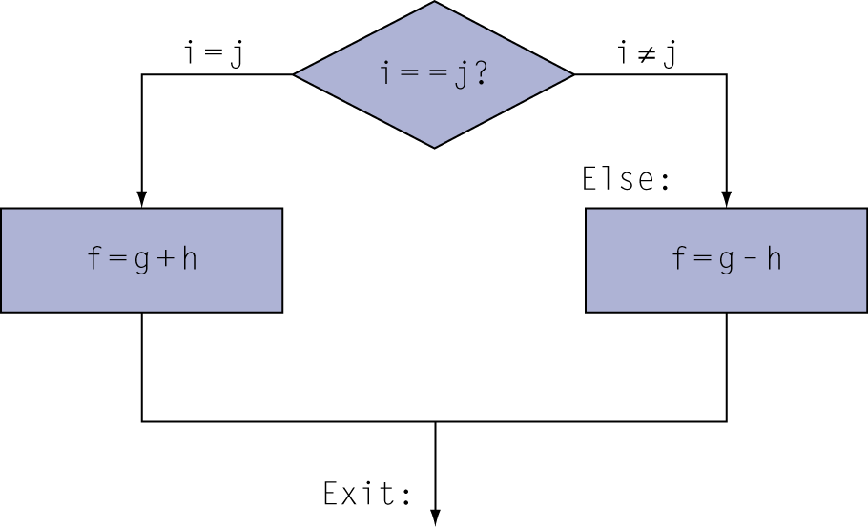
Compiling If Statements
C code:
if (i==j) f = g+h; else f = g-h;
f, g, … in $s0, $s1, …
Compiled MIPS code:
bne $s3, $s4, Else add $s0, $s1, $s2 j Exit Else: sub $s0, $s1, $s2 Exit: …
Assembler calculates addresses

Slide 21
Compiling Loop Statements
C code:
while (save[i] == k) i += 1;
i in $s3, k in $s5, address of save in $s6
Compiled MIPS code:
Loop: sll $t1, $s3, 2 add $t1, $t1, $s6 lw $t0, 0($t1) bne $t0, $s5, Exit addi $s3, $s3, 1 j Loop Exit: …

Slide 22
Basic Blocks
A basic block is a sequence of instructions with
No embedded branches (except at end)
No branch targets (except at beginning)
A compiler identifies basic blocks for optimization
An advanced processor can accelerate execution of basic blocks

Slide 23
More Conditional Operations
Set result to 1 if a condition is true
Otherwise, set to 0
slt rd, rs, rt
if (rs < rt) rd = 1; else rd = 0;
slti rt, rs, constant
if (rs < constant) rt = 1; else rt = 0;
Use in combination with beq, bne
slt $t0, $s1, $s2 # if ($s1 < $s2) bne $t0, $zero, L # branch to L

Slide 24
Branch Instruction Design
Why not blt, bge, etc?
Hardware for <, ≥, … slower than =, ≠
Combining with branch involves more work per instruction, requiring a slower clock
All instructions penalized!
beq and bne are the common case
This is a good design compromise

Slide 25
Procedure Calling
Steps required
Place parameters in registers
Transfer control to procedure
Acquire storage for procedure
Perform procedure’s operations
Place result in register for caller
Return to place of call
§2.8 Supporting Procedures in Computer Hardware

Slide 26
Register Usage
$a0 – $a3: arguments (reg’s 4 – 7)
$v0, $v1: result values (reg’s 2 and 3)
$t0 – $t9: temporaries
Can be overwritten by callee
$s0 – $s7: saved
Must be saved/restored by callee
$gp: global pointer for static data (reg 28)
$sp: stack pointer (reg 29)
$fp: frame pointer (reg 30)
$ra: return address (reg 31)

Slide 27
Procedure Call Instructions
Procedure call: jump and link
jal ProcedureLabel
Address of following instruction put in $ra
Jumps to target address
Procedure return: jump register
jr $ra
Copies $ra to program counter
Can also be used for computed jumps
e.g., for case/switch statements

Slide 28
Leaf Procedure Example
C code:
int leaf_example (int g, h, i, j) { int f; f = (g + h) - (i + j); return f; }
Arguments g, …, j in $a0, …, $a3
f in $s0 (hence, need to save $s0 on stack)
Result in $v0

Slide 29
Leaf Procedure Example
MIPS code:
leaf_example: addi $sp, $sp, -4 sw $s0, 0($sp) add $t0, $a0, $a1 add $t1, $a2, $a3 sub $s0, $t0, $t1 add $v0, $s0, $zero lw $s0, 0($sp) addi $sp, $sp, 4 jr $ra
Save $s0 on stack
Procedure body
Result
Restore $s0
Return

Slide 30
Non-Leaf Procedures
Procedures that call other procedures
For nested call, caller needs to save on the stack:
Its return address
Any arguments and temporaries needed after the call
Restore from the stack after the call

Slide 31
Non-Leaf Procedure Example
C code:
int fact (int n) { if (n < 1) return f; else return n * fact(n - 1); }
Argument n in $a0
Result in $v0

Slide 32
Non-Leaf Procedure Example
MIPS code:
fact: addi $sp, $sp, -8 # adjust stack for 2 items sw $ra, 4($sp) # save return address sw $a0, 0($sp) # save argument slti $t0, $a0, 1 # test for n < 1 beq $t0, $zero, L1 addi $v0, $zero, 1 # if so, result is 1 addi $sp, $sp, 8 # pop 2 items from stack jr $ra # and return L1: addi $a0, $a0, -1 # else decrement n jal fact # recursive call lw $a0, 0($sp) # restore original n lw $ra, 4($sp) # and return address addi $sp, $sp, 8 # pop 2 items from stack mul $v0, $a0, $v0 # multiply to get result jr $ra # and return

Slide 33
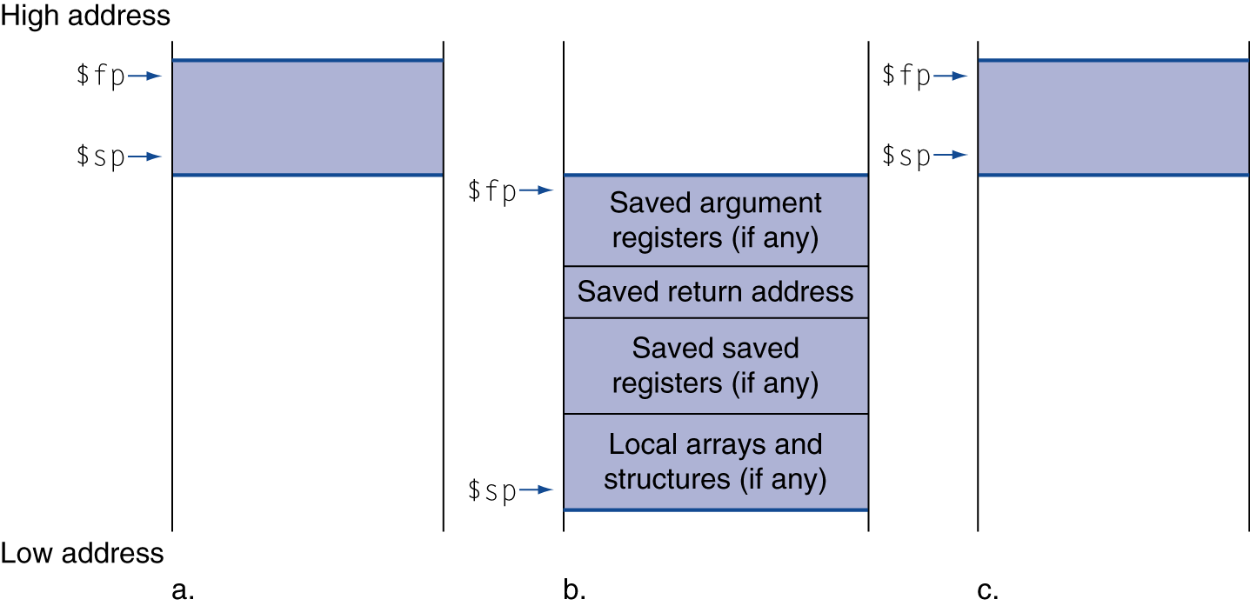
Local Data on the Stack
Local data allocated by callee
e.g., C automatic variables
Procedure frame (activation record)
Used by some compilers to manage stack storage

Slide 34
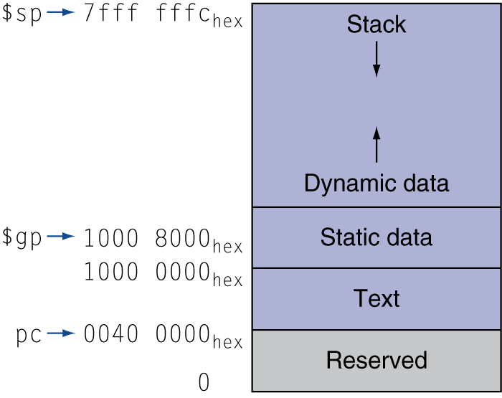
Memory Layout
Text: program code
Static data: global variables
e.g., static variables in C, constant arrays and strings
$gp initialized to address allowing ±offsets into this segment
Dynamic data: heap
E.g., malloc in C, new in Java
Stack: automatic storage

Slide 35
Branch Addressing
Branch instructions specify
Opcode, two registers, target address
Most branch targets are near branch
Forward or backward
op
rs
rt
constant or address
6 bits
5 bits
5 bits
16 bits
PC-relative addressing
Target address = PC + offset × 4
PC already incremented by 4 by this time

Slide 36
Jump Addressing
Jump (j and jal) targets could be anywhere in text segment
Encode full address in instruction
op
address
6 bits
26 bits
(Pseudo)Direct jump addressing
Target address = PC_{31…28} : (address × 4)

Slide 37
Target Addressing Example
Loop code from earlier example
Assume Loop at location 80000
Loop: sll $t1, $s3, 2 | 80000 | 0 | 0 | 19 | 9 | 4 | 0
add $t1, $t1, $s6 | 80004 | 0 | 9 | 22 | 9 | 0 | 32
lw $t0, 0($t1) | 80008 | 35 | 9 | 8 | 0
bne $t0, $s5, Exit | 80012 | 5 | 8 | 21 | 2
addi $s3, $s3, 1 | 80016 | 8 | 19 | 19 | 1
j Loop | 80020 | 2 | 20000
Exit: … | 80024

Slide 38
Branching Far Away
If branch target is too far to encode with 16-bit offset, assembler rewrites the code
Example
beq $s0,$s1, L1
↓
bne $s0,$s1, L2 j L1 L2: …

Slide 39
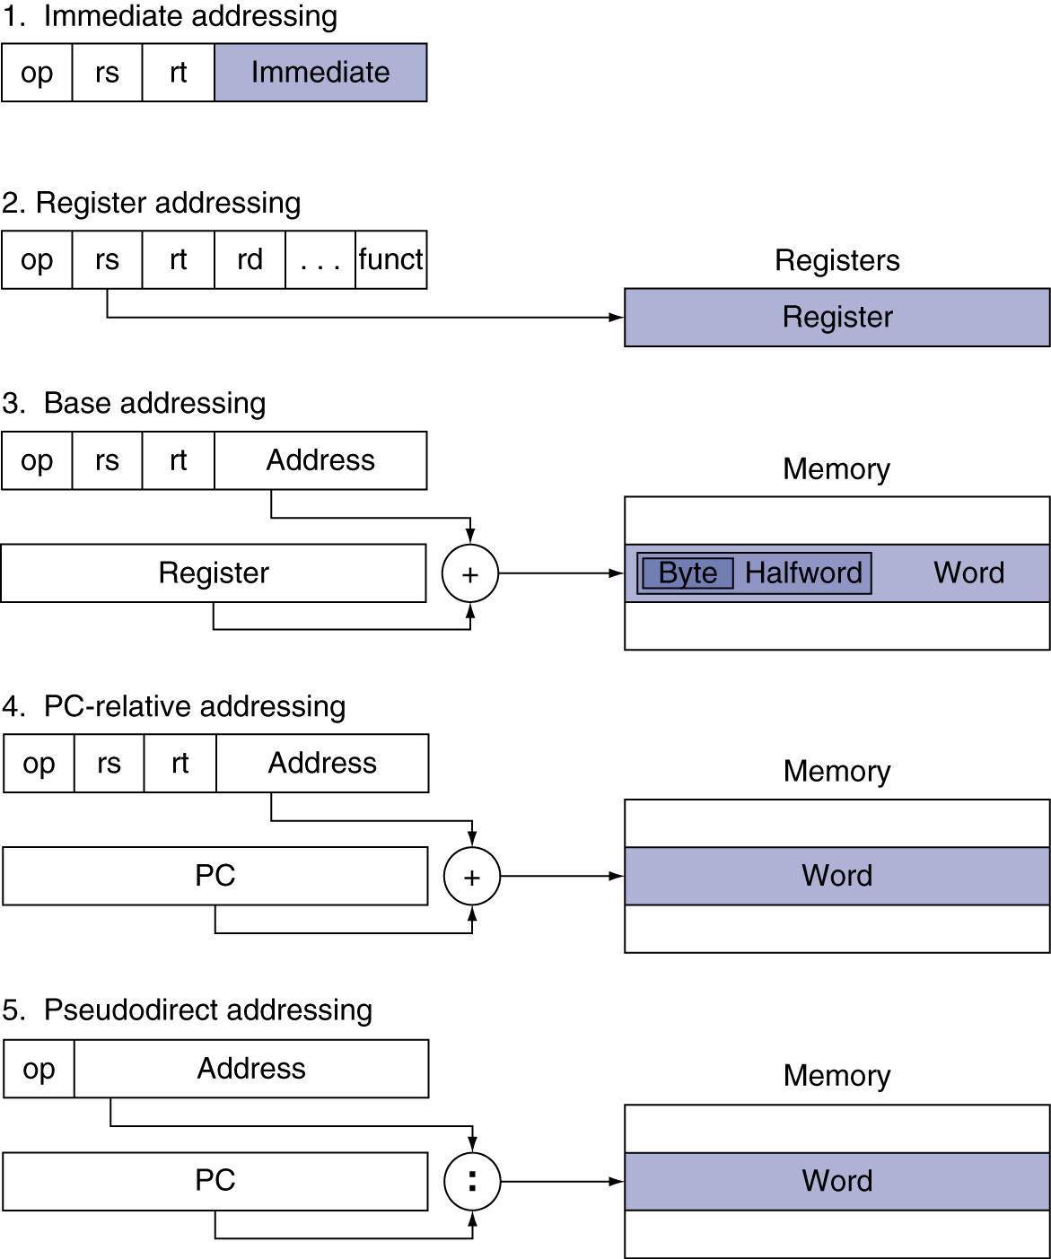
Addressing Mode Summary

Slide 40
Synchronization
Two processors sharing an area of memory
P1 writes, then P2 reads
Data race if P1 and P2 don’t synchronize
Result depends of order of accesses
Hardware support required
Atomic read/write memory operation
No other access to the location allowed between the read and write
Could be a single instruction
E.g., atomic swap of register ↔ memory
Or an atomic pair of instructions
§2.11 Parallelism and Instructions: Synchronization

Slide 41
Synchronization in MIPS
Load linked: ll rt, offset(rs)
Store conditional: sc rt, offset(rs)
Succeeds if location not changed since the ll
Returns 1 in rt
Fails if location is changed
Returns 0 in rt
Example: atomic swap (to test/set lock variable)
try: add $t0,$zero,$s4 ;copy exchange value
ll $t1,0($s1) ;load linked
sc $t0,0($s1) ;store conditional
beq $t0,$zero,try ;branch store fails
add $s4,$zero,$t1 ;put load value in $s4

Slide 42
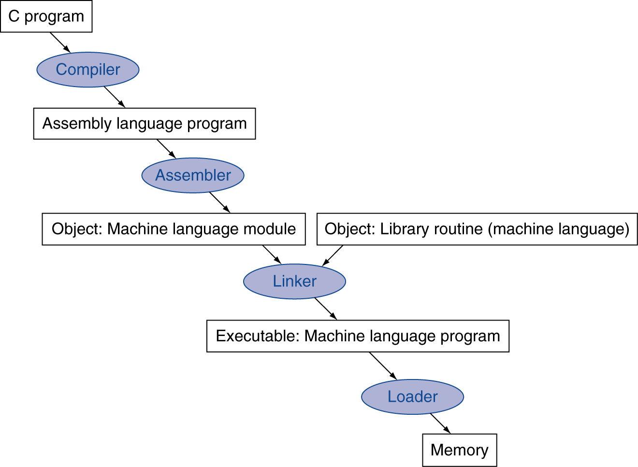
Translation and Startup
Many compilers produce object modules directly
§2.12 Translating and Starting a Program
Static linking

Slide 43
Producing an Object Module
Assembler (or compiler) translates program into machine instructions
Provides information for building a complete program from the pieces
Header: described contents of object module
Text segment: translated instructions
Static data segment: data allocated for the life of the program
Relocation info: for contents that depend on absolute location of loaded program
Symbol table: global definitions and external refs
Debug info: for associating with source code

Slide 44
Linking Object Modules
Produces an executable image
1. Merges segments
2. Resolve labels (determine their addresses)
3. Patch location-dependent and external refs
Could leave location dependencies for fixing by a relocating loader
But with virtual memory, no need to do this
Program can be loaded into absolute location in virtual memory space

Slide 45
Loading a Program
Load from image file on disk into memory
1. Read header to determine segment sizes
2. Create virtual address space
3. Copy text and initialized data into memory
Or set page table entries so they can be faulted in
4. Set up arguments on stack
5. Initialize registers (including $sp, $fp, $gp)
6. Jump to startup routine
Copies arguments to $a0, … and calls main
When main returns, do exit syscall

Slide 46
Dynamic Linking
Only link/load library procedure when it is called
Requires procedure code to be relocatable
Avoids image bloat caused by static linking of all (transitively) referenced libraries
Automatically picks up new library versions

Slide 47
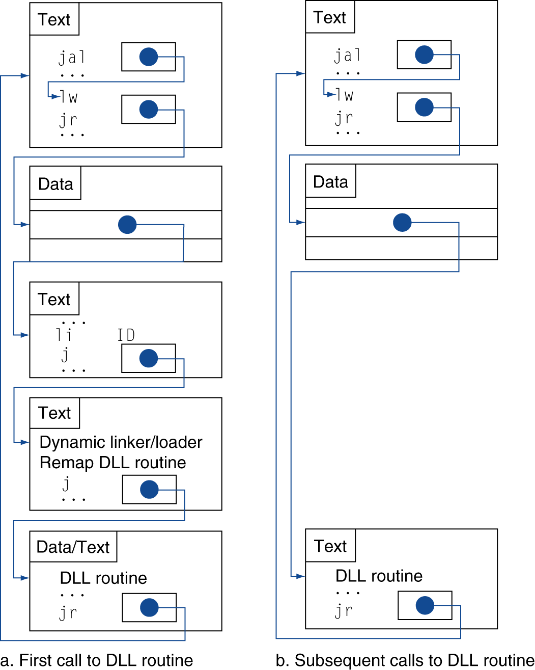
Lazy Linkage
Indirection table
Stub: Loads routine ID, Jump to linker/loader
Linker/loader code
Dynamically mapped code

Slide 48
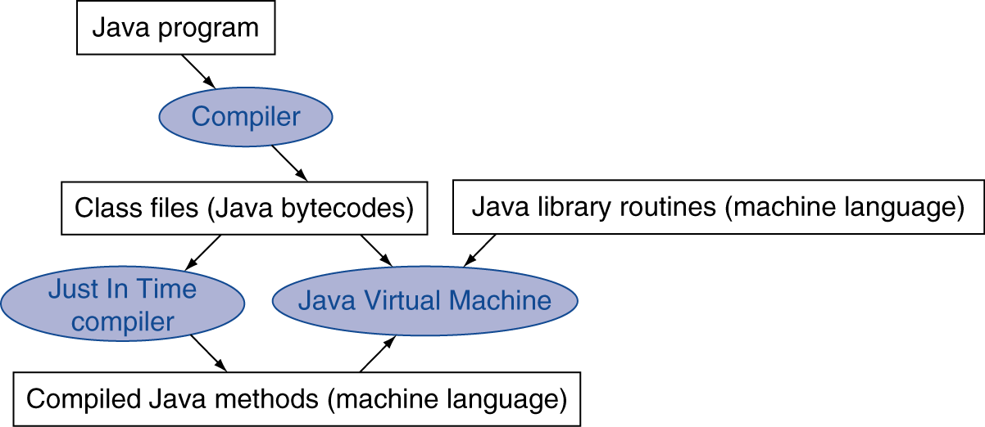
Starting Java Applications
Simple portable instruction set for the JVM
Compiles bytecodes of “hot” methods into native code for host machine
Interprets bytecodes

Slide 49
Effect of Compiler Optimization
Compiled with gcc for Pentium 4 under Linux

Slide 50
Effect of Language and Algorithm

Slide 51
Lessons Learnt
Instruction count and CPI are not good performance indicators in isolation
Compiler optimizations are sensitive to the algorithm
Java/JIT compiled code is significantly faster than JVM interpreted
Comparable to optimized C in some cases
Nothing can fix a dumb algorithm!

Slide 52
Different processor architectures

Slide 53
ARM & MIPS Similarities
ARM: the most popular embedded core
Similar basic set of instructions to MIPS
§2.16 Real Stuff: ARM Instructions
 | ARM | MIPS
Date announced | 1985 | 1985
Instruction size | 32 bits | 32 bits
Address space | 32-bit flat | 32-bit flat
Data alignment | Aligned | Aligned
Data addressing modes | 9 | 3
Registers | 15 × 32-bit | 31 × 32-bit
Input/output | Memory mapped | Memory mapped

Slide 54
Compare and Branch in ARM
Uses condition codes for result of an arithmetic/logical instruction
Negative, zero, carry, overflow
Compare instructions to set condition codes without keeping the result
Each instruction can be conditional
Top 4 bits of instruction word: condition value
Can avoid branches over single instructions

Slide 55
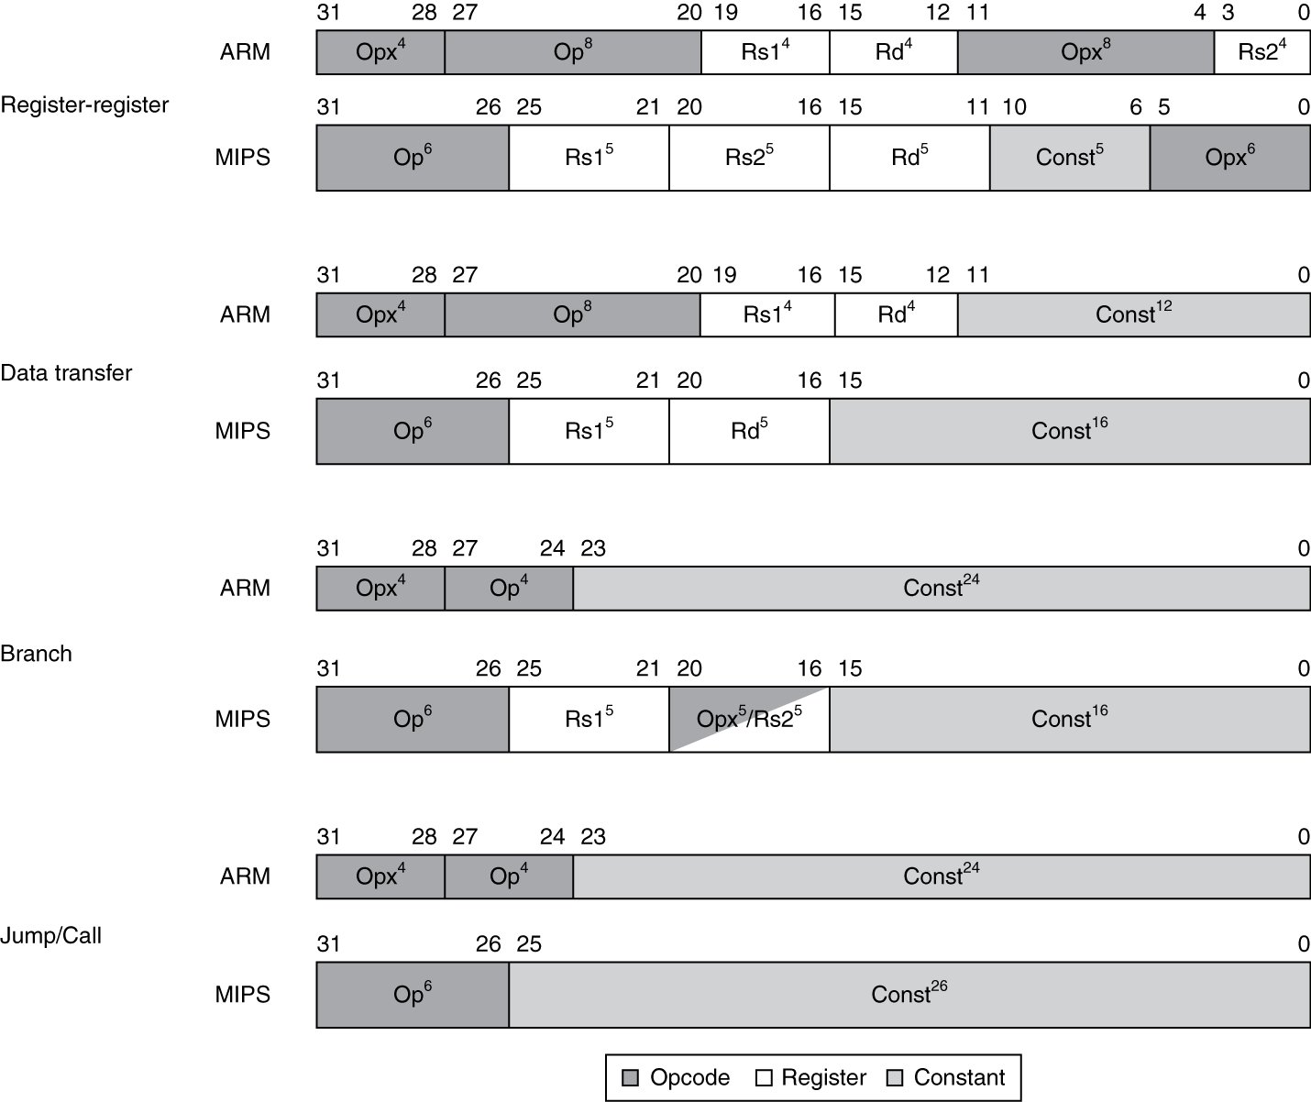
Instruction Encoding

Slide 56
The Intel x86 ISA
Evolution with backward compatibility
8080 (1974): 8-bit microprocessor
Accumulator, plus 3 index-register pairs
8086 (1978): 16-bit extension to 8080
Complex instruction set (CISC)
8087 (1980): floating-point coprocessor
Adds FP instructions and register stack
80286 (1982): 24-bit addresses, MMU
Segmented memory mapping and protection
80386 (1985): 32-bit extension (now IA-32)
Additional addressing modes and operations
Paged memory mapping as well as segments
§2.17 Real Stuff: x86 Instructions

Slide 57
The Intel x86 ISA
Further evolution…
i486 (1989): pipelined, on-chip caches and FPU
Compatible competitors: AMD, Cyrix, …
Pentium (1993): superscalar, 64-bit datapath
Later versions added MMX (Multi-Media eXtension) instructions
The infamous FDIV bug
Pentium Pro (1995), Pentium II (1997)
New microarchitecture (see Colwell, The Pentium Chronicles)
Pentium III (1999)
Added SSE (Streaming SIMD Extensions) and associated registers
Pentium 4 (2001)
New microarchitecture
Added SSE2 instructions

Slide 58
The Intel x86 ISA
And further…
AMD64 (2003): extended architecture to 64 bits
EM64T – Extended Memory 64 Technology (2004)
AMD64 adopted by Intel (with refinements)
Added SSE3 instructions
Intel Core (2006)
Added SSE4 instructions, virtual machine support
AMD64 (announced 2007): SSE5 instructions
Intel declined to follow, instead…
Advanced Vector Extension (announced 2008)
Longer SSE registers, more instructions
If Intel didn’t extend with compatibility, its competitors would!
Technical elegance ≠ market success

Slide 59
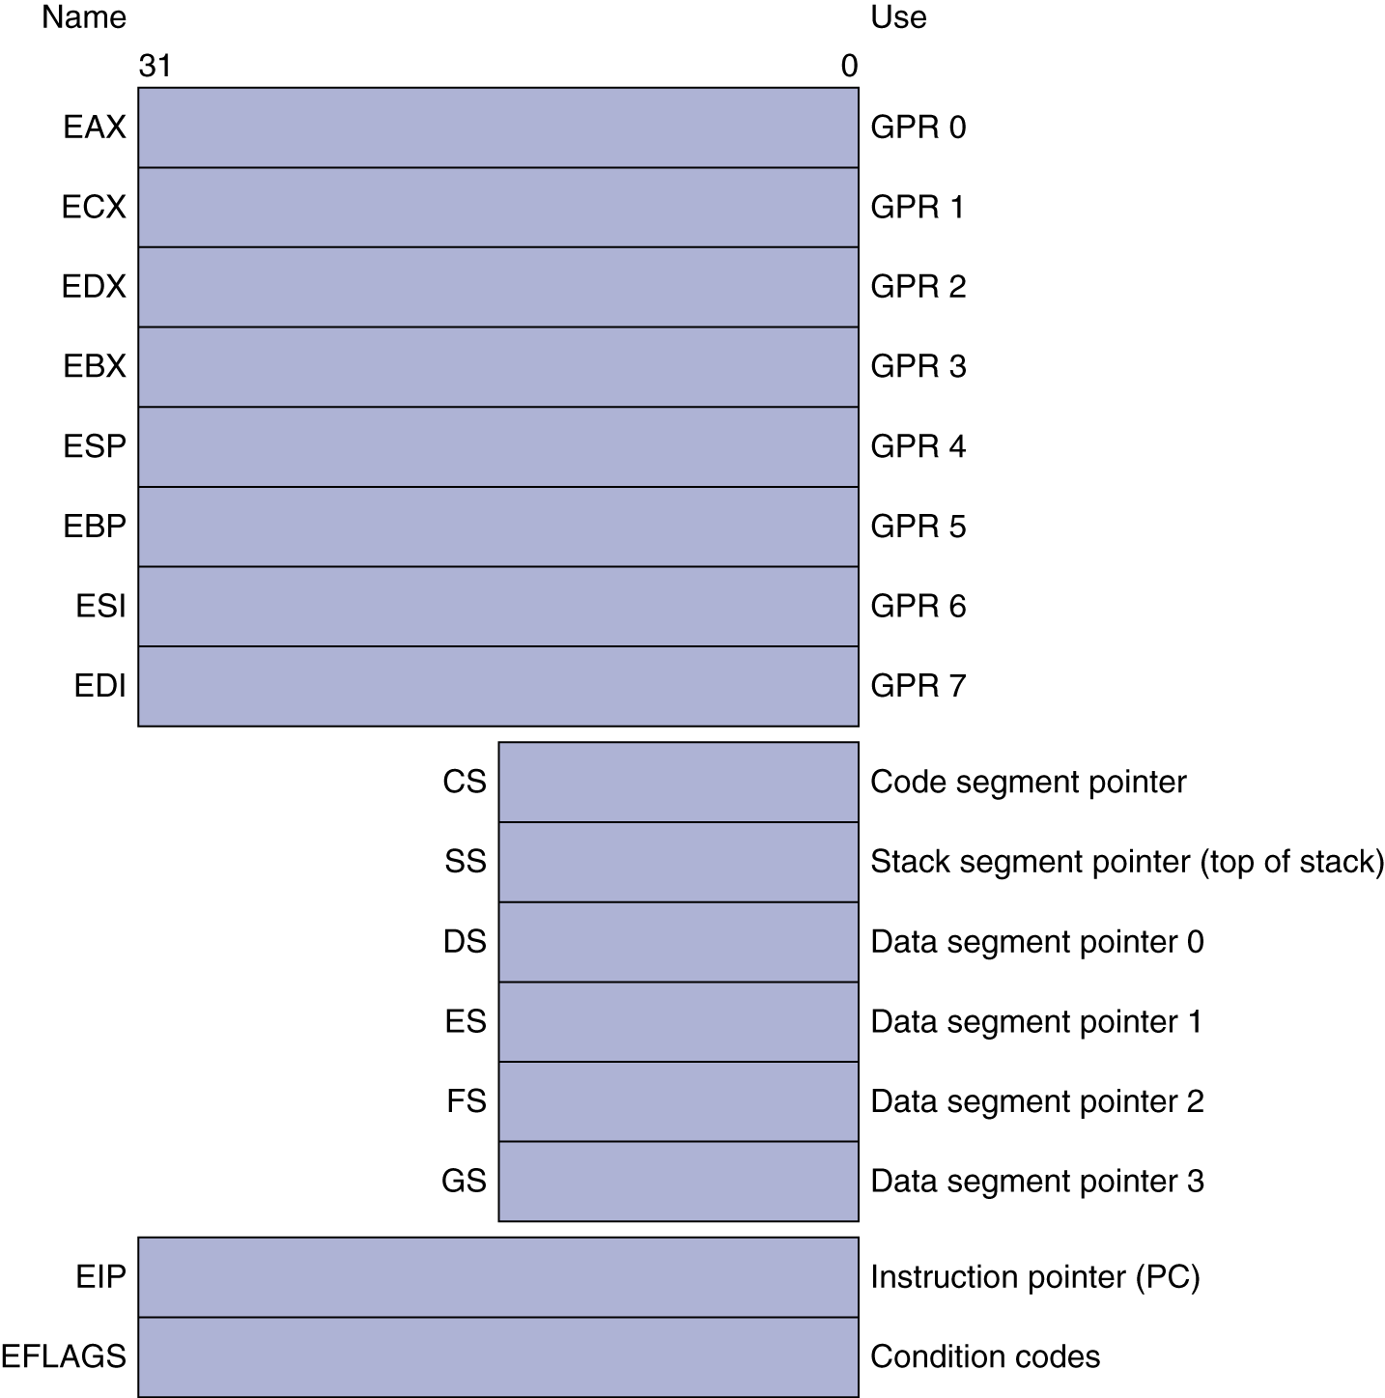
Basic x86 Registers

Slide 60
Basic x86 Addressing Modes
Two operands per instruction
Source/dest operand | Second source operand
Register | Register
Register | Immediate
Register | Memory
Memory | Register
Memory | Immediate
Memory addressing modes
Address in register
Address = R_{base} + displacement
Address = R_{base} + 2^{scale} × R_{index} (scale = 0, 1, 2, or 3)
Address = R_{base} + 2^{scale} × R_{index} + displacement

Slide 61
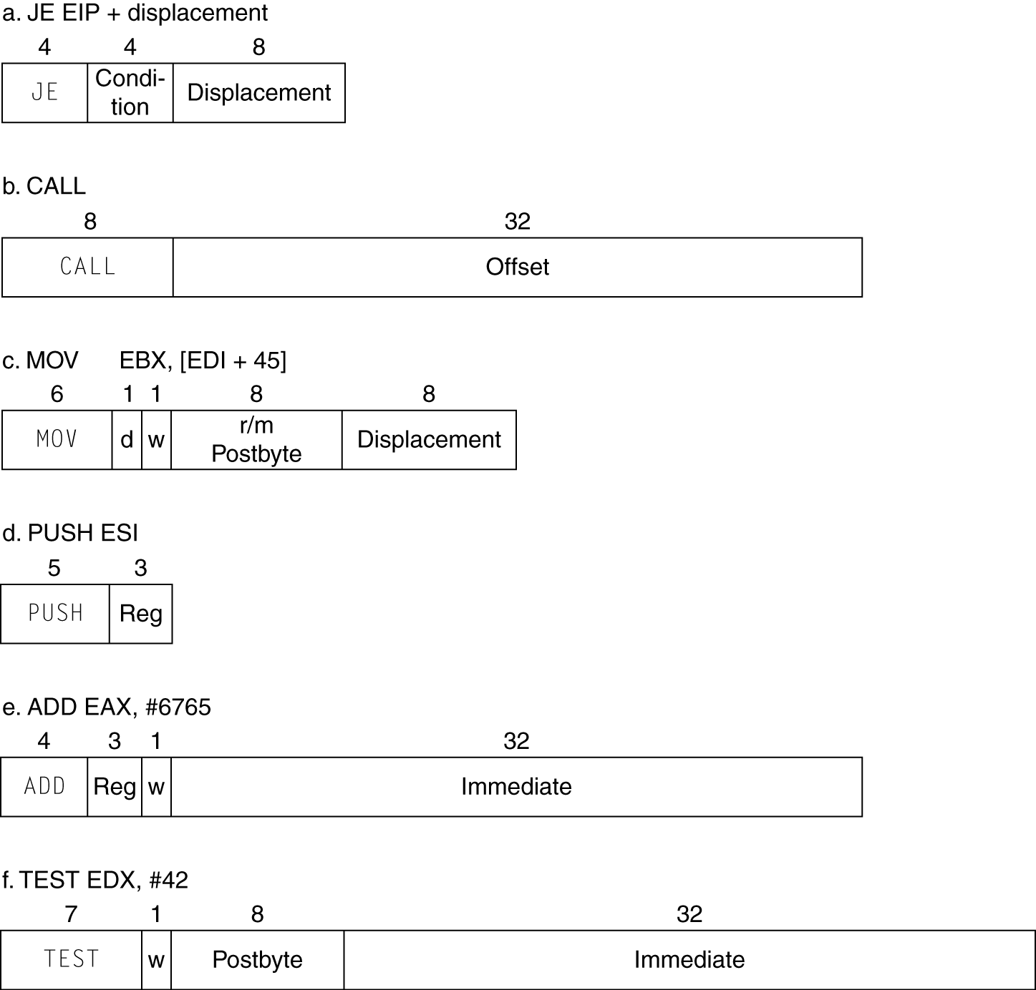
x86 Instruction Encoding
Variable length encoding
Postfix bytes specify addressing mode
Prefix bytes modify operation
Operand length, repetition, locking, …

Slide 62
Implementing IA-32
Complex instruction set makes implementation difficult
Hardware translates instructions to simpler microoperations
Simple instructions: 1–1
Complex instructions: 1–many
Microengine similar to RISC
Market share makes this economically viable
Comparable performance to RISC
Compilers avoid complex instructions

Slide 63
ARM v8 Instructions
In moving to 64-bit, ARM did a complete overhaul
ARM v8 resembles MIPS
Changes from v7:
No conditional execution field
Immediate field is 12-bit constant
Dropped load/store multiple
PC is no longer a GPR
GPR set expanded to 32
Addressing modes work for all word sizes
Divide instruction
Branch if equal/branch if not equal instructions
§2.18 Real Stuff: ARM v8 (64-bit) Instructions

Slide 64
Fallacies
Powerful instruction ⇒ higher performance
Fewer instructions required
But complex instructions are hard to implement
May slow down all instructions, including simple ones
Compilers are good at making fast code from simple instructions
Use assembly code for high performance
But modern compilers are better at dealing with modern processors
More lines of code ⇒ more errors and less productivity
§2.19 Fallacies and Pitfalls

Slide 65
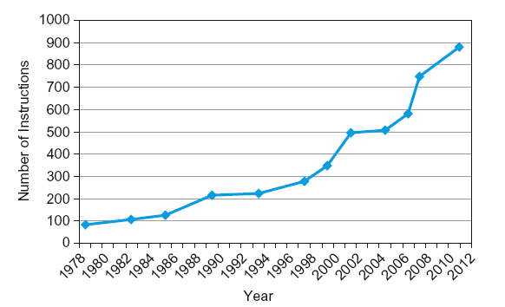
Fallacies
Backward compatibility ⇒ instruction set doesn’t change
But they do accrete more instructions
x86 instruction set

Slide 66
Concluding Remarks
Design principles
1. Simplicity favors regularity
2. Smaller is faster
3. Make the common case fast
4. Good design demands good compromises
Layers of software/hardware
Compiler, assembler, hardware
MIPS: typical of RISC ISAs
c.f. x86
§2.20 Concluding Remarks

