Slide 1
Chapter 1
Computer Abstractions and Technology

Slide 2
Classes of Computers
Personal computers
General purpose, variety of software
Subject to cost/performance tradeoff
Server computers
Network based
High capacity, performance, reliability
Range from small servers to building sized

Slide 3
Classes of Computers
Supercomputers
High-end scientific and engineering calculations
Highest capability but represent a small fraction of the overall computer market
Embedded computers
Hidden as components of systems
Stringent power/performance/cost constraints

Slide 4
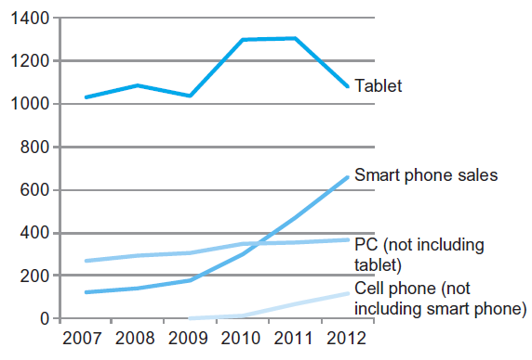
The PostPC Era

Slide 5
The PostPC Era
Personal Mobile Device (PMD)
Battery operated
Connects to the Internet
Hundreds of dollars
Smart phones, tablets, electronic glasses
Cloud computing
Warehouse Scale Computers (WSC)
Software as a Service (SaaS)
Portion of software run on a PMD and a portion run in the Cloud
Amazon AWS, Google Compute Engine, Microsoft Azure

Slide 6
Computer HARDWARE and SOFTWARE

Slide 7
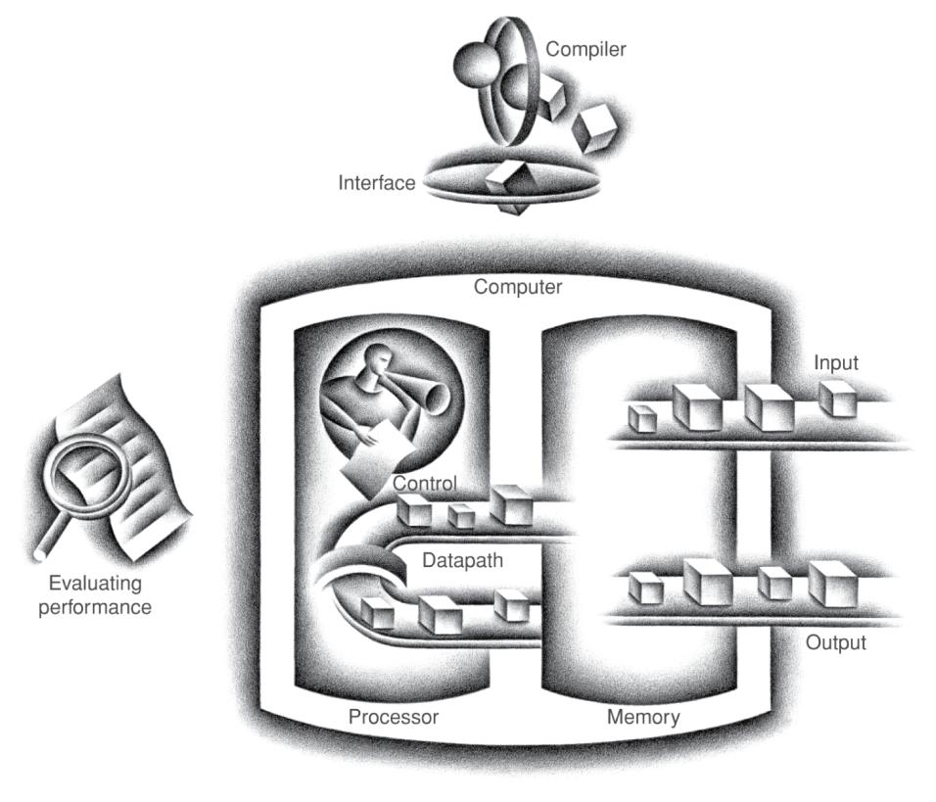
Components of a Computer
Same components for all kinds of computer
Desktop, server, embedded
Input/output includes
User-interface devices
Display, keyboard, mouse
Storage devices
Hard disk, CD/DVD, flash
Network adapters
For communicating with other computers
§1.4 Under the Covers
The BIG Picture

Slide 8
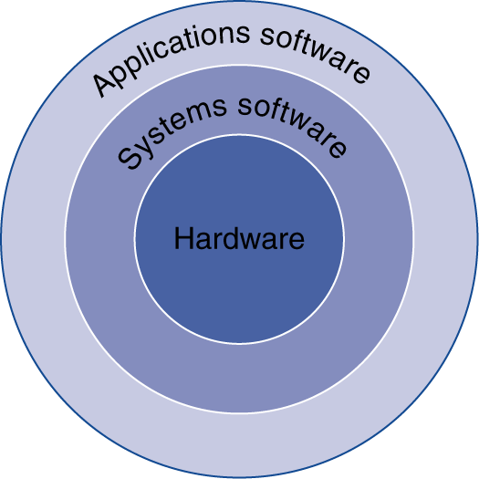
Below Your Program
Application software
Written in high-level language
System software
Compiler: translates HLL code to machine code
Operating System: service code
Handling input/output
Managing memory and storage
Scheduling tasks & sharing resources
Hardware
Processor, memory, I/O controllers
§1.3 Below Your Program

Slide 9
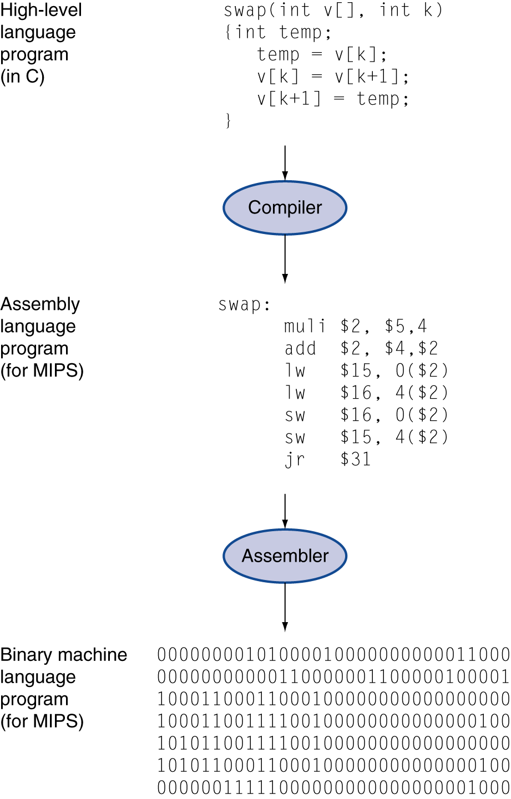
Levels of Program Code
High-level language
Level of abstraction closer to problem domain
Provides for productivity and portability
Assembly language
Textual representation of instructions
Hardware representation
Binary digits (bits)
Encoded instructions and data

Slide 10
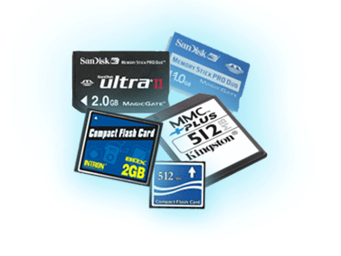
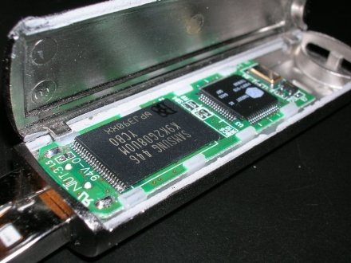
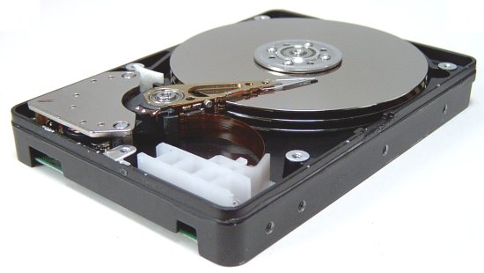
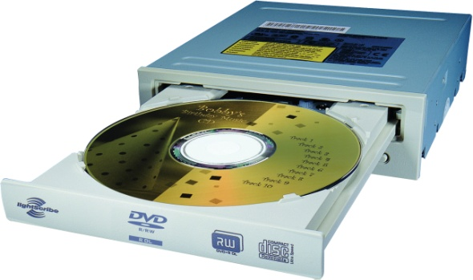
A Safe Place for Data
Volatile main memory
Loses instructions and data when power off
Non-volatile secondary memory
Magnetic disk
Flash memory
Optical disk (CDROM, DVD)

Slide 11
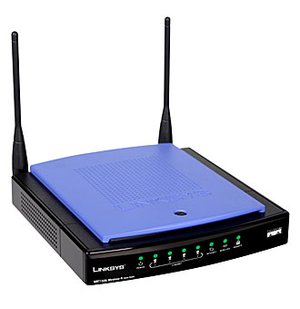
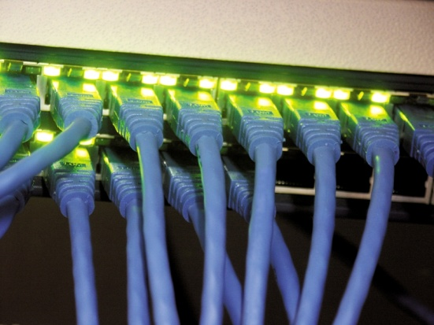
Networks
Communication, resource sharing, nonlocal access
Local area network (LAN): Ethernet
Wide area network (WAN): the Internet
Wireless network: WiFi, Bluetooth

Slide 12
Abstractions
The BIG Picture
Abstraction helps us deal with complexity
Hide lower-level detail
Instruction set architecture (ISA)
The hardware/software interface
Application binary interface
The ISA plus system software interface
Implementation
The details underlying and interface

Slide 13
Integrated Circuit Cost
Nonlinear relation to area and defect rate
Wafer cost and area are fixed
Defect rate determined by manufacturing process
Die area determined by architecture and circuit design

Slide 14
Performance

Slide 15
Defining Performance
§1.6 Performance
Which airplane has the best performance?

Slide 16
Response Time and Throughput
Response time
How long it takes to do a task
Throughput
Total work done per unit time
e.g., tasks/transactions/… per hour
How are response time and throughput affected by
Replacing the processor with a faster version?
Adding more processors?
We’ll focus on response time for now…

Slide 17
Relative Performance
Define Performance = 1/Execution Time
“X is n time faster than Y”
Example: time taken to run a program
10s on A, 15s on B
Execution Time_{B} / Execution Time_{A} = 15s / 10s = 1.5
So A is 1.5 times faster than B

Slide 18
Measuring Execution Time
Elapsed time
Total response time, including all aspects
Processing, I/O, OS overhead, idle time
Determines system performance
CPU time
Time spent processing a given job
Discounts I/O time, other jobs’ shares
Comprises user CPU time and system CPU time
Different programs are affected differently by CPU and system performance

Slide 19
Measuring performance on benchmarks
Benchmark: agreed upon application, used for performance studies
Real application
Most representative
Most difficult to set up
Application kernels
Find the most time consuming part of an app
Synthetic benchmarks
Simplified kernels
Useful for design studies
Peak performance
Only useful in marketing slides

Slide 20
Understanding Performance
Algorithm
Determines number of operations executed
Programming language, compiler, architecture
Determine the number of machine instructions executed per operation
Processor and memory system
Determine how fast instructions are executed
I/O system (including OS)
Determines how fast I/O operations are executed

Slide 21
CPU Clocking
Operation of digital hardware governed by a constant-rate clock
Clock period
Clock (cycles)
Data transfer and computation
Update state
Clock period: duration of a clock cycle
e.g., 250ps = 0.25ns = 250×10^{–12}s
Clock frequency (rate): cycles per second
e.g., 4.0GHz = 4000MHz = 4.0×10⁹Hz

Slide 22
CPU Time
Performance improved by
Reducing number of clock cycles
Increasing clock rate
Hardware designer must often trade off clock rate against cycle count

Slide 23
Instruction Count and CPI
Instruction Count for a program
Determined by program, ISA and compiler
Average cycles per instruction
Determined by CPU hardware
If different instructions have different CPI
Average CPI affected by instruction mix

Slide 24
CPI Example
Computer A: Cycle Time = 250ps, CPI = 2.0
Computer B: Cycle Time = 500ps, CPI = 1.2
Same ISA
Which is faster, and by how much?
A is faster…
…by this much

Slide 25
CPI in More Detail
If different instruction classes take different numbers of cycles
Weighted average CPI
Relative frequency

Slide 26
Performance Summary
The BIG Picture
Performance depends on
Algorithm: affects IC, possibly CPI
Programming language: affects IC, CPI
Compiler: affects IC, CPI
Instruction set architecture: affects IC, CPI, T_{c}

Slide 27
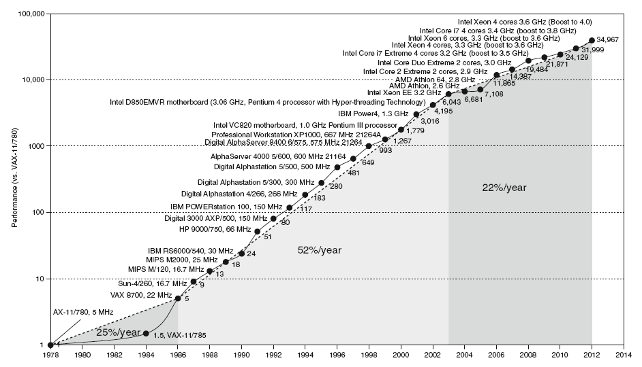
Uniprocessor Performance
§1.8 The Sea Change: The Switch to Multiprocessors
Constrained by power, instruction-level parallelism, memory latency

Slide 28
Multiprocessors
Multicore microprocessors
More than one processor per chip
Requires explicitly parallel programming
Compare with instruction level parallelism
Hardware executes multiple instructions at once
Hidden from the programmer
Hard to do
Programming for performance
Load balancing
Optimizing communication and synchronization

Slide 29
Pitfall: Amdahl’s Law
Improving an aspect of a computer and expecting a proportional improvement in overall performance
§1.10 Fallacies and Pitfalls
Example: multiply accounts for 80s/100s
How much improvement in multiply performance to get 5× overall?
Can’t be done!
Corollary: make the common case fast

Slide 30
POWER CONSUMPTION

Slide 31
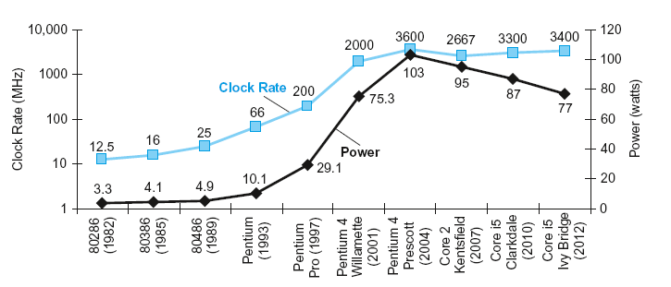
Power Trends
§1.7 The Power Wall
In CMOS IC technology
×30
5V → 1V
×1000

Slide 32
Reducing Power
Suppose a new CPU has
85% of capacitive load of old CPU
15% voltage and 15% frequency reduction
The power wall
We can’t reduce voltage further
We can’t remove more heat
How else can we improve performance?

Slide 33
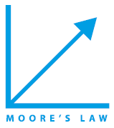
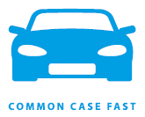
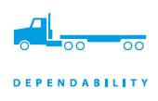
Eight Great Ideas
Design for Moore’s Law
Use abstraction to simplify design
Make the common case fast
Performance via parallelism
Performance via pipelining
Performance via prediction
Hierarchy of memories
Dependability via redundancy
§1.2 Eight Great Ideas in Computer Architecture

Slide 34
Concluding Remarks
Cost/performance is improving
Due to underlying technology development
Hierarchical layers of abstraction
In both hardware and software
Instruction set architecture
The hardware/software interface
Execution time: the best performance measure
Power is a limiting factor
Use parallelism to improve performance
§1.9 Concluding Remarks

