Slide 1
TaintDroid: An Information-Flow Tracking System for Realtime Privacy Monitoring on Smartphones
Written by Enck, Gilbert, Chun, Cox, Jung, McDanniel, and Sheth
in 2010, 9th USENIX Symposium
Paper presentation by Hyanglim You
Mar 19th 2014

Slide 2
Outline
Background and Motivation
  Threat in Privacy Information
  Gathering unnecessary data
  Goal & Challenges
Dynamic Taint Analysis
TaintDroid System
  Four level tracking techniques
Experiment results & Performance
Weaknesses & Improvement
Summary

Slide 3
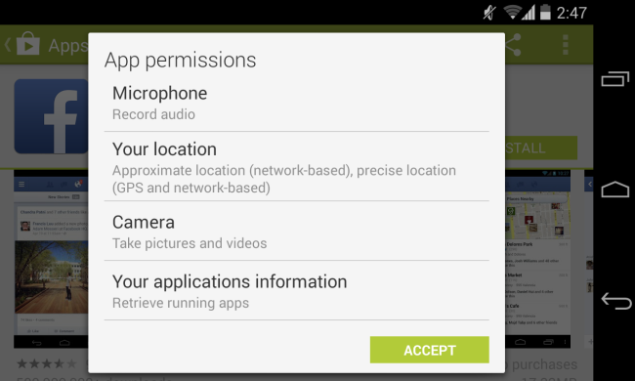
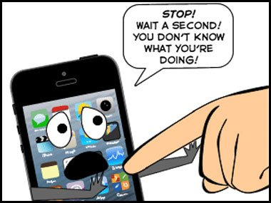
Threats in Privacy Info.
Smartphone App
  Permissions
  Information & Resources
  e.g., location, microphone,
  camera, etc.
No guarantee of your privacy information will be safe

Slide 4
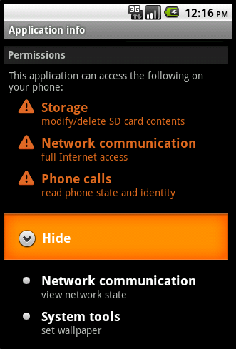
Gathering unnecessary data
What do you expect from a WallPaper app?
Are you agree a WallPaper app with gathering your phone number, subscriber identifier (e.g., IMSI), and the currently entered voice mail number on the phone?
Found by App Genome Project at Blackhat in July 2010 https://blog.lookout.com/blog/2010/07/29/mobile-application-analysis-blackhat/
From the reference [4]

Slide 5
Goal
Want : Use valuable information legitimately
(e.g., navigation app uses location info.)
Don’t want : Abuse valuable information
(e.g., pervious wallpaper app example)
Need : Know what applications are doing
with private information
Goal : Monitor app behavior to find when privacy information leaves the phone.

Slide 6

Challenge
Balance between utility and private risks
Problems
  Smart phones are constrained by resources.
  A number of types of information
  Constantly changing information
  Applications share their information
  with one another

Slide 7
Dynamic Taint Analysis
i = get_input();
two = 2;
j = i + two;
send_to_sink(j);
Basic idea
  Tracking information dependencies from the origin
Concept
  Taint source
  Taint sink
  Taint propagation
From the reference [2]

Slide 8
Dynamic Taint Analysis
Tag
i = get_input();
two = 2;
j = i + two;
send_to_sink(j);
Basic idea
  Tracks information dependencies from the origin
Concept
  Taint source
  Taint sink
  Taint propagation

Slide 9
Dynamic Taint Analysis
i = get_input();
two = 2;
j = two * i;
send_to_sink(j);
Basic idea
  Tracks information dependencies from an origin
Concept
  Taint source
  Taint propagation
  Taint sink
Tag
Tag

Slide 10
Dynamic Taint Analysis
i = get_input();
two = 2;
j = i + two;
send_to_sink(j);
Basic idea
  Tracks information dependencies from an origin
Concept
  Taint source
  Taint propagation
  Taint sink
Tag

Slide 11
TaintDroid
Not an app but an extension to the Android mobile-phone platform to track the flow of privacy sensitive data (system-wide integration)
Detect when sensitive data leaves the system via untrusted applications
Existing solutions
  rely on heavy-weight whole-system emulation
Use Android’s VM architecture and integrate several levels of tracking techniques

Slide 12
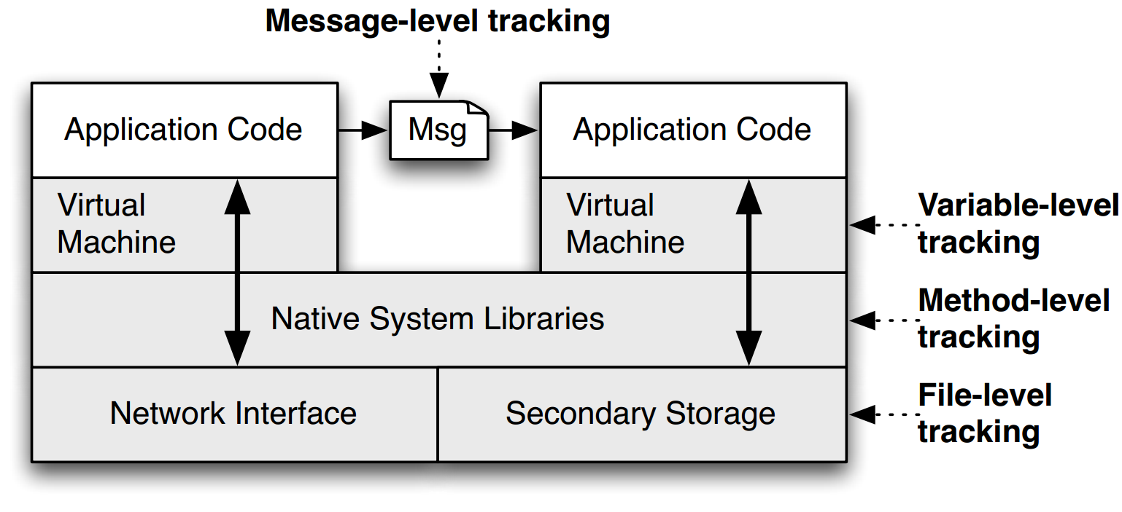
Four levels of Tracking Tech.
Figure 1: From the original paper

Slide 13
Four levels of Tracking Tech.
Labeled data
Figure 1: From the original paper

Slide 14
Variable level Tracking
Tracks within VM environment by modifying Dalvik VM interpreter.
Dalvik VM instance stores/propagates taint tag on variables
Dalvik VM interpreter

Slide 15
Method level Tracking
Applications can execute native methods using the Java Native interface (JNI )
Data flow is propagated by pre-defined method profiles

Slide 16
Message level Tracking
Binder IPC (Inter Process Communication)
  a component-based processing and IPC framework
Message taint tags are propagated during IPC
Binder IPC

Slide 17
File level Tracking
Taint tags may be lost when data is written to a file
Stores file taint tags in the extended attributes of the file system and updates/propagates

Slide 18
Experiment and Findings
Setup
  1100 samples of the most popular Android applications
  358 of 1100 required Internet permissions or different sensitive information
  Randomly selected 30 of them
Findings
  Over 1000 TCP connections and 105 TCP connections containing private information
  15 of them were sharing the location with a third party advertisement server without notifying the user

Slide 19
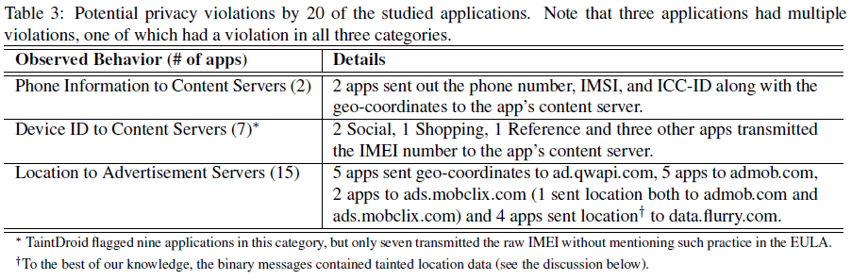
Findings (detail)
Table3: From the original paper

Slide 20
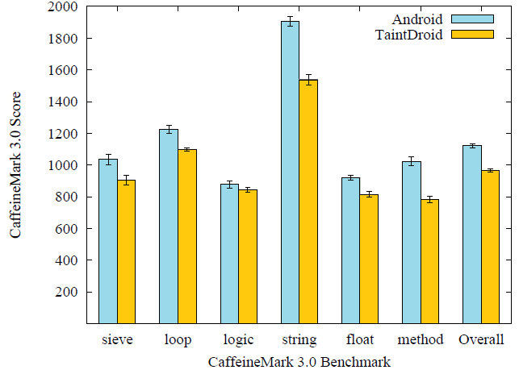
Performance
Figure 5: From the original paper
Memory overhead 4.4%
IPC overhead 27%
Others
    App load: 3% (2ms)
    Address book: (< 20 ms)
      5.5% create, 18% read
    Phone call: 10% (10ms)
    Take picture: 29% (0.5s)
Only
14% overhead
Execution time results of the CaffeineMark 3.0 Benchmark
Scores correspond to the number of Java instructions / second
This benchmark is useful for relative comparisons

Slide 21
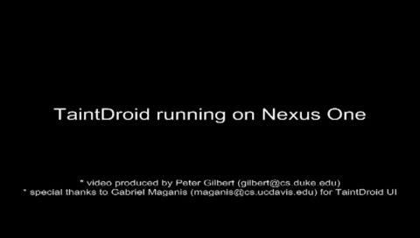
Demo
from http://appanalysis.org/demo/

Slide 22
Limitations/Weaknesses
Approach Limitations: Only tracks data flows (i.e., explicit flows) to minimize performance overhead
Taint Source Limitations: False positives can occur when the tracked information contains configuration identifiers
Overall overhead might not be enough
IMSI
MCC
MNC
MSIN

Slide 23
Improvements
Integrate with expert rating systems
  to know what the most important privacy information
Use machine learning techniques to decide correct taint source
Combine with implicit way analysis

Slide 24
Summary
Provides an efficient, system-wide information flow tracking tool that can simultaneously track multiple sources of sensitive data.
Integrates four level of taint propagation (variable-level, message-level, method-level, and file-level) to achieve a 14% performance.
Found 15 of the 30 applications reported users’ locations to remote advertising servers
Updated continually and the source code was opened to the public
  http://appanalysis.org/download.html

Slide 25
Principal References
[1] Main Paper : William Enck et al., TaintDroid: An Information-Flow Tracking System for RealTime Privacy Monitoring on Smartphones.
[2] Dynamic Taint Analysis: http://users.ece.cmu.edu/~dbrumley/courses/18487-f10/files/taint-analysis-overview.pdf
[3] All You Ever Wanted to Know about Dynamic Taint Analysis and Forward Symbolic Execution (but Might Have Been Afraid to Ask) http://ieeexplore.ieee.org/xpl/login.jsp?tp=&arnumber=5504796&url=http%3A%2F%2Fieeexplore.ieee.org%2Fxpls%2Fabs_all.jsp%3Farnumber%3D5504796
[4] Demo: http://appanalysis.org/demo

Slide 26
Thank you
&
Questions?

Slide 27
Notes
Most images of the non-relevant techniques (e.g., smartphone image) in this presentation is borrowed from Google image search results
Tables and charts is from the main paper

