Slide 1

Computability & Complexity Theory
Charles E. Hughes
COT 6410 – Spring 2014
Notes

Slide 2
Who, What, Where and When
2
Instructor: Charles Hughes;
Harris Engineering 247C; 823-2762
(phone is not a good way to get me);
charles.e.hughes@knights.ucf.edu
(e-mail is a good way to get me)
Subject: COT6410
Web Page: http://www.cs.ucf.edu/courses/cot6410/spr20124
Meetings: TR 1:30PM-2:45PM, CB1-120;
28 periods, each 75 minutes long.
Final Exam (Tuesday, April 29 from 1:00PM to 3:50PM) is separate from class meetings
Office Hours: TR 3:00PM-4:15PM

Slide 3
Text Material
3
This and other material linked from web site.
References:
  Arora&Barak, Computational Complexity: A Modern Approach, Cambridge University Press, 2009. http://www.cs.princeton.edu/theory/complexity/
  Sipser, Introduction to the Theory of Computation 3rd Ed., Cengage Learning, 2013.
  Garey&Johnson, Computers and Intractability: A guide to the Theory of NP-Completeness, W. H. Freeman & Co., 1979.
  Papadimitriou & Lewis, Elements of the Theory of Computation, Prentice-Hall, 1997.
  Hopcroft, Motwani&Ullman, Intro to Automata Theory, Languages and Computation 3rd Ed., Prentice-Hall, 2006.
  Davis, Sigal&Weyuker, Computability, Complexity and Languages 2nd Ed, Acad. Press (Morgan Kaufmann), 1994.
  Oded Goldreich, Computational Complexity: A Conceptual Approach, Cambridge University Press, 2008. http://www.wisdom.weizmann.ac.il/~odedg/cc-drafts.html
  Oded Goldreich, P, NP, and NP-Completeness: The Basics of Complexity Theory, Cambridge University Press, 2010. http://www.wisdom.weizmann.ac.il/~odedg/bc-drafts.html

Slide 4
Goals of Course
Introduce Computability and Complexity Theory, including
  Simple notions in theory of computation
    Algorithms and effective procedures
    Decision and optimization problems
    Decision problems have yes/no answer to each instance
  Limits of computation
    Turing Machines and other equivalent models
    Determinism and non-determinism
    Undecidable problems
    The technique of reducibility
    The ubiquity of undecidability (Rice’s Theorem)
    The notions of semi-decidable (re) and of co-re sets
  Complexity theory
    Order notation (quick review)
    Polynomial reducibility
    Time complexity, the sets P, NP, co-NP, NP-complete, NP-hard, etc., and the question does P=NP? Sets in NP and NP-Complete.
4

Slide 5
Expected Outcomes
5
You will gain a solid understanding of various types of computational models and their relations to one another.
You will have a strong sense of the limits that are imposed by the very nature of computation, and the ubiquity of unsolvable problems throughout CS.
You will understand the notion of computational complexity and especially of the classes of problems known as P, NP, co-NP, NP-complete and NP-Hard.
You will (hopefully) come away with stronger formal proof skills and a better appreciation of the importance of discrete mathematics to all aspects of CS.

Slide 6
Keeping Up
6
I expect you to visit the course web site regularly (preferably daily) to see if changes have been made or material has been added.
Attendance is preferred, although I do not take roll.
I do, however, ask lots of questions in class and give lots of hints about the kinds of questions I will ask on exams. It would be a shame to miss the hints, or to fail to impress me with your insightful in-class answers.
You are responsible for all material covered in class, whether in the notes or not.

Slide 7
Rules to Abide By
7
Do Your Own Work
  When you turn in an assignment, you are implicitly telling me that these are the fruits of your labor. Do not copy anyone else's homework or let anyone else copy yours. In contrast, working together to understand lecture material and solutions to problems not posed as assignments is encouraged.
Late Assignments
  I will accept no late assignments, except under very unusual conditions, and those exceptions must be arranged with me in advance unless associated with some tragic event.
Exams
  No communication during exams, except with me or a designated proctor, will be tolerated. A single offense will lead to termination of your participation in the class, and the assignment of a failing grade.

Slide 8
Grading
8
Grading of Assignments
  I will grade harder than my actual expectations run. In general, I will award everyone 110% of the grade they are assigned on the returned papers when it comes to final grade computation.
Exam Weights
  The weights of exams will be adjusted to your personal benefits, as I weigh the exam you do well in more than one in which you do less well.

Slide 9
Important Dates
9
Midterm – Tues., February 25 (tentative)
Spring Break – March 3-8
Withdraw Deadline – Tuesday, March 18
Final – Tues., April 29, 1:00PM–3:50PM

Slide 10
Evaluation (tentative)
10
Mid Term – 125 points ; Final – 175 points
Assignments – 100 points;
Paper and Presentation – 75 points
Extra – 25 points used to increase weight of exams or assignments, always to your benefit
Total Available: 500 points
Grading will be A >= 90%, B+ >= 85%,
B >= 80%, C+ >= 75%, C >= 70%,
D >= 50%, F < 50% (Minuses might be used)

Slide 11
What We are Studying
Computability Theory
The study of what can/cannot be done via purely computational means.
Complexity Theory
The study of what can/cannot be done well via purely computational means.

Slide 12
Decision Problems
A set of input data items (input "instances” or domain)
Each input data item defines a question with an answer Yes/No or True/False or 1/0.
A decision problem can be viewed as a relation between its domain and its binary range
A decision problem can also be viewed as a partition of the input domain into those that give rise to true instances and those that give rise to false instances.
In each case, we seek an algorithmic solution (in the form of a predicate) or a proof that none exists
When an algorithmic solution exists, we seek an efficient algorithm, or proofs of problem’s inherent complexity

Slide 13
Graph Coloring
Instance: A graph G = (V, E) and an integer k.
Question: Can G be "properly colored" with at most k colors?
Proper Coloring: a color is assigned to each vertex so that adjacent vertices have different colors.
Suppose we have two instances of this problem (1) is True (Yes) and the other (2) is False (No).
AND, you know (1) is Yes and (2) is No. (Maybe you have a secret program that has analyzed the two instance.)

Slide 14
Checking a “Yes” Answer
Without showing how your program works (you may not even know), how can you convince someone else that instance (1) is, in fact, a Yes instance?
We can assume the output of the program was an actual coloring of G. Just give that to a doubter who can easily check that no adjacent vertices are colored the same, and that no more than k colors were used.
How about the No instance?
What could the program have given that allows us to quickly "verify" (2) is a No instance?
    No One Knows!!

Slide 15
Checking a “No” Answer
The only thing anyone has thought of is to have it test all possible ways to k-color the graph – all of which fail, of course, if “No” is the correct answer.
There are an exponential number of things (colorings) to check.
For some problems, there seems to be a big difference between verifying Yes and No instances.
To solve a problem efficiently, we must be able to solve both Yes and No instances efficiently.

Slide 16
Hard and Easy
True Conjecture: If a problem is easy to solve, then it is easy to verify (just solve it and compare).
Contrapositive: If a problem is hard to verify, then it is (probably) hard to solve.
There is nothing magical about Yes and No instances – sometimes the Yes instances are hard to verify and No instances are easy to verify.
And, of course, sometimes both are hard to verify.

Slide 17
Easy Verification
Are there problems in which both Yes and No instances are easy to verify?
Yes. For example: Search a list L of n values for a key x.
Question: Is x in the list L?
Yes and No instances are both easy to verify.
In fact, the entire problem is easy to solve!!

Slide 18
Verify vs Solve
Conjecture: If both Yes and No instances are easy to verify, then the problem is easy to solve.
No one has yet proven this claim, but most researchers believe it to be true.
Note: It is usually relatively easy to prove something is easy – just write an algorithm for it and prove it is correct and that it is fast (usually, we mean polynomial).
But, it is usually very difficult to prove something is hard – we may not be clever enough yet. So, you will often see "appears to be hard."

Slide 19
Instances vs Problems
Each instance has an 'answer.‘
  An instance’s answer is the solution of the instance - it is not the solution of the problem.
  A solution of the problem is a computational procedure that finds the answer of any instance given to it – the procedure must halt on all instances – it must be an 'algorithm.'

Slide 20
Three Classes of Problems
  Problems can be classified to be in one of three groups (classes):
  Undecidable, Exponential, and Polynomial.
  Theoretically, all problems belong to exactly one of these three classes and our job is often to find which one.

Slide 21
Why do we Care?
When given a new problem to solve (design an algorithm for), if it's undecidable, or even exponential, you will waste a lot of time trying to write a polynomial solution for it!!
If the problem really is polynomial, it will be worthwhile spending some time and effort to find a polynomial solution.
You should know something about how hard a problem is before you try to solve it.

Slide 22
Procedure (Program)
  A finite set of operations (statements) such that
    Each statement is formed from a predetermined finite set of symbols and is constrained by some set of language syntax rules.
    The current state of the machine model is finitely presentable.
    The semantic rules of the language specify the effects of the operations on the machine’s state and the order in which these operations are executed.
    If the procedure (eventually) halts when started on some input, it produces the correct answer to this given instance of the problem.

Slide 23
Algorithm
A procedure that
  Correctly solves any instance of a given problem.
  Completes execution in a finite number of steps no matter what input it receives.

Slide 24
Sample Algorithm/Procedure
  { Example algorithm:
  Linear search of a finite list for a key;
  If key is found, answer “Yes”;
  If key is not found, answer “No”; }
  { Example procedure:
  Linear search of a finite list for a key;
  If key is found, answer “Yes”;
  If key is not found, try this strategy again; }
  Note: Latter is not unreasonable if the list can be changed by some concurrent thread.

Slide 25
Procedure vs Algorithm
Looking back at our approaches to “find a key in a finite list,” we see that the algorithm always halts and always reports the correct answer. In contrast, the procedure does not halt in some cases, but never lies.
What this illustrates is the essential distinction between an algorithm and a procedure – algorithms always halt in some finite number of steps, whereas procedures may run on forever for certain inputs. A particularly silly procedure that never lies is a program that never halts for any input.

Slide 26
Notion of Solvable
A problem is solvable if there exists an algorithm that solves it (provides the correct answer for each instance).
The fact that a problem is solvable or, equivalently, decidable does not mean it is solved. To be solved, someone must have actually produced a correct algorithm.
The distinction between solvable and solved is subtle. Solvable is an innate property – an unsolvable problem can never become solved, but a solvable one may or may not be solved in an individual’s lifetime.

Slide 27
An Old Solvable Problem
Does there exist a set of positive whole numbers, a, b, c and an n>2 such that a^{n}+b^{n} = c^{n}?
In 1637, the French mathematician, Pierre de Fermat, claimed that the answer to this question is “No”. This was called Fermat’s Last Theorem, despite the fact that he never produced a proof of its correctness.
While this problem remained unsolved until Fermat’s claim was verified in 1995 by Andrew Wiles, the problem was always solvable, since it had just one question, so the solution was either “Yes” or “No”, and an algorithm exists for each of these candidate solutions.

Slide 28
Research Territory
  Decidable – vs – Undecidable
  (area of Computability Theory)
  Exponential – vs – polynomial
  (area of Computational Complexity)
  For “easy” problems, we want to determine lower and upper bounds on complexity and develop best Algorithms
  (area of Algorithm Design/Analysis)

Slide 29
A CS Grand Challenge
Does P=NP?
There are many equivalent ways to describe P and NP. For now, we will use the following.
P is the set of decision problems (those whose instances have “Yes”/ “No” answers) that can be solved in polynomial time on a deterministic computer (no concurrency or guesses allowed).
NP is the set of decision problems that can be solved in polynomial time on a non-deterministic computer (equivalently one that can spawn an unbounded number of parallel threads; equivalently one that can be verified in polynomial time on a deterministic computer).
Again, as “Does P=NP?” has just one question, it is solvable, we just don’t yet know which solution, “Yes” or “No”, is the correct one.

Slide 30
Computability vs Complexity
Computability focuses on the distinction between solvable and unsolvable problems, providing tools that may be used to identify unsolvable problems – ones that can never be solved by mechanical (computational) means. Surprisingly, unsolvable problems are everywhere as you will see.
In contrast, complexity theory focuses on how hard it is to solve problems that are known to be solvable. Hard solvable problems abound in the real world. We will address computability theory for the first part of this course, returning to complexity theory later in the semester.

Slide 31
History
The Quest for Mechanizing Mathematics
Notes:
31

Slide 32
Hilbert, Russell and Whitehead
32
Late 1800’s to early 1900’s
Axiomatic schemes
  Axioms plus sound rules of inference
  Much of focus on number theory
First Order Predicate Calculus
  ∀x∃y [y > x]
Second Order (Peano’s Axiom)
  ∀P [[P(0) && ∀x[P(x) ⇒P(x+1)]] ⇒ ∀xP(x)]
Notes:
32

Slide 33
Hilbert
33
In 1900 declared there were 23 really important problems in mathematics.
Belief was that the solutions to these would help address math’s complexity.
Hilbert’s Tenth asks for an algorithm to find the integral zeros of polynomial equations with integral coefficients. This is now known to be impossible (In 1972, Matiyacevič showed this undecidable).
Notes:
33

Slide 34
Hilbert’s Belief
34
All mathematics could be developed within a formal system that allowed the mechanical creation and checking of proofs.
Notes:
34

Slide 35
Gödel
35
In 1931 he showed that any first order theory that embeds elementary arithmetic is either incomplete or inconsistent.
He did this by showing that such a first order theory cannot reason about itself. That is, there is a first order expressible proposition that cannot be either proved or disproved, or the theory is inconsistent (some proposition and its complement are both provable).
Gödel also developed the general notion of recursive functions but made no claims about their strength.
Notes:
35

Slide 36
Turing (Post, Church, Kleene)
36
In 1936, each presented a formalism for computability.
  Turing and Post devised abstract machines and claimed these represented all mechanically computable functions.
  Church developed the notion of lambda-computability from recursive functions (as previously defined by Gödel and Kleene) and claimed completeness for this model.
Kleene demonstrated the computational equivalence of recursively defined functions to Post-Turing machines.
Church’s notation was the lambda calculus, which later gave birth to Lisp.
Notes:
36

Slide 37
More on Emil Post
37
In the 1920’s, starting with notation developed by Frege and others in 1880s, Post devised the truth table form we all use now for Boolean expressions (propositional logic). This was a part of his PhD thesis in which he showed the axiomatic completeness of the propositional calculus.
In the late 1930’s and the 1940’s, Post devised symbol manipulation systems in the form of rewriting rules (precursors to Chomsky’s grammars). He showed their equivalence to Turing machines.
In 1940s, Post showed the complexity (undecidability) of determining what is derivable from an arbitrary set of propositional axioms.
Notes:
37

Slide 38
Computability
The study of what can/cannot be done via purely mechanical means

Slide 39
Goals on Computability
Provide characterizations (computational models) of the class of effective procedures / algorithms.
Study the boundaries between complete (or so it seems) and incomplete models of computation.
Study the properties of classes of solvable and unsolvable problems.
Solve or prove unsolvable open problems.
Determine reducibility and equivalence relations among unsolvable problems.
Apply results to various other areas of CS.

Slide 40
Basic Definitions
The Preliminaries

Slide 41
Effective Procedure
41
A process whose execution is clearly specified to the smallest detail
Such procedures have, among other properties, the following:
  Processes must be finitely describable and the language used to describe them must be over a finite alphabet.
  The current state of the machine model must be finitely presentable.
  Given the current state, the choice of actions (steps) to move to the next state must be easily determinable from the procedure’s description.
  Each action (step) of the process must be capable of being carried out in a finite amount of time.
  The semantics associated with each step must be clear and unambiguous.

Slide 42
Algorithm
42
An effective procedure that halts on all input
The key term here is “halts on all input”
By contrast, an effective procedure may halt on all, none or some of its input.
The domain of an algorithm is its entire domain of possible inputs.

Slide 43
Sets, Problems & Predicates
43
Set -- A collection of atoms from some universe U. Ø denotes the empty set.
(Decision) Problem -- A set of questions, each of which has answer “yes” or “no”.
Predicate -- A mapping from some universe U into the Boolean set {true, false}. A predicate need not be defined for all values in U.

Slide 44
How They relate
44
Let S be an arbitrary subset of some universe U. The predicate χ_{S} over U may be defined by:
χ_{S}(x) = true if and only if x ∈ S
χ_{S} is called the characteristic function of S.
Let K be some arbitrary predicate defined over some universe U. The problem P_{K} associated with K is the problem to decide of an arbitrary member x of U, whether or not K(x) is true.
Let P be an arbitrary decision problem and let U denote the set of questions in P (usually just the set over which a single variable part of the questions ranges). The set S_{P} associated with P is
{ x | x ∈ U and x has answer “yes” in P }

Slide 45
Categorizing Problems (Sets)
45
Solvable or Decidable -- A problem P is said to be solvable (decidable) if there exists an algorithm F which, when applied to a question q in P, produces the correct answer (“yes” or “no”).
Solved -- A problem P is said to solved if P is solvable and we have produced its solution.
Unsolved, Unsolvable (Undecidable) -- Complements of above

Slide 46
Existence of Undecidables
46
A counting argument
  The number of mappings from ℵ to ℵ is at least as great as the number of subsets of ℵ. But the number of subsets of ℵ is uncountably infinite (ℵ₁). However, the number of programs in any model of computation is countably infinite (ℵ₀). This latter statement is a consequence of the fact that the descriptions must be finite and they must be written in a language with a finite alphabet. In fact, not only is the number of programs countable, it is also effectively enumerable; moreover, its membership is decidable.
A diagonalization argument
  Will be shown later in class

Slide 47
Categorizing Problems (Sets) # 2
47
Recursively enumerable -- A set S is recursively enumerable (re) if S is empty (S = Ø) or there exists an algorithm F, over the natural numbers ℵ, whose range is exactly S. A problem is said to be re if the set associated with it is re.
Semi-Decidable -- A problem is said to be semi-decidable if there is an effective procedure F which, when applied to a question q in P, produces the answer “yes” if and only if q has answer “yes”. F need not halt if q has answer “no”.
Notes:
47

Slide 48
Immediate Implications
48
P solved implies P solvable implies P semi-decidable (re).
P non-re implies P unsolvable implies P unsolved.
P finite implies P solvable.
Notes:
48

Slide 49
Slightly Harder Implications
P enumerable iff P semi-decidable.
P solvable iff both S_{P} and (U — S_{P}) are re (semi-decidable).
We will prove these later.

Slide 50
Hilbert’s Tenth
Diophantine Equations are Unsolvable
One Variable Diophantine Equations are Solvable

Slide 51
Diophantine Equations
51
Polynomial equation: P(x₁, x₂, …, x_{n}) = 0
Coefficients and exponents in P must be positive integer constants
Implied existential quantifier for each variable, indicating a selection of integral values for each of x₁, x₂, …, x_{n}
Answer is “yes” if P(a₁, a₂, …, a_{n}) evaluates to 0, for some integer assignment x₁=a₁, x₂=a₂, …, x_{n}=a_{n}
Notes:
51

Slide 52
Hilbert’s 10th is Semi-Decidable
52
Consider over one variable: P(x) = 0
Can semi-decide by plugging in
0, 1, -1, 2, -2, 3, -3, …
This terminates and says “yes” if P(x) evaluates to 0, eventually. Unfortunately, it never terminates if there is no x such that P(x) =0
Can easily extend to P(x₁,x₂,..,x_{k}) = 0
Think about how to do this correctly and what the pitfalls are
Notes:
52

Slide 53
P(x) = 0 is Decidable
53
c_{n} x^{n} + c_{n-1} x^{n-1} +… + c₁ x + c₀ = 0
x^{n} = -(c_{n-1} x^{n-1} + … + c₁ x + c₀)/c_{n}
|x^{n}| ≤ c_{max}(|x^{n-1}| + … + |x| + 1|)/|c_{n}|
|x^{n}| ≤ c_{max}(n |x^{n-1}|)/|c_{n}|, since |x|≥1
|x| ≤ n×c_{max}/|c_{n}|
Notes:
53

Slide 54
P(x) = 0 is Decidable
54
Can bound the search to values of x in range
[± n * ( c_{max} / c_{n} )], where
n = highest order exponent in P(x)
c_{max} = largest absolute value coefficient
c_{n} = coefficient of highest order term
Once we have a search bound and we are dealing with a countable set, we have an algorithm to decide if there is an x.
Cannot find bound when more than one variable, so cannot extend to P(x₁,x₂,..,x_{k}) = 0.
Notes:
54

Slide 55
Undecidability
We Can’t Do It All

Slide 56
Classic Unsolvable Problem
Given an arbitrary program P, in some language L, and an input x to P, will P eventually stop when run with input x?
The above problem is called the “Halting Problem.” It is clearly an important and practical one – wouldn't it be nice to not be embarrassed by having your program run “forever” when you try to do a demo?
Unfortunately, there’s a fly in the ointment as one can prove that no algorithm can be written in L that solves the halting problem for L.

Slide 57
Some terminology
We will say that a procedure, f, converges on input x if it eventually halts when it receives x as input. We denote this as f(x)↓.
We will say that a procedure, f, diverges on input x if it never halts when it receives x as input. We denote this as f(x)↑.
Of course, if f(x)↓ then f defines a value for x. In fact we also say that f(x) is defined if f(x)↓ and undefined if f(x)↑.
Finally, we define the domain of f as {x | f(x)↓}.
The range of f is {y | f(x)↓ and f(x) = y }.

Slide 58
Halting Problem
Assume we can decide the halting problem. Then there exists some total function Halt such that
1 if ϕ_{x} (y) ↓
Halt(x,y) =
0 if ϕ_{x} (y) ↑
Here, we have numbered all programs and ϕ_{x} refers to the x-th program in this ordering. Now we can view Halt as a mapping from ℵ into ℵ by treating its input as a single number representing the pairing of two numbers via the one-one onto function
pair(x,y) = <x,y> = 2^{x} (2y + 1) – 1
with inverses
<z>₁ = log₂(z+1)
<z>₂ = ((( z + 1 ) // 2 ^{<z>1} ) – 1 ) // 2

Slide 59
The Contradiction
Now if Halt exist, then so does Disagree, where
0 if Halt(x,x) = 0, i.e, if ϕ_{x} (x) ↑
Disagree(x) =
μy (y == y+1) if Halt(x,x) = 1, i.e, if ϕ_{x} (x) ↓
Since Disagree is a program from ℵ into ℵ , Disagree can be reasoned about by Halt. Let d be such that Disagree = ϕ_{d}, then
Disagree(d) is defined ⇔ Halt(d,d) = 0
⇔ ϕ_{d} (d) ↑
⇔ Disagree(d) is undefined
But this means that Disagree contradicts its own existence. Since every step we took was constructive, except for the original assumption, we must presume that the original assumption was in error. Thus, the Halting Problem is not solvable.

Slide 60
Halting is recognizable
While the Halting Problem is not solvable, it is re, recognizable or semi-decidable.
To see this, consider the following semi-decision procedure. Let P be an arbitrary procedure and let x be an arbitrary natural number. Run the procedure P on input x until it stops. If it stops, say “yes.” If P does not stop, we will provide no answer. This semi-decides the Halting Problem. Here is a procedural description.
Semi_Decide_Halting() {
Read P, x;
P(x);
Print “yes”;
}

Slide 61
Why not just algorithms?
A question that might come to mind is why we could not just have a model of computation that involves only programs that halt for all input. Assume you have such a model – our claim is that this model must be incomplete!
Here’s the logic. Any programming language needs to have an associated grammar that can be used to generate all legitimate programs. By ordering the rules of the grammar in a way that generates programs in some lexical or syntactic order, we have a means to recursively enumerate the set of all programs. Thus, the set of procedures (programs) is re. using this fact, we will employ the notation that ϕ_{x} is the x-th procedure and ϕ_{x}(y) is the x-th procedure with input y. We also refer to x as the procedure’s index.

Slide 62
The universal machine
First, we can all agree that any complete model of computation must be able to simulate programs in its own language. We refer to such a simulator (interpreter) as the Universal machine, denote Univ. This program gets two inputs. The first is a description of the program to be simulated and the second of the input to that program. Since the set of programs in a model is re, we will assume both arguments are natural numbers; the first being the index of the program. Thus,
Univ(x,y) = ϕ_{x}(y)

Slide 63
Non-re Problems
There are even “practical” problems that are worse than unsolvable -- they’re not even semi-decidable.
The classic non-re problem is the Uniform Halting Problem, that is, the problem to decide of an arbitrary effective procedure P, whether or not P is an algorithm.
Assume that the algorithms can be enumerated, and that F accomplishes this. Then
F(x) = F_{x}
where F₀, F₁, F₂, … is a list of indexes of all and only the algorithms

Slide 64
The Contradiction
Define G( x ) = Univ ( F(x) , x ) + 1 = ϕ_{F(x)}( x ) = F_{x}(x) + 1
But then G is itself an algorithm. Assume it is the g-th one
F(g) = F_{g} = G
Then, G(g) = F_{g}(g) + 1 = G(g) + 1
But then G contradicts its own existence since G would need to be an algorithm.
This cannot be used to show that the effective procedures are non-enumerable, since the above is not a contradiction when G(g) is undefined. In fact, we already have shown how to enumerate the (partial) recursive functions.

Slide 65
Consequences
To capture all the algorithms, any model of computation must include some procedures that are not algorithms.
Since the potential for non-termination is required, every complete model must have some for form of iteration that is potentially unbounded.
This means that simple, well-behaved for-loops (the kind where you can predict the number of iterations on entry to the loop) are not sufficient. While type loops are needed, even if implicit rather than explicit.

Slide 66
Insights

Slide 67
Non-re nature of algorithms
No generative system (e.g., grammar) can produce descriptions of all and only algorithms
No parsing system (even one that rejects by divergence) can accept all and only algorithms
Of course, if you buy Church’s Theorem, the set of all procedures can be generated. In fact, we can build an algorithmic acceptor of such programs.

Slide 68
Many unbounded ways
How do you achieve divergence, i.e., what are the various means of unbounded computation in each of our models?
GOTO: Turing Machines and Register Machines
Minimization: Recursive Functions
  Why not primitive recursion/iteration?
Fixed Point: Ordered Petri Nets,
(Ordered) Factor Replacement Systems

Slide 69
Non-determinism
It sometimes doesn’t matter
  Turing Machines, Finite State Automata,
  Linear Bounded Automata
It sometimes helps
  Push Down Automata
It sometimes hinders
  Factor Replacement Systems, Petri Nets

Slide 70
Models of Computation
Turing Machines
Register Machines
Factor Replacement Systems
Recursive Functions

Slide 71
Turing Machines
1st Model
A Linear Memory Machine

Slide 72
Basic Description
We will use a simplified form that is a variant of Post’s and Turing’s models.
Here, each machine is represented by a finite set of states of states Q, the simple alphabet {0,1}, where 0 is the blank symbol, and each state transition is defined by a 4-tuple of form
q a X s
where q a is the discriminant based on current state q, scanned symbol a; X can be one of {R, L, 0, 1}, signifying move right, move left, print 0, or print 1; and s is the new state.
Limiting the alphabet to {0,1} is not really a limitation. We can represent a k-letter alphabet by encoding the j-th letter via j 1’s in succession. A 0 ends each letter, and two 0’s ends a word.
We rarely write quads. Rather, we typically will build machines from simple forms.

Slide 73
Base Machines
R -- move right over any scanned symbol
L -- move left over any scanned symbol
0 -- write a 0 in current scanned square
1 -- write a 1 in current scanned square
We can then string these machines together with optionally labeled arc.
A labeled arc signifies a transition from one part of the composite machine to another, if the scanned square’s content matches the label. Unlabeled arcs are unconditional. We will put machines together without arcs, when the arcs are unlabeled.

Slide 74
Useful Composite Machines
R -- move right to next 0 (not including current square)
…?11…10… ⇒ …?11…10…
L -- move left to next 0 (not including current square)
…011…1?… ⇒ …011…1?…
R -- move right to next 00 (not including current square)
…?11…1011…10…11…100… ⇒ …?11…1011…10…11…100…
L -- move left to next 00 (not including current square)
…0011…1011…10…11…1?… ⇒ …0011…1011…10…11…1?…

Slide 75
Commentary on Machines
These machines can be used to move over encodings of letters or encodings of unary based natural numbers.
In fact, any effective computation can easily be viewed as being over natural numbers. We can get the negative integers by pairing two natural numbers. The first is the sign (0 for +, 1 for -). The second is the magnitude.

Slide 76
Computing with TMs
A reasonably standard definition of a Turing computation of some n-ary function F is to assume that the machine starts with a tape containing the n inputs, x1, … , xn in the form
…01^{x1}01^{x2}0…01^{xn}0…
and ends with
…01^{x1}01^{x2}0…01^{xn}01^{y}0…
where y = F(x1, … , xn).

Slide 77
Addition by TM
Need the copy family of useful submachines, where C_{k} copies k-th preceding value.
The add machine is then
C₂ C₂ L 1 R L 0

Slide 78
Turing Machine Variations
Two tracks
N tracks
Non-deterministic (We will return to this)
Two-dimensional
K dimensional
Two stack machines
Two counter machines

Slide 79
Register Machines
2nd Model
Feels Like Assembly Language

Slide 80
Register Machine Concepts
A register machine consists of a finite length program, each of whose instructions is chosen from a small repertoire of simple commands.
The instructions are labeled from 1 to m, where there are m instructions. Termination occurs as a result of an attempt to execute the m+1-st instruction.
The storage medium of a register machine is a finite set of registers, each capable of storing an arbitrary natural number.
Any given register machine has a finite, predetermined number of registers, independent of its input.

Slide 81
Computing by Register Machines
A register machine partially computing some n-ary function F typically starts with its argument values in the first n registers and ends with the result in the n+1-st register.
We extend this slightly to allow the computation to start with values in its k+1-st through k+n-th register, with the result appearing in the k+n+1-th register, for any k, such that there are at least k+n+1 registers.
Sometimes, we use the notation of finishing with the results in the first register, and the arguments appearing in 2 to n+1.

Slide 82
Register Instructions
Each instruction of a register machine is of one of two forms:
INC_{r}[i] –
increment r and jump to i.
DEC_{r}[p, z] –
if register r > 0, decrement r and jump to p
else jump to z
Note, we do not use subscripts if obvious.

Slide 83
Addition by RM
Addition (r3 ← r1 + r2)
1. DEC3[1,2] : Zero result (r3) and work (r4) registers
2. DEC4[2,3]
3. DEC1[4,6] : Add r1 to r3, saving original r1 in r4
4. INC3[5]
5. INC4[3]
6. DEC4[7,8] : Restore r1
7. INC1[6]
8. DEC2[9,11] : Add r2 to r3, saving original r2 in r4
9. INC3[10]
10. INC4[8]
11. DEC4[12,13] : Restore r2
12. INC2[11]
13. : Halt by branching here

Slide 84
Limited Subtraction by RM
Subtraction (r3 ← r1 - r2, if r1≥r2; 0, otherwise)
1. DEC3[1,2] : Zero result (r3) and work (r4) registers
2. DEC4[2,3]
3. DEC1[4,6] : Add r1 to r3, saving original r1 in r4
4. INC3[5]
5. INC4[3]
6. DEC4[7,8] : Restore r1
7. INC1[6]
8. DEC2[9,11] : Subtract r2 from r3, saving original r2 in r4
9. DEC3[10,10] : Note that decrementing 0 does nothing
10. INC4[8]
11. DEC4[12,13] : Restore r2
12. INC2[11]
13. : Halt by branching here

Slide 85
Factor Replacement Systems
3rd Model
Deceptively Simple

Slide 86
Factor Replacement Concepts
A factor replacement system (FRS) consists of a finite (ordered) sequence of fractions, and some starting natural number x.
A fraction a/b is applicable to some natural number x, just in case x is divisible by b. We always chose the first applicable fraction (a/b), multiplying it times x to produce a new natural number x*a/b. The process is then applied to this new number.
Termination occurs when no fraction is applicable.
A factor replacement system partially computing n-ary function F typically starts with its argument encoded as powers of the first n odd primes. Thus, arguments x1,x2,…,xn are encoded as 3^{x1}5^{x2}…p_{n}^{xn}. The result then appears as the power of the prime 2.

Slide 87
Addition by FRS
Addition is 3^{x1}5^{x2} becomes 2^{x1+x2}
or, in more details, 2⁰3^{x1}5^{x2} becomes 2^{x1+x2} 3⁰5⁰
2 / 3
2 / 5
Note that these systems are sometimes presented as rewriting rules of the form
bx → ax
meaning that a number that has can be factored as bx can have the factor b replaced by an a.
The previous rules would then be written
3x → 2x
5x → 2x

Slide 88
Limited Subtraction by FRS
Subtraction is 3^{x1}5^{x2} becomes 2^{max(0,x1-x2)}
3⋅5x → x
3x → 2x
5x → x

Slide 89
Ordering of Rules
The ordering of rules are immaterial for the addition example, but are critical to the workings of limited subtraction.
In fact, if we ignore the order and just allow any applicable rule to be used we get a form of non-determinism that makes these systems equivalent to Petri nets.
The ordered kind are deterministic and are equivalent to a Petri net in which the transitions are prioritized.

Slide 90
Why Deterministic?
To see why determinism makes a difference, consider
3⋅5x → x
3x → 2x
5x → x
Starting with 135 = 3³5¹, deterministically we get
135 ⇒ 9 ⇒ 6 ⇒ 4 = 2²
Non-deterministically we get a larger, less selective set.
135 ⇒ 9 ⇒ 6 ⇒ 4 = 2²
135 ⇒ 90 ⇒ 60 ⇒ 40 ⇒ 8 = 2³
135 ⇒ 45 ⇒ 3 ⇒ 2 = 2¹
135 ⇒ 45 ⇒ 15 ⇒ 1 = 2⁰
135 ⇒ 45 ⇒ 15 ⇒ 5 ⇒ 1 = 2⁰
135 ⇒ 45 ⇒ 15 ⇒ 3 ⇒ 2 = 2¹
135 ⇒ 45 ⇒ 9 ⇒ 6 ⇒ 4 = 2²
135 ⇒ 90 ⇒ 60 ⇒ 40 ⇒ 8 = 2³
…
This computes 2^{z} where 0 ≤ z≤x₁. Think about it.

Slide 91
More on Determinism
In general, we might get an infinite set using non-determinism, whereas determinism might produce a finite set. To see this consider a system
2x → x
2x → 4x
starting with the number 2.

Slide 92
Sample RM and FRS
Present a Register Machine that computes IsOdd. Assume R2=x; at termination, set R2=1 if x is odd; 0 otherwise.
1. DEC2[2, 4]
2. DEC2[1, 3]
3. INC2[4]
4.
Present a Factor Replacement System that computes IsOdd. Assume starting number is 3^x; at termination, result is 2=2^1 if x is odd; 1= 2^0 otherwise.
3*3 x → x
3 x → 2 x

Slide 93
Sample FRS
Present a Factor Replacement System that computes IsPowerOf2. Assume starting number is 3^{x} 5; at termination, result is 2=2¹ if x is a power of 2; 1= 2⁰ otherwise
3²*5 x → 5*7 x
3*5*7 x → x
3*5 x → 2 x
5*7 x → 7*11 x
7*11 x → 3*11 x
11 x → 5 x
5 x → x
7 x → x

Slide 94
Systems Related to FRS
Petri Nets:
  Unordered
  Ordered
  Negated Arcs
Vector Addition Systems:
  Unordered
  Ordered
Factors with Residues:
  a x + c → b x + d
Finitely Presented Abelian Semi-Groups

Slide 95
Petri Net Operation
Finite number of places, each of which can hold zero of more markers.
Finite number of transitions, each of which has a finite number of input and output arcs, starting and ending, respectively, at places.
A transition is enabled if all the nodes on its input arcs have at least as many markers as arcs leading from them to this transition.
Progress is made whenever at least one transition is enabled. Among all enabled, one is chosen randomly to fire.
Firing a transition removes one marker per arc from the incoming nodes and adds one marker per arc to the outgoing nodes.

Slide 96
Petri Net Computation
A Petri Net starts with some finite number of markers distributed throughout its n nodes.
The state of the net is a vector of n natural numbers, with the i-th component’s number indicating the contents of the i-th node. E.g., <0,1,4,0,6> could be the state of a Petri Net with 5 places, the 2nd, 3rd and 5th, having 1, 4, and 6 markers, resp., and the 1st and 4th being empty.
Computation progresses by selecting and firing enabled transitions. Non-determinism is typical as many transitions can be simultaneously enabled.
Petri nets are often used to model coordination algorithms, especially for computer networks.

Slide 97
Variants of Petri Nets
A Petri Net is not computationally complete. In fact, its halting and word problems are decidable. However, its containment problem (are the markings of one net contained in those of another?) is not decidable.
A Petri net with prioritized transitions, such that the highest priority transitions is fired when multiple are enabled is equivalent to an FRS. (Think about it).
A Petri Net with negated input arcs is one where any arc with a slash through it contributes to enabling its associated transition only if the node is empty. These are computationally complete. They can simulate register machines. (Think about this also).

Slide 98
Petri Net Example
R
S
Want S
Want R
Want R
Want S
…
…
Release
Marker
Release
Place
Transition
Arc

Slide 99
Vector Addition
Start with a finite set of vectors in integer n-space.
Start with a single point with non-negative integral coefficients.
Can apply a vector only if the resultant point has non-negative coefficients.
Choose randomly among acceptable vectors.
This generates the set of reachable points.
Vector addition systems are equivalent to Petri Nets.
If order vectors, these are equivalent to FRS.

Slide 100
Vectors as Resource Models
Each component of a point in n-space represents the quantity of a particular resource.
The vectors represent processes that consume and produce resources.
The issues are safety (do we avoid bad states) and liveness (do we attain a desired state).
Issues are deadlock, starvation, etc.

Slide 101
Factors with Residues
Rules are of form
  a_{i} x + c_{i} → b_{i} x + d_{i}
  There are n such rules
  Can apply if number is such that you get a residue (remainder) c_{i} when you divide by a_{i}
  Take quotient x and produce a new number
  b_{i} x + d_{i}
  Can apply any applicable one (no order)
These systems are equivalent to Register Machines.

Slide 102
Abelian Semi-Group
S = (G, •) is a semi-group if
  G is a set, • is a binary operator, and
  Closure: If x,y ∈ G then x • y ∈ G
  Associativity: x • (y • z) = (x • y) • z
S is a monoid if
  Identity: ∃e ∈ G ∀x ∈ G [e • x = x • e = x]
S is a group if
  Inverse: ∀x ∈ G ∃x⁻¹ ∈ G [x⁻¹ • x = x • x⁻¹ = e]
S is Abelian if • is commutative

Slide 103
Finitely Presented
S = (G, •), a semi-group (monoid, group), is finitely presented if there is a finite set of symbols, Σ, called the alphabet or generators, and a finite set of equalities
(α_{i} = β_{i}), the reflexive transitive closure of which determines equivalence classes over G.
Note, the set G is the closure of the generators under the semi-group’s operator •.
The problem of determining membership in equivalence classes for finitely presented Abelian semi-groups is equivalent to that of determining mutual derivability in an unordered FRS or Vector Addition System with inverses for each rule.

Slide 104
Recursive Functions
Primitive and μ-Recursive

Slide 105
Primitive Recursive
An Incomplete Model

Slide 106
Basis of PRFs
The primitive recursive functions are defined by starting with some base set of functions and then expanding this set via rules that create new primitive recursive functions from old ones.
The base functions are:
C_{a}(x₁,…,x_{n}) = a : constant functions
(x₁,…,x_{n}) = x_{i} : identity functions
: aka projection
S(x) = x+1 : an increment function

Slide 107
Building New Functions
Composition:
If G, H₁, … , H_{k} are already known to be primitive recursive, then so is F, where
F(x₁,…,x_{n}) = G(H₁(x₁,…,x_{n}), … , H_{k}(x₁,…,x_{n}))
Iteration (aka primitive recursion):
If G, H are already known to be primitive recursive, then so is F, where
F(0, x₁,…,x_{n}) = G(x₁,…,x_{n})
F(y+1, x₁,…,x_{n}) = H(y, x₁,…,x_{n}, F(y, x₁,…,x_{n}))
We also allow definitions like the above, except iterating on y as the last, rather than first argument.

Slide 108
Addition & Multiplication
Example: Addition
+(0,y) = (y)
+(x+1,y) = H(x,y,+(x,y))
where H(a,b,c) = S( (a,b,c))
Example: Multiplication
*(0,y) = C₀(y)
*(x+1,y) = H(x,y,*(x,y))
where H(a,b,c) = +( (a,b,c), (a,b,c))
= b+c = y + *(x,y) = (x+1)*y

Slide 109
Basic Arithmetic
x + 1:
x + 1 = S(x)
x – 1:
0 - 1 = 0
(x+1) - 1 = x
x + y:
x + 0 = x
x+ (y+1) = (x+y) + 1
x – y: // limited subtraction
x – 0 = x
x – (y+1) = (x–y) – 1

Slide 110
2nd Grade Arithmetic
x * y:
x * 0 = 0
x * (y+1) = x*y + x
x!:
0! = 1
(x+1)! = (x+1) * x!

Slide 111
Basic Relations
x == 0:
0 == 0 = 1
(y+1) == 0 = 0
x == y:
x==y = ((x – y) + (y – x )) == 0
x ≤y :
x≤y = (x – y) == 0
x ≥ y:
x≥y = y≤x
x > y :
x>y = ~(x≤y) /* See ~ on next page */
x < y :
x<y = ~(x≥y)

Slide 112
Basic Boolean Operations
~x:
~x = 1 – x or (x==0)
signum(x): 1 if x>0; 0 if x==0
~(x==0)
x && y:
x&&y = signum(x*y)
x || y:
x||y = ~((x==0) && (y==0))

Slide 113
Definition by Cases
One case
g(x) if P(x)
f(x) =
h(x) otherwise
f(x) = P(x) * g(x) + (1-P(x)) * h(x)
Can use induction to prove this is true for all k>0, where
g₁(x) if P₁(x)
g₂(x) if P₂(x) && ~P₁(x)
f(x) = …
g_{k}(x) if P_{k}(x) && ~(P₁(x) || … || ~P_{k-1}(x))
h(x) otherwise

Slide 114
Bounded Minimization 1
f(x) = μ z (z ≤ x) [ P(z) ] if ∃ such a z,
= x+1, otherwise
where P(z) is primitive recursive.
Can show f is primitive recursive by
f(0) = 1-P(0)
f(x+1) = f(x) if f(x) ≤ x
= x+2-P(x+1) otherwise

Slide 115
Bounded Minimization 2
f(x) = μ z (z < x) [ P(z) ] if ∃ such a z,
= x, otherwise
where P(z) is primitive recursive.
Can show f is primitive recursive by
f(0) = 0
f(x+1) = μ z (z ≤ x) [ P(z) ]

Slide 116
Intermediate Arithmetic
x // y:
x//0 = 0 : silly, but want a value
x//(y+1) = μ z (z<x) [ (z+1)*(y+1) > x ]
x | y: x is a divisor of y
x|y = ((y//x) * x) == y

Slide 117
Primality
firstFactor(x): first non-zero, non-one factor of x.
firstfactor(x) = μ z (2 ≤ z ≤ x) [ z|x ] ,
0 if none
isPrime(x):
isPrime(x) = firstFactor(x) == x && (x>1)
prime(i) = i-th prime:
prime(0) = 2
prime(x+1) = μ z(prime(x)< z ≤prime(x)!+1)[isPrime(z)]
We will abbreviate this as p_{i} for prime(i)

Slide 118
Exponents
x^y:
x^0 = 1
x^(y+1) = x * x^y
exp(x,i): the exponent of p_{i} in number x.
exp(x,i) = μ z (z<x) [ ~(p_{i}^(z+1) | x) ]

Slide 119
Pairing Functions
pair(x,y) = <x,y> = 2^{x} (2y + 1) – 1
with inverses
<z>₁ = exp(z+1,0)
<z>₂ = ((( z + 1 ) // 2 ^{<z>1} ) – 1 ) // 2
These are very useful and can be extended to encode n-tuples
<x,y,z> = <x, <y,z> > (note: stack analogy)

Slide 120
Pairing Function is 1-1 Onto
Prove that the pairing function <x,y> = 2^x (2y + 1) - 1 is 1-1 onto the natural numbers.
Approach 1:
We will look at two cases, where we use the following modification of the pairing function, <x,y>+1, which implies the problem of mapping the pairing function to Z⁺.

Slide 121
Case 1 (x=0)
Case 1:
For x = 0, <0,y>+1 = 2⁰(2y+1) = 2y+1. But every odd number is by definition one of the form 2y+1, where y≥0; moreover, a particular value of y is uniquely associated with each such odd number and no odd number is produced when x=0. Thus, <0,y>+1 is 1-1 onto the odd natural numbers.

Slide 122
Case 2 (x > 0)
Case 2:
For x > 0, <x,y>+1 = 2^{x}(2y+1), where 2y+1 ranges over all odd number and is uniquely associated with one based on the value of y (we saw that in case 1). 2^{x} must be even, since it has a factor of 2 and hence 2^{x}(2y+1) is also even. Moreover, from elementary number theory, we know that every even number except zero is of the form 2^{x}z, where x>0, z is an odd number and this pair x,y is unique. Thus, <x,y>+1 is 1-1 onto the even natural numbers, when x>0.
The above shows that <x,y>+1 is 1-1 onto Z⁺, but then <x,y> is 1-1 onto ℵ, as was desired.

Slide 123
Pairing Function is 1-1 Onto
Approach 2:
Another approach to show a function f over S is
1-1 onto T is to show that
f ⁻¹(f(x)) = x, for arbitrary x∈S and that
f (f⁻¹ (z)) = z, for arbitrary z∈T.
Thus, we need to show that
(<x,y>₁,<x,y>₂) = (x,y) for arbitrary (x,y)∈ℵ×ℵ and
<<z>₁,<z>₂> = z for arbitrary z∈ℵ.

Slide 124
Alternate Proof
Let x,y be arbitrary natural number, then <x,y> = 2^{x}(2y+1)-1.
Moreover, <2^{x}(2y+1)-1>₁ = Factor(2^{x}(2y+1),0) = x, since 2y+1 must be odd, and
<2^{x}(2y+1)-1>₂ = ((2^{x}(2y+1)/2^Factor(2^{x}(2y+1),0))-1)/2 = 2y/2 = y.
Thus, (<x,y>₁,<x,y>₂) = (x,y), as was desired.
Let z be an arbitrary natural number, then the inverse of the pairing is (<z>₁,<z>₂)
Moreover, <<z>₁,<z>₂> = 2^<z>₁ *(2<z>₂+1)-1
= 2^Factor(z+1,0)*(2*((z+1)/ 2^Factor(z+1,0))/2-1+1)-1
= 2^Factor(z+1,0)*( (z+1)/ 2^Factor(z+1,0))-1
= (z+1) – 1
= z, as was desired.

Slide 125
Application of Pairing
Show that prfs are closed under Fibonacci induction. Fibonacci induction means that each induction step after calculating the base is computed using the previous two values, where the previous values for f(1) are f(0) and 0; and for x>1, f(x) is based on f(x-1) and f(x-2).
The formal hypothesis is:
Assume g and h are already known to be prf, then so is f, where
f(0,x) = g(x);
f(1,x) = h(f(0,x), 0); and
f(y+2,x) = h(f(y+1,x), f(y,x))
Proof is by construction

Slide 126
Fibonacci Recursion
Let K be the following primitive recursive function, defined by induction on the primitive recursive functions, g, h, and the pairing function.
K(0,x) = B(x)
B(x) = < g(x), C₀(x) > // this is just <g(x), 0>
K(y+1, x) = J(y, x, K(y,x))
J(y,x,z) = < h(<z>₁, <z>₂), <z>₁ >
// this is < f(y+1,x), f(y,x)>, even though f is not yet shown to be prf!!
This shows K is prf.
f is then defined from K as follows:
f(y,x) = <K(y,x)>₁ // extract first value from pair encoded in K(y,x)
This shows it is also a prf, as was desired.

Slide 127
μ Recursive
4th Model
A Simple Extension to Primitive Recursive

Slide 128
μ Recursive Concepts
All primitive recursive functions are algorithms since the only iterator is bounded. That’s a clear limitation.
There are algorithms like Ackerman’s function that cannot be represented by the class of primitive recursive functions.
The class of recursive functions adds one more iterator, the minimization operator (μ), read “the least value such that.”

Slide 129
Ackermann’s Function
A(1, j)=2j for j ≥ 1
A(i, 1)=A(i-1, 2) for i ≥ 2
A(i, j)=A(i-1, A(i, j-1)) for i, j ≥ 2
Wilhelm Ackermann observed in 1928 that this is not a primitive recursive function.
Ackermann’s function grows too fast to have a for-loop implementation.
The inverse of Ackermann’s function is important to analyze Union/Find algorithm.

Slide 130
Union/Find
Start with a collection S of unrelated elements – singleton equivalence classes
Union(x,y), x and y are in S, merges the class containing x ([x]) with that containing y ([y])
Find(x) returns the canonical element of [x]
Can see if x≡y, by seeing if Find(x)==Find(y)
How do we represent the classes?

Slide 131
The μ Operator
Minimization:
If G is already known to be recursive, then so is F, where
F(x1,…,xn) = μy (G(y,x1,…,xn) == 1)
We also allow other predicates besides testing for one. In fact any predicate that is recursive can be used as the stopping condition.

Slide 132
Equivalence of Models
Equivalency of computation by
Turing machines,
register machines,
factor replacement systems,
recursive functions

Slide 133
Proving Equivalence
Constructions do not, by themselves, prove equivalence.
To do so, we need to develop a notion of an “instantaneous description” (id) of each model of computation (well, almost as recursive functions are a bit different).
We then show a mapping of id’s between the models.

Slide 134
Instantaneous Descriptions
An instantaneous description (id) is a finite description of a state achievable by a computational machine, M.
Each machine starts in some initial id, id₀.
The semantics of the instructions of M define a relation ⇒_{M} such that, id_{i} ⇒_{M} id_{i+1}, i≥0, if the execution of a single instruction of M would alter M’s state from id_{i} to id_{i+1} or if M halts in state id_{i} and id_{i+1}=id_{i}.
⇒⁺_{M} is the transitive closure of ⇒_{M}
⇒*_{M} is the reflexive transitive closure of ⇒_{M}

Slide 135
id Definitions
For a register machine, M, an id is an s+1 tuple of the form
(i, r₁,…,r_{s})_{M} specifying the number of the next instruction to be executed and the values of all registers prior to its execution.
For a factor replacement system, an id is just a natural number.
For a Turing machine, M, an id is some finite representation of the tape, the position of the read/write head and the current state. This is usually represented as a string αqxβ, where α (β) is the shortest string representing all non-blank squares to the left (right) of the scanned square, x is the symbol at the scanned square and q is the current state.
Recursive functions do not have id’s, so we will handle their simulation by an inductive argument, using the primitive functions are the basis and composition, induction and minimization in the inductive step.

Slide 136
Equivalence Steps
Assume we have a machine M in one model of computation and a mapping of M into a machine M’ in a second model.
Assume the initial configuration of M is id₀ and that of M’ is id’₀
Define a mapping, h, from id’s of M into those of M’, such that,
R_{M} = { h(d) | d is an instance of an id of M }, and
  id’₀⇒*_{M’} h(id₀), and h(id₀) is the only member of R_{M} in the configurations encountered in this derivation.
  h(id_{i})⇒⁺_{M’} h(id_{i+1}), i≥0, and h(id_{i+1}) is the only member of R_{M} in this derivation.
The above, in effect, provides an inductive proof that
  id₀⇒*_{M} id implies id’₀⇒*_{M’} h(id), and
  If id’₀⇒*_{M’} id’ then either id₀⇒*_{M} id, where id’ = h(id), or
  id’ ∉ R_{M}

Slide 137
All Models are Equivalent
Equivalency of computation by
Turing machines, register machines,
factor replacement systems,
recursive functions

Slide 138
Our Plan of Attack
We will now show
TURING ≤ REGISTER ≤ FACTOR ≤ RECURSIVE ≤ TURING
where by A ≤ B, we mean that every instance of A can be replaced by an equivalent instance of B.
The transitive closure will then get us the desired result.

Slide 139
TURING ≤ REGISTER

Slide 140
Encoding a TM’s State
Assume that we have an n state Turing machine. Let the states be numbered 0,…, n-1.
Assume our machine is in state 7, with its tape containing
… 0 0 1 0 1 0 0 1 1 q7 0 0 0 …
The underscore indicates the square being read. We denote this by the finite id
1 0 1 0 0 1 1 q7 0
In this notation, we always write down the scanned square, even if it and all symbols to its right are blank.

Slide 141
More on Encoding of TM
An id can be represented by a triple of natural numbers, (R,L,i), where R is the number denoted by the reversal of the binary sequence to the right of the qi, L is the number denoted by the binary sequence to the left, and i is the state index.
So,
… 0 0 1 0 1 0 0 1 1 q7 0 0 0 …
is just (0, 83, 7).
… 0 0 1 0 q5 1 0 1 1 0 0 …
is represented as (13, 2, 5).
We can store the R part in register 1, the L part in register 2, and the state index in register 3.

Slide 142
Simulation by RM
1. DEC3[2,q0] : Go to simulate actions in state 0
2. DEC3[3,q1] : Go to simulate actions in state 1
…
n. DEC3[ERR,qn-1] : Go to simulate actions in state n-1
…
qj. IF_r1_ODD[qj+2] : Jump if scanning a 1
qj+1. JUMP[set_k] : If (qj 0 0 qk) is rule in TM
qj+1. INC1[set_k] : If (qj 0 1 qk) is rule in TM
qj+1. DIV_r1_BY_2 : If (qj 0 R qk) is rule in TM
MUL_r2__BY_2
JUMP[set_k]
qj+1. MUL_r1_BY_2 : If (qj 0 L qk) is rule in TM
IF_r2_ODD then INC1
DIV_r2__BY_2[set_k]
…
set_n-1. INC3[set_n-2] : Set r3 to index n-1 for simulating state n-1
set_n-2. INC3[set_n-3] : Set r3 to index n-2 for simulating state n-2
…
set_0. JUMP[1] : Set r3 to index 0 for simulating state 0

Slide 143
Fixups
Need epilog so action for missing quad (halting) jumps beyond end of simulation to clean things up, placing result in r1.
Can also have a prolog that starts with arguments in first n registers and stores values in r1, r2 and r3 to represent Turing machines starting configuration.

Slide 144
Prolog
Example assuming n arguments (fix as needed)
1. MUL_rn+1_BY_2[2] : Set rn+1 = 11…10₂, where, #1's = r1
2. DEC1[3,4] : r1 will be set to 0
3. INCn+1[1] :
4. MUL_rn+1_BY_2[5] : Set rn+1 = 11…1011…10₂, where, #1's = r1, then r2
5. DEC2[6,7] : r2 will be set to 0
6. INCn+1[4] :
…
3n-2. DECn[3n-1,3n+1] : Set rn+1 = 11…1011…1011…1₂, where, #1's = r1, r2,…
3n-1. MUL_rn+1_BY_2[3n] : rn will be set to 0
3n. INCn+1[3n-2] :
3n+1 DECn+1[3n+2,3n+3] : Copy rn+1 to r1, rn+1 is set to 0
3n+2. INC2[3n+1] :
3n+3. : r2 = left tape, r1 = 0 (right), r3 = 0 (initial state)

Slide 145
Epilog
1. DEC3[1,2] : Set r3 to 0 (just cleaning up)
2. IF_r1_ODD[3,5] : Are we done with answer?
3. INC2[4] : putting answer in r2
4. DIV_r1_BY_2[2] : strip a 1 from r1
DEC1[5,6] : Set r1 to 0 (prepare for answer)
DEC2[6,7] : Copy r2 to r1
INC1[6] :
: Answer is now in r1

Slide 146
REGISTER ≤ FACTOR

Slide 147
Encoding a RM’s State
This is a really easy one based on the fact that every member of Z⁺ (the positive integers) has a unique prime factorization. Thus all such numbers can be uniquely written in the form
where the p_{i}'s are distinct primes and the k_{i}'s are non-zero values, except that the number 1 would be represented by 2⁰.
Let R be an arbitrary n-register machine, having m instructions.
Encode the contents of registers r1,…,rn by the powers of p₁,…p_{n} .
Encode rule number's 1,…,m by primes p_{n+1} ,…, p_{n+m}
Use pn+m+1 as prime factor that indicates simulation is done.
This is in essence the Gödel number of the RM’s state.

Slide 148
Simulation by FRS
Now, the j-th instruction (1≤j≤m) of R has associated factor replacement rules as follows:
j. INCr[i]
p_{n+j}x → p_{n+i}p_{r}x
j. DECr[s, f]
p_{n+j}p_{r}x → p_{n+s}x
p_{n+j}x → p_{n+f}x
We also add the halting rule associated with m+1 of
p_{n+m+1}x → x

Slide 149
Importance of Order
The relative order of the two rules to simulate a DEC are critical.
To test if register r has a zero in it, we, in effect, make sure that we cannot execute the rule that is enabled when the r-th prime is a factor.
If the rules were placed in the wrong order, or if they weren't prioritized, we would be non-deterministic.

Slide 150
Example of Order
Consider the simple machine to compute r1:=r2 – r3 (limited)
1. DEC3[2,3]
2. DEC2[1,1]
3. DEC2[4,5]
4. INC1[3]
5.

Slide 151
Subtraction Encoding
Start with 3^{x}5^{y}7
  7 • 5 x → 11 x
  7 x → 13 x
  11 • 3 x → 7 x
  11 x → 7 x
  13 • 3 x → 17 x
  13 x → 19 x
  17 x → 13 • 2 x
  19 x → x

Slide 152
Analysis of Problem
If we don't obey the ordering here, we could take an input like 3⁵5²7 and immediately apply the second rule (the one that mimics a failed decrement).
We then have 3⁵5²13, signifying that we will mimic instruction number 3, never having subtracted the 2 from 5.
Now, we mimic copying r2 to r1 and get 2⁵5²19 .
We then remove the 19 and have the wrong answer.

Slide 153
FACTOR ≤ RECURSIVE

Slide 154
Universal Machine
In the process of doing this reduction, we will build a Universal Machine.
This is a single recursive function with two arguments. The first specifies the factor system (encoded) and the second the argument to this factor system.
The Universal Machine will then simulate the given machine on the selected input.

Slide 155
Encoding FRS
Let (n, ((a₁,b₁), (a₂,b₂), … ,(a_{n},b_{n})) be some factor replacement system, where (a_{i},b_{i}) means that the i-th rule is
a_{i}x → b_{i}x
Encode this machine by the number F,

Slide 156
Simulation by Recursive # 1
We can determine the rule of F that applies to x by
RULE(F, x) = μ z (1 ≤ z ≤ exp(F, 0)+1) [ exp(F, 2*z-1) | x ]
Note: if x is divisible by a_{i}, and i is the least integer for which this is true, then exp(F,2*i-1) = a_{i} where a_{i} is the number of prime factors of F involving p_{2i-1}. Thus, RULE(F,x) = i.
If x is not divisible by any a_{i}, 1≤i≤n, then x is divisible by 1, and RULE(F,x) returns n+1. That’s why we added p_{2n+1} p_{2n+2}.
Given the function RULE(F,x), we can determine NEXT(F,x), the number that follows x, when using F, by
NEXT(F, x) = (x // exp(F, 2*RULE(F, x)-1)) * exp(F, 2*RULE(F, x))

Slide 157
Simulation by Recursive # 2
The configurations listed by F, when started on x, are
CONFIG(F, x, 0) = x
CONFIG(F, x, y+1) = NEXT(F, CONFIG(F, x, y))
The number of the configuration on which F halts is
HALT(F, x) = μ y [CONFIG(F, x, y) == CONFIG(F, x, y+1)]
This assumes we converge to a fixed point only if we stop

Slide 158
Simulation by Recursive # 3
A Universal Machine that simulates an arbitrary Factor System, Turing Machine, Register Machine, Recursive Function can then be defined by
Univ(F, x) = exp ( CONFIG ( F, x, HALT ( F, x ) ), 0)
This assumes that the answer will be returned as the exponent of the only even prime, 2. We can fix F for any given Factor System that we wish to simulate.

Slide 159
FRS Subtraction
2⁰3ª5^{b} ⇒ 2^{a-b}
3*5x → x or 1/15
5x → x or 1/5
3x → 2x or 2/3
Encode F = 2³ 3¹⁵ 5¹ 7⁵ 11¹ 13³ 17² 19¹ 23¹
Consider a=4, b=2
RULE(F, x) = μ z (1 ≤ z ≤ 4) [ exp(F, 2*z-1) | x ]
RULE (F,3⁴ 5²) = 1, as 15 divides 3⁴ 5²
NEXT(F, x) = (x // exp(F, 2*RULE(F, x)-1)) * exp(F, 2*RULE(F, x))
NEXT(F,3⁴ 5²) = (3⁴ 5² // 15 * 1) = 3³5¹
NEXT(F,3³ 5¹) = (3³ 5¹ // 15 * 1) = 3²
NEXT(F,3²) = (3² // 3 * 2) = 2¹3¹
NEXT(F, 2¹3¹) = (2¹3¹ // 3 * 2) = 2²
NEXT(F, 2²) = (2² // 1 * 1) = 2²

Slide 160
Rest of simulation
CONFIG(F, x, 0) = x
CONFIG(F, x, y+1) = NEXT(F, CONFIG(F, x, y))
CONFIG(F,3⁴ 5²,0) = 3⁴ 5²
CONFIG(F,3⁴ 5²,1) = 3³5¹
CONFIG(F,3⁴ 5²,2) = 3²
CONFIG(F,3⁴ 5²,3) = 2¹3¹
CONFIG(F,3⁴ 5²,4) = 2²
CONFIG(F,3⁴ 5²,5) = 2²
HALT(F, x)=μy[CONFIG(F,x,y)==CONFIG(F,x,y+1)] = 4
Univ(F, x) = exp ( CONFIG ( F, x, HALT ( F, x ) ), 0)
= exp(2²,0) = 2

Slide 161
Simplicity of Universal
A side result is that every computable (recursive) function can be expressed in the form
F(x) = G(μ y H(x, y))
where G and H are primitive recursive.

Slide 162
RECURSIVE ≤ TURING

Slide 163
Standard Turing Computation
Our notion of standard Turing computability of some n-ary function F assumes that the machine starts with a tape containing the n inputs, x1, … , xn in the form
…01^{x1}01^{x2}0…01^{xn}0…
and ends with
…01^{x1}01^{x2}0…01^{xn}01^{y}0…
where y = F(x1, … , xn).

Slide 164
More Helpers
To build our simulation we need to construct some useful submachines, in addition to the R, L, R, L, and C_{k} machines already defined.
T -- translate moves a value left one tape square
…?01^{x}0… ⇒ …?1^{x}00…
Shift -- shift a rightmost value left, destroying value to its left
…01^{x1}01^{x2}0… ⇒ …01^{x2}0…
Rot_{k} -- Rotate a k value sequence one slot to the left
…01^{x1}01^{x2}0…01^{xk}0…
⇒ …01^{x2}0…01^{xk}01^{x1}0…

Slide 165
Basic Functions
All Basis Recursive Functions are Turing computable:
C_{a}^{n}(x₁,…,x_{n}) = a
(R1)ªR
(x₁,…,x_{n}) = x_{i}
C_{n-i+1}
S(x) = x+1
C₁1R

Slide 166
Closure Under Composition
If G, H₁, … , H_{k} are already known to be Turing computable, then so is F, where
F(x₁,…,x_{n}) = G(H1(x₁,…,x_{n}), … , Hk(x₁,…,x_{n}))
To see this, we must first show that if E(x₁,…,x_{n}) is Turing computable then so is
E<m>(x₁,…,x_{n}, y₁,…,y_{m}) = E(x₁,…,x_{n})
This can be computed by the machine
L^{n+m} (Rot_{n+m})^{n} R^{n+m} E L^{n+m+1} (Rot_{n+m})^{m} R^{n+m+1}
Can now define F by
H₁ H₂<1> H₃<2> … H_{k}<k-1> G Shift^{k}

Slide 167
Closure Under Induction
To prove the that Turing Machines are closed under induction (primitive recursion), we must simulate some arbitrary primitive recursive function F(y,x₁,x₂, …, x_{n}) on a Turing Machine, where
F(0, x₁,x₂, …, x_{n}) = G(x₁,x₂, …, x_{n})
F(y+1, x₁,x₂, …, x_{n}) = H(y, x₁,x₂, …, x_{n}, F(y,x₁,x₂, …, x_{n}))
Where, G and H are Standard Turing Computable. We define the function F for the Turing Machine as follows:
Since our Turing Machine simulator can produce the same value for any arbitrary PRF, F, we show that Turing Machines are closed under induction (primitive recursion).
0
R^{n+2}
GL^{n+1} L
1
0R^{n+2} H Shift L^{n+2} 1

Slide 168
Closure Under Minimization
If G is already known to be Turing computable, then so is F, where
F(x₁,…,x_{n}) = μy (G(x₁,…,x_{n}, y) == 1)
This can be done by

Slide 169
Consequences of Equivalence
Theorem: The computational power of Recursive Functions, Turing Machines, Register Machine, and Factor Replacement Systems are all equivalent.
Theorem: Every Recursive Function (Turing Computable Function, etc.) can be performed with just one unbounded type of iteration.
Theorem: Universal machines can be constructed for each of our formal models of computation.

Slide 170
Additional Notations
Includes comment on our notation versus that of others

Slide 171
Universal Machine
Others consider functions of n arguments, whereas we had just one. However, our input to the FRS was actually an encoding of n arguments.
The fact that we can focus on just a single number that is the encoding of n arguments is easy to justify based on the pairing function.
Some presentations order arguments differently, starting with the n arguments and then the Gödel number of the function, but closure under argument permutation follows from closure under substitution.

Slide 172
Universal Machine Mapping
Φ^{(n)}(f, x₁,…,x_{n}) = Univ (f, )
We will sometimes adopt the above and also its common shorthand
ϕ_{f}^{(n)}(x₁,…,x_{n}) = ϕ^{(n)}(f, x₁,…,x_{n})
and the even shorter version
ϕ_{f}(x₁,…,x_{n}) = ϕ^{(n)}(f, x₁,…,x_{n})

Slide 173
SNAP and TERM
Our CONFIG is essentially the common SNAP (snapshot) with arguments permuted
SNAP(f, x, t) = CONFIG(f, x, t)
Termination in our notation occurs when we reach a fixed point, so
TERM(f, x) = (NEXT(f, x) == x)
Again, we used a single argument but that can be extended as we have already shown.

Slide 174
STP Predicate
STP(f, x1,…,xn, t ) is a predicate defined to be true iff ϕ_{f} (x1,…,xn) converges in at most t steps.
STP is primitive recursive since it can be defined by
STP(f, x, s ) = TERM(f, CONFIG(f, x, s) )
Extending to many arguments is easily done as before.

Slide 175
Recursively Enumerable
Properties of re Sets

Slide 176
Definition of re
Some texts define re in the same way as I have defined semi-decidable.
S ⊆ ℵ is semi-decidable iff there exists a partially computable function g where
S = { x ∈ ℵ | g(x)↓ }
I prefer the definition of re that says
S ⊆ ℵ is re iff S = ∅ or there exists a totally computable function f where
S = { y | ∃x f(x) == y }
We will prove these equivalent. Actually, f can be a primitive recursive function.

Slide 177
Semi-Decidable Implies re
Theorem: Let S be semi-decided by G_{S}. Assume G_{S} is the g_{S} function in our enumeration of effective procedures. If S = Ø then S is re by definition, so we will assume wlog that there is some a ∈ S. Define the enumerating algorithm F_{S} by
F_{S}(<x,t>) = x * STP(g_{s}, x, t )
+ a * (1-STP(g_{s}, x, t ))
Note: F_{S} is primitive recursive and it enumerates every value in S infinitely often.

Slide 178
re Implies Semi-Decidable
Theorem: By definition, S is re iff S == Ø or there exists an algorithm F_{S}, over the natural numbers ℵ, whose range is exactly S. Define
μy [y == y+1] if S == Ø
ψ_{S}(x) =
signum((μy[F_{S}(y)==x])+1), otherwise
This achieves our result as the domain of ψ_{S} is the range of F_{S}, or empty if S == Ø.

Slide 179
Domain of a Procedure
Corollary: S is re/semi-decidable iff S is the domain / range of a partial recursive predicate F_{S}.
Proof: The predicate ψ_{S} we defined earlier to semi-decide S, given its enumerating function, can be easily adapted to have this property.
μy [y == y+1] if S == Ø
ψ_{S}(x) =
x*signum((μy[F_{S}(y)==x])+1), otherwise

Slide 180
Recursive Implies re
Theorem: Recursive implies re.
Proof: S is recursive implies there is a total recursive function f_{S} such that
S = { x ∈ ℵ | f_{s}(x) == 1 }
Define g_{s}(x) = μy (f_{s}(x) == 1)
Clearly
dom(g_{s}) = {x ∈ ℵ | g_{s}(x)↓}
= { x ∈ ℵ | f_{s}(x) == 1 }
= S

Slide 181
Related Results
Theorem: S is re iff S is semi-decidable.
Proof: That’s what we proved.
Theorem: S and ~S are both re (semi-decidable)
iff S (equivalently ~S) is recursive (decidable).
Proof: Let f_{S} semi-decide S and f_{S’} semi-decide ~S. We can decide S by g_{S}
g_{S}(x) = STP(f_{S}, x, μt (STP(f_{S}, x, t) || STP(f_{S’} ,x, t))
~S is decided by g_{S’}(x) = ~g_{S}(x) = 1- g_{S}(x).
The other direction is immediate since, if S is decidable then ~S is decidable (just complement g_{S}) and hence they are both re (semi-decidable).

Slide 182
Enumeration Theorem
Define
W_{n} = { x ∈ ℵ | ϕ(x,n)↓ }
Theorem: A set B is re iff there exists an n such that B = W_{n}.
Proof: Follows from definition of ϕ(x,n).
This gives us a way to enumerate the recursively enumerable sets.
Note: We will later show (again) that we cannot enumerate the recursive sets.

Slide 183
The Set K
K = { n ∈ ℵ | n ∈ W_{n} }
Note that
n ∈ W_{n} ⇔ ϕ(n,n)↓ ⇔ HALT(n,n)
Thus, K is the set consisting of the indices of each program that halts when given its own index
K can be semi-decided by the HALT predicate above, so it is re.

Slide 184
K is not Recursive
Theorem: We can prove this by showing ~K is not re.
If ~K is re then ~K = W_{i}, for some i.
However, this is a contradiction since
i ∈ K ⇔ i ∈ W_{i} ⇔ i ∈ ~K ⇔ i ∉ K

Slide 185
re Characterizations
Theorem: Suppose S ≠∅ then the following are equivalent:
S is re
S is the range of a primitive rec. function
S is the range of a recursive function
S is the range of a partial rec. function
S is the domain of a partial rec. function

Slide 186
S-m-n Theorem

Slide 187
Parameter (S-m-n) Theorem
Theorem: For each n,m>0, there is a prf S_{m}^{n}(y, u₁,…,u_{n}) such that
ϕ^{(m+n)}(y, x₁,…,x_{m}, u₁,…,u_{n})
= ϕ^{(m)}(S_{m}^{n}(y,u₁,…,u_{n}), x₁,…, x_{m})
The proof of this is highly dependent on the system in which you proved universality and the encoding you chose.

Slide 188
S-m-n for FRS
We would need to create a new FRS, from an existing one F, that fixes the value of u_{i} as the exponent of the prime p_{m+i}.
Sketch of proof:
Assume we normally start with p₁^{x1} … p_{m}^{xm} p₁^{u1} … p_{m+n}^{un} σ
Here the first m are variable; the next n are fixed; σ denotes prime factors used to trigger first phase of computation.
Assume that we use fixed point as convergence.
We start with just p₁^{x1} … p_{m}^{xm}, with q the first unused prime.
q α x → q β x replaces α x→ β x in F, for each rule in F
q x → q x ensures we loop at end
x → q p_{m+1}^{u1} … p_{m+n}^{un} σ x
adds fixed input, start state and q
this is selected once and never again
Note: q = prime(max(n+m, lastFactor(Product[i=1 to r] α_{i} β_{i} ))+1)
where r is the number of rules in F.

Slide 189
Details of S-m-n for FRS
The number of F (called F, also) is 2^{r}3^{a1}5^{b1}…p_{2r-1}^{ar}p_{2r}^{br}
S_{m,n}(F, u₁,…u_{n}) = 2^{r+2}3^{q×a1}5^{q×b1}…p_{2r-1}^{q×ar}p_{2r}^{q×br}
p_{2r+1}^{q}p_{2r+2}^{q} p_{2r+3}p_{2r+4} ^{q pm+1u1 … pm+nun σ}
This represents the rules we just talked about. The first added rule pair means that if the algorithm does not use fixed point, we force it to do so. The last rule pair is the only one initially enabled and it adds the prime q, the fixed arguments u₁,…u_{n}, the enabling prime q, and the σ needed to kick start computation. Note that σ could be a 1, if no kick start is required.
S_{m,n}= S_{m}^{n} is clearly primitive recursive. I’ll leave the precise proof of that as a challenge to you.

Slide 190
Quantification#1
S is decidable iff there exists an algorithm χ_{S} (called S’s characteristic function) such that
x ∈ S ⇔ χ_{S}(x)
This is just the definition of decidable.
S is re iff there exists an algorithm A_{S} where
x ∈ S ⇔ ∃t A_{S}(x,t)
This is clear since, if g_{S} is the index of the procedure ψ_{S} defined earlier that semi-decides S then
x ∈ S ⇔ ∃t STP(g_{S}, x, t)
So, A_{S}(x,t) = STPg_{S}( x, t ), where STPg_{S} is the STP function with its first argument fixed.
Creating new functions by setting some one or more arguments to constants is an application of S_{m}^{n}.

Slide 191
Quantification#2
S is re iff there exists an algorithm A_{S} such that
x ∉ S ⇔ ∀t A_{S}(x,t)
This is clear since, if g_{S} is the index of the procedure ψ_{S} that semi-decides S, then
x ∉ S ⇔ ~∃t STP(g_{S}, x, t) ⇔ ∀t ~STP(g_{S}, x, t)
So, A_{S}(x,t) = ~STPg_{S}( x, t ), where STPg_{S} is the STP function with its first argument fixed.
Note that this works even if S is recursive (decidable). The important thing there is that if S is recursive then it may be viewed in two normal forms, one with existential quantification and the other with universal quantification.
The complement of an re set is co-re. A set is recursive (decidable) iff it is both re and co-re.

Slide 192
Diagonalization and Reducibility

Slide 193
Non-re Problems
There are even “practical” problems that are worse than unsolvable -- they’re not even semi-decidable.
The classic non-re problem is the Uniform Halting Problem, that is, the problem to decide of an arbitrary effective procedure P, whether or not P is an algorithm.
Assume that the algorithms can be enumerated, and that F accomplishes this. Then
F(x) = F_{x}
where F₀, F₁, F₂, … is a list of all the algorithms

Slide 194
The Contradiction
Define G( x ) = Univ ( F(x) , x ) + 1 = ϕ(F(x), x)+1 = F_{x}(x) + 1
But then G is itself an algorithm. Assume it is the g-th one
F(g) = F_{g} = G
Then, G(g) = F_{g}(g) + 1 = G(g) + 1
But then G contradicts its own existence since G would need to be an algorithm.
This cannot be used to show that the effective procedures are non-enumerable, since the above is not a contradiction when G(g) is undefined. In fact, we already have shown how to enumerate the (partial) recursive functions.

Slide 195
The Set TOT
The listing of all algorithms can be viewed as
TOT = { f ∈ ℵ | ∀x ϕ(f, x)↓ }
We can also note that
TOT = { f ∈ ℵ | W_{f} =ℵ }
Theorem: TOT is not re.

Slide 196
Quantification#3
The Uniform Halting Problem was already shown to be non-re. It turns out its complement is also not re. We’ll cover that later. In fact, we will show that TOT requires an alternation of quantifiers. Specifically,
f ∈ TOT⇔ ∀x∃t ( STP( f, x, t ) )
and this is the minimum quantification we can use, given that the quantified predicate is recursive.

Slide 197
Reducibility

Slide 198
Reduction Concepts
Proofs by contradiction are tedious after you’ve seen a few. We really would like proofs that build on known unsolvable problems to show other, open problems are unsolvable. The technique commonly used is called reduction. It starts with some known unsolvable problem and then shows that this problem is no harder than some open problem in which we are interested.

Slide 199
Diagonalization is a Bummer
The issues with diagonalization are that it is tedious and is applicable as a proof of undecidability or non-re-ness for only a small subset of the problems that interest us.
Thus, we will now seek to use reduction wherever possible.
To show a set, S, is undecidable, we can show it is as least as hard as the set K₀. That is, K₀ ≤ S. Here the mapping used in the reduction does not need to run in polynomial time, it just needs to be an algorithm.
To show a set, S, is not re, we can show it is as least as hard as the set TOTAL (the set of algorithms). That is, TOTAL ≤ S.

Slide 200
Reduction to TOTAL
We can show that the set K₀ (Halting) is no harder than the set TOTAL (Uniform Halting). Since we already know that K₀ is unsolvable, we would now know that TOTAL is also unsolvable. We cannot reduce in the other direction since TOTAL is in fact harder than K₀.
Let ϕ_{F} be some arbitrary effective procedure and let x be some arbitrary natural number.
Define F_{x}(y) = ϕ_{F}(x), for all y ∈ ℵ
Then F_{x} is an algorithm if and only if ϕ_{F} halts on x.
Thus, K₀ ≤ TOTAL, and so a solution to membership in TOTAL would provide a solution to K₀, which we know is not possible.

Slide 201
Reduction to ZERO
We can show that the set TOTAL is no harder than the set ZERO = { f | ∀x ϕ_{f}(x) = 0 }. Since we already know that TOTAL is non-re, we would now know that ZERO is also non-re.
Let ϕ_{f} be some arbitrary effective procedure.
Define F_{f}(y) = ϕ_{f}(x) – ϕ_{f}(x), for all x ∈ ℵ
Then F_{f} is an algorithm that produces 0 for all input (is in the set ZERO) if and only if ϕ_{f} halts on all input x. Thus, TOTAL ≤ ZERO.
Thus a semi-decision procedure for ZERO would provide one for TOTAL, a set already known to be non-re.

Slide 202
Classic Undecidable Sets
The universal language
K₀ = L_{u} = { <f, x> | ϕ_{f} (x) is defined }
Membership problem for L_{u} is the Halting Problem.
The sets L_{ne} and L_{e}, where
NON-EMPTY = L_{ne} = { f | ∃ x ϕ_{f} (x) ↓ }
EMPTY = L_{e} = { f | ∀ x ϕ_{f} (x) ↑ }
are the next ones we will study.

Slide 203
L_{ne} is re
L_{ne} is enumerated by
F( <f, x, t> ) = f * STP( f, x, t )
This assumes that 0 is in L_{ne} since 0 probably encodes some trivial machine. If this isn’t so, we’ll just slightly vary our enumeration of the recursive functions so it is true.
Thus, the range of this total function F is exactly the indices of functions that converge for some input, and that’s L_{ne}.

Slide 204
L_{ne} is Non-Recursive
Note in the previous enumeration that F is a function of just one argument, as we are using an extended pairing function <x,y,z> = <x,<y,z>>.
Now L_{ne} cannot be recursive, for if it were then L_{u} is recursive by the reduction we showed before.
In particular, from any index x and input y, we created a new function which accepts all input just in case the x-th function accepts y. Hence, this new function’s index is in L_{ne} just in case (x, y) is in L_{u}.
Thus, a decision procedure for L_{ne} (equivalently for L_{e}) implies one for L_{u}.

Slide 205
L_{ne} is re by Quantification
Can do by observing that
f ∈ L_{ne} ⇔ ∃ <x,t> STP( f, x, t)
By our earlier results, any set whose membership can be described by an existentially quantified recursive predicate is re (semi-decidable).

Slide 206
L_{e} is not re
If L_{e} were re, then L_{ne} would be recursive since it and its complement would be re.
Can also observe that L_{e} is the complement of an re set since
f ∈ L_{e} ⇔ ∀ <x,t> ~STP( f, x, t)
⇔ ~∃ <x,t> STP( f, x, t)
⇔ f ∉ L_{ne}

Slide 207
Reduction and Equivalence
m-1, 1-1, Turing Degrees

Slide 208
Many-One Reduction
Let A and B be two sets.
We say A many-one reduces to B,
A ≤_{m} B, if there exists a total recursive function f such that
x ∈ A ⇔ f(x) ∈ B
We say that A is many-one equivalent to B,
A ≡_{m} B, if A ≤_{m} B and B ≤_{m} A
Sets that are many-one equivalent are in some sense equally hard or easy.

Slide 209
Many-One Degrees
The relationship A ≡_{m} B is an equivalence relationship (why?)
If A ≡_{m} B, we say A and B are of the same many-one degree (of unsolvability).
Decidable problems occupy three m-1 degrees: ∅, ℵ, all others.
The hierarchy of undecidable m-1 degrees is an infinite lattice (I’ll discuss in class)

Slide 210
One-One Reduction
Let A and B be two sets.
We say A one-one reduces to B, A ≤₁ B,
if there exists a total recursive 1-1 function f such that
x ∈ A ⇔ f(x) ∈ B
We say that A is one-one equivalent to B,
A ≡₁ B, if A ≤₁ B and B ≤₁ A
Sets that are one-one equivalent are in a strong sense equally hard or easy.

Slide 211
One-One Degrees
The relationship A ≡₁ B is an equivalence relationship (why?)
If A ≡₁ B, we say A and B are of the same one-one degree (of unsolvability).
Decidable problems occupy infinitely many 1-1 degrees: each cardinality defines another 1-1 degree (think about it).
The hierarchy of undecidable 1-1 degrees is an infinite lattice.

Slide 212
Turing (Oracle) Reduction
Let A and B be two sets.
We say A Turing reduces to B, A ≤_{t} B, if the existence of an oracle for B would provide us with a decision procedure for A.
We say that A is Turing equivalent to B,
A ≡_{t} B, if A ≤_{t} B and B ≤_{t} A
Sets that are Turing equivalent are in a very loose sense equally hard or easy.

Slide 213
Turing Degrees
The relationship A ≡_{t} B is an equivalence relationship (why?)
If A ≡_{t} B, we say A and B are of the same Turing degree (of unsolvability).
Decidable problems occupy one Turing degree. We really don’t even need the oracle.
The hierarchy of undecidable Turing degrees is an infinite lattice.

Slide 214
Complete re Sets
A set C is re 1-1 (m-1, Turing) complete if, for any re set A, A ≤₁ (≤_{m} , ≤_{t} ) C.
The set HALT is an re complete set (in regard to 1-1, m-1 and Turing reducibility).
The re complete degree (in each sense of degree) sits at the top of the lattice of re degrees.

Slide 215
The Set Halt = K₀ = L_{u}
Halt = K₀ = L_{u} = { <f, x> | ϕ_{f} (x) ↓}
Let A be an arbitrary re set. By definition, there exists an effective procedure ϕ_{a}, such that dom(ϕ_{a}) = A. Put equivalently, there exists an index, a, such that A = W_{a}.
x ∈ A iff x ∈ dom(ϕ_{a}) iff ϕ_{a}(x)↓ iff <a,x> ∈ K₀
The above provides a 1-1 function that reduces A to K₀ (A ≤₁ K₀)
Thus the universal set, Halt = K₀ = L_{u}, is an re
(1-1, m-1, Turing) complete set.

Slide 216
The Set K
K = { f | ϕ_{f}(f) is defined }
Define f_{x}(y) = ϕ_{f}(x). That is, f_{x}(y) = ϕ_{f}(x). The index for f_{x} can be computed from f and x using S_{1,1}, where we add a dummy argument, y, to ϕ_{f}. Let that index be f_{x}. (Yeah, that’s overloading.)
<f,x> ∈ K₀ iff x ∈ dom(ϕ_{f}) iff ∀y[ϕ_{fx}(y)↓] iff f_{x} ∈ K.
The above provides a 1-1 function that reduces K₀ to K.
Since K₀ is an re (1-1, m-1, Turing) complete set and K is re, then K is also re (1-1, m-1, Turing) complete.

Slide 217
Reduction and Rice’s

Slide 218
Either Trivial or Undecidable
Let P be some set of re languages, e.g. P = { L | L is infinite re }.
We call P a property of re languages since it divides the class of all re languages into two subsets, those having property P and those not having property P.
P is said to be trivial if it is empty (this is not the same as saying P contains the empty set) or contains all re languages.
Trivial properties are not very discriminating in the way they divide up the re languages (all or nothing).

Slide 219
Rice’s Theorem
Rice’s Theorem: Let P be some non-trivial property of the re languages. Then
L_{P} = { x | dom [x] is in P (has property P) }
is undecidable. Note that membership in L_{P} is based purely on the domain of a function, not on any aspect of its implementation.

Slide 220
Rice’s Proof-1
Proof: We will assume, wlog, that P does not contain Ø. If it does we switch our attention to the complement of P. Now, since P is non-trivial, there exists some language L with property P. Let [r] be a recursive function whose domain is L (r is the index of a semi-decision procedure for L). Suppose P were decidable. We will use this decision procedure and the existence of r to decide K₀.

Slide 221
Rice’s Proof-1
First we define a function F_{r,x,y} for r and each function ϕ_{x} and input y as follows.
F_{r,x,y}( z ) = ϕ( x , y ) + ϕ( r , z )
The domain of this function is L if ϕ_{x} (y) converges, otherwise it’s Ø. Now if we can determine membership in L_{P} , we can use this algorithm to decide K₀ merely by applying it to F_{r,x,y}. An answer as to whether or not F_{r,x,y} has property P is also the correct answer as to whether or not ϕ_{x} (y) converges.

Slide 222
Rice’s Proof-1
Thus, there can be no decision procedure for P. And consequently, there can be no decision procedure for any non-trivial property of re languages.
Note: This does not apply if P is trivial, nor does it apply if P can differentiate indices that converge for precisely the same values.

Slide 223
I/O Property
An I/O property, P, of indices of recursive function is one that cannot differentiate indices of functions that produce precisely the same value for each input.
This means that if two indices, f and g, are such that ϕ_{f} and ϕ_{g} converge on the same inputs and, when they converge, produce precisely the same result, then both f and g must have property P, or neither one has this property.
Note that any I/O property of recursive function indices also defines a property of re languages, since the domains of functions with the same I/O behavior are equal. However, not all properties of re languages are I/O properties.

Slide 224
Strong Rice’s Theorem
Rice’s Theorem: Let P be some non-trivial I/O property of the indices of recursive functions. Then
S_{P} = { x | ϕ_{x} has property P) }
is undecidable. Note that membership in S_{P} is based purely on the input/output behavior of a function, not on any aspect of its implementation.

Slide 225
Strong Rice’s Proof
Given x, y, r, where r is in the set
S_{P}.= {f | ϕ_{f} has property P},
define the function
f_{x,y,r}(z) = ϕ_{x}(y) - ϕ_{x}(y) + ϕ_{r}(z).
f_{x,y,r}(z) = ϕ_{r}(z) if ϕ_{x}(y)↓ ; = φ if ϕ_{x}(y)↑ .
Thus, ϕ_{x}(y)↓ iff f_{x,y,r} has property P, and so
K₀ ≤ S_{P}.

Slide 226
Picture Proof
^{x}
^{ϕ}_{x}^{(y)}
^{y}
^{∀z f}_{x,y,r}^{(z)=ϕ}_{r}^{(z) If ϕ}_{x}^{(y)↓}
^{rng(f}_{x,y,r}^{)=rng(ϕ}_{r}^{) If ϕ}_{x}^{(y)↓}
^{dom(f}_{x,y,r}^{)=dom(ϕ}_{r}^{) If ϕ}_{x}^{(y)↓}
^{z}
^{ϕ}_{r}^{(z)}
^{dom(f}_{x,y,r}^{)=φ If ϕ}_{x}^{(y)↑}
^{rng(f}_{x,y,r}^{)=φ If ϕ}_{x}^{(y)↑}
^{∃z f}_{x,y,r}^{(z)≠ϕ}_{r}^{(z) If ϕ}_{x}^{(y)↑}
Black is for standard Rice’s Theorem;
Black and Red are needed for Strong Version
Blue is just another version based on range

Slide 227
Corollaries to Rice’s
Corollary: The following properties of re sets are undecidable
a) L = Ø
b) L is finite
c) L is a regular set
d) L is a context-free set

Slide 228
Constant time:
Not amenable to Rice’s

Slide 229
Constant Time
CTime = { M | ∃K [ M halts in at most K steps independent of its starting configuration ] }
RT cannot be shown undecidable by Rice’s Theorem as it breaks property 2
  Choose M1 and M2 to each Standard Turing Compute (STC) ZERO
  M1 is R (move right to end on a zero)
  M2 is L R R (time is dependent on argument)
  M1 is in CTime; M2 is not , but they have same I/O behavior, so CTime does not adhere to property 2

Slide 230
Quantifier Analysis
CTime = { M | ∃K ∀C [ STP(M, C, K) ] }
This would appear to imply that CTime is not even re. However, a TM that only runs for K steps can only scan at most K distinct tape symbols. Thus, if we use unary notation, CTime can be expressed
CTime = { M | ∃K ∀C_{|C|≤K} [ STP(M, C, K) ] }
We can dovetail over the set of all TMs, M, and all K, listing those M that halt in constant time.

Slide 231
Complexity of CTime
Can show it is equivalent to the Halting Problem for TM’s with Infinite Tapes (not unbounded but truly infinite)
This was shown in 1966 to be undecidable.
It was also shown to be re, just as we have done so for CTime.

Slide 232
Exam#1 Review

Slide 233
Sample Question#1
1. Prove that the following are equivalent
  S is an infinite recursive (decidable) set.
  S is the range of a monotonically increasing total recursive function.
  Note: f is monotonically increasing means that ∀x f(x+1) > f(x).

Slide 234
Sample Question#2
2. Let A and B be re sets. For each of the following, either prove that the set is re, or give a counterexample that results in some known non-re set.
  A ∪ B
  A ∩ B
  ~A

Slide 235
Sample Question#3
3. Present a demonstration that the even function is primitive recursive.
even(x) = 1 if x is even
even(x) = 0 if x is odd
You may assume only that the base functions are prf and that prf’s are closed under a finite number of applications of composition and primitive recursion.

Slide 236
Sample Question#4
4. Given that the predicate STP and the function VALUE are prf’s, show that we can semi-decide
{ f | ϕ_{f} evaluates to 0 for some input}
Note: STP( f, x, s ) is true iff ϕ_{f}(x) converges in s or fewer steps and, if so, VALUE(f, x, s) = ϕ_{f}(x).

Slide 237
Sample Question#5
5. Let S be an re (recursively enumerable), non-recursive set, and T be an re, possibly recursive set. Let
E = { z | z = x + y, where x ∈ S and y ∈ T }.
Answer with proofs, algorithms or counterexamples, as appropriate, each of the following questions:
(a) Can E be non re?
(b) Can E be re non-recursive?
(c) Can E be recursive?

Slide 238
Sample Question#6
6. Assuming that the Uniform Halting Problem (TOTAL) is undecidable (it’s actually not even re), use reduction to show the undecidability of
{ f | ∀x ϕ_{f} (x+1) > ϕ_{f} (x) }

Slide 239
Sample Question#7
7. Let Incr = { f | ∀x, ϕ_{f}(x+1)>ϕ_{f}(x) }.
Let TOT = { f | ∀x, ϕ_{f}(x)↓ }.
Prove that Incr ≡_{m} TOT. Note Q#6 starts this one.

Slide 240
Sample Question#8
8. Let Incr = { f | ∀x ϕ_{f}(x+1)>ϕ_{f}(x) }. Use Rice’s theorem to show Incr is not recursive.

Slide 241
Sample Question#9
9. Let S be a recursive (decidable set), what can we say about the complexity (recursive, re non-recursive, non-re) of T, where T ⊂ S?

Slide 242
Sample Question#10
10. Define the pairing function <x,y> and its two inverses <z>₁ and <z>₂, where if
z = <x,y>, then x = <z>₁ and y = <z>₂.

Slide 243
Sample Question#11
11. Assume A ≤_{m} B and B ≤_{m} C.
Prove A ≤_{m} C.

Slide 244
Sample Question#12
12. Let P = { f | ∃ x [ STP(f, x, x) ] }. Why does Rice’s theorem not tell us anything about the undecidability of P?

Slide 245
Exam#1 Topics

Slide 246
Exclusions
No explicit Turing Machines to write
No explicit FRSs to write
No explicit Register Machines to write
No explicit S-m-n theorem, but assumed ability to apply it

Slide 247
Inclusions
A question with multiple parts that uses quantification (STP/VALUE)
Various re and recursive equivalent definitions
Proofs of equivalence of definitions
Consequences of recursiveness or re-ness of a problem
Closure of recursive/re sets
Gödel numbering (pairing functions and inverses)
Models of computation/equivalences (not details but understanding)
Primitive recursion and its limitation; bounded versus unbounded μ
Notion of universal machine
A proof by diagonalization (there are just two possibilities)
A question about K and/or K₀
Many-one reduction(s)
Rice’s Theorem (its proof and its variants)
Applications of Rice’s Theorem and when it cannot be applied

Slide 248
Post Systems

Slide 249
Thue Systems
Devised by Axel Thue
Just a string rewriting view of finitely presented monoids
T = (Σ, R), where Σ is a finite alphabet and R is a finite set of bi-directional rules of form α_{i} ↔ β_{i} , α_{i}, β_{i}∈Σ*
We define ⇔* as the reflexive, transitive closure of ⇔, where w ⇔ x iff w=yαz and x=yβz, where α ↔ β

Slide 250
Semi-Thue Systems
Devised by Emil Post
A one-directional version of Thue systems
S = (Σ, R), where Σ is a finite alphabet and R is a finite set of rules of form
α_{i} → β_{i} , α_{i}, β_{i}∈Σ*
We define ⇒* as the reflexive, transitive closure of ⇒, where w ⇒ x iff w=yαz and x=yβz, where α → β

Slide 251
Word Problems
Let S = (Σ, R) be some Thue (Semi-Thue) system, then the word problem for S is the problem to determine of arbitrary words w and x over S, whether or not w ⇔* x (w ⇒* x )
The Thue system word problem is the problem of determining membership in equivalence classes. This is not true for Semi-Thue systems.
We can always consider just the relation ⇒* since the symmetric property of ⇔* comes directly from the rules of Thue systems.

Slide 252
Post Canonical Systems
These are a generalization of Semi-Thue systems.
P = (Σ, V, R), where Σ is a finite alphabet, V is a finite set of “variables”, and R is a finite set of rules.
Here the premise part (left side) of a rule can have many premise forms, e.g, a rule appears as
P_{1,1}α_{1,1} P_{1,2}… α_{1,n1}P_{1,n1}α_{1,n1+1} ,
P_{2,1}α_{2,1} P_{2,2}… α_{2,n2}P_{2,n2}α_{2,n2+1} ,
…
P_{k,1}α_{k,1} P_{k,2}… α_{k,nk}P_{k,nk}α_{k,nk+1} ,
→ Q₁β₁ Q₂… β_{nk+1}Q_{nk+1}β_{nk+1+1}
In the above, the P’s and Q’s are variables, the α’s and β’s are strings over Σ, and each Q must appear in at least one premise.
We can extend the notion of ⇒* to these systems considering sets of words that derive conclusions. Think of the original set as axioms, the rules as inferences and the final word as a theorem to be proved.

Slide 253
Examples of Canonical Forms
Propositional rules
P, P ⊃ Q → Q
~P, P ∪ Q → Q
P ∩ Q → P oh, oh a ∩ (b ∩ c) ⇒ a ∩ (b
P ∩ Q → Q
(P ∩ Q) ∩ R ↔ P ∩ (Q ∩ R)
(P ∪ Q) ∪ R ↔ P ∪ (Q ∪ R)
~(~P) ↔ P
P ∪ Q → Q ∪ P
P ∩ Q → Q ∩ P
Some proofs over {a,b,(,),~,⊃,∪,∩}
{a ∪ c, b ⊃ ~c, b} ⇒ {a ∪ c, b ⊃ ~c, b, ~c} ⇒
{a ∪ c, b ⊃ ~c, b, ~c, c ∪ a} ⇒
{a ∪ c, b ⊃ ~c, b, ~c, c ∪ a, a} which proves “a”

Slide 254
Simplified Canonical Forms
Each rule of a Semi-Thue system is a canonical rule of the form
PαQ → PβQ
Each rule of a Thue system is a canonical rule of the form
PαQ ↔ PβQ
Each rule of a Post Normal system is a canonical rule of the form
αP → Pβ
Tag systems are just Normal systems where all premises are of the same length (the deletion number), and at most one can begin with any given letter in Σ. That makes Tag systems deterministic.

Slide 255
Examples of Post Systems
Alphabet Σ = {a,b,#}. Semi-Thue rules:
aba → b
#b# → λ
For above, #a^{n}ba^{m}# ⇒* λ iff n=m
Alphabet Σ = {0,1,c,#}. Normal rules:
0c → 1
1c → c0
#c → #1
0 → 0
1 → 1
# → #
For above, binaryc# ⇒* binary+1# where binary is some binary number.

Slide 256
Simulating Turing Machines
Basically, we need at least one rule for each 4-tuple in the Turing machine’s description.
The rules lead from one instantaneous description to another.
The Turing ID αqaβ is represented by the string hαqaβh, a being the scanned symbol.
The tuple q a b s leads to
qa → sb
Moving right and left can be harder due to blanks.

Slide 257
Details of Halt(TM) ≤ Word(ST)
Let M = (Q, {0,1}, T), T is Turing table.
If qabs ∈ T, add rule qa → sb
If qaRs ∈ T, add rules
  q1b → 1sb a=1, ∀b∈{0,1}
  q1h → 1s0h a=1
  cq0b → c0sb a=0, ∀b,c∈{0,1}
  hq0b → hsb a=0, ∀b∈{0,1}
  cq0h → c0s0h a=0, ∀c∈{0,1}
  hq0h → hs0h a=0
If qaLs ∈ T, add rules
  bqac → sbac ∀a,b,c∈{0,1}
  hqac → hs0ac ∀a,c∈{0,1}
  bq1h → sb1h a=1, ∀b∈{0,1}
  hq1h → hs01h a=1
  bq0h → sbh a=0, ∀b∈{0,1}
  hq0h → hs0h a=0

Slide 258
Clean-Up
Assume q₁ is start state and only one accepting state exists q₀
We will start in h1^{x}q₁0h, seeking to accept x (enter q₀) or reject (run forever).
Add rules
  q₀a → q₀ ∀a∈{0,1}
  bq₀ → q₀ ∀b∈{0,1}
The added rule allows us to “erase” the tape if we accept x.
This means that acceptance can be changed to generating hq₀h.
The next slide shows the consequences.

Slide 259
Semi-Thue Word Problem
Construction from TM, M, gets:
h1^{x}q₁0h ⇒_{∑(M)}* hq₀h iff x∈L(M).
hq₀h ⇒_{∏(M)}* h1^{x}q₁0h iff x∈L(M).
hq₀h ⇔_{∑ (M)}* h1^{x}q₁0h iff x∈L(M).
Can recast both Semi-Thue and Thue Systems to ones over alphabet {a,b} or {0,1}. That is, a binary alphabet is sufficient for undecidability.

Slide 260
Formal Language Review
Pretty Basic Stuff

Slide 261
Closure Properties
Regular (Finite State) Languages
  Union, intersection, complement, substitution, quotient (with anything), max, min, cycle, reversal
  Use of Pumping Lemma and Myhill-Nerode
Context Free
  Union, intersection with regular, substitution, quotient with regular, cycle, reversal
  Use of Pumping and Ogden’s Lemma
Context Sensitive Languages
  Union, intersection, complement, Epsilon-free substitution, cycle, reversal

Slide 262
Non-Closure
CFLs not closed under
  Intersection, complement, max, min
CSLs not closed under
  Homomorphism (or substitution with empty string), max (similar to homomorphism)

Slide 263
Grammars and re Sets
Every grammar lists an re set.
Some grammars (regular, CFL and CSG) produce recursive sets.
Type 0 grammars are as powerful at listing re sets as Turing machines are at enumerating re sets (Proof later).

Slide 264
Formal Language
Undecidability Continued
PCP and Traces

Slide 265
Post Correspondence Problem
Many problems related to grammars can be shown to be no more complex than the Post Correspondence Problem (PCP).
Each instance of PCP is denoted: Given n>0, Σ a finite alphabet, and two n-tuples of words
( x₁, … , x_{n} ), ( y₁, … , y_{n} ) over Σ,
does there exist a sequence i₁, … , i_{k} , k>0, 1 ≤ i_{j} ≤ n, such that
x_{i1} … x_{ik} = y_{i1} … y_{ik} ?
Example of PCP:
n = 3, Σ = { a , b }, ( a b a , b b , a ), ( b a b , b , b a a ).
Solution 2 , 3, 1 , 2
b b a a b a b b = b b a a b a b b

Slide 266
PCP Example#2
Start with Semi-Thue System
  aba → ab; a → aa; b → a
  Instance of word problem: bbbb ⇒*? aa
Convert to PCP
  [bbbb* ab ab aa aa a a ]
  [ aba aba a a b b *aa]
  And * * a a b b
  * * a a b b

Slide 267
How PCP Construction Works?
Using underscored letters avoids solutions that don’t relate to word problem instance. E.g.,
aba a
ab aa
Top row insures start with [W₀*
Bottom row insures end with *W_{f}]
Bottom row matches W_{i}, while top matches W_{i+1} (one is underscored)

Slide 268
Ambiguity of CFG
Problem to determine if an arbitrary CFG is ambiguous
  S → A | B
  A → x_{i} A [i] | x_{i} [i] 1 ≤ i ≤ n
  B → y_{i} B [i] | y_{i} [i] 1 ≤ i ≤ n
  A ⇒* x_{i1} … x_{ik} [i_{k}] … [i₁] k > 0
  B ⇒* y_{i1} … y_{ik} [i_{k}] … [i₁] k > 0
Ambiguous if and only if there is a solution to this PCP instance.

Slide 269
Intersection of CFLs
Problem to determine if arbitrary CFG’s define overlapping languages
Just take the grammar consisting of all the A-rules from previous, and a second grammar consisting of all the B-rules. Call the languages generated by these grammars, L_{A} and L_{B}.
L_{A} ∩ L_{B} ≠ Ø, if and only there is a solution to this PCP instance.

Slide 270
CSG Produces Something
S → x_{i} S y_{i}^{R} | x_{i} T y_{i}^{R} 1 ≤ i ≤ n
a T a → * T *
* a → a *
a * → * a
T → *
Our only terminal is *. We get strings of form *^{2j+1}, for some j’s if and only if there is a solution to this PCP instance.

Slide 271
Traces (Valid Computations)
A trace of a machine M, is a word of the form
# X₀ # X₁ # X₂ # X₃ # … # X_{k-1} # X_{k} #
where X_{i} ⇒ X_{i+1} 0 ≤ i < k, X₀ is a starting configuration and X_{k} is a terminating configuration.
We allow some laxness, where the configurations might be encoded in a convenient manner. Many texts show that a context free grammar can be devised which approximates traces by either getting the even-odd pairs right, or the odd-even pairs right. The goal is to then to intersect the two languages, so the result is a trace. This then allows us to create CFLs L1 and L2, where L1 ∩ L2 ≠ Ø , just in case the machine has an element in its domain. Since this is undecidable, the non-emptiness of the intersection problem is also undecidable. This is an alternate proof to one we already showed based on PCP.

Slide 272
Traces of FRS
I have chosen, once again to use the Factor Replacement Systems, but this time, Factor Systems with Residues.
The rules are unordered and each is of the form
a x + b → c x + d
These systems need to overcome the lack of ordering when simulating Register Machines. This is done by
j. INC_{r}[i] p_{n+j} x → p_{n+i} p_{r} x
j. DEC_{r}[s, f] p_{n+j} p_{r} x → p_{n+s} x
p_{n+j} pr x + k p_{n+j} → p_{n+f} p_{r} x + k p_{n+f} , 1 ≤ k < p_{r}
We also add the halting rule associated with m+1 of
p_{n+m+1} x → 0
Thus, halting is equivalent to producing 0. We can also add one more rule that guarantees we can reach 0 on both odd and even numbers of moves
0 → 0

Slide 273
Intersection of CFLs
Let (n, ((a1,b1,c1,d1) , … ,(ak,bk,ck,dk) ) be some factor replacement system with residues. Define grammars G1 and G2 by using the 4k+2 rules
  G : F_{i} → 1^{ai}F_{i}1^{ci} | 1^{ai+bi}#1^{ci+di} 1 ≤ i ≤ k
  S₁ → # F_{i} S₁ | # F_{i} # 1 ≤ i ≤ k
  S₂ → # 1^{x0}S₁1^{z0}# Z₀ is 0 for us
  G1 starts with S₁ and G2 with S₂
Thus, using the notation of writing Y in place of 1^{Y},
  L1 = L( G1 ) = { #Y₀ # Y₁ # Y₂ # Y₃ # … # Y_{2j} # Y_{2j+1} # }
  where Y_{2i} ⇒ Y_{2i+1} , 0 ≤ i ≤ j.
  This checks the even/odd steps of an even length computation.
  But, L2 = L( G2 ) = { #X₀ # X₁ # X₂ # X₃ # X₄ # … # X_{2k-1} # X_{2k}# Z₀ # }
  where X_{2i-1} ⇒ X_{2i} , 1 ≤ i ≤ k.
  This checks the odd/even steps of an even length computation.

Slide 274
Intersection Continued
Now, X₀ is chosen as some selected input value to the Factor System with Residues, and Z₀ is the unique value (0 in our case) on which the machine halts. But,
L1 ∩ L2 = {#X₀ # X₁ # X₂ # X₃ # X₄ # … # X_{2k-1} # X_{2k}# Z₀ # }
where X_{i} ⇒ X_{i+1} , 0 ≤ i < 2k, and X_{2k} ⇒ Z₀ . This checks all steps of an even length computation. But our original system halts if and only if it produces 0 (Z₀) in an even (also odd) number of steps. Thus the intersection is non-empty just in case the Factor System with residue eventually produces 0 when started on X₀, just in case the Register Machine halts when started on the register contents encoded by X₀.

Slide 275
Quotients of CFLs (concept)
  Let L1 = L( G1 ) = { $ # Y₀ # Y₁ # Y₂ # Y₃ # … # Y_{2j} # Y_{2j+1} # }
  where Y_{2i} ⇒ Y_{2i+1} , 0 ≤ i ≤ j.
  This checks the even/odd steps of an even length computation.
  Now, let L2 = L( G2 ) = {X₀ $ # X₀ # X₁ # X₂ # X₃ # X₄ # … # X_{2k-1} # X_{2k}# Z₀ #}
  where X_{2i-1} ⇒ X_{2i} , 1 ≤ i ≤ k and Z is a unique halting configuration.
  This checks the odd/steps of an even length computation, and includes an extra copy of the starting number prior to its $.
Now, consider the quotient of L2 / L1 . The only ways a member of L1 can match a final substring in L2 is to line up the $ signs. But then they serve to check out the validity and termination of the computation. Moreover, the quotient leaves only the starting point (the one on which the machine halts.) Thus,
L2 / L1 = { X₀ | the system halts}.
Since deciding the members of an re set is in general undecidable, we have shown that membership in the quotient of two CFLs is also undecidable.

Slide 276
Quotients of CFLs (precise)
Let (n, ((a1,b1,c1,d1) , … ,(ak,bk,ck,dk) ) be some factor replacement system with residues. Define grammars G1 and G2 by using the 4k+4 rules
  G : F_{i} → 1^{ai}F_{i}1^{ci} | 1^{ai+bi}#1^{ci+di} 1 ≤ i ≤ k
  T₁ → # F_{i} T₁ | # F_{i} # 1 ≤ i ≤ k
  A → 1 A 1 | $ #
  S₁ → $T₁
  S₂ → A T₁ # 1^{z0} # Z₀ is 0 for us
  G1 starts with S₁ and G2 with S₂
Thus, using the notation of writing Y in place of 1^{Y},
  L1 = L( G1 ) = { $ #Y₀ # Y₁ # Y₂ # Y₃ # … # Y_{2j} # Y_{2j+1} # }
  where Y_{2i} ⇒ Y_{2i+1} , 0 ≤ i ≤ j.
  This checks the even/odd steps of an even length computation.
  But, L2 = L( G2 ) = { X $ #X₀ # X₁ # X₂ # X₃ # X₄ # … # X_{2k-1} # X_{2k}# Z₀ # }
  where X_{2i-1} ⇒ X_{2i} , 1 ≤ i ≤ k and X = X₀
  This checks the odd/steps of an even length computation, and includes
  an extra copy of the starting number prior to its $.

Slide 277
Finish Quotient
Now, consider the quotient of L2 / L1 . The only ways a member of L1 can match a final substring in L2 is to line up the $ signs. But then they serve to check out the validity and termination of the computation. Moreover, the quotient leaves only the starting number (the one on which the machine halts.) Thus,
L2 / L1 = { X | the system F halts on zero }.
Since deciding the members of an re set is in general undecidable, we have shown that membership in the quotient of two CFLs is also undecidable.

Slide 278
Traces and Type 0
Here, it is actually easier to show a simulation of a Turing machine than of a Factor System.
Assume we are given some machine M, with Turing table T (using Post notation). We assume a tape alphabet of Σ that includes a blank symbol B.
Consider a starting configuration C0. Our rules will be
  S → # C0 # where C0 = Yq0aX is initial ID
  q a → s b if q a b s ∈ T
  b q a x → b a s x if q a R s ∈ T, a,b,x ∈ Σ
  b q a # → b a s B # if q a R s ∈ T, a,b ∈ Σ
  # q a x → # a s x if q a R s ∈ T, a,x ∈ Σ, a≠B
  # q a # → # a s B # if q a R s ∈ T, a ∈ Σ, a≠B
  # q a x → # s x # if q a R s ∈ T, x ∈ Σ, a=B
  # q a # → # s B # if q a R s ∈ T, a=B
  b q a x → s b a x if q a L s ∈ T, a,b,x ∈ Σ
  # q a x → # s B a x if q a L s ∈ T, a,x ∈ Σ
  b q a # → s b a # if q a L s ∈ T, a,b ∈ Σ, a≠B
  # q a # → # s B a # if q a L s ∈ T, a ∈ Σ, a≠B
  b q a # → s b # if q a L s ∈ T, b ∈ Σ, a=B
  # q a # → # s B # if q a L s ∈ T, a=B
  f → λ if f is a final state
  # → λ just cleaning up the dirty linen

Slide 279
CSG and Undecidability
We can almost do anything with a CSG that can be done with a Type 0 grammar. The only thing lacking is the ability to reduce lengths, but we can throw in a character that we think of as meaning “deleted”. Let’s use the letter d as a deleted character, and use the letter e to mark both ends of a word.
Let G = ( V, T, P , S) be an arbitrary Type 0 grammar.
Define the CSG G’ = (V ∪ {S’, D}, T ∪ {d, e}, S’, P’), where P’ is
  S’ → e S e
  D x → x D when x ∈ V ∪ T
  D e → e d push the delete characters to far right
  α → β where α → β ∈ P and |α| ≤ |β|
  α → βD^{k} where α → β ∈ P and |α| - |β| = k > 0
Clearly, L(G’) = { e w e d^{m} | w ∈ L(G) and m≥0 is some integer }
For each w ∈ L(G), we cannot, in general, determine for which values of m, e w e dm ∈ L(G’). We would need to ask a potentially infinite number of questions of the form
“does e w e d^{m} ∈ L(G’)” to determine if w ∈ L(G). That’s a semi-decision procedure.

Slide 280
Some Consequences
CSGs are not closed under Init, Final, Mid, quotient with regular sets and homomorphism (okay for λ-free homomorphism)
We also have that the emptiness problem is undecidable from this result. That gives us two proofs of this one result.
For Type 0, emptiness and even the membership problems are undecidable.

Slide 281
Summary of Grammar Results

Slide 282
Decidability
Everything about regular
Membership in CFLs and CSLs
  CKY for CFLs
Emptiness for CFLs

Slide 283
Undecidability
Is L =∅, for CSL, L?
Is L=Σ*, for CFL (CSL), L?
Is L₁=L₂ for CFLs (CSLs), L₁, L₂?
Is L₁⊆L₂ for CFLs (CSLs ), L₁, L₂?
Is L₁∩L₂=∅ for CFLs (CSLs ), L₁, L₂?
Is L regular, for CFL (CSL), L?
Is L₁∩L₂ a CFL for CFLs, L₁, L₂?
Is ~L CFL, for CFL, L?

Slide 284
More Undecidability
Is CFL, L, ambiguous?
Is L=L², L a CFL?
Does there exist a finite n, L^{n}=L^{N+1}?
Is L₁/L₂ finite, L₁ and L₂ CFLs?
Membership in L₁/L₂, L₁ and L₂ CFLs?

Slide 285
Word to Grammar Problem
Recast semi-Thue system making all symbols non-terminal, adding S and V to non-terminals and terminal set Σ={a}
  G: S → h1^{x}q₁0h
  hq₀h → V
  V → aV
  V → λ
x∈L(M) iff L(G) ≠ Ø iff L(G) infinite
iff λ ∈ L(G) iff a ∈ L(G) iff L(G) = Σ*

Slide 286
Consequences for Grammar
Unsolvables
  L(G) = Ø
  L(G) = Σ*
  L(G) infinite
  w ∈ L(G), for arbitrary w
  L(G) ⊇ L(G2)
  L(G) = L(G2)
Latter two results follow when have
  G2: S → aS | λ a∈Σ

Slide 287
Turing Machine Traces
A valid trace
  C₁ # C₂^{R} $ C₃ # C₄^{R} … $ C_{2k-1} # C_{2k}^{R} $, where k ≥ 1 and C_{i} ⇒_{M} C_{i+1}, for 1 ≤ i < 2k. Here, ⇒_{M} means derive in M, and C^{R} means C with its characters reversed
An invalid trace
  C₁ # C₂^{R} $ C₃ # C₄^{R} … $ C_{2k-1} # C_{2k}^{R} $, where k ≥ 1 and for some i, it is false that
  C_{i} ⇒_{M} C_{i+1}.

Slide 288
What’s Context Free?
Given a Turing Machine M
  The set of invalid traces of M is Context Free
  The set of valid traces is Context Sensitive
  The set of valid terminating traces is Context Sensitive
  The complement of the valid traces is Context Free
  The complement of the valid terminating traces is Context Free

Slide 289
Partially correct traces
  L1 = L( G1 ) = { #Y₀ # Y₁ # Y₂ # Y₃ # … # Y_{2j} # Y_{2j+1} # }
  where Y_{2i} ⇒ Y_{2i+1} , 0 ≤ i ≤ j.
  This checks the even/odd steps of an even length computation.
  But, L2 = L( G2 ) = {#X₀#X₁#X₂#X₃#X₄ #…# X_{2k-1}#X_{2k}#Z₀#}
  where X_{2i-1} ⇒ X_{2i} , 1 ≤ i ≤ k.
  This checks the odd/steps of an even length computation.
  L = L1 ∩ L2 describes correct traces (checked even/odd and odd/even). If Z₀ is chosen to be a terminal configuration, then these are terminating traces. If we pick a fixed X₀, then X₀ is a halting configuration iff L is non-empty. This is an independent proof of the undecidability of the non-empty intersection problem for CFGs and the non-emptiness problem for CSGs.

Slide 290
What’s Undecidable?
We cannot decide if the set of valid terminating traces of an arbitrary machine M is non-empty.
We cannot decide if the complement of the set of valid terminating traces of an arbitrary machine M is everything. In fact, this is not even semi-decidable.

Slide 291
L = Σ*?
If L is regular, then L = Σ*? is decidable
  Easy – Reduce to minimal deterministic FSA, A_{L} accepting L. L = Σ* iff A_{L} is a one-state machine, whose only state is accepting
If L is context free, then L = Σ*? is undecidable
  Just produce the complement of a Turing Machine’s valid terminating traces

Slide 292
Undecidability of Finite Convergence for Operators on Formal Languages
Relation to Real-Time
(Constant Time) Execution

Slide 293
Powers of CFLs
Let G be a context free grammar.
Consider L(G)^{n}
Question1: Is L(G) = L(G)²?
Question2: Is L(G)^{n} = L(G)^{n+1}, for some finite n>0?
These questions are both undecidable.
Think about why question1 is as hard as whether or not L(G) is Σ*.
Question2 requires much more thought.

Slide 294
L(G) = L(G)²?
The problem to determine if L = Σ* is Turing reducible to the problem to decide if
L • L ⊆ L, so long as L is selected from a class of languages C over the alphabet Σ for which we can decide if Σ ∪ {λ} ⊆ L.
Corollary 1:
The problem “is L • L = L, for L context free or context sensitive?” is undecidable

Slide 295
L(G) = L(G)²? is undecidable
Question: Does L • L get us anything new?
  i.e., Is L • L = L?
Membership in a CSL is decidable.
Claim is that L = Σ* iff
  (1) Σ ∪ {λ} ⊆ L ; and
  (2) L • L = L
Clearly, if L = Σ* then (1) and (2) trivially hold.
Conversely, we have Σ* ⊆ L*= ∪ _{n≥0} L^{n} ⊆ L
  first inclusion follows from (1); second from (2)

Slide 296
Finite Power Problem
The problem to determine, for an arbitrary context free language L, if there exist a finite n such that L^{n} = L^{n+1} is undecidable.
L₁ = { C₁# C₂^{R} $ |
C₁, C₂ are configurations },
L₂ = { C₁#C₂^{R}$C₃#C₄^{R} … $C_{2k-1}#C_{2k}^{R}$ | where k ≥ 1 and, for some i, 1 ≤ i < 2k, C_{i} ⇒_{M} C_{i+1} is false },
L = L₁ ∪ L₂ ∪ {λ}.

Slide 297
Undecidability of ∃n L^{n} = L^{n+1}
L is context free.
Any product of L₁ and L₂, which contains L₂ at least once, is L₂. For instance, L₁ • L₂ = L₂ • L₁ = L₂ • L₂ = L₂.
This shows that (L₁ ∪ L₂)^{n} = L₁^{n} ∪ L₂.
Thus, L^{n} = {λ} ∪ L₁ ∪ L₁² … ∪ L₁^{n} ∪ L₂.
Analyzing L₁ and L₂ we see that L₁^{n} ∩ L₂ ≠ Ø just in case there is a word C₁ # C₂^{R} $ C₃ # C₄^{R} … $ C_{2n-1} # C_{2n}^{R} $ in L₁^{n} that is not also in L₂.
But then there is some valid trace of length 2n.
L has the finite power property iff M executes in constant time.

Slide 298
Simple Operators
Concatenation
  A • B = { xy | x ∈ A & y ∈ B }
Insertion
  A  B = { xyz | y ∈ A, xz ∈ B, x, y, z ∈ Σ*}
  Clearly, since x can be λ, A • B ⊆ A  B

Slide 299
K-insertion
A  ^{[ k ]} B = { x₁y₁x₂y₂ … x_{k}y_{k}x_{k+1} |
y₁y₂ … y_{k} ∈ A,
x₁x₂ … x_{k}x_{k+1} ∈ B,
x_{i}, y_{j} ∈ Σ*}
Clearly, A • B ⊆ A  ^{[ k ]} B , for all k>0

Slide 300
Iterated Insertion
A (1) ^{[ n ]} B = A ^{[ n ]} B
A (k+1) ^{[ n ]} B = A ^{[ n ]} (A (k) ^{[ n ]} B)

Slide 301
Shuffle
Shuffle (product and bounded product)
  A  B = ∪ _{j ≥ 1} A ^{[ j ]} B
  A ^{[ k ]} B = ∪ _{1≤j≤k} A ^{[ j ]} B = A ^{[ k ]} B
One is tempted to define shuffle product as
A  B = A ^{[ k ]} B where
k = μ y [ A ^{[ j ]} B = A ^{[ j+1]} B ]
but such a k may not exist – in fact, we will show the undecidability of determining whether or not k exists

Slide 302

More Shuffles
Iterated shuffle
  A ⁰ B = A
  A ^{k +1} B = (A ^{[ k ]} B)  B
Shuffle closure
  A * B = ∪ _{k ≥ 0} (A ^{[ k ]} B)

Slide 303
Crossover
Unconstrained crossover is defined by
A ⊗_{u} B = { wz, yx | wx∈A and yz∈B}
Constrained crossover is defined by
A ⊗_{c} B = { wz, yx | wx∈A and yz∈B,
|w| = |y|, |x| = |z| }

Slide 304
Who Cares?
People with no real life (me?)
Insertion and a related deletion operation are used in biomolecular computing and dynamical systems
Shuffle is used in analyzing concurrency as the arbitrary interleaving of parallel events
Crossover is used in genetic algorithms

Slide 305
Some Known Results
Regular languages, A and B
  A • B is regular
  A  ^{[ k ]} B is regular, for all k>0
  A  B is regular
  A * B is not necessarily regular
    Deciding whether or not A * B is regular is an open problem

Slide 306
More Known Stuff
CFLs, A and B
  A • B is a CFL
  A  B is a CFL
  A  ^{[ k ]} B is not necessarily a CFL, for k>1
    Consider A=a^{n}b^{n}; B = c^{m}d^{m} and k=2
    Trick is to consider (A  ^{[ 2 ]} B) ∩ a*c*b*d*
  A  B is not necessarily a CFL
  A * B is not necessarily a CFL
    Deciding whether or not A * B is a CFL is an open problem

Slide 307
Immediate Convergence
L = L² ?
L = L L ?
L = L  L ?
L = L * L ?
L = L ⊗_{c} L ?
L = L ⊗_{u} L ?

Slide 308
Finite Convergence
∃k>0 L^{k} = L^{k+1}
∃k≥0 L (k)  L = L (k+1)  L
∃k≥0 L ^{[ k ]} L = L ^{[ k+1 ]} L
∃k≥0 L ^{k} L = L ^{k +1} L
∃k≥0 L (k) ⊗_{c} L = L (k+1) ⊗_{c} L
∃k≥0 L (k) ⊗_{u} L = L (k+1) ⊗_{u} L
∃k≥0 A (k)  B = A (k+1)  B
∃k≥0 A ^{[ k ]} B = A ^{[ k+1 ]} B
∃k≥0 A ^{k} B = A ^{k +1} B
∃k≥0 A (k) ⊗_{c} B = A (k+1) ⊗_{c} B
∃k≥0 A (k) ⊗_{u} B = A (k+1) ⊗_{u} L

Slide 309
Finite Power of CFG
Let G be a context free grammar.
Consider L(G)^{n}
Question1: Is L(G) = L(G)²?
Question2: Is L(G)^{n} = L(G)^{n+1}, for some finite n>0?
These questions are both undecidable.
Think about why question1 is as hard as whether or not L(G) is Σ*.
Question2 requires much more thought.

Slide 310
1981 Results
Theorem 1:
The problem to determine if L = Σ* is Turing reducible to the problem to decide if
L • L ⊆ L, so long as L is selected from a class of languages C over the alphabet Σ for which we can decide if Σ ∪ {λ} ⊆ L.
Corollary 1:
The problem “is L • L = L, for L context free or context sensitive?” is undecidable

Slide 311
Proof #1
Question: Does L • L get us anything new?
  i.e., Is L • L = L?
Membership in a CSL is decidable.
Claim is that L = Σ* iff
  (1) Σ ∪ {λ} ⊆ L ; and
  (2) L • L = L
Clearly, if L = Σ* then (1) and (2) trivially hold.
Conversely, we have Σ* ⊆ L*= ∪ _{n≥0} L^{n} ⊆ L
  first inclusion follows from (1); second from (2)

Slide 312
Subsuming •
Let ⊕ be any operation that subsumes concatenation, that is A • B ⊆ A ⊕ B.
Simple insertion is such an operation, since A • B ⊆ A  B.
Unconstrained crossover also subsumes •,
A ⊗_{c} B = { wz, yx | wx∈A and yz∈B}

Slide 313
L = L ⊕ L ?
Theorem 2:
The problem to determine if L = Σ* is Turing reducible to the problem to decide if L ⊕ L ⊆ L, so long as
L • L ⊆ L ⊕ L and L is selected from a class of languages C over Σ for which we can decide if
Σ ∪ {λ} ⊆ L.

Slide 314
Proof #2
Question: Does L ⊕ L get us anything new?
  i.e., Is L ⊕ L = L?
Membership in a CSL is decidable.
Claim is that L = Σ* iff
  (1) Σ ∪ {λ} ⊆ L ; and
  (2) L ⊕ L = L
Clearly, if L = Σ* then (1) and (2) trivially hold.
Conversely, we have Σ* ⊆ L*= ∪ _{n≥0} L^{n} ⊆ L
  first inclusion follows from (1); second from (1), (2) and the fact that L • L ⊆ L ⊕ L

Slide 315
Summary of Grammar Results

Slide 316
Decidability
Everything about regular
Membership in CFLs and CSLs
  CKY for CFLs
Emptiness for CFLs

Slide 317
Undecidability
Is L =∅, for CSL, L?
Is L=Σ*, for CFL (CSL), L?
Is L₁=L₂ for CFLs (CSLs), L₁, L₂?
Is L₁⊆L₂ for CFLs (CSLs ), L₁, L₂?
Is L₁∩L₂=∅ for CFLs (CSLs ), L₁, L₂?
Is L regular, for CFL (CSL), L?
Is L₁∩L₂ a CFL for CFLs, L₁, L₂?
Is ~L CFL, for CFL, L?

Slide 318
More Undecidability
Is CFL, L, ambiguous?
Is L=L², L a CFL?
Does there exist a finite n, L^{n}=L^{N+1}?
Is L₁/L₂ finite, L₁ and L₂ CFLs?
Membership in L₁/L₂, L₁ and L₂ CFLs?

Slide 319
Propositional Calculus
Axiomatizable Fragments

Slide 320
Propositional Calculus
Mathematical of unquantified logical expressions
Essentially Boolean algebra
Goal is to reason about propositions
Often interested in determining
  Is a well-formed formula (wff) a tautology?
  Is a wff refutable (unsatisfiable)?
  Is a wff satisfiable? (classic NP-complete)

Slide 321
Tautology and Satisfiability
The classic approaches are:
  Truth Table
  Axiomatic System (axioms and inferences)
Truth Table
  Clearly exponential in number of variables
Axiomatic Systems Rules of Inference
  Substitution and Modus Ponens
  Resolution / Unification

Slide 322
Proving Consequences
Start with a set of axioms (all tautologies)
Using substitution and MP
(P, P ⊃Q ⇒ Q)
derive consequences of axioms (also tautologies, but just a fragment of all)
Can create complete sets of axioms
Need 3 variables for associativity, e.g.,
(p1 ∨ p2) ∨ p3 ⊃ p1 ∨ (p2 ∨ p3)

Slide 323
Some Undecidables
Given a set of axioms,
  Is this set complete?
  Given a tautology T, is T a consequent?
The above are even undecidable with one axiom and with only 2 variables. I will show this result shortly.

Slide 324
Refutation
If we wish to prove that some wff, F, is a tautology, we could negate it and try to prove that the new formula is refutable (cannot be satisfied; contains a logical contradiction).
This is often done using resolution.

Slide 325
Resolution
Put formula in Conjunctive Normal Form (CNF)
If have terms of conjunction
(P ∨ Q), (R ∨ ~Q)
then can determine that (P ∨ R)
If we ever get a null conclusion, we have refuted the proposition
Resolution is not complete for derivation, but it is for refutation

Slide 326
Axioms
Must be tautologies
Can be incomplete
Might have limitations on them and on WFFs, e.g.,
  Just implication
  Only n variables
  Single axiom

Slide 327
Simulating Machines
Linear representations require associativity, unless all operations can be performed on prefix only (or suffix only)
Prefix and suffix based operations are single stacks and limit us to CFLs
Can simulate Post normal Forms with just 3 variables.

Slide 328
Diadic PIPC
Diadic limits us to two variables
PIPC means Partial Implicational Propositional Calculus, and limits us to implication as only connective
Partial just means we get a fragment
Problems
  Is fragment complete?
  Can F be derived by substitution and MP?

Slide 329
Living without Associativity
Consider a two-stack model of a TM
Could somehow use one variable for left stack and other for right
Must find a way to encode a sequence as a composition of forms – that’s the key to this simulation

Slide 330
Composition Encoding
Consider (p ⊃ p), (p ⊃ (p ⊃ p) ),
(p ⊃ (p ⊃ (p ⊃ p) ) ), …
  No form is a substitution instance of any of the other, so they can’t be confused
  All are tautologies
Consider ((X ⊃ Y) ⊃ Y)
  This is just X ∨ Y

Slide 331
Encoding
Use (p ⊃ p) as form of bottom of stack
Use (p ⊃ (p ⊃ p)) as form for letter 0
Use (p ⊃ (p ⊃ (p ⊃ p))) as form for 1
Etc.
String 01 (reading top to bottom of stack) is
  ( ( (p ⊃ p) ⊃ ( (p ⊃ p) ⊃ ( (p ⊃ p) ⊃ (p ⊃ p) ) ) ) ⊃
  ( ( (p ⊃ p) ⊃ ( (p ⊃ p) ⊃ ( (p ⊃ p) ⊃ (p ⊃ p) ) ) ) ⊃
  ( (p ⊃ p) ⊃ ( (p ⊃ p) ⊃ ( (p ⊃ p) ⊃ (p ⊃ p) ) ) ) ) )

Slide 332
Encoding
Ι(p) abbreviates [p ⊃ p]
Φ₀(p) is [p ⊃ Ι(p)] which is [p ⊃ [p ⊃ p]]
Φ₁(p) is [p ⊃ Φ₀(p)]
ξ₁(p) is [p ⊃ Φ₁(p)]
ξ₂(p) is [p ⊃ ξ₁ (p)]
ξ₃(p) is [p ⊃ ξ₂ (p)]
ψ₁(p) is [p ⊃ ξ₃ (p)]
ψ₂(p) is [p ⊃ ψ₁ (p)]
…
ψ_{m}(p) is [p ⊃ ψ_{m-1} (p)]

Slide 333
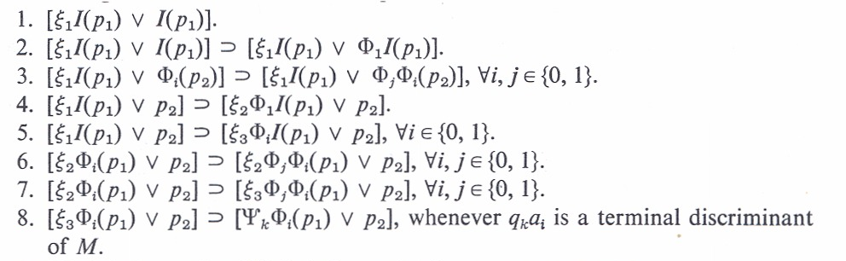
Creating Terminal IDs

Slide 334
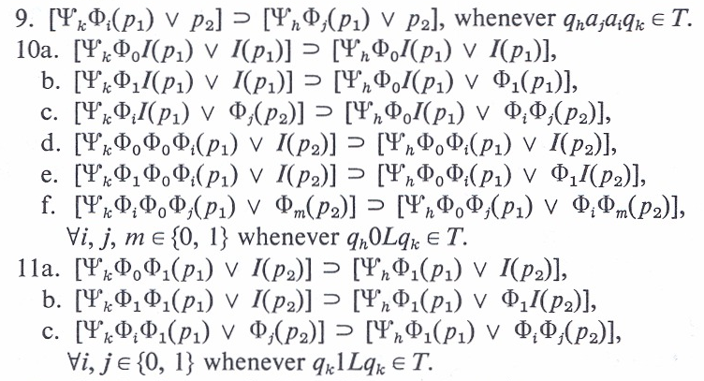
Reversing Print and Left

Slide 335
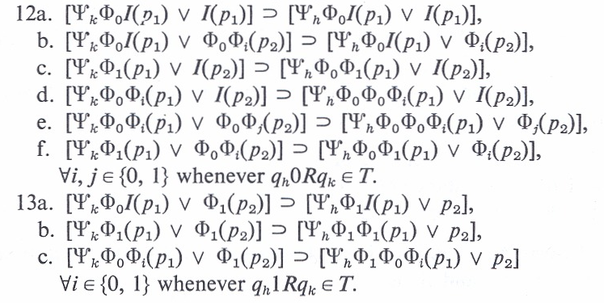
Reversing Right

Slide 336
ORDER ANALYSIS

Slide 337
Notion of “Order”
Throughout the complexity portion of this course, we will be interested in how long an algorithm takes on the instances of some arbitrary "size" n. Recognizing that different times can be recorded for two instance of size n, we only ask about the worst case.
We also understand that different languages, computers, and even skill of the implementer can alter the "running time."

Slide 338
Notion of “Order”
As a result, we really can never know "exactly" how long anything takes.
So, we usually settle for a substitute function, and say the function we are trying to measure is "of the order of" this new substitute function.

Slide 339
Notion of “Order”
"Order" is something we use to describe an upper bound upon something else (in our case, time, but it can apply to almost anything).
For example, let f(n) and g(n) be two functions. We say "f(n) is order g(n)" when there exists constants c and N such that f(n) ≤ cg(n) for all n ≥ N.
What this is saying is that when n is 'large enough,' f(n) is bounded above by a constant multiple of g(n).

Slide 340
Notion of “Order”
This is particularly useful when f(n) is not known precisely, is complicated to compute, and/or difficult to use. We can, by this, replace f(n) by g(n) and know we aren't "off too far."
We say f(n) is "in the order of g(n)" or, simply,
f(n) ∈ O(g(n)).
Usually, g(n) is a simple function, like nlog(n), n³, 2^{n}, etc., that's easy to understand and use.

Slide 341
Notion of “Order”
Order of an Algorithm: The maximum number of steps required to find the answer to any instance of size n, for any arbitrary value of n.
For example, if an algorithm requires at most 6n²+3n–6 steps on any instance of size n, we say it is "order n²" or, simply, O(n²).

Slide 342
Order
Let the order of algorithm X be in O(f_{x}(n)).
Then, for algorithms A and B and their respective order functions, f_{A}(n) and f_{B}(n), consider the limit of f_{A}(n)/f_{B}(n) as n goes to infinity.
If this value is
  0 A is faster than B
  constant A and B are "equally slow/fast"
  infinity A is slower than B.

Slide 343
Order of a Problem
Order of a Problem
The order of the fastest algorithm that can ever solve this problem. (Also known as the "Complexity" of the problem.)
  Often difficult to determine, since this allows for algorithms not yet discovered.

Slide 344
Decision vs Optimization
    Two types of problems are of particular interest:
    Decision Problems ("Yes/No" answers)
    Optimization problems ("best" answers)
    (there are other types)

Slide 345
Vertex Cover (VC)
Suppose we are in charge of a large network (a graph where edges are links between pairs of cities (vertices). Periodically, a line fails. To mend the line, we must call in a repair crew that goes over the line to fix it. To minimize down time, we station a repair crew at one end of every line. How many crews must you have and where should they be stationed?
This is called the Vertex Cover Problem. (Yes, it sounds like it should be called the Edge Cover problem – something else already had that name.)
An interesting problem – it is among the hardest problems, yet is one of the easiest of the hard problems.

Slide 346
VC Decision vs Optimization
As a Decision Problem:
Instances: A graph G and an integer k.
Question: Does G possess a vertex Cover with at most k vertices?
As an Optimization Problem:
Instances: A graph G.
Question: What is the smallest k for which G possesses a vertex cover?

Slide 347
Relation of VC Problems
If we can (easily) solve either one of these problems, we can (easily) solve the other. (To solve the optimization version, just solve the decision version with several different values of k. Use a binary search on k between 1 and n. That is log(n) solutions of the decision problem solves the optimization problem. It's simple to solve the decision version if we can solve the optimization version.
We say their time complexity differs by no more than a multiple of log(n).
If one is polynomial then so is the other.
If one is exponential, then so is the other.
We say they are equally difficult (both poly. or both exponential).

Slide 348
Smallest VC
A "stranger version"
Instances: A graph G and an integer k.
Question: Does the smallest vertex cover of G have exactly k vertices?
This is a decision problem. But, notice that it does not seem to be easy to verify either Yes or No instances!! (We can easily verify No instances for which the VC number is less than k, but not when it is actually greater than k.)
So, it would seem to be in a different category than either of the other two. Yet, it also has the property that if we can easily solve either of the first two versions, we can easily solve this one.

Slide 349
Natural Pairs of Problems
    Interestingly, these usually come in pairs
    a decision problem, and
    an optimization problem.
    Equally easy, or equally difficult, to solve.
    Both can be solved in polynomial time, or both require exponential time.

Slide 350
A Word about Time
An algorithm for a problem is said to be polynomial if there exists integers k and N such that t(n), the maximum number of steps required on any instance of size n, is at most n^{k}, for all n ≥ N.
Otherwise, we say the algorithm is exponential. Usually, this is interpreted to mean t(n) ≥ c^{n} for an infinite set of size n instances, and some constant c > 1 (often, we simply use c = 2).

Slide 351
A Word about “Words”
Normally, when we say a problem is "easy" we mean that it has a polynomial algorithm.
But, when we say a problem is "hard" or “apparently hard" we usually mean no polynomial algorithm is known, and none seems likely.
It is possible a polynomial algorithm exists for "hard" problems, but the evidence seems to indicate otherwise.

Slide 352
A Word about Abstractions
Problems we will discuss are usually "abstractions" of real problems. That is, to the extent possible, non-essential features have been removed, others have been simplified and given variable names, relationships have been replaced with mathematical equations and/or inequalities, etc.
If an abstraction is hard, then the real problem is probably even harder!!

Slide 353
A Word about Toy Problems
This process, Mathematical Modeling, is a field of study in itself, and not our interest here.
On the other hand, we sometimes conjure up artificial problems to put a little "reality" into our work. This results in what some call "toy problems."
Again, if a toy problem is hard, then the real problem is probably harder.

Slide 354
Very Hard Problems
Some problems have no algorithm (e. g., Halting Problem.)
No mechanical/logical procedure will ever solve all instances of any such problem!!
Some problems have only exponential algorithms (provably so – they must take at least order 2^{n} steps) So far, only a few have been proven, but there may be many. We suspect so.

Slide 355
Easy Problems
  Many problems have polynomial algorithms (Fortunately).
  Why fortunately? Because, most exponential algorithms are essentially useless for problem instances with n much larger than 50 or 60. We have algorithms for them, but the best of these will take 100's of years to run, even on much faster computers than we now envision.

Slide 356
Three Classes of Problems
  Problems proven to be in these three groups (classes) are, respectively,
  Undecidable, Exponential, and Polynomial.
  Theoretically, all problems belong to exactly one of these three classes.

Slide 357
Unknown Complexity
Practically, there are a lot of problems (maybe, most) that have not been proven to be in any of the classes (Yet, maybe never will be).
Most currently "lie between" polynomial and exponential – we know of exponential algorithms, but have been unable to prove that exponential algorithms are necessary.
Some may have polynomial algorithms, but we have not yet been clever enough to discover them.

Slide 358
Why do we Care?
If an algorithm is O(n^{k}), increasing the size of an instance by one gives a running time that is O((n+1)^{k})
That’s really not much more.
With an increase of one in an exponential algorithm, O(2^{n}) changes to O(2^{n+1}) = O(2*2^{n}) = 2*O(2^{n}) – that is, it takes about twice as long.

Slide 359
A Word about “Size”
Technically, the size of an instance is the minimum number of bits (information) needed to represent the instance – its "length."
  This comes from early Formal Language researchers who were analyzing the time needed to 'recognize' a string of characters as a function of its length (number of characters).
  When dealing with more general problems there is usually a parameter (number of vertices, processors, variables, etc.) that is polynomially related to the length of the instance. Then, we are justified in using the parameter as a measure of the length (size), since anything polynomially related to one will be polynomially related to the other.

Slide 360
The Subtlety of “Size”
But, be careful.
For instance, if the "value" (magnitude) of n is both the input and the parameter, the 'length' of the input (number of bits) is log₂(n). So, an algorithm that takes n time is running in n = 2^{log2(n)} time, which is exponential in terms of the length, log₂(n), but linear (hence, polynomial) in terms of the "value," or magnitude, of n.
It's a subtle, and usually unimportant difference, but it can bite you.

Slide 361
Subset Sum
Problem – Subset Sum
Instances: A list L of n integer values and an integer B.
Question: Does L have a subset which sums exactly to B?
No one knows of a polynomial (deterministic) solution to this problem.
On the other hand, there is a very simple (dynamic programming) algorithm that runs in O(nB) time.
Why isn't this "polynomial"?
Because, the "length" of an instance is nlog(B) and
nB > (nlog(B))^k for any fixed k.

Slide 362
Why do we Care?
When given a new problem to solve (design an algorithm for), if it's undecidable, or even exponential, you will waste a lot of time trying to write a polynomial solution for it!!
If the problem really is polynomial, it will be worthwhile spending some time and effort to find a polynomial solution.
You should know something about how hard a problem is before you try to solve it.

Slide 363
Research Territory
  Decidable – vs – Undecidable
  (area of Computability Theory)
  Exponential – vs – polynomial
  (area of Computational Complexity)
  Algorithms for any of these
  (area of Algorithm Design/Analysis)

Slide 364
Complexity Theory
Second Part of Course

Slide 365
Models of Computation
NonDeterminism
Since we can't seem to find a model of computation that is more powerful than a TM, can we find one that is 'faster'?
In particular, we want one that takes us from exponential time to polynomial time.
Our candidate will be the NonDeterministic Turing Machine (NDTM).

Slide 366
NDTM's
In the basic Deterministic Turing Machine (DTM) we make one major alteration (and take care of a few repercussions):
  The 'transition functon' in DTM's is allowed to become a 'transition mapping' in NDTM's.
This means that rather than the next action being totally specified (deterministic) by the current state and input character, we now can have many next actions - simultaneously. That is, a NDTM can be in many states at once. (That raises some interesting problems with writing on the tape, just where the tape head is, etc., but those little things can be explained away).

Slide 367
NDTM's
We also require that there be only one halt state - the 'accept' state. That also raises an interesting question - what if we give it an instance that is not 'acceptable'? The answer - it blows up (or goes into an infinite loop).
The solution is that we are only allowed to give it 'acceptable' input. That means
  NDTM's are only defined for decision problems
  and, in particular, only for Yes instances.

Slide 368
NDTM's
We want to determine how long it takes to get to the accept state - that's our only motive!!
So, what is a NDTM doing?
In a normal (deterministic) algorithm, we often have a loop where each time through the loop we are testing a different option to see if that "choice" leads to a correct solution. If one does, fine, we go on to another part of the problem. If one doesn't, we return to the same place and make a different choice, and test it, etc.

Slide 369
NDTM's
If this is a Yes instance, we are guaranteed that an acceptable choice will eventually be found and we go on.
In a NDTM, what we are doing is making, and testing, all of those choices at once by 'spawning' a different NDTM for each of them. Those that don't work out, simply die (or something).
This is kind of like the ultimate in parallel programming.

Slide 370
NDTM's
To allay concerns about not being able to write on the tape, we can allow each spawned NDTM to have its own copy of the tape with a read/write head.
The restriction is that nothing can be reported back except that the accept state was reached.

Slide 371
NDTM's
Another interpretation of nondeterminism:
  From the basic definition, we notice that out of every state having a nondeterministic choice, at least one choice is valid and all the rest sort of die off. That is they really have no reason for being spawned (for this instance - maybe for another). So, we station at each such state, an 'oracle' (an all knowing being) who only allows the correct NDTM to be spawned.
An 'Oracle Machine.'

Slide 372
NDTM's
This is not totally unreasonable. We can look at a non deterministic decision as a deterministic algorithm in which, when an "option" is to be tested, it is very lucky, or clever, to make the correct choice the first time.
In this sense, the two machines would work identically, and we are just asking "How long does a DTM take if it always makes the correct decisions?"

Slide 373
NDTM's
As long as we are talking magic, we might as well talk about a 'super' oracle stationed at the start state (and get rid of the rest of the oracles) whose task is to examine the given instance and simply tell you what sequence of transitions needs to be executed to reach the accept state.
He/she will write them to the left of cell 0 (the instance is to the right).

Slide 374
NDTM's
Now, you simply write a DTM to run back and forth between the left of the tape to get the 'next action' and then go back to the right half to examine the NDTM and instance to verify that the provided transition is a valid next action. As predicted by the oracle, the DTM will see that the NDTM would reach the accept state and can report the number of steps required.

Slide 375
NDTM's
All of this was originally designed with Language Recognition problems in mind. It is not a far stretch to realize the Yes instances of any of our more real word-like decision problems defines a language, and that the same approach can be used to "solve" them.
Rather than the oracle placing the sequence of transitions on the tape, we ask him/her to provide a 'witness' to (a 'proof' of) the correctness of the instance.

Slide 376
NDTM's
For example, in the SubsetSum problem, we ask the oracle to write down the subset of objects whose sum is B (the desired sum). Then we ask "Can we write a deterministic polynomial algorithm to test the given witness."
The answer for SubsetSum is Yes, we can, i.e., the witness is verifiable in deterministic polynomial time.

Slide 377
NDTM's - Witnesses
Just what can we ask and expect of a "witness"?
The witness must be something that
    (1) we can verify to be accurate (for the given the problem and instance) and
    (2) we must be able to "finish off" the solution.
    All in polynomial time.

Slide 378
NDTM's - Witnesses
The witness can be nothing!
    Then, we are on our own. We have to "solve the instance in polynomial time."
The witness can be "Yes."
    Duh. We already knew that. We have to now verify the yes instance is a yes instance (same as above).
The witness has to be something other than nothing and Yes.

Slide 379
NDTM's - Witnesses
The information provided must be something we could have come up with ourselves, but probably at an exponential cost. And, it has to be enough so that we can conclude the final answer Yes from it.
Consider a witness for the graph coloring problem:
Given: A graph G = (V, E) and an integer k.
Question: Can the vertices of G be assigned colors so
that adjacent vertices have different
colors and use at most k colors?

Slide 380
NDTM's - Witnesses
The witness could be nothing, or Yes.
    But that's not good enough - we don't know of a polynomial algorithm for graph coloring.
It could be "vertex 10 is colored Red."
    That's not good enough either. Any single vertex can be colored any color we want.
It could be a color assigned to each vertex.
    That would work, because we can verify its validity in polynomial time, and we can conclude the correct answer of Yes.

Slide 381
NDTM's - Witnesses
What if it was a color for all vertices but one?
    That also is enough. We can verify the correctness of the n-1 given to us, then we can verify that the one uncolored vertex can be colored with a color not on any neighbor, and that the total is not more than k.
What if all but 2, 3, or 20 vertices are colored
    All are valid witnesses.
What if half the vertices are colored?
    Usually, No. There's not enough information. Sure, we can check that what is given to us is properly colored, but we don't know how to "finish it off."

Slide 382
NDTM's - Witnesses
An interesting question: For a given problem, what is (are) the limits to what can be provided that still allows a polynomial verification?

Slide 383
NDTM's
A major question remains: Do we have, in NDTMs, a model of computation that solves all deterministic exponential (DE) problems in polynomial time (nondeterministic polynomial time)??
It definitely solves some problems we think are DE in nondeterministic polynomial time.

Slide 384
NDTM's
But, so far, all problems that have been proven to require deterministic exponential time also require nondeterministic exponential time.
So, the jury is still out. In the meantime, NDTMs are still valuable, because they identify a larger class of problems than does a deterministic TM - the set of decision problems for which Yes instances can be verified in polynomial time.

Slide 385
Problem Classes
We now begin to discuss several different classes of problems. The first two will be:
NP 'Nondeterministic' Polynomial
P 'Deterministic' Polynomial,
The 'easiest' problems in NP
Their definitions are rooted in the depths of Formal Languages and Automata Theory as just described, but it is worth repeating some of it in the next few slides.

Slide 386
Problem Classes
We assume knowledge of Deterministic and Nondeterministic Turing Machines. (DTM's and NDTM's)
The only use in life of a NDTM is to scan a string of characters X and proceed by state transitions until an 'accept' state is entered.
X must be in the language the NDTM is designed to recognize. Otherwise, it blows up!!

Slide 387
Problem Classes
So, what good is it?
We can count the number of transitions on the shortest path (elapsed time) to the accept state!!!
If there is a constant k for which the number of transitions is at most |X|^{k}, then the language is said to be 'nondeterministic polynomial.'

Slide 388
Problem Classes
The subset of YES instances of the set of instances of a decision problem, as we have described them above, is a language.
  When given an instance, we want to know that it is in the subset of Yes instances. (All answers to Yes instances look alike - we don't care which one we get or how it was obtained).
  This begs the question "What about the No instances?"
  The answer is that we will get to them later. (They will actually form another class of problems.)

Slide 389
Problem Classes
This actually defines our first Class, NP, the set of decision problems whose Yes instances can be solved by a Nondeterministic Turing Machine in polynomial time.
That knowledge is not of much use!! We still don't know how to tell (easily) if a problem is in NP. And, that's our goal.
Fortunately, all we are doing with a NDTM is tracing the correct path to the accept state. Since all we are interested in doing is counting its length, if someone just gave us the correct path and we followed it, we could learn the same thing - how long it is.

Slide 390
Problem Classes
It is even simpler than that (all this has been proven mathematically). Consider the following problem:
  You have a big van that can carry 10,000 lbs. You also have a batch of objects with weights w₁, w₂, …, w_{n} lbs. Their total sum is more than 10,000 lbs, so you can't haul all of them.
  Can you load the van with exactly 10,000 lbs?
  (WOW. That's the SubsetSum problem.)

Slide 391
Problem Classes
Now, suppose it is possible (i.e., a Yes instance) and someone tells you exactly what objects to select.
We can add the weights of those selected objects and verify the correctness of the selection.
This is the same as following the correct path in a NDTM. (Well, not just the same, but it can be proven to be equivalent.)
Therefore, all we have to do is count how long it takes to verify that a "correct" answer" is in fact correct.

Slide 392
Class – NP
We are now ready for our
First Significant Class of Problems:
The Class NP

Slide 393
Class – NP
We have, already, an informal definition for the set NP. We will now try to get a better idea of what NP includes, what it does not include, and give a formal definition.

Slide 394
Class – NP
    Consider two seemingly closely related statements (versions) of a single problem. We show they are actually very different. Let G = (V, E) be a graph.
      Definition: X ⊆ V(G) is a vertex cover if every edge in G has at least one endpoint in X.

Slide 395
Class – NP
    Version 1. Given a graph G and an integer k.
    Does G contain a vertex cover
    with at most k vertices?
    Version 2. Given a graph G and an integer k.
    Does the smallest vertex cover of G
    have exactly k vertices?

Slide 396
Class – NP
    Suppose, for either version, we are given a graph G and an integer k for which the answer is "yes." Someone also gives us a set X of vertices and claims
    "X satisfies the conditions."

Slide 397
Class – NP
    In Version 1, we can fairly easily check that the claim is correct – in polynomial time.
    That is, in polynomial time, we can check that X has k vertices, and that X is a vertex cover.

Slide 398
Class – NP
    In Version 2, we can also easily check that X has exactly k vertices and that X is a vertex cover.
    But, we don't know how to easily check that there is not a smaller vertex cover!!
    That seems to require exponential time.
    These are very similar looking "decision" problems (Yes/No answers), yet they are VERY different in this one important respect.

Slide 399
Class – NP
    In the first: We can verify a correct answer in polynomial time.
    In the second: We apparently can not verify a correct answer in polynomial time.
        (At least, we don't know how to verify one in polynomial time.)

Slide 400
Class – NP
    Could we have asked to be given something that would have allowed us to easily verify that X was the smallest such set?
    No one knows what to ask for!!
    To check all subsets of k or fewer vertices requires exponential time (there can be an exponential number of them).

Slide 401
Class – NP
    Version 1 problems make up the class called NP
    Definition: The Class NP is the set of all decision problems for which answers to Yes instances can be verified in polynomial time.
    {Why not the NO instances? We'll answer that later.}
    For historical reasons, NP means
    "Nondeterministic Polynomial."
    (Specifically, it does not mean "not polynomial").

Slide 402
Class – NP
Version 2 of the Vertex Cover problem is not unique. There are other versions that exhibit this same property. For example,
Version 3: Given: A graph G = (V, E) and an
integer k.
Question: Do all vertex covers of G
have more than k vertices?
What would/could a 'witness' for a Yes instance be?

Slide 403
Class – NP
Again, no one knows except to list all subsets of at most k vertices. Then we would have to check each of the possible exponential number of sets.
Further, this is not isolated to the Vertex Cover problem. Every decision problem has a 'Version 3,' also known as the 'complement' problem (we will discuss these further at a later point).

Slide 404
Class – NP
All problems in NP are decidable.
That means there is an algorithm.
And, the algorithm is no worse than O(2^{n}).

Slide 405
Class – NP
    Version 2 and 3 problems are apparently not in NP.
    So, where are they??
We need more structure! {Again, later.}
First we look inward, within NP.

Slide 406
Class – P
Second Significant Class of Problems: The Class P

Slide 407
Class – P
    Some decision problems in NP can be solved (without knowing the answer in advance) - in polynomial time. That is, not only can we verify a correct answer in polynomial time, but we can actually compute the correct answer in polynomial time - from "scratch."
      These are the problems that make up the class P.
        P is a subset of NP.

Slide 408
Class – P
Problems in P can also have a witness – we just don't need one. But, this line of thought leads to an interesting observation. Consider the problem of searching a list L for a key X.
Given: A list L of n values and a key X.
Question: Is X in L?

Slide 409
Class – P
We know this problem is in P. But, we can also envision a nondeterministic solution. An oracle can, in fact, provide a "witness" for a Yes instance by simply writing down the index of where X is located.
We can verify the correctness with one simple comparison and reporting, Yes the witness is correct.

Slide 410
Class – P
Now, consider the complement (Version 3) of this problem:
Given: A list L of n values and a key X.
Question: Is X not in L?
Here, for any Yes instance, no 'witness' seems to exist, but if the oracle simply writes down "Yes" we can verify the correctness in polynomial time by comparing X with each of the n values and report "Yes, X is not in the list."

Slide 411
Class – P
Therefore, both problems can be verified in polynomial time and, hence, both are in NP.
This is a characteristic of any problem in P - both it and its complement can be verified in polynomial time (of course, they can both be 'solved' in polynomial time, too.)
Therefore, we can again conclude P ⊆ NP.

Slide 412
Class – P
There is a popular conjecture that if any problem and its complement are both in NP, then both are also in P.
This has been the case for several problems that for many years were not known to be in P, but both the problem and its complement were known to be in NP.
For example, Linear Programming (proven to be in P in the 1980's), and Prime Number (proven in 2006 to be in P).
A notable 'holdout' to date is Graph Isomorphism.

Slide 413
Class – P
    There are a lot of problems in NP that we do not know how to solve in polynomial time. Why?
      Because they really don't have polynomial algorithms?
      Or, because we are not yet clever enough to have found a polynomial algorithm for them?

Slide 414
Class – P
    At the moment, no one knows.
    Some believe all problems in NP have polynomial algorithms. Many do not (believe that).
    The fundamental question in theoretical computer science is:
      Does P = NP?
      There is an award of one million dollars for a proof.
      – Either way, True or False.

Slide 415
Other Classes
We now look at other classes of problems.
Hard appearing problems can turn out to be easy to solve. And, easy looking problems can actually be very hard (Graph Theory is rich with such examples).
We must deal with the concept of "as hard as," "no harder than," etc. in a more rigorous way.

Slide 416
"No harder than"
Problem A is said to be 'no harder than' problem B when the smallest class containing A is a subset of the smallest class containing B.
Recall that f_{X}(n) is the order of the smallest complexity class containing problem X.
If, for some constant α,
f_{A}(n) ≤ n^{α}f_{B}(n),
the time to solve A is no more than some polynomial multiple of the time required to solve B, i.e., A is 'no harder than' B.

Slide 417
"No harder than"
The requirement for determining the relative difficulty of two problems A and B requires that we know, at least, the order of the fastest algorithm for problem B and the order of some algorithm for Problem A.
We may not know either!!
In the following we exhibit a technique that can allow us to determine this relationship without knowing anything about an algorithm for either problem.

Slide 418
    The "Key" to Complexity Theory
    'Reductions,' 'Reductions,' 'Reductions.'

Slide 419
Reductions
For any problem X, let X(I_{X}, Answer_{X}) represents an algorithm for problem X – even if none is known to exist.
  I_{X} is an arbitray instance given to the algorithm and Answer_{X} is the returned answer determined by the algorithm.

Slide 420
Reductions
Definition: For problems A and B, a (Polynomial) Turing Reduction is an algorithm A(I_{A}, Answer_{A}) for solving all instances of problem A and satisfies the following:
    (1) Constructs zero or more instances of problem B and invokes algorithm B(I_{B}, Answer_{B}), on each.
    (2) Computes the result, Answer_{A}, for I_{A}.
    (3) Except for the time required to execute algorithm B, the execution time of algorithm A must be polynomial with respect to the size of I_{A}.

Slide 421
Reductions
proc A(I_{A}, Answer_{A})
  For i = 1 to alpha
        Compute I_{B}
      B(I_{B}, Answer_{B})
  End For
  Compute Answer_{A}
End proc

Slide 422
Reductions
We may assume a 'best' algorithm for problem B without actually knowing it.
If A(I_{A}, Answer_{A}) can be written without algorithm B, then problem A is simply a polynomial problem.

Slide 423
Reductions
The existence of a Turing reduction is often stated as:
    "Problem A reduces to problem B" or, simply,
    "A  B"
    (Note: G & J use a symbol that I don't have.).

Slide 424
Reductions
Theorem. If A  B and problem B is polynomial, then problem A is polynomial.
Corollary. If A  B and problem A is exponential, then problem B is exponential.

Slide 425
Reductions
The previous theorem and its corollary do not capture the full implication of Turing reductions.
Regardless of the complexity class problem B is in, a Turing reduction implies problem A is in a subclass.
Regardless of the class problem A might be in, problem B is in a super class.

Slide 426
Reductions
Theorem. If A  B , then problem A is "no harder than" problem B.
Proof: Let t_{A}(n) and t_{B}(n) be the maximum times for algorithms A and B per the definition. Thus, f_{A}(n) ≤ t_{A}(n). Further, since we assume the best algorithm for B, t_{B}(n) = f_{B}(n). Since A  B, there is a constant k such that t_{A}(n) ≤ n^{k}t_{B}(n). Therefore, f_{A}(n) ≤ t_{A}(n) ≤ n^{k}t_{B}(n) = n^{k}f_{B}(n). That is, A is no harder than B.

Slide 427
Reductions
Theorem.
    If A  B and B  C then A  C.
Definition.
    If A  B and B  A, then A and B are polynomially equivalent.

Slide 428
Reductions
A  B means:
    'Problem A is no harder than problem B,' and
    'Problem B is as hard as problem A.'

Slide 429
An Aside (Computability Theory)
Without condition (3) of the definition, a simple Reduction results.
If problem B is decidable,
then so is problem A.
Equivalently,
If problem A is undecidable,
then problem B is undecidable.

Slide 430
Special Type of Reduction
Polynomial Transformation
(Refer to the definition of Turing Reductions)
(1) Problems A and B must both be decision problems.
(2) A single instance, I_{B}, of problem B is constructed from a single instance, I_{A}, of problem A.
  (3) I_{B} is true for problem B if and only if I_{A} is true for problem A.

Slide 431
NP–Complete
Third Significant Class of Problems: The Class NP–Complete

Slide 432
NP–Complete
    Polynomial Transformations enforce an equivalence relationship on all decision problems, particularly, those in the Class NP. Class P is one of those classes and is the "easiest" class of problems in NP.
    Is there a class in NP that is the hardest class in NP?
    A problem B in NP such that A _{P} B for every A in NP.

Slide 433
NP–Complete
    In 1971, Stephen Cook proved there was. Specifically, a problem called
    Satisfiability (or, SAT).

Slide 434
Satisfiability
U = {u₁, u₂,…, u_{n}}, Boolean variables.
C = {c₁, c₂,…, c_{m}}, "OR clauses"
For example:
c_{i} = (u₄ ∨ u₃₅ ∨ ~u₁₈ ∨ u₃… ∨ ~u₆)

Slide 435
Satisfiability
Can we assign Boolean values to the variables in U so that every clause is TRUE?
There is no known polynomial algorithm!!

Slide 436
NP–Complete
Cooks Theorem:
1) SAT is in NP
2) For every problem A in NP,
A _{P} SAT
Thus, SAT is as hard as every problem in NP.
(For a proof, see Garey and Johnson, pgs. 39 – 44)

Slide 437
NP–Complete
Since SAT is itself in NP, that means SAT is a hardest problem in NP (there can be more than one.).
A hardest problem in a class is called the "completion" of that class.
Therefore, SAT is NP–Complete.

Slide 438
NP–Complete
    Today, there are 100's, if not 1,000's, of problems that have been proven to be NP–Complete. (See Garey and Johnson, Computers and Intractability: A Guide to the Theory of NP–Completeness, for a list of over 300 as of the early 1980's).

Slide 439
P = NP?
If P = NP then all problems in NP are polynomial problems.
If P ≠ NP then all NP–C problems are at least super-polynomial and perhaps exponential. That is, NP-C problems could require sub-exponential super-polynomial time.

Slide 440
P = NP?
Why should P equal NP?
  There seems to be a huge "gap" between the known problems in P and Exponential. That is, almost all known polynomial problems are no worse than n³ or n⁴.
  Where are the O(n⁵⁰) problems?? O(n¹⁰⁰)? Maybe they are the ones in NP–Complete?
  It's awfully hard to envision a problem that would require n¹⁰⁰, but surely they exist?
  Some of the problems in NP–C just look like we should be able to find a polynomial solution (looks can be deceiving, though).

Slide 441
P ≠ NP?
Why should P not equal NP?
    P = NP would mean, for any problem in NP, that it is just as easy to solve an instance form "scratch," as it is to verify the answer if someone gives it to you. That seems a bit hard to believe.
    There simply are a lot of awfully hard looking problems in NP–Complete (and Co–NP-Complete) and some just don't seem to be solvable in polynomial time.
    An awfully lot of smart people have tried for a long time to find polynomial algorithms for some of the problems in NP-Complete - with no luck.

Slide 442
NP-Complete; NP-Hard
A decision problem, C, is NP-complete if:
  C is in NP and
  C is NP-hard. That is, every problem in NP is polynomially reducible to C.
D polynomially reduces to C means that there is a deterministic polynomial-time many-one algorithm, f, that transforms each instance x of D into an instance f(x) of C, such that the answer to f(x) is YES if and only if the answer to x is YES.
To prove that an NP problem A is NP-complete, it is sufficient to show that an already known NP-complete problem polynomially reduces to A. By transitivity, this shows that A is NP-hard.
A consequence of this definition is that if we had a polynomial time algorithm for any NP-complete problem C, we could solve all problems in NP in polynomial time. That is, P = NP.
Note that NP-hard does not necessarily mean NP-complete, as a given NP-hard problem could be outside NP.

Slide 443
Satisfiability
U = {u₁, u₂,…, u_{n}}, Boolean variables.
C = {c₁, c₂,…, c_{m}}, "OR clauses"
For example:
c_{i} = (u₄ ∨ u₃₅ ∨ ~u₁₈ ∨ u₃… ∨ ~u₆)

Slide 444
Satisfiability
Can we assign Boolean values to the variables in U so that every clause is TRUE?
There is no known polynomial algorithm!!

Slide 445
SAT
SAT is the problem to decide of an arbitrary Boolean formula (wff in the propositional calculus) whether or not this formula is satisfiable (has a set of variable assignments that evaluate the expression to true).
SAT clearly can be solved in time k2^{n}, where k is the length of the formula and n is the number of variables in the formula.
What we can show is that SAT is NP-complete, providing us our first concrete example of an NP-complete decision problem.

Slide 446
Simulating ND TM
Given a TM, M, and an input w, we need to create a formula, ϕ_{M,w}, containing a polynomial number of terms that is satisfiable just in case M accepts w in polynomial time.
The formula must encode within its terms a trace of configurations that includes
  A term for the starting configuration of the TM
  Terms for all accepting configurations of the TM
  Terms that ensure the consistency of each configuration
  Terms that ensure that each configuration after the first follows from the prior configuration by a single move

Slide 447
Cook’s Theorem
ϕ_{M,w} = φcell ∧ φstart ∧ φmove ∧ φaccept
See the following for a detailed description and discussion of the four terms that make up this formula.
http://www.cs.tau.ac.il/~safra/Complexity/Cook.ppt

Slide 448
NP–Complete
    Within a year, Richard Karp added 22 problems to this special class.
    These included such problems as:
    3-SAT
    3DM
    Vertex Cover,
    Independent Set,
    Knapsack,
    Multiprocessor Scheduling, and
    Partition.

Slide 449
SubsetSum
S = {s₁, s₂, …, s_{n}}
    set of positive integers
    and an integer B.
    Question: Does S have a subset whose values sum to B?
No one knows of a polynomial algorithm.
{No one has proven there isn’t one, either!!}

Slide 450
SubsetSum
The following polynomial transformations have been shown to exist.(Later, we will see what these problems actually are.)
Theorem. SAT _{P} 3SAT
Theorem. 3SAT _{P} SubsetSum
Theorem. SubsetSum _{P} Partition

Slide 451
Example SubsetSum
Assuming a 3SAT expression (a + c + c) (b + b + ~c), the following shows the reduction from 3SAT to Subset-Sum.
a b c a + ~b + c ~a + b + ~c
a 1 1
~a 1 1
b 1 1
~b 1 1
c 1 1
~c 1 1
C1 1
C1’ 1
C2 1
C2’ 1
1 1 1 3 3

Slide 452
Partition
Let i₁, i₂, .., i_{n} be a multi-set of positive natural numbers. Partition asks if this multi-set can be partitioned into two sub multi-sets whose union is the original multi-set and whose sums are equal.
Partition is related to the optimization problem of dividing the multi-set into two partitions whose sums are as close to each other as possible.

Slide 453
Partition
Partition is polynomial equivalent to SubsetSum
  Let i₁, i₂, .., i_{n} , G be an instance of SubsetSum. This instance has answer “yes” iff
  i₁, i₂, .., i_{n} , 2*Sum(i₁, i₂, .., i_{n} ) – G,Sum(i₁, i₂, .., i_{n} ) + G
  has answer “yes” in Partition. Here we assume that
  G ≤ Sum(i₁, i₂, .., i_{n} ), for, if not, the answer is “no.”
  Let i₁, i₂, .., i_{n} be an instance of Partition. This instance has answer “yes” iff
  i₁, i₂, .., i_{n} , Sum(i₁, i₂, .., i_{n} )/2
  has answer “yes” in SubsetSum

Slide 454
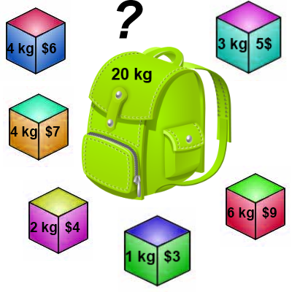
Knapsack 0-1 Problem
The goal is to maximize the value of a knapsack that can hold at most W units (i.e. lbs or kg) worth of goods from a list of items I₀, I₁, … I_{n-1}.
  Each item has 2 attributes:
    Value – let this be v_{i} for item I_{i}
    Weight – let this be w_{i} for item I_{i}
Thanks to Arup Guha

Slide 455
Knapsack Optimize vs Decide
As stated the Knapsack problem is an optimization problem.
We can restate as decision problem to determine if there exists a set of items with weight < W that reaches some fixed goal value, G.

Slide 456
Knapsack and SubsetSum
Let v_{i} = w_{i} for each item I_{i}.
By doing so, the value is maximized when the Knapsack is filled as close to capacity.
The related decision problem is to determine is we can attain capacity (W).
Clearly then, given an instance of the SubsetSum problem, we can create an instance of the Knapsack decision problem problem, such that we reach the goal sum, G, iff we can attain a Knapsack value of G.

Slide 457
Knapsack Decision Problem
The reduction from SubsetSum shows that the Knapsack decision problem is at least as hard as SubsetSum, so it is NP-Complete if it is in NP.
Think about whether or not it is in NP.

Slide 458
Related Bin Packing
Have a bin capacity of B.
Have item set S = {s₁, s₂, …, s_{n}}
Use all items in S, minimizing the number of bins, while adhering to the constraint that any such subset must sum to B or less.

Slide 459
Knapsack 0-1 Problem
The difference between this problem and the fractional knapsack one is that you CANNOT take a fraction of an item.
  You can either take it or not.
  Hence the name Knapsack 0-1 problem.

Slide 460
Knapsack 0-1 Problem
Brute Force
  The naïve way to solve this problem is to cycle through all 2^{n} subsets of the n items and pick the subset with a legal weight that maximizes the value of the knapsack.
  We can come up with a dynamic programming algorithm that USUALLY does better than this brute force technique.

Slide 461
Knapsack 0-1 Problem
We are going to solve the problem in terms of sub-problems.
Our first attempt might be to characterize a sub-problem as follows:
  Let S_{k} be the optimal subset of elements from {I₀, I₁, …, I_{k}}.
    What we find is that the optimal subset from the elements {I₀, I₁, …, I_{k+1}} may not correspond to the optimal subset of elements from {I₀, I₁, …, I_{k}} in any regular pattern.
  Basically, the solution to the optimization problem for S_{k+1} might NOT contain the optimal solution from problem S_{k}.

Slide 462
Knapsack 0-1 Problem
Let’s illustrate that point with an example:
Item Weight Value
I₀ 3 10
I₁ 8 4
I₂ 9 9
I₃ 8 11
The maximum weight the knapsack can hold is 20.
The best set of items from {I₀, I₁, I₂} is {I₀, I₁, I₂}
BUT the best set of items from {I₀, I₁, I₂, I₃} is {I₀, I₂, I₃}.
  In this example, note that this optimal solution, {I₀, I₂, I₃}, does NOT build upon the previous optimal solution, {I₀, I₁, I₂}.
    (Instead it builds upon the solution, {I₀, I₂}, which is really the optimal subset of {I₀, I₁, I₂} with weight 12 or less.)

Slide 463
Knapsack 0-1 problem
So now we must re-work the way we build upon previous sub-problems…
  Let B[k, w] represent the maximum total value of a subset S_{k} with weight w.
  Our goal is to find B[n, W], where n is the total number of items and W is the maximal weight the knapsack can carry.
So our recursive formula for subproblems:
B[k, w] = B[k - 1,w], if w_{k} > w
= max { B[k - 1,w], B[k - 1,w - w_{k}] + v_{k}}, otherwise
In English, this means that the best subset of S_{k} that has total weight w is:
  The best subset of S_{k-1} that has total weight w, or
  The best subset of S_{k-1} that has total weight w-w_{k} plus the item k

Slide 464
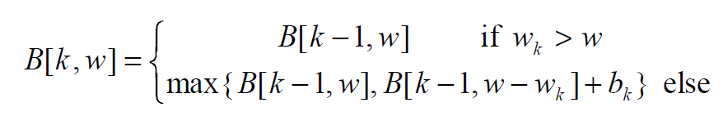
Knapsack 0-1 Problem –
Recursive Formula
The best subset of S_{k} that has the total weight w, either contains item k or not.
First case: w_{k} > w
  Item k can’t be part of the solution! If it was the total weight would be > w, which is unacceptable.
Second case: w_{k} ≤ w
  Then the item k can be in the solution, and we choose the case with greater value.

Slide 465
Knapsack 0-1 Algorithm
for w = 0 to W { // Initialize 1st row to 0’s
B[0,w] = 0
}
for i = 1 to n { // Initialize 1st column to 0’s
B[i,0] = 0
}
for i = 1 to n {
for w = 0 to W {
if w_{i} <= w { //item i can be in the solution
if v_{i} + B[i-1,w-w_{i}] > B[i-1,w]
B[i,w] = v_{i} + B[i-1,w- w_{i}]
else
B[i,w] = B[i-1,w]
}
else B[i,w] = B[i-1,w] // w_{i} > w
}
}

Slide 466
Knapsack 0-1 Problem
Let’s run our algorithm on the following data:
  n = 4 (# of elements)
  W = 5 (max weight)
  Elements (weight, value):
  (2,3), (3,4), (4,5), (5,6)

Slide 467
Knapsack 0-1 Example
i / w | 0 | 1 | 2 | 3 | 4 | 5
0 | 0 | 0 | 0 | 0 | 0 | 0
1 | 0
2 | 0
3 | 0
4 | 0
// Initialize the base cases
for w = 0 to W
B[0,w] = 0
for i = 1 to n
B[i,0] = 0

Slide 468
Knapsack 0-1 Example
Items:
1: (2,3)
2: (3,4)
3: (4,5)
4: (5,6)
i / w | 0 | 1 | 2 | 3 | 4 | 5
0 | 0 | 0 | 0 | 0 | 0 | 0
1 | 0
2 | 0
3 | 0
4 | 0
i / w | 0 | 1 | 2 | 3 | 4 | 5
0 | 0 | 0 | 0 | 0 | 0 | 0
1 | 0 | 0
2 | 0
3 | 0
4 | 0
i = 1
v_{i} = 3
w_{i} = 2
w = 1
w-w_{i} = -1
if w_{i} <= w //item i can be in the solution
if v_{i} + B[i-1,w-w_{i}] > B[i-1,w]
B[i,w] = v_{i} + B[i-1,w- w_{i}]
else
B[i,w] = B[i-1,w]
else B[i,w] = B[i-1,w] // w_{i} > w

Slide 469
Knapsack 0-1 Example
Items:
1: (2,3)
2: (3,4)
3: (4,5)
4: (5,6)
i / w | 0 | 1 | 2 | 3 | 4 | 5
0 | 0 | 0 | 0 | 0 | 0 | 0
1 | 0 | 0
2 | 0
3 | 0
4 | 0
i / w | 0 | 1 | 2 | 3 | 4 | 5
0 | 0 | 0 | 0 | 0 | 0 | 0
1 | 0 | 0 | 3
2 | 0
3 | 0
4 | 0
i = 1
v_{i} = 3
w_{i} = 2
w = 2
w-w_{i} = 0
if w_{i} <= w //item i can be in the solution
if v_{i} + B[i-1,w-w_{i}] > B[i-1,w]
B[i,w] = v_{i} + B[i-1,w- w_{i}]
else
B[i,w] = B[i-1,w]
else B[i,w] = B[i-1,w] // w_{i} > w
if w_{i} <= w //item i can be in the solution
if v_{i} + B[i-1,w-w_{i}] > B[i-1,w]
B[i,w] = v_{i} + B[i-1,w- w_{i}]
else
B[i,w] = B[i-1,w]
else B[i,w] = B[i-1,w] // w_{i} > w

Slide 470
Knapsack 0-1 Example
Items:
1: (2,3)
2: (3,4)
3: (4,5)
4: (5,6)
i / w | 0 | 1 | 2 | 3 | 4 | 5
0 | 0 | 0 | 0 | 0 | 0 | 0
1 | 0 | 0 | 3
2 | 0
3 | 0
4 | 0
i / w | 0 | 1 | 2 | 3 | 4 | 5
0 | 0 | 0 | 0 | 0 | 0 | 0
1 | 0 | 0 | 3 | 3
2 | 0
3 | 0
4 | 0
i = 1
v_{i} = 3
w_{i} = 2
w = 3
w-w_{i} = 1
if w_{i} <= w //item i can be in the solution
if v_{i} + B[i-1,w-w_{i}] > B[i-1,w]
B[i,w] = v_{i} + B[i-1,w- w_{i}]
else
B[i,w] = B[i-1,w]
else B[i,w] = B[i-1,w] // w_{i} > w

Slide 471
Knapsack 0-1 Example
Items:
1: (2,3)
2: (3,4)
3: (4,5)
4: (5,6)
i / w | 0 | 1 | 2 | 3 | 4 | 5
0 | 0 | 0 | 0 | 0 | 0 | 0
1 | 0 | 0 | 3 | 3
2 | 0
3 | 0
4 | 0
i / w | 0 | 1 | 2 | 3 | 4 | 5
0 | 0 | 0 | 0 | 0 | 0 | 0
1 | 0 | 0 | 3 | 3 | 3
2 | 0
3 | 0
4 | 0
i = 1
v_{i} = 3
w_{i} = 2
w = 4
w-w_{i} = 2
if w_{i} <= w //item i can be in the solution
if v_{i} + B[i-1,w-w_{i}] > B[i-1,w]
B[i,w] = v_{i} + B[i-1,w- w_{i}]
else
B[i,w] = B[i-1,w]
else B[i,w] = B[i-1,w] // w_{i} > w

Slide 472
Knapsack 0-1 Example
Items:
1: (2,3)
2: (3,4)
3: (4,5)
4: (5,6)
i / w | 0 | 1 | 2 | 3 | 4 | 5
0 | 0 | 0 | 0 | 0 | 0 | 0
1 | 0 | 0 | 3 | 3 | 3
2 | 0
3 | 0
4 | 0
i / w | 0 | 1 | 2 | 3 | 4 | 5
0 | 0 | 0 | 0 | 0 | 0 | 0
1 | 0 | 0 | 3 | 3 | 3 | 3
2 | 0
3 | 0
4 | 0
i = 1
v_{i} = 3
w_{i} = 2
w = 5
w-w_{i} = 3
if w_{i} <= w //item i can be in the solution
if v_{i} + B[i-1,w-w_{i}] > B[i-1,w]
B[i,w] = v_{i} + B[i-1,w- w_{i}]
else
B[i,w] = B[i-1,w]
else B[i,w] = B[i-1,w] // w_{i} > w

Slide 473
Knapsack 0-1 Example
Items:
1: (2,3)
2: (3,4)
3: (4,5)
4: (5,6)
i / w | 0 | 1 | 2 | 3 | 4 | 5
0 | 0 | 0 | 0 | 0 | 0 | 0
1 | 0 | 0 | 3 | 3 | 3 | 3
2 | 0
3 | 0
4 | 0
i / w | 0 | 1 | 2 | 3 | 4 | 5
0 | 0 | 0 | 0 | 0 | 0 | 0
1 | 0 | 0 | 3 | 3 | 3 | 3
2 | 0 | 0
3 | 0
4 | 0
i = 2
v_{i} = 4
w_{i} = 3
w = 1
w-w_{i} = -2
if w_{i} <= w //item i can be in the solution
if v_{i} + B[i-1,w-w_{i}] > B[i-1,w]
B[i,w] = v_{i} + B[i-1,w- w_{i}]
else
B[i,w] = B[i-1,w]
else B[i,w] = B[i-1,w] // w_{i} > w
if w_{i} <= w //item i can be in the solution
if v_{i} + B[i-1,w-w_{i}] > B[i-1,w]
B[i,w] = v_{i} + B[i-1,w- w_{i}]
else
B[i,w] = B[i-1,w]
else B[i,w] = B[i-1,w] // w_{i} > w

Slide 474
Knapsack 0-1 Example
Items:
1: (2,3)
2: (3,4)
3: (4,5)
4: (5,6)
i / w | 0 | 1 | 2 | 3 | 4 | 5
0 | 0 | 0 | 0 | 0 | 0 | 0
1 | 0 | 0 | 3 | 3 | 3 | 3
2 | 0 | 0
3 | 0
4 | 0
i / w | 0 | 1 | 2 | 3 | 4 | 5
0 | 0 | 0 | 0 | 0 | 0 | 0
1 | 0 | 0 | 3 | 3 | 3 | 3
2 | 0 | 0 | 3
3 | 0
4 | 0
i = 2
v_{i} = 4
w_{i} = 3
w = 2
w-w_{i} = -1
if w_{i} <= w //item i can be in the solution
if v_{i} + B[i-1,w-w_{i}] > B[i-1,w]
B[i,w] = v_{i} + B[i-1,w- w_{i}]
else
B[i,w] = B[i-1,w]
else B[i,w] = B[i-1,w] // w_{i} > w

Slide 475
Knapsack 0-1 Example
Items:
1: (2,3)
2: (3,4)
3: (4,5)
4: (5,6)
i / w | 0 | 1 | 2 | 3 | 4 | 5
0 | 0 | 0 | 0 | 0 | 0 | 0
1 | 0 | 0 | 3 | 3 | 3 | 3
2 | 0 | 0 | 3
3 | 0
4 | 0
i / w | 0 | 1 | 2 | 3 | 4 | 5
0 | 0 | 0 | 0 | 0 | 0 | 0
1 | 0 | 0 | 3 | 3 | 3 | 3
2 | 0 | 0 | 3 | 4
3 | 0
4 | 0
i = 2
v_{i} = 4
w_{i} = 3
w = 3
w-w_{i} = 0
if w_{i} <= w //item i can be in the solution
if v_{i} + B[i-1,w-w_{i}] > B[i-1,w]
B[i,w] = v_{i} + B[i-1,w- w_{i}]
else
B[i,w] = B[i-1,w]
else B[i,w] = B[i-1,w] // w_{i} > w
if w_{i} <= w //item i can be in the solution
if v_{i} + B[i-1,w-w_{i}] > B[i-1,w]
B[i,w] = v_{i} + B[i-1,w- w_{i}]
else
B[i,w] = B[i-1,w]
else B[i,w] = B[i-1,w] // w_{i} > w

Slide 476
Knapsack 0-1 Example
Items:
1: (2,3)
2: (3,4)
3: (4,5)
4: (5,6)
i / w | 0 | 1 | 2 | 3 | 4 | 5
0 | 0 | 0 | 0 | 0 | 0 | 0
1 | 0 | 0 | 3 | 3 | 3 | 3
2 | 0 | 0 | 3 | 4
3 | 0
4 | 0
i / w | 0 | 1 | 2 | 3 | 4 | 5
0 | 0 | 0 | 0 | 0 | 0 | 0
1 | 0 | 0 | 3 | 3 | 3 | 3
2 | 0 | 0 | 3 | 4 | 4
3 | 0
4 | 0
i = 2
v_{i} = 4
w_{i} = 3
w = 4
w-w_{i} = 1
if w_{i} <= w //item i can be in the solution
if v_{i} + B[i-1,w-w_{i}] > B[i-1,w]
B[i,w] = v_{i} + B[i-1,w- w_{i}]
else
B[i,w] = B[i-1,w]
else B[i,w] = B[i-1,w] // w_{i} > w

Slide 477
Knapsack 0-1 Example
Items:
1: (2,3)
2: (3,4)
3: (4,5)
4: (5,6)
i / w | 0 | 1 | 2 | 3 | 4 | 5
0 | 0 | 0 | 0 | 0 | 0 | 0
1 | 0 | 0 | 3 | 3 | 3 | 3
2 | 0 | 0 | 3 | 4 | 4
3 | 0
4 | 0
i / w | 0 | 1 | 2 | 3 | 4 | 5
0 | 0 | 0 | 0 | 0 | 0 | 0
1 | 0 | 0 | 3 | 3 | 3 | 3
2 | 0 | 0 | 3 | 4 | 4 | 7
3 | 0
4 | 0
i = 2
v_{i} = 4
w_{i} = 3
w = 5
w-w_{i} = 2
if w_{i} <= w //item i can be in the solution
if v_{i} + B[i-1,w-w_{i}] > B[i-1,w]
B[i,w] = v_{i} + B[i-1,w- w_{i}]
else
B[i,w] = B[i-1,w]
else B[i,w] = B[i-1,w] // w_{i} > w

Slide 478
Knapsack 0-1 Example
Items:
1: (2,3)
2: (3,4)
3: (4,5)
4: (5,6)
i / w | 0 | 1 | 2 | 3 | 4 | 5
0 | 0 | 0 | 0 | 0 | 0 | 0
1 | 0 | 0 | 3 | 3 | 3 | 3
2 | 0 | 0 | 3 | 4 | 4 | 7
3 | 0
4 | 0
i / w | 0 | 1 | 2 | 3 | 4 | 5
0 | 0 | 0 | 0 | 0 | 0 | 0
1 | 0 | 0 | 3 | 3 | 3 | 3
2 | 0 | 0 | 3 | 4 | 4 | 7
3 | 0 | 0 | 3 | 4
4 | 0
i = 3
v_{i} = 5
w_{i} = 4
w = 1..3
w-w_{i} = -3..-1
if w_{i} <= w //item i can be in the solution
if v_{i} + B[i-1,w-w_{i}] > B[i-1,w]
B[i,w] = v_{i} + B[i-1,w- w_{i}]
else
B[i,w] = B[i-1,w]
else B[i,w] = B[i-1,w] // w_{i} > w
if w_{i} <= w //item i can be in the solution
if v_{i} + B[i-1,w-w_{i}] > B[i-1,w]
B[i,w] = v_{i} + B[i-1,w- w_{i}]
else
B[i,w] = B[i-1,w]
else B[i,w] = B[i-1,w] // w_{i} > w

Slide 479
Knapsack 0-1 Example
Items:
1: (2,3)
2: (3,4)
3: (4,5)
4: (5,6)
i / w | 0 | 1 | 2 | 3 | 4 | 5
0 | 0 | 0 | 0 | 0 | 0 | 0
1 | 0 | 0 | 3 | 3 | 3 | 3
2 | 0 | 0 | 3 | 4 | 4 | 7
3 | 0 | 0 | 3 | 4
4 | 0
i / w | 0 | 1 | 2 | 3 | 4 | 5
0 | 0 | 0 | 0 | 0 | 0 | 0
1 | 0 | 0 | 3 | 3 | 3 | 3
2 | 0 | 0 | 3 | 4 | 4 | 7
3 | 0 | 0 | 3 | 4 | 5
4 | 0
i = 3
v_{i} = 5
w_{i} = 4
w = 4
w-w_{i} = 0
if w_{i} <= w //item i can be in the solution
if v_{i} + B[i-1,w-w_{i}] > B[i-1,w]
B[i,w] = v_{i} + B[i-1,w- w_{i}]
else
B[i,w] = B[i-1,w]
else B[i,w] = B[i-1,w] // w_{i} > w
if w_{i} <= w //item i can be in the solution
if v_{i} + B[i-1,w-w_{i}] > B[i-1,w]
B[i,w] = v_{i} + B[i-1,w- w_{i}]
else
B[i,w] = B[i-1,w]
else B[i,w] = B[i-1,w] // w_{i} > w

Slide 480
Knapsack 0-1 Example
Items:
1: (2,3)
2: (3,4)
3: (4,5)
4: (5,6)
i / w | 0 | 1 | 2 | 3 | 4 | 5
0 | 0 | 0 | 0 | 0 | 0 | 0
1 | 0 | 0 | 3 | 3 | 3 | 3
2 | 0 | 0 | 3 | 4 | 4 | 7
3 | 0 | 0 | 3 | 4 | 5
4 | 0
i / w | 0 | 1 | 2 | 3 | 4 | 5
0 | 0 | 0 | 0 | 0 | 0 | 0
1 | 0 | 0 | 3 | 3 | 3 | 3
2 | 0 | 0 | 3 | 4 | 4 | 7
3 | 0 | 0 | 3 | 4 | 5 | 7
4 | 0
i = 3
v_{i} = 5
w_{i} = 4
w = 5
w-w_{i} = 1
if w_{i} <= w //item i can be in the solution
if v_{i} + B[i-1,w-w_{i}] > B[i-1,w]
B[i,w] = v_{i} + B[i-1,w- w_{i}]
else
B[i,w] = B[i-1,w]
else B[i,w] = B[i-1,w] // w_{i} > w
if w_{i} <= w //item i can be in the solution
if v_{i} + B[i-1,w-w_{i}] > B[i-1,w]
B[i,w] = v_{i} + B[i-1,w- w_{i}]
else
B[i,w] = B[i-1,w]
else B[i,w] = B[i-1,w] // w_{i} > w

Slide 481
Knapsack 0-1 Example
Items:
1: (2,3)
2: (3,4)
3: (4,5)
4: (5,6)
i / w | 0 | 1 | 2 | 3 | 4 | 5
0 | 0 | 0 | 0 | 0 | 0 | 0
1 | 0 | 0 | 3 | 3 | 3 | 3
2 | 0 | 0 | 3 | 4 | 4 | 7
3 | 0 | 0 | 3 | 4 | 5 | 7
4 | 0
i / w | 0 | 1 | 2 | 3 | 4 | 5
0 | 0 | 0 | 0 | 0 | 0 | 0
1 | 0 | 0 | 3 | 3 | 3 | 3
2 | 0 | 0 | 3 | 4 | 4 | 7
3 | 0 | 0 | 3 | 4 | 5 | 7
4 | 0 | 0 | 3 | 4 | 5
i = 4
v_{i} = 6
w_{i} = 5
w = 1..4
w-w_{i} = -4..-1
if w_{i} <= w //item i can be in the solution
if v_{i} + B[i-1,w-w_{i}] > B[i-1,w]
B[i,w] = v_{i} + B[i-1,w- w_{i}]
else
B[i,w] = B[i-1,w]
else B[i,w] = B[i-1,w] // w_{i} > w
if w_{i} <= w //item i can be in the solution
if v_{i} + B[i-1,w-w_{i}] > B[i-1,w]
B[i,w] = v_{i} + B[i-1,w- w_{i}]
else
B[i,w] = B[i-1,w]
else B[i,w] = B[i-1,w] // w_{i} > w

Slide 482
Knapsack 0-1 Example
Items:
1: (2,3)
2: (3,4)
3: (4,5)
4: (5,6)
i / w | 0 | 1 | 2 | 3 | 4 | 5
0 | 0 | 0 | 0 | 0 | 0 | 0
1 | 0 | 0 | 3 | 3 | 3 | 3
2 | 0 | 0 | 3 | 4 | 4 | 7
3 | 0 | 0 | 3 | 4 | 5 | 7
4 | 0 | 0 | 3 | 4 | 5
i / w | 0 | 1 | 2 | 3 | 4 | 5
0 | 0 | 0 | 0 | 0 | 0 | 0
1 | 0 | 0 | 3 | 3 | 3 | 3
2 | 0 | 0 | 3 | 4 | 4 | 7
3 | 0 | 0 | 3 | 4 | 5 | 7
4 | 0 | 0 | 3 | 4 | 5 | 7
i = 4
v_{i} = 6
w_{i} = 5
w = 5
w-w_{i} = 0
if w_{i} <= w //item i can be in the solution
if v_{i} + B[i-1,w-w_{i}] > B[i-1,w]
B[i,w] = v_{i} + B[i-1,w- w_{i}]
else
B[i,w] = B[i-1,w]
else B[i,w] = B[i-1,w] // w_{i} > w
if w_{i} <= w //item i can be in the solution
if v_{i} + B[i-1,w-w_{i}] > B[i-1,w]
B[i,w] = v_{i} + B[i-1,w- w_{i}]
else
B[i,w] = B[i-1,w]
else B[i,w] = B[i-1,w] // w_{i} > w

Slide 483
Knapsack 0-1 Example
Items:
1: (2,3)
2: (3,4)
3: (4,5)
4: (5,6)
i / w | 0 | 1 | 2 | 3 | 4 | 5
0 | 0 | 0 | 0 | 0 | 0 | 0
1 | 0 | 0 | 3 | 3 | 3 | 3
2 | 0 | 0 | 3 | 4 | 4 | 7
3 | 0 | 0 | 3 | 4 | 5 | 7
4 | 0 | 0 | 3 | 4 | 5 | 7
We’re DONE!!
The max possible value that can be carried in this knapsack is $7

Slide 484
Knapsack 0-1 Problem – Run Time
for w = 0 to W
B[0,w] = 0
for i = 1 to n
B[i,0] = 0
for i = 1 to n
for w = 0 to W
< the rest of the code >
What is the running time of this algorithm?
O(n*W) – of course, W can be mighty big
What is an analogy in world of sorting?
Remember that the brute-force algorithm takes: O(2^{n})
O(W)
O(n)
Repeat n times
O(W)

Slide 485
Polynomial Transformations
Polynomial transformations are also known as Karp Reductions
When a reduction is a polynomial transformation, we subscript the symbol with a "p" as follows:
A _{P} B

Slide 486
Polynomial Transformations
Following Garey and Johnson, we recognize three forms of polynomial transformations.
(a) restriction,
(b) local replacement, and
(c) component design.

Slide 487
Polynomial Transformations
Restriction allows nothing much more complex than renaming the objects in I_{A} so that they are, in a straightforward manner, objects in I_{B}.
For example, objects in I_{A} could be a collection of cities with distances between certain pairs of cities. In I_{B}, these might correspond to vertices in a graph and weighted edges.

Slide 488
Polynomial Transformations
The term 'restriction' alludes to the fact that a proof of correctness often is simply describing the subset of instances of problem B that are essentially identical (isomorphic) to the instances of problem A, that is, the instances of B are restricted to those that are instances of A. To apply restriction, the relevant instances in Problem B must be identifiable in polynomial time.
For example, if P ≠ NP and B is defined over the set of all graphs, we can not restrict to the instances that possess a Hamiltonian Circuit.

Slide 489
Polynomial Transformations
Local Replacement is more complex because there is usually not an obvious map between instance I_{A} and instance I_{B}. But, by modifying objects or small groups of objects a transformation often results. Sometimes the alterations are such that some feature or property of problem A that is not a part of all instances of problem B can be enforced in problem B. As in (a), the instances of problem B are usually of the same type as of problem A.

Slide 490
Polynomial Transformations
In a sense, Local Replacement might be viewed as a form of Restriction. In Local Replacement, we describe how to construct the instances of B that are isomorphic to the instances of A, and in Restriction we describe how to eliminate instances of B that are not isomorphic to instances of A.

Slide 491
Polynomial Transformations
Component Design is when instances of problem B are essentially constructed "from scratch," and there may be little resemblance between instances of A and those of B. 3SAT to SubsetSum falls into this category.

Slide 492
3SAT to Vertex Cover
Vertex cover seeks a set of vertices that cover every edge in some graph
Let I_{3-SAT} be an arbitrary instance of 3-SAT. For integers n and m, U = {u₁, u₂, …, u_{n}} and C_{i} = [z_{i1}, z_{i2}, z_{i3}} for 1 ≤ i ≤ m, where each z_{ij} is either a u_{k} or u_{k}' for some k.
Construct an instance of VC as follows.
For each i, 1 ≤ i ≤ n, construct two vertices, u_{i} and u_{i}' with an edge between them.
For each clause C_{i} = [z_{i1}, z_{i2}, z_{i3}}, 1 ≤ i ≤ m, construct three vertices z_{i1}, z_{i2}, and z_{i3} and form a "triangle on them. Each z_{ij} is one of the Boolean variables u_{k} or its complement u_{k}'. Draw an edge between z_{ij} and the Boolean variable (whichever it is) Each z_{ij} has degree 3. Finally, set k = n+2m.
Theorem. The given instance of 3-SAT is satisfiable if and only if the constructed instance of VC has a vertex cover with at most k vertices.

Slide 493
VERTEX COVERING (VC) Decision Problem is NP-Hard

Slide 494
VC Variable Gadget
X
~X

Slide 495
VC Clause Gadget
b
a
~c
a + b + ~c

Slide 496
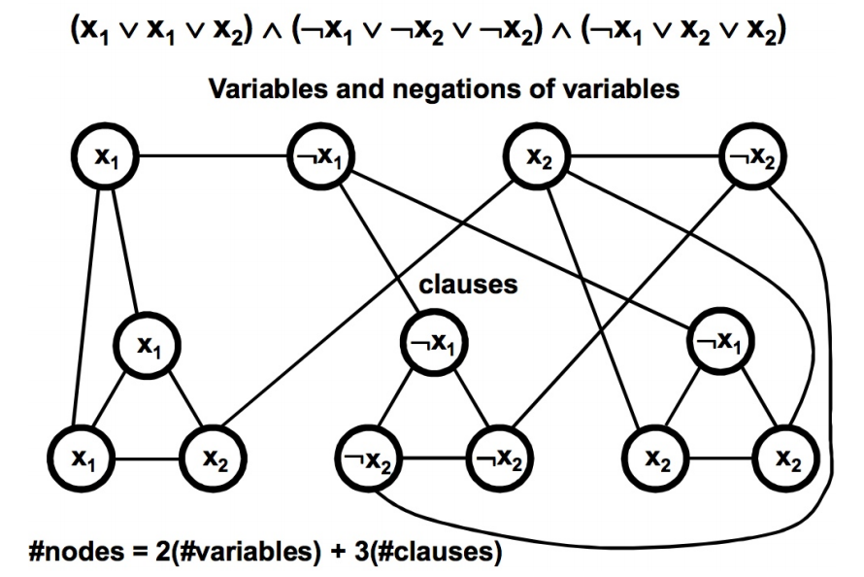
VC Gadgets Combined

Slide 497
K-Color (KC) Decision Problem is NP-Hard

Slide 498
3C Super Gadget
T
F
B

Slide 499
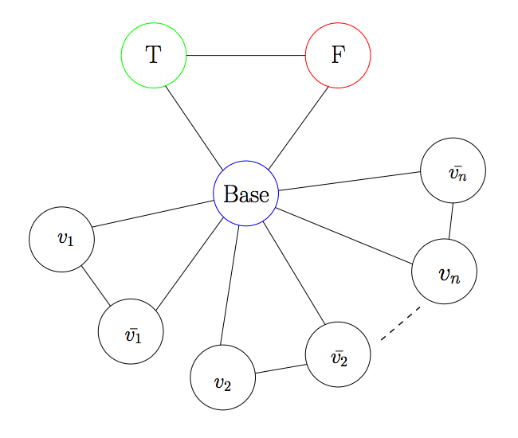
KC Super + Variables Gadget

Slide 500
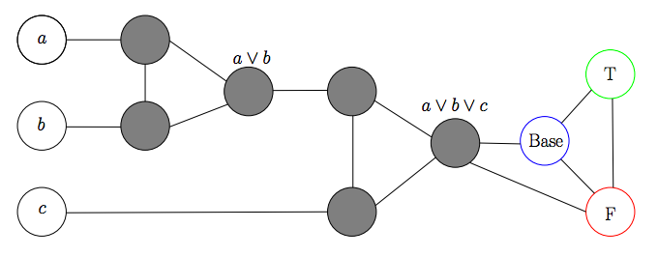
KC Clause Gadget

Slide 501
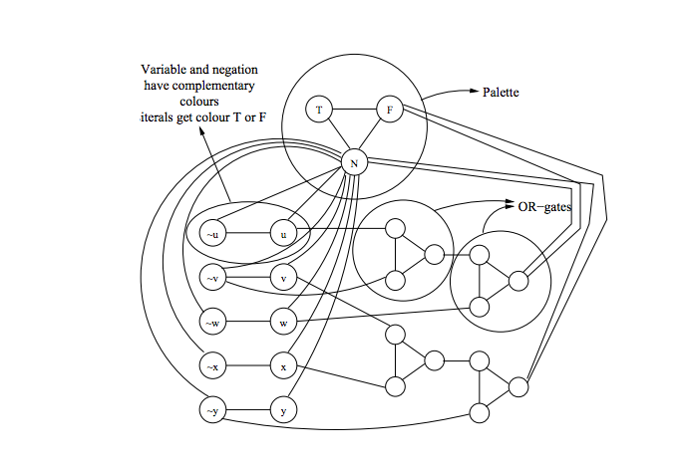
KC Gadgets Combined
K = 3

Slide 502
Register allocation
Liveness: A variable is live if its current assignment may be used at some future point in a program’s flow
Optimizers often try to keep live variables in registers
If two variables are simultaneously live, they need to be kept in separate registers
Consider the K-coloring problem (can the nodes of a graph be colored with at most K colors under the constraint that adjacent nodes must have different colors?
Register Allocation reduces to K-coloring by mapping each variable to a node and inserting an edge between variables that are simultaneously live
K-coloring reduces to Register Allocation by interpreting nodes as variables and edges as indicating concurrent liveness
This is a simple because it’s an isomorphism

Slide 503
Hamiltonian Circuit (HC) Decision Problem is NP-Hard

Slide 504
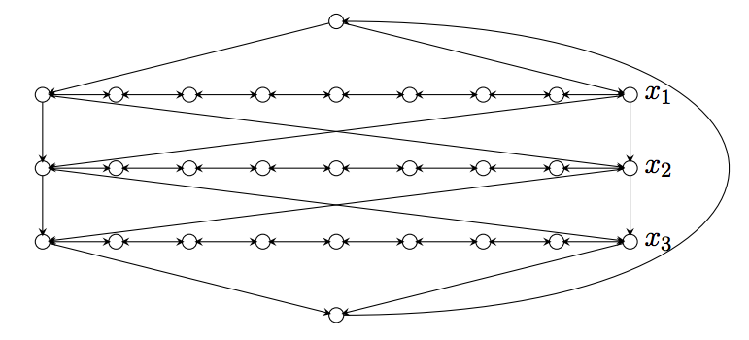
HC Variable Gadget

Slide 505
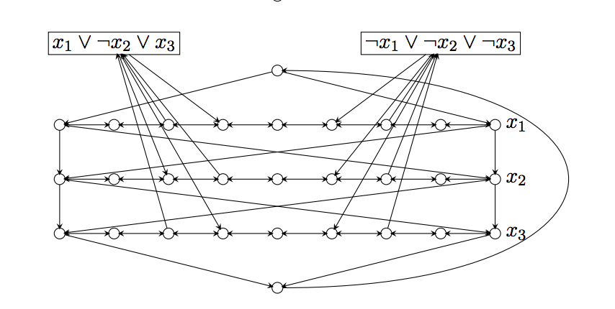
HC Gadgets Combined

Slide 506
Hamiltonian Path
Note we can split an arbitrary node, v, into two (v’,v’’ – one, v’, has in-edges of v, other, v’’, has out-edges. Path (not cycle) must start at v’’ and end at v’ and goal is still K.

Slide 507
Travelling Salesman
Start with HC = (V,E), K=|V|
Set edges from HC instance to 1
Add edges between pairs that lack such edges and make those weights 2 (often people make these K+1); this means that the reverse of unidirectional links also get weight 2
Goal weight is K for cycle

Slide 508
Processor Scheduling is NP-Hard

Slide 509
Processor scheduling
A Process Scheduling Problem can be described by
  m processors P₁, P₂, …, P_{m},
  processor timing functions S₁, S₂, …, S_{m}, each describing how the corresponding processor responds to an execution profile,
  additional resources R₁, R₂, …, R_{k}, e.g., memory
  transmission cost matrix C_{ij} (1 ≤ i , j ≤ m), based on proc. data sharing,
  tasks to be executed T₁, T₂, …, T_{n},
  task execution profiles A₁, A₂, …, A_{n},
  a partial order defined on the tasks such that T_{i} < T_{j} means that T_{i} must complete before T_{j} can start execution,
  communication matrix D_{ij} (1 ≤ i , j ≤ n); D_{ij} can be non-zero only if T_{i} < T_{j},
  weights W₁, W₂, …, W_{n} -- cost of deferring execution of task.

Slide 510
Complexity overview
The intent of a scheduling algorithm is to minimize the sum of the weighted completion times of all tasks, while obeying the constraints of the task system. Weights can be made large to impose deadlines.
The general scheduling problem is quite complex, but even simpler instances, where the processors are uniform, there are no additional resources, there is no data transmission, the execution profile is just processor time and the weights are uniform, are very hard.
In fact, if we just specify the time to complete each task and we have no partial ordering, then finding an optimal schedule on two processors is an NP-complete problem. It is essentially the subset-sum problem. I will discuss this a bit more at a later time.

Slide 511
2 Processor scheduling
The problem of optimally scheduling n tasks T₁, T₂, …, T_{n} onto 2 processors with an empty partial order < is the same as that of dividing a set of positive whole numbers into two subsets, such that the numbers are as close to evenly divided. So, for example, given the numbers
3, 2, 4, 1
we could try a “greedy” approach as follows:
put 3 in set 1
put 2 in set 2
put 4 in set 2 (total is now 6)
put 1 in set 1 (total is now 4)
This is not the best solution. A better option is to put 3 and 2 in one set and 4 and 1 in the other. Such a solution would have been attained if we did a greedy solution on a sorted version of the original numbers. In general, however, sorting doesn’t work.

Slide 512
2 Processor nastiness
Try the unsorted list
7, 7, 6, 6, 5, 4, 4, 5, 4
Greedy (Always in one that is least used)
7, 6, 5, 5 = 23
7, 6, 4, 4, 4 = 25
Optimal
7, 6, 6, 5 = 24
7, 4, 4, 4, 5 = 24
Sort it
7, 7, 6, 6, 5, 5, 4, 4, 4
7, 6, 5, 4, 4 = 26
7, 6, 5, 4 = 22
Even worse than greedy unsorted

Slide 513
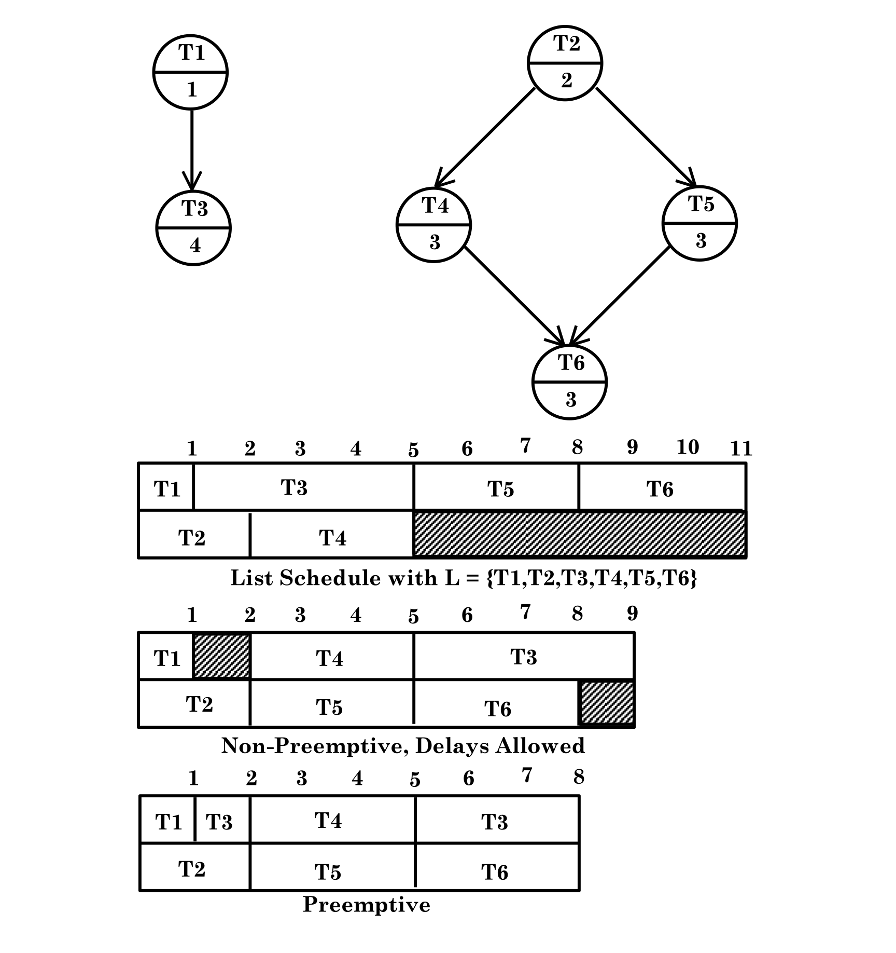
2 Processor with partial order

Slide 514
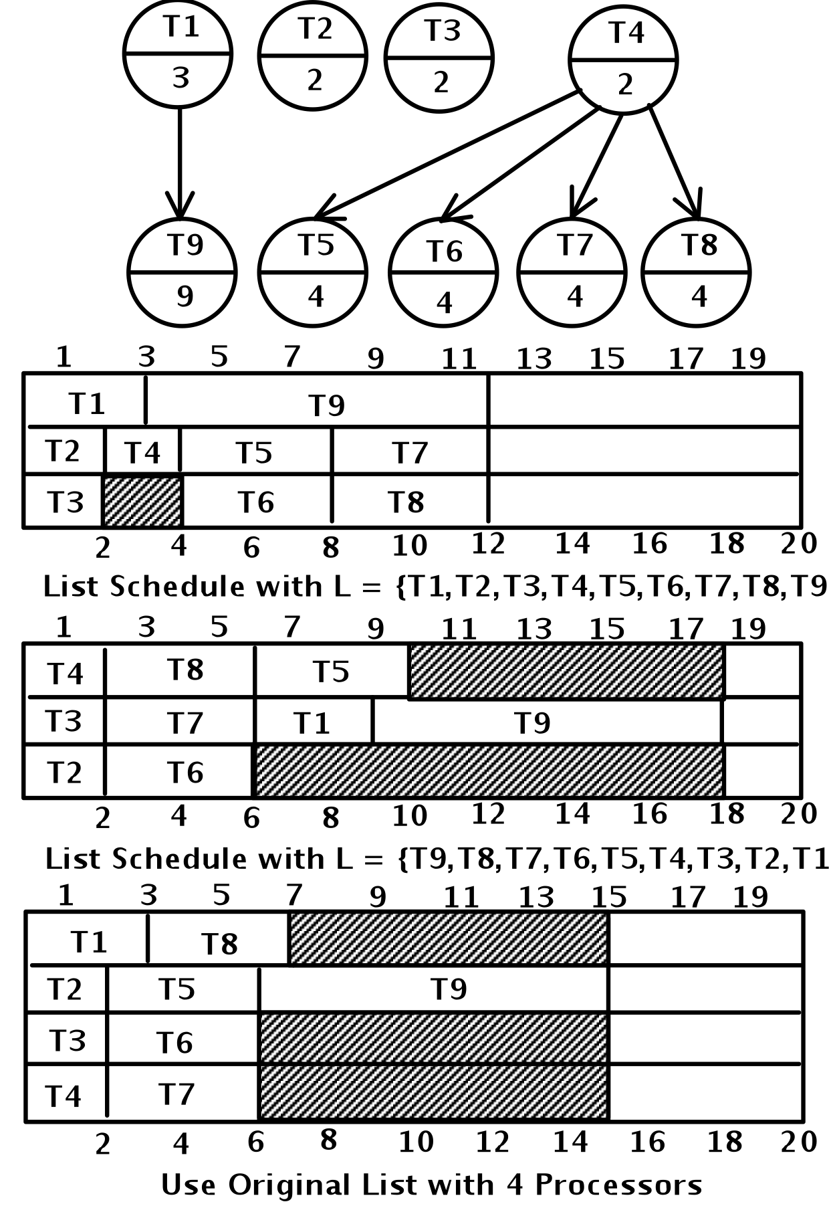
Anomalies everywhere

Slide 515
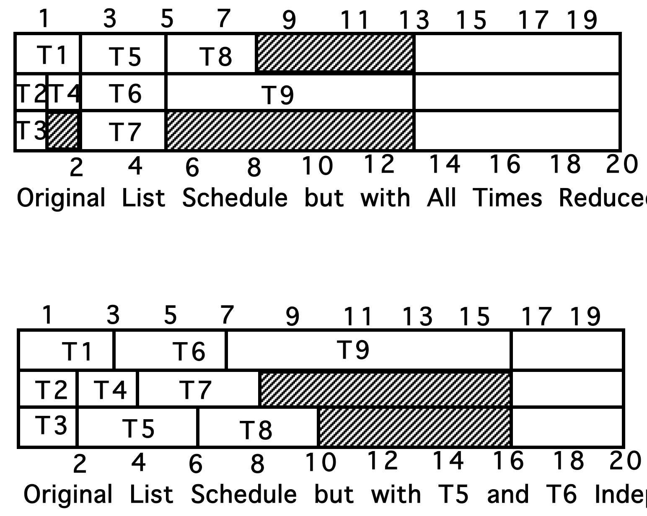
More anomalies

Slide 516
Heuristics
While it is not known whether or not P = NP?, it is clear that we need to “solve” problems that are NP-complete since many practical scheduling and networking problems are in this class. For this reason we often choose to find good “heuristics” which are fast and provide acceptable, though not perfect, answers. The First Fit and Best Fit algorithms we previously discussed are examples of such acceptable, imperfect solutions.

Slide 517
Critical path or level strategy
A UET is a Unit Execution Tree. Our Tree is funny. It has a single leaf by standard graph definitions.
1. Assign L(T) = 1, for the leaf task T
2. Let labels 1, …, k-1 be assigned. If T is a task with lowest numbered immediate successor then define L(T) = k (non-deterministic)
This is an order n labeling algorithm that can easily be implemented using a breadth first search.
Note: This can be used for a forest as well as a tree. Just add a new leaf. Connect all the old leafs to be immediate successors of the new one. Use the above to get priorities, starting at 0, rather than 1. Then delete the new node completely.
Note: This whole thing can also be used for anti-trees. Make a schedule, then read it backwards. You cannot just reverse priorities.

Slide 518
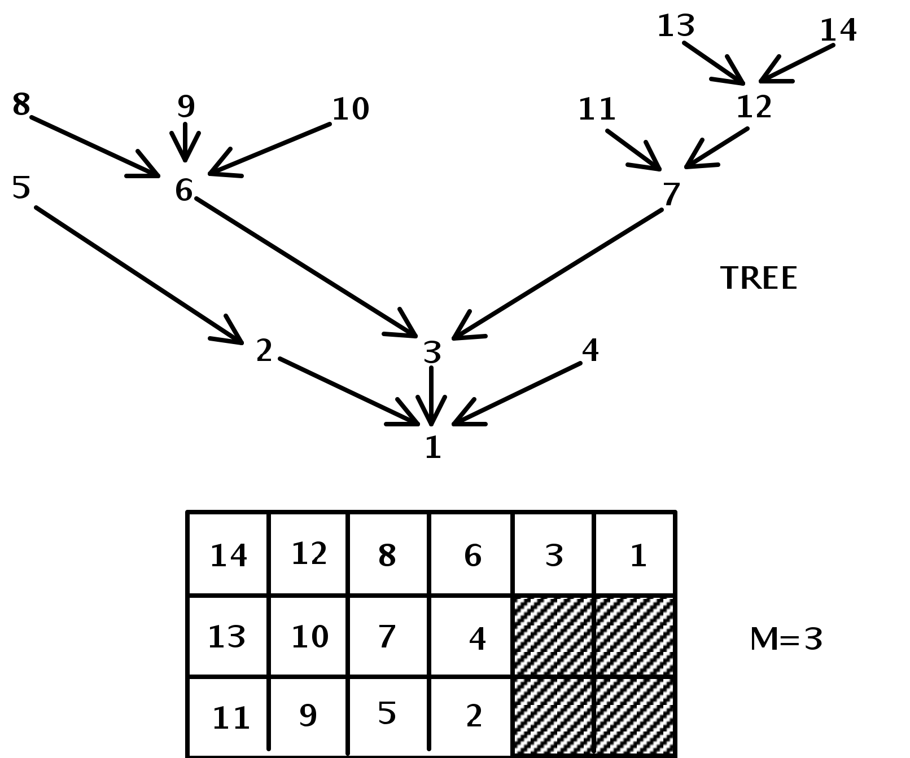
Level strategy and UET
Theorem: Level Strategy is optimal for unit execution, m arbitrary, forest precedence

Slide 519
Level – DAG with unit time
1. Assign L(T) = 1, for an arbitrary leaf task T
2. Let labels 1, …, k-1 be assigned. For each task T such that
{ L(T’) is defined for all T’ in Successor(T) }
Let N(T) be decreasing sequence of set members in
{S(T’) | T’ is in S(T)}
Choose T* with least N(T*).
Define L(T*) = K.
This is an order n² labeling algorithm. Scheduling with it involves n union / find style operations. Such operations have been shown to be implementable in nearly constant time using an “amortization” algorithm.
Theorem: Level Strategy is optimal for unit execution, m=2, dag precedence.

Slide 520

Assignment#8.1
1. Consider the simple scheduling problem where we have a set of independent tasks running on a fixed number of processors, and we wish to minimize finishing time.
How would a list (first fit, no preemption) strategy schedule tasks with the following IDs and execution times onto four processors? Answer using Gantt chart.
(T1,4) (T2,1) (T3,3) (T4,6) (T5,2) (T6,1) (T7,4) (T8,5) (T9,7) (T10,3) (T11,4)
Now show what would happen if the times were sorted non-decreasing.
Now show what would happen if the times were sorted non-increasing.

Slide 521
Assignment#8.2
Looking back at Page 518, consider adding two additional tasks numbered 15 and 16 that are siblings of 13 and 14. These four tasks must be completed before 12 is started.
a) Write the Gantt chart down that shows the new schedule associated with this enhanced tree
b) Write down the Gantt chart that is associated with the corresponding anti-tree, in which all arc are turned in the opposite direction. Use the technique of reversing the schedule from (a)
c) Write down the Gantt chart associated with the anti-tree of b), where we now use the priorities obtained by treating lower numbered tasks as higher priority ones
d) Comment on the results seen in (2) versus (3), providing insight as to why they are different and why one is better than the other.

Slide 522
Integer Linear Programming
Show for 0-1 integer linear programming by constraining solution space. Start with an instance of SAT (or 3SAT), assuming variables v1,…, vn and clauses c1,…, cm
For each variable vi, have constraint that 0 ≤ vi ≤ 1
For each clause we provide a constraint that it must be satisfied (evaluate to at least 1). For example, if clause cj is v2 ∨ ~v3 ∨ v5 ∨ v6 then add the constraint
v2 + (1-v3) + v5 + v6 ≥ 1
A solution to this set of integer linear constraints implies a solution to the instance of SAT and vice versa
Can also start with SubsetSum – think about it.

Slide 523
Fourth Significant Class of Problems:
The Class Co–NP
(The COmplement problems of NP)

Slide 524
Co–NP
    For any decision problem A in NP, there is a ‘complement’ problem Co–A defined on the same instances as A, but with a question whose answer is the negation of the answer in A. That is, an instance is a "yes" instance for A if and only if it is a "no" instance in Co–A.
    Notice that the complement of a complement problem is the original problem.

Slide 525
Co–NP
    Co–NP is the set of all decision problems whose complements are members of NP.
    For example: consider Graph Color
      GC
      Given: A graph G and an integer k.
      Question: Can G be properly colored with k colors?

Slide 526
Co–NP
    The complement problem of GC
    Co–GC
    Given: A graph G and an integer k.
    Question: Do all proper colorings of G require more than k colors?

Slide 527
Co–NP
    Notice that Co–GC is a problem that does not appear to be in the set NP. That is, we know of no way to check in polynomial time the answer to a "Yes" instance of Co–GC.
    What is the "answer" to a Yes instance that can be verified in polynomial time?

Slide 528
Co–NP
    Not all problems in NP behave this way. For example, if X is a problem in class P, then both "yes" and "no" instances can be solved in polynomial time.
    That is, both "yes" and "no" instances can be verified in polynomial time and hence, X and Co–X are both in NP, in fact, both are in P.
    This implies P = Co–P and, further,
      P = Co–P ⊆ NP ∩ Co–NP.

Slide 529
Co–NP
    This gives rise to a second fundamental question:
      NP = Co–NP?
    If P = NP, then NP = Co–NP.
    This is not "if and only if."
    It is possible that NP = Co–NP and, yet, P ≠ NP.

Slide 530
Co–NP
If A _{P} B and both are in NP, then the same polynomial transformation will reduce Co-A to Co–B. That is, Co–A _{P} Co–B. Therefore, Co–SAT is 'complete' in Co–NP.
In fact, corresponding to NP–Complete is the complement set Co–NP–Complete, the set of hardest problems in Co–NP.

Slide 531
Turing Reductions
Now, return to Turing Reductions.
Recall that Turing reductions include polynomial transformations as a special case. So, we should expect they will be more powerful.

Slide 532
Turing Reductions
    (1) Problems A and B can, but need not, be
    decision problems.
    (2) No restriction placed upon the number
    of instances of B that are constructed.
    (3) Nor, how the result, Answer_{A}, is computed.
    In effect, we use an Oracle for B.

Slide 533
Turing Reductions
Technically, Turing Reductions include Polynomial Transformations, but it is useful to distinguish them.
Polynomial transformations are often the easiest to apply.

Slide 534
NP–Hard
Fifth Significant Class of Problems:
The Class NP–Hard

Slide 535
NP–Hard
To date, we have concerned ourselves with decision problems. We are now in a position to include additional problems. In particular, optimization problems.
We require one additional tool – the second type of transformation discussed above – Turing reductions.

Slide 536
NP–Hard
    Definition: Problem B is NP–Hard if there is a polynomial time Turing reduction A  B for some problem A in NP–Complete.
    This implies NP–Hard problems are at least as hard as NP–Complete problems. Therefore, they can not be solved in polynomial time unless P = NP (and maybe not then).
    This use of an oracle, allows us to reduce co-NP-Complete problems to NP-Complete ones and vice versa.

Slide 537
QSAT
QSAT is the problem to determine if an arbitrary fully quantified Boolean expression is true. Note: SAT only uses existential.
QSAT is NP-Hard, but may not be in NP.
QSAT can be solved in polynomial space (PSPACE).

Slide 538
NP–Hard
    Polynomial transformations are Turing reductions.
    Thus, NP–Complete is a subset of NP–Hard.
    Co–NP–Complete also is a subset of NP–Hard.
    NP–Hard contains many other interesting problems.

Slide 539
NP–Equivalent
Co–NP problems are solvable in polynomial time if and only if their complement problem in NP is solvable in polynomial time.
Due to the existence of Turing reductions reducing either to the other.
Other problems not known to be in NP can also have this property (besides those in Co–NP).

Slide 540
NP–Equivalent
Problem B in NP–Hard is NP–Equivalent when B reduces to any problem X in NP, That is, B  X.
Since B is in NP–Hard, we already know there is a problem A in NP–Complete that reduces to B. That is, A  B.
Since X is in NP, X  A. Therefore, X  A  B  X.
Thus, X, A, and B are all polyomially equivalent, and we can say
Theorem. Problems in NP–Equivalent are polynomial if and only if P = NP.

Slide 541
NP–Equivalent
Problem X need not be, but often is, NP–Complete.
In fact, X can be any problem in NP or Co–NP.

Slide 542
NP-Hard
NP-Hard has two competing definitions
Some think of NP-Hard as involving many-one reductions and thus being decision problems
Others think of NP-Hard as involving Turing reductions and thus being functional problems
We will choose the latter which includes the former. Note, there is no conflict with NP-Complete since an NP-Complete problem is in NP and is therefore a decision problem

Slide 543
FP and FNP
FP is functional equivalent to P
R(x,y) in FP if can provide value y for input x via deterministic polynomial time algorithm
FNP is functional equivalent to NP; R(x,y) in FNP if can verify any pair (x,y) via deterministic polynomial time algorithm

Slide 544
TFNP
TFNP is the subset of FNP where a solution always exists, i.e., there is a y for each x such that R(x,y).
  Task of a TFNP algorithm is to find a y, given x, such that R(x,y)
  Unlike FNP, the search for a y is always successful
FNP properly contains TFNP contains FP (we don't know if proper)

Slide 545
Prime Factoring
Prime factoring is defined as, given n and k, does n have a prime factor <k?
Factoring is in NP and co-NP
  Given candidate factor can check its primality in poly time and then see if it divides n
  Given candidate set of factors can check their primalities, and see if product equals n; if so, and no candidate < k, then answer is no

Slide 546
Prime Factoring and TFNP
Prime Factoring as a functional problem is in TFNP, but is it in FP?
If TFNP in FP then TFNP = FP since FP contained in TFNP
If that is so, then carrying out Prime Factoring is in FP and its decision problem is in P
  If this is so, we must fear for encryption, most of which depends on difficulty of finding factors of a large number

Slide 547
More TFNP
There is no known recursive enumeration of TFNP but there is of FNP
  This is similar to total versus partially recursive functions (analogies are everywhere)
It appears that TFNP does not have any complete problems!!!
  But there are subclasses of TFNP that do have complete problems!!

Slide 548
Another Possible Analogy
Is P = (NP intersect Co-NP)?
Recall that REC = (RE intersect co-RE)
The analogous result may not hold here

Slide 549
Turing vs m-1 Reductions
  In effect, our normal polynomial reduction (≤p) is a many-one polynomial time reduction as it just asks and then accepts its oracle’s answer
  In contrast, NP-Easy and NP-Equivalent employ a Turing machine polynomial time reduction (≤tp) that uses rather than mimics answers from its oracle

Slide 550
NP-Easy and Equivalent
NP-Easy -- these are problems that are polynomial when using an NP oracle (≤tp)
NP-Equivalent is the class of NP-Easy and NP-Hard problems (assuming Turing rather than many-one reductions)
  In essence this is functional equivalent of NP-Complete but also of Co-NP-Complete since can negate answers

Slide 551
More Examples of NP Complete Problems

Slide 552

TipOver

Slide 553
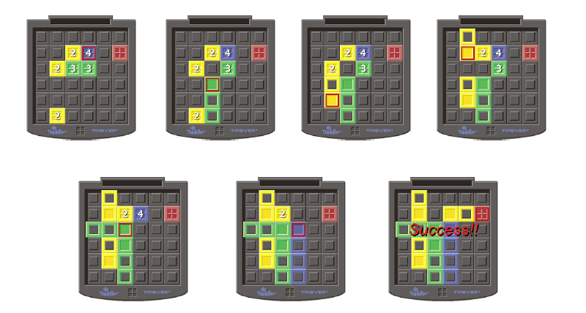
Rules of Game
Numbers are height of crate stack;
If could get 4 high out of way we can attain goal

Slide 554
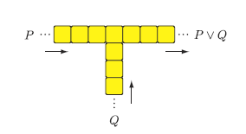
Problematic OR Gadget
Can go out where did not enter

Slide 555

Directional gadget
Single stack is two high;
tipped over stack is one high, two long;
red square is location of person travelling the towers

Slide 556
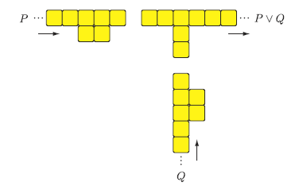
One directional Or gadget

Slide 557
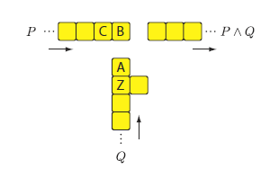
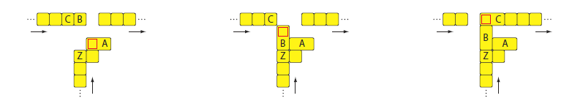
AND Gadget
How AND Works

Slide 558
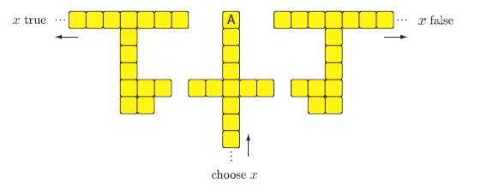
Variable Select Gadget
Tip A left to set x true; right to set x false
Can build bridge to go back but never to change choice

Slide 559
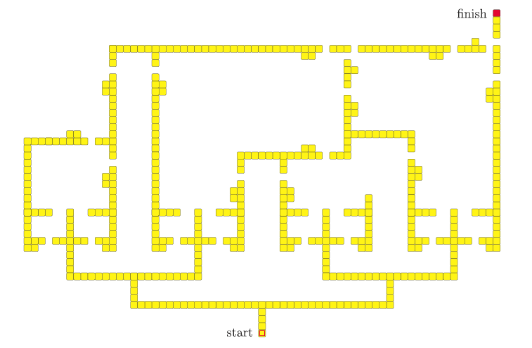
((x∨~x∨y)∧(~y∨z∨w)∧~w)
∧
∧
∨
Bridges back for true paths
∨
∨
∨
x
~x
y
~y
z
~z
w
~w

Slide 560
Win Strategy is NP-Complete
TipOver win strategy is NP-Complete
Minesweeper consistency is NP-Complete
Phutball single move win is NP-Complete
  Do not know complexity of winning strategy
Checkers is really interesting
  Single move to King is in P
  Winning strategy is PSpace-Complete

Slide 561
Finding Triangle Strips
Adapted from presentation by
Ajit Hakke Patil
Spring 2010

Slide 562
Graphics Subsystem
The graphics subsystem (GS) receives graphics commands from the application running on CPU over a bus, builds the image specified by the commands, and outputs the resulting image to display hardware
Graphics Libraries:
  OpenGL, DirectX.

Slide 563
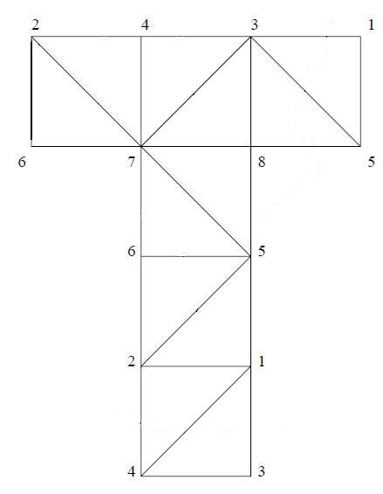

Surface Visualization
As Triangle Mesh
Generated by triangulating the geometry

Slide 564
Triangle List vs Triangle Strip
Triangle List: Arbitrary ordering of triangles.
Triangle Strip: A triangle strip is a sequential ordering of triangles. i.e consecutive triangles share an edge
In case of triangle lists we draw each triangle separately.
So for drawing N triangles you need to call/send 3N vertex drawing commands/data.
However, using a Triangle Strip reduces this requirement from 3N to N + 2, provided a single strip is sufficient.

Slide 565
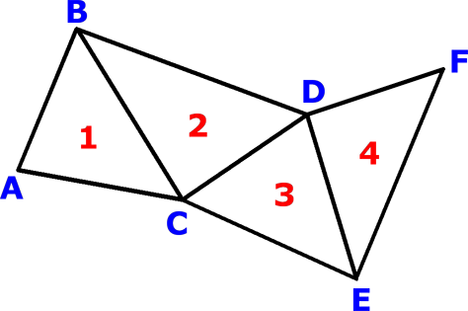
Triangle List vs Triangle Strip
four separate triangles: ABC, CBD, CDE, and EDF
But if we know that it is a triangle strip or if we rearrange the triangles such that it becomes a triangle strip, then we can store it as a sequence of vertices ABCDEF
This sequence would be decoded as a set of triangles ABC, BCD, CDE and DEF
Storage requirement:
  3N => N + 2

Slide 566
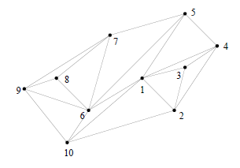
Tri-strips example
Single tri-strip that describes triangles is:
1,2,3,4,1,5,6,7,8,9,6,10,1,2

Slide 567
K-Stripability
Given some positive integer k (less than the number of triangles).
Can we create k tri-strips for some given triangulation – no repeated triangles.

Slide 568
Triangle List vs Triangle Strip
// Draw Triangle List
glBegin(GL_TRIANGLES);
For each Triangle
{
glVertex3f(x1,y1,z1);// vertex 1 glVertex3f(x2,y2,z2);// vertex 2
glVertex3f(x3,y3,z3);// vertex 3
}
glEnd();
// Draw Triangle Strip
glBegin(GL_TRIANGLE_STRIP);
For each Vertex
{
glVertex3f(x,y,z); //vertex
}
glEnd();

Slide 569
Problem Definition
Given a triangulation T = {t₁, t₂, t₃ ,.. t_{n}}. Find the triangle strip (sequential ordering) for it?
Converting this to a decision problem.
Formal Definition:
Given a triangulation T = {t₁, t₂, t₃ ,.. t_{N}}. Does there exists a triangle strip?

Slide 570
NP Proof
Provided a witness of a ‘Yes’ instance of the problem. we can verify it in polynomial time by checking if the sequential triangles are connected.
Cost of checking if the consecutive triangles are connected
  For i to N -1
    Check of i_{th} and i+1_{th} triangle are adjacent (have a common edge)
    Three edge comparisions or six vertex comparisions
  ~ 6N
Hence it is in NP.

Slide 571
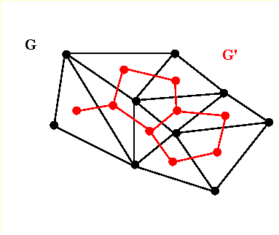
Dual Graph
The dual graph of a triangulation is obtained by defining a vertex for each triangle and drawing an edge between two vertices if their corresponding triangles share an edge
This gives the triangulations edge-adjacency in terms of a graph
Cost of building a Dual Graph
  O(N²)
e.g G’ is a dual graph of G.

Slide 572
NP-Completeness
To prove it’s NP-Complete we reduce a known NP-Complete problem to this one; the Hamiltonian Path Problem.
Hamiltonian Path Problem:
  Given: A Graph G = (V, E). Does G contains a path that visits every vertex exactly once?

Slide 573
NP-Completeness proof by restriction
Accept an Instance of Hamiltonian Path, G = (V, E), we restrict this graph to have max. degree = 3.The problem is still NP-Complete.
Construct an Instance of HasTriangleStrip
  G’ = G
    V’ = V
    E’ = E
  Let this be the dual graph G’ = (V’, E’) of the triangulation T = {t1, t2, t3 ,.. tN}.
    V’ ~ Vertex v_{i} represents triangle t_{i,} i = 1 to N
    E’ ~ An edge represents that two triangles are edge-adjacent (share an edge)
Return HasTriangleStrip(T)

Slide 574
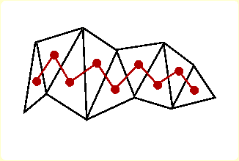
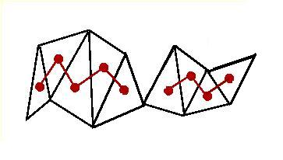
NP-Completeness
G will have a Hamiltonian Path iff G’ has one (they are the same).
G’ has a Hamiltonian Path iff T has a triangle strip of length N – 1.
T will have a triangle strip of length N – 1 iff G (G’) has a Hamiltonian Path.
‘Yes’ instance maps to ‘Yes’ instance. ‘No’ maps to ‘No.’

Slide 575
HP <_{P} HasTriangleStrip
The ‘Yes/No’ instance maps to ‘Yes/No’ instance respectively and the transformation runs in polynomial time.
Polynomial Transformation
Hence finding Triangle Strip in a given triangulation is a NP-Complete Problem

