Slide 1
Bounded-skew Steiner tree
Michael Do

Slide 2
Steiner Tree Problem
Given:
  A graph G = (V, E)
  A list of nodes N that is a subset of V
  A length l
Question:
  Does there exists a sub-tree T that connects all the nodes N such that the sum of the length of all the edges in T is less than l?

Slide 3
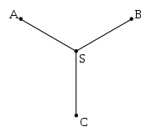
Steiner Tree

Slide 4
Steiner Tree

Slide 5
Steiner Tree

Slide 6
Application [1]
Usage in VLSI design in clock routing
Distribution of clock signals such that they arrive at elements simultaneously
Originally dealt with creating a Zero-skew tree
Circuits could still operate with minor timing differences

Slide 7
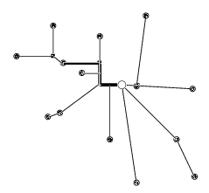
VLSI Steiner Tree

Slide 8
Problem
Given:
  A graph G = (V, E)
  A node r and set of nodes N such that r is not in N and r and N are in V
  A bound b
Question:
  What is the minimum length of a Steiner tree T of G that connects r to all nodes N, such that the skew of T does not exceed b?

Slide 9
Problem
Given:
  A graph G = (V, E)
  A node r and set of nodes N such that r is not in N and r and N are in V
  A bound b
  A length l
Question:
  Does there exist a Steiner tree T of G that connects r to all the nodes in N, such that skew of T does not exceed b and the sum of all the edges in the Steiner tree does not exceed l?

Slide 10
In NP
Given a witness containing a tree with a root:
  Check the sum of the length of all edges do not exceed l
  The difference in the length between any two root-to-leaf paths do not exceed b
Can be verified in polynomial time

Slide 11
Proof of NP-Completeness
By Restriction
  Restrict the problem to cases where the bound b is infinity
  Can be solved using the Steiner Tree problem
  Steiner Tree to Bounded-skew Steiner tree
    From the list of nodes to be spanned, arbitrarily choose one to be the source and let the others be the terminals
    Set the bound to infinity

Slide 12
Proof of NP-Completeness
By Restriction
  Bounded-skew Steiner Tree to Steiner tree
    Let the union of the source and the terminals be the nodes
    Disregard the bound

Slide 13
Reference
Jason Cong and Cheng-Kok Koh. Minimum-Cost Bounded-Skew Clock Routing. Circuits and Systems 1 (1995)

