Slide 1

Complexity Theory
Complexity
Charles E. Hughes
COT6410 – Spring 2023 Notes

Slide 2
Graph Coloring
Instance: A graph G = (V, E) and an integer k.
Question: Can G be "properly colored" with at most k colors?
Proper Coloring: one of the k colors is assigned to each vertex so that adjacent vertices have different colors.
Suppose we have two instances of this problem (1) is True (Yes) and the other (2) is False (No).
AND you know (1) is Yes and (2) is No. (Maybe you have a secret program or Oracle that has analyzed the two instances.)

Slide 3
Checking a “Yes” Answer
Without showing how your program works (you may not even know), how can you convince someone else that instance (1) is, in fact, a Yes instance?
We can assume the output of the program was an actual coloring of G. Just give that to a doubter who can easily check that no adjacent vertices are colored the same, and that no more than k colors were used.
How about the No instance?
What could the program have given that allows us to quickly "verify" (2) is a No instance?
    No One Knows!!
For all problems seem to be harder than there exists ones in many contexts
Think re versus co-re

Slide 4
Checking a “No” Answer
The only thing anyone has thought of is to have it test all possible ways to k-color the graph – all of which fail, of course, if “No” is the correct answer.
There are an exponential number of things (colorings) to check.
For some problems, there seems to be a big difference between verifying Yes and No instances.
To solve a problem efficiently, we must be able to solve both Yes and No instances efficiently and so it would seem we should be able to verify both quickly.

Slide 5
Hard and Easy
True Conjecture: If a problem is easy to solve, then it is easy to verify (just solve it and compare).
Contrapositive: If a problem is hard to verify, then it is (probably) hard to solve.
There is nothing magical about Yes and No instances – sometimes the Yes instances are hard to verify and No instances are easy to verify.
Consider Tautology – yes is for all;
Refutable is complement of Tautology and is there exist
And, of course, sometimes both are hard to verify, e.g., QSAT as it and its complement are the same

Slide 6
Easy Verification
Are there problems in which both Yes and No instances are easy to verify?
Yes. For example: Search a list L of n values for a key x.
Question: Is x in the list L?
Yes and No instances are both easy to verify.
In fact, the entire problem is easy to solve!!
Analogy: recursive means re and co-re

Slide 7
Verify vs Solve
Conjecture: If both Yes and No instances are easy to verify, then the problem is easy to solve.
Analogy (Failure?): Does re/co-re imply recursive have analogy here?
No one has yet proven this claim, but most researchers believe it to be true.
Note: It is usually relatively easy to prove something is easy – just write an algorithm for it and prove it is correct and that it is fast (usually, we mean polynomial).
But it is usually very difficult to prove something is hard – we may not be clever enough yet. So, you will often see "appears to be hard."

Slide 8
A CS Grand Challenge
Does P=NP?
There are many equivalent ways to describe P and NP. For now, we will use the following.
P is the set of decision problems (those whose instances have “Yes”/ “No” answers) that can be solved in polynomial time on a deterministic computer (no unbounded concurrency or guesses allowed).
NP is the set of decision problems that can be solved in polynomial time on a non-deterministic computer (equivalently one that can spawn an unbounded number of parallel threads; equivalently one that can be verified in polynomial time on a deterministic computer).
Again, as “Does P=NP?” has just one question, it is solvable, we just don’t yet know which solution, “Yes” or “No”, is the correct one.

Slide 9
Why is P Verify Same as NP
Assume we can verify each guess in polynomial time
We can then spawn each guess on a separate thread and check in poly time
  or
Just make a magic correct guess and verify it in poly time

Slide 10
Decision vs Optimization
    Two types of problems are of particular interest:
    Decision Problems ("Yes/No" answers)
    Optimization problems ("best" answers)
    (there are other types)

Slide 11
Vertex Cover (VC)
Suppose we are in charge of a large network (a graph where edges are links between pairs of cities (vertices). Periodically, a line fails. To mend the line, we must call in a repair crew that goes over the line to fix it. To minimize down time, we station a repair crew at one end of every line. How many crews must you have and where should they be stationed?
This is called the Vertex Cover Problem. (Yes, it sounds like it should be called the Edge Cover problem – something else already had that name and it is in P.)
An interesting problem – it seems to be a hard problem but may not be.

Slide 12
VC Decision vs Optimization
As a Decision Problem:
  Instances: A graph G and an integer k.
  Question: Does G possess a vertex Cover with at most k vertices?
As an Optimization Problem:
  Instances: A graph G.
  Question: What is the smallest k for which G possesses a vertex cover?

Slide 13
Relation of VC Problems
If we can (easily) solve either one of these problems, we can (easily) solve the other. To solve the optimization version, just solve the decision version with several different values of k. Use a binary search on k between 1 and n. That is log(n) solutions of the decision problem solves the optimization problem. It's simple to solve the decision version if we can solve the optimization version (why?).
We say their time complexity differs by no more than a multiple of log(n).
If one is polynomial, then so is the other.
If one is exponential, then so is the other.
We say they are equally difficult (both poly. or both exponential).

Slide 14
A Word about Time
An algorithm for a problem is said to be polynomial if there exists integers k and N such that t(n), the maximum number of steps required on any instance of size n, is at most n^{k}, for all n ≥ N.
Otherwise, we say the algorithm is exponential. Usually, this is interpreted to mean t(n) ≥ c^{n} for an infinite set of size n instances, and some constant c > 1 (often, we simply use c = 2).

Slide 15
Three Classes of Problems
  Problems proven to be in these three groups (classes) are, respectively,
  Undecidable, Exponential, and Polynomial.
  Theoretically, all problems belong to exactly one of these three classes.

Slide 16
Unknown Complexity
Practically, there are a lot of problems (maybe, most) that have not been proven to be in any of the classes (Yet, maybe never will be).
Most currently "lie between" polynomial and exponential – we know of exponential algorithms but have been unable to prove that exponential algorithms are necessary.
Some may have polynomial algorithms, but we have not yet been clever enough to discover them.
Some are provably exponentially hard.

Slide 17
Subset Sum
Problem – Subset Sum
Instances: A list L of n integer values and an integer B.
Question: Does L have a subset that sums exactly to B?
No one knows of a polynomial (deterministic) solution to this problem.
On the other hand, there is a very simple (dynamic programming) algorithm that runs in O(nB) time.
Why isn't this "polynomial"?
  Because the "length" of an instance is n lg(B) and
  nB > (n lg(B))^k for any fixed k, when B is sufficiently large

Slide 18
Research Territory
  Decidable – vs – Undecidable
  (area of Computability Theory)
  Exponential – vs – polynomial
  (area of Computational Complexity)
  Algorithms for any of these
  (area of Algorithm Design/Analysis)

Slide 19
NonDeterminism

Slide 20
Models of Computation
Non-Determinism
Since we can't seem to find a model of computation that is more powerful than a TM, can we find one that is 'faster'?
In particular, we want one that takes us from exponential time to polynomial time.
Our candidate will be the Non-Deterministic Turing Machine (NDTM).

Slide 21
NDTMs
As NDTMs are automata, we only care about what they accept and generally have just one accepting state. We want to determine how long it takes to get to the accept state - that's our only motive!!
So, what is a NDTM doing?
In a NDTM, like in a NFA or NPDA, what we are doing is making, and testing, all of those choices at once by 'spawning' a different NDTM for each of them. Those that don't work out, simply die (or something).
This is the ultimate in parallel programming.

Slide 22
NDTM and Oracles
Another interpretation of non-determinism:
From the basic definition, we notice that out of every state having a non-deterministic choice, at least one choice is valid and all the rest sort of die off. That is, they really have no reason for being spawned for this instance. So, we station at each such state, an 'oracle' (an all-knowing being) who only allows the correct NDTM to be spawned.
An 'Oracle Machine.’
All we care about is the time associated with the right choices. In fact, we can have a single oracle that makes all the right choices in advance, if they exist.

Slide 23
Checking an Oracle/Witness
For example, in the SubsetSum problem, we ask the oracle to write down the subset of objects whose sum is B (the desired sum). Then we ask "Can we write a deterministic polynomial algorithm to test the given witness."
The answer for SubsetSum is Yes, we can, i.e., the witness is verifiable in deterministic polynomial time.

Slide 24
NDTMs - Witnesses
Just what can we ask and expect of a "witness"?
The witness must be something that
    (1) we can verify to be accurate (for the given problem and instance) and
    (2) we must be able to "finish off" the solution.
    All in polynomial time.

Slide 25
Witness and Graph Coloring
The information provided must be something we could have come up with ourselves, but probably at an exponential cost. And, it has to be enough so that we can conclude the final answer Yes from it.
Consider a witness for the graph coloring problem:
Given: A graph G = (V, E) and an integer k.
Question: Can the vertices of G be assigned colors so that adjacent vertices have different colors and use at most k colors?

Slide 26
Good and Bad Witnesses
The witness could just say Yes or No.
    But that's not good enough - we don't know of a polynomial algorithm for graph coloring.
It could be "vertex 10 is colored Red."
    That's not good enough either. Any single vertex can be colored any color we want.
It could be a color assigned to each vertex.
    That would work, because we can verify its validity in polynomial time, and we can conclude the correct answer of Yes.

Slide 27
More on Witnesses
What if it was a color for all vertices but one?
    That also is enough. We can verify the correctness of the n-1 given to us, then we can verify that the one uncolored vertex can be colored with a color not on any neighbor, and that the total is not more than k.
What if all but 2, 3, or 20 vertices are colored
    All are valid witnesses. (Potentially exponential but for a constant, not a variable n)
What if half the vertices are colored?
    Usually, No. There's not enough information. Sure, we can check that what is given to us is properly colored, but we don't know how to "finish it off” except perhaps in k^{n/2} time.

Slide 28
Deterministic Exponential Time
A major question remains: Do we have, in NDTMs, a model of computation that solves all deterministic exponential (DE) problems in polynomial time (nondeterministic polynomial time)??
It definitely solves some problems we think are DE in nondeterministic polynomial time.

Slide 29
DEXP Versus NEXP
But, so far, all problems that have been proven to require deterministic exponential time also require nondeterministic exponential time.
So, the jury is still out. In the meantime, NDTMs are still valuable, because they might identify a larger class of problems than does a deterministic TM - the set of decision problems for which Yes instances can be verified in polynomial time.

Slide 30
Problem Classes
We now begin to discuss several different classes of problems. The first two will be:
NP 'Nondeterministic' Polynomial
P 'Deterministic' Polynomial,
The 'easiest' problems in NP
Their definitions are rooted in the depths of Computability Theory as just described, but it is worth repeating some of it in the next few slides.

Slide 31
Class – NP
First Significant Complexity Class of Problems

Slide 32
Vertex Cover Definition
    Consider two seemingly closely related statements (versions) of a single problem. We show they are actually very different. Let G = (V, E) be a graph.
      Definition: X ⊆ V(G) is a vertex cover if every edge in G has at least one endpoint in X.

Slide 33
Variants of VC
    Version 1. Given a graph G and an integer k.
    Does G contain a vertex cover
    with at most k vertices?
    Version 2. Given a graph G and an integer k.
    Does the smallest vertex cover of G
    have exactly k vertices?
    Suppose, for either version, the answer is "yes," and someone also gives us a set X of vertices and claims
    "X satisfies the conditions."

Slide 34
Version 1 of VC
    In Version 1, we can easily check that the claim is correct – in polynomial time.
    That is, in polynomial time, we can check that X has k vertices, and that X is a vertex cover.

Slide 35
Version 2 of VC
    In Version 2, we can also easily check that X has exactly k vertices and that X is a vertex cover.
    But we don't know how to easily check that there is not a smaller vertex cover!!
    That seems to require exponential time.
    These are very similar looking "decision" problems (Yes/No answers), yet they are VERY different in this one important respect.

Slide 36
Version 1 in NP
    Version 1 problems make up the class called NP
    Definition: The Class NP is the set of all decision problems for which answers to Yes instances can be verified in polynomial time.
    For historical reasons, NP means
    "Nondeterministic Polynomial."
    (Specifically, it does not mean "not polynomial").

Slide 37
Version 3 of VC
Version 2 of the Vertex Cover problem is not unique. There are other versions that exhibit this same property. For example,
Version 3: Given: A graph G = (V, E) and an
integer k.
Question: Do all vertex covers of G
have more than k vertices?
What would/could a 'witness' for a Yes instance be?
Version 3 is the Complement Problem of Version 1.
It is a “for all not” versus a “there exist.”

Slide 38
Characteristics of NP
All problems in NP are decidable.
That means there is an algorithm.
And the algorithm is no worse than O(2^{n}).

Slide 39
Non-NP
    Version 2 and 3 problems are apparently not in NP.
    So, where are they??
We need more structure! {Again, later.}
First we look inward, within NP.

Slide 40
Class – P
Second Significant Complexity Class of Problems

Slide 41
P Contained in NP
    Some decision problems in NP can be solved (without knowing the answer in advance) - in polynomial time. That is, not only can we verify a correct answer in polynomial time, but we can actually compute the correct answer in polynomial time - from "scratch."
      These are the problems that make up the class P.
        P is a subset of NP.

Slide 42
A Witness Analogy for P
Problems in P can also have a witness – we just don't need one. This line of thought leads to an interesting observation.
Given: A list L of n values and a key X.
Question: Is X in L?
An oracle can provide a "witness" for a Yes instance by writing the index k for X.
We can verify the correctness with one simple comparison Is L[k] = X?

Slide 43
Complement of P
Now, consider the complement (Version 3) of this problem:
Given: A list L of n values and a key X.
Question: Is X not in L?
Here, for any Yes instance, no 'witness' seems to exist, but if the oracle simply writes down "Yes" we can verify the correctness in polynomial time by comparing X with each of the n values and report "Yes, X is not in the list“ if that is so.

Slide 44
P and Co-P
Therefore, both problems can be verified in polynomial time and, hence, both are in NP.
This is a characteristic of any problem in P - both it and its complement can be verified in polynomial time (of course, they can both be 'solved' in polynomial time, too.)
Therefore, we can again conclude P ⊆ NP.

Slide 45
NP and Co-NP
There is a popular conjecture that if any problem and its complement are both in NP, then both are also in P.
This has been the case for several problems that for many years were not known to be in P, but both the problem and its complement were known to be in NP.
For example, Linear Programming (proven to be in P in the 1980’s).
A notable 'holdout' to date is Graph Isomorphism.

Slide 46
Is P=NP?
    At the moment, no one knows.
    Some believe all problems in NP have polynomial algorithms. Many do not (believe that).
    The fundamental question in theoretical computer science is:
      Does P = NP?
      There is an award of one million dollars for a proof.
      – Either way, True or False.

Slide 47
    The "Key" to
    Complexity Theory
    'Reductions,' 'Reductions,' 'Reductions.'

Slide 48
Abstract Solution
For any problem X, let X(I_{X}, Answer_{X}) represents an algorithm for problem X – even if none is known to exist.
  I_{X} is an arbitrary instance given to the algorithm and Answer_{X} is the returned answer determined by the algorithm.

Slide 49
Polynomial Time Reductions
Definition: For problems A and B, a (Polynomial) Turing Reduction is an algorithm A(I_{A}, Answer_{A}) for solving all instances of problem A and satisfies the following:
    (1) Constructs zero or more instances of problem B and invokes algorithm B(I_{B}, Answer_{B}), on each.
    (2) Computes the result, Answer_{A}, for I_{A}.
    (3) Except for the time required to execute algorithm B, the execution time of algorithm A must be polynomial with respect to the size of I_{A}.
    We say A ≤_{P} B

Slide 50
Best Algorithm for B
We may assume a 'best' algorithm for problem B without actually knowing it.
If A(I_{A}, Answer_{A}) can be written without algorithm B, then problem A is simply a polynomial problem.

Slide 51
PolyTime Reductions
Theorem. If A ≤_{P} B and problem B is polynomial, then problem A is polynomial.
Corollary. If A ≤_{P} B and problem A is exponential, then problem B is exponential.

Slide 52
PT Reduction Theorem
Theorem. If A ≤_{P} B , then problem A is "no harder than" problem B.
Proof: Let f_{X}(n) be the inherent complexity of problem X. Let t_{A}(n) and t_{B}(n) be the maximum times for some algorithms to solve A and B.
Thus, f_{A}(n) ≤ t_{A}(n). Further, since we assume the best algorithm for B, t_{B}(n) = f_{B}(n). Since A ≤_{P} B, there is a constant k such that t_{A}(n) ≤ n^{k}t_{B}(n). Therefore, f_{A}(n) ≤ t_{A}(n) ≤ n^{k}t_{B}(n) = n^{k}f_{B}(n). That is, A is no harder than B within a polynomial factor.

Slide 53
PT Reductions Properties
Theorem. (transitivity)
    If A ≤_{P} B and B ≤_{P} C then A ≤_{P} C.
Definition.
    If A ≤_{P} B and B ≤_{P} A, then A and B are polynomially equivalent. A≡_{p}B
Note reflexive as A ≤_{P} A

Slide 54
NP–Complete
Third Significant Complexity Class of Problems

Slide 55
NP–Complete
    Polynomial Transformations enforce an equivalence relationship on all decision problems, particularly, those in the Class NP. Class P is one of those classes and is the "easiest" class of problems in NP.
    Is there a class in NP that is the hardest class in NP?
    A problem B in NP such that A ≤_{P} B for every A in NP is called NP-Complete
    (Analogy to re-complete)

Slide 56
NP–Hard
    A problem B such that A ≤_{P} B for every A in NP-Complete is called NP-Hard
    (Second Analogy to re-hard)

Slide 57
Propositional Logic
How Hard Can That Be?

Slide 58
Propositional Calculus
Mathematical of unquantified logical expressions
Essentially Boolean algebra
Goal is to reason about propositions
Often interested in determining
  Is a well-formed formula (wff) a tautology?
  Is a wff refutable (unsatisfiable)?
  Is a wff satisfiable? (will show this is the canonical NP-complete problem)

Slide 59
Tautology and Satisfiability
The classic approaches are:
  Truth Table
  Axiomatic System (axioms and inferences)
Truth Table
  Clearly exponential in number of variables
Axiomatic Systems Rules of Inference
  Substitution and Modus Ponens
  Resolution / Unification (1st order only)

Slide 60
Proving Consequences
Start with a set of axioms (all tautologies)
Using substitution and MP
(P, P ⊃Q ⇒ Q)
derive consequences of axioms (also tautologies, but just a fragment of all unless axioms are “complete”)
Can create complete sets of axioms
Need 3 variables for associativity, e.g.,
(p1 ∨ p2) ∨ p3 ⊃ p1 ∨ (p2 ∨ p3)

Slide 61
Some Undecidables
Given a set of axioms,
  Is this set complete?
  Given a tautology T, is T a consequent?
The above are even undecidable with one axiom and with only 2 variables. I will show the latter result shortly.

Slide 62
Refutation
If we wish to prove that some wff, F, is a tautology, we could negate it and try to prove that the new formula is refutable (cannot be satisfied; contains a logical contradiction).
This is often done using resolution.

Slide 63
Resolution
Put formula in Conjunctive Normal Form (CNF)
If have terms of conjunction
(P ∨ Q), (R ∨ ~Q)
then can determine that (P ∨ R)
If we ever get a null conclusion, we have refuted the proposition
Resolution is not complete for derivation, but it is for refutation

Slide 64
Axioms
Must be tautologies
Can be incomplete
Might have limitations on them and on WFFs, e.g.,
  Just implication
  Only n variables
  Single axiom

Slide 65
Simulating Machines
Linear representations require associativity, unless all operations can be performed on prefix only (or suffix only)
Prefix and suffix-based operations are single stacks and limit us to CFLs
Can simulate Post normal Forms with just 3 variables. A PNF has rules αP → Pβ

Slide 66
Diadic PIPC
Diadic limits us to two variables
PIPC means Partial Implicational Propositional Calculus, and limits us to implication as only connective
Partial just means we get a fragment
Problems
  Is fragment complete?
  Can F be derived by substitution and MP?

Slide 67
Living without Associativity
Consider a two-stack model of a TM
Could somehow use one variable for left stack and other for right
Must find a way to encode a sequence as a composition of forms – that’s the key to this simulation

Slide 68
Composition Encoding
Consider (p ⊃ p), (p ⊃ (p ⊃ p) ),
(p ⊃ (p ⊃ (p ⊃ p) ) ), …
  No form is a substitution instance of any of the other, so they can’t be confused
  All are tautologies
Consider ((X ⊃ Y) ⊃ Y)
  This is just X ∨ Y

Slide 69
Encoding
Use (p ⊃ p) as form of bottom of stack
Use (p ⊃ (p ⊃ p)) as form for letter 0
Use (p ⊃ (p ⊃ (p ⊃ p))) as form for 1
Etc.
String 01 (reading top to bottom of stack) is
  ( ( (p ⊃ p) ⊃ ( (p ⊃ p) ⊃ ( (p ⊃ p) ⊃ (p ⊃ p) ) ) ) ⊃
  ( ( (p ⊃ p) ⊃ ( (p ⊃ p) ⊃ ( (p ⊃ p) ⊃ (p ⊃ p) ) ) ) ⊃
  ( (p ⊃ p) ⊃ ( (p ⊃ p) ⊃ ( (p ⊃ p) ⊃ (p ⊃ p) ) ) ) ) )

Slide 70
TM to Encode
Tape alphabet {0,1} 0 is blank
State set {q₁, q₂, … , q_{m}}
  q₁ is start state
  Machine halts if we reach a discriminant (state, scanned symbol) with no associated action

Slide 71
Encoding Functions
Ι(p) abbreviates [p ⊃ p] // stack bottom
Φ₀(p) is [p ⊃ Ι(p)] which is [p ⊃ [p ⊃ p]] // symbol 0
Φ₁(p) is [p ⊃ Φ₀(p)] // symbol 1
ξ₁(p) is [p ⊃ Φ₁(p)] // helper 1
ξ₂(p) is [p ⊃ ξ₁ (p)] // helper 2
ξ₃(p) is [p ⊃ ξ₂ (p)] // helper 3
ψ₁(p) is [p ⊃ ξ₃ (p)] // symbol q₁
ψ₂(p) is [p ⊃ ψ₁ (p)] // symbol q₂
…
ψ_{m}(p) is [p ⊃ ψ_{m-1} (p)] // symbol q_{m}

Slide 72
Example TM ID
Let a TM’s ID be
110 q₅ 1101
Tape could be represented by two stacks
Stack 1 is right side, reading left to right
q₅ 1101
Stack 2 is left side, reading right to left
011

Slide 73
Encoded Example TM ID
q₅ 1101 (stack 1, read left to right)
011 (stack 2, read left to right)
ψ₅( Φ₁( Φ₁( Φ₀( Φ₁( I (p₁) ) ) ) ) ) ∨ Φ₀( Φ₁( Φ₁( I (p₂) ) ) )
Consider a Turing Table entry q₅ 1 L q₂
We could have an implication like
[ψ₅(Φ₁(p₁)) ∨ Φ₀(p₂)] ⊃ [ψ₂(Φ₀(Φ₁(p₁))) ∨ p₂]
Using substitution (see red) and MP
[ψ₅(Φ₁(Φ₁(Φ₀(Φ₁(I(p₁)))))) ∨ Φ₀(Φ₁(Φ₁(I(p₁))))] ⇒
[ψ₂(Φ₀(Φ₁(Φ₁(Φ₀(Φ₁(I(p₁))))))) ∨ Φ₁(Φ₁(I(p₁)))]
This mimics one step of forward computation

Slide 74
Running Backwards
The simulation we show actually will mimic the TM running backwards so the rule on the previous page will actually be
[ψ₂(Φ₀(Φ₁(p₁))) ∨ p₂] ⊃ [ψ₅(Φ₁(p₁)) ∨ Φ₀(p₂)]
To kick things off, my rules want to allow me to deduce any arbitrary halting ID
We use three helper forms to do this; they are ξ₁(p), ξ₂(p), and ξ₃(p)

Slide 75
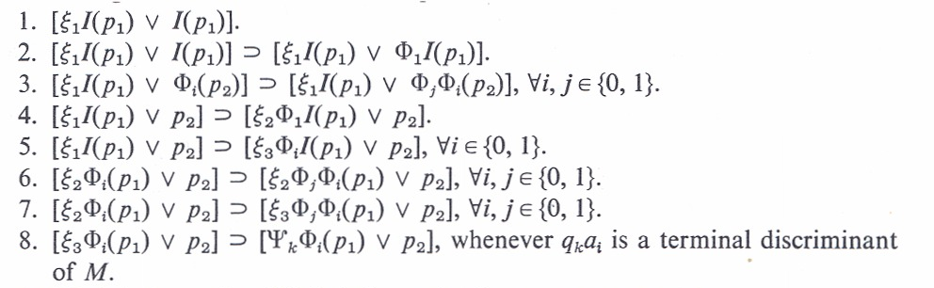
ξ₁ Sets Up Stack 2
The only axiom that does not involve a form for which MP can be applied is
1. [ξ₁I(p₁) ∨ I(p₁)]
The above reflects two empty stacks
Using ξ₁ rules, we generate any and all possible left-hand sides of tape in stack 2
This guarantees that left side is either empty (rule 4) or starts with a 1 (rule 2)
If we apply rule 2 then rule 3 can expand the left side

Slide 76
ξ₂ Starts Up Stack1
Two possibilities follow
Either Rule 4 replaces ξ₁ with ξ₂ and assures that the right side of tape (stack 1) has a 1 as its rightmost symbol
Or Rule 5 replaces ξ₁ with ξ₃ and assures that the right side of tape (stack 1) has just a scanned symbol (can be a 0 or 1)
If we use ξ₂ then rule 6 can expand the right side but at some point we use rule 7 to switch to ξ₃

Slide 77
ξ₃ Insures Terminal Discriminamt
Rule 8 replaces ξ₃ with any ψ_{k} such that q_{k}i halts (no rule) and i, represented by Φ_{i}, is on the top of stack 1 (new wff will be of form ψ_{k}(Φ_{i}(p₁)) ∨ p₂
This is the point where the simulation of the TM begins, except we run TM in reverse via rules 9-13 (and their subparts)
While these rules can be a bit complex at first they are just the same ones we used to map a TM to a semi-Thue system or a PSG

Slide 78
Putting it Together
The main point is that the axioms produce a bunch of items that are easy to check for validity (the stuff involving the forms ξ₁, ξ₂, and ξ₃ plus exactly those representations of starting IDs for which the TM halts
If we could decide what Tautologies are producible by this Propositional System then we would be able to solve the Halting Problem for TMs
This proves the deducibility problem for Fragments of the 2-Variable Implicational Calculus (PIPC) is unsolvable
This is true even though two variables are insufficient to represent the basic notion of associativity!!!

Slide 79
Creating Terminal IDs

Slide 80
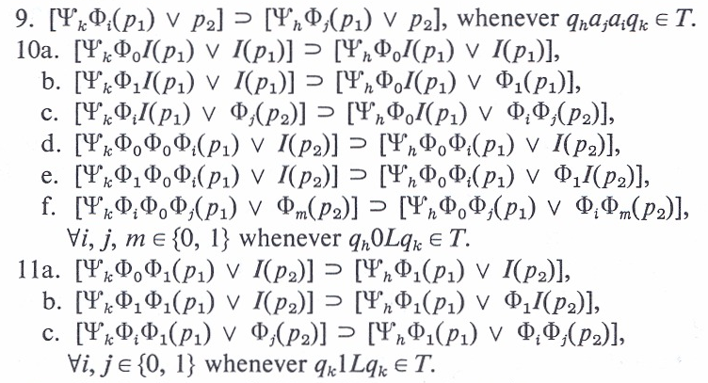
Reversing Print and Left

Slide 81
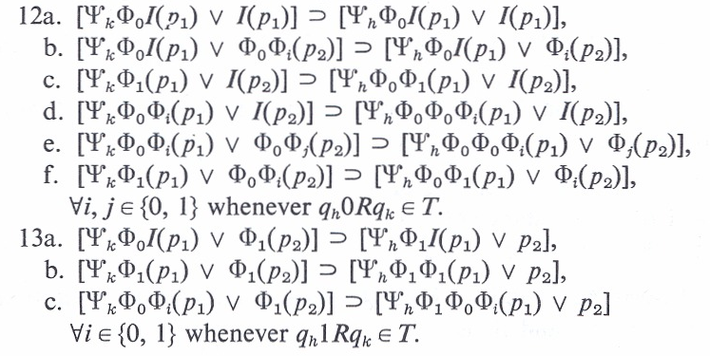
Reversing Right

Slide 82
Satisfiability
How Hard Can That Be?

Slide 83
Conjunctive Normal Form
U = {u₁, u₂,…, u_{n}}, Boolean variables.
C = {c₁, c₂,…, c_{m}}, "OR clauses"
For example:
c_{i} = (u₄ ∨ u₃₅ ∨ ~u₁₈ ∨ u₃… ∨ ~u₆)

Slide 84
Satisfiability Challenge
Can we assign Boolean values to the variables in U so that every clause is TRUE?
There is no known polynomial time algorithm!!

Slide 85
Cook’s Theorem
Cooks Theorem:
1) SAT is in NP
2) For every problem A in NP,
A ≤_{P} SAT
Thus, SAT is as hard as every problem in NP.

Slide 86
SAT as NP–Complete
Since SAT is itself in NP, that means SAT is a hardest problem in NP (there can be more than one.).
A hardest problem in a class is called the "completion" of that class.
Therefore, SAT is NP–Complete.

Slide 87
Ubiquity
    Today, there are many 1,000’s of problems that have been proven to be NP–Complete. (See Garey and Johnson, Computers and Intractability: A Guide to the Theory of NP–Completeness, for a list of over 300 as of the early 1980's).

Slide 88
What about P = NP?
If P = NP then all problems in NP are polynomial problems.
If P ≠ NP then all NP–C problems are at least super-polynomial and perhaps exponential. That is, NP-C problems could require sub-exponential super-polynomial time. (Example of super-polynomial, sub-exponential is o(2^{o(n)}), e.g., 2^{∛n}

Slide 89
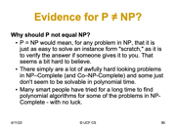
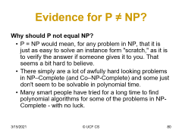
Evidence for P = NP?
Why should P equal NP?
There seems to be a huge "gap" between the known problems in P and Exponential. That is, almost all known polynomial problems are no worse than n³ or n⁴.
Where are the O(n⁵⁰) problems?? O(n¹⁰⁰)? Maybe they are the ones in NP–Complete?
It's awfully hard to envision a problem that would require n¹⁰⁰, but surely they exist?
Some of the problems in NP–C just look like we should be able to find a polynomial solution (looks can be deceiving, though).

Slide 90
Evidence for P ≠ NP?
Why should P not equal NP?
    P = NP would mean, for any problem in NP, that it is just as easy to solve an instance form "scratch," as it is to verify the answer if someone gives it to you. That seems a bit hard to believe.
    There simply are a lot of awfully hard looking problems in NP–Complete (and Co–NP-Complete) and some just don't seem to be solvable in polynomial time.
    Many smart people have tried for a long time to find polynomial algorithms for some of the problems in NP-Complete - with no luck.

Slide 91
NP-Complete; NP-Hard
A decision problem, C, is NP-complete if:
  C is in NP and
  C is NP-hard. That is, every problem in NP is polynomially reducible to C.
D polynomially reduces to C means that there is a deterministic polynomial-time many-one algorithm, f, that transforms each instance x of D into an instance f(x) of C, such that the answer to f(x) is YES if and only if the answer to x is YES.
To prove that an NP problem A is NP-complete, it is sufficient to show that an already known NP-complete problem polynomially reduces to A. By transitivity, this shows that A is NP-hard.
A consequence of this definition is that if we had a polynomial time algorithm for any NP-complete problem C, we could solve all problems in NP in polynomial time. That is, P = NP.
Note that NP-hard does not necessarily mean NP-complete, as a given NP-hard problem could be outside NP. Analogy to re-complete

Slide 92
Returning to SAT
SAT is the problem to decide of an arbitrary Boolean formula (wff in the propositional calculus) whether or not this formula is satisfiable (has a set of variable assignments that evaluate the expression to true).
SAT clearly can be solved in time k2^{n}, where k is the length of the formula and n is the number of variables in the formula.
What we now show is that SAT is NP-complete, providing us our first concrete example of an NP-complete decision problem.

Slide 93
Simulating NDTM
Given a NDTM, M, and an input w, we need to create a formula, ϕ_{M,w}, containing a polynomial number of terms that is satisfiable just in case M accepts w in polynomial time.
The formula must encode within its terms a trace of configurations that includes
  A term for the starting configuration of the TM
  Terms for all accepting configurations of the TM
  Terms that ensure the consistency of each configuration
  Terms that ensure that each configuration after the first follows from the prior configuration by a single move

Slide 94
Tableaus
A tableau is an array of tape alphabet symbols.
  It represents a configuration history of one branch of our NDTM’s nondeterminism.
  If the NDTM runs in n^{k} time, the tableau is an
  (n^{k} × n^{k}) tableau.
    It’s big enough downward because the TM runs in n^{k}.
    …and rightward because the TM can only count to n^{k}.
  We assume that every configuration starts and ends with a # symbol.
  We think of our tableau as looking like this in the “beginning”: the starting configuration across the top, and the other configurations blank.
    (We quote “beginning” because SAT isn’t really a stateful algorithm, but just go with it for now.)
  But we’ve assumed that we can “represent” alphabet symbols. How do we do that, in SAT?
# | q₀ | w₁ | w₂ | … | w_{n} | □ | … | □ | # | ↑ n^{k} ↓
# |  |  |  |  |  |  |  |  | #
# |  |  |  |  |  |  |  |  | #
# |  |  |  |  |  |  |  |  | #
# |  |  |  |  |  |  |  |  | #
# |  |  |  |  |  |  |  |  | #
# |  |  |  |  |  |  |  |  | #
# |  |  |  |  |  |  |  |  | #
# |  |  |  |  |  |  |  |  | #
# |  |  |  |  |  |  |  |  | #
← n^{k} →

Slide 95
Encoding the Tableau: Basics
Consider a set comprised of:
  The tape alphabet
  The state set
  The separator character
C = Γ ∪ Q ∪ { # }
Consider a cell variable:
x_{i,j,c}
Turning this variable on corresponds to setting cell (i, j) = c, for some c ∈ C.
 | 1 | 2 | 3 | 4 | 5 | 6 | 7 | 8 | 9 | 10
1 | # | q₀ | w₁ | w₂ | … | w_{n} | □ | … | □ | #
2 | # |  |  |  |  |  |  |  |  | #
3 | # |  |  |  |  |  |  |  |  | #
4 | # |  |  |  |  |  |  |  |  | #
5 | # |  |  |  |  |  |  |  |  | #
6 | # |  |  |  |  |  |  |  |  | #
7 | # |  |  |  |  |  |  |  |  | #
8 | # |  |  |  |  |  |  |  |  | #
9 | # |  |  |  |  |  |  |  |  | #
10 | # |  |  |  |  |  |  |  |  | #

Slide 96
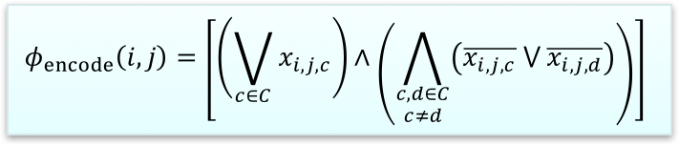
Encoding the Tableau: Cells
Consider our tableau alphabet:
C = Γ ∪ Q ∪ { # }
Consider a cell and corresponding variable:
x_{i,j,c}
Now we need to make sure the tableau is consistently encoded.
  Create a clause for each cell (i, j).
  The left demands x_{i,j,c} be true for some c.
  The right demands x_{i,j,c} be true for only one c.
 | 1 | 2 | 3 | 4 | 5 | 6 | 7 | 8 | 9 | 10
1 | # | q₀ | w₁ | w₂ | … | w_{n} | □ | … | □ | #
2 | # |  |  |  |  |  |  |  |  | #
3 | # |  |  |  |  |  |  |  |  | #
4 | # |  |  |  |  |  |  |  |  | #
5 | # |  |  |  |  |  |  |  |  | #
6 | # |  |  |  |  |  |  |  |  | #
7 | # |  |  |  |  |  |  |  |  | #
8 | # |  |  |  |  |  |  |  |  | #
9 | # |  |  |  |  |  |  |  |  | #
10 | # |  |  |  |  |  |  |  |  | #
$$φ_{encode}\left(i,j\right)=\left[\left(\bigvee_{c∈C}{x_{i,j,c}}\right)∧\left(\bigwedge_{\begin{aligned}c,d∈C \\ c≠d\end{aligned}}{\left(\overline{x_{i,j,c}} ⋁ \overline{x_{i,j,d}}\right)}\right)\right]$$

Slide 97
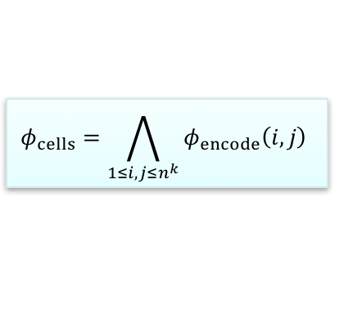

Encoding the Tableau: The Tableau
Tableau alphabet: C = Γ ∪ Q ∪ { # }
Cell variable: x_{i,j,c}
Create an encoding clause for each cell (i, j).
Now repeat the clause across the tableau.
This is our cell formula. It ensures that each cell in the tableau is assigned a single symbol.
 | 1 | 2 | 3 | 4 | 5 | 6 | 7 | 8 | 9 | 10
1 | # | q₀ | w₁ | w₂ | … | w_{n} | □ | … | □ | #
2 | # |  |  |  |  |  |  |  |  | #
3 | # |  |  |  |  |  |  |  |  | #
4 | # |  |  |  |  |  |  |  |  | #
5 | # |  |  |  |  |  |  |  |  | #
6 | # |  |  |  |  |  |  |  |  | #
7 | # |  |  |  |  |  |  |  |  | #
8 | # |  |  |  |  |  |  |  |  | #
9 | # |  |  |  |  |  |  |  |  | #
10 | # |  |  |  |  |  |  |  |  | #
$$φ_{encode}\left(i,j\right)=\left[\left(\bigvee_{c∈C}{x_{i,j,c}}\right)∧\left(\bigwedge_{\begin{aligned}c,d∈C \\ c≠d\end{aligned}}{\left(\overline{x_{i,j,c}} ⋁ \overline{x_{i,j,d}}\right)}\right)\right]$$
$$φ_{cells}=\bigwedge_{1≤i,j≤n^{k}}{φ_{encode}\left(i,j\right)}$$

Slide 98
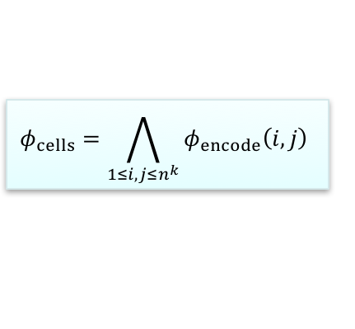
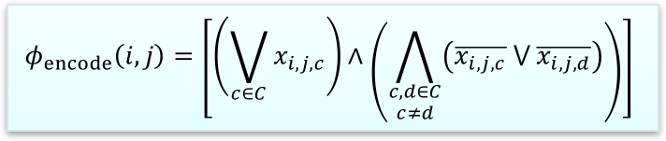
Encoding the Tableau: Complexity
We can create the single-cell encoding formula in polynomial time with a |C|² iteration.
We can create the entire cell formula in polynomial time with an n^{2k} iteration around that.
So we can say that φ_{cells} is satisfied by, and only by, a properly encoded tableau, and is created in polynomial time.
$$φ_{encode}\left(i,j\right)=\left[\left(\bigvee_{c∈C}{x_{i,j,c}}\right)∧\left(\bigwedge_{\begin{aligned}c,d∈C \\ c≠d\end{aligned}}{\left(\overline{x_{i,j,c}} ⋁ \overline{x_{i,j,d}}\right)}\right)\right]$$
 | 1 | 2 | 3 | 4 | 5 | 6 | 7 | 8 | 9 | 10
1 | # | q₀ | w₁ | w₂ | … | w_{n} | □ | … | □ | #
2 | # |  |  |  |  |  |  |  |  | #
3 | # |  |  |  |  |  |  |  |  | #
4 | # |  |  |  |  |  |  |  |  | #
5 | # |  |  |  |  |  |  |  |  | #
6 | # |  |  |  |  |  |  |  |  | #
7 | # |  |  |  |  |  |  |  |  | #
8 | # |  |  |  |  |  |  |  |  | #
9 | # |  |  |  |  |  |  |  |  | #
10 | # |  |  |  |  |  |  |  |  | #
$$φ_{cells}=\bigwedge_{1≤i,j≤n^{k}}{φ_{encode}\left(i,j\right)}$$

Slide 99
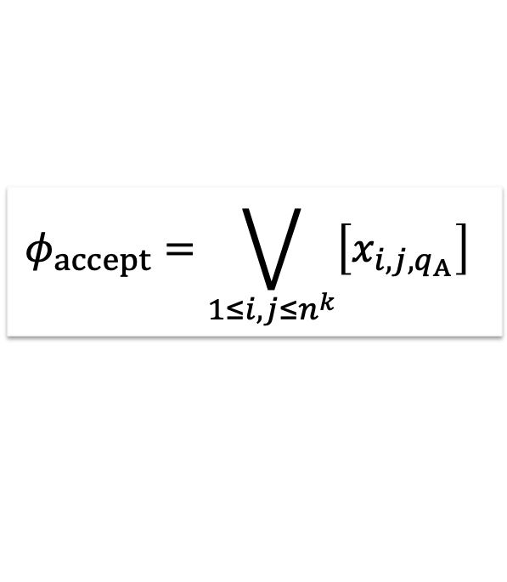
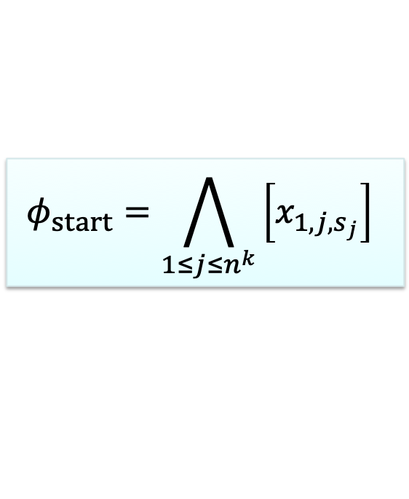
Starting and Accepting
Starting and accepting are (comparatively) easy.
To start, take the start configuration padded to n^{k} length with blanks…
S = #q₀w₁w₂…w_{n}□…□# so that |S| = n^{k}
…and require the first row be equal to the start configuration:
Then to accept, just require an accept state somewhere in the tableau.
 | 1 | 2 | 3 | 4 | 5 | 6 | 7 | 8 | 9 | 10
1 | # | q₀ | w₁ | w₂ | … | w_{n} | □ | … | □ | #
2 | # |  |  |  |  |  |  |  |  | #
3 | # |  |  |  |  |  |  |  |  | #
4 | # |  |  |  |  |  |  |  |  | #
5 | # | w₁ | w₂ | … | q_{A} | … | □ | … | □ | #
6 | # |  |  |  |  |  |  |  |  | #
7 | # |  |  |  |  |  |  |  |  | #
8 | # |  |  |  |  |  |  |  |  | #
9 | # |  |  |  |  |  |  |  |  | #
10 | # |  |  |  |  |  |  |  |  | #
$$φ_{start}=\bigwedge_{1≤j≤n^{k}}{\left[x_{1,j,s_{j}}\right]}$$
$$φ_{accept}=\bigvee_{1≤i,j≤n^{k}}{\left[x_{i,j,q_{A}}\right]}$$

Slide 100
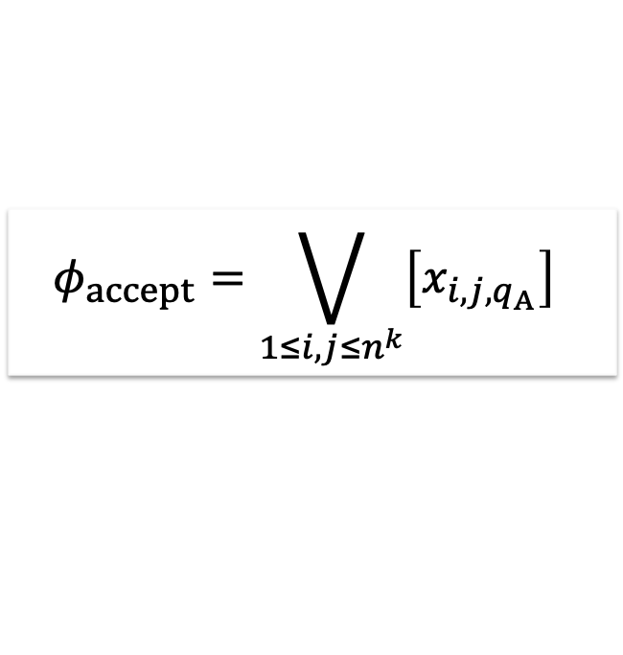
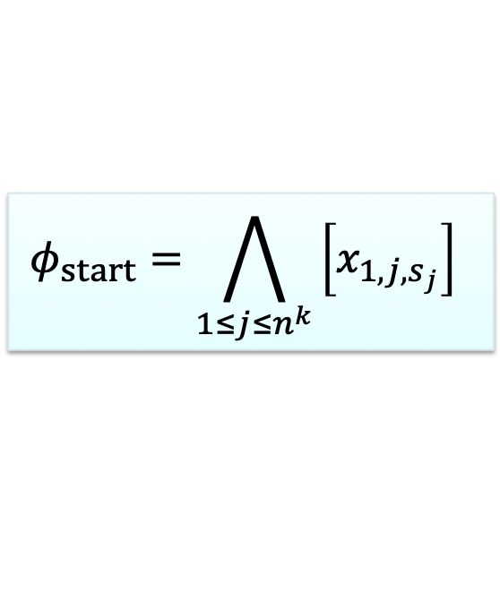
Starting and Accepting
$$φ_{start}=\bigwedge_{1≤j≤n^{k}}{\left[x_{1,j,s_{j}}\right]}$$
$$φ_{accept}=\bigvee_{1≤i,j≤n^{k}}{\left[x_{i,j,q_{A}}\right]}$$
 | 1 | 2 | 3 | 4 | 5 | 6 | 7 | 8 | 9 | 10
1 | # | q₀ | w₁ | w₂ | … | w_{n} | □ | … | □ | #
2 | # |  |  |  |  |  |  |  |  | #
3 | # |  |  |  |  |  |  |  |  | #
4 | # |  |  |  |  |  |  |  |  | #
5 | # | z₁ | z₂ | … | q_{A} | … | □ | … | □ | #
6 | # |  |  |  |  |  |  |  |  | #
7 | # |  |  |  |  |  |  |  |  | #
8 | # |  |  |  |  |  |  |  |  | #
9 | # |  |  |  |  |  |  |  |  | #
10 | # |  |  |  |  |  |  |  |  | #
We can generate the start and accept formulas in n^{k} and (n^{k})² time, both polynomial.
So now we can say that:
φ_{start} is satisfied by, and only by, a tableau with the starting configuration of M on w encoded as its first row and is created in polynomial time.
…and…
φ_{accept} is satisfied by, and only by, a tableau encoding an accepting configuration as one of its rows and is created in polynomial time.

Slide 101
Transitions
Now, for transitions. Recall the discussions we had about ID changes being limited to three characters or six, when looking at transitions..
  A given 2x3 window is legal if it does not violate our machine’s transition function.
  Given the linear sets of states and tape symbols, and the finite size of 2x3 windows, we can make a polynomial-sized set of all legal windows.
Let a sequence A = (a₁, …, a₆) be a 2x3 window, with a₁ the top left cell, a₂ the top middle, etc.
  We say that A is legal if it represents a legal window. Here we have q₀ a R q₁
 | 1 | 2 | 3 | 4 | 5 | 6 | 7 | 8 | 9 | 10
1 | # | q₀ | a | b | c | a | □ | □ | □ | #
2 | # | a | q₁ | b | c | a | □ | □ | □ | #
3 | # |  |  |  |  |  |  |  |  | #
4 | # |  |  |  |  |  |  |  |  | #
5 | # |  |  |  |  |  |  |  |  | #
6 | # |  |  |  |  |  |  |  |  | #
7 | # |  |  |  |  |  |  |  |  | #
8 | # |  |  |  |  |  |  |  |  | #
9 | # |  |  |  |  |  |  |  |  | #
10 | # |  |  |  |  |  |  |  |  | #

Slide 102
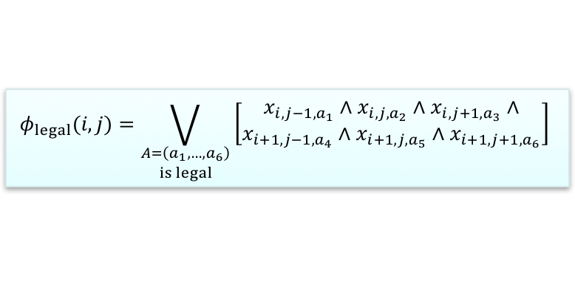
Transitions
  A given 2x3 window is legal if it does not violate our machine’s transition function. We have a polynomial-sized set of all legal windows.
  Let a sequence A = (a₁, …, a₆) be a 2x3 window. A is legal if it represents a legal window.
  Now we can come up with a formula to say that the window top-centered at cell (i, j) is legal.
Don’t be intimidated by this formula!
  It’s just counting off the six cells of the window and demanding that each be equal to the corresponding cell in some legal window.
 | 1 | 2 | 3 | 4 | 5 | 6 | 7 | 8 | 9 | 10
1 | # | q₀ | a | b | c | a | □ | □ | □ | #
2 | # | a | q₁ | b | c | a | □ | □ | □ | #
3 | # |  |  |  |  |  |  |  |  | #
4 | # |  |  |  |  |  |  |  |  | #
5 | # |  |  |  |  |  |  |  |  | #
6 | # |  |  |  |  |  |  |  |  | #
7 | # |  |  |  |  |  |  |  |  | #
8 | # |  |  |  |  |  |  |  |  | #
9 | # |  |  |  |  |  |  |  |  | #
10 | # |  |  |  |  |  |  |  |  | #
$$φ_{legal}(i,j)=\bigvee_{\begin{aligned}A=\left(a_{1},…,a_{6}\right) \\ is legal\end{aligned}}{\left[\begin{aligned}x_{i,j−1,a_{1}}∧x_{i,j,a_{2}}∧x_{i,j+1,a_{3}}∧ \\ x_{i+1,j−1,a_{4}}∧x_{i+1,j,a_{5}}∧x_{i+1,j+1,a_{6}}\end{aligned}\right]}$$

Slide 103
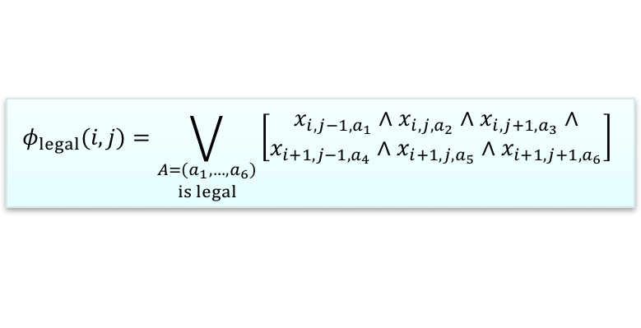
Transitions
A given 2x3 window is legal if it does not violate our machine’s transition function.
We have a polynomial-sized set of all legal windows.
Let a sequence A = (a₁, …, a₆) be a 2x3 window. A is legal if it represents a legal window.
Since we have a polynomial number of legal windows, this formula is also polynomial. So we can say:
φ_{legal} (i, j) is satisfied by, and only by, a tableau whose window top-centered at (i, j) is legal; and is created in polynomial time.
 | 1 | 2 | 3 | 4 | 5 | 6 | 7 | 8 | 9 | 10
1 | # | q₀ | a | b | c | a | □ | □ | □ | #
2 | # | a | q₁ | b | c | a | □ | □ | □ | #
3 | # |  |  |  |  |  |  |  |  | #
4 | # |  |  |  |  |  |  |  |  | #
5 | # |  |  |  |  |  |  |  |  | #
6 | # |  |  |  |  |  |  |  |  | #
7 | # |  |  |  |  |  |  |  |  | #
8 | # |  |  |  |  |  |  |  |  | #
9 | # |  |  |  |  |  |  |  |  | #
10 | # |  |  |  |  |  |  |  |  | #
$$φ_{legal}(i,j)=\bigvee_{\begin{aligned}A=\left(a_{1},…,a_{6}\right) \\ is legal\end{aligned}}{\left[\begin{aligned}x_{i,j−1,a_{1}}∧x_{i,j,a_{2}}∧x_{i,j+1,a_{3}}∧ \\ x_{i+1,j−1,a_{4}}∧x_{i+1,j,a_{5}}∧x_{i+1,j+1,a_{6}}\end{aligned}\right]}$$

Slide 104
Windows and Configurations
Consider any upper and lower configuration in the tableau, so that the lower configuration is the one immediately below – that is, following – the upper.
If all the windows top-centered on cells in the upper configuration are legal, then:
  The legality of the windows that don’t involve the state symbol easily ensures the legality of the configuration below them.
  The window top-centered on the state symbol in the upper configuration is sufficient to ensure that the state symbol in the lower configuration makes a legal move.
The upper configuration yields the lower one if and only if all the windows top-centered on cells in the upper configuration are legal – and that holds all the way down the tableau.
 | 1 | 2 | 3 | 4 | 5 | 6 | 7 | 8 | 9 | 10
1 | # | q₀ | a | b | c | a | □ | □ | □ | #
2 | # | a | q₁ | b | c | a | □ | □ | □ | #
3 | # |  |  |  |  |  |  |  |  | #
4 | # |  |  |  |  |  |  |  |  | #
5 | # |  |  |  |  |  |  |  |  | #
6 | # |  |  |  |  |  |  |  |  | #
7 | # |  |  |  |  |  |  |  |  | #
8 | # |  |  |  |  |  |  |  |  | #
9 | # |  |  |  |  |  |  |  |  | #
10 | # |  |  |  |  |  |  |  |  | #

Slide 105
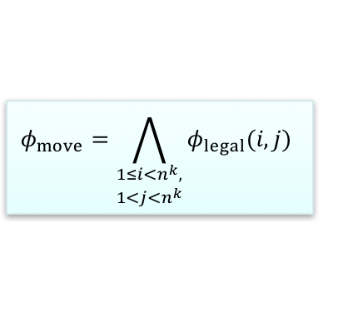

Windows and Configurations
$$φ_{legal}(i,j)=\bigvee_{\begin{aligned}A=\left(a_{1},…,a_{6}\right) \\ is legal\end{aligned}}{\left[\begin{aligned}x_{i,j−1,a_{1}}∧x_{i,j,a_{2}}∧x_{i,j+1,a_{3}}∧ \\ x_{i+1,j−1,a_{4}}∧x_{i+1,j,a_{5}}∧x_{i+1,j+1,a_{6}}\end{aligned}\right]}$$
φ_{legal} (i, j) is satisfied by, and only by, a tableau whose window top-centered at (i, j) is legal; and is created in polynomial time.
An upper configuration yields a lower one iff all the windows top-centered within the upper are legal.
  This holds all the way down the tableau.
Then we have:
And can say φ_{move} is satisfied by, and only by, a tableau that does not violate the machine’s transition function; and is created in polynomial time.
 | 1 | 2 | 3 | 4 | 5 | 6 | 7 | 8 | 9 | 10
1 | # | q₀ | a | b | c | a | □ | □ | □ | #
2 | # | a | q₁ | b | c | a | □ | □ | □ | #
3 | # |  |  |  |  |  |  |  |  | #
4 | # |  |  |  |  |  |  |  |  | #
5 | # |  |  |  |  |  |  |  |  | #
6 | # |  |  |  |  |  |  |  |  | #
7 | # |  |  |  |  |  |  |  |  | #
8 | # |  |  |  |  |  |  |  |  | #
9 | # |  |  |  |  |  |  |  |  | #
10 | # |  |  |  |  |  |  |  |  | #
$$φ_{move}=\bigwedge_{\begin{aligned}1≤i<n^{k}, \\ 1<j<n^{k}\end{aligned}}{φ_{legal}(i,j)}$$

Slide 106
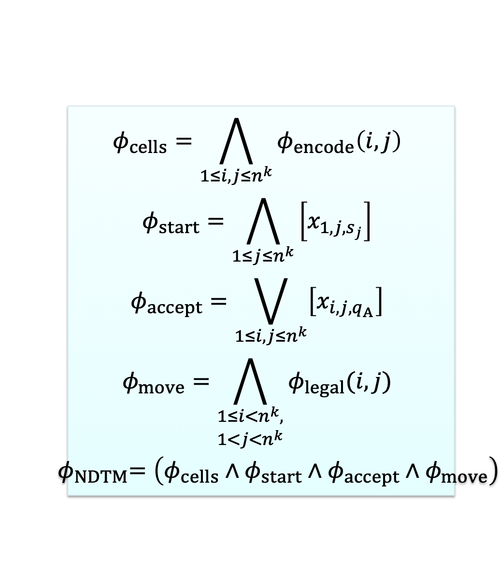
Pulling It Together
$$\begin{matrix}φ_{cells}=\bigwedge_{1≤i,j≤n^{k}}{φ_{encode}\left(i,j\right)} \\ φ_{start}=\bigwedge_{1≤j≤n^{k}}{\left[x_{1,j,s_{j}}\right]} \\ φ_{accept}=\bigvee_{1≤i,j≤n^{k}}{\left[x_{i,j,q_{A}}\right]} \\ φ_{move}=\bigwedge_{\begin{aligned}1≤i<n^{k}, \\ 1<j<n^{k}\end{aligned}}{φ_{legal}(i,j)} \\ { φ}_{NDTM}=\left(φ_{cells}∧φ_{start}∧φ_{accept}∧φ_{move}\right)\end{matrix}$$
We have:
  φ_{cells} is satisfied by, and only by, a properly encoded tableau.
  φ_{start} is satisfied by, and only by, a tableau with the starting configuration of M on w encoded as its first row.
  φ_{accept} is satisfied by, and only by, a tableau encoding an accepting configuration as one of its rows.
  φ_{move} is satisfied by, and only by, a tableau that does not violate the machine’s transition function.
  All are created in polynomial time.
Then φ_{NDTM} is satisfied by, and only by, a tableau encoding an accepting computation history of M on w, and is created in polynomial time.

Slide 107
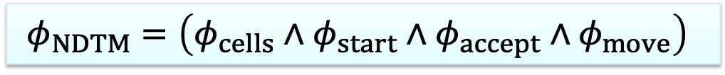
SAT is NP-Complete
$$φ_{NDTM}=\left(φ_{cells}∧φ_{start}∧φ_{accept}∧φ_{move}\right)$$
φ_{NDTM} created from NDTM M and input w is satisfied by, and only by, a tableau encoding an accepting computation history of M on w, and is created in polynomial time.
This means that:
  SAT accepts φ_{NDTM} if and only if such a tableau exists…
  …if and only if the NDTM we are encoding into φ_{NDTM} accepts w.
We’ve just polynomially reduced every possible NP language to SAT.
Let’s convince ourselves of that a bit more.
  By definition, any NP language has an NDTM M that decides it in polynomial time.
We can decide any NP language with a result from SAT using the following algorithm:
On input <M, w>:
  Create φ_{NDTM} from M and w.
  Run the decider for SAT on φ_{NDTM}.
  Accept if SAT accepts, reject if it rejects.
SAT is NP-complete.

Slide 108
Cook’s Theorem
ϕ_{M,w} = φ_{cells} ∧ φ_{start} ∧ φ_{accept} ∧ φ_{move}
See the following for another detailed description and discussion of the four terms that make up this formula.
http://www.cs.tau.ac.il/~safra/Complexity/Cook.ppt

Slide 109
NP–Complete
Within a year, Richard Karp added 22 problems to this special class.
We will focus on:
3-SAT
Integer Linear Programming
SubsetSum
Partition
Vertex Cover
Independent Set
K-Color
Multiprocessor Scheduling

Slide 110
Co-NP
A problem is in co-NP if its complement is in NP
  This is like co-RE, with respect to RE problems.
An example is the problem to determine if a Boolean expression is a tautology.
  If the answer to the problem "is B in TAUT ?" is NO, then B is in the complement of SAT.
A more direct example of a co-NP problem is to determine if a Boolean expression is self-contradictory.
  This is the complement of the notion of satisfiability but not of an instance of satisfiability as the complement of an expression in SAT can also be in SAT.

Slide 111
SAT to 3SAT
3-SAT means that each clause has exactly three terms
If one term, e.g., (p), expand to (p∨p∨p)
If two terms, e.g., (p∨q), expand to (p∨q∨p)
Any clause with three terms is fine
If n > three terms, can reduce to two clauses, one with three terms and one with n-1 terms, e.g., (p1∨p2∨…∨pn) to
(p1∨p2∨z) & (p3∨…∨pn∨~z), where z is a new variable. If n=4, we are done, else apply this approach again with the clause having n-1 terms

Slide 112
3SAT Growth is Linear
Let’s make sure we have not grown the length of the expression going from an instance E of SAT to 3SAT by more than a polynomial amount.
Let N be the number of clauses in E and let n be number of variables in E. Worst case length of E is then nN literals.
If a clause in E has k≥3 literals, we want to define G(k)=number of literals in the 3SAT version, E’.
G(3)=3; G(4)=G(3)+G(3)=6; G(5)=G(4)+G(3)=9; G(6)=G(5)+G(3)=12;…; G(k)=3(k-2), k≥3.
The worst case is bounded above by 3nN literals in E’ which is polynomial (linear) growth.

Slide 113
Linear Programming (LP)
Linear Programming (LP) is like solving a set of linear equations but allows not just equality (=) but also inequality (>, <, ≥, ≤)
In fact, LP usually also includes an optimization function, but we are limiting ourselves to decision problems
Example:
x + y > 7
x - y ≥ 4
Has many solutions, some of which are integral, e.g.,
x=7, y=1

Slide 114
Integer LP (ILP)
Integer Linear Programming (ILP) just constrains the solutions to an LP problem to be integral values
This constraint, on the surface, may seem to make the problem easier but, in fact, makes it harder
This is even true when we view this as a decision problem where we just ask
“Is there a solution to this instance of ILP”
We will see this complexity play out in the next few slides

Slide 115
0-1 ILP
0-1 ILP constrains the solution space to variable values of 0 or 1
Start with an instance of SAT (or 3SAT), assuming
variables v1,…, vn and clauses c1,…, cm
For each variable vi, have the constraint that 0 ≤ vi ≤ 1
For each clause we provide a constraint that it must be satisfied (evaluate to at least 1). For example, if clause cj is
v2 ∨ ~v3 ∨ v5 ∨ v6 then add the constraint
v2 + (1-v3) + v5 + v6 ≥ 1
A solution to this set of integer linear constraints implies a solution to the instance of SAT and vice versa
Note this works for any SAT instance not just 3SAT

Slide 116
0-1 ILP is NP-Complete
Previous page just show 0-1 ILP is NP-Hard
Must show it is in NP
Can do by trying all 2^{k} 0-1 assignments to k variables
Or can show that verifying a solution is in P – it’s really just linear

Slide 117
0-1 ILP Example
Original SAT: E = (a+b+~c+d+e)(~b)(~a+~d)(b+c+~e)
0 ≤ a ≤ 1; 0 ≤ b ≤ 1; 0 ≤ c ≤ 1;
0 ≤ d ≤ 1; 0 ≤ e ≤ 1
a+b+(1-c)+d+e ≥ 1;
alternatively, a+b-c+d+e ≥ 0
1-b ≥ 1;
alternatively, b = 0
(1-a)+(1-d) ≥ 1;
alternatively, a+d ≤ 1
b+c+(1-e) ≥ 1;
alternatively, b+c-e ≥ 0

Slide 118
What about ILP?
As we said, ILP just constrains the solution to integers not to binary values
Clearly ILP is NP-Hard as the constrained version of 0-1 ILP is NP-Hard
Showing ILP is in NP is easy using a verifier; you give me a proposed solution and I can check it in linear time

Slide 119
What about Linear Programming (LP) #1?
Linear programming just requires that solution be real number values
The only constraints are in the simultaneous inequalities (and equalities)
If you limit LP to equalities, then it has a well-known complexity of O(N³) using Gaussian Elimination or one of its variants

Slide 120
What about Linear Programming (LP) #2?
The problem of solving LP appeared to be exponential for a long time and was, and still is, generally attacked using the Simplex Method which involves adding slack variables, e.g.,
x + y < 7 iff x + y + e = 7 for some e > 0 and
x + y ≤ 7 iff x + y + f = 7 for some f ≥ 0
One can show cases where the Simplex Method takes exponential time, but its average case is O(N^{√d}) time where N is the number of variables and d is bounded above by the size of the input in bits

Slide 121
What about Linear Programming (LP) #3?
In 1984, LP was shown to be of polynomial complexity
Complexity is O(N^{3.5} L lg L lglg L) where N is number of variables and L is the size of the input in bits
Simplex is still used much as QuickSort is used for sorting even though its worst case is O(N²) as its expected performance is O(N lg N) and it often converges in O(N)
Note neither Simplex nor QuickSort are heuristics as each gives the correct result. I bring that up as later we will talk about heuristics for NP-Hard problems. There are some nice cases and some strange ones.

Slide 122
SubsetSum
S = {s₁, s₂, …, s_{n}}
    set of positive integers
    and an integer G.
    Question: Does S have a subset whose values sum to the goal G?
Note: This is really a Bag (Multiset) not a Set
No one knows of a polynomial algorithm.
{No one has proven there isn’t one, either!!}

Slide 123
SubsetSum is in NP
You give me a “solution” to [ {s₁, s₂, …, s_{n}}, G ]
Your solution is just a subset of the set of integers {1 .. n}
I make sure that each number you give me is unique and in the correct range (that takes me n units of time). If not, I reject your “solution”
I then add the selected numbers together. That takes the sum of the log based 2 of the numbers you selected. I then check that the sum equals G. If so, I verify; if not, I reject.
Note that the original representation is of length the sum of the log based 2 of the s_{i}’s and G so my growth of time is linear
Thus, I can verify in polynomial time

Slide 124
Example SubsetSum
Instance
[(15, 17, 27, 11, 4, 12, 33, 5, 6, 21, 2), 57]
A solution is 15, 17, 11, 12, 2 (or with indices just 1,2,4,6,11)
Note that an item can only be chosen once
Note that we can try a heuristic like sorting low to high
[(2, 4, 5, 6, 11, 12, 15, 17, 21, 27, 33), 57]
But an attack with that might have us choose
2, 4, 5, 6, 11, 12, 15 and we are stuck
In above, one can backtrack to remove 15 and replace by 17 works, but backtracking is in general exponential
Try high to low [(33, 27, 21, 17, 15, 12, 11, 6, 5, 4, 2), 57]
33, 27 (Fail), 33, 21, 17 (Fail), 33, 21, 15 (Fail), etc.
Clearly all these are potentially exponential approaches

Slide 125
SAT ≤_{P} 3SAT ≤_{P}
SubsetSum ≡_{p} Partition
Theorem. SAT ≤_{P} 0-1ILP ≤_{P} ILP
Theorem. SAT ≤_{P} 3SAT
Theorem. 3SAT ≤_{P} SubsetSum
Theorem. SubsetSum ≤_{P} Partition
Theorem. Partition ≤_{P} SubsetSum (for fun)
Therefore, not only is SAT in NP–Complete, but so are 0-1ILP, ILP, 3SAT, Partition, and SubsetSum.

Slide 126
3SAT ≤_{p} SubsetSum
Assuming a 3SAT expression (a + ~b + c) (~a + b + ~c)
 | a | b | c | a+~b+c | ~a+b+~c
a | 1 | 0 | 0 | 1 | 0
~a | 1 | 0 | 0 | 0 | 1
b | 0 | 1 | 0 | 0 | 1
~b | 0 | 1 | 0 | 1 | 0
c | 0 | 0 | 1 | 1 | 0
~c | 0 | 0 | 1 | 0 | 1
C1 | 0 | 0 | 0 | 1 | 0
C1’ | 0 | 0 | 0 | 1 | 0
C2 | 0 | 0 | 0 | 0 | 1
C2’ | 0 | 0 | 0 | 0 | 1
 | 1 | 1 | 1 | 3 | 3

Slide 127
SubsetSum Matrix
One column per variable and one column per clause
Two rows per variable (true/false so only one can be chosen per variable) and two rows per clause (optional pads to get to 3’s in clause columns, provided we are already at least a 1).
Each row is a number and summing them never results in carry to next column, so each column is independent of other and only influenced by rows we select.
Goal of 1 … 1 3… 3 forces one choice (true or false per variable) and satisfiability for every clause (must have a 1 in at least one variable row of each clause column )

Slide 128
How it works
Satisfying (a + ~b + c) (~a + b + ~c)
Make a, b and c true (satisfies)
Rows a, b and c get us 11121
Padding with C1, C2 and C2’ gets 11133
Make a, ~b and c true (does not satisfy)
Rows a, ~b and c get us 11130
No amount of padding can get the last column to be 3 (2 is max)

Slide 129
Partition
Given a Multiset S = {s₁, s₂, …, s_{n}}, where each s_{i} is a positive integer, can we partition it into two sub-bags P1, P2 such that P1 ∪ P2 = S and P1 ∩ P2 = ∅ ?
Note: If S contains multiple copies of some integer, each is considered distinct and thus does not unduly influence the intersection and union operators above

Slide 130
SubsetSum≡_{p}Partition Details
Partition is polynomial equivalent to SubsetSum
  Let i₁, i₂, .., i_{n} , G be an instance of SubsetSum. This instance has answer “yes” iff
  i₁, i₂, .., i_{n} , 2*Sum(i₁, i₂, .., i_{n} ) – G,Sum(i₁, i₂, .., i_{n} ) + G
  has answer “yes” in Partition. Here we assume that
  G ≤ Sum(i₁, i₂, .., i_{n} ), for, if not, the answer is “no.”
  Let i₁, i₂, .., i_{n} be an instance of Partition. This instance has answer “yes” iff
  i₁, i₂, .., i_{n} , Sum(i₁, i₂, .., i_{n} )/2
  has answer “yes” in SubsetSum

Slide 131
SubsetSum ≡_{p} Partition
[(15, 17, 27, 11, 4, 12, 33, 5, 6, 21, 2), 57]
A solution is 15, 17, 11, 12, 2
Sum of all is 153
Mapping to Partition is
  (15, 17, 27, 11, 4, 12, 33, 5, 6, 21, 2, 306-57, 153+57)
  (15, 17, 27, 11, 4, 12, 33, 5, 6, 21, 2, 249, 210)
  (15+17+11+12+2+249) = 306
  (27+4+33+5+6+21+210) = 306
Going other direction map above to
  [(15, 17, 27, 11, 4, 12, 33, 5, 6, 21, 2, 249, 210), 306]

Slide 132
VERTEX COVERING (VC) Decision Problem is NP-Hard

Slide 133
3SAT to Vertex Cover
Vertex cover seeks a set of vertices that cover every edge in some graph
Let I_{3-SAT} be an arbitrary instance of 3-SAT. For integers n and m,
U = {u₁, u₂, …, u_{n}} and C_{i} = {z_{i1}, z_{i2}, z_{i3}} for 1 ≤ i ≤ m,
where each z_{ij} is either a u_{k} or u_{k}' for some k.
Construct an instance of VC as follows.
For each i, 1 ≤ i ≤ n, construct two vertices, u_{i} and u_{i}' with an edge between them.
For each clause C_{i} = {z_{i1}, z_{i2}, z_{i3}}, 1 ≤ i ≤ m, construct three vertices z_{i1}, z_{i2}, and z_{i3} and form a "triangle on them. Each z_{ij} is one of the Boolean variables u_{k} or its complement u_{k}'. Draw an edge between z_{ij} and the Boolean variable (whichever it is). Each z_{ij} has degree 3. Finally, set k = n+2m.
Theorem. The given instance of 3-SAT is satisfiable if and only if the constructed instance of VC has a vertex cover with at most k vertices.

Slide 134
VC Variable Gadget
X
~X
To cover the edge in between x and ~x, at least one of these must be chosen

Slide 135
VC Clause Gadget
b
a
~c
a + b + ~c
To cover the edges here, at least two of three vertices must be chosen

Slide 136
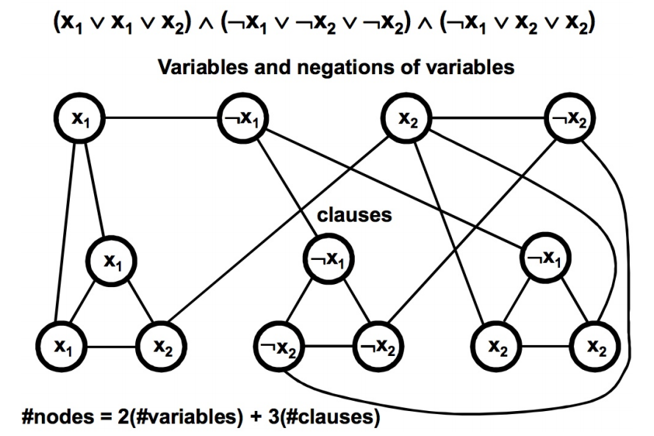
VC Gadgets Combined
Goal is to cover all variables (really edges) with v + 2c nodes (minimum needed); v=#variables; c = #clauses; for above that is 2 + 2*3 = 8: Light blue are choices

Slide 137
Why VC Gadgets Work
For each variable gadget, we must either choose the variable or its complement to cover the edge connecting them; Choosing both is wasteful
For each clause gadget, we must cover its internal edges. This requires 2 per clause, but also need to cover all edges entering from variable gadgets, if not already covered by the selection of the corresponding variable gadget
If we can cover all edges, with just v+2c nodes then we have attained the minimum possible and guaranteed that each clause has at least one of its literals true. This allows the corresponding variable selection (true/false) to cover the incoming edge allowing the three internal edges to be covered by the other two variable nodes in the clause. If more than one literal is covered, you have a choice of which covered internal node to not choose for the clause gadget

Slide 138
Explaining Example
Solution choses ~x1, x2; By choosing those variable gadget nodes we cover both variable gadgets. We know we must cover all clause gadgets and the edges entering them from the variable gadgets. For the first clause, we do not need to cover the edge entering from variable gadget x2, but we must cover the other two external edges and the three internal edges. Choosing the two x1 nodes in clause 1 covers all external and internal edges. Had we chosen ~x1 in the x1 variable gadget and ~x2 in the x2 variable gadget we would have had to chose x2 in the first clause gadget thereby exceeding our quota of v + 2c. I leave it to you to see why the others work and to understand why we had no actual constraints in the third clause gadget (any two would have worked).

Slide 139
VC Just the Gadgets
(a,~b,~c)(~a,b,~c)(~a,~b,c)
a
~a
b
~b
c
~c
~b
b
~b
a
~c
~a
~c
~a
c
Requires |V| + 2*|C|
Trivial to reach goal if no other edges

Slide 140
VC + Variable/Clause Edges
(a,~b,~c)(~a,b,~c)(~a,~b,c)
a
~a
b
~b
c
~c
~b
b
~b
a
~c
~a
~c
~a
c
GOAL = 3 + 3*2 = 9
The choice of variable assignments influences which nodes in clauses must be chosen to cover external edges

Slide 141
VC with Forced Solution
(a,~b,~c)(~a,b,~c)(~a,~b,c)
a
~a
b
~b
c
~c
~b
b
~b
a
~c
~a
~c
~a
c
GOAL = 3 + 3*2 = 9
Assignment is a, b, c

Slide 142
VC Partially Forced Soln
(a,~b,~c)(~a,b,~c)(~a,~b,c)
a
~a
b
~b
c
~c
~b
b
~b
a
~c
~a
~c
~a
c
GOAL = 3 + 3*2 = 9
Assignment is ~a, ~b, ~c

Slide 143
VC Ex#2 Bad Assign
(a,~b,~c)(~a,b,~c)(~a,~b,c)
a
~a
b
~b
c
~c
~b
b
~b
a
~c
~a
~c
~a
c
GOAL = 3 + 3*2 = 9
Assignment is ~a, b, c
FAIL!!!

Slide 144
Independent Set
Independent Set
  Given Graph G = (V, E), a subset S of the vertices is independent if there are no edges between vertices in S
  The k-IS problem is to determine for a k>0 and a graph G, whether G has an independent set of k nodes
Note there is a related NP-Hard optimization problem to find a Maximum Independent Set. It is even hard to approximate a solution to the Maximum Independent Set Problem.

Slide 145
IS (VC) Clause Gadget
b
a
~c
a + b + ~c

Slide 146
3SAT to IS
(a + ~b + c) (~a + b + ~c)(a + b + c), k=3 (k=number of clauses, not variables)
b
~b
b
~a
~c
a
c
a
c

Slide 147
Explaining the example
b
~b
b
~a
~c
a
c
a
c
In each clause gadget we can only chose one node, else we would be choosing two nodes with a shared edge. Assume we select a in clause 1, we cannot choose ~a in any other clause as they have a shared edge. After choosing a in clause 1, we could choose either b or ~c in clause 2. Assume we select ~c in clause 2, we cannot choose c in any other clause as they have a shared edge. To reach three (the number of clauses, we need a choice left for clause 3. Fortunately, we have two choices, either a or b (I chose b in this case).

Slide 148
K-Color (KC) Decision Problem is NP-Hard

Slide 149
K-Coloring
Given:
A graph G = (V, E) and an integer k.
Question:
Can the vertices of G be assigned colors from a palette of size k, so that adjacent vertices have different colors and use at most k colors?
3Coloring (3C) uses k=3

Slide 150
3C Super Gadget
T
F
B

Slide 151
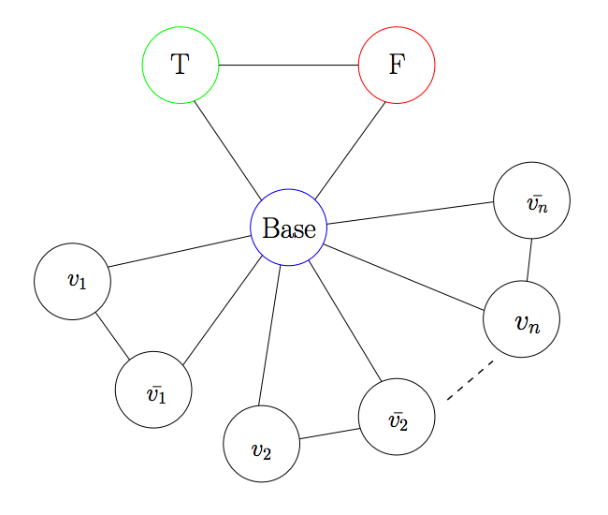
3C Super + Variables Gadget

Slide 152
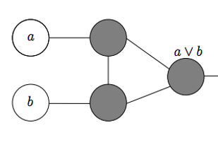
A Simple OR Gadget
?

Slide 153
What if a, b?
?

Slide 154
What if a, b, T?
F
T
B

Slide 155
What if a, b, F?
?
F
B

Slide 156
What if a, b, B?
?
B
F

Slide 157
What if ~a, ~b?
?

Slide 158
What if ~a, ~b, F?
T
F
B

Slide 159
What if ~a, ~b, T?
?
T
B

Slide 160
What if ~a, ~b, B?
?
B
T

Slide 161
What if a, ~b?
?

Slide 162
What if a, ~b, T?
F
T
B

Slide 163
What if a, ~b, B?
F
B
T

Slide 164
What if a, ~b, F?
B
F
T

Slide 165
What if ~a, b? same as a, ~b
B/T/F

Slide 166
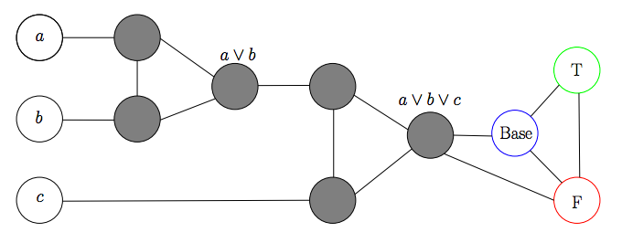
3C Clause Gadget

Slide 167
Consider a, b, c
T
F/B
B
T
T
B/F
T
F
T

Slide 168
Consider a, b, ~c
F
T
F
B
T

Slide 169
Consider ~a, b, c or a, ~b, c
F
B
T
T/B/F
T
F
T

Slide 170
Consider ~a, b, ~c or a, ~b, ~c
F
F
T
T/B/F
F
B
T

Slide 171
Consider ~a, ~b, c
F
B
F
F
T
F
T

Slide 172
Consider ~a, ~b, ~c
F
F
X
F
F
F
B
T

Slide 173
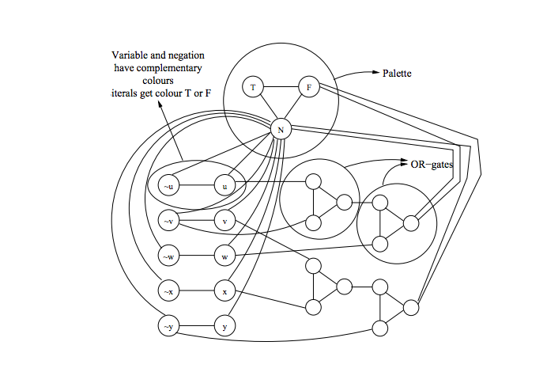
KC Gadgets Combined
(u + ~v + w) (v + x + ~y)
B
K = 3

Slide 174
Register Allocation
Liveness: A variable is live if its current assignment may be used at some future point in a program’s flow
Optimizers often try to keep live variables in registers
If two variables are simultaneously live, they need to be kept in separate registers
Consider the K-coloring problem (can the nodes of a graph be colored with at most K colors under the constraint that adjacent nodes must have different colors?)
Register Allocation reduces to K-coloring by mapping each variable to a node and inserting an edge between variables that are simultaneously live
K-coloring reduces to Register Allocation by interpreting nodes as variables and edges as indicating concurrent liveness
This is a simple mapping because it’s an isomorphism

Slide 175
Live Variable Analysis
Code
No Optimization
T1 = 1
T2 = 2
T3 = T1 * T2
T4 = T1 + 3
T5 = T3 * T4
T6 = T5 / T3
OUT T5
OUT T6
a = 1;
b = 2;
c = a * b;
d = a + 3;
e = c * 2;
f = e / c;
Print e, f;
T1
T2
Minimum colors are 3 so need 3 registers to avoid spilling to memory and reloading
T3
T6
T4
T5

Slide 176
Processor Scheduling is NP-Hard

Slide 177
Processor Scheduling
A Process Scheduling Problem can be described by
  m processors P₁, P₂, …, P_{m},
  processor timing functions S₁, S₂, …, S_{m}, each describing how the corresponding processor responds to an execution profile,
  additional resources R₁, R₂, …, R_{k}, e.g., memory
  transmission cost matrix C_{ij} (1 ≤ i , j ≤ m), based on proc. data sharing,
  tasks to be executed T₁, T₂, …, T_{n},
  task execution profiles A₁, A₂, …, A_{n},
  a partial order defined on the tasks such that T_{i} < T_{j} means that T_{i} must complete before T_{j} can start execution,
  communication matrix D_{ij} (1 ≤ i , j ≤ n); D_{ij} can be non-zero only if T_{i} < T_{j},
  weights W₁, W₂, …, W_{n} -- cost of deferring execution of task.

Slide 178
Complexity Overview
The intent of a scheduling algorithm is to minimize the sum of the weighted completion times of all tasks, while obeying the constraints of the task system. Weights can be made large to impose deadlines.
The general scheduling problem is quite complex, but even simpler instances, where the processors are uniform, there are no additional resources, there is no data transmission, the execution profile is just processor time and the weights are uniform, are very hard.
In fact, if we just specify the time to complete each task and we have no partial ordering, then finding an optimal schedule on two processors is an NP-complete problem. It is essentially the optimization version of the Partition or equally can be viewed as a SubsetSum problem.

Slide 179
2 Processor Scheduling
The problem of optimally scheduling n tasks T₁, T₂, …, T_{n} onto 2 processors with an empty partial order < is the same as that of dividing a set of positive whole numbers into two subsets, such that the numbers are as close to evenly divided. So, for example, given the numbers
3, 2, 4, 1
we could try a “greedy” approach as follows:
put 3 in set 1
put 2 in set 2
put 4 in set 2 (total is now 6)
put 1 in set 1 (total is now 4)
This is not the best solution. A better option is to put 3 and 2 in one set and 4 and 1 in the other. Such a solution would have been attained if we did a greedy solution on a sorted version of the original numbers. In general, however, sorting doesn’t work.

Slide 180
2 Processor Nastiness
Try the unsorted list (result is no worse than opt * (2-1/m))
7, 7, 6, 6, 5, 4, 4, 5, 4
Greedy (Always in one that is least used)
7, 6, 5, 5 = 23
7, 6, 4, 4, 4 = 25
Optimal
7, 6, 6, 5 = 24
7, 4, 4, 4, 5 = 24
Sort it (non-increasing) (opt * (4/3-1/3m)) Sort it (non-decreasing) (opt*(2-1/m))
7, 7, 6, 6, 5, 5, 4, 4, 4 4, 4, 4, 5, 5, 6, 6, 7, 7
7, 6, 5, 4, 4 = 26 4, 4, 5, 6, 7 = 26
7, 6, 5, 4 = 22 4, 5, 6, 7 = 22
Both sorts are even worse than greedy unsorted !! (not a general result)

Slide 181
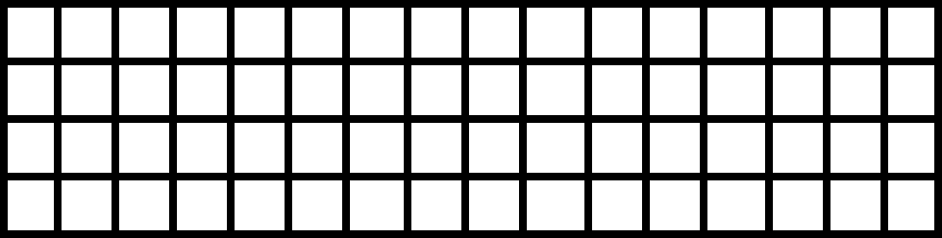
Challenge Problem
Consider the simple scheduling problem where we have a set of independent tasks running on a fixed number of processors, and we wish to minimize finishing time.
How would a list (first fit, no preemption) strategy schedule tasks with the following IDs and execution times onto four processors? Answer using Gantt chart.
(T1,4) (T2,1) (T3,3) (T4,6) (T5,2) (T6,1) (T7,4) (T8,5) (T9,7) (T10,3) (T11,4) (2-1/m)
Now show what would happen if the times were sorted non-decreasing. (2-1/m)
Now show what would happen if the times were sorted non-increasing. (4/3-1/3m)

Slide 182
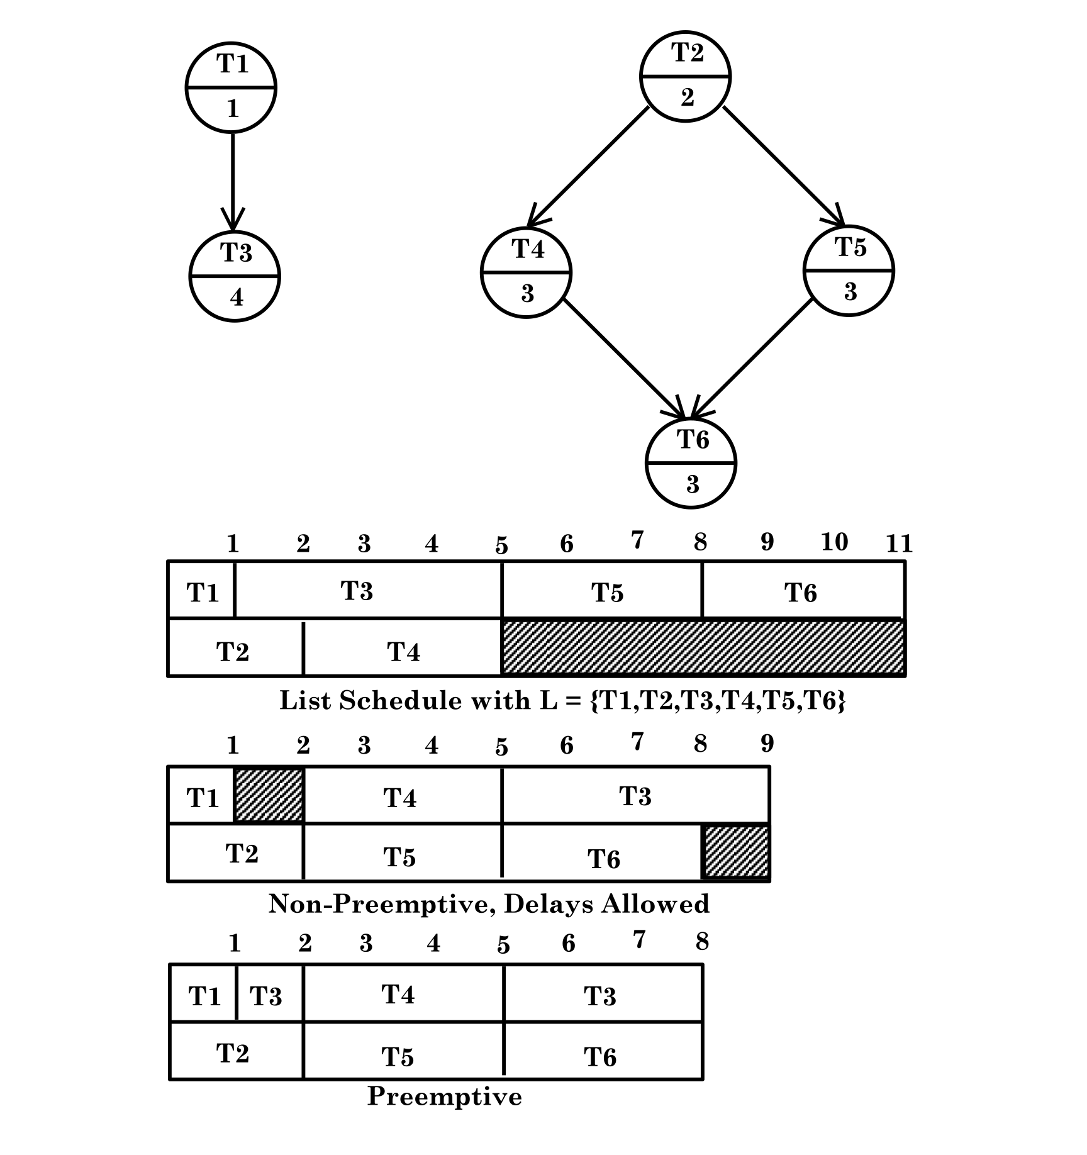
2 Processor with partial order

Slide 183
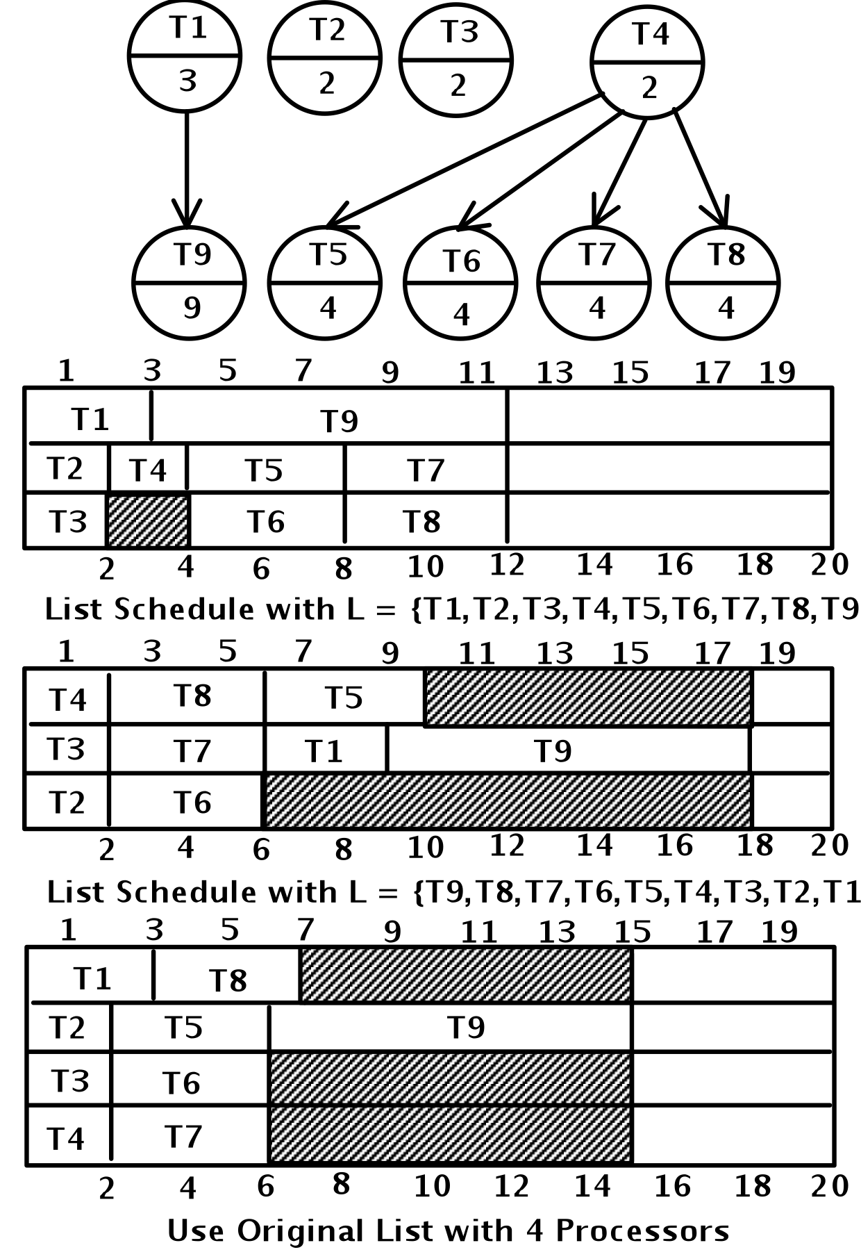
Anomalies everywhere

Slide 184
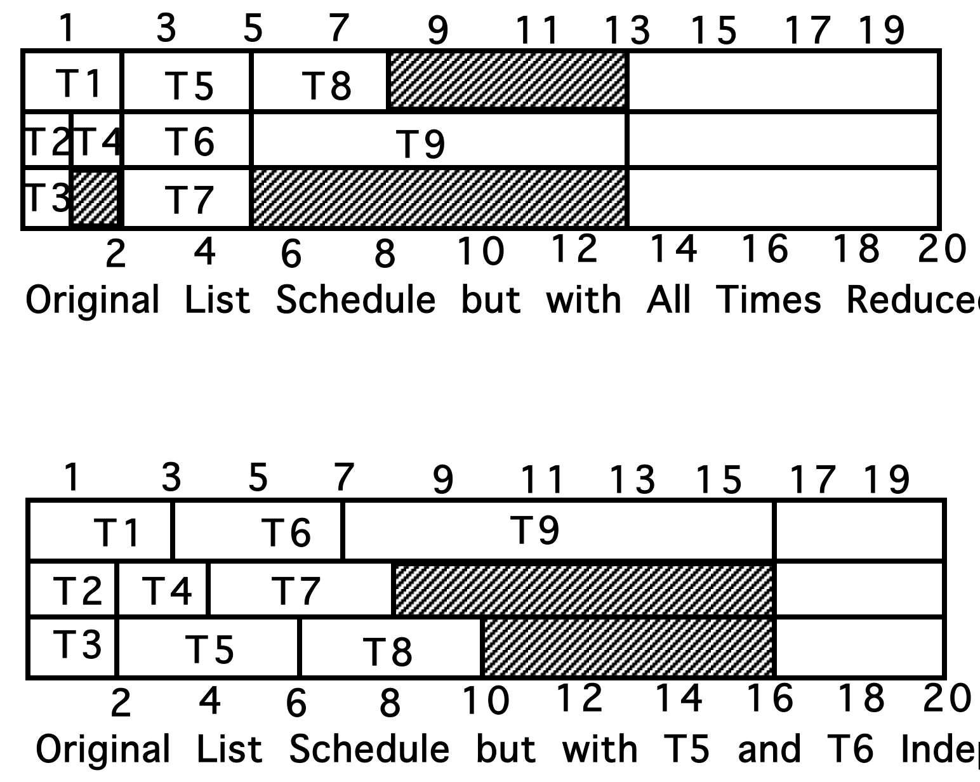
More anomalies

Slide 185
Critical path or level strategy
A UET is a Unit Execution Tree. Our Tree is funny. It has a single leaf by standard graph definitions.
1. Assign L(T) = 1, for the leaf task T
2. Let labels 1, …, k-1 be assigned. If T is a task with lowest numbered immediate successor then define L(T) = k (non-deterministic)
This is an order n labeling algorithm that can easily be implemented using a breadth first search.
Note: This can be used for a forest as well as a tree. Just add a new leaf. Connect all the old leafs to be immediate parents of the new one. Use the above to get priorities, starting at 0, rather than 1. Then delete the new node completely.
Note: This whole thing can also be used for anti-trees. Make a schedule, read it backwards. You cannot just reverse priorities.

Slide 186
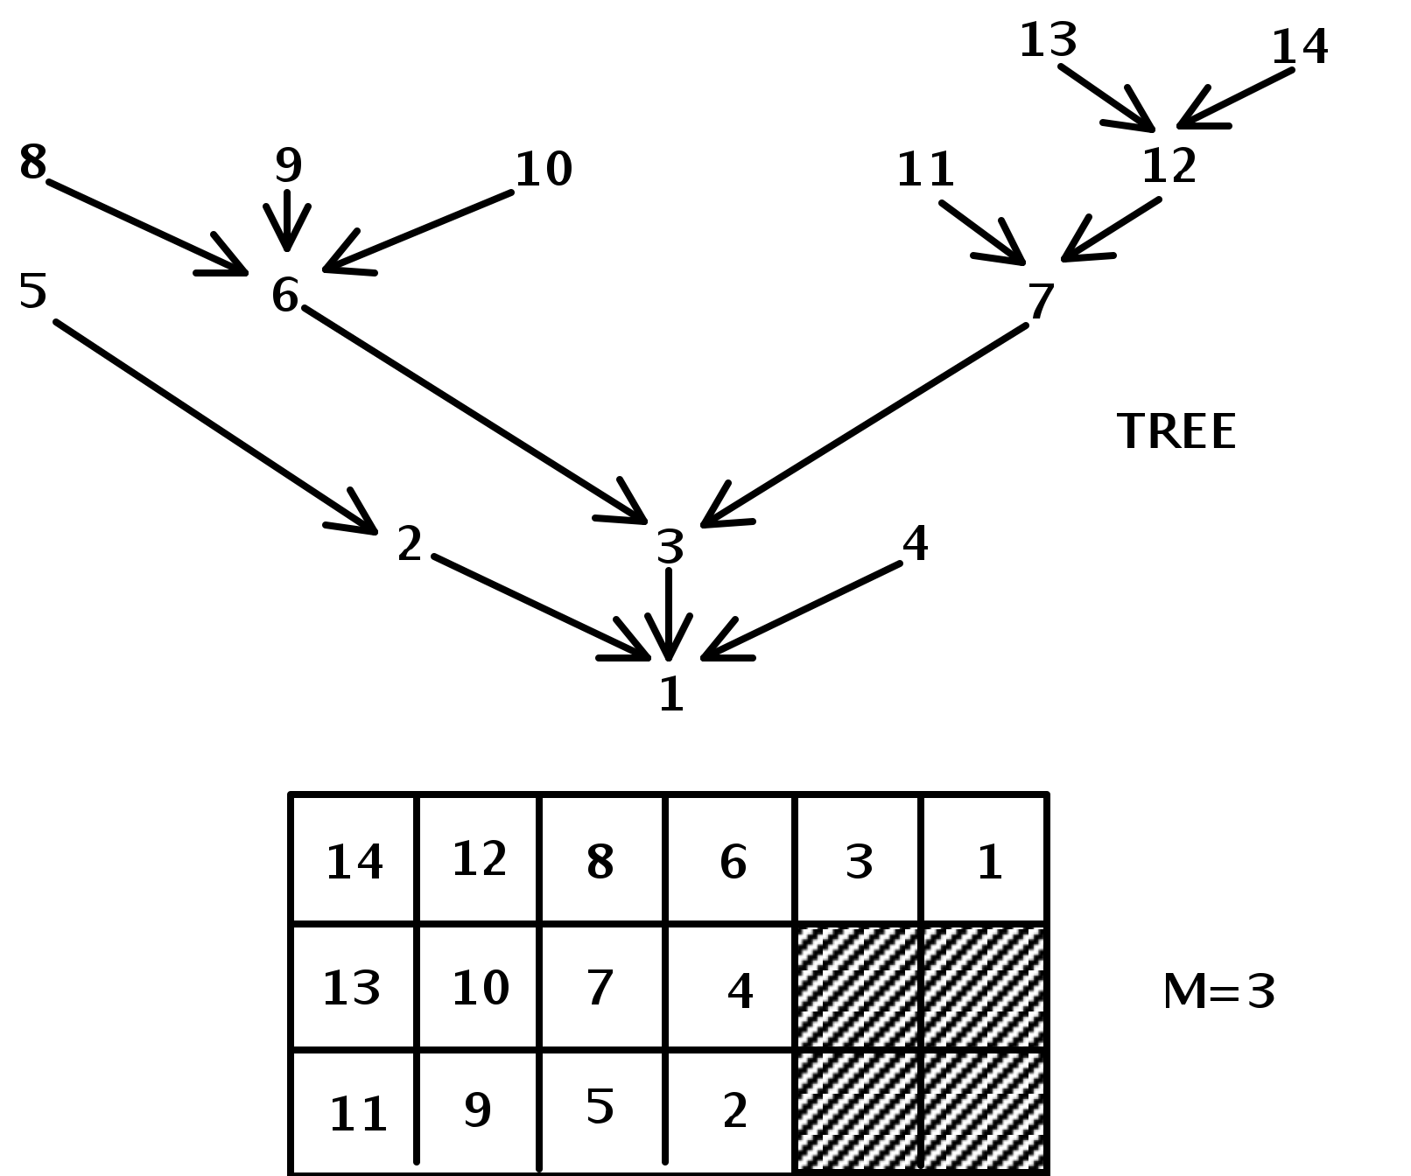
Level strategy and UET
Theorem: Level Strategy is optimal for unit execution, m arbitrary, forest precedence

Slide 187
Level – DAG with unit time
1. Assign L(T) = 1, for an arbitrary leaf task T
2. Let labels 1, …, K-1 be assigned. For each task T such that
{ L(T’) is defined for all T’ in Successor(T) = S(T) }
Let N(T) be decreasing sequence of set members in
{L(T’) | T’ is in S(T)}
Choose T* with least N(T*).
Define L(T*) = K.
This is an order n² labeling algorithm. Scheduling with it involves n union / find style operations. Such operations have been shown to be implementable in nearly constant time using an “amortization” algorithm.
Theorem: Level Strategy is optimal for unit execution, m=2, dag precedence.

Slide 188
Thought Experiment
Looking back at the UET example, consider adding two additional tasks numbered 15 and 16 that are siblings of 13 and 14. These four tasks must be completed before 12 is started.
a) Show the Gantt chart that reflects the new schedule associated with this enhanced tree
b) Show the Gantt chart that is associated with the corresponding anti-tree, in which all arcs are turned in the opposite direction. Use the technique of reversing the schedule from (a)
c) Show the Gantt chart associated with the anti-tree of b), where we now use the priorities obtained by treating lower numbered tasks as higher priority ones
d) Comment on the results seen in (b) versus (c), providing insight as to why they are different and why one is better than the other.

Slide 189
UNIVERSE OF SETS
NP-Complete
NP
P
Co-NP

Slide 190
Hamiltonian Circuit (HC) Decision Problem is NP-Hard

Slide 191
Hamiltonian Path/Circuit
A Hamiltonian Path is a path through a graph from one node ‘start’ to another node ‘end’ that visits every node in the graph just once.
A Hamiltonian Circuit is a Hamiltonian Path whose end node is adjacent to its start node. It can also be viewed that the start and end nodes are the same and that the only repeated node is the start node with its only repetition being at the end of the path.

Slide 192
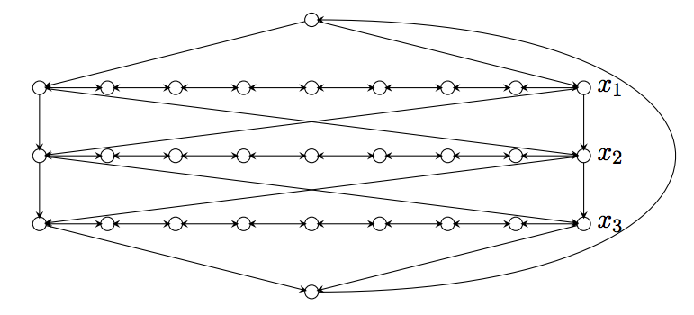
HC Variable Gadget
This has many Hamiltonian Circuits

Slide 193
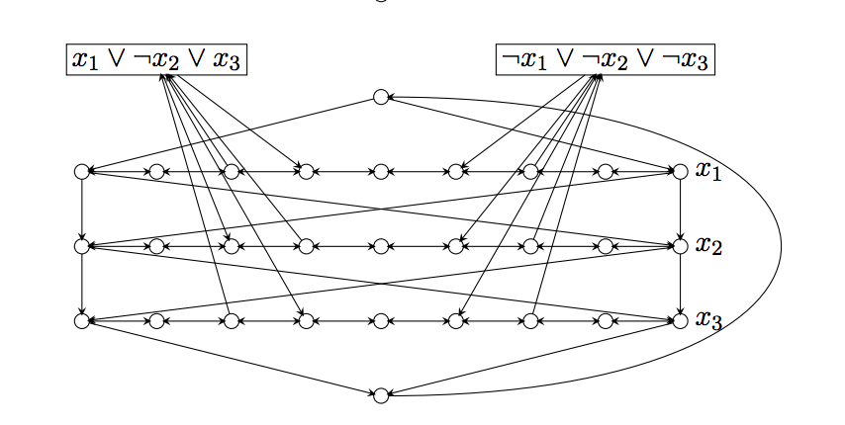
HC Gadgets Combined
We will set convention on x_{i} true to be left to right and x_{i} false to be right to left (can fix for opposite)
This has a Hamiltonian Circuit iff all clauses are satisfied with consistent assignments to each variable. Note left to right assigns X_{i} as true; right to left assigns ¬X_{i} as true. There are filler nodes on left and right and between clauses.

Slide 194
Hamiltonian Path
Note we can split an arbitrary node, v, into two (v’,v’’) – one, v’, has in-edges of v, other, v’’, has out-edges. Path (not cycle) must start at v’’ and end at v’ and goal is still K (the number of vertices).

Slide 195
Travelling Salesman
Travelling Salesman Problem:
Given a list of cities and the distances between each pair of cities, what is the shortest possible route that visits each city and returns to the origin city?
This is a Hamiltonian Cycle with weights on edges and we seek minimum weight for cycle.
The decision problem version involves setting a goal weight, L, and asking if we can achieve it.

Slide 196
Travelling Salesman and HC
Start with HC = (V,E), K=|V|
Set edges from HC instance to 1
Add edges between pairs that lack such edges and make those weights 2 (often people make these K+1); this means that the reverse of unidirectional links also get weight 2
Goal weight is K for cycle

Slide 197
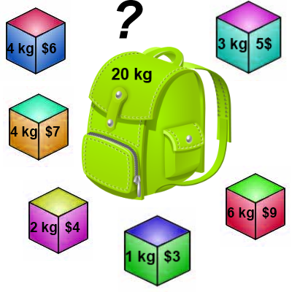
Knapsack 0-1 Problem
The goal is to maximize the value of a knapsack that can hold at most W units (i.e. lbs or kg) worth of goods from a list of items I₀, I₁, … I_{n-1}.
  Each item has 2 attributes:
    Value – let this be v_{i} for item I_{i}
    Weight – let this be w_{i} for item I_{i}
Thanks to Arup Guha

Slide 198
Knapsack 0-1 Problem
The difference between this problem and the fractional knapsack one is that you CANNOT take a fraction of an item.
  You can either take it or leave it.
  Hence the name Knapsack 0-1 problem.

Slide 199
Knapsack Optimize vs Decide
The optimization problem is to have the sum of the chosen values, v_{i}, to be as large as possible with the constraint that the sum of the corresponding weights, w_{i}, cannot exceed W.
We can restate as decision problem to determine if there exists a set of items, each with equal weights and values < W, that reaches some fixed goal value, W.

Slide 200
Knapsack and SubsetSum
Let v_{i} = w_{i} for each item I_{i}.
By doing so, the value is maximized when the Knapsack is filled as close to capacity.
The related decision problem is to determine if we can attain capacity (W).
Clearly then, given an instance of the SubsetSum problem, we can create an instance of the Knapsack decision problem problem, such that we reach the goal sum, G, iff we can attain a Knapsack value of G.

Slide 201
Knapsack Decision Problem
The reduction from SubsetSum shows that the Knapsack decision problem is at least as hard as SubsetSum, so it is NP-Complete if it is in NP.
Think about whether or not it is in NP.
Now, think about the optimization problem.

Slide 202
Related Bin Packing
Have a bin capacity of B.
Have item set S = {s₁, s₂, …, s_{n}}
Use all items in S, minimizing the number of bins, while adhering to the constraint that any such subset must sum to B or less.
This is similar to the processor scheduling problem without constraints, except we optimize on number of processors, not finishing time for all tasks. It is NP-Hard (WHY?)

Slide 203
Knapsack 0-1 Problem
Brute Force
  The naïve way to solve the 0-1 Knapsack problem is to cycle through all 2^{n} subsets of the n items and pick the subset with a legal weight that maximizes the value of the knapsack.
  We can come up with a dynamic programming algorithm that is USUALLY faster than this brute force technique.

Slide 204
Knapsack 0-1 Problem
We are going to solve the problem in terms of sub-problems and memoization (dynamic programming).
Our first attempt might be to characterize a sub-problem as follows:
  Let S_{k} be the optimal subset of elements from
  {I₀, I₁, …, I_{k}}.
    What we find is that the optimal subset from the elements {I₀, I₁, …, I_{k+1}} may not correspond to the optimal subset of elements from {I₀, I₁, …, I_{k}} in any regular pattern.
  Basically, the solution to the optimization problem for S_{k+1} might NOT contain the optimal solution from problem S_{k}.

Slide 205
Knapsack 0-1 Problem
Let’s illustrate that point with an example:
Item Weight Value
I₀ 3 10
I₁ 8 4
I₂ 9 9
I₃ 8 11
The maximum weight the knapsack can hold is 20.
The best set of items from {I₀, I₁, I₂} is {I₀, I₁, I₂}
BUT the best set of items from {I₀, I₁, I₂, I₃} is {I₀, I₂, I₃}.
  In this example, note that this optimal solution, {I₀, I₂, I₃}, does NOT build upon the previous optimal solution, {I₀, I₁, I₂}.
    (Instead it builds upon the solution, {I₀, I₂}, which is really the optimal subset of {I₀, I₁, I₂} with weight 12 or less.)

Slide 206
Knapsack 0-1 problem
So now we must re-work the way we build upon previous sub-problems…
  Let B[k, w] represent the maximum total value of a subset S_{k} with weight w.
  Our goal is to find B[n, W], where n is the total number of items and W is the maximal weight the knapsack can carry.
So our recursive formula for subproblems:
B[k, w] = B[k - 1,w], if w_{k} > w
= max { B[k - 1,w], B[k - 1,w - w_{k}] + v_{k}}, otherwise
In English, this means that the best subset of S_{k} that has total weight w is:
  The best subset of S_{k-1} that has total weight w, or
  The best subset of S_{k-1} that has total weight w-w_{k} plus the item k

Slide 207
Knapsack 0-1 Problem –
Recursive Formula
B[k, w] = B[k - 1,w], if w_{k} > w
= max { B[k - 1,w], B[k - 1,w - w_{k}] + v_{k}}, otherwise
The best subset of S_{k} that has the total weight w, either contains item k or not.
First case: w_{k} > w
  Item k can’t be part of the solution! If it was the total weight would be > w, which is unacceptable.
Second case: w_{k} ≤ w
  Then the item k can be in the solution, and we choose the case with greater value.

Slide 208
Knapsack 0-1 Algorithm
for w = 0 to W // Initialize 1st row to 0’s
B[0,w] = 0
for i = 1 to n // Initialize 1st column to 0’s
B[i,0] = 0
for i = 1 to n
for w = 1 to W
if w_{i} <= w //item i can be in the solution
if v_{i} + B[i-1,w-w_{i}] > B[i-1,w]
B[i,w] = v_{i} + B[i-1,w- w_{i}]
else
B[i,w] = B[i-1,w]
else B[i,w] = B[i-1,w] // w_{i} > w

Slide 209
Knapsack 0-1 Problem
Let’s run our algorithm on the following data:
  n = 4 (# of elements)
  W = 5 (max weight)
  Elements (weight, value):
  (2,3), (3,4), (4,5), (5,6)

Slide 210
Knapsack 0-1 Example
i / w | 0 | 1 | 2 | 3 | 4 | 5
0 | 0 | 0 | 0 | 0 | 0 | 0
1 | 0
2 | 0
3 | 0
4 | 0
// Initialize the base cases
for w = 0 to W
B[0,w] = 0
for i = 1 to n
B[i,0] = 0

Slide 211
Knapsack 0-1 Example
Items:
1: (2,3)
2: (3,4)
3: (4,5)
4: (5,6)
i / w | 0 | 1 | 2 | 3 | 4 | 5
0 | 0 | 0 | 0 | 0 | 0 | 0
1 | 0
2 | 0
3 | 0
4 | 0
i / w | 0 | 1 | 2 | 3 | 4 | 5
0 | 0 | 0 | 0 | 0 | 0 | 0
1 | 0 | 0
2 | 0
3 | 0
4 | 0
i = 1
v_{i} = 3
w_{i} = 2
w = 1
w-w_{i} = -1
if w_{i} <= w //item i can be in the solution
if v_{i} + B[i-1,w-w_{i}] > B[i-1,w]
B[i,w] = v_{i} + B[i-1,w- w_{i}]
else
B[i,w] = B[i-1,w]
else B[i,w] = B[i-1,w] // w_{i} > w

Slide 212
Knapsack 0-1 Example
Items:
1: (2,3)
2: (3,4)
3: (4,5)
4: (5,6)
i / w | 0 | 1 | 2 | 3 | 4 | 5
0 | 0 | 0 | 0 | 0 | 0 | 0
1 | 0 | 0
2 | 0
3 | 0
4 | 0
i / w | 0 | 1 | 2 | 3 | 4 | 5
0 | 0 | 0 | 0 | 0 | 0 | 0
1 | 0 | 0 | 3
2 | 0
3 | 0
4 | 0
i = 1
v_{i} = 3
w_{i} = 2
w = 2
w-w_{i} = 0
if w_{i} <= w //item i can be in the solution
if v_{i} + B[i-1,w-w_{i}] > B[i-1,w]
B[i,w] = v_{i} + B[i-1,w- w_{i}]
else
B[i,w] = B[i-1,w]
else B[i,w] = B[i-1,w] // w_{i} > w

Slide 213
Knapsack 0-1 Example
Items:
1: (2,3)
2: (3,4)
3: (4,5)
4: (5,6)
i / w | 0 | 1 | 2 | 3 | 4 | 5
0 | 0 | 0 | 0 | 0 | 0 | 0
1 | 0 | 0 | 3
2 | 0
3 | 0
4 | 0
i / w | 0 | 1 | 2 | 3 | 4 | 5
0 | 0 | 0 | 0 | 0 | 0 | 0
1 | 0 | 0 | 3 | 3
2 | 0
3 | 0
4 | 0
i = 1
v_{i} = 3
w_{i} = 2
w = 3
w-w_{i} = 1
if w_{i} <= w //item i can be in the solution
if v_{i} + B[i-1,w-w_{i}] > B[i-1,w]
B[i,w] = v_{i} + B[i-1,w- w_{i}]
else
B[i,w] = B[i-1,w]
else B[i,w] = B[i-1,w] // w_{i} > w

Slide 214
Knapsack 0-1 Example
Items:
1: (2,3)
2: (3,4)
3: (4,5)
4: (5,6)
i / w | 0 | 1 | 2 | 3 | 4 | 5
0 | 0 | 0 | 0 | 0 | 0 | 0
1 | 0 | 0 | 3 | 3
2 | 0
3 | 0
4 | 0
i / w | 0 | 1 | 2 | 3 | 4 | 5
0 | 0 | 0 | 0 | 0 | 0 | 0
1 | 0 | 0 | 3 | 3 | 3
2 | 0
3 | 0
4 | 0
i = 1
v_{i} = 3
w_{i} = 2
w = 4
w-w_{i} = 2
if w_{i} <= w //item i can be in the solution
if v_{i} + B[i-1,w-w_{i}] > B[i-1,w]
B[i,w] = v_{i} + B[i-1,w- w_{i}]
else
B[i,w] = B[i-1,w]
else B[i,w] = B[i-1,w] // w_{i} > w

Slide 215
Knapsack 0-1 Example
Items:
1: (2,3)
2: (3,4)
3: (4,5)
4: (5,6)
i / w | 0 | 1 | 2 | 3 | 4 | 5
0 | 0 | 0 | 0 | 0 | 0 | 0
1 | 0 | 0 | 3 | 3 | 3
2 | 0
3 | 0
4 | 0
i / w | 0 | 1 | 2 | 3 | 4 | 5
0 | 0 | 0 | 0 | 0 | 0 | 0
1 | 0 | 0 | 3 | 3 | 3 | 3
2 | 0
3 | 0
4 | 0
i = 1
v_{i} = 3
w_{i} = 2
w = 5
w-w_{i} = 3
if w_{i} <= w //item i can be in the solution
if v_{i} + B[i-1,w-w_{i}] > B[i-1,w]
B[i,w] = v_{i} + B[i-1,w- w_{i}]
else
B[i,w] = B[i-1,w]
else B[i,w] = B[i-1,w] // w_{i} > w

Slide 216
Knapsack 0-1 Example
Items:
1: (2,3)
2: (3,4)
3: (4,5)
4: (5,6)
i / w | 0 | 1 | 2 | 3 | 4 | 5
0 | 0 | 0 | 0 | 0 | 0 | 0
1 | 0 | 0 | 3 | 3 | 3 | 3
2 | 0
3 | 0
4 | 0
i / w | 0 | 1 | 2 | 3 | 4 | 5
0 | 0 | 0 | 0 | 0 | 0 | 0
1 | 0 | 0 | 3 | 3 | 3 | 3
2 | 0 | 0
3 | 0
4 | 0
i = 2
v_{i} = 4
w_{i} = 3
w = 1
w-w_{i} = -2
if w_{i} <= w //item i can be in the solution
if v_{i} + B[i-1,w-w_{i}] > B[i-1,w]
B[i,w] = v_{i} + B[i-1,w- w_{i}]
else
B[i,w] = B[i-1,w]
else B[i,w] = B[i-1,w] // w_{i} > w

Slide 217
Knapsack 0-1 Example
Items:
1: (2,3)
2: (3,4)
3: (4,5)
4: (5,6)
i / w | 0 | 1 | 2 | 3 | 4 | 5
0 | 0 | 0 | 0 | 0 | 0 | 0
1 | 0 | 0 | 3 | 3 | 3 | 3
2 | 0 | 0
3 | 0
4 | 0
i / w | 0 | 1 | 2 | 3 | 4 | 5
0 | 0 | 0 | 0 | 0 | 0 | 0
1 | 0 | 0 | 3 | 3 | 3 | 3
2 | 0 | 0 | 3
3 | 0
4 | 0
i = 2
v_{i} = 4
w_{i} = 3
w = 2
w-w_{i} = -1
if w_{i} <= w //item i can be in the solution
if v_{i} + B[i-1,w-w_{i}] > B[i-1,w]
B[i,w] = v_{i} + B[i-1,w- w_{i}]
else
B[i,w] = B[i-1,w]
else B[i,w] = B[i-1,w] // w_{i} > w

Slide 218
Knapsack 0-1 Example
Items:
1: (2,3)
2: (3,4)
3: (4,5)
4: (5,6)
i / w | 0 | 1 | 2 | 3 | 4 | 5
0 | 0 | 0 | 0 | 0 | 0 | 0
1 | 0 | 0 | 3 | 3 | 3 | 3
2 | 0 | 0 | 3
3 | 0
4 | 0
i / w | 0 | 1 | 2 | 3 | 4 | 5
0 | 0 | 0 | 0 | 0 | 0 | 0
1 | 0 | 0 | 3 | 3 | 3 | 3
2 | 0 | 0 | 3 | 4
3 | 0
4 | 0
i = 2
v_{i} = 4
w_{i} = 3
w = 3
w-w_{i} = 0
if w_{i} <= w //item i can be in the solution
if v_{i} + B[i-1,w-w_{i}] > B[i-1,w]
B[i,w] = v_{i} + B[i-1,w- w_{i}]
else
B[i,w] = B[i-1,w]
else B[i,w] = B[i-1,w] // w_{i} > w

Slide 219
Knapsack 0-1 Example
Items:
1: (2,3)
2: (3,4)
3: (4,5)
4: (5,6)
i / w | 0 | 1 | 2 | 3 | 4 | 5
0 | 0 | 0 | 0 | 0 | 0 | 0
1 | 0 | 0 | 3 | 3 | 3 | 3
2 | 0 | 0 | 3 | 4
3 | 0
4 | 0
i / w | 0 | 1 | 2 | 3 | 4 | 5
0 | 0 | 0 | 0 | 0 | 0 | 0
1 | 0 | 0 | 3 | 3 | 3 | 3
2 | 0 | 0 | 3 | 4 | 4
3 | 0
4 | 0
i = 2
v_{i} = 4
w_{i} = 3
w = 4
w-w_{i} = 1
if w_{i} <= w //item i can be in the solution
if v_{i} + B[i-1,w-w_{i}] > B[i-1,w]
B[i,w] = v_{i} + B[i-1,w- w_{i}]
else
B[i,w] = B[i-1,w]
else B[i,w] = B[i-1,w] // w_{i} > w

Slide 220
Knapsack 0-1 Example
Items:
1: (2,3)
2: (3,4)
3: (4,5)
4: (5,6)
i / w | 0 | 1 | 2 | 3 | 4 | 5
0 | 0 | 0 | 0 | 0 | 0 | 0
1 | 0 | 0 | 3 | 3 | 3 | 3
2 | 0 | 0 | 3 | 4 | 4
3 | 0
4 | 0
i / w | 0 | 1 | 2 | 3 | 4 | 5
0 | 0 | 0 | 0 | 0 | 0 | 0
1 | 0 | 0 | 3 | 3 | 3 | 3
2 | 0 | 0 | 3 | 4 | 4 | 7
3 | 0
4 | 0
i = 2
v_{i} = 4
w_{i} = 3
w = 5
w-w_{i} = 2
if w_{i} <= w //item i can be in the solution
if v_{i} + B[i-1,w-w_{i}] > B[i-1,w]
B[i,w] = v_{i} + B[i-1,w- w_{i}]
else
B[i,w] = B[i-1,w]
else B[i,w] = B[i-1,w] // w_{i} > w

Slide 221
Knapsack 0-1 Example
Items:
1: (2,3)
2: (3,4)
3: (4,5)
4: (5,6)
i / w | 0 | 1 | 2 | 3 | 4 | 5
0 | 0 | 0 | 0 | 0 | 0 | 0
1 | 0 | 0 | 3 | 3 | 3 | 3
2 | 0 | 0 | 3 | 4 | 4 | 7
3 | 0
4 | 0
i / w | 0 | 1 | 2 | 3 | 4 | 5
0 | 0 | 0 | 0 | 0 | 0 | 0
1 | 0 | 0 | 3 | 3 | 3 | 3
2 | 0 | 0 | 3 | 4 | 4 | 7
3 | 0 | 0 | 3 | 4
4 | 0
i = 3
v_{i} = 5
w_{i} = 4
w = 1..3
w-w_{i} = -3..-1
if w_{i} <= w //item i can be in the solution
if v_{i} + B[i-1,w-w_{i}] > B[i-1,w]
B[i,w] = v_{i} + B[i-1,w- w_{i}]
else
B[i,w] = B[i-1,w]
else B[i,w] = B[i-1,w] // w_{i} > w

Slide 222
Knapsack 0-1 Example
Items:
1: (2,3)
2: (3,4)
3: (4,5)
4: (5,6)
i / w | 0 | 1 | 2 | 3 | 4 | 5
0 | 0 | 0 | 0 | 0 | 0 | 0
1 | 0 | 0 | 3 | 3 | 3 | 3
2 | 0 | 0 | 3 | 4 | 4 | 7
3 | 0 | 0 | 3 | 4
4 | 0
i / w | 0 | 1 | 2 | 3 | 4 | 5
0 | 0 | 0 | 0 | 0 | 0 | 0
1 | 0 | 0 | 3 | 3 | 3 | 3
2 | 0 | 0 | 3 | 4 | 4 | 7
3 | 0 | 0 | 3 | 4 | 5
4 | 0
i = 3
v_{i} = 5
w_{i} = 4
w = 4
w-w_{i} = 0
if w_{i} <= w //item i can be in the solution
if v_{i} + B[i-1,w-w_{i}] > B[i-1,w]
B[i,w] = v_{i} + B[i-1,w- w_{i}]
else
B[i,w] = B[i-1,w]
else B[i,w] = B[i-1,w] // w_{i} > w

Slide 223
Knapsack 0-1 Example
Items:
1: (2,3)
2: (3,4)
3: (4,5)
4: (5,6)
i / w | 0 | 1 | 2 | 3 | 4 | 5
0 | 0 | 0 | 0 | 0 | 0 | 0
1 | 0 | 0 | 3 | 3 | 3 | 3
2 | 0 | 0 | 3 | 4 | 4 | 7
3 | 0 | 0 | 3 | 4 | 5
4 | 0
i / w | 0 | 1 | 2 | 3 | 4 | 5
0 | 0 | 0 | 0 | 0 | 0 | 0
1 | 0 | 0 | 3 | 3 | 3 | 3
2 | 0 | 0 | 3 | 4 | 4 | 7
3 | 0 | 0 | 3 | 4 | 5 | 7
4 | 0
i = 3
v_{i} = 5
w_{i} = 4
w = 5
w-w_{i} = 1
if w_{i} <= w //item i can be in the solution
if v_{i} + B[i-1,w-w_{i}] > B[i-1,w]
B[i,w] = v_{i} + B[i-1,w- w_{i}]
else
B[i,w] = B[i-1,w]
else B[i,w] = B[i-1,w] // w_{i} > w

Slide 224
Knapsack 0-1 Example
Items:
1: (2,3)
2: (3,4)
3: (4,5)
4: (5,6)
i / w | 0 | 1 | 2 | 3 | 4 | 5
0 | 0 | 0 | 0 | 0 | 0 | 0
1 | 0 | 0 | 3 | 3 | 3 | 3
2 | 0 | 0 | 3 | 4 | 4 | 7
3 | 0 | 0 | 3 | 4 | 5 | 7
4 | 0
i / w | 0 | 1 | 2 | 3 | 4 | 5
0 | 0 | 0 | 0 | 0 | 0 | 0
1 | 0 | 0 | 3 | 3 | 3 | 3
2 | 0 | 0 | 3 | 4 | 4 | 7
3 | 0 | 0 | 3 | 4 | 5 | 7
4 | 0 | 0 | 3 | 4 | 5
i = 4
v_{i} = 6
w_{i} = 5
w = 1..4
w-w_{i} = -4..-1
if w_{i} <= w //item i can be in the solution
if v_{i} + B[i-1,w-w_{i}] > B[i-1,w]
B[i,w] = v_{i} + B[i-1,w- w_{i}]
else
B[i,w] = B[i-1,w]
else B[i,w] = B[i-1,w] // w_{i} > w

Slide 225
Knapsack 0-1 Example
Items:
1: (2,3)
2: (3,4)
3: (4,5)
4: (5,6)
i / w | 0 | 1 | 2 | 3 | 4 | 5
0 | 0 | 0 | 0 | 0 | 0 | 0
1 | 0 | 0 | 3 | 3 | 3 | 3
2 | 0 | 0 | 3 | 4 | 4 | 7
3 | 0 | 0 | 3 | 4 | 5 | 7
4 | 0 | 0 | 3 | 4 | 5
i / w | 0 | 1 | 2 | 3 | 4 | 5
0 | 0 | 0 | 0 | 0 | 0 | 0
1 | 0 | 0 | 3 | 3 | 3 | 3
2 | 0 | 0 | 3 | 4 | 4 | 7
3 | 0 | 0 | 3 | 4 | 5 | 7
4 | 0 | 0 | 3 | 4 | 5 | 7
i = 4
v_{i} = 6
w_{i} = 5
w = 5
w-w_{i} = 0
if w_{i} <= w //item i can be in the solution
if v_{i} + B[i-1,w-w_{i}] > B[i-1,w]
B[i,w] = v_{i} + B[i-1,w- w_{i}]
else
B[i,w] = B[i-1,w]
else B[i,w] = B[i-1,w] // w_{i} > w

Slide 226
Knapsack 0-1 Example
Items:
1: (2,3)
2: (3,4)
3: (4,5)
4: (5,6)
i / w | 0 | 1 | 2 | 3 | 4 | 5
0 | 0 | 0 | 0 | 0 | 0 | 0
1 | 0 | 0 | 3 | 3 | 3 | 3
2 | 0 | 0 | 3 | 4 | 4 | 7
3 | 0 | 0 | 3 | 4 | 5 | 7
4 | 0 | 0 | 3 | 4 | 5 | 7
We’re DONE!!
The max possible value that can be carried in this knapsack is $7

Slide 227
Knapsack 0-1 Problem – Run Time
for w = 0 to W
B[0,w] = 0
for i = 1 to n
B[i,0] = 0
for i = 1 to n
for w = 0 to W
< the rest of the code >
What is the running time of this algorithm?
O(n*W) – of course, W can be mighty big
What is an analogy in world of sorting?
Remember that the brute-force algorithm takes: O(2^{n})
O(W)
O(n)
Repeat n times
O(W)

Slide 228
Tiling
Undecidable, NP-Complete, and Easy Variants

Slide 229

Basic Idea of Tiling
A single tile has colors on all four sides.
Tiles are often called dominoes as
assembling them follows the rules of
placing dominoes. That is, the color
(or number) of a side must match that
of its adjacent tile, e.g., tile, t2, to right
of a tile, t1, must have same color on
Its left as is on the right side of t1.
This constraint applies to top and bottom as
well as sides. Boundary tiles do not necessarily
have constraints on their sides that touch
the boundaries, but these can be forced.
I chose to have each tile have a mirror tile
in the vertical and horizontal directions.

Slide 230
Instance of Tiling Problem
A finite set of tile types (a type is determined by the colors of its edges)
Some 2d area (finite or infinite) on which the tiles are to be laid out
An optional starting set of tiles in fixed positions
The goal is to tile the plane following the adjacency constraints and whatever constraints are indicated by the starting configuration.

Slide 231
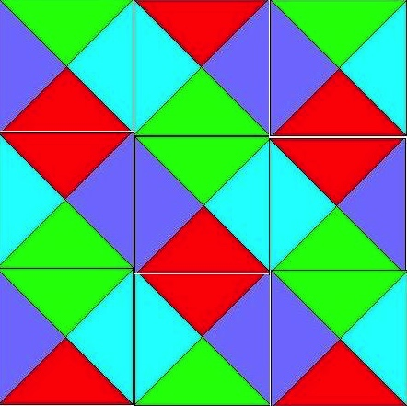
A Valid 3 by 3 Tiling of Tile Types from a Previous Slide

Slide 232
Some Variations
Infinite 2d plane (impossible, co-re-non-rec) in general
  Our four tile types can easily tile the 2d plane
Finite 2d plane (hard in general)
  Our four tile types can easily tile any finite 2d plane
  This is called the Bounded Tiling Problem
One-dimensional space
  This is related to cycles in a directed graph
  Each tile type A is a vertex
  if tile A has right color c and tile B has left color c then draw a directed edge form vertex A to vertex B
  There’s a cycle iff we can infinitely tile along x-axis

Slide 233
Tiling the Plane
We will start with a Post Machine, M = (Q, Σ, δ, q₀), with tape alphabet Σ = {0,1} where 0 is blank and δ maps pairs from Q×Σ to Q×(Σ ∪ {R,L}). M starts in state q₀
  (Turing Machine with each action being L, R or Print)
We will consider the case of M starting with a blank tape
We will constrain our machine to never go to the left of its starting position (semi unbounded tape)
We will mimic the computation steps of M
Termination occurs if in state q reading b and δ(q,b) is not defined
We will use the fact that halting when starting at the left end of a semi unbounded tape in its initial state with a blank tape is undecidable; we will actually look at complement of this

Slide 234
The Tiling Decision Problem
Given a finite set of tile types and a starting tile in lower left corner of 2d plane, can we tile all places in the plane?
A place is defined by its coordinates (x,y), x≥0, y≥0
The fixed starting tile is at (0,0)

Slide 235
Colors
Given M, define our tile colors as
{X, Y, *, 0, 1, Y0, Y1} ∪ Q×{0,1} ∪ Q×{Y0,Y1} ∪ Q×{R,L}
X appears only on bottom of any and all tiles that are resting on the X-axis
Y appears only on left of as part of any and all tiles that are adjacent to the Y-axis
Y is part of the label on top of any tile with its left side adjacent to the Y-axis

Slide 236
Simple Tiles
Simplest tile (represents Blank on X axis)
Start tile (state q0; scanned symbol blank)
0
Note that these can lead to an unbounded linear replication of blanks
0
0
X
Note that the only tile with 0 on the left is the above one, leading to all blanks along X axis
Note that a single tile is used for state and scanned square
q₀,Y0
Y
0
X

Slide 237
Tiles for Copying Tape Cell
Copy cells not on
left boundary except the
scanned square
0
1
*
*
*
*
0
1
Y0
Y1
Copy cells on
left boundary except the scanned square
Y
*
Y
*
Y0
Y1

Slide 238
Right Move δ(q,a) = (p,R)
a
*
p,R
q,a
p,b
where b∈Σ={0,1}
p,R
*
b
Ya
Y
p,R
q,Ya

Slide 239
Left Move δ(q,a) = (p,L)
p,b
*
p,L
b
a
where b∈Σ={0,1}
p,L
*
q,a
p,Yb
Y
p,L
No possibility of moving left if at the left end
Yb

Slide 240
Print δ(q,a) = (p,c)
p,c
*
*
q,a
p,Yc
Y
*
q,Ya

Slide 241
Corner Tile and Bottom Row
q₀,Y0
Y
0
X
Zero-ed Row is forced to be
q₀,Y0
B
0
Y
0
0
0
0
0
………...
X
X
X

Slide 242
First Action Print
As we cannot move left of leftmost character first action is either right or print. Assume for now that δ(q₀,0) = (p,a)
p,Ya
0
0
Y
*
*
*
*
*
………...
q₀,Y0
0
0
q₀,Y0
0
0
Y
0
0
0
0
0
………...
X
X
X

Slide 243
First Action Right Move
As we cannot move left of leftmost character first action is either right or print. Assume for now that δ(q₀,0) = (p,R)
Y0
p,0
0
Y
p,R
p,R
*
*
*
………...
q₀,Y0
0
0
q₀,Y0
0
0
Y
0
0
0
0
0
………...
X
X
X

Slide 244
The Rest of the Story Part 1
Inductively we can show that, if the i-th row represents an infinite transcription of the Turing configuration after step i then the (i+1)-st represents such a transcription after step i+1. Since we have shown the base case, we have a successful simulation.

Slide 245
The Rest of the Story Part 2
Consider the case where M eventually halts when started on a blank tape in state q₀. In this case we will reach a point where no actions fill the slots above the one representing the current state. That means that we cannot tile the plane.
If M never halts, then we can tile the plane (in the limit).

Slide 246
The Rest of the Story Part 3
The consequences of Parts 1 and 2 are that Tiling the plane is as hard as the complement of the Halting problem
(∀t [~STP(M, 0, t)]) //0 (tape is blank)
which is co-RE Complete.
This is not surprising as this problem involve a universal quantification over all coordinates (x,y) in the plane.

Slide 247
Constraints on M
The starting blank tape is not a real constraint as we can create M so its first actions are to write arguments on its tape.
The semi unbounded tape is not new. If you look back at Standard Turing Computing (STC), we assumed there that we never moved left of the blank preceding our first argument.
If you prefer to consider all computation based on the STC model, then we can add to M the simple prologue
(R1)^{x1}R(R1)^{x2}R…(R1)^{xk}R so the actual computation starts with a vector of x1 … xk on the tape and with the scanned square as the blank to the right of this vector. The rest of the tape is blank.
Think about how, in the preceding pages, you could start the tiling in this configuration.

Slide 248
Bounded Tiling Problem #1
Consider a slight change to our machine M. First, it is non-deterministic, so our transition function maps to sets.
Second, we add two auxiliary states
{q_{a}, q_{r}}, where q_{a} is our only accept state and q_{r} is our only reject state.
We make it so the reject state has no successor states, but the accept state always transitions back to itself rewriting the scanned square unchanged.
We also assume our machine accepts or rejects in at most n^{k} steps, where n is the length of its starting input which is written immediately to the right of the initial scanned square.

Slide 249
Bounded Tiling Problem #2
We limit our rows and column to be of size
n^{k}+1. We change our initial condition of the tape to start with the input to M. Thus, it looks like
Note that there are n^{k} – n of these blank representations at the end.
q₀,Y0
x₀
X_{n-1}
0
Y
0
0
0
0
0
0
0
…
…
X
X
X
X

Slide 250
Bounded Tiling Problem #3
The finitely bounded Tiling Problem we just described mimics the operation of any given polynomially-bound non-deterministic Turing machine (this could have been our starting point, rather than SAT).
This machine can tile the finite plane of size
(n^{k}+1) * (n^{k}+1) just in case the initial string is accepted in n^{k} or fewer steps on some path (really a trace of at most n^{k}).
If the string is not accepted, then we will hit a reject state on all paths and never complete tiling.(assume reject occurs in < n^{k} time)
This shows that the bounded tiling problem is NP-Hard
Is it in NP? Yes. How? Well, we can be shown a tiling (posed solution takes space polynomial in n) and check it for completeness and consistency (this takes linear time in terms of proposed solution). Thus, we can verify the solution in time polynomial in n.

Slide 251
A Final Comment on Tiling
If you look back at the unbounded version, you can see that we could have simulated a non-deterministic Turing machine there, but it would have had the problem that the plane would be tiled if any of the non-deterministic choices diverged and that is not what we desired.
However, we need to use a non-deterministic machine for the finite case as we made this so it tiles iff some path led to acceptance. If all lead to rejection, we get stalled out on all paths as the reject state can go nowhere.

Slide 252
Tiling Example
Turing Machine mimicking NP rejects (or for unbounded accepts) strings that start with at least two 1’s in succession. This is designed
q₀ 0 0 q₂
q₀ 1 R q₁
q₁ 0 L q₂
q₁ 1 1 q₃
q₂ 0 0 q₂ // accepting for NP; rejecting for TM
q₂ 1 1 q₂
No q₃ rules so entering here stops tiling

Slide 253
Tile Replication
0
1
*
*
*
*
0
1
Y0
Y1
Y
*
Y
*
Y0
Y1

Slide 254
q₀ 0 0 q₂ q₀ 1 R q₁
q₂,0
1
q₁,0
*
*
*
q₁,R
q₁,R
*
q₀,0
q₀,1
0
q₀,0 ⇒ q₂,0
q₀,1 0 ⇒ 1 q₁,0; q₀,1 1 ⇒ 1 q₁,1
q₂,Y0
Y1
q₁,1
Y
*
Y
q₁,R
q1,R
*
q₀,Y0
q₀,Y1
1
q₀,Y0 ⇒ q₂,Y0
q₀,Y1 0 ⇒ Y1 q₁,0; q₀,Y1 1 ⇒ Y1 q₁,1

Slide 255
q₁ 0 L q₂ q₁ 1 1 q₃
q₂,0
q₂,1
0
q₃,1
*
q₂,L
*
q₂,L
q₂,L
*
*
*
0
1
q₁,0
q₁,1
q₂,Y0
q₂,Y1
q₃,Y1
Y
q₂,L
Y
q₂,L
Y
*
Y0
Y1
q₁,Y1
0 q₁,0 ⇒ q₂,0 0; 1 q₁,0 ⇒ q₂,1 0
Y0 q₁,0 ⇒ q₂,Y0 0; Y1 q₁,0 ⇒ q₂,Y1 0
q₁,1 ⇒ q₃,1
q₁,Y1 ⇒ q₃,Y1

Slide 256
q₂ 0 0 q₂ q₂ 1 1 q₂
q₂,0
q₂,1
*
*
*
*
q₂,0
q₂,1
q₂,0 ⇒ q₂,0 q₂,1 ⇒ q₂,1
q₂,Y0
q₂,Y1
Y
*
Y
*
q₂,Y0
q₂,Y1
q₂,Y0 ⇒ q₂,Y0 q₂,Y1 ⇒ q₂,Y1

Slide 257
Showing Rows of Tiles
The following presents two starting situations
Case 1: Tape contains 1 0 …..; ID = q₀1
Case 2: Tape contains 1 1 …..; ID = q₀11
NTM version should accept case 1; DTM rejects
NTM should reject case 2; DTM accepts
Note: We cycle on accept and hang on reject with NTM but we do opposite on DTM
NTM is for an example of NP Complete
DTM is for an example of Co-RE Complete

Slide 258
Sample Starting Rows
q₀,Y1
0
0
Y
0
0
0
0
0
………...
X
X
X
q₀,Y1
1
0
0
Y
0
0
0
0
0
…
0
0
X
X
X
X

Slide 259
Case 1; Two More Rows
q₂,Y1
0
0
0
Y
q₂,L
q₂,L
*
*
*
…
*
*
Y1
q₁,0
0
0
Y1
q₁,0
0
0
Y
q₁,R
q₁,R
*
*
*
…
*
*
q₀,Y1
0
0
0
q₀,Y1
0
0
0
Y
0
0
0
0
0
…
0
0
X
X
X
X

Slide 260
Case 1; Row 3 repeated
q₂,Y1
0
0
0
Y
*
*
*
*
*
…
*
*
q₂,Y1
0
0
0
q₂,Y1
0
0
0
Y
*
*
*
*
*
…
*
*
q₂,Y1
0
0
0
q₂,Y1
0
0
0
Y
q₂,L
q₂,L
*
*
*
…
*
*
Y1
q1,0
0
0

Slide 261
Case 2; Only Two More Rows
Y1
q₃,1
0
0
Y
*
*
*
*
*
…
*
*
Y1
q₁,1
0
0
Y1
q₁,1
0
0
Y
q₁,R
q₁,R
*
*
*
…
*
*
q₀,Y1
1
0
0
q₀,Y1
1
0
0
Y
0
0
0
0
0
…
0
0
X
X
X
X

Slide 262
More on Variations
One-dimensional space (I asked you to think about that on an earlier slide)
Infinite 3d space (worse than re/co-re in general)
  This become a there exists, for all, problem – Does there exist an initial tape for which M never halts
  In fact, one can mimic acceptance of no inputs here, meaning M is not an algorithm iff we can not tile any one of the x-y planes in the 3d space

Slide 263
PCP Revisited
Bounded Post Correspondence

Slide 264
Word Problems
Let S = (Σ, R) be some Thue (Semi-Thue) system, then the word problem for S is the problem to determine of arbitrary words w and x over S, whether or not w ⇔* x ( w ⇒* x )
The Thue system word problem is the problem of determining membership in equivalence classes. This is not true for Semi-Thue systems.
We can always consider just the relation ⇒* since the symmetric property of ⇔* comes directly from the rules of Thue systems.

Slide 265
Simulating Turing Machines
Basically, we need at least one rule for each 4-tuple in the Turing machine’s description.
The rules lead from one instantaneous description to another.
The Turing ID αqaβ is represented by the string hαqaβh, a being the scanned symbol.
The tuple q a b s leads to
qa → sb
Moving right and left can be harder due to blanks.

Slide 266
Details of Halt(TM) ≤ Word(ST)
Let M = (Q, {0,1}, T), T is Turing table.
If qabs ∈ T, add rule qa → sb // simple rewrite of scan
If qaRs ∈ T, add rules
  q1b → 1sb a=1, ∀b∈{0,1} // left non-blank; scan not blank
  q1h → 1s0h a=1 // right blank; scan not blank
  cq0b → c0sb a=0, ∀b,c∈{0,1} // left and right non-blank; scan blank
  hq0b → hsb a=0, ∀b∈{0,1} // left blank; right not blank; scan blank
  cq0h → c0s0h a=0, ∀c∈{0,1} // left not blank; right blank; scan blank
  hq0h → hs0h a=0 // blank tape to blank tape
If qaLs ∈ T, add rules
  bqac → sbac ∀a,b,c∈{0,1} // left and right had non-blanks
  hqac → hs0ac ∀a,c∈{0,1} // left blank; right not blank
  bq1h → sb1h a=1, ∀b∈{0,1} // left not blank; right blank; scan not blank
  hq1h → hs01h a=1 // left blank; right blank; scan not blank
  bq0h → sbh a=0, ∀b∈{0,1} // left not blank; right blank; scan blank
  hq0h → hs0h a=0 // blank tape to blank tape

Slide 267
Clean-Up
Assume q₁ is start state and only one accepting state exists q₀
We will start in h1^{x}q₁0h, seeking to accept x (enter q₀) or reject (run forever).
Add rules
  q₀a → q₀ ∀a∈{0,1}
  bq₀ → q₀ ∀b∈{0,1}
  hq₀h → hq₀h
The added rule allows us to “erase” the tape if we accept x.
This means that acceptance can be changed to generating hq₀h.
The last rule says derivations of hq₀h can be even or odd.
The next slide shows the consequences.

Slide 268
Semi-Thue Word Problem
Construction from TM, M, gets:
h1^{x}q₁0h ⇒_{∑(M)}* hq₀h iff x∈L(M).
hq₀h ⇒_{∏(M)}* h1^{x}q₁0h iff x∈L(M).
hq₀h ⇔_{∑/∏(M)}* h1^{x}q₁0h iff x∈L(M).
Can recast both Semi-Thue and Thue Systems to ones over alphabet {a,b} or {0,1}. That is, a binary alphabet is sufficient for undecidability.

Slide 269
ST to PCP Example
Start with Semi-Thue System
  aba → ab; a → aa; b → a
  Instance of word problem: bbbb ⇒*? aa
Convert to PCP
  [bbbb* ab ab aa aa a a ]
  [ aba aba a a b b *aa]
  And * * a a b b
  * * a a b b

Slide 270
How PCP Construction Works?
Using underscored letters avoids solutions that don’t relate to word problem instance. E.g.,
ab aa
aba a
leads to solution no matter the question
Top row insures start with [W₀*
Bottom row insures end with *W_{f}]
Bottom row matches W_{i}, while top matches W_{i+1} (one is underscored)
Get Solution for PCP iff W₀ ⇒* W_{f}

Slide 271
ST to PCP Example
Start with Semi-Thue System
  aba → ab; a → aa; b → a
  Instance of word problem: bbbb ⇒*? aa
Convert to PCP
  [bbbb* ab ab aa aa a a ]
  [ aba aba a a b b *aa]
  And * * a a b b
  * * a a b b
  Show correspondence (note: two steps in one at start)
  [bbbb* a b a b * ab a * ab * aa ]
  [ b b b b * aba b * aba * ab *aa]

Slide 272
Bounded Variation
Limit correspondence to a length that is polynomial in n, where n is length of initial input string.
Outline of proof we can get for almost free
  Convert halting problem for a Non-deterministic Turing machine to word problem for a Semi-Thue System
  Note: we originally did for deterministic machines, but the construction works for non-determinism and maps nicely to Semi-Thue systems which are non-deterministic by definition.
  Recast as an instance of PCP
  Limit the length of word to (n+2)^{k}, where original TM accepts or rejects in n^{k} steps.

Slide 273
Another Approach
There is a tighter bound on Bounded PCP.
Given sequences (x1, x2, …, xn) and (y1, y2, …, yn), and a positive integer
K ≤ p(max(|x1|+…+|xn|, |y1|+…+|yn|),
where p is some polynomial, is there a solution to this instance involving indices i1, …,ik, k≤K (not necessarily distinct), of integers between 1 and n, such that the corresponding x and y strings are identical.
Follows from Constable, Hunt and Sahni (1974). “On the Computational Complexity of Program Scheme Equivalence,” Siam Journal of Computing 9(2), 396-416.

Slide 274
MaxCut
NPC Problem where
MinCut variation is in P

Slide 275
Max(Min)Cut
For a graph, a maximum (minimum) cut is a cut whose size is at least the size (at most the size) of any other cut. That is, it is a partition of the graph’s vertices into two complementary sets S and T, such that the number of edges between S and T is as large (as small) as possible. Finding such a cut is known as the MaxCut (MinCut) problem.

Slide 276
Weighted Cuts
The weighted MaxCut (MinCut), starts with a graph with weighted edges and the objective is to maximize (minimize) the total weight of the edges between S and its complement rather than the number of the edges.
These are clearly not decision problems as we are interested in optimization, so where do they and decision problem versions lie in the Complexity Hierarchy?

Slide 277
Unweighted and Weighted Cuts
MaxCut (MinCut) focuses on dividing network into two parts where we cut edges joining members of each part. Goal is maximum (minimum) edge cuts
MinCut and its weighted variant are discussed in COT5405 and are in the Class P
MaxCut (weighted and unweighted), however, is not known to be in P

Slide 278


Unweighted MaxCut Example
A
A
C
B
C
B
D
E
D
E

Slide 279
Partition Reviewed
Recall that Partition is a decision problem.
Given multiset X= {x₁, x₂, … x_{n}}, where each x_{i} is a positive integer, can we partition this into two sets Y and
Z = X – Y, such that the sums of the elements of each partition are the same.
We showed, Partition is in NP
Given a candidate partition, we can check to see if it’s legitimate in deterministic polynomial time.
We then showed SS ≤_{P} Partition, where SS is SubsetSum, known to be in NPC (3SAT ≤_{P} SS).
We actually showed SS ≡_{P} Partition, but that was overkill

Slide 280
Weighted MaxCut as a DP
Given a weighted graph G = (V, E) and a proposed weight W, is the Weighted MaxCut of G at least W.
We will show that this decision problem is in NPC and that its related Optimization problem, “what is the value of Weighted MaxCut?” is NP-Hard.
Note that NP-Hard problems do not need to be decision problems, although they can be. This optimization one is not.

Slide 281
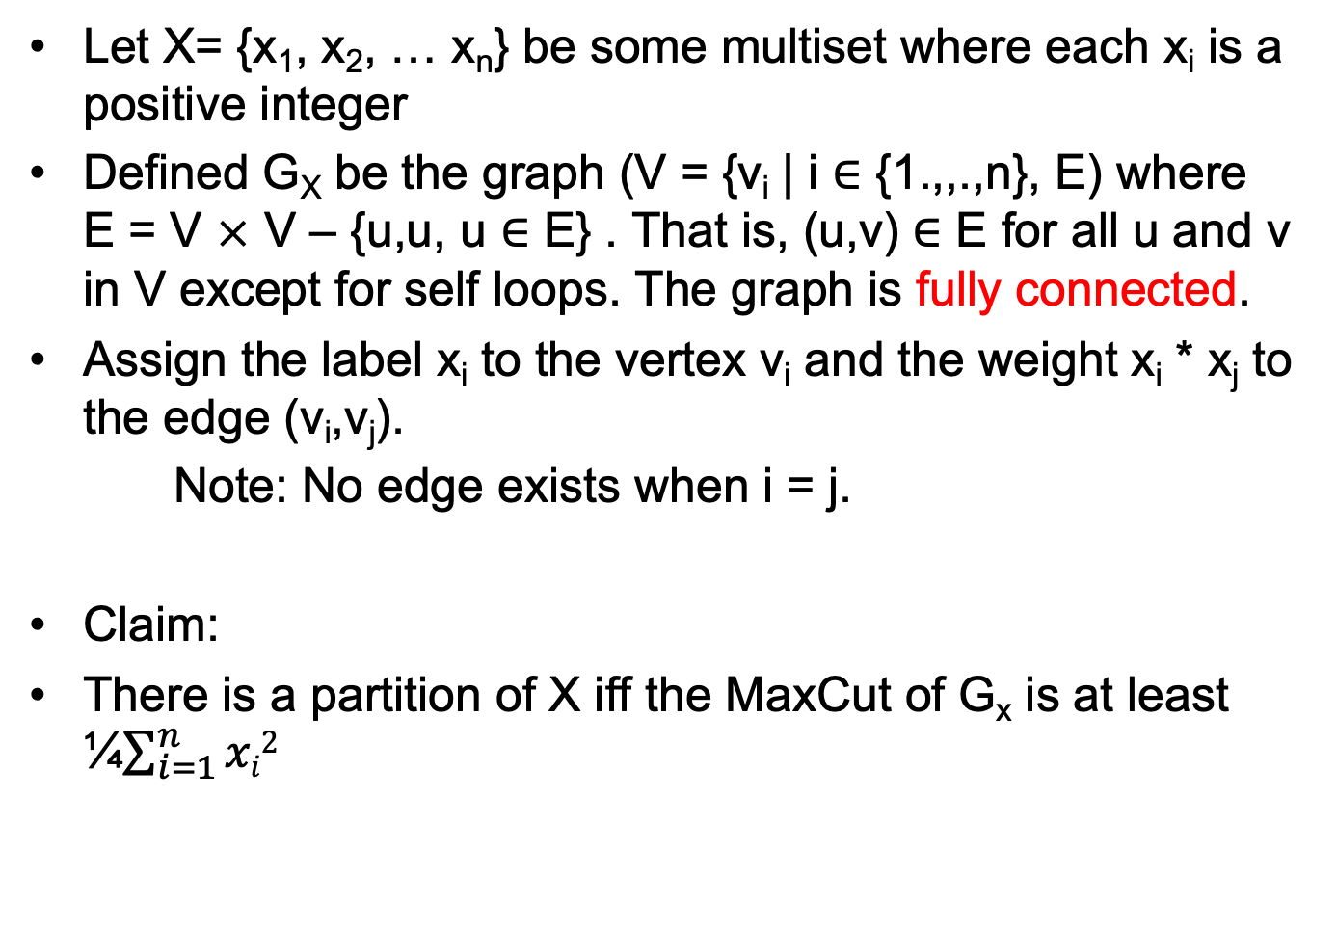
The Construction
Let X= {x₁, x₂, … x_{n}} be some multiset where each x_{i} is a positive integer
Defined G_{X} be the graph (V = {v_{i} | i ∈ {1.,,.,n}, E) where
E = V ✕ V – {u,u, u ∈ E} . That is, (u,v) ∈ E for all u and v in V except for self loops. The graph is fully connected.
Assign the label x_{i} to the vertex v_{i} and the weight x_{i} * x_{j} to the edge (v_{i},v_{j}).
Note: No edge exists when i = j.
Claim:
There is a partition of X iff the MaxCut of G_{x} is at least ¼$\sum_{i=1}^{n}{xi2}$

Slide 282
Weighted MaxCut Example
{1, 2, 3, 4}
{1, 4}
{2, 3}
2
1
2
3
8
4
3
12
Sum = 10
Want ≥ ¼ sum² = 25
2 + 3 + 8 + 12 = 25

Slide 283
Weighted MaxCut Example
1
{1, 2, 3, 4}
Bad Choice
{4}
{1, 2, 3}
4
2
8
4
3
12
Sum = 10
Want ≥ ¼ sum² = 25
4 + 8 + 12 = 24 < 25
(sum-1)(sum+1) = 99 < 100

Slide 284
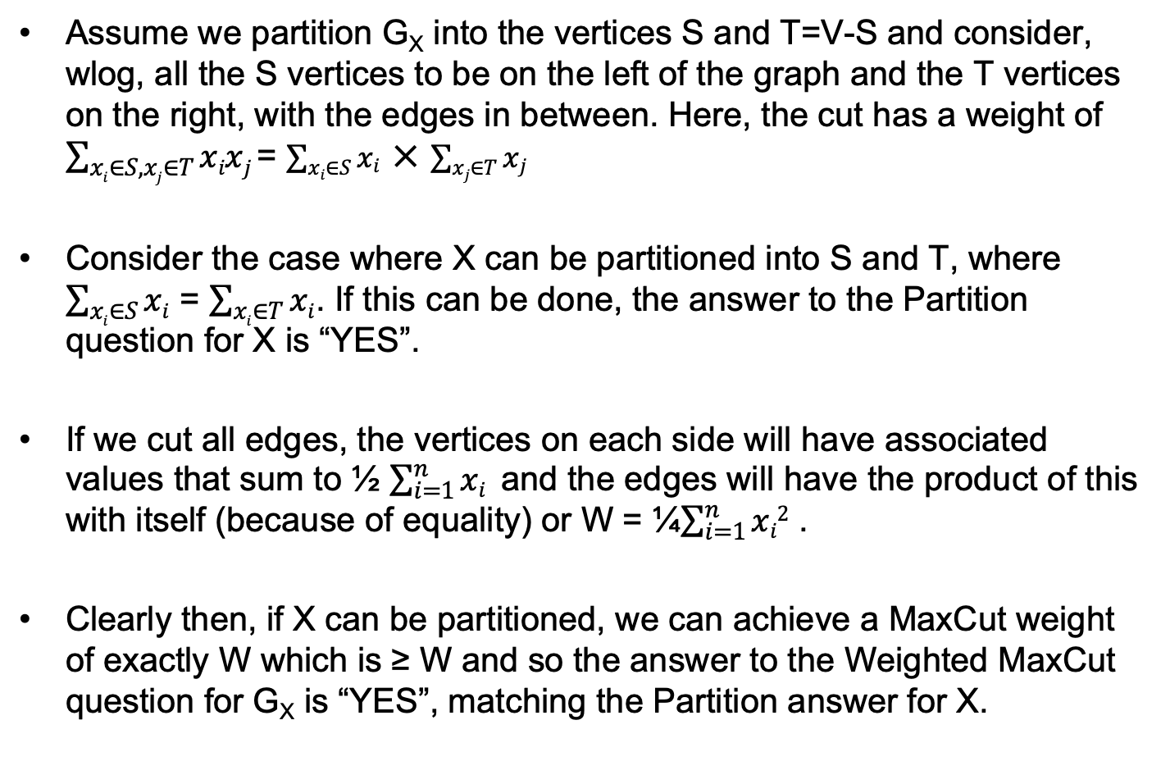
The Reasoning Part 1
Assume we partition G_{X} into the vertices S and T=V-S and consider, wlog, all the S vertices to be on the left of the graph and the T vertices on the right, with the edges in between. Here, the cut has a weight of $\sum_{xi∈S,xj∈T}{xixj}$= $\sum_{xi∈S}{xi} ✕ \sum_{xj∈T}{xj}$
Consider the case where X can be partitioned into S and T, where $\sum_{xi∈S}{xi}$ = $\sum_{xi∈T}{xi}$. If this can be done, the answer to the Partition question for X is “YES”.
If we cut all edges, the vertices on each side will have associated values that sum to ½ $\sum_{i=1}^{n}{xi}$ and the edges will have the product of this with itself (because of equality) or W = ¼$\sum_{i=1}^{n}{xi2}$ .
Clearly then, if X can be partitioned, we can achieve a MaxCut weight of exactly W which is ≥ W and so the answer to the Weighted MaxCut question for G_{X} is “YES”, matching the Partition answer for X.

Slide 285
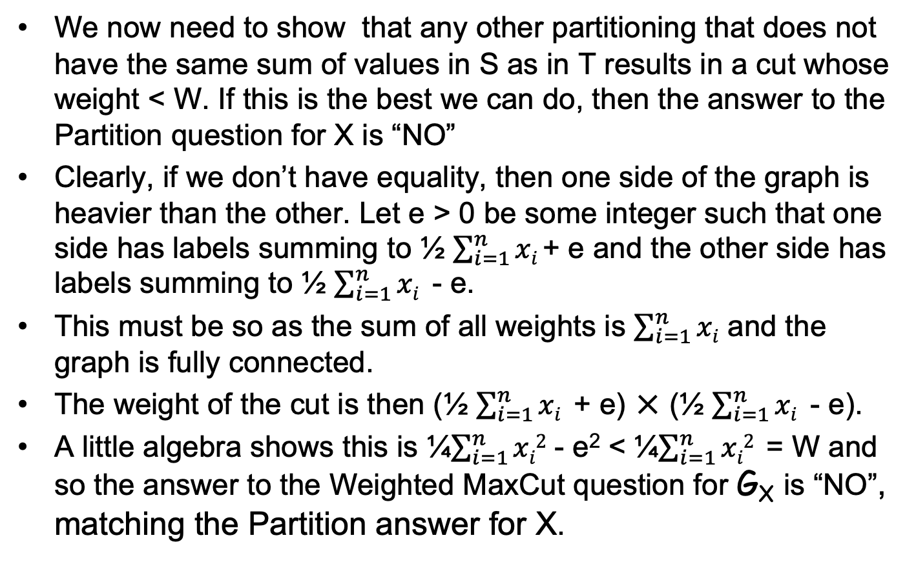
The Reasoning Part 2
We now need to show that any other partitioning that does not have the same sum of values in S as in T results in a cut whose weight < W. If this is the best we can do, then the answer to the Partition question for X is “NO”
Clearly, if we don’t have equality, then one side of the graph is heavier than the other. Let e > 0 be some integer such that one side has labels summing to ½ $\sum_{i=1}^{n}{xi}$+ e and the other side has labels summing to ½ $\sum_{i=1}^{n}{xi}$ - e.
This must be so as the sum of all weights is $\sum_{i=1}^{n}{xi}$ and the graph is fully connected.
The weight of the cut is then (½ $\sum_{i=1}^{n}{xi}$ + e) ✕ (½ $\sum_{i=1}^{n}{xi}$ - e).
A little algebra shows this is ¼$\sum_{i=1}^{n}{xi2}$ - e² < ¼$\sum_{i=1}^{n}{xi2}$ = W and so the answer to the Weighted MaxCut question for G_{X} is “NO”, matching the Partition answer for X.

Slide 286
The Reasoning Part 3
Theorem:
Weighted MaxCut is in NPC
Proof:
We previously showed
Weighted MaxCut is in NP
The last few slides show that
Partition ≤_{P} Weighted MaxCut
Combining these, Weighted Partition is in NPC as Partition was previously shown to be in NPC.

Slide 287
The Reasoning Part 4
Theorem:
Weighted MaxCut Optimization is NP-Hard
Proof:
Let G = (V, E) be some weighted graph. Let W be some weight that we wish to equal or exceed with a cut of G. Assume that we have an Oracle for the Weighted MaxCut Optimization Problem that will report the maximum weight, M. G has a cut ≥ W iff M ≥ W. The work to set up the question and use the answer of the Oracle is constant (so polynomial) time. This means that
Weighted MaxCut ≤_{P} Weighted MaxCut Optimization.
Thus, Weighted MaxCut Optimization is NP-Hard.
Is it NP-Easy?

Slide 288
Unweighted MaxCut
This just says that we have a graph with no weights on its edges, so we want to cut as many edges as possible and answer the question as to whether that number is greater than or equal to some goal K.
This problem is also in NPC. Its proof follows from Max 2-SAT. This is determining an assignment that maximizes the number of clauses set to true. We will discuss various 2-SAT problems soon.

Slide 289
Co-NP
Fourth Significant Class of Problems

Slide 290
Co–NP
    For any decision problem A in NP, there is a ‘complement’ problem Co–A defined on the same instances as A, but with a question whose answer is the negation of the answer in A. That is, an instance is a "yes" instance for A if and only if it is a "no" instance in Co–A.
    Notice that the complement of the complement of a problem is the original problem.

Slide 291
GC and Co–GC
    Co–NP is the set of all decision problems whose complements are members of NP.
    Graph Color GC
      Given: A graph G and an integer k.
      Question: Can G be properly colored with k colors?
    Co–GC
    Given: A graph G and an integer k.
    Question: Do all proper colorings of G require more than k colors?

Slide 292
Co–GC
    Notice that Co–GC is a problem that does not appear to be in the set NP. That is, we know of no way to check in polynomial time the answer to a "Yes" instance of Co–GC.
    What is the "answer" to a Yes instance that can be verified in polynomial time?

Slide 293
P and Co-P
    Not all problems in NP behave this way. For example, if X is a problem in class P, then both "yes" and "no" instances can be solved in polynomial time.
    That is, both "yes" and "no" instances can be verified in polynomial time and hence, X and Co–X are both in NP, in fact, both are in P.
    This implies P = Co–P and, further,
      P = Co–P ⊆ NP ∩ Co–NP.

Slide 294
Co–NP
    This gives rise to a second fundamental question:
      NP = Co-NP?
    If P = NP, then NP = Co-NP.
    This is not "if and only if."
    It is possible that NP = Co-NP
    and, yet, P ≠ NP.

Slide 295
Co–NP Complete
If A ≤_{P} B and both are in NP, then the same polynomial transformation will reduce Co-A to Co–B. That is,
Co–A ≤_{P} Co–B. Therefore, Co–SAT is 'complete' in
Co–NP.
In fact, corresponding to NP–Complete is the complement set Co–NP–Complete, the set of hardest problems in Co–NP.

Slide 296
Turing Reductions
Now, return to Turing Reductions.
Recall that Turing reductions include polynomial transformations as a special case. So, we should expect they will be more powerful.

Slide 297
Turing Reductions
    (1) Problems A and B can, but need not, be
    decision problems.
    (2) No restriction placed upon the number
    of instances of B that are constructed.
    (3) Nor, how the result, Answer_{A}, is computed.
    In effect, we use an Oracle for B.

Slide 298
NP–Hard
Fifth Significant Class of Problems

Slide 299
NP–Hard
To date, we have concerned ourselves with decision problems. We are now ready to include additional problems, in particular, optimization problems.
We require one additional tool – the second type of transformation discussed earlier – Turing reductions.

Slide 300
NP–Hard
    Definition: Problem B is NP–Hard if there is a polynomial time Turing reduction A ≤_{PT} B for some problem A in NP–Complete.
    This implies NP–Hard problems are at least as hard as NP–Complete problems. Therefore, they cannot be solved in polynomial time unless P = NP (and maybe not then).
    This use of an oracle, allows us to reduce co-NP-Complete problems to NP-Complete ones and vice versa.

Slide 301
QSAT
QSAT is the problem to determine if an arbitrary fully quantified Boolean expression is true. Note: SAT only uses existential.
QSAT is NP-Hard but may not be in NP.
QSAT can be solved in polynomial space (PSPACE).

Slide 302
NP–Hard
    Polynomial transformations are Turing reductions.
    Thus, NP–Complete is a subset of NP–Hard.
    Co–NP–Complete also is a subset of NP–Hard.
    NP–Hard contains many other interesting problems.

Slide 303
NP-Easy
NP-Easy is the set of function problems that are solvable in polynomial time by a deterministic Turing machine with an oracle for some decision problem in NP.
That is, given an Oracle for some NP problem Y, if X is Turing reducible to Y in polynomial time, then X is NP-Easy.

Slide 304
NP–Easy
NP-Easy problem X need not be, but often is,
NP-Complete.
In fact, X can be any problem in NP or Co–NP.
More to the point, an NP-Easy problem does not even need to be a decision problem – it can be an optimization problem or some other problem seeking a numerical rather than binary (yes/no answer).

Slide 305
NP–Equivalent
Problem B in NP–Hard is NP–Equivalent when B reduces to some problem X in NP, That is, B ≤_{PT} X. This is, when B is also NP-Easy.
Since B is in NP–Hard, we already know there is a problem A in NP–Complete that reduces to B. That is, A ≤_{PT} B.
Since X is in NP, X ≤_{PT} A. Therefore, X ≤_{PT} A ≤_{PT} B ≤_{PT} X.
Thus, X, A, and B are all polynomially equivalent, and we can say
Theorem. Problems in NP–Equivalent are polynomial if and only if
P = NP.
Example: Optimization version of Subset-Sum is NP-Equivalent.

Slide 306
NP-Easy and Equivalent
NP-Easy -- these are problems that are polynomial when using an NP oracle (≤pt)
NP-Equivalent is the class of NP-Easy and NP-Hard problems (assuming Turing rather than many-one reductions)
  In essence this is the functional equivalent of NP-Complete but also of
  Co-NP-Complete since we can negate answers

Slide 307
Turing vs m-1 Reductions
  In effect, our normal polynomial reduction (≤p) is a many-one polynomial time reduction as it just asks and then accepts its oracle’s answer
  In contrast, NP-Easy and NP-Equivalent employ a Turing machine polynomial time reduction (≤pt) that uses rather than mimics answers from its oracle

Slide 308
SubsetSum Optimization
NP-Equivalence

Slide 309
SubsetSum Optimization (SSO)
S = {s₁, s₂, …, s_{n}}
    set of positive integers
    and an integer B.
  Optimization: Find a subset of S whose values sum to the largest
  attainable value ≤B?
  Strategy: Use Oracle for SubsetSum Decision Problem but only use
  it a polynomial number of times –
  Great care must be taken here as
  B takes only log₂ B bits to represent

Slide 310
SSO is NP-Hard
We can show SS ≤_{PT} SSO
Let [(s1, s2, …, sn), B] be an instance of SubsetSum (we’ll call it SS)
We can ask the oracle for SSO for the largest value G ≤ B such that some subsequence of (s1, s2, …, sn) equals G. If its answer is B we say “YES”; else we say “NO”

Slide 311
SSO is NP-Easy
We can show SSO ≤_{PT} SubsetSum
Let S = [(s1, s2, …, sn), B] be an instance of SSO
Again, our goal is to find the largest value G ≤ B such that some subsequence of (s1, s2, …, sn) equals G
The challenge is to do this in a number of steps that is polynomial in the size of the question. As any integer k can be represented in log₂k bits, we need to make sure we don’t ask more than log₂S questions of our oracle, where S is the length of the representation of
[(s1, s2, …, sn), B].
Read the next slide very carefully

Slide 312
A Subtle Failure
Let [(s1, s2, …, sn), B] be an instance of SSO. Below sequence A is (s1, s2, …, sn)
  SUBSET-SUM-OPTIMIZATION(sequence A, int B) {
  for i=B downto 1
  if ( SubsetSum(A, i) ) then return i;
  return 0;
  }
This calls the oracle SS up to B times
As B is 2^{log2(B)}, we might ask an exponential number of questions relative to the representation of our input parameter B
As B can be as large as the sum of the sequence (s1, s2, …, sn), the value B can be exponential in the size of the representation of our input and so our reduction is not polynomially bounded.

Slide 313
Using SubsetSum Oracle
SUBSET-SUM-OPTIMIZATION(sequence A, int B) {
int best = B;
for i = floor(log₂B) downto 0 do
  A = A + { 2^{i} }; // add to multiset;succeeds now
for i = floor(log₂B) downto 0 do {
A = A - { 2^{i} }; // remove from multiset
    if !SUBSET-SUM(A, best) then // 2^{i} was essential
  best = best - 2^{i}; // reduce best
}
return best;
}

Slide 314
Example of SubsetSum Opt
Initial Values:
A = {1, 4, 5, 7}, best = B = 15
A = {1, 4, 5, 7, 8, 4, 2, 1}, best = 15
A = {1, 4, 5, 7, 4, 2, 1}, best = 15
A = {1, 4, 5, 7, 2, 1}, best = 15
A = {1, 4, 5, 7, 1}, best = 15-2 = 13
A = {1, 4, 5, 7}, best = 13

Slide 315
Another Example
Initial Values:
A = {1, 4, 5, 7}, best = B = 20
A = {1, 4, 5, 7, 16, 8, 4, 2, 1}, best = 20
A = {1, 4, 5, 7, 8, 4, 2, 1}, best = 20
A = {1, 4, 5, 7, 4, 2, 1}, best = 20
A = {1, 4, 5, 7, 2, 1}, best = 20
A = {1, 4, 5, 7, 1}, best = 20-2 = 18
A = {1, 4, 5, 7}, best = 18-1 = 17

Slide 316
Another Example
Initial Values:
A = {1, 4, 5, 7}, best = B = 31
A = {1, 4, 5, 7, 16, 8, 4, 2, 1}, best = 31
A = {1, 4, 5, 7, 8, 4, 2, 1}, best = 31
A = {1, 4, 5, 7, 4, 2, 1}, best = 23
A = {1, 4, 5, 7, 2, 1}, best = 19
A = {1, 4, 5, 7, 1}, best = 17
A = {1, 4, 5, 7}, best = 17

Slide 317
Analysis
Each of the two loops has O(log₂B) iterations, which is linear with respect to the size of B’s representation.
Note that if we tried all values less that B, we would have O(B) tries and that is exponential in log₂B, the size of B.
The correct solution takes advantage of the NP-complete power of the oracle.

Slide 318
Minimum Colors for a Graph
We know K-Color (KC) is NP Complete
We can reduce KC to MinColor problem just by seeing if MinColor is ≤ K. Thus, MinColor is NP-Hard
How do we reduce MinColor to KC asking only a log number of questions of the oracle for KC?
Consider, if N nodes, then can easily N-Color
Can we N/2-Color?
  If so, then try N/4
  If not, then try 3N/4
This is a simple binary search for optimal value

Slide 319
2SAT
A Subset of 3SAT
How hard?

Slide 320
2SAT
We showed that 3SAT is NP Complete
What about 2SAT (two variable per clause)?
Remember that 2 variables still result in undecidable deducibility from finite axion sets, so we might be suspicious that there are some challenging issues here.

Slide 321
Attacking 2SAT
First we need to convert a 2SAT instance to a different form, the so-called implicative normal form (INF). Note that the expression a∨b is equivalent to
¬a⇒b ∧ ¬b⇒a
(if one of the two variables is false, then the other one must be true).
We now construct a directed graph of these implications: for each variable x there will be two vertices x and ¬x. The edges will correspond to the implications.

Slide 322
Comment about Single Variable Terms
If we have a term that involves just one variable, it can be (x∨¬x) and this term is true so it can be removed, or (x∨x) so x must be true, or (¬x∨¬x) so x must be false.
If either of the last two cases exist in a 2-CNF then we can replace all literals involving x with either true or false in any term it exists. If we replace with true, that term can be removed as it’s already satisfied. If false, we have another single literal term and the process continues.
This is a simple preprocessing step, so we can assume wlog that no such cases exist. That is that all terms involve two distinct variables.

Slide 323
2SAT Example
Let's look at an example in 2-CNF form:
(a ∨ ¬b) ∧ (¬a ∨ b) ∧ (¬a ∨ ¬b) ∧ (a ∨ ¬c)
The oriented graph will contain the following vertices and edges:
(a ∨ ¬b) (¬a ∨ b) (¬a ∨ ¬b) (a ∨ ¬c)
¬a⇒¬b a⇒b a⇒¬b ¬a⇒¬c
b⇒a ¬b⇒¬a b⇒¬a c⇒a

Slide 324
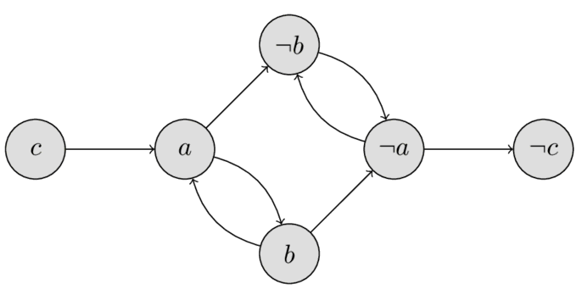
Graph from 2SAT Example
If there is an edge a⇒b, then there also is an edge ¬b⇒¬a
A contradiction exists if there is a cycle, for any variable x, that involves x and ¬x (means x ⇔* ¬x, which is a self-contradiction)
What if there is path from some variable x to ¬x or vice versa?
x⇒*¬x can only be satisfied if x is false (¬x true)
¬x⇒*x can only be satisfied if ¬x is false (x true)
Neither case is contradictory by itself

Slide 325




Finding a Solution for 2SAT
Looking at our graph, c must be false, but so must a and b, as each has a path to its complement
Note that, if a is true, b is true, and if a is false, b is false
Fortunately, there are no cycles involving a variable and its complement, so we have a solution <a = F; b = F; c = F>
The trick now is to discover that solution in an algorithmic manner

Slide 326
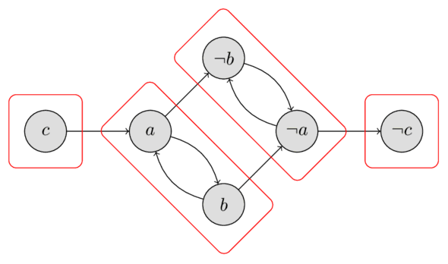
Strongly Connected Components (SCC)
A directed graph is strongly connected if there is a path between all pairs of vertices.
A strongly connected component (SCC) of a directed graph is a maximal strongly connected subgraph. For example, there are 4 SCCs in the graph we have been investigating.

Slide 327
Computing SCC
There are several efficient linear time algorithms for finding the strongly connected components of a graph, based on depth first search
The two common approaches are Tarjan’s and Kosaraju’s Algorithms

Slide 328
Kosaraju’s Finding-all SCC
Finding-all-SCC(G) {
  Perform DFS on G ;
  Construct G^{T} ;
  while (some node in G^{T} is undiscovered)
{ u = undiscovered node with latest finishing time** ;
Perform DFS on G^{T} starting from u ;
} // nodes in the DFS tree from u forms an SCC
}
// ** Finishing times always refer to Step 1’s DFS

Slide 329
Mapping 2SAT to SCC
In terms of the implication graph based on the INF, two literals belong to the same strongly connected component whenever there exist chains of implications from one literal to the other and vice versa.
Therefore, the two literals must have the same value in any satisfying assignment to the given 2-satisfiability instance. In particular, if a variable and its negation both belong to the same strongly connected component, the instance cannot be satisfied, because it is impossible to assign both these literals the same value.
This is a necessary and sufficient condition: a 2-CNF formula is satisfiable if and only if there is no variable that belongs to the same strongly connected component as its negation.

Slide 330
Solving SCC and 2SAT
(a ∨ ¬b) ∧ (¬a ∨ b) ∧ (¬a ∨ ¬b) ∧ (a ∨ ¬c)
Create Implication Graph, G, and run FindingAllSCC(G)
While some variable is not yet assigned
  Start at a partition that has no outgoing edges
  Assign true to all literals in the partition
  Remove partition and its incoming edges
We get
  ¬c = T
  ¬a = ¬b = T
  And so, a = b = c = F

Slide 331
Any Hard Problems Here?
Minimum-ones 2SAT problem: Provide a satisfying assignment that sets a minimum number of variables to true.
Uniform Min-Ones-2SAT is the restriction of Min-Ones-2SAT to input instances without mixed clauses (must be all positive or all negative literals in each clause)
Positive Min-Ones-2SAT is the restriction of Uniform Min-Ones-2SAT to inputs containing only positive clauses (no negations)

Slide 332
Uniform Min-Ones-2SAT
Uniform Min-Ones-2SAT is NP-Hard as we can reduce Min-Vertex-Cover to it
In fact, Uniform Min-Ones-2SAT is NP-Equivalent because Min-Ones-2SAT is NP-Easy
The best known (to me) uniform minimum-ones 2SAT problem algorithm has a running time of O(1.21061^{n}) on a satisfiable 2SAT formula with n variables

Slide 333
Uniform Min-Ones-2SAT
This is interesting as the problem of determining haplotype classifications and propensity for certain genetic diseases can be mapped onto Uniform Min-Ones-2SAT
Note that each individual has a haplotype pair associated with a stretch of DNA, one inherited from their mother and the other from their father
We can focus on one gene looking for an explanation of a disease
Assume access to reliable haplotype data. Together with this haplotype data for some population of individuals, we assume we know, for each individual, whether that person shows symptoms of the relevant disease or not.
4/11/23

Slide 334
The Mapping
Have each clause correspond to an individual in some group of related people (preservation of haplotypes over generations is likely) and each Boolean variable correspond to a haplotype
In general, each individual with some target disease has at least one haplotype that has a responsible variation and each individual without the disease has at least one without the variation
An individual without the disease is represented by negative literals in the two haplotypes; one with it is represented by two positive literals
Finding an assignment with as few ones as possible represents an explanation for the disease with the smallest possible number of defective haplotypes. This matches an expectation that the population should contain more normal haplotypes than defective ones.

Slide 335
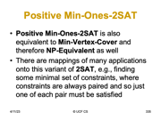
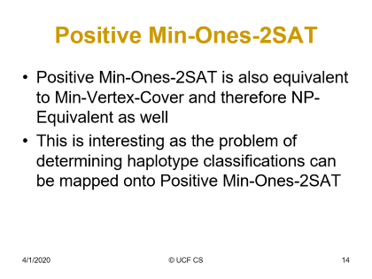
Positive Min-Ones-2SAT
Positive Min-Ones-2SAT is also equivalent to Min-Vertex-Cover and therefore NP-Equivalent as well
There are mappings of many applications onto this variant of 2SAT, e.g., finding some minimal set of constraints, where constraints are always paired and so just one of each pair must be satisfied

Slide 336
VC to Positive Min-Ones-2SAT
B
D
F
A
C
E
Can we cover all edges with just 3 vertices?
Recast as Positive Min-Ones-2SAT. Each Node is a variable, each edge is an or (∨). Above is
(A∨B)(A∨C),(B∨C),(B∨D),(C∨E),(D∨E),(D∨F)
To answer VC of 3, ask “is minimum positive assignment 3 or fewer?”
B,C,D works and tells us which vertices to choose to 3-cover above
If we added edge between E and F, the min would be 4 and we would require 4 vertices to cover all edges and 4 variables set to true
This shows Positive Min-Ones-2SAT is NP-Hard

Slide 337
Positive Min-Ones-2SAT to VC
Be sure 2SAT instance has a solution (O(n))
Associate every variable with a vertex
If (v1∨v2) is a clause, add an edge between v1 and v2 in graph
Now to find min, start with n/2, where we have n variables and do a binary search for min using oracle for VC
Max number of queries of VC oracle is just log₂n so this is NP-Easy and therefore NP-Equivalent

Slide 338
Finding Triangle Strips
Adapted from presentation by
Ajit Hakke Patil
Spring 2010

Slide 339
Graphics Subsystem
The graphics subsystem (GS) receives graphics commands from the application, builds the image specified by the commands, and outputs the resulting image to display hardware
Graphics Libraries:
  OpenGL, WebGL, DirectX.

Slide 340
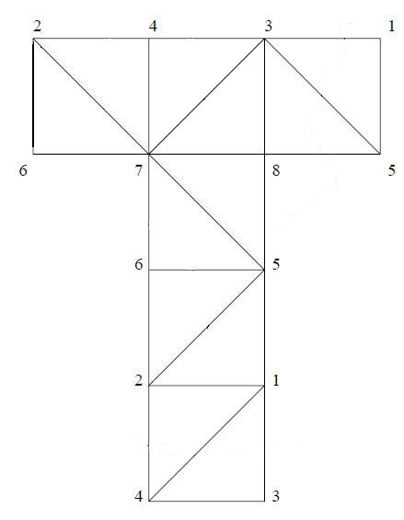

Surface Visualization
As Triangle Mesh
Generated by triangulating the geometry

Slide 341
Triangle List vs Triangle Strip
Triangle List: Arbitrary ordering of triangles.
Triangle Strip: A triangle strip is a sequential ordering of triangles, where consecutive triangles share an edge
In case of triangle lists we draw each triangle separately.
So for drawing N triangles we need to call/send 3N vertex drawing commands/data.
However, using a Triangle Strip reduces this requirement from 3N to N + 2, provided a single strip is sufficient.

Slide 342
Triangle Strip vs Triangle List
// Draw Triangle List
glBegin(GL_TRIANGLES);
For each Triangle
{
glVertex3f(x1,y1,z1);// vertex 1 glVertex3f(x2,y2,z2);// vertex 2
glVertex3f(x3,y3,z3);// vertex 3
}
glEnd();
// Draw Triangle Strip
glBegin(GL_TRIANGLE_STRIP);
For each Vertex
{
glVertex3f(x,y,z); //vertex
}
glEnd();

Slide 343
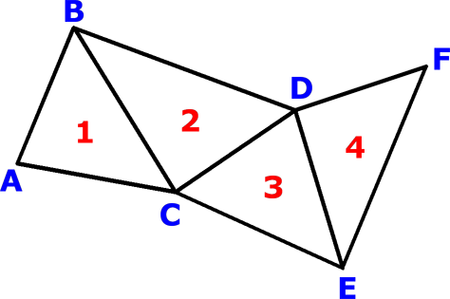
Triangle List vs Triangle Strip
four separate triangles: ABC, CBD, CDE, and EDF
But if we know that it is a triangle strip or if we rearrange the triangles such that it becomes a triangle strip, then we can store it as a sequence of vertices ABCDEF
This sequence would be decoded as a set of triangles ABC, BCD, CDE, and DEF
Storage requirement:
  3N => N + 2

Slide 344
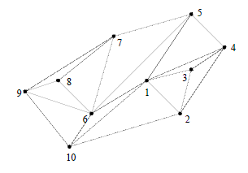
Tri-strips example
Single tri-strip that describes triangles is:
1,2,3,4,1,5,6,7,8,9,6,10,1,2

Slide 345
K-Stripability
Given some positive integer K (less than the number of triangles).
Can we create K tri-strips for some given triangulation – no repeated triangles.

Slide 346
Problem Definition
Given a triangulation T = {t₁, t₂, t₃ ,.. t_{n}}. Find the triangle strip (sequential ordering) for it?
Converting this to a decision problem.
Formal Definition:
Given a triangulation T = {t₁, t₂, t₃ ,.. t_{N}}. Does there exists a triangle strip?

Slide 347
NP Proof
Provided a witness of a ‘Yes’ instance of the problem. This must be a sequence of the original triangles where each triangle has a common edge with next one in sequence. We can verify it in polynomial time by checking if the sequential triangles are connected.
Cost of checking if the consecutive triangles are connected
  For i = 1 to N -1
    Check of i_{th} and i+1_{th} triangle are adjacent (have a common edge)
    Up to three edge comparisons or six vertex comparisons
  ~ 6N
Hence it is in NP.

Slide 348
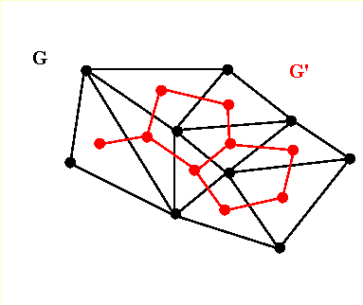
Dual Graph
The dual graph of a triangulation is obtained by defining a vertex for each triangle and drawing an edge between two vertices if their corresponding triangles share an edge
This gives the triangulations edge-adjacency in terms of a graph
Cost of building a Dual Graph
  O(N²)
e.g G’ is a dual graph of G.

Slide 349
NP-Completeness
To prove it’s NP-Complete we reduce a known NP-Complete problem to this one; the Hamiltonian Path Problem.
Hamiltonian Path Problem:
  Given: A Graph G = (V, E). Does G contain a path that visits every vertex exactly once?

Slide 350
NP-Completeness proof by restriction
Accept an Instance of Hamiltonian Path, G = (V, E), we restrict this graph to have max degree = 3.The problem is still NP-Complete. In fact, the gadget we built on Page 192 has max degree 3
Construct an Instance of HasTriangleStrip
  G’ = G
    V’ = V
    E’ = E
  Let this be the dual graph G’ = (V’, E’) of the triangulation
  T = {t1, t2, t3 ,.. tN}.
    V’ ~ Vertex v_{i} represents triangle t_{i,} i = 1 to N
    E’ ~ An edge represents that two triangles are edge-adjacent (share an edge)
Return HasTriangleStrip(T)

Slide 351
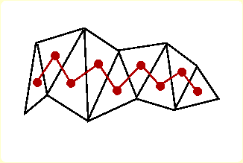
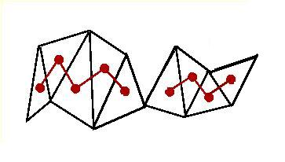
NP-Completeness
G will have a Hamiltonian Path iff G’ has one (they are the same).
G’ has a Hamiltonian Path iff T has a triangle strip of length N – 1.
T will have a triangle strip of length N – 1 iff G (G’) has a Hamiltonian Path.
‘Yes’ instance maps to ‘Yes’ instance. ‘No’ maps to ‘No.’

Slide 352
HP ≤_{P} HasTriangleStrip
The ‘Yes/No’ instance maps to ‘Yes/No’ instance respectively and the transformation runs in polynomial time.
Polynomial Transformation
Hence finding Triangle Strip in a given triangulation is an NP-Complete Problem

Slide 353
More Complexity Topics

Slide 354
Weakly NP-Hard/Complete
Have pseudo polynomial time algorithms – ones that are polynomial in parameter values, rather than size of parameters
Knapsack is Weakly NP-Hard
Subset-Sum is Weakly NP-Complete
A key issue is that problem is no longer in NP if use unary representation of parameters

Slide 355
Strongly NP-Hard/Complete
Do not have pseudo polynomial time algorithms – ones that are polynomial in parameter values, rather than size of parameters
Bin Packing (scheduling) is Strongly NP-Hard
A key issue is that problem remains in NP even if use unary representation of parameters

Slide 356
PSPACE
PSPACE is set of problems solvable deterministically in polynomial space with unlimited time
PSPACE = ∪ SPACE(n^{k})
PSPACE = co-PSPACE = NPSPACE (non-deter, doesn’t matter)
PSPACE is a strict superset of CSLs
PSPACE-Complete Problem is, given a regular expression e over Σ, does e denote all strings in Σ*?
Other PSPACE-Complete problem are QSAT and CSL membership
NP ⊆ PSPACE = NPSPACE

Slide 357
EXPTIME and EXPSPACE
EXPTIME is the set of problems solvable in 2^{p(n)} on a deterministic TM where p is some polynomial.
NEXPTIME is the set of problems solvable in 2^{p(n)} on a non-deterministic TM.
EXPSPACE is the set of problems solvable in 2^{p(n)} space and unbounded time

Slide 358
Elementary Functions

Slide 359
Alternating TM (ATM)
ATM adds to NDTM notation the notion where, for each state q, q has one of the following properties: (accept, reject, ∨, ∧)
  ∨ means ATM accepts the string if any final state reached after q is accepting
  ∧ means ATM accepts the string if all final states reached after q are accepting
AP = PSPACE where AP is class of problems solvable in polynomial time on an ATM
AL = P where AL is like AP, except we are limited to log space.

Slide 360
QSAT, Petri Net, Presburger
QSAT is solvable by an ATM in polynomial time and polynomial space
As noted, before, QSAT is PSPACE-Complete
Petri net reachability is EXPSPACE-hard and requires 2-EXPTIME
Presburger arithmetic is at least in 2-EXPTIME, at most in 3-EXPTIME, and can be solved by an ATM with n alternating quantifiers in doubly exponential time

Slide 361
Why is Space so Different?
We will show that PSPACE = NPSPACE even though we cannot show P = NP. In fact, we suspect it is not so.
Savitch’s Theorem:
if f ∈ Ω(lg(n)), e.g, f describes the binary representation of nodes in a graph of size n, or f says that we look at our input value of n, then
NSPACE(f(n)) ⊆ DSPACE(f(n)²)
This says what we want as, if f(n) is a polynomial, then so is f(n)².

Slide 362
Key Element of Proof
If L is in NSPACE(f(n)) then a tree showing the decision process for membership in L is really a directed graph with O(2^{f(n)}) nodes associated with each of the states that the TM might be in
For each x ∊ {0,1}⁺, x ∊ L iff there is a path from the start configuration to the accepting configuration
Connectivity from start to accept is what leads to acceptance
Use SAT and f(n) = lg(n) as an example to understand this – if want determinism then need to recall all prior choices on current path to backtrack – non-determinism just needs to know choices made on this one path

Slide 363
Vertex Connectivity
In Algorithm Design and Analysis, we focus on time, so long as space is not unreasonable
We would typically use DFS to determine if a start node s has a path to another node t in a directed graph G=(V,E)
Time is O(N), N=|V|+|E|; Space is O(N lg₂N)
The lg₂N is for activation records storing node numbers/prior choices for backing up -- there are other things in the activation record, but they have constant size
We wish to ignore time and do better on size!!!

Slide 364
What if Non-Deterministic?
Consider a non-deterministic DFS algorithm to search for the existence of a path from a start node s to another node t in a directed graph G=(V,E)
Time is O(N), N=|V|+|E|
Space is O(lg₂N) because we don’t need to remember the path or prior choices that led us to a given point since there is no backtracking
Savitch’s Theorem says we can do this deterministically in O((lg₂N)²) space

Slide 365
Space Complexity of Connectivity
We wish to show an O((log₂N)²)-space deterministic algorithm to decide if there is a path between two vertices in a directed graph with N vertices (that’s a generalization of problem)
Key insight is to show we can use a binary search to look for paths of length up to k, initially setting k=N
Given k, start node s, and end node t, we check if there is a path from s to t recursively using a midpoint u that is at most ceiling (k/2) away from each (binary search)
This takes O(log₂N) vs N depth of recursive calls (not running time)
Each recursive call uses O(lg₂N) space for stack (activation record: locals + parameters + return address + return value which must include identify information about node associated with call)
Total space is then lg₂N * lg₂N = (lg₂N)²

Slide 366
Pseudo Savitch Code
Bool k_edge_path (node s, node t, int k) {
if k == 0 return s == t
if k == 1 return s == t || (s, t) in edges
for u in nodes // this introduces O(N) time
if k_edge_path(s, u, floor(k / 2)) && k_edge_path(u, t, ceil(k / 2)) return true
return false
}

Slide 367
Analyzing Savitch Code
Bool k_edge_path (node s, node t, int k)
// Requires s, t, and k be remembered
// Because we have the following, all paths can be viewed as
// length k (N) at start.
if k == 0 return s == t
if k == 1 return s == t || (s, t) in edges
// Order N for checking all possible intermediaries
for u in nodes // this introduces O(N) time
// Divide and conquer (lg depth)
if k_edge_path(s, u, floor(k / 2))
&& k_edge_path(u, t, ceil(k / 2)) return true
return false

Slide 368
Getting Back to NPSPACE
A non-deterministic algorithm using f(n) space on any given path has a tree of all paths that has up to 2^{f(n)} nodes. Note that n could be the length of input representing the lg of a binary decision tree’s number of vertices.
Based on prior discussion, we can deterministically decide if a starting configuration leads to acceptance in (lg₂(2^{f(n)}))²-space = f(n)²-space
If f(n) is a polynomial so is f(n)²
Thus, PSPACE = NPSPACE

Slide 369
CSLs and PSPACE
The derivation problem for context-sensitive grammars is in PSPACE(n) (LBA) (due to Kuroda)
Using Savitch’s results we have that PSPACE is closed under nondeterminism but linear space may not be
This shows that non-deterministic context-sensitive grammars are also in PSPACE
In fact, CSL membership is PSPACE-complete even though CSL = PSPACE(n)

Slide 370
CSL Derivation is PSPACE-C
PSPACE = NPSPACE =
PSPACE = AP (Poly time on ATM)
QSAT, the quantified satisfiability problem, QSAT is PSPACE-complete
SAT can be solved by an LBA with O(n) space = PSPACE(n)
Again, CSL membership is
PSPACE-complete even though
CSL = NPSPACE(n)

Slide 371
Complexity Hierarchy
P ⊆ NP ⊆ PSPACE = NPSPACE ⊆ EXPTIME ⊆ NEXPTIME ⊆ EXPSPACE ⊈ 2-EXPTIME ⊈ 3-EXPTIME ⊈ … ⊈ ELEMENTARY ⊈ PRF ⊈ REC
What if P ≠ EXPTIME; At least one of these is true
  P ⊈ NP
  NP ⊈ PSPACE
  PSPACE ⊈ EXPTIME
If NP ≠ NEXPTIME; At least of these is true
  NP ⊈ PSPACE
  PSPACE ⊈ EXPTIME
  EXPTIME ⊈ NEXPTIME
    Note that EXPTIME = NEXPTIME iff P=NP
    Note that k-EXPTIME ⊈ (k+1)-EXPTIME, k>0
What If PSPACE ≠ EXPSPACE; At least one of these is true
  PSPACE ⊈ EXPTIME
  EXPTIME ⊈ EXPSPACE

Slide 372
FP and FNP
FP is functional equivalent to P
R(x,y) in FP if can provide value y for input x via a deterministic polynomial time algorithm
FNP is functional equivalent to NP;
R(x,y) in FNP if can verify any pair (x,y) via a deterministic polynomial time algorithm

Slide 373
TFNP
TFNP is the subset of FNP where a solution always exists, i.e., there is a y for each x such that R(x,y).
  Task of a TFNP algorithm is to find a y,
  given x, such that R(x,y)
  Unlike FNP, the search for a y is always successful
FNP properly contains TFNP contains FP (we don't know if proper)

Slide 374
Prime Factoring
Prime factoring is defined as, given n and k, does n have a prime factor < k?
Factoring is in NP and co-NP
  Given candidate factor can check its primality in poly time and then see if it divides n
  Given candidate set of factors can check their primalities, and see if product equals n; if so, and no candidate < k, then answer is no

Slide 375
Prime Factoring and TFNP
Prime Factoring as a functional problem is in TFNP, but is it in FP?
If TFNP in FP, then TFNP = FP since FP is contained in TFNP
If that is so, then carrying out Prime Factoring is in FP and its decision problem is in P
  If this is so, we must fear for encryption techniques, most of which depend on difficulty of finding factors of a large number

Slide 376
More TFNP
There is no known recursive enumeration of TFNP but there is of FNP
  This is similar to total versus partially recursive functions (analogies are everywhere)
It appears that TFNP does not have any complete problems!!!
  But there are subclasses of TFNP that do have complete problems!!

Slide 377
Another Possible Analogy
Is P = (NP ∩ Co-NP)?
Recall that REC = (RE ∩ co-RE)
The analogous result may not hold here
Prime Factoring is in NP ∩ Co-NP!!
We are at risk if P = (NP ∩ Co-NP) as then Prime Factoring is in P

Slide 378
Constraint Satisfaction
Many decision problems are instances of constraint satisfaction
  Example: K-Color must obey constraint that adjacent nodes have different colors
  Example: SAT says assignment makes every clause true
  Uniform Min-Ones-2SAT is a constraint problem with paired constraints
In fact, there is a class of programming languages that employ constraint-based reasoning, e.g., CLP(R)

Slide 379
Promise Problems
There is an analogy here to semi-dec.
You have a predicate that never lies on its promise set.
It is promised that some of its input should get answer yes (L_{yes}) and others no (L_{no}), but there are maybes. On a maybe, it can give any answer or not even halt.
Note: L_{yes} ∩ L_{no}= ∅
L_{yes} ∪ L_{no} is the promise and may not = L

Slide 380
Promise in Computability
I wish to check if a program produces the output zero when given zero as input.
The promise set is the set of programs that converge in 100 steps or fewer for all input.
Some programs should get answer yes (L_{yes}) and others no (L_{no}). Our analyzer knows if the program halts in 100 steps and, if so, knows if the program produces 0 (is in L_{yes}) or not (is in L_{no}). However, if it’s not in the promise set, we could just keep checking for an answer and potentially never halt or just throw out a random answer.
This is not dissimilar to what VALUE does if ~STP.
The problem is trivial if a program is in the promise set but membership in that set is unsolvable (co-re-complete).

Slide 381
Promise in Complexity
I wish to check if if a graph is 4-colorable
The promise set is the set of set of planar graphs.
Checking to see if a graph is planar is easy (O(N))
If a graph is planar (in the promise set), the answer is yes so L_{yes} = promise set. Demonstrating this coloring is not easy but we are assured it exists
What if we get a graph that is not planar, then the problem is NP-Complete to determine if it’s 4-colorable

Slide 382
Are Approximations Hard?
PCP (Probabilistically Checkable Proofs)
  Applies to NP-Hard constraint satisfaction problems (CSP)
  This states that to determine if an approximation to any CSP gets things right most of the time is NP-Hard
There are multiple formulations of this but here is one:
  Satisfying any fixed percentage of constraints is itself NP-Hard
    Example: Satisfying 99% of the pairs in a k-coloring

Slide 383
Unique Label Color
I have an undirected graph and I want to color it while obeying a set of pairwise constraints.
For example, maybe nodes 1 and 2 are connected and the pairwise constraints say, if 1 is colored red then 2 must also be red, but if 1 is colored blue, 2 is green, and if 1 is colored green, 2 must be blue.
Clearly, once I choose a color for either node 1 or 2, I know the color for the other.
In fact, if I have a connected component of the graph, coloring one node determines the colors of all others and so we can just cycle through assignments for any one node to see if the constraints can be satisfied.

Slide 384
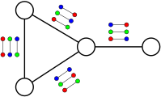
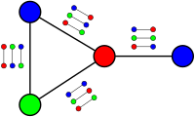
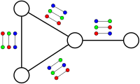
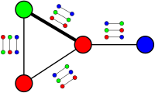
Examples from Wikipedia
100% satisfiable
75% satisfiable
check all cases

Slide 385
The Easy and the “Hard”
For satisfiable (100% can be assigned) graphs/color pair constraints, it is easy to determine.
However, it seems hard to compute the best percentage satisfied for a set of unsatisfiable graphs/color pair constraints
This seems so even if all we want is a good approximation.

Slide 386
What is the 3-Color Problem?
This just extends the constraints with two options for the neighbors.
Everyone has the two-choice constraints
Red – Blue
Red – Green
Blue – Green
That simple extension makes coloring an NP-Complete problem

Slide 387
Khot’s Conjecture
It starts with a Graph, G, and some set of colors, often many more than needed to properly color G, and some added pairwise constraints, e.g., if we color a node red, all adjacent nodes must be green.
Assuming we have some finite large set of these pairwise constraints, and we know that there exists some coloring of G that satisfies 99% of them, then finding a coloring that satisfies just 1% is hard (NP-Hard)
In fact, if x is a large percentage, even 99.999%, then this applies to finding a coloring that satisfies just 0.001% of the constraints (lots of constraint options here)

Slide 388
Is Khot’s Conjecture True?
FALSE: If the constraints can be mostly satisfied, all known cases have easy solutions to check satisfaction of some small number of constraints. Also, a large subset of these problems were shown not to require exponential time.
TRUE: Recent results show that, if our constraints give us two color choices for neighbors, not just one, then the problem is NP-Hard. This can be extended to show that if there is a solution for almost half the constraints, then the problem is NP-Hard to satisfy a small percentage of the constraints. That’s nice but does it apply when we start by having almost all constraints satisfiable by some coloring?? It does, however, provide tantalizing evidence in support of Khot’s Conjecture.

Slide 389
Why Do We Care
It is in the intersection of Khot’s Conjecture and the question as to whether P ≠ NP where things get really interesting.
Specifically, if Khot’s conjecture is true and P ≠ NP, then NP-Hard problems not only require exponential time but also it will be the case that getting good, generally applicable, polynomial-time approximations is out of our reach.

