Slide 2
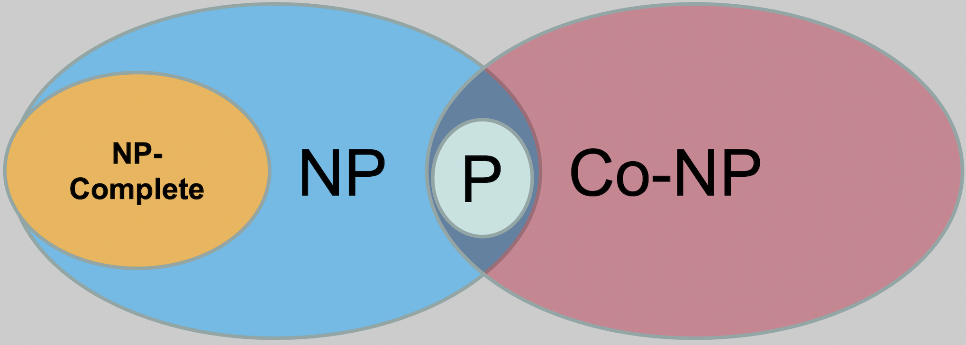
Computer Science; College of Engineering & Computer Science

