Slide 1

Review Of Unique Key Horn Functions
Kristóf Bérczi, Endre Boros, Ondřej Čepek, Petr Kučera, Kazuhisa Makino
Presented by: Timothy Deligero
Presented Date: 4/7/20
Instructor: Charles Hughes
Notes:
Hello everyone, my name is Timothy Deligero, and today I’m presenting a research paper done on the topic of unique key horn functions.

Slide 2

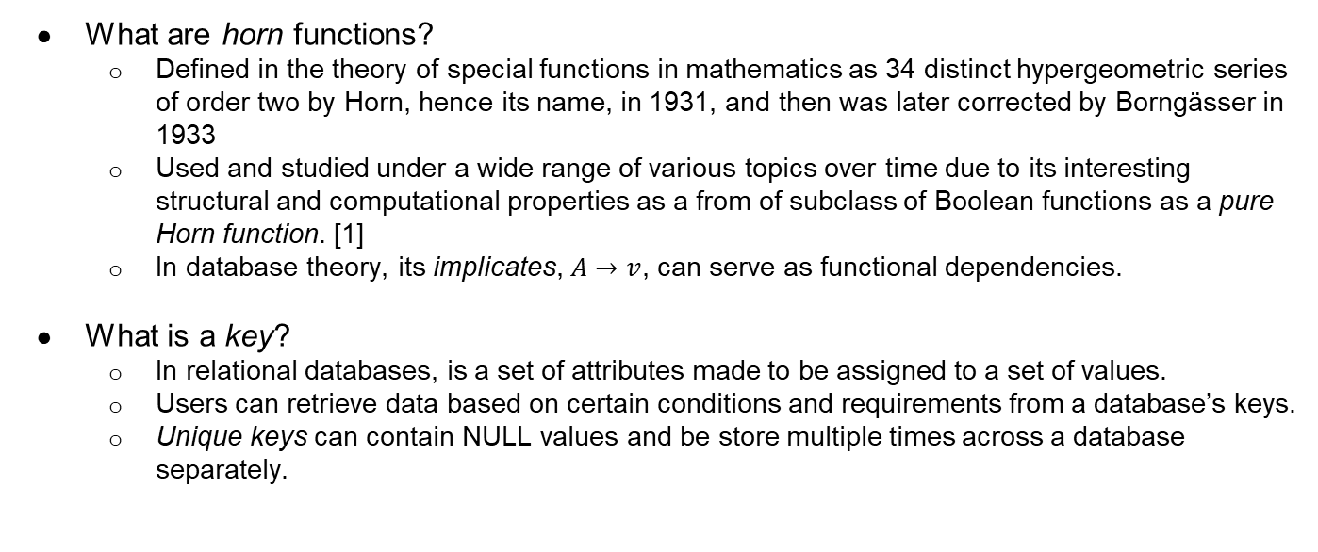
Introduction: What are Keys and Horns?
What are horn functions?
  Defined in the theory of special functions in mathematics as 34 distinct hypergeometric series of order two by Horn, hence its name, in 1931, and then was later corrected by Borngässer in 1933
  Used and studied under a wide range of various topics over time due to its interesting structural and computational properties as a from of subclass of Boolean functions as a pure Horn function. [1]
  In database theory, its implicates, $A→v$, can serve as functional dependencies.
What is a key?
  In relational databases, is a set of attributes made to be assigned to a set of values.
  Users can retrieve data based on certain conditions and requirements from a database’s keys.
  Unique keys can contain NULL values and be store multiple times across a database separately.
Notes:
To start off the presentation, horn functions and keys should be defined. Horn functions were defined in the theory of special functions in mathematics as 34 distinct hypergeometric series of order two by Horn, hence its name, in 1931, and then was later corrected by Borngässer in 1933. However, over time horn functions, specifically pure Horn functions, were used and studied under many various topics due to its properties in both structure and computability in the form of Boolean functions, one of which are database theory, which horn functions in particular have a very strong relationship with due to having the similar algorithmic problems. Keys have also been important in the research of database theory, especially relational databases, where it is a set of attributes made to be uniquely assigned to a set a values, allowing users to retrieve data based on certain conditions and requirements from a database’s key set.
A CNF $Φ$ and its Boolean function representation is called a horn if each of its clauses in its set have at most one positive literal or Boolean variable and called a pure horn if each of its clauses in its set have exactly one positive literal or Boolean variable. Each CNF is defined into a single Boolean function. However, every Boolean function will have multiple representations of CNFs. Pure horn clauses from its CNF can also be viewed as implications in the form of $A→v$, where $A$ is the body and $v$ is the head. For example, given a clause $C=\overline{b}∨\overline{c}∨e$, its implication equivalent of a pure Horn CNF would be $bc→e$, where $A=bc$ and $v=e$. The research paper [1] states that $A→v$ is an implicate of a Horn function $h$ if any assignment $x∈{\left\{0, 1\right\}}^{V}$ that falsifies $A→v$ also falsifies $h$. [1] If $h$ is represented by a pure Horn CNF then the clauses of this CNF are all implicates of $h$. A pure Horn function is a key Horn if any of its implicates within its body is a key of the function.

Slide 3
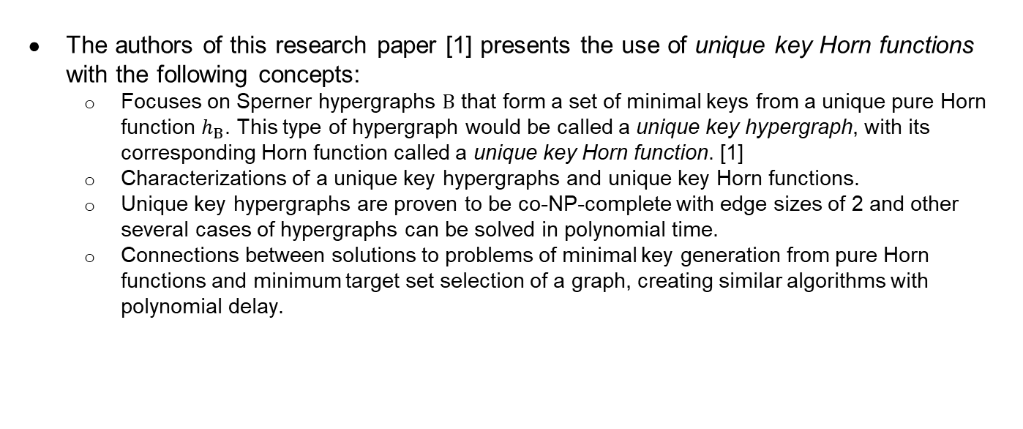
Proposal: Unique Key Horn Functions
The authors of this research paper [1] presents the use of unique key Horn functions with the following concepts:
  Focuses on Sperner hypergraphs $Β$ that form a set of minimal keys from a unique pure Horn function $h_{Β}$. This type of hypergraph would be called a unique key hypergraph, with its corresponding Horn function called a unique key Horn function. [1]
  Characterizations of a unique key hypergraphs and unique key Horn functions.
  Unique key hypergraphs are proven to be co-NP-complete with edge sizes of 2 and other several cases of hypergraphs can be solved in polynomial time.
  Connections between solutions to problems of minimal key generation from pure Horn functions and minimum target set selection of a graph, creating similar algorithms with polynomial delay.
Notes:
The authors Bérczi, Boros, Čepek, Kučera, and Makino have proposed the use of unique key Horn functions as a form of pure Horn functions to represent a minimal key set formed by a Sperner hypergraph otherwise defined as a unique key hypergraph by the research paper. [1] Along with defining the characterizations of unique key hypergraphs and unique key Horn functions, the research paper [1] proves that unique key graphs are co-NP-complete when all of its edges are of size two and certain cases of hypergraphs that can be solved in polynomial time. It also provides connections between both problems of generating minimum key sets and minimal targets sets in terms of similar algorithms with polynomial delay and hardness.

Slide 4
Background and Related Work
Horn functions have been used and studied under many various topics:
  Directed hypergraphs in graph theory and combinatorics
  Implication systems in machine learning
  Database theory (e.g. relational databases as functional dependencies)
  Lattices and closure systems in algebra and concept lattice analysis
  Hydra functions using key Horn functions.
Horn functions have very strong relation to database theory using their implications and CNF representations.
Notes:
As discussed previously about Horn functions, there have been various topics that have discussed Horn functions in different uses, such as:
Directed hypergraphs in graph theory and combinatorics.
Implication systems in machine learning.
Database theory (e.g. relational databases as functional dependencies).
Lattices and closure systems in algebra and concept lattice analysis.
Hydra functions, where the bodies of the Horn functions are of size two, or in a CNF representation have clauses containing two literals.
Given its established properties, Horn functions have strong relations to databases, as its algorithmic problems give the same type of context to problems arising from databases and its implications are used in a similar manner as to assigning unique values to a set of attributes to create functional dependencies in a database. Minimizing the CNF representation of a pure Horn functions is difficult, as the process is dependent on many variables, such as number of literals, number of clauses, etc. Previous research has denoted that established algorithms, even for special cases, such as the discussed hydra functions, have been proven to be NP-hard.

Slide 5
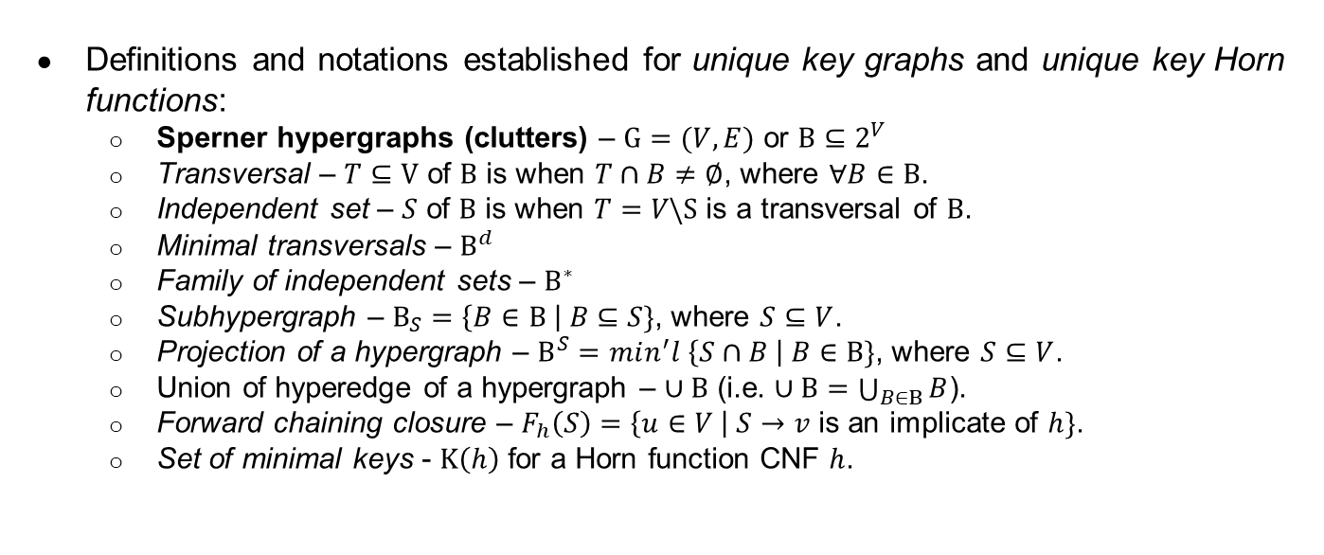
Unique Key Horn Functions: Terminology
Definitions and notations established for unique key graphs and unique key Horn functions:
  Sperner hypergraphs (clutters) – $G=(V, E)$ or $Β⊆2^{V}$
  Transversal – $T⊆V$ of $Β$ is when $T∩B≠∅$, where $∀B∈Β$.
  Independent set – $S$ of $Β$ is when $T=V\backslash S$ is a transversal of $Β$.
  Minimal transversals – $Β^{d}$
  Family of independent sets – $Β^{∗}$
  Subhypergraph – $Β_{S}=\left\{B∈Β \right| B⊆S\}$, where $S⊆V$.
  Projection of a hypergraph – $Β^{S}=min^{′}l \left\{S∩B \right| B∈Β\}$, where $S⊆V$.
  Union of hyperedge of a hypergraph – $∪Β$ (i.e. $∪Β=\bigcup_{B∈Β}{B}$).
  Forward chaining closure – $F_{h}\left(S\right)=\left\{u∈V \right| S→v$ is an implicate of $h\}$.
  Set of minimal keys - $K\left(h\right)$ for a Horn function CNF $h$.
Notes:
There are a couple of definitions and notations established for unique key graphs (Sperner hypergraphs with minimal key sets) and unique key Horn functions in the paper [1]:
Sperner hypergraphs (clutters) – Given a Sperner hypergraph $(V, E)$, or $Β⊆2^{V}$, where $V$ is the set of Boolean variables in this paper [1], for subsets $A$, $B∈E$, $A⊈B$ and $A≠B$ (i.e. no hyperedge properly contains one another, where $B$ is a hyperedge).
A transversal $T⊆V$ of $Β$ is when $T∩B≠∅$, where $∀B∈Β$.
An independent set $S$ of $Β$ is when $T=V\backslash S$ is a transversal of $Β$.
$Β^{d}$ is denoted as a set of minimal transversals of $Β$, with $Β^{∗}$ being a family of its independent sets.
A subhypergraph of $Β$ induced by $S$, where $S⊆V$, is denoted as $Β_{S}=\left\{B∈Β \right| B⊆S\}$. If $S∈Β^{∗}$, then $Β_{S}=∅$.
A projection of $Β$ to $S$ is denoted as $Β^{S}=min^{′}l \left\{S∩B \right| B∈Β\}$, where $min^{′}l\{H\}$ denotes the family consisting of inclusionwise minimal members of $H$ and $S⊆V$. If $S$ is not a transversal of $Β$, then $Β^{S}=\left\{∅\right\}$.
Notation $∪Β$ is denoted as the union of hyperedges of a hypergraph (i.e. $∪Β=\bigcup_{B∈Β}{B}$).
A forward chaining closure is defined as $F_{h}\left(S\right)=\left\{u∈V \right| S→v$ is an implicate of $h\}$.
The set of minimal keys for a Horn function CNF $h$ is defined as $K\left(h\right)$.
These definitions and notations will be used for the Lemmas, Theorems, and Corollaries presented by the research paper. [1] Given that the proofs are very complex and elaborate, they’ll be summarized with the bulletin points and given a quick explanation on what they’re used for. It is encourage to read the research paper [1] to get a clear idea of what the proofs are explaining.

Slide 6
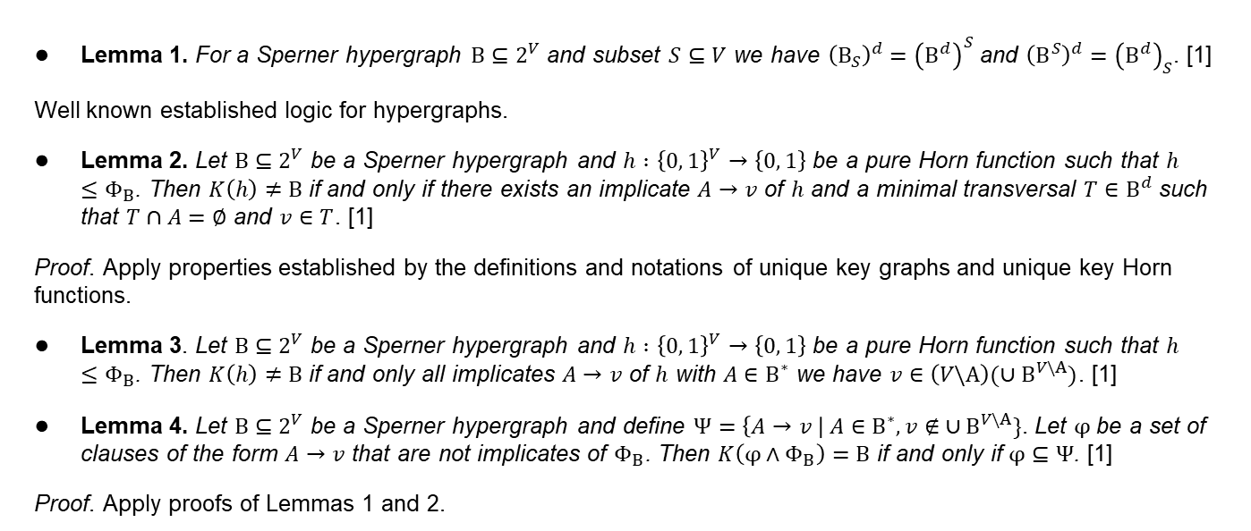
Unique Key Horn Functions: Characterizations
Lemma 1. For a Sperner hypergraph $Β⊆2^{V}$ and subset $S⊆V$ we have ${\left(Β_{S}\right)}^{d}={\left(Β^{d}\right)}^{S}$ and ${\left(Β^{S}\right)}^{d}={\left(Β^{d}\right)}_{S}$. [1]
Well known established logic for hypergraphs.
Lemma 2. Let $Β⊆2^{V}$ be a Sperner hypergraph and $h :{\left\{0, 1\right\}}^{V}→\left\{0, 1\right\}$ be a pure Horn function such that $h≤Φ_{Β}$. Then $K\left(h\right)≠Β$ if and only if there exists an implicate $A→v$ of $h$ and a minimal transversal $T∈Β^{d}$ such that $T∩A=∅$ and $v∈T$. [1]
Proof. Apply properties established by the definitions and notations of unique key graphs and unique key Horn functions.
Lemma 3. Let $Β⊆2^{V}$ be a Sperner hypergraph and $h :{\left\{0, 1\right\}}^{V}→\left\{0, 1\right\}$ be a pure Horn function such that $h≤Φ_{Β}$. Then $K\left(h\right)≠Β$ if and only all implicates $A→v$ of $h$ with $A∈Β^{∗}$ we have $v∈\left(V\backslash A\right)(∪Β^{V\backslash A})$. [1]
Lemma 4. Let $Β⊆2^{V}$ be a Sperner hypergraph and define $Ψ=\left\{A→v \right| A∈Β^{∗}, v∉ ∪Β^{V\backslash A}\}$. Let $φ$ be a set of clauses of the form $A→v$ that are not implicates of $Φ_{Β}$. Then $K\left(φ∧Φ_{Β}\right)=Β$ if and only if $φ⊆Ψ$. [1]
Proof. Apply proofs of Lemmas 1 and 2.
Notes:
The Lemmas and Theorems of this section are used to characterize the unique key graphs and unique key Horn functions presented in the research paper. [1] Lemma 1 is already established and well known from previous research papers. Lemma 2 is used to address the relationship of minimal transversal to unique key graphs.

Slide 7
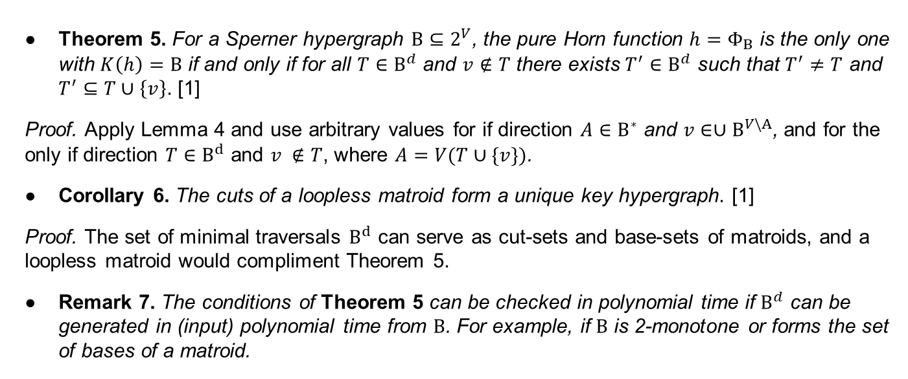
Unique Key Horn Functions: Characterizations
Theorem 5. For a Sperner hypergraph $Β⊆2^{V}$, the pure Horn function $h=Φ_{Β}$ is the only one with $K\left(h\right)=Β$ if and only if for all $T∈Β^{d}$ and $v∉T$ there exists $T^{′}∈Β^{d}$ such that $T^{′}≠T$ and $T^{′}⊆T∪\left\{v\right\}$. [1]
Proof. Apply Lemma 4 and use arbitrary values for if direction $A∈Β^{∗}$ and $v∈∪$ $Β^{V\backslash A}$, and for the only if direction $T∈Β^{d}$ and $v ∉T$, where $A=V(T∪\{v\})$.
Corollary 6. The cuts of a loopless matroid form a unique key hypergraph. [1]
Proof. The set of minimal traversals $Β^{d}$ can serve as cut-sets and base-sets of matroids, and a loopless matroid would compliment Theorem 5.
Remark 7. The conditions of Theorem 5 can be checked in polynomial time if $Β^{d}$ can be generated in (input) polynomial time from $Β$. For example, if $Β$ is 2-monotone or forms the set of bases of a matroid.
Notes:
By applying Lemma 4, Theorem 5 can be proven to be true in its bidirectional implication, further explaining the minimal traversal within a unique key graph. This logic also applies to matroid, as the set of minimal traversals can serve as the cut-sets or base-sets of a loopless matroid, which compliments Theorem 5.

Slide 8
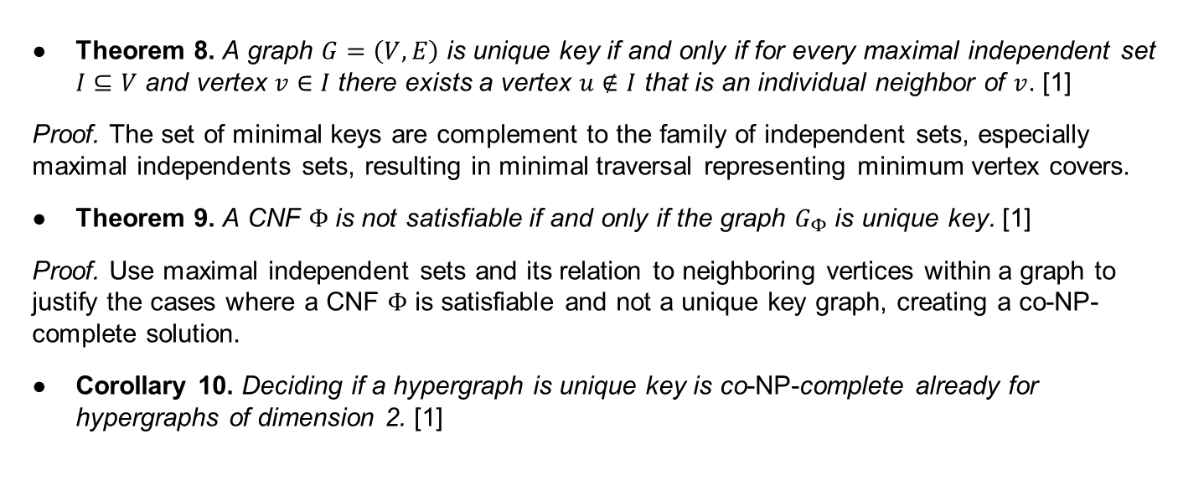
Unique Key Graphs: Complexity
Theorem 8. A graph $G=\left(V, E\right)$ is unique key if and only if for every maximal independent set $I⊆V$ and vertex $v∈I$ there exists a vertex $u∉I$ that is an individual neighbor of $v$. [1]
Proof. The set of minimal keys are complement to the family of independent sets, especially maximal independents sets, resulting in minimal traversal representing minimum vertex covers.
Theorem 9. A CNF $Φ$ is not satisfiable if and only if the graph $G_{Φ}$ is unique key. [1]
Proof. Use maximal independent sets and its relation to neighboring vertices within a graph to justify the cases where a CNF $Φ$ is satisfiable and not a unique key graph, creating a co-NP-complete solution.
Corollary 10. Deciding if a hypergraph is unique key is co-NP-complete already for hypergraphs of dimension 2. [1]
Notes:
For this section, lets assume we have a Sperner hypergraph with edges of size $2$, meaning that there are only pairs of vertices with a single edge connected between them. Since it is established that the minimal transversal are complement to the independent sets of a Sperner hypergraph, they also represent the minimum vertex covers, giving an idea of the neighboring vertices with a unique key graph. The proof shown by the research paper [1] basically proves the opposite of the statement, meaning that a CNF $Φ$ is satisfiable if and only if the graph $G_{Φ}$ is not a unique key, which also means that there exists a maximal independent set that contains vertex $z$ with no individual neighbor. This shown that determining a unique key graph from this type of Sperner hypergraph is co-NP-complete, as there is a polynomial algorithm that exists to solve the “NO” instances for unique key hypergraphs.

Slide 9
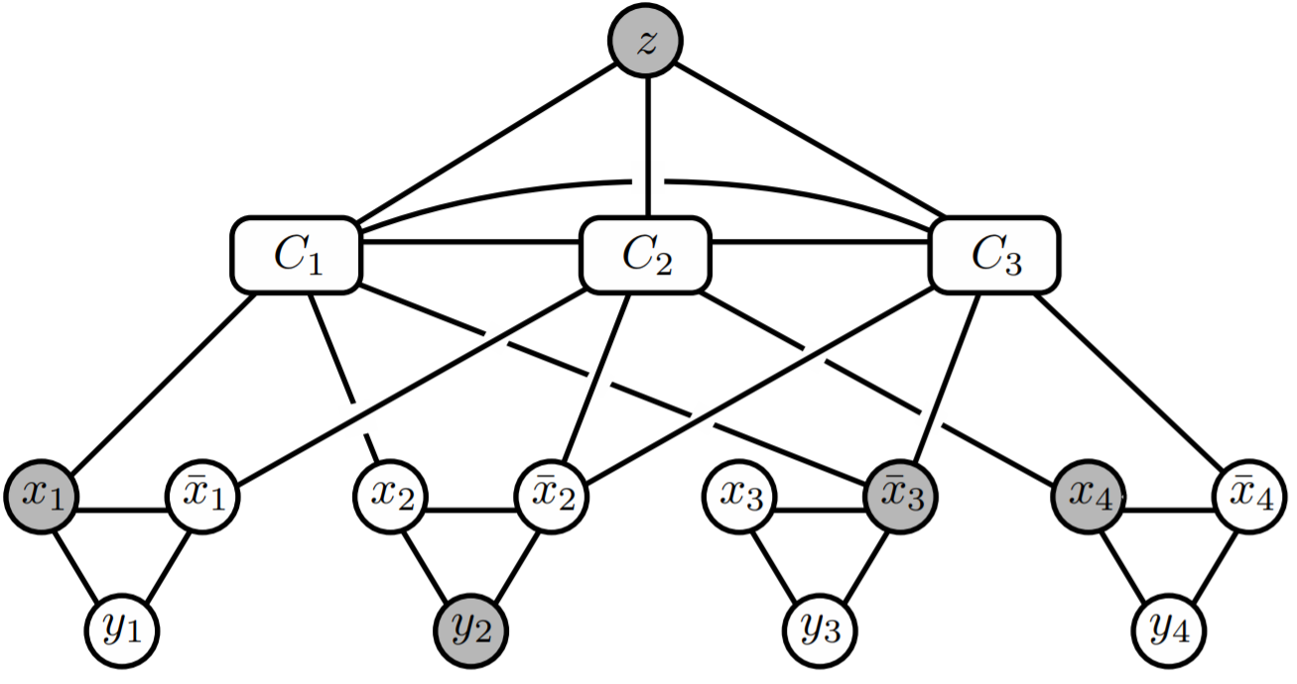
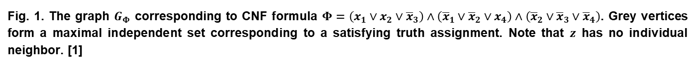
Fig. 1. The graph $G_{Φ}$ corresponding to CNF formula $Φ=\left(x_{1}∨x_{2}∨{\overline{x}}_{3}\right)∧\left({\overline{x}}_{1}∨{\overline{x}}_{2}∨x_{4}\right)∧\left({\overline{x}}_{2}∨{\overline{x}}_{3}∨{\overline{x}}_{4}\right)$. Grey vertices form a maximal independent set corresponding to a satisfying truth assignment. Note that $z$ has no individual neighbor. [1]
Notes:
The above figure represents an instance of a graph $G_{Φ}$ that corresponds to a given CNF $Φ$ constructed for Theorem 9 and Corollary 10 to prove that there exist a polynomial time algorithm that solves the minimal key generation problem for hypergraphs with edges sizes of two. This proves that a CNF $Φ$ is satisfiable if and only if its represented graph is not a unique key graph, making the minimal key generation for hypergraphs of edges of dimension two co-NP-complete.

Slide 10
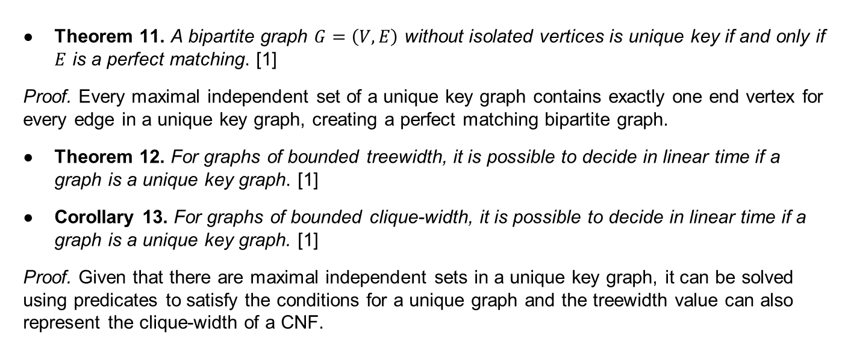
Unique Key Graphs: Examples
Theorem 11. A bipartite graph $G=\left(V, E\right)$ without isolated vertices is unique key if and only if $E$ is a perfect matching. [1]
Proof. Every maximal independent set of a unique key graph contains exactly one end vertex for every edge in a unique key graph, creating a perfect matching bipartite graph.
Theorem 12. For graphs of bounded treewidth, it is possible to decide in linear time if a graph is a unique key graph. [1]
Corollary 13. For graphs of bounded clique-width, it is possible to decide in linear time if a graph is a unique key graph. [1]
Proof. Given that there are maximal independent sets in a unique key graph, it can be solved using predicates to satisfy the conditions for a unique graph and the treewidth value can also represent the clique-width of a CNF.
Notes:
Bipartite graphs consist of two disjoint and independent vertex sets where every edge connects a pair of vertices from one set to another. This also means that no edges exists between a pair of vertices within the same set. Hypergraphs can be represented as bipartite graph, also known as incidence graphs in this type of context, if it contains fixed parts and no unconnected vertices. For a unique key graph, every maximal independent set of a unique key graph contains exactly one end vertex for every edge in the graph, creating a perfect matching bipartite graph.
The treewidth graphs consist of undirected edges with numbers associated with. This type of association is used for many applications commonly for the purpose of parameterized complexity analysis in graph algorithms. For unique key graphs and their CNF representations, the number associated with bounded treewidth graph should be clique-width size in this type of context. Given that there are maximal independent sets in a unique key graph, it can be solved using predicates to satisfy the conditions for a unique graph and the treewidth value can also represent the clique-width of a CNF.

Slide 11
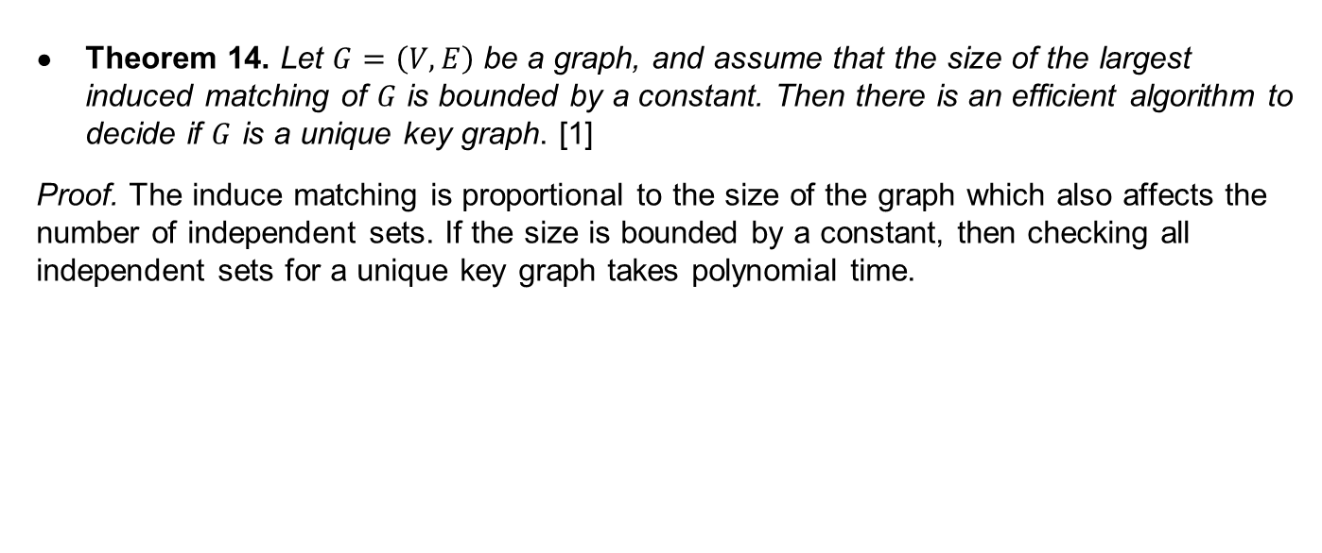
Unique Key Graphs: Examples
Theorem 14. Let $G=\left(V, E\right)$ be a graph, and assume that the size of the largest induced matching of $G$ is bounded by a constant. Then there is an efficient algorithm to decide if $G$ is a unique key graph. [1]
Proof. The induce matching is proportional to the size of the graph which also affects the number of independent sets. If the size is bounded by a constant, then checking all independent sets for a unique key graph takes polynomial time.
Notes:
An induced matching, or strong matching, in graphs is where a subset of edges of an undirected graph do not share any vertices other than its single pair of vertices connected in between within its subset. This definition matches the independent sets used for unique key graphs which compliments the topic. The induce matching in a graph is proportional to its size which also affects the number of independent sets. If the size is bounded by a constant, then checking all independent sets for a unique key graph takes polynomial time.

Slide 12
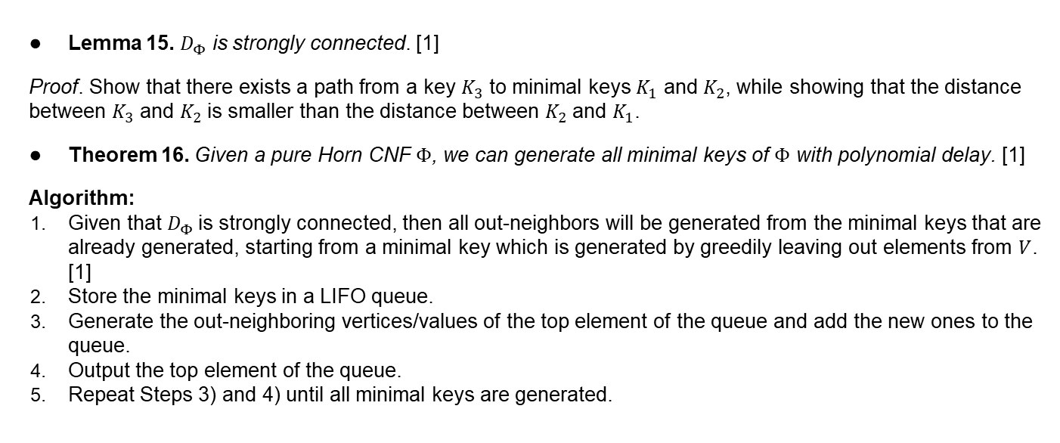
MIN-KEY and MIN-TSS Problems
Lemma 15. $D_{Φ}$ is strongly connected. [1]
Proof. Show that there exists a path from a key $K_{3}$ to minimal keys $K_{1}$ and $K_{2}$, while showing that the distance between $K_{3}$ and $K_{2}$ is smaller than the distance between $K_{2}$ and $K_{1}$.
Theorem 16. Given a pure Horn CNF $Φ$, we can generate all minimal keys of $Φ$ with polynomial delay. [1]
Algorithm:
Given that $D_{Φ}$is strongly connected, then all out-neighbors will be generated from the minimal keys that are already generated, starting from a minimal key which is generated by greedily leaving out elements from $V$. [1]
Store the minimal keys in a LIFO queue.
Generate the out-neighboring vertices/values of the top element of the queue and add the new ones to the queue.
Output the top element of the queue.
Repeat Steps 3) and 4) until all minimal keys are generated.
Notes:
Given a directed graph representation of a pure Horn CNF $Φ$ , it is guaranteed to be strongly connected with Lemma 15 and its proof. Knowing that, a generation algorithm provided by the research paper [1] can be used on a pure Horn CNF to generate all minimal keys with polynomial delay, where the polynomial delay is dependent o the inputted CNF. This leads into proving that the MIN-TSS problem can also be solved in polynomial delay if its bounded.

Slide 13
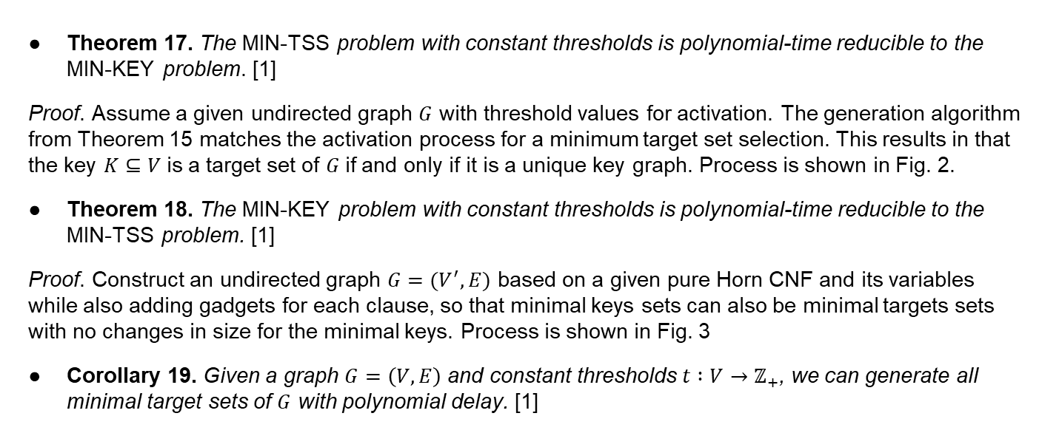
MIN-KEY and MIN-TSS Problems
Theorem 17. The MIN-TSS problem with constant thresholds is polynomial-time reducible to the MIN-KEY problem. [1]
Proof. Assume a given undirected graph $G$ with threshold values for activation. The generation algorithm from Theorem 15 matches the activation process for a minimum target set selection. This results in that the key $K⊆V$is a target set of $G$if and only if it is a unique key graph. Process is shown in Fig. 2.
Theorem 18. The MIN-KEY problem with constant thresholds is polynomial-time reducible to the MIN-TSS problem. [1]
Proof. Construct an undirected graph $G=(V^{′}, E)$ based on a given pure Horn CNF and its variables while also adding gadgets for each clause, so that minimal keys sets can also be minimal targets sets with no changes in size for the minimal keys. Process is shown in Fig. 3
Corollary 19. Given a graph $G=\left(V, E\right)$ and constant thresholds $t :V→ℤ_{+}$, we can generate all minimal target sets of $G$ with polynomial delay. [1]
Notes:
The minimum target set selection problem involves finding a minimum size initial set of Nodes/vertices $S$, also known as the target set, that will eventually activate the entire graph. The given graph is defined to be an undirected graph $G = (V, E)$and we are also given a threshold function $t(v)$. Initially, the subset $S ⊆ V$will be activated before activating the rest of the neighboring vertices. A vertex $v$ becomes activated if at least $t(v)$of its neighbors are already active.
The following MIN-KEY and MIN-TSS problems can be proven to have strong relations by showing they are polynomial-time reducible to each other with proofs shown and their examples from Fig. 2 and Fig. 3. This leads into Corollary 19, by applying Theorems 16 and 17, showing that we can general minimal target sets of a given graph in polynomial delay.

Slide 14
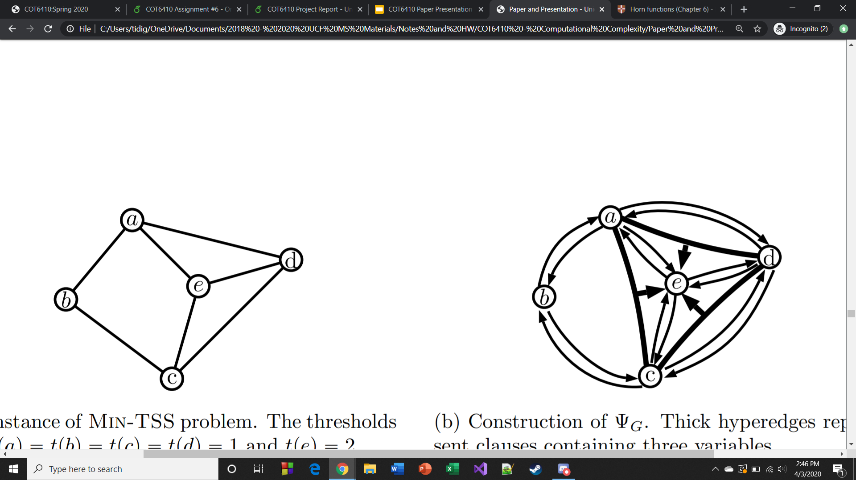


(a) Instance of MIN-TSS problem. The thresholds are $t\left(a\right)=t\left(b\right)=t\left(c\right)=t\left(d\right)=1$ and $t\left(e\right)=2$.
(b) Construction of $Ψ_{G}.$ Thick hyperedges represent clauses containing three variables.
Fig. 2. An illustration of Theorem 17. The CNF associated to $G$ is $Ψ_{G}=\left(b→a\right)∧\left(e→a\right)∧\left(d→a\right)∧\left(a→b\right)∧\left(c→b\right)∧\left(b→c\right)∧\left(d→c\right)∧\left(e→c\right)∧\left(a→d\right)∧\left(c→d\right)∧\left(e→d\right)∧\left(\left\{a, c\right\}→e\right)∧\left(\left\{a, d\right\}→e\right)∧\left(\left\{c, d\right\}→e\right)$. [1]
Notes:
The figure above shows an instance of Theorem 17, showing that based on a given graph of MIN-TSS, it can be converted to a graph associated with pure Horn CNF, while also showing that the minimal targets sets can be minimal keys in a unique key graph.

Slide 15
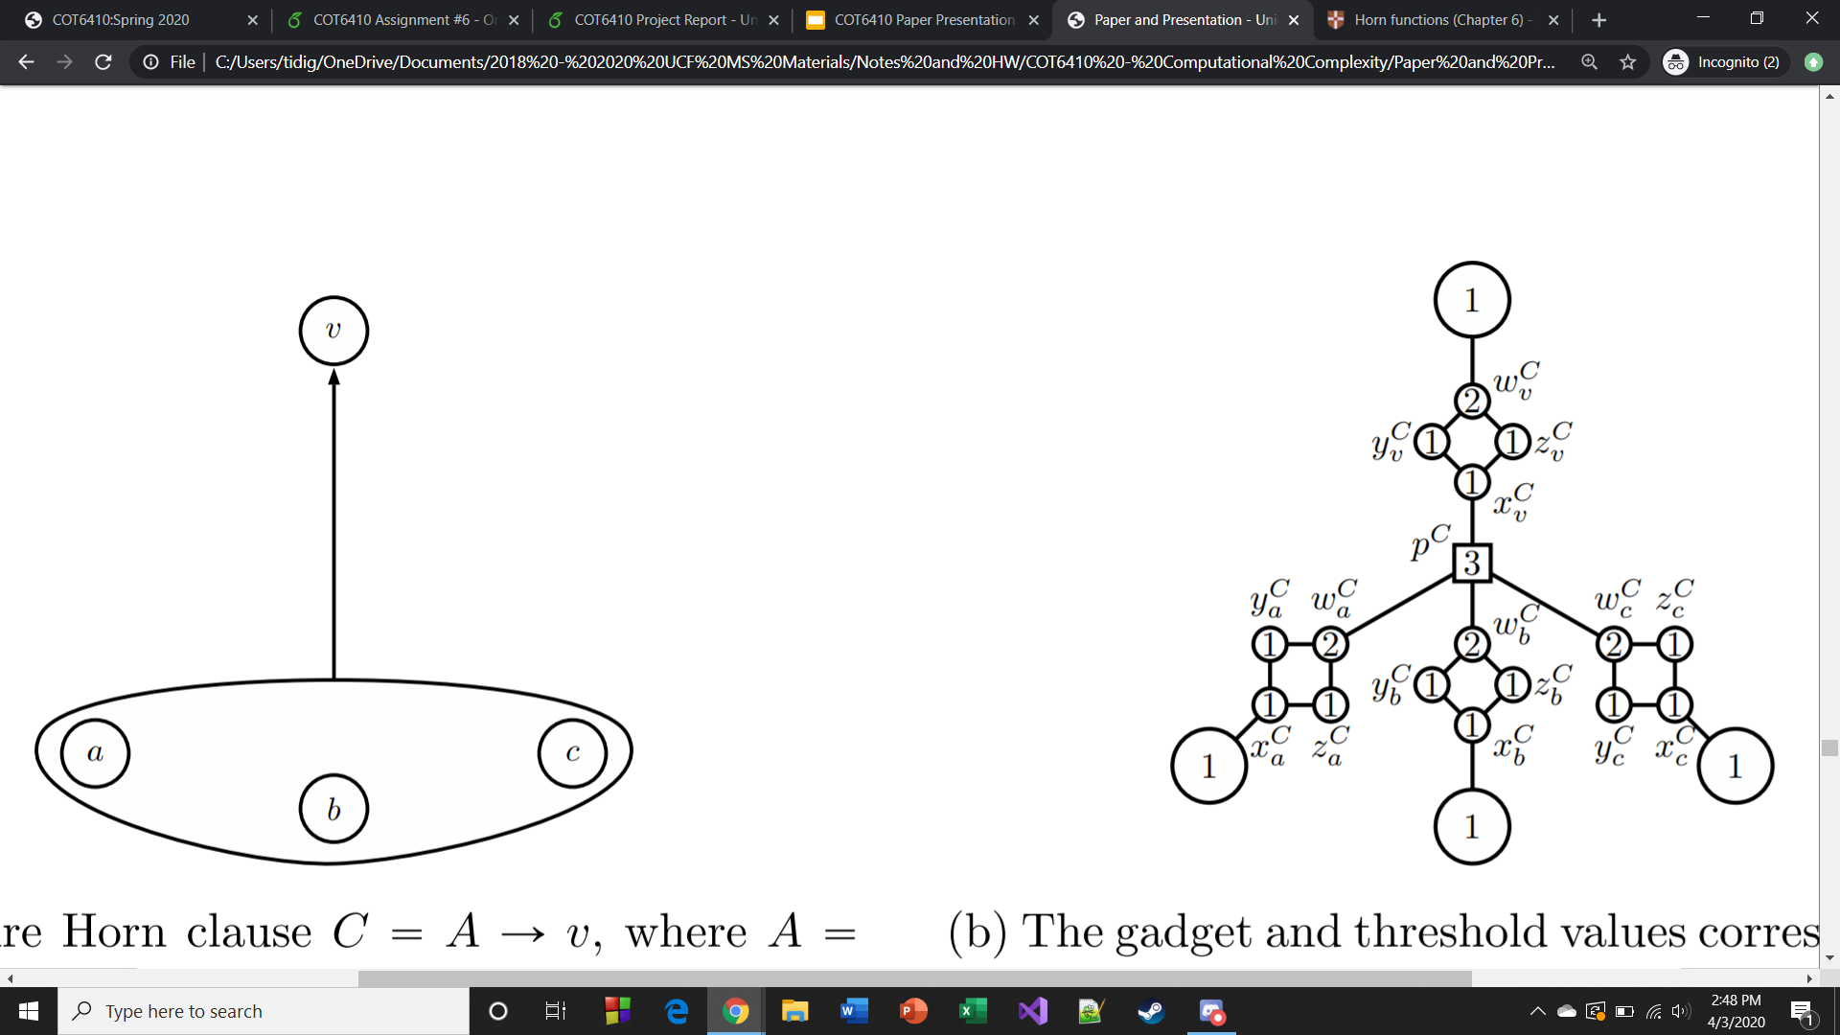


(a) A pure Horn clause $C=A→v$, where $A=\left\{a, b, c\right\}.$
(b) The gadget and threshold values corresponding to $C=A→v$.
Fig. 3. An illustration of Theorem 18. Note that the size of the graph G is polynomial in the length of the input. [1]
Notes:
The figure above shows an instance of Theorem 18 by showing the construction of the new graph with new gadgets contain vertices with certain threshold values corresponding to clauses of pure Horn CNF. This is done to prove that minimal keys can also be targets sets of a given graph $G$ of a target selection problem, without having to change the size.

Slide 16
Discussion and Summary
Major Contributions:
  Effective elaboration of definitions and notations used for Lemmas, Theorems, and Corollaries.
  Presented cases of representations of unique key graphs present new different models to hypergraphs.
  Algorithms are both effective and efficient for both MIN-KEY and MIN-TSS problems and show valid similarities.
  The new reduction using gadgets presented for the MIN-TSS can potentially be used for various problems to reduce to the MIN-TSS problem to prove they can be solved with polynomial delay.
Weaknesses and Criticisms:
  Little variety in the models that can be represented as hypergraphs, or specifically unique key graphs.
  Only presents one example to associate with the MIN-KEY problem and does go into detail of the polynomial delay dependent on the inputted CNF.
Future research and extensions:
  Full survey paper on the versatility of pure Horn CNFs.
  Extended research on different types of graphs that can be presented as hypergraphs or unique key graphs under certain conditions, as well as apply the MIN-KEY problem to other various problems outside of MIN-TSS.
  Look into unbounded MIN-TSS problem and observe if it can be solve in polynomial delay when associated with the MIN-Key problem.
  Provide software implementation on the presented algorithms for effectiveness and efficiency analysis.
Notes:
The research paper [1] is effective on elaborating the different definitions and notations of Sperner hypergraphs, pure Horn CNFs, unique key graphs, and unique key Horn functions when applying them to multiple Lemmas, Theorems, and Corollaries and their proofs. The presented cases of different types of graphs as unique key graphs under certain conditions give new representations of Sperner hypergraphs which extends the research on different models of hypergraphs. The algorithms presented for both MIN-KEY and MIN-TSS problems are both very simple and explained really well on their similarities based on their polynomial-time reductions. The introductions of the new gadgets containing vertices and threshold values for activation, when reducing the MIN-Key problem to the MIN-TSS problem, is creative and can introduce a new type of reduction when regarding other problems that can potentially reduce to the MIN-TSS problem regarding constructed graphs, while also proving that those certain problems can be solved with polynomial delay.
There are a few weaknesses and criticisms that can be made of the research paper. [1] There is very little variety in regards of the presented cases of graphs that can be represented as hypergraphs, or unique key graphs, under certain conditions. This is because their proofs are all dependent on independent sets, creating similar graphs with little difference, thus lacking any meaningful variety when discussing cases of the graphs that can serve as Sperner hypergraphs, with the only difference being in how each graph functions outsides of its bounded conditions. Also, while the discussion of algorithms for both MIN-KEY and MIN-TSS are valid, the researchers do not go into detail of the polynomial delay in terms of the inputted CNF between outputs despite mentioning the exponential size of minimal keys in a pure Horn CNF and only presents one example for the associate of the MIN-KEY problem to other various problems.
For future research papers and extensions, a full survey paper discussing the many topics that have been done in regards of pure Horn CNFs, including the research presented here, giving an idea of its versatility. There could also be open discussion on different types of graphs that can be represent as Sperner hypergraphs, and maybe even unique key graphs given the right conditions, as well as potential for this approach to be associated with various problems to prove that certain problems can be solved with polynomial delay given the right conditions and presenting new reductions between the MIN-KEY problem. There could also be software implementations and a thorough analysis of the algorithms presented here can be done in extended research to get a full perspective of their effectiveness and efficiency given different inputted CNFs presented in graphed results.

Slide 17
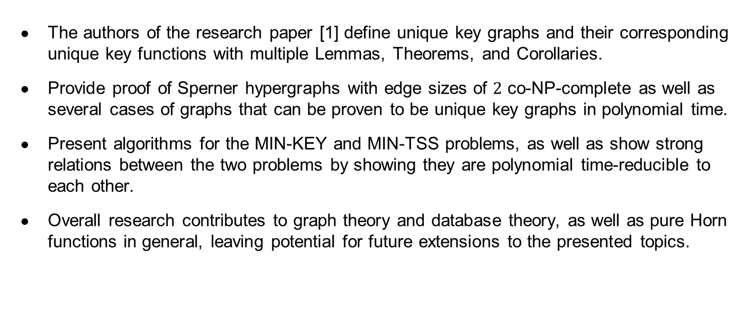
Conclusion
The authors of the research paper [1] define unique key graphs and their corresponding unique key functions with multiple Lemmas, Theorems, and Corollaries.
Provide proof of Sperner hypergraphs with edge sizes of $2$ co-NP-complete as well as several cases of graphs that can be proven to be unique key graphs in polynomial time.
Present algorithms for the MIN-KEY and MIN-TSS problems, as well as show strong relations between the two problems by showing they are polynomial time-reducible to each other.
Overall research contributes to graph theory and database theory, as well as pure Horn functions in general, leaving potential for future extensions to the presented topics.
Notes:
In conclusion, the research paper [1] defines and characterizes both unique key graphs and their corresponding unique key Horn functions through multiple Lemmas, Theorems, and Corollaries. It also provided proofs that Sperner hypergraphs with edges of size two is co-NP-complete when finding whether or not it is a unique key graph, as well as for certain cases of graphs, that can be solved in polynomial time if it is a unique key graph based on certain conditions and requirements. Algorithms were also provided for both minimal key generation and minimal target set selection problems that are related to graphs and their pure Horn function CNF representations, showcasing that both problems have strong relations with each other and are polynomial-time reducible to each other. Overall, the research done provides major contributions to graph theory and database theory, as well as pure Horn functions in general, leaving opportunities and potential for future research to extend upon the presented topics as well as attribute to the versatility of pure Horn functions.

Slide 18
References
[1] K. Bérczi, E. Boros, O. Čepek, P. Kučera, and K. Makino, “Unique key Horn functions,” Feb. 2020.
Notes:
Here is the reference to the research paper used for this presentation, as well as the link if you want to read it for yourself.

Slide 19
Questions and Answers
Questions?
Notes:
Are there any questions?
Thank you for your time.

