Slide 1

Designing RNA Structures is Hard
A report on the paper by Édouard Bonnet, Paweł Rzążewski, and Florian Sikora

Slide 2
RNA Secondary Structure Design
Secondary structure is important in the biological function of the molecule
Solving the problem has real world applications:
  Pharmaceutical research
  Biochemistry
  Synthetic biology
  RNA nanostructures
Notes:
Takeaway: this problem is REALLY important in modern medicine. Existing tools are either heuristics, take exponential time, or are crowd sourced by presenting the problem as a video game (EteRNA)

Slide 3
RNA Structures
RNA is made up of 4 nucleotides, labeled A, U, C, and G
The primary structure of an RNA molecule is just a string over the alphabet {A, U, C, G} – each element is a base
Nucleotides can bind together: A with U, C with G in the Watson-Crick energy model
Each binding reduces the free energy of the molecule
The secondary structure of a molecule is the set of positional pair bindings

Slide 4
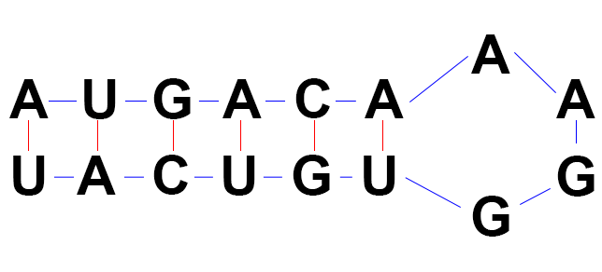
RNA Structures
This structure is called a stem loop
In a pseudo-knot-free structure, no stem contains part of a stem from another stem loop
A minimum free energy (MFE) structure is one with the maximal number of bases paired (each pair is worth -1 energy)
Sequences want to fold into an MFE configuration
Notes:
Real-world RNA molecules are made up a bunch of these stem loops. They are actually not planar, and the teritary structure is what shape the molecule takes in three dimensions.

Slide 5
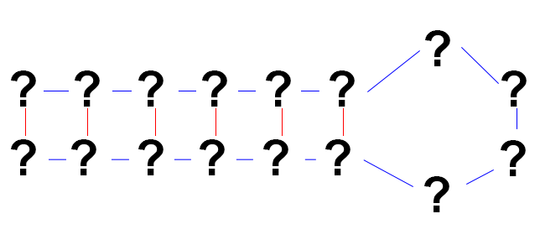
RNA Structures
The RNA-DESIGN problem
  Given a secondary structure, fill in the bases
  The solution cannot fold into any other structure with more bound pairs
RNA-DESIGN-EXTENSION (RDE): we are given some fixed bases in the sequence
Thesis: RNA-DESIGN-EXTENSION is NP-Complete
Notes:
RNA-DESIGN-EXTENSION is the more real-world problem, as there are usually base constraints as well as a structure in a problem instance.

Slide 6
Robustness of Proof
Uses Watson-Crick energy model (simplest)
  Other models are not uniform, more complex
  Prove hardness independently of energy model
Ignore pseudo-knots
  Again, proving hardness in the easier case
Reductions structure maps well to stem loops
  This is realistic, stem loops are a basic RNA building block
Notes:
Here the authors argue why their proof is applicable to the real world: it proves hardness on a simple, but still realistic, model.

Slide 7
RNA-DESIGN-EXTENSION is in NP
The inverse problem is RNA-FOLDING
  Given an RNA sequence, compute its MFE folding
  Can be solved with DP in polynomial time
We can use RNA-FOLDING as an oracle to verify solutions to RNA-DESIGN-EXTENSION
Having such an oracle means that RNA-DESIGN-EXTENSION is in NP

Slide 8
Proving RDE is NP-Complete
Reduce from E3-SAT
  Each clause contains 3 distinct variables
  Known NP-Hard if each variable is used up to 4 times
Map SAT instance onto a string representation of RDE
Label the string representation with bases
Show that the base sequence labels are a solution to the RDE instance iff the SAT instance is satisfiable

Slide 9
Representing Secondary Structures
A structure a well-parenthesized expression with dots (((..)(..)))
()’s represent a base pair, . represents an unpaired base
A sequence is a string of the same length from {1,2,3,4}
  1=A, 2=C, 3=G, 4=U so proper pairs sum to 5
  Sequence w corresponds to structure S if proper pairs match
Sequence is a design if it can’t fold into anything with more pairs
A partial sequence is a sequence with some ?’s (unassigned)
A partial sequence w’ is a design extension if the ?’s can be filled in to turn it into a design.
Notes:
If you imagine bending the structure instance around the dots so the proper open and close parentheses line up, you can see how this representation maps to the stem loop structure we discussed earlier.
We won’t have time to delve into the utility of making the base pairs add up to 5, but it plays into the details of the matching and counting arguments we’ll skim over in the next few slides.
A partial sequence represents the constraint that some of the bases are fixed in the problem instance.

Slide 10
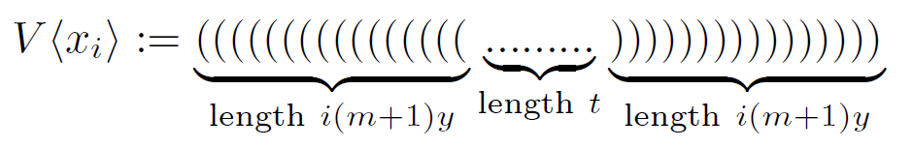
Building the RDE instance: variables
Start with a E3-SAT instance with n variable and m clauses
Define t := n^2 and y := (n+3m)t
  Note t=Θ(n^2), y=Θ(n^3); y >> t >> n
A variable gadget V<Xi> is:
Where (‘s are labeled 1, )’s are labeled 4, and .’s are labeled 2 if the variable is true, else 3
The parentheses are the arch of the variable
Notes:
Credit for the gadget diagrams, for the rest of the presentation, is to the original paper.
Note that matching parentheses pair with each other, as desired, and that since the dots are all labeled 2 or 3, they cannot pair with anything else in the variable gadget.
The variable number of parentheses make the variable gadgets unique and help provide the matching properties. There is some clever math done by counting them to prove the properties we will just believe in this presentation.

Slide 11
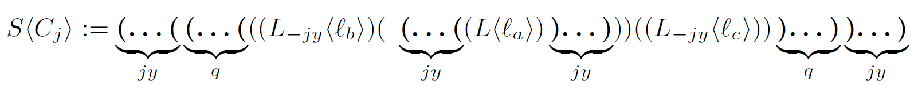
Building the RDE instance: clauses
Let a clause Cj contain three literals la, lb, lc; a < b < c
  la is the same gadget as V<Xa>
  lb and lc are V<Xb>, V<Xc> with jy parentheses pairs remove
  The clause is
Define t := n^2 and y := (n+3m)t
  Note t=Θ(n^2), y=Θ(n^3); y >> t >> n
A variable gadget V<Xi> is:
The jy+q parentheses are the arch of the clause
  The outer jy parentheses are the first arch layer
  The inner q parentheses are the second arch layer
Notes:
Again, the exact number of parentheses is not so important as understanding the overall structure

Slide 12
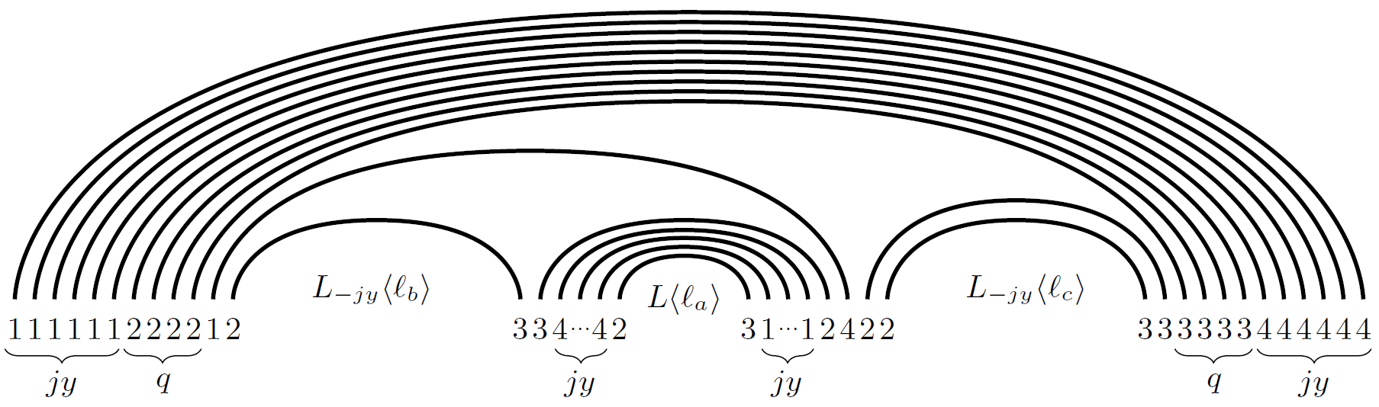
Building the RDE instance
The entire instance is clauses interleaved with variables such that every clause is between the corresponding V<Xb> and V<Xc> gadgets
Notes:
Here we show the numbering of the clause. The literals are numbered like the variables they derive from.
The entire instance is just variables and clauses interleaved so that a clause is always between the variable gadgets corresponding to its outer literals. Such an order can be found in polynomial time.

Slide 13
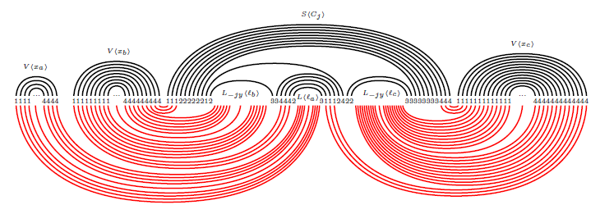
SAT unsatisfiable -> no design extension
Black lines are by given construction, red lines are a re-matching by removing some parentheses
If clause is unsatisfiable, then it is possible to rematch to a better structure
This implies the originally constructed structure is NOT a design extension
Notes:
This is the crux of the proof. The careful construction of the parentheses counts and base labeling can be used to show that if the SAT instance is unsatisfiable, you can find another structure (here shown in red) that matches MORE base pairs in the solution sequence than the structure we constructed. That means that our construction is not an MFE folding of the solution, and therefore isn’t a design extension.
This largely depends on the 2/3 true/false labeling of the dots in the variable and literal gadgets.

Slide 14
SAT satisfiable -> design extension
This direction is too gory for full details
Given a structure S with a satisfiable SAT instance, assume
  There is a better structure S’ for the corresponding sequence w
  Assume wlog that S’ actually is the maximal matching
By an argument of counting matching parts of S’, can prove that there exists S’’ which matches even MORE bases in w
But this is a contradiction, so S’ cannot exist
Therefore S itself must be the maximal matching and is a design extension
We have proven SAT satisfiable iff the corresponding sequence is a design extension, thus RDE is NP-Hard
We showed earlier than RDE is in NP, thus RDE is NP-Complete
Notes:
Whereas the previous direction of the proof used the labeling to show that a better structure could be found, this direction uses a lot of counting parentheses depth to show how, by replacing some sections of S’ with sections from S containing the same clause and variable gadgets, S’’ that is better than S’ can be found.

Slide 15
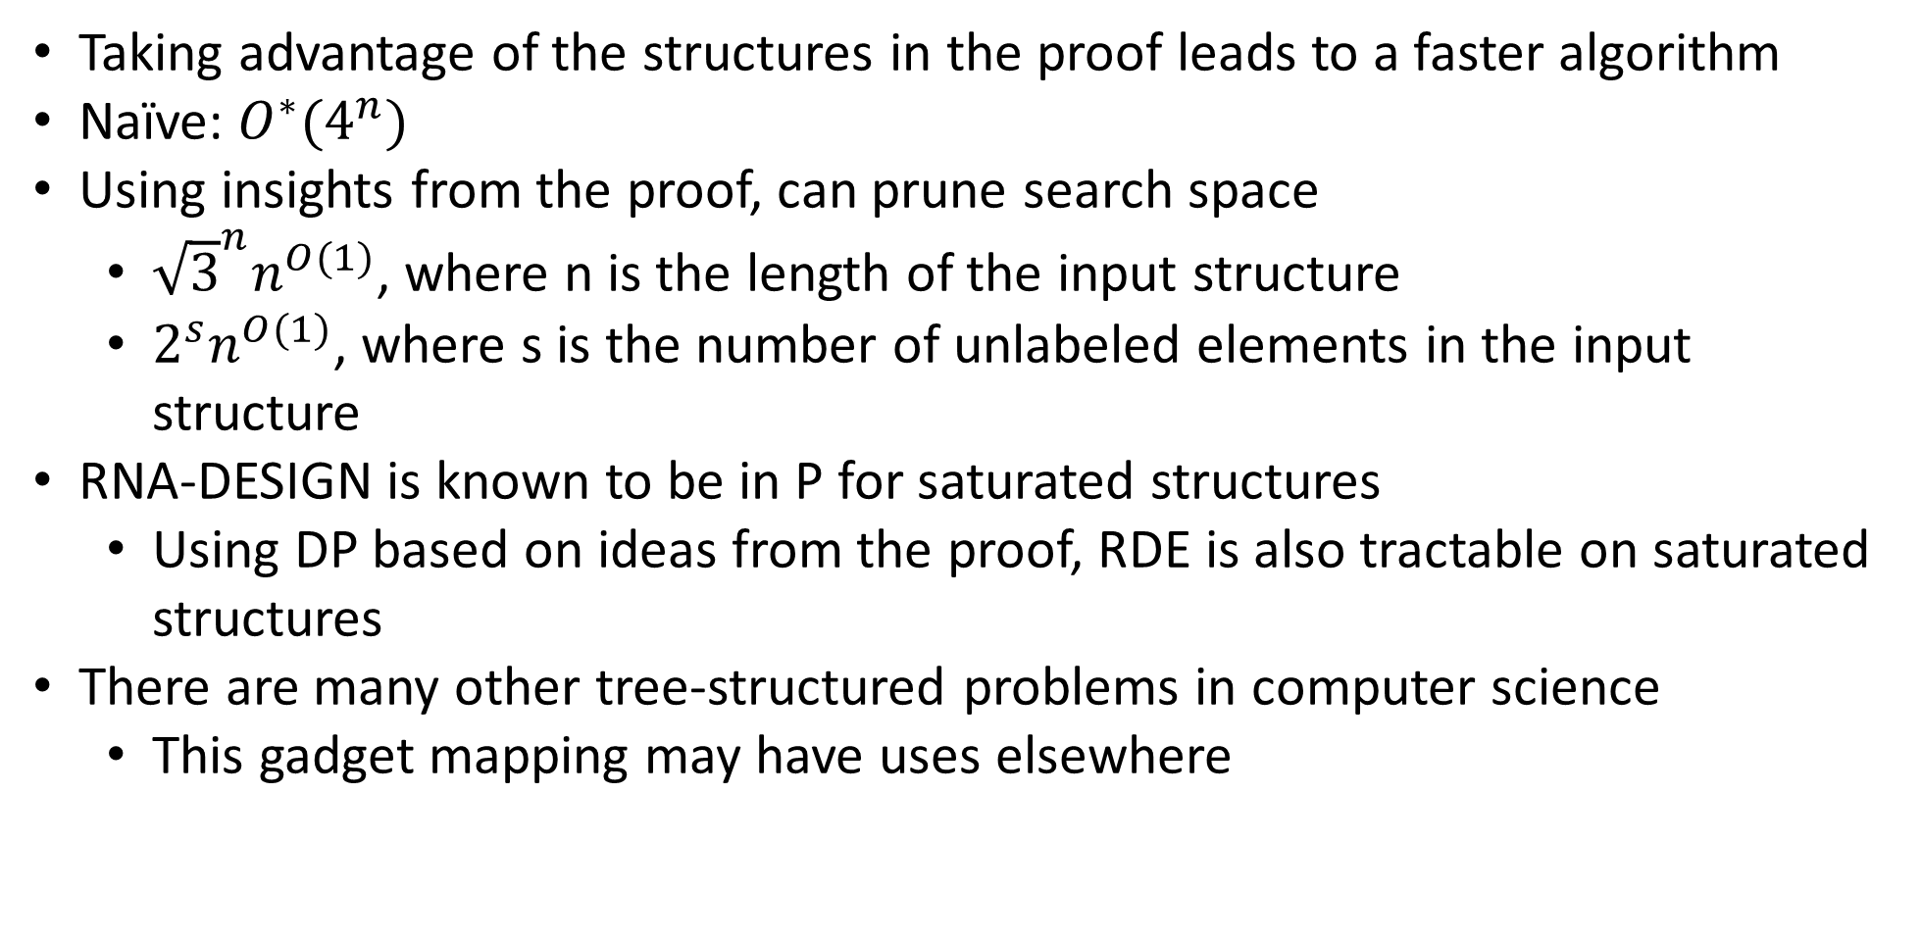
Algorithmic Consequences
Taking advantage of the structures in the proof leads to a faster algorithm
Naïve: $O^{∗}(4^{n})$
Using insights from the proof, can prune search space
  ${\sqrt{3}}^{n}n^{O(1)}$, where n is the length of the input structure
  $2^{s}n^{O(1)}$, where s is the number of unlabeled elements in the input structure
RNA-DESIGN is known to be in P for saturated structures
  Using DP based on ideas from the proof, RDE is also tractable on saturated structures
There are many other tree-structured problems in computer science
  This gadget mapping may have uses elsewhere
Notes:
The proof of hardness, which has been an open problem for a while, is a great result on its own. However, as often happens, the proof gave the authors insight into the structure of the problem, and they were able to describe an algorithm than could solve the problem in better than the naïve brute force method.

Slide 16
Questions?
Notes:
Credit for the gadget diagrams, for the rest of the presentation, is to the original paper
Note that matching parens pair with each other, as desired, and that since the dots are all labeled 2 or 3, they cannot pair with anything else in the variable gadget

