Slide 1
Complexity Theory More Complexity
Charles E. Hughes
COT6410 – Spring 2022 Notes

Slide 2
More Examples of NP Complete Problems

Slide 3
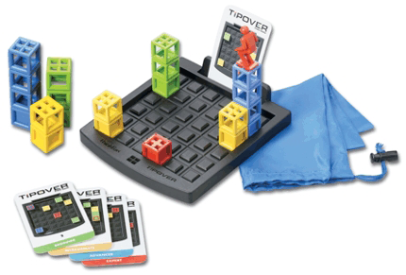
TipOver

Slide 4
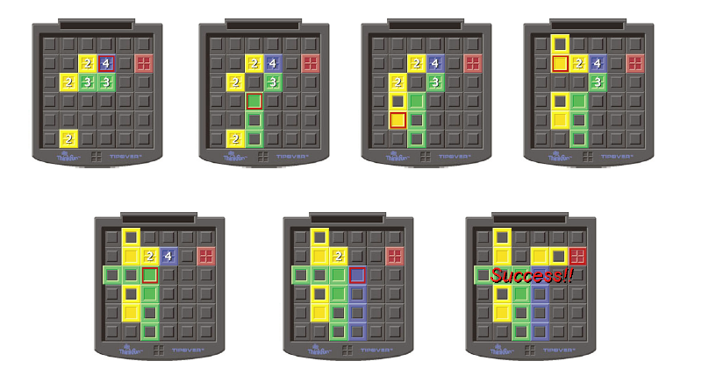
Rules of Game
Numbers are height of crate stack;
If could get 4 high out of way we can attain goal

Slide 5
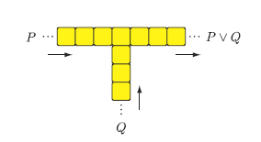
Problematic OR Gadget
Can go out where did not enter

Slide 6
Directional gadget
Single stack is two high;
tipped over stack is one high, two long;
red square is location of person travelling the towers

Slide 7
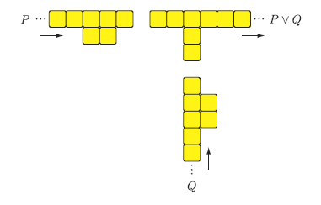
One directional Or gadget

Slide 8
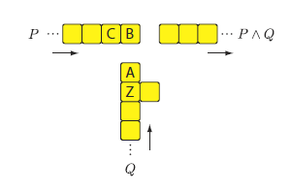
AND Gadget
How AND Works

Slide 9
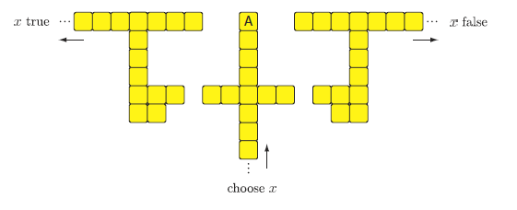
Variable Select Gadget
Tip A left to set x true; right to set x false
Can build bridge to go back but never to change choice

Slide 10
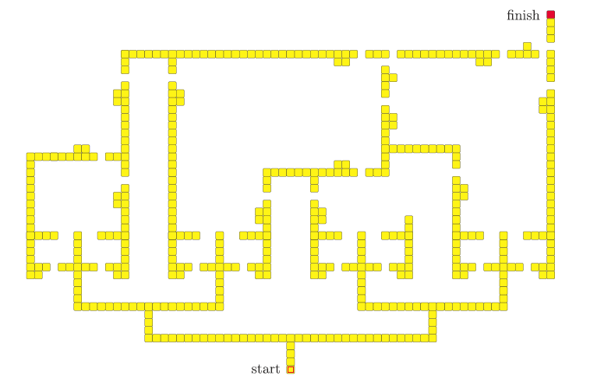
((x∨~x∨y)∧(~y∨z∨w)∧~w)
∧
∧
∨
Bridges back for true paths
∨
∨
∨
x
~x
y
~y
z
~z
w
~w

Slide 11
Win Strategy is NP-Complete
TipOver win strategy is NP-Complete
Minesweeper consistency is NP-Complete
Phutball single move win is NP-Complete
Do not know complexity of winning strategy
Checkers is really interesting
Single move to King is in P
Winning strategy is PSpace-Complete

