Slide 1

Complexity Theory
Introduction
Charles E. Hughes
COT6410 – Spring 2022 Notes

Slide 2
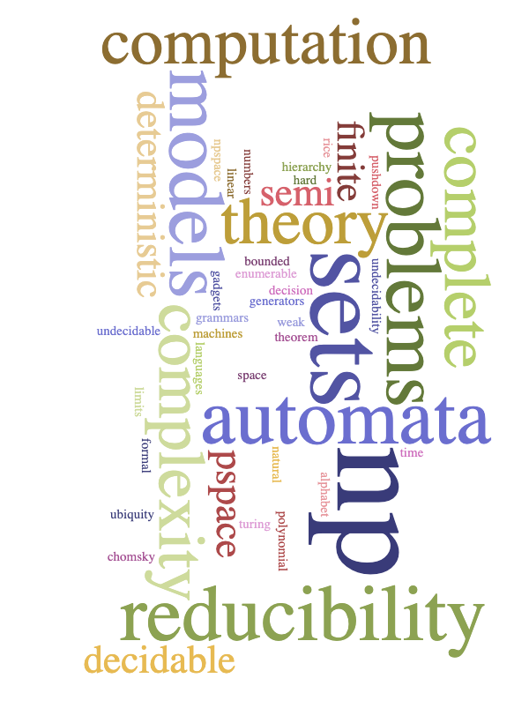
Word Cloud for Course

Slide 3
Who, What, Where and When
3
Instructor: Charles Hughes;
HEC-247C (but will be virtual)
charles.hughes@ucf.edu
(e-mail is a good way to get me)
Use Subject: COT6410
Office Hours: TR 10:45AM-12:00PM
Web Page: https://www.cs.ucf.edu/courses/cot6410/Spring2022
Meetings: TR 9:00AM-10:15AM, HEC-103
28 periods, each 75 minutes long.
Final Exam (Thursday, April 28 from 7:00AM to 9:50AM) is separate from class meetings
GTA: Parisa Darbar Kozekanan
Use Subject: COT6410
Office Hours: TBD

Slide 4
Zoom Meeting Links
Class (TR 9:00-10:15)
  When not face-to-face, we will use
  https://tinyurl.com/yckpdx92
My Office Hours (TR 10:45-11:55)
  Office hours will be virtual
  https://tinyurl.com/y3ffvbm3
GTA’s Office Hours (MW 1:30-3:00)
  TBD

Slide 5
Text Material
References:
My Notes and videos
Sipser, Introduction to the Theory of Computation 3rd Ed., Cengage Learning, 2013.
Hopcroft, Motwani&Ullman, Intro to Automata Theory, Languages and Computation 3rd Ed., Prentice-Hall, 2006.
Garey&Johnson, Computers and Intractability: A Guide to the Theory of NP-Completeness, W. H. Freeman & Co., 1979.
Cooper, Computability Theory 2nd Ed., Chapman-Hall/CRC Mathematics Series, 2003.
Davis, Sigal&Weyuker, Computability, Complexity and Languages 2nd Ed., Acad. Press (Morgan Kaufmann), 1994.
Papadimitriou & Lewis, Elements of the Theory of Computation, Prentice-Hall, 1997.
Bernard Moret, The Theory of Computation, Addison-Wesley, 1998.
Oded Goldreich, Computational Complexity: A Conceptual Approach, Cambridge University Press, 2008.
Oded Goldreich, P, NP, and NP-Completeness: The Basics of Complexity Theory, Cambridge University Press, 2010.
Arora&Barak, Computational Complexity: A Modern Approach, Cambridge University Press, 2009.
Various other people’s notes on web
5

Slide 6
Goals of First Part of Course
Notion of decision problems
  Sets of natural numbers
  Sets of strings over some finite alphabet (language)
Recognizers versus Generators
  Grammars as language generators (Chomsky Hierarchy)
Various models of computation
  Weak models such as finite, pushdown, and linear bounded automata
  Review of major results from automata and formal language theory
  Turing Machines and other equivalent models
  Deterministic versus non-deterministic models
  Relation of models to sets/languages they recognize
6

Slide 7
Core Goals of Course
Limits of computation
  Undecidable problems
  Enumerable/semi-decidable problems
  The technique of reducibility
  The ubiquity of undecidability, including Rice’s Theorem
  The notion of semi-decidable (re) and of co-re sets
Complexity theory
  Polynomial reducibility
  Time complexity, the sets P, NP, co-NP, NP-complete, NP-hard, etc., and the question does P=NP?
  Space complexity, the sets PSPACE, PSPACE-complete, NPSPACE
  Various NP complete problems
7

Slide 8
Expected Outcomes
8
You will gain a solid understanding of various types of computational models and their relations to one another.
You will have a strong sense of the limits that are imposed by the very nature of computation, and the ubiquity of unsolvable problems throughout CS.
You will understand the notion of computational complexity and especially of the classes of problems known as P, NP, co-NP, NP-complete and NP-Hard.
You will (hopefully) come away with stronger formal proof skills and a better appreciation of the importance of discrete mathematics to all aspects of CS.
And I hope you have fun – if you come with an open mind, you may find the course to be enjoyable.

Slide 9
Keeping Up
9
I expect you to visit the course web site regularly (preferably daily) to see if changes have been made or material has been added.
Attendance is preferred, although I do not take roll.
I do, however, ask lots of questions in class and give lots of hints about the kinds of questions I will ask on exams. It would be a shame to miss the hints, or to fail to impress me with your insightful in-class answers.
You are responsible for all material covered in class, whether in the notes or not.

Slide 10
Rules to Abide By
10
Do Your Own Work
  When you turn in an assignment, you are implicitly telling me that these are the fruits of your labor. Do not copy anyone else's homework or let anyone else copy yours. In contrast, working together to understand lecture material and solutions to problems not posed as assignments is encouraged.
Late Assignments
  I will accept no late assignments, except under very unusual conditions, and those exceptions must be arranged with me in advance unless associated with some tragic event.
Exams
  No communication during exams, except with me or a designated proctor, will be tolerated. A single offense will lead to termination of your participation in the class, and the assignment of a failing grade.

Slide 11
Grading
11
Grading of Assignments and Exams
  I will endeavor to return the midterm exam within a week of its taking place and each assignment within a week of its due date.
Exam Weights
  The weights of exams will be adjusted to your personal benefits, as I weigh the exam you do well in more than one in which you do less well.
Paper, Presentation Slides, Video
  This should be informative for you and me.

Slide 12
Important Dates
12
Midterm – Thursday, March 3 (tentative)
Withdraw Deadline – Friday, March 25
Spring Break – March 6-12
Final – Tues., April 28, 7:00AM – 9:50AM

Slide 13
Evaluation (tentative)
13
Midterm – 125 points ; Final – 125 points
Assignments – 75 points
Paper and Presentation – 125 points
Extra – 50 points used to increase weight of exams or maybe paper/presentation, always to your benefit
Total Available: 500 points
Grading will be A >= 90%, B+ >= 85%,
B >= 80%, C+ >= 75%, C >= 70%,
D >= 50%, F < 50% (Minuses might be used)

Slide 14
Decision Problems
A set of input data items ("instances” from some universe of discourse, e.g., natural numbers, strings over alphabet, graphs, …)
Each input data item defines a question with an answer Yes/No or True/False or 1/0.
A decision problem can be viewed as a relation between its universe of discourse and its binary range
A decision problem can also be viewed as a partition of the universe of discourse into those that give rise to true instances and those that give rise to false instances.
In each case, we seek an algorithmic solution (in the form of a predicate) or a proof that none exists
When an algorithmic solution exists, we seek an efficient algorithm, or proofs of the problem’s inherent complexity
Sometimes, when the problem appears to be intractable, we seek out fast heuristic approximate solutions

Slide 15
Instances vs Problems
Each instance has an 'answer.‘
  An instance’s answer is the solution of the instance - it is not the solution of the problem.
  A solution of the problem is a computational procedure that finds the answer of any instance given to it – the procedure must halt on all instances – it must be an 'algorithm.'

Slide 16
Assignment # 1 is Required for Financial Aid
Complete questionnaire (in quizzes category) on Webcourses.
Complete all questions on time for a few free points out of total points for all assignments.
Complete and submit by one minute before Midnight Friday, 1/14.

Slide 17
UNIVERSE OF DISCOURSE
USUALLY STRINGS OR NATURAL NUMBERS
DECISION PROBLEMS
S
Subset of interest,
maybe with ordered elements
For some element, x, is x in S?
Question: How many subsets of Natural Numbers are there?
How many languages are there over some finite alphabet?
Example 1: S is set of Primes and x is a natural number; is x in S (is x a prime)?
Example 2: S is an undirected graph (pairs of neighbors); is S 3-colorable?
Example 3: S is a program in C; is S syntactically correct?
Example 4: S is program in C; does S halt on all input?
Example 5: S is a set of strings; is the language S Regular, Context-Free, … ?

Slide 18
Recognizer and Generators
When we discuss languages and classes of languages, we discuss recognizers and generators
A recognizer for a specific language is a program or computational model that differentiates members from non-members of the given language
A portion of the job of a compiler is to check to see if an input is a legitimate member of some specific programming language – we refer to this as a syntactic recognizer
A generator for a specific language is a program that generates all and only members of the given language, (usually based on a grammar)
In general, it is not individual languages that interest us, but rather classes of languages that are definable by some specific class of recognizers or generators
One type of recognizer is called an automata and there are multiple classes of automata
One type of generator is called a grammar and there are multiple classes of grammars
Our first journey will be a review of automata and grammars

Slide 19
UNIVERSE OF LANGUAGES
RE = Semi-Dec = Phrase-Structured
Recursive = Decidable
Context-Sensitive
Context-Free
DCFL
REGULAR
Non-RE

Slide 20
MODELS OF COMPUTATION
AUTOMATA Recognizers
Turing Machines (DTM = NDTM)
LBAs (DLBAs = NDLBAs)
NPDAs
DPDAs
DFAs = NDFAs
Of these models, only TMs can do general computation

Slide 21
REWRITING SYSTEMS
GRAMMARS
Generators
Type 0=Phrase-Structured
Type 1=Context-Sensitive
Type 2=Context-Free
Deterministic CFG
LR(k)
Type 3=
Regular =
Right Linear

Slide 22
What We are Studying
Computability Theory
The study of what can/cannot be done via purely computational means.
Complexity Theory
The study of what can/cannot be done well via purely computational means.

Slide 23
Three Classes of Problems
  Problems are often classified in one of three groups (classes):
  Undecidable (impossible), Exponential (hard), and Polynomial (easy).
  Theoretically, all problems belong to exactly one of these three classes and our job is often to find which one.

Slide 24
Why do we Care?
When given a new problem to solve (design an algorithm for), if it's undecidable, or even exponential, you will waste a lot of time trying to write a polynomial solution for it!!
If the problem really is polynomial, it will be worthwhile spending some time and effort to find a polynomial solution and, better yet, the lowest degree polynomial solution.
You should know something about how hard a problem is before you try to solve it.

Slide 25
Effective Procedure
25
A process whose execution is clearly specified to the smallest detail
Such procedures have, among other properties, the following:
  Processes must be finitely describable, and the language used to describe them must be over a finite alphabet.
  The current state of the machine model must be finitely presentable.
  Given the current state, the choice of actions (steps) to move to the next state must be easily determinable from the procedure’s description.
  Each action (step) of the process must be capable of being carried out in a finite amount of time.
  The semantics associated with each step must be clear and unambiguous.

Slide 26
Algorithm
26
An effective procedure that halts on all input
The key term here is “halts on all input”
By contrast, an effective procedure may halt on all, none or some of its input.
The domain of an algorithm is its entire universe of possible inputs
The domain of a procedure is the inputs on which it converges (stops).

Slide 27
Sample Algorithm/Procedure
  { Example algorithm:
  Linear search of a finite list for a key;
  If key is found, answer “Yes”;
  If key is not found, answer “No”; }
  { Example procedure:
  Linear search of a finite list for a key;
  If key is found, answer “Yes”;
  If key is not found, try this strategy again; }
  Note: Latter is not unreasonable if the list can be altered by some properly synchronized concurrent thread.

Slide 28
Procedure vs Algorithm
Looking back at our approaches to “find a key in a finite list,” we see that the algorithm always halts and always reports the correct answer. In contrast, the procedure does not halt in some cases, but never lies.
What this illustrates is the essential distinction between an algorithm and a procedure – algorithms always halt in some finite number of steps, whereas procedures may run on forever for certain inputs. A particularly silly procedure that never lies is a program that never halts for any input.

Slide 29
Notion of Solvable
A problem is solvable if there exists an algorithm that solves it (provides the correct answer for each instance).
The fact that a problem is solvable or, equivalently, decidable or, equivalently, recursive does not mean it is solved. To be solved, someone must have produced a correct algorithm.
The distinction between solvable and solved is subtle. Solvable is an innate property – an unsolvable problem can never become solved, but a solvable one may or may not be solved in an individual’s lifetime.

Slide 30
An Old Solvable Problem
Does there exist a set of positive whole numbers, a, b, c and an n>2 such that a^{n}+b^{n} = c^{n}?
In 1637, the French mathematician, Pierre de Fermat, claimed that the answer to this question is “No”. This was called Fermat’s Last Theorem, even though he never produced a proof of its correctness.
While this problem remained unsolved until Fermat’s claim was verified in 1995 by Andrew Wiles, the problem was always solvable, since it had just one question, so the solution was either “Yes” or “No”, and an algorithm exists for each of these candidate solutions.

Slide 31
Research Territory
  Decidable – vs – Undecidable
  (area of Computability Theory)
  Exponential – vs – polynomial
  (area of Computational Complexity)
  For “easy” problems, we want to determine lower and upper bounds on complexity and develop best Algorithms
  (area of Algorithm Design/Analysis)

Slide 32
Computability vs Complexity
Computability focuses on the distinction between solvable and unsolvable problems, providing tools that may be used to identify unsolvable problems – ones that can never be solved by mechanical (computational) means. Interestingly, unsolvable problems are everywhere as you will see.
In contrast, complexity theory focuses on how hard it is to solve problems that are known to be solvable. Hard solvable problems abound in the real world. We will address computability theory for the first part of this course, returning to complexity theory later in the semester.

