Slide 1
Notes:
TeachLivE (teaching and learning in a virtual environment) is a collaboration between Education, CS and Modeling&Simulation. CREST (the Center for Research in Educational Simulation & Training) houses TeachLivE. withing the College of Community Innovation and Education (CCIE) at the University of Central Florida (UCF). SREAL (the Synthetic Reality Lab) is the development and CS/M&S contributor to the collaboration. Charlie Hughes, my injured academic dad, is the founder of SREAL and the technical lead for CREST/TeachLivE.

Slide 2
Research Findings
4 10-minute Sessions can change teacher behavior
Training transfers into the real classroom
Areas measured:
Positive Specific Praise
Asking Higher Order Questions
Notes:
The TeachLivE effort started as a UCF attempt to improve teacher preparation, focusing initially on Middle School (the hardest environment for most novice teachers). After we had recruited a few external partners (initially Utah State), the Bill & Melinda Gates Foundation awarded us a grant to show effectiveness (see research findings from national study), scalability and commercial potential. I, Aleshia, was Director of Technology Development. Within 18 months, we scaled to 65 partners and commercialized before the grant ended (mursion.com).

Slide 3
Parents & Administrators
Notes:
Not extended our range during the Gates project to add a high school version, scenarios for PTA meetings, scenarios for interviewing for one's first position as a teacher, and scenarios to prepare administrators.

Slide 4
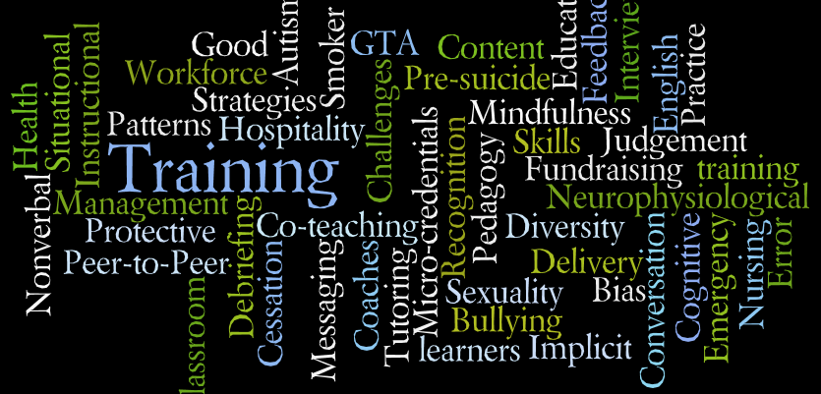
Notes:
The "word cloud" shows how quickly the TeachLivE paradigm found its way into many, many domains of human-to-human interaction.

Slide 5
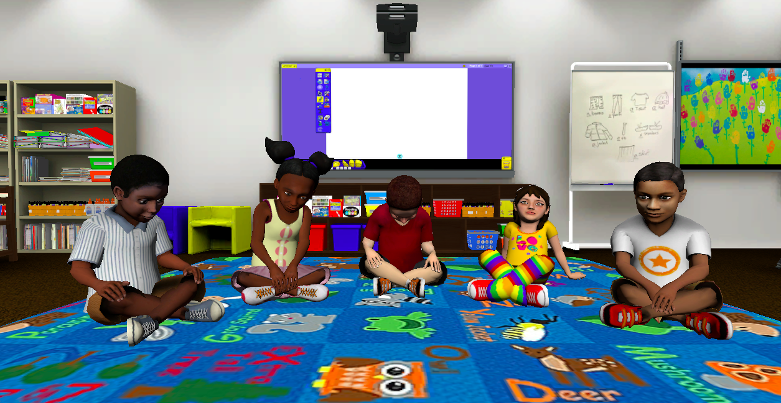
Kindergarten
Notes:
We recently added Kindergarten scenarios. Thisd one is one with the children on the floor in criss-cross positions. Note that Martin, the boy in the middle, exhibits behaviors associated with children with autism. In fact, Martin was designed by a young man with autism and his mother. he appears in a high school scene you will see shortly.

Slide 6
When Immersive is Needed?
Notes:
If one thinks about the Kindergarten scene, where the students are n the floor, one immediately realizes that experiencing this on a screen is very limiting. We want participants to get on the ground and have eye-to-eye contact with the children. Using an HMD encourages this and, if a teacher candidate does not get on the ground with the children, we would question if they have chosen the right profession.

Slide 7
Current Projects
Interviewing Adolescents about Non-Suicidal Self Injurious Behavior (NSSI)
Sexual Health Discussions for those with Intellectual Challenges
GTA Training for Active Learning Environments (Physics, Chem., etc.)
Inclusive Classrooms: English Language Learners, Autism, Cognitive Challenges
Notes:
The UCF team and their academic partners)and Mursion and its commercial partners have greatly expanded the use cases for the TeachLivE technologies over the past four years. At UCF we are focusing on inclusive classrooms, medical student training (teen self harm prevention and sexual health) a GTA training. We are, of course, als doing basic research in Extended Reality (XR), including a participant's sense of presence (mention your work) and virtual body ownership, and analysis of a participant's emotional state and messaging (verbal and non-verbal).

Slide 8
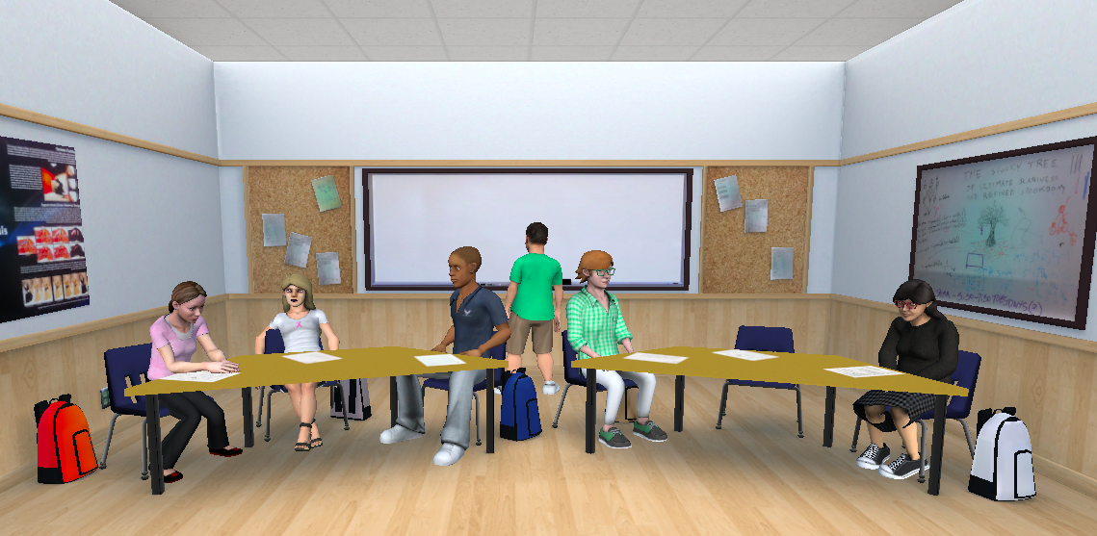
Inclusive High School Class
Notes:
This show an inclusive high school classroom. Martin, at board, is a child with autism; Bailey (on far left) is a cild with intellectual and emotional challenges).

Slide 9
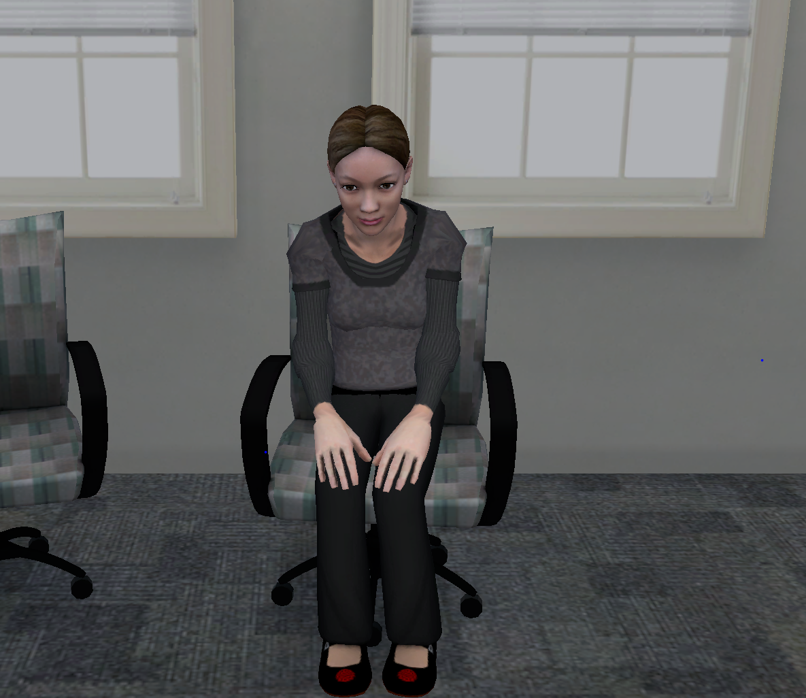
Non-Suicidal Self Injury
Notes:
This young lady is a "cutter" as in the streaming series "Sharp Objects." She is used in scenarios to prepare pediatrician and general practitioners to help address the needs of such patients.

Slide 10
GTA Training
Notes:
This shows one of our lab scenes for preparing GTAs for active learning environments. The project is NSF-funded and led by a faculty member in Physics.

Slide 11
Behind the Scenes
Notes:
We are not magicians; we have not passed the Turing Test. We use an "Interactor," a human-in-the-loop. However, only one Interactor is required to control up to six virtual characters, each of which has a fixed behaviors/background/personality profile but not a "script," and each avatar is trained for a scenarios. The software can support multiple Interactors and we use that in training new Interactors.

Slide 12
Why Not Artificial Intelligence?
AI Can’t handle complex, contextual interactions.
Multiple correct ways to teach / converse / interact.
Multiple paths to desired outcomes.
Dynamic difficulty scaling.
Efficient use of resources.
Notes:
Why not AI? Here are a few reasons.

Slide 13
Machine Learning Research Directions
Computer recognition of emotions.
Using wearable devices to respond to learner stress levels.
Recognition of specific verbal and non-verbal teacher behaviors.
Notes:
Why machine learning in some parts of the system. Here are a few instances where it is not just helpful but also mandatory.

