Slide 1
Who, What, Where and When
1
Instructor: Charles Hughes;
HEC-247C
charles.hughes@ucf.edu
(e-mail is a good way to get me)
Use Subject: COT6410
Office Hours: TR 3:15PM-4:30PM
Web Page: http://www.cs.ucf.edu/courses/cot6410/Spring2019
Meetings: TR 1:30PM-2:45PM, HEC-103;
28 periods, each 75 minutes long.
Final Exam (Tuesday, April 30 from 1:00PM to 3:50PM) is separate from class meetings
GTA: Harish Raviprakash; harishr@knights.ucf.edu
Use Subject: COT6410
Office Hours: MW 1:30PM-3:00PM; Room: HEC-308

Slide 2
Text Material
References:
Cooper, Computability Theory 2nd Ed., Chapman-Hall/CRC Mathematics Series, 2003.
Garey&Johnson, Computers and Intractability: A Guide to the Theory of NP-Completeness, W. H. Freeman & Co., 1979.
Davis, Sigal&Weyuker, Computability, Complexity and Languages 2nd Ed., Acad. Press (Morgan Kaufmann), 1994.
Papadimitriou & Lewis, Elements of the Theory of Computation, Prentice-Hall, 1997.
Bernard Moret, The Theory of Computation, Addison-Wesley, 1998.
Hopcroft, Motwani&Ullman, Intro to Automata Theory, Languages and Computation 3rd Ed., Prentice-Hall, 2006.
Oded Goldreich, Computational Complexity: A Conceptual Approach, Cambridge University Press, 2008.
Draft available at http://www.wisdom.weizmann.ac.il/~/oded/cc-drafts.html
Oded Goldreich, P, NP, and NP-Completeness: The Basics of Complexity Theory, Cambridge University Press, 2010.
Draft available at http://www.wisdom.weizmann.ac.il/~/oded/bc-drafts.html
Arora&Barak, Computational Complexity: A Modern Approach, Cambridge University Press, 2009.
Draft available at http://www.cs.princeton.edu/theory/complexity/
Sipser, Introduction to the Theory of Computation 3rd Ed., Cengage Learning, 2013.
2

Slide 3
Goals of Course
Introduce Computability and Complexity Theory, including
  Review background on automata and formal languages
  Basic notions in theory of computation
    Algorithms and effective procedures
    Decision and optimization problems
    Decision problems have yes/no answer to each instance
  Limits of computation
    Turing Machines and other equivalent models
    Determinism and non-determinism
    Undecidable problems
    The technique of reducibility; The ubiquity of undecidability (Rice’s Theorem)
    The notions of semi-decidable (re) and of co-re sets
  Complexity theory
    Order notation (quick review)
    Polynomial reducibility
    Time complexity, the sets P, NP, co-NP, NP-complete, NP-hard, etc., and the question does P=NP? Sets in NP and NP-Complete.
    Gadgets and other reduction techniques
3

Slide 4
Expected Outcomes
4
You will gain a solid understanding of various types of computational models and their relations to one another.
You will have a strong sense of the limits that are imposed by the very nature of computation, and the ubiquity of unsolvable problems throughout CS.
You will understand the notion of computational complexity and especially of the classes of problems known as P, NP, co-NP, NP-complete and NP-Hard.
You will (hopefully) come away with stronger formal proof skills and a better appreciation of the importance of discrete mathematics to all aspects of CS.

Slide 5
Keeping Up
5
I expect you to visit the course web site regularly (preferably daily) to see if changes have been made or material has been added.
Attendance is preferred, although I do not take roll.
I do, however, ask lots of questions in class and give lots of hints about the kinds of questions I will ask on exams. It would be a shame to miss the hints, or to fail to impress me with your insightful in-class answers.
You are responsible for all material covered in class, whether in the notes or not.

Slide 6
Rules to Abide By
6
Do Your Own Work
  When you turn in an assignment, you are implicitly telling me that these are the fruits of your labor. Do not copy anyone else's homework or let anyone else copy yours. In contrast, working together to understand lecture material and solutions to problems not posed as assignments is encouraged.
Late Assignments
  I will accept no late assignments, except under very unusual conditions, and those exceptions must be arranged with me in advance unless associated with some tragic event.
Exams
  No communication during exams, except with me or a designated proctor, will be tolerated. A single offense will lead to termination of your participation in the class, and the assignment of a failing grade.

Slide 7
Grading
7
Grading of Assignments and Exams
  I will endeavor to return each exam within a week of its taking place and each assignment within a week of its due date.
Exam Weights
  The weights of exams will be adjusted to your personal benefits, as I weigh the exam you do well in more than one in which you do less well.

Slide 8
Important Dates
8
Midterm – Tues., March 5 (tentative)
Spring Break – March11-16
Withdraw Deadline – Wednesday, March 20
Final – Tues., April 30, 1:00PM–3:50PM

Slide 9
Evaluation (tentative)
9
Mid Term – 125 points ; Final – 200 points
Assignments – 75 points;
Paper and Presentation – 75 points
Extra – 25 points used to increase weight of exams or maybe paper/presentation, always to your benefit
Total Available: 500 points
Grading will be A >= 90%, B+ >= 85%,
B >= 80%, C+ >= 75%, C >= 70%,
D >= 50%, F < 50% (Minuses might be used)

Slide 10
Decision Problems
A set of input data items (input "instances” or domain)
Each input data item defines a question with an answer Yes/No or True/False or 1/0.
A decision problem can be viewed as a relation between its domain and its binary range
A decision problem can also be viewed as a partition of the input domain into those that give rise to true instances and those that give rise to false instances.
In each case, we seek an algorithmic solution (in the form of a predicate) or a proof that none exists
When an algorithmic solution exists, we seek an efficient algorithm, or proofs of the problem’s inherent complexity

Slide 11
UNIVERSE OF DISCOURSE
USUALLY STRINGS OR NATURAL NUMBERS
DECISION PROBLEMS
S
Subset of interest,
maybe with ordered elements
For some element, x, is x in S?
Question: How many subsets of Natural Numbers are there?
Example 1: S is set of Primes and x is a natural number; is x in S (is x a prime)?
Example 2: S is an undirected graph (pairs for neighbors); is S 3-colorable?
Example 3: S is a program in C; is S syntactically correct?
Example 4: S is program in C; does S halt on all input?
Example 5: S is a set of strings; is the language S Regular, Context-Free, … ?

Slide 12
Recognizer and Generators
When we discuss languages and classes of languages, we discuss recognizers and generators
A recognizer for a specific language is a program or computational model that differentiates members from non-members of the given language
A portion of the job of a compiler is to check to see if an input is a legitimate member of some specific programming language – we refer to this as a syntactic recognizer
A generator for a specific language is a program that generates all and only members of the given language
In general, it is not individual languages that interest us, but rather classes of languages that are definable by some specific class of recognizers or generators
One type of recognizer is called an automata and there are multiple classes of automata
One type of generator is called a grammar and there are multiple classes of grammars
Our first journey will be a review of automata and grammars

Slide 13
Alphabets and Strings
DEFINITION 1. An alphabet Σ is a finite, non-empty set of abstract symbols.
DEFINITION 2. Σ*, the set of all strings over the alphabet, S, is given inductively as follows.
  Basis: λ ∈ Σ* ( the null string is denoted by λ, it is the string of length 0, that is |λ| = 0) [text uses ε but I avoid that as hate saying ε ∈ A; it’s really confusing when manually written]
  ∀a ∈ Σ, a ∈ Σ* (the members of S are strings of length 1, |a| = 1)
  Induction rule: If x ∈ Σ*, and a ∈ Σ, then a⋅x ∈ Σ* and x⋅a ∈ Σ*. Furthermore, λ⋅x = x⋅λ = x, and |a⋅x| = |x⋅a| = 1+ |x|.
  NOTE: “a⋅x” denotes “a concatenated to x” and is formed by appending the symbol a to the left end of x. Similarly, x⋅a, denotes appending a to the right end of x. In either case, if x is the null string (λ), then the resultant string is “a”.
  We could have skipped saying ∀a ∈ Σ, a ∈ Σ*, as this is covered by the induction step.

Slide 14
Languages
DEFINITION 3. Let Σ be an alphabet. A language over Σ is a subset, L, of Σ*.
Example. Languages over the alphabet Σ = {a, b}.
  Ø (the empty set) is a language over Σ
  Σ* (the universal set) is a language over Σ
  {a, bb, aba } (a finite subset of Σ*) is a language over Σ.
  { ab^{n}a^{m} | n = m², n, m ≥ 0 } (infinite subset) is a language over Σ.
DEFINITION 4. Let L and M be two languages over Σ. Then the concatenation of L with M, denoted L⋅M is the set,
L⋅M = { x⋅y | x ∈ L and y ∈ M }
The concatenation of arbitrary strings x and y is defined inductively as follows.
Basis: When |x| ≤ 1 or |y| ≤ 1, then x⋅y is defined as in Definition 2.
Inductive rule: when |x| > 1 and |y| > 1, then x = x’ ⋅ a for some a ∈ Σ and x’ ∈ Σ*, where |x’| = |x|-1. Then x⋅y = x’⋅(a⋅y).

Slide 15
UNIVERSE OF LANGUAGES
RE = Semi-Dec = Phrase-Structured
Recursive = Decidable
Context-Sensitive
Context-Free
DCFL
REGULAR
Non-RE

Slide 16
REWRITING SYSTEMS
GRAMMARS
Type 0=Phrase-Structured
Type 1=Context-Sensitive
Type 2=Context-Free
Deterministic CFG
LR(k)
Type 3=
Regular =
Right Linear

Slide 17
MODELS OF COMPUTATION
AUTOMATA
Recognizers that use State & storage
Turing Machines (DTM = NDTM)
LBAs (DLBAs = NDLBAs)
NPDAs
DPDAs
DFAs = NDFAs
Of these models, only TMs can do general computation

Slide 18
What We are Studying
Computability Theory
The study of what can/cannot be done via purely computational means.
Complexity Theory
The study of what can/cannot be done well via purely computational means.

Slide 19
Graph Coloring
Instance: A graph G = (V, E) and an integer k.
Question: Can G be "properly colored" with at most k colors?
Proper Coloring: a color is assigned to each vertex so that adjacent vertices have different colors.
Suppose we have two instances of this problem (1) is True (Yes) and the other (2) is False (No).
AND, you know (1) is Yes and (2) is No. (Maybe you have a secret program that has analyzed the two instance.)

Slide 20
Checking a “Yes” Answer
Without showing how your program works (you may not even know), how can you convince someone else that instance (1) is, in fact, a Yes instance?
We can assume the output of the program was an actual coloring of G. Just give that to a doubter who can easily check that no adjacent vertices are colored the same, and that no more than k colors were used.
How about the No instance?
What could the program have given that allows us to quickly "verify" (2) is a No instance?
    No One Knows!!

Slide 21
Checking a “No” Answer
The only thing anyone has thought of is to have it test all possible ways to k-color the graph – all of which fail, of course, if “No” is the correct answer.
There are an exponential number of things (colorings) to check.
For some problems, there seems to be a big difference between verifying Yes and No instances.
To solve a problem efficiently, we must be able to solve both Yes and No instances efficiently.

Slide 22
Hard and Easy
True Conjecture: If a problem is easy to solve, then it is easy to verify (just solve it and compare).
Contrapositive: If a problem is hard to verify, then it is (probably) hard to solve.
There is nothing magical about Yes and No instances – sometimes the Yes instances are hard to verify and No instances are easy to verify.
And, of course, sometimes both are hard to verify.

Slide 23
Easy Verification
Are there problems in which both Yes and No instances are easy to verify?
Yes. For example: Search a list L of n values for a key x.
Question: Is x in the list L?
Yes and No instances are both easy to verify.
In fact, the entire problem is easy to solve!!

Slide 24
Verify vs Solve
Conjecture: If both Yes and No instances are easy to verify, then the problem is easy to solve.
No one has yet proven this claim, but most researchers believe it to be true.
Note: It is usually relatively easy to prove something is easy – just write an algorithm for it and prove it is correct and that it is fast (usually, we mean polynomial).
But, it is usually very difficult to prove something is hard – we may not be clever enough yet. So, you will often see "appears to be hard."

Slide 25
Instances vs Problems
Each instance has an 'answer.‘
  An instance’s answer is the solution of the instance - it is not the solution of the problem.
  A solution of the problem is a computational procedure that finds the answer of any instance given to it – the procedure must halt on all instances – it must be an 'algorithm.'

Slide 26
Three Classes of Problems
  Problems can be classified to be in one of three groups (classes):
  Undecidable, Exponential, and Polynomial.
  Theoretically, all problems belong to exactly one of these three classes and our job is often to find which one.

Slide 27
Why do we Care?
When given a new problem to solve (design an algorithm for), if it's undecidable, or even exponential, you will waste a lot of time trying to write a polynomial solution for it!!
If the problem really is polynomial, it will be worthwhile spending some time and effort to find a polynomial solution and, better yet, the lowest degree polynomial solution.
You should know something about how hard a problem is before you try to solve it.

Slide 28
Procedure (Program)
  A finite set of operations (statements) such that
    Each statement is finitely presented and formed from a predetermined finite set of symbols and is constrained by some set of language syntax rules.
    The current state of the machine model is finitely presentable.
    The semantic rules of the language specify the effects of the operations on the machine’s state and the order in which these operations are executed.
    If the procedure (eventually) halts when started on some input, it produces the correct answer to this given instance of the problem.

Slide 29
Algorithm
A procedure that
  Correctly solves any instance of a given problem.
  Completes execution in a finite number of steps no matter what input it receives.

Slide 30
Sample Algorithm/Procedure
  { Example algorithm:
  Linear search of a finite list for a key;
  If key is found, answer “Yes”;
  If key is not found, answer “No”; }
  { Example procedure:
  Linear search of a finite list for a key;
  If key is found, answer “Yes”;
  If key is not found, try this strategy again; }
  Note: Latter is not unreasonable if the list can be increased in size by some properly synchronized concurrent thread.

Slide 31
Procedure vs Algorithm
Looking back at our approaches to “find a key in a finite list,” we see that the algorithm always halts and always reports the correct answer. In contrast, the procedure does not halt in some cases, but never lies.
What this illustrates is the essential distinction between an algorithm and a procedure – algorithms always halt in some finite number of steps, whereas procedures may run on forever for certain inputs. A particularly silly procedure that never lies is a program that never halts for any input.

Slide 32
Notion of Solvable
A problem is solvable if there exists an algorithm that solves it (provides the correct answer for each instance).
The fact that a problem is solvable or, equivalently, decidable does not mean it is solved. To be solved, someone must have actually produced a correct algorithm.
The distinction between solvable and solved is subtle. Solvable is an innate property – an unsolvable problem can never become solved, but a solvable one may or may not be solved in an individual’s lifetime.

Slide 33
An Old Solvable Problem
Does there exist a set of positive whole numbers, a, b, c and an n>2 such that a^{n}+b^{n} = c^{n}?
In 1637, the French mathematician, Pierre de Fermat, claimed that the answer to this question is “No”. This was called Fermat’s Last Theorem, despite the fact that he never produced a proof of its correctness.
While this problem remained unsolved until Fermat’s claim was verified in 1995 by Andrew Wiles, the problem was always solvable, since it had just one question, so the solution was either “Yes” or “No”, and an algorithm exists for each of these candidate solutions.

Slide 34
Research Territory
  Decidable – vs – Undecidable
  (area of Computability Theory)
  Exponential – vs – polynomial
  (area of Computational Complexity)
  For “easy” problems, we want to determine lower and upper bounds on complexity and develop best Algorithms
  (area of Algorithm Design/Analysis)

Slide 35
A CS Grand Challenge
Does P=NP?
There are many equivalent ways to describe P and NP. For now, we will use the following.
P is the set of decision problems (those whose instances have “Yes”/ “No” answers) that can be solved in polynomial time on a deterministic computer (no concurrency or guesses allowed).
NP is the set of decision problems that can be solved in polynomial time on a non-deterministic computer (equivalently one that can spawn an unbounded number of parallel threads; equivalently one that can be verified in polynomial time on a deterministic computer).
Again, as “Does P=NP?” has just one question, it is solvable, we just don’t yet know which solution, “Yes” or “No”, is the correct one.

Slide 36
Computability vs Complexity
Computability focuses on the distinction between solvable and unsolvable problems, providing tools that may be used to identify unsolvable problems – ones that can never be solved by mechanical (computational) means. Surprisingly, unsolvable problems are everywhere as you will see.
In contrast, complexity theory focuses on how hard it is to solve problems that are known to be solvable. Hard solvable problems abound in the real world. We will address computability theory for the first part of this course, returning to complexity theory later in the semester.

Slide 37
Review
Regular languages

Slide 38
Regular Languages # 1
Finite state automata and Regular languages
  Definitions: Deterministic and Non-Deterministic
  Notions of state transitions, acceptance and language accepted
  State diagrams and state tables
  Construction from descriptions of languages
  Conversion of NFA to DFA
    λ-Closure
    Subset construction
    Reachable states
    Reaching states
    Minimizing DFAs (distinguishable states)

Slide 39
Regular Languages # 2
Regular expressions and Regular Sets
  Definition of regular expressions and regular sets
  Every regular set is a regular language
  Every regular language is a regular set
    Ripping states (GNFA)
    R_{i,j}^{k} expressions
      R_{ij}^{k+1} = (R_{ij}^{k} + R_{ik}^{k} ・ ( R_{kk}^{k} )* ・ R_{kj}^{k})
      L(A) = +_{f∈F} R_{1f}^{n}
    Regular equations
      Uniqueness of solution to R=Q+RP
      Solving for expressions associated with states

Slide 40
Regular Languages # 3
Pumping Lemma
  Classic non-regular languages {0^{n} 1^{n} | n >= 0}
  Formal statement and proof of Pumping Lemma for Regular Languages
  Use of Pumping Lemma (Adversarial Nature)
Minimization (using distinguishable states)
Myhill-Nerode
  Right Invariant Equivalence Relations (RIER)
  Specific RIER, x R_{L} y ∀z [xz∈L ⇔ yz∈L] is minimal
  Uniqueness of minimum state DFA based on R_{L}
  Use to show languages are no Regular

Slide 41
Regular Languages # 4
Grammars
  Definition of grammar and notions of derivation and language
  Restricted grammars: Regular (right and left linear)
  Why you can’t mix right and left linear and stay in Regular domain
  Relation of regular grammars to finite state automata

Slide 42
Regular Languages # 5
Closures
  Union, Concatenation, Keene star
  Complement, Exclusive Union, Intersection, Set Difference, Reversal
  Substitution, Homomorphism, Quotient, Prefix, Suffix, Substring
  Max, Min
Decidable Properties
  Membership
  L = Ø
  L = Σ*
  Finiteness / Infiniteness
  Equivalence

Slide 43
Review
Context-Free &
Context-Sensitive languages

Slide 44
Context-Free #1
Context free grammars
  Writing grammars for specific languages
  Leftmost and rightmost derivations, Parse trees, Ambiguity
  Closure (union, concatenation, reversal, substitution, homomorphism)
  Pumping Lemma for CFLs

Slide 45
Context-Free #2
Context free grammars
  Chomsky Normal Form
    Remove lambda rules
    Remove chain rules
    Remove non-generating (unproductive) non-terminals (and rules)
    Remove unreachable non-terminals (and rules)
    Make rhs match CNF constraints
  CKY algorithm

Slide 46
Context-Free #3
Push-down automata
  Various notions of acceptance and their equivalence
  Deterministic vs non-deterministic
  Equivalence to CFLs
    CFG to PDA definitely; PDA to CFG, only conceptually
  Top-down vs bottom up parsing

Slide 47
Context-Free #4
Closure
  Union, concatenation, star
  Substitution
  Intersection with regular
  Quotient with regular, Prefix, Suffix, Substring
Non-Closure
  Intersection, complement, min, max

Slide 48
Context-Sensitive
Context sensitive grammars and LBAs
  Rules for CSG
  Ability to shuttle symbols to preset places
  Just basic definition of LBA

Slide 49
Concrete Model of FSA
L is a finite state (regular) language over finite alphabet Σ
Each x_{i} is a character in Σ
w = x₁ x₂ … x_{n} is a string to be tested for membership in L
x₁ | x₂ | x₃ | … |  |  |  |  | X_{n-1} | x_{n}
q₀
Arrow above represents read head that starts on left.
q₀ ∈ Q (finite state set) is initial state of machine.
Only action at each step is to change state based on character being read and current state. State change is determined by a transition function δ: Q × Σ ➝ Q.
Once state is changed, read head moves right.
Machine stops when head passes last input character.
Machine accepts string as member of L if it ends up in a state from Final State set F ⊆ Q.

Slide 50
Finite State Automata
A deterministic finite state automaton (DFA) A is defined by a 5-tuple
A = (Q,Σ,δ,q₀,F), where
  Q is a finite set of symbols called the states of A
  Σ is a finite set of symbols called the alphabet of A
  δ is a function from Q×Σ into Q (δ: Q×Σ → Q) called the transition function of A
  q₀∈Q is a unique element of Q called the start state
  F is a subset of Q (F ⊆ Q) called the final states (can be empty)

Slide 51
DFA Transitions
Given a DFA, A = (Q,Σ,δ,q₀,F), we can definition the reflexive transitive closure of δ, δ*:Q×Σ* → Q, by
  δ*(q,λ) = q where λ is the string of length 0
    Note that text uses ∊ rather than λ as symbol for string of length zero
  δ*(q,ax) = δ*(δ(q,a),x), where a ∈ Σ and x ∈ Σ*
  Note that this means
  δ*(q,a) = δ(q,a), where a ∈ Σ as a = aλ
We also define the transitive closure of δ, δ⁺, by
  δ⁺(q,w) = δ*(q,w) when |w|>0 or, equivalently, w ∈ Σ⁺
The function δ* describes every step of computation by the automaton starting in some state until it runs out of characters to read

Slide 52
Regular Languages and DFAs
Given a DFA, A = (Q,Σ,δ,q₀,F), we can define the language accepted by A as those strings that cause it to end up in a final state once it has consumed the entire string
Formally, the language accepted by A is
  { w | δ*(q₀,w) ∈ F }
We generally refer to this language as L(A)
We define the notion of a Regular Language by saying that a language is Regular if and only if it is accepted (recognized) by some DFA

Slide 53
State Diagram
A finite state automaton can be described by a state diagram, where
  Each state is represented by a node labelled with that state, e.g., q
  The state state has an arc entering it with no source, e.g., q₀
  Each transition δ(q,a) = s is represented by a directed arc from node q to node s that is labelled with the letter a, e.g., q ª s
  Each final state has an extra circle around its node, e.g., f

Slide 54
Sample DFAs # 1, 2
0
0
1
A
E
O
1
A = ( {E,O}, {0,1}, δ, E, {O}), where δ is defined by above diagram. L(A) = { w | w is a binary string of odd parity }
00
01,10
Σ
C
11
NC
00,11
X
A’
01,10
A’ = ( {C,NC,X}, {00,01,10,11}, δ’, C, {NC}), where δ’ is defined by above diagram. L(A’) = { w | w is a pair of binary strings where the bottom string is the 2’s complement of the top one, both read least (lsb) to most significant bit (msb) }

Slide 55
Sample DFA # 3
0
1
0
1
0
A”
0
1
2
1
0
A” = ( {0,1,2}, {0,1}, δ”, 0, {2}), where δ” is defined by above diagram. L(A”) = { w | w is a binary string of length at least 1 being read left to right (msb to lsb) that, when interpreted as a decimal number divided by 3, has a remainder of 2 }

Slide 56
State Transition Table
A finite state automaton can be described by a state transition table with |Q| rows and |Σ| columns
Rows are labelled with state names and columns with input letters
The start state has some indicator, e.g., a greater than sign (>q) and each final state has some indicator, e.g., an underscore (f)
The entry in row q, column a, contains δ(q,a)
In general we will use state diagrams, but transition tables are useful in some cases (state minimization)

Slide 57
Sample DFA # 4
 | 0 | 1
0 % 5 | 0 % 5 | 1 % 5
1 % 5 | 2 % 5 | 3 % 5
2 % 5 | 4 % 5 | 0 % 5
3 % 5 | 1 % 5 | 2 % 5
4 % 5 | 3 % 5 | 4 % 5
Accept State
A’’’ = ( {0%5,1%5,2%5,3%5,4%5}, {0,1}, δ’’’, 0, {3%5}), where δ’’’ is defined by above diagram.
L(A’’) = { w | w is a binary string of length at least 1 being read left to right (msb to lsb) that, when interpreted as a decimal number divided by 5, has a remainder of 3 }
Really, this is better done as a state diagram, but have put this up so you can see the pattern.

Slide 58
Sample DFA # 5
 | A-Z | a-z | 0-9 | @#$%^&
Empty | A | a | 0 | @
A | A | Aa | A0 | A@
a | Aa | a | a0 | a@
0 | A0 | a0 | 0 | 0@
@ | A@ | a@ | 0@ | @
Aa | Aa | Aa | Aa0 | Aa@
A0 | A0 | Aa0 | A0 | A0@
A@ | A@ | Aa@ | A0@ | A@
a0 | Aa0 | a0 | a0 | a0@
a@ | Aa@ | a@ | a0@ | a@
0@ | A0@ | a0@ | 0@ | 0@
Aa0 | Aa0 | Aa0 | Aa0 | Aa0@
Aa@ | Aa@ | Aa@ | Aa0@ | Aa@
A0@ | A0@ | Aa0@ | A0@ | A0@
a0@ | Aa0@ | a0@ | a0@ | a0@
Aa0@ | Aa0@ | Aa0@ | Aa0@ | Aa0@
This checks a string to see if it’s a legal password. In our case, a legal password must contain at least one of each of the following: lower case letter, upper case letter, number, and special character from the following set {!@#$%^&}. No other characters are allowed

Slide 59
DFA Closure
Regular languages (those recognized by DFAs) are closed under complement, union, intersection, difference and exclusive or (⊕) and many other set operations
Let A₁ = (Q₁,Σ,δ₁,q₀,F₁), A₂ = (Q₂,Σ,δ₂,s₀,F₂) be arbitrary DFAs
Σ*-L(A₁) is recognized by A₁^{C} = (Q₁,Σ,δ₁,q₀,Q₁-F₁)
Define A₃ = (Q₁×Q₂,Σ,δ₃,<q₀,s₀>,F₃) where
δ₃(<q,s>,a)= <δ₁(q,a),δ₂(s,a)>, q∈Q₁, s∈Q₂, a∈Σ
  L(A₁)∪L(A₂) is recognized when F₃=(F₁×Q₂)∪(Q₁×F₂)
  L(A₁)∩L(A₂) is recognized when F₃=F₁×F₂
  L(A₁) - L(A₂) is recognized when F₃=F₁×(Q₂-F₂)
  L(A₁) ⊕ L(A₂) is recognized when F₃=F₁×(Q₂-F₂)∪(Q₁-F₁)×F₂

Slide 60
Complement of Regular Sets
Let A = (Q,Σ,δ,q₀,F)
Simply create new automaton
A^{C} = (Q,Σ,δ,q₀,Q-F)
L(A^{C}) = { w | δ*(q₀,w) ∊ Q-F } =
{ w | δ*(q₀,w) ∉ F } =
{ w | w ∉ L(A) }
Again, imagine trying to do this in the context of regular expressions
Choosing the right representation can make a very big difference in how easy or hard it is to prove some property is true

Slide 61
Parallelizing DFAs
Regular sets can be shown closed under many binary operations using the notion of parallel machine simulation
Let A₁ = (Q₁,Σ,δ₁,q₀,F₁) and A₂ = (Q₂,Σ,δ₂,s₀,F₂) where
Q₁∩Q₂ = Ø
B = (Q₁×Q₂,Σ,δ₃,<q₀,s_{0>,}F₃) where
δ₃(<q,s>,a) = < δ₁(q,a), δ₂(s,a) >
Union is F₃ = F₁×Q₂ ∪ Q₁×F₂
Intersection is F₃ = F₁×F₂
  Can do by combining union and complement
Difference is F₃ = F₁×(Q₂ – F₂)
  Can do by combining intersection and complement
Exclusive Or is F₃=F₁×(Q₂-F₂)∪(Q₁-F₁)×F₂

Slide 62
Non-determinism NFA
A non-deterministic finite state automaton (NFA) A is defined by a 5-tuple
A = (Q,Σ,δ,q₀,F), where
  Q is a finite set of symbols called the states of A
  Σ is a finite set of symbols called the alphabet of A
  δ is a function from Q×Σ_{e} into P(Q) = 2^{Q} ; Note: Σ_{e} = (Σ∪{λ})
  (δ: Q× Σ_{e} → P(Q)) called the transition function of A; by definition q ∈ δ(q,λ)
  q₀∈Q is a unique element of Q called the start state
  F is a subset of Q (F ⊆ Q) called the final states
  Note that a state/input (called a discriminant) can lead nowhere new, one place or many places in an NFA; moreover, an NFA can jump between states even without reading any input symbol
  For simplicity, we often extend the definition of δ: Q× Σ_{e} to a variant that handles sets of states, where δ: P(Q)× Σ_{e} is defined as
  δ(S,a) = ∪_{q∈S} δ(q,a), where a ∈ Σ_{e} – if S=Ø, ∪_{q∈S} δ(q,a) =Ø

Slide 63
NFA Transitions
Given an NFA, A = (Q,Σ,δ,q₀,F), we can define the reflexive transitive closure of δ, δ*:P(Q)×Σ* → P(Q), by
  λ-Closure(S) = { t | t ∊ δ*(S,λ)}, S ∈ P(Q) – extended δ
  δ*(S,λ) = λ-Closure(S)
  δ*(S,ax) = δ*(λ-Closure(δ(S,a),x)), where a ∈ Σ and x ∈ Σ*
    Note that δ*(S,ax) = ∪_{q∈S} ∪_{p∈λ-Closure(δ(q,a))} δ*(p,x), where a ∈ Σ and x ∈ Σ*
We also define the transitive closure of δ, δ⁺, by
  δ⁺(S,w) = δ*(S,w) when |w|>0 or, equivalently, w ∈ Σ⁺
The function δ* describes every “possible” step of computation by the non-deterministic automaton starting in some state until it runs out of characters to read

Slide 64
NFA Languages
Given an NFA, A = (Q,Σ,δ,q₀,F), we can define the language accepted by A as those strings that allow it to end up in a final state once it has consumed the entire string – here we just mean that there is some accepting path
Formally, the language accepted by A is
  { w | (δ*(λ-Closure({q₀}),w) ∩ F) ≠ Ø }
Notice that we accept if there is any set of choices of transitions that lead to a final state

Slide 65
Finite State Diagram
A non-deterministic finite state automaton can be described by a finite state diagram, except
  We now can have transitions labelled with λ
  The same letter can appear on multiple arcs from a state q to multiple distinct destination states

Slide 66
Equivalence of DFA and NFA
Clearly every DFA is an NFA except that δ(q,a) = s becomes δ(q,a) = {s}, so any language accepted by a DFA can be accepted by an NFA.
The challenge is to show every language accepted by an NFA is accepted by an equivalent DFA. That is, if A is an NFA, then we can construct a DFA A’, such that L(A’) = L(A).

Slide 67
Constructing DFA from NFA
Let A = (Q,Σ,δ,q₀,F) be an arbitrary NFA
Let S be an arbitrary subset of Q.
  Construct the sequence seq(S) to be a sequence that contains all elements of S in lexicographical order, using angle brackets to . That is, if S={q1, q3, q2} then seq(S)=<q1,q2,q3>. If S=Ø then seq(S)=<>
Our goal is to create a DFA, A’, whose state set contains seq(S), whenever there is some w such that S=δ*(q₀,w)
To make our life easier, we will act as if the states of A’ are sets, knowing that we really are talking about corresponding sequences

Slide 68
λ-Closure
Define the λ-Closure of a state q as the set of states one can arrive at from q, without reading any additional input.
Formally λ-Closure(q) = { t | t ∊ δ*(q,λ) }
We can extend this to S ∈ P(Q) by
λ-Closure(S) = { t | t ∊ δ*(q,λ), q ∈ S } = { t | t ∊ λ-Closure(q),q ∈ S}
0
0
A:
1
B
λ
1
D
λ
E
A
C
1
0,1
State | A | B | C | D | E
λ-closure | { A } | { B , C } | { C } | { D, E } | { E }

Slide 69
Details of DFA
Let A = (Q,Σ,δ,q₀,F) be an arbitrary NFA
In an abstract sense,
A’ = (<P(Q)>,Σ,δ’, <λ-Closure({q₀})>, F’),
but we really don’t need so many states (2^{|Q|}) and we can iteratively determine those needed by starting at λ-Closure({q₀}) and keeping only states reachable from here
Define δ’(<S>,a) = <λ-Closure(δ(S,a))> =
<∪_{q∈S} λ-Closure(δ(q,a)) >, where a∈Σ, S ∈ P(Q)
F’ = {<S> ∈ <P(Q)> | (S ∩ F) ≠ Ø }

Slide 70
Regular Languages and NFAs
Showing that every NFA can be simulated by a DFA that accepts the same language proves the following
A language is Regular if and only if it is accepted (recognized) by some NFA

Slide 71
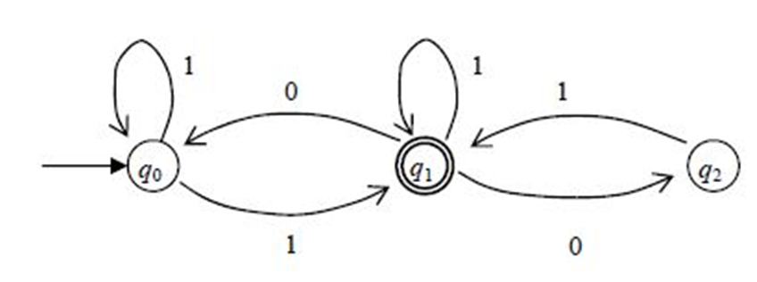
Convert from NFA to DFA

Slide 72
Lexical Analysis
Consider distinguishing variable names from keywords like IF, THEN, ELSE, etc.
This really screams for non-determinism
Non deterministic automata typically have fewer states
However, non-deterministic FSA interpretation is not as fast as deterministic

Slide 73
Practice Problems
73
Practice
Using DFA’s (not any equivalent notation) show that the Regular Languages are closed under Min, where
Min(L) = { w | w ∈ L, but no proper prefix of w is in L}.. This means that w ∈ Min(L) iff w ∈ L and for no y≠λ is x in L, where w=xy. Said a third way, w is not an extension of any element in L.
a.) Present a transition diagram for an NFA for the language associated with the regular expression
(1011 + 111 + 101)*.
b.) Use the standard conversion technique (subsets of states) to convert the NFA from (a) to an equivalent DFA. Be sure to not include unreachable states.

Slide 74
Practice DFA/NFA
74
Present a transition diagram for a DFA that recognizes the set of binary strings that, when interpreted as entering the DFA most to least significant digit, each represents a binary number that is divisible by either 2 or 3 or both. Thus, 100, 110, 1001 and 1100 are in the language, but 01, 101, 111 and 1011 are not.
a.) Present a transition diagram with no lambda transitions for an NFA associated with the regular expression (0111 + 111 + 011)*.
Your NFA must have no more than four states.
b.) Use the standard conversion technique (subsets of states) to convert the NFA from (a) to an equivalent DFA. Be sure to not include unreachable states.

Slide 75
Regular Expressions
Primitive:
  Φ denotes {}
  λ denotes {λ}
  a where a is in Σ denotes {a}
Closure:
  If R and S are regular expressions then so are R ・ S, R + S and R*, where
    R ・ S denotes RS = { xy | x is in R and y is in S }
    R + S denotes R∪S = { x | x is in R or x is in S }
    R* denotes R*
Parentheses are used as needed

Slide 76
Regular Sets =
Regular Languages
Show every regular expression denotes a language recognized by a finite state automaton (can do deterministic or non-deterministic)
Show every Finite State Automata recognizes a language denoted by a regular expression

Slide 77
Every Regular Set is a Regular Language
Primitive:
  Φ denotes {}
  λ denotes {λ}
  a where a is in Σ denotes {a}
Closure: (Assume that R’s and S’s states do not overlap)
  R ・ S start with machine for R, add λ transitions from
  every final state of R’s recognizer to start state of S,
  making final state of S final states of new machine
  R + S create new start state and add λ transitions from new
  state to start states of each of R and S, making union
  of R’s and S’s final states the new final states
  R* add λ transitions from each final state of R back to its start
  state, keeping original start and final states (gets R⁺) – FIX?
λ
a
a

Slide 78
Every Regular Language is a Regular Set Using R_{ij}^{k}
This is a challenge that can be addressed in multiple ways but I like to start with the R_{ij}^{k} approach. Here’s how it works.
Let A = (Q,Σ,δ,q₁,F) be a DFA, where Q = {q₁,q₂, … , q_{n}}
R_{ij}^{k} = {w | δ*(q_{i},w) = q_{j}, and no intermediate state visited between q_{i} and q_{j}, while reading w, has index > k
Basis: k=0, R_{ij}⁰ = { a | δ(q_{i},a) = q_{j} } sets are either Φ, λ, or an element of Σ or λ + element of Σ, and so are regular sets
Inductive hypothesis: Assume R_{ij}^{m} are regular sets for
0 ≤ m ≤ k
Inductive step: k+1, R_{ij}^{k+1} = (R_{ij}^{k} + R_{ik+1}^{k} ・ ( R_{k+1k+1}^{k} )* ・ R_{k+1j}^{k})
L(A) = +_{f∈F} R_{1f}^{n}

Slide 79
Convert to RE
0
1
1
1
q1
q2
q3
0
0, 1

Slide 80
0
1
1
1
q1
q2
q3
0
0, 1
R₁₁⁰= λ R₁₂⁰= 0 R₁₃⁰= φ
R₂₁⁰= 0 R₂₂⁰= λ + 1 R₂₃⁰= 0 + 1
R₃₁⁰= φ R₃₂⁰= 1 R₃₃⁰= λ + 1
R₁₁¹= λ R₁₂¹= 0 R₁₃¹= φ
R₂₁¹= 0 R₂₂¹= λ + 1 + 00 R₂₃¹= 0 + 1
R₃₁¹ = φ R₃₂¹= 1 R₃₃¹= λ + 1
R₁₁²= λ + 0(1+00)*0 R₁₂²= 0(1+00)* R₁₃²= 0(1+00)*(0+1)
R₂₁²= (1+00)*0 R₂₂²= (1+00)* R₂₃²= (1+00)*(0+1)
R₃₁²= 1(1+00)*0 R₃₂²= 1(1+00)* R₃₃²= λ+1+1(1+00)*(0+1)
L = R₁₂³=
0(1+00)* + 0(1+00)*(0+1) (1+1(1+00)*(0+1))* 1(1+00)*

Slide 81
State Ripping Concept
This is similar to generalized automata approach but with fewer arcs than text. It actually gets some of its motivation from R_{ij}^{k} approach as well
Add a new start state and add a λ–transition to existing start state
Add a new final state q_{f} and insert λ–transitions from all existing final states to the new one; make the old final states non-final
Leaving the start and final states, successively pick states to remove
For each state to be removed, change the arcs of every pair of externally entering and exiting arcs to reflect the regular expression that describes all strings that could result is such a double transition; be sure to account for loops in the state being removed. Also, or (+) together expressions that have the same start and end nodes
When have just start and final, the regular expression that leads from start to final describes the associated regular set

Slide 82
State Ripping Details
Let B be the node to be removed
Let e1 be the regular expression on the arc from some node A to some node B (A≠B); e2 be the expression from B back to B (or λ if there is no recursive arc); e3 be the expression on the arc from B to some other node C (C ≠B but C could be A); e4 be the expression from A to C
Erase the existing arcs from A to B and A to C, adding a new arc from A to C labelled with the expression
e4 + e1 e2* e3
Do this for all nodes that have edges to B until B has no more entering edges; at this point remove B and any edges it has to other nodes and itself
Iterate until all but the start and final nodes remain
The expression from start to final describes regular set that is equivalent to regular language accepted by original automaton
Note: Your choices of the order of removal make a big difference in how hard or easy this is

Slide 83
Use Ripping; Rip q3
0
1
1
1
q0
q1
q2
q3
λ
λ
0
0+1
qf
0
1+(0+1)1⁺
q0
q1
q2
λ
λ
0
qf

Slide 84
Use Ripping; Rip q1
0
1+(0+1)1⁺
q0
q1
q2
λ
λ
0
qf
1+(0+1)1⁺+00
0
q0
q2
λ
qf

Slide 85
Use Ripping; Rip q2
1+(0+1)1⁺+00
0
q0
q2
λ
qf
0 (1+(0+1)1⁺+00)*
q0
qf
λ
L = 0 (1+(0+1)1⁺+00)* = 0 (1+(0+1)1⁺+00)*

Slide 86
Regular Equations
Assume that R, Q and P are sets such that P does not contain the string of length zero, and R is defined by
R = Q + RP
We wish to show that
R = QP*

Slide 87
Show QP* is a Solution
We first show that QP* is contained in R. By definition, R = Q + RP.
To see if QP* is a solution, we insert it as the value of R in Q + RP and see if the equation balances
R = Q + QP*P = Q(λ+P*P) = QP*
Hence QP* is a solution, but not necessarily the only solution.

Slide 88
Uniqueness of Solution
To prove uniqueness, we show that R is contained in QP*.
By definition, R = Q+RP = Q+(Q+RP)P
= Q+QP+RP² = Q+QP+(Q+RP)P²
= Q+QP+QP²+RP³
...
= Q(λ+P+P²+ ... +P^{i})+RP^{i+1}, for all i>=0
Choose any w in R, where |W| = k. Then, from above,
R = Q(λ+P+P²+ ... +P^{k})+RP^{k+1}
but, since P does not contain the string of length zero, w is not in RP^{k+1}. But then w is in
Q(λ+P+P²+ ... +P^{k}) and hence w is in QP*.

Slide 89

Example
We use the above to solve simultaneous regular equations. For example, we can associate regular expressions with finite state automata as follows
Hence,
For A, Q=λ+B1; P=0
A = QP* = (λ+B1)0*
= B10* + 0*
B = B10*1 + B0 + 0*1
For B, Q=0*1; P= B10*1 + B0 = B(10*1 + 0)
and therefore
B = 0*1(10*1 + 0)*
Note: This technique fails if there are lambda transitions.

Slide 90
Using Regular Equations
0
1
1
1
A
B
C
0
0, 1
A = λ + B0
B = A0 + C1 + B1
C = B(0+1) + C1; C = B(0+1)1*
B = 0 + B00 + B(0+1)1⁺ + B1
B = 0 + B (00+(0+1) 1⁺ + 1); B = 0(00 +(0+1)1⁺ + 1)*
This is same form as with state ripping. It won’t always be so.

Slide 91
Practice NFAs
Write NFAs for each of the following
  ( 111 + 000 )⁺
  (0+1)* 101 (0+1)⁺
  (1 (0+1)* 0) + (0 (0+1)* 1)
Convert each NFA you just created to an equivalent DFA.

Slide 92
DFAs to REs
For each of the DFAs you created for the previous page, use ripping of states and then regular equations to compute the associated regular expression. Note: You obviously ought to get expressions that are equivalent to the initial expressions.

Slide 93
State Minimization
Text makes it an assignment on Page 299 in Sipser Edition 2.
This is too important to defer, IMHO.
First step is to remove any state that is unreachable from the start state; a depth first search rooted at start state will identify all reachable states
One seeks to merge compatible states – states q and s are compatible if, for all strings x, δ*(q,x) and δ*(s,x) are either both an accepting or both rejecting states
One approach is to discover incompatible states – states q and s are incompatible if there exists a string x such that one of δ*(q,x) and δ*(s,x) is an accepting state and the other is not
There are many ways to approach this but my favorite is to do incompatible states via an n by n lower triangular matrix

Slide 94
Sample Minimization
This uses a transition table
Just an X denotes
Immediately incompatible
Pairs are dependencies for compatibility
If a dependent is incompatible, so are pairs that depend on it
When done, any not x--ed out are compatible
Here, new states are <1,3>, <2,4,5>, <6>; <1,3> is start and not accept; others are accept
Write new diagram

Slide 95
Reversal of Regular Sets
It is easier to do this with regular sets than with DFAs
Let E be some arbitrary expression; E^{R} is formed by
  Primitives: Ø^{R}=Ø λ^{R}=λ a^{R}=a
  Closure:
    (A ・ B)^{R} = (B^{R} ・ A^{R})
    (A + B)^{R} = (A^{R} + B^{R})
    (A*)^{R} = (A^{R}*)
Challenge: How would you do this with FSA models?
  Start with DFA; change all final to start states; change start to a final state; and reverse edges
  Note that this creates multiple start states; can create a new start state with λ-transitions to multiple starts

Slide 96
Substitution
A substitution is a function, f, from each member, a, of an alphabet, Σ, to a language L_{a}
Regular languages are closed under substitution of regular languages (i.e., each L_{a} is regular)
Easy to prove by replacing each member of Σ in a regular expression for a language L with regular expression for L_{a}
A homomorphism is a substitution where each L_{a} is a single string

Slide 97
Quotient with Regular Sets
Quotient of two languages B and C, denoted B/C, is defined as
B/C = {x | ∃y∈C where xy∈B}
Let B be recognized by DFA
A_{B} = (Q_{B},Σ,δ_{B},q_{1B},F_{B}) and C by
A_{C} = (Q_{C},Σ,δ_{C},q_{1C},F_{C})
Define the recognizer for B/C by
A_{B/C} = (Q_{B}∪Q_{B}×Q_{C},Σ,δ_{B/C},q_{1B}, F_{B}×F_{C})
δ_{B/C}(q,a) = {δ_{B}(q,a)} a∈Σ,q∈Q_{B}
δ_{B/C}(q,λ) = {<q,q_{1C}>} q∈Q_{B}
δ_{B/C}(<q,p>,λ) = {δ_{B}(q,a),δ_{C}(p,a)} a∈Σ,q∈Q_{B},p∈Q_{C}
The basic idea is that we simulate B and then randomly decide it has seen x and continue by looking for y, simulating B continuing after x but with C starting from scratch

Slide 98
Quotient Again
Assume some class of languages, C, is closed under concatenation, intersection with regular and substitution of members of C, show C is closed under Quotient with Regular
L/R = { x |∃y∈R where xy∈L }
  Define Σ’ = { a’ | a∈Σ }
  Let h(a) = a; h(a’) = λ where a∈Σ
  Let g(a) = a’ where a∈Σ
  Let f(a) = {a,a’} where a∈Σ
  L/R = h( f(L) ∩ ( Σ* ・ g(R) ) )

Slide 99
Applying Meta Approach
INIT(L) = { x |∃y∈Σ* where xy∈L }
  INIT(L) = h( f(L) ∩ ( Σ* ・ g(Σ*) ) )
  Also INIT(L) = L / Σ*
LAST(L) = { y |∃x∈Σ* where xy∈L }
  LAST(L) = h( f(L) ∩ ( g(Σ*) ・ Σ* ) )
MID(L) = { y |∃x,z∈Σ* where xyz∈L }
    MID(L) = h( f(L) ∩ ( g(Σ*) ・ Σ* ・ g(Σ*) ) )
EXTERIOR(L) = { xz |∃y∈Σ* where xyz∈L }
      EXTERIOR(L) = h( f(L) ∩ ( Σ* ・ g(Σ*) ・ Σ* ) )

Slide 100
Making Life Easy
The key in proving closure is to always try to identify the “best” equivalent formal model for regular sets when trying to prove a particular property
For example, how could you even conceive of proving closure under intersection and complement in regular expression notations?
Note how much easier quotient is when have closure under concatenation, and substitution and intersection with regular languages than showing in FSA notation

Slide 101
Reachable and Reaching
Reachablefrom(q) = { p | ∃w ∍ δ(q,w)=p }
  Just do depth first search from q, marking all reachable states. Works for NFA as well.
Reachingto(q) = { p | ∃w ∍ δ(p,w)=q }
  Do depth first from q, going backwards on transitions, marking all reaching states. Works for NFA as well.

Slide 102
Min and Max
Min(L) = { w | w∈L and no proper prefix of w is in L } =
{ w | w∈L and if w=xy, x∈Σ*, y∈Σ⁺ then x∉L}
Max(L) = { w | w∈L and w is not the proper prefix of any word in L } = { w | w∈L and if y∈Σ⁺ then wy∉L }
Examples:
  Min(0(0+1)*) = {0}
  Max(0(0+1)*) = {}
  Min(01 + 0 + 10) = {0,10}
  Max(01 + 0 + 10) = {01,10}
  Min({a^{i}b^{j}c^{k} | i ≤ k or j ≤ k}) = {a^{i}b^{j}c^{k} | | i,j ≥0, k = min(i, j)}
  Max({a^{i}b^{j}c^{k} | i ≤ k or j ≤ k}) = {} because k has no bound
  Min({a^{i}b^{j}c^{k} | i ≥ k or j ≥ k}) = {λ}
  Max({a^{i}b^{j}c^{k} | i ≥ k or j ≥ k}) = {a^{i}b^{j}c^{k} | | i,j ≥0, k = max(i, j)}

Slide 103
Regular Closed under Min
Assume L is regular then Min(L) is regular
Let L= L(A), where A = (Q,Σ,δ,q₀,F) is a DFA with no state unreachable from q₀
Define A_{min} = (Q∪{dead},Σ,δ_{min},q₀,F), where for a∈Σ
δ_{min}(q,a) = δ(q,a), if q∈Q-F; δ_{min}(q,a) = dead, if q∈F;
δ_{min}(dead,a) = dead
The reasoning is that the machine A_{min} accepts only elements in L that are not extensions of shorter strings in L. By making it so transitions from all final states in A_{min} go to the new “dead” state, we guarantee that extensions of accepted strings will not be accepted by this new automaton.
Therefore, Regular Languages are closed under Min.

Slide 104
Regular Closed under Max
Assume L is regular then Max(L) is regular
Let L= L(A), where A = (Q,Σ,δ,q₀,F) is a DFA with no state unreachable from q₀
Define A_{max} = (Q,Σ,δ,q₀,F_{max}), where
F_{max}= { f | f∈F and Reachablefrom⁺(f)∩F=Φ }
where Reachablefrom⁺(q) = { p | ∃w ∍ |w|>0 and δ(q,w) = p }
The reasoning is that the machine A_{max} accepts only elements in L that cannot be extended. If there is a non-empty string that leads from some final state f to any final state, including f, then f cannot be final in A_{max}. All other final states can be retained.
The inductive definition of Reachablefrom⁺ is:
1. Reachablefrom⁺(q) contains { s | there exists an element of Σ, a, such that δ(q,a) = s }
2. If s is in Reachablefrom⁺ (q) then Reachablefrom⁺ (q) contains
{ t | there exists an element of Σ, a, such that δ(s,a) = t }
3. No other states are in Reachablefrom⁺(q)
Therefore, Regular Languages are closed under Max.

Slide 105
Practice R_{ij}^{k}
Convert the DFA below to a regular expression, first by using either the GNFA (or state ripping) or the R_{ij}^{k} approach, and then by using regular equations. You must show all steps in each part of this solution.
0
1
1
A:
A
1
B
0
C
0
D
1
0
105

Slide 106
Practice Minimization
Minimize the number of states in the following DFA, showing the determination of incompatible states (table on right).
Construct and write down your new, equivalent automaton!!
 | a | b | c
>1 | 2 | 3 | 5 |  | 2
2 | 5 | 4 | 4 |  | 3
3 | 2 | 4 | 5 |  | 4
4 | 6 | 4 | 2 |  | 5
5 | 5 | 2 | 4 |  | 6
6 | 5 | 4 | 2 |  |  | >1 | 2 | 3 | 4 | 5
106

Slide 107
Pumping Lemma Concept
Let A = (Q,Σ,δ,q₁,F) be a DFA, where Q = {q₁,q₂, … , q_{N}}
The “pigeon hole principle” tells us that whenever we visit N+1 or more states, we must visit at least one state more than once (loop)
Any string, w, of length N or greater leads to us making N transitions after visiting the start state, and so we visit at least one state more than once when reading w

Slide 108
Pumping Lemma For Regular
Theorem: Let L be regular then there exists an N>0 such that, if w ∈ L and
|w| ≥ N, then w can be written in the form xyz, where |xy| ≤ N, |y|>0, and for all i≥0, xy^{i}z ∈ L
This means that interesting regular languages (infinite ones) have a very simple self-embedding property that occurs early in long strings

Slide 109
Pumping Lemma Proof
If L is regular then it is recognized by some DFA, A=(Q,Σ,δ,q₀,F). Let |Q| = N states. For any string w, such that |w| ≥ N, A must make N+1 state visits to consume its first N characters, followed by |w|-N more state visits.
In its first N+1 state visits, A must enter at least one state two or more times.
Let w = v₁…v_{j}…v_{k}…v_{m}, where m =|w|, and δ(q₀,v₁…v_{j})=δ(q₀,v₁…v_{k}), k > j, and let this state represent the first one repeated while A consumes w.
Define x = v₁…v_{j}, y = v_{i+1}…v_{k}, and z = v_{k+1}…v_{m}. Clearly w=xyz. Moreover, since k > j, |y| > 0, and since k ≤ N, |xy| ≤ N.
Since A is deterministic, δ(q₀,xy)=δ(q₀,xy^{i}), for all i ≥ 0.
Thus, if w ∈ L, δ(q₀,xyz) ∈ F, and so δ(q₀,xy^{i}z) ∈ F, for all i ≥ 0.
Consequently, if w ∈ L, |w|≥N, then w can be written in the form xyz, where
|xy| ≤ N, |y| > 0, and for all i ≥ 0, xy^{i}z ∈ L.

Slide 110
Lemma’s Adversarial Process
Assume L = {a^{n}b^{n} | n>0 } is regular
P.L.: Provides N > 0
  We CANNOT choose N; that’s the P.L.’s job
Our turn: Choose a^{N}b^{N} ∈ L
  We get to select a string in L
P.L.: a^{N}b^{N} = xyz, where |xy| ≤ N, |y| > 0, and for all i ≥ 0, xy^{i}z ∈ L
  We CANNOT choose split, but P.L. is constrained by N
Our turn: Choose i = 0.
  We have the power here
P.L: a^{N-|y|}b^{N} ∈ L; just a consequence of P.L.
Our turn: a^{N-|y|}b^{N} ∉ L; just a consequence of L’s structure
CONTRADICTION, so L is NOT regular

Slide 111
xwx is not Regular (PL)
L = { x w x | x,w∈{a,b}+} :
Assume that L is Regular.
PL: Let N > 0 be given by the Pumping Lemma.
YOU: Let s be a string, s ∈ L, such that s = a^{N}baa^{N}b
PL: Since s ∈ L and |s| ≥ N, s can be split into 3 pieces, s = xyz, such that |xy| ≤ N and |y| > 0 and ∀ i ≥ 0 xy^{i}z ∈ L
YOU: Choose i = 2
PL: xy²z = xyyz ∈ L
Thus, a^{N + |y|}baa^{N}b would be in L, but this is not so since N+|y| ≠ N
We have arrived at a contradiction.
Therefore L is not Regular.

Slide 112
a^{Fib(k)} is not Regular (PL)
L = {a^{Fib(k)} | k>0} :
Assume that L is regular
Let N be the positive integer given by the Pumping Lemma
Let s be a string s = a^{Fib(N+3)}∈ L
Since s ∈ L and |s| ≥ N (Fib(N+3)>N in all cases; actually Fib(N+2)>N as well), s is split by PL into xyz, where |xy| ≤ N and |y| > 0 and for all i ≥ 0, xy^{i}z ∈ L
We choose i = 2; by PL: xy²z = xyyz∈ L
Thus, a^{Fib(N+3)+|y|} would be ∈ L. This means that there is a Fibonacci number between Fib(N+3) and Fib(N+3)+N, but the smallest Fibonacci greater than Fib(N+3) is Fib(N+3)+Fib(N+2) and Fib(N+2)>N
This is a contradiction, therefore L is not regular ■
Note: Using values less than N+3 could be dangerous because N could be 1 and both Fib(2) and Fib(3) are within N (1) of Fib(1).

Slide 113
Pumping Lemma Problems
Use the Pumping Lemma to show each of the following is not regular
  { 0^{m} 1^{2n} | m ≤ n }
  { ww^{R} | w ∈ {a,b}⁺ }
  { 1^{n2} | n > 0 }
  { ww | w ∈ {a,b}⁺ }

Slide 114
Myhill-Nerode Theorem
The following are equivalent:
L is accepted by some DFA
L is the union of some of the classes of a right invariant equivalence relation, R, of finite index.
The specific right invariance equivalence relation
R_{L} where x R_{L} y iff ∀z [ xz ∈ L iff yz ∈ L ]
has finite index
Definition. R is a right invariant equivalence relation iff R is an equivalence relation and ∀z [ x R y implies xz R yz ].
Note: This is only meaningful for relations over strings.

Slide 115
Myhill-Nerode 1 ⇒ 2
Assume L is accepted by some DFA, A = (Q,Σ,δ,q₁,F)
Define R_{A} by x R_{A} y iff δ*(q₁,x) = δ*(q₁,y). First, R_{A} is defined by equality and so is obviously an equivalence relation (Clearly if δ*(q₁,x) = δ*(q₁,y) then ∀z δ*(q₁,xz) = δ*(q₁,yz) because A is deterministic. Moreover if ∀z δ*(q₁,xz) = δ*(q₁,yz) then δ*(q₁,x) = δ*(q₁,y), just by letting z = λ. Putting it together x R_{A} y L iff ∀z xz R_{A} yz. Thus, R_{A} is right invariant; its index is |Q| which is finite; and L(A) = ∪_{δ*(x)∊F}[x]_{RA}, where [x]_{RA} refers to the equivalence class containing the string x.

Slide 116
Myhill-Nerode 2 ⇒ 3
Assume L is the union of some of the classes of a right invariant equivalence relation, R, of finite index.
Since x R y iff ∀z [ xz R yz ], R is right invariant and L is the union of some of the equivalence classes, then
x R y ⇒ ∀z [ xz ∈ L iff yz ∈ L ] ⇒ x R_{L} y.
This means that the index of R_{L} is less than or equal to that of R and so is finite. Note than the index of R_{L} is then less than or equal to that of any other right invariant equivalence relation, R, of finite index that defines L.

Slide 117
Myhill-Nerode 3 ⇒ 1
Assume the specific right invariance equivalence relation R_{L} where x R_{L} y iff ∀z [ xz ∈ L iff yz ∈ L ]
has finite index
Define the automaton A = (Q,Σ,δ,q₁,F) by
Q = { [x]_{RL} | x ∈ Σ* }
δ([x]_{RL},a) = [xa]_{RL}
q1 = [λ]
F = { [x]_{RL} | x ∈ L }
Note: This is the minimum state automaton and all others are either equivalent or have redundant indistinguishable states

Slide 118
Use of Myhill-Nerode
L = {a^{n}b^{n} | n>0 } is NOT regular.
Assume otherwise.
M-N says that the specific r.i. equiv. relation R_{L} has finite index, where x R_{L} y iff ∀z [ xz ∈ L iff yz ∈ L ].
Consider the equivalence classes [a^{i}b] and [a^{j}b], where i,j>0 and i ≠ j.
a^{i}bb^{i-1} ∈ L but a^{j}bb^{i-1} ∉ L and so [a^{i}b] is not related to [a^{j}b] under R_{L} and thus [a^{i}b] ≠ [a^{j}b].
This means that R_{L} has infinite index.
Therefore L is not regular.

Slide 119
xwx is not Regular (MN)
L = { x a x | x∈{a,b}+} :
We consider the right invariant equivalence class [a^{i}b], i>0.
It’s clear that a^{i}baa^{i}b is in the language, but a^{k}baa^{i}b is not when k < i.
This shows that there is a separate equivalence class, [a^{i}b], induced by R_{L}, for each i>0. Thus, the index of R_{L} is infinite and Myhill‐Nerode states that L cannot be Regular.

Slide 120
a^{Fib(k)} is not Regular (MN)
L = {a^{Fib(k)} | k>0} :
We consider the collection of right invariant equivalence classes [a^{Fib(j)}], j > 2.
It’s clear that a^{Fib(j)}a^{Fib(j+1)} is in the language, but a^{Fib(k)}a^{Fib(j+1)} is not when k>2 and k≠j and k≠j+2
This shows that there is a separate equivalence class [a^{Fib(j)}] induced by R_{L}, for each j > 2.
Thus, the index of R_{L} is infinite and Myhill-Nerode states that L cannot be Regular.

Slide 121
Myhill-Nerode and Minimization
Corollary: The minimum state DFA for a regular language, L, is formed from the specific right invariance equivalence relation R_{L} where
x R_{L} y iff ∀z [ xz ∈ L iff yz ∈ L ]
Moreover, all minimum state machines have the same structure as the above, except perhaps for the names of states

Slide 122
What is Regular So Far?
Any language accepted by a DFA
Any language accepted by an NFA
Any language specified by a Regular Expression
Any language representing the unique solution to a set of properly constrained regular equations

Slide 123
What is NOT Regular?
Well, anything for which you cannot write an accepting DFA or NFA, or a defining regular expression, or a right/left linear grammar, or a set of regular equations, but that’s not a very useful statement
There are two tools we have:
  Pumping Lemma for Regular Lnaguges
  Myhill-Nerode Theorem

Slide 124
Finite State Transducers
A transducer is a machine with output
Mealy Model
  M = (Q, Σ, Γ, δ, γ, q₀)
    Γ is the finite output alphabet
    γ: Q × Σ → Γ is the output function
  Essentially a Mealy Model machine produced a character of output for each character of input it consumes, and it does so on the transitions from one state to the next.
  A Mealy Model represents a synchronous circuit whose output is triggered each time a new input arrives.

Slide 125
Sample Mealy Model
Write a Mealy finite state machine that produces the 2’s complement result of subtracting 1101 from a binary input stream (assuming at least 4 bits of input)
1/1,0/0
NC
1..1
0011
C
1..1
001
C
1..1
00
1/0
C
1..1
0
1/0
C
1..1
1/0
1/1,0/0
0/1
0/1
1/0
1/0
NC
1..1
0/1
NC
1..1
001
NC
1..1
00
0/0,1/1
NC
1..1
0
0/0,1/1
0/1
0/1

Slide 126
Finite State Transducers
Moore Model
  M = (Q, Σ, Γ, δ, γ, q₀)
    Γ is the finite output alphabet
    γ: Q → Γ is the output function
  Essentially a Moore Model machine produced a character of output whenever it enters a state, independent of how it arrived at that state.
  A Moore Model represents an asynchronous circuit whose output is a steady state until new input arrives.

Slide 127
Practice MNT, Grammar, Mealy
127
For each of the following, prove it is not regular by using the Pumping Lemma or Myhill-Nerode. You must do at least one of these using the Pumping Lemma and at least one using Myhill-Nerode.
L = { x#y | x, y∈ {0,1}⁺ and y is the ones complement of x }
L = { a^{i}b^{j}c^{k} | i > j * k }
L = { x w x | x, w ∈ {a,b}⁺ Here |x|>0 and |w|>0 }
Write a regular (right linear) grammar that generates L = { w | w ∈ {0,1}⁺ and w interpreted as a binary number is divisible by either 2 or 3 or both. .
Present a Mealy Model finite state machine that reads an input x ∈ {0, 1}⁺ and produces the binary number that represents the result of adding binary 1001 to x (assumes all numbers are positive, including results). Assume that x is read starting with its least significant digit.
Examples: 00010 → 01011; 00101 → 01110;
00111 → 10000; 00110 → 01111

Slide 128
Decision and Closure Properties
Regular Languages

Slide 129
Decidable Properties
Membership (just run DFA over string)
L = Ø: Minimize and see if minimum state DFA is
L = Σ*: Minimize and see if minimum state DFA is
Finiteness: Minimize and see if there are no loops emanating from a final state
Equivalence: Minimize both and see if isomorphic
Σ
A
Σ
A

Slide 130
Closure Properties
Virtually everything with members of its own class as we have already shown
Union, concatenation, Kleene *, complement, intersection, set difference, reversal, substitution, homomorphism, quotient with regular sets, Prefix, Suffix, Substring, Exterior, Min, Max and so much more

Slide 131
Formal Languages
Includes and Expands on
Chapter 2 of Sipser

Slide 132
History of Formal Language
In 1940s, Emil Post (mathematician) devised rewriting systems as a way to describe how mathematicians do proofs. Purpose was to mechanize them.
Early 1950s, Noam Chomsky (linguist) developed a hierarchy of rewriting systems (grammars) to describe natural languages.
Late 1950s, Backus-Naur (computer scientists) devised BNF (a variant of Chomsky’s context-free grammars) to describe the programming language Algol.
1960s was the time of many advances in parsing. In particular, parsing of context free was shown to be no worse than O(n³). More importantly, useful subsets were found that could be parsed in O(n).

Slide 133
Formalism for Grammars
Definition : A language is a set of strings of characters from some alphabet.
The strings of the language are called sentences or statements.
A string over some alphabet is a finite sequence of symbols drawn from that alphabet.
A meta-language is a language that is used to describe another language.
A very well known meta-language is BNF (Backus Naur Form)
It was developed by John Backus and Peter Naur, in the late 50s, to describe programming languages.
Noam Chomsky in the early 50s developed context free grammars that can be expressed using BNF.

Slide 134
Grammars
G = (V, Σ, R, S) is a Phrase Structured Grammar (PSG) where
  V: Finite set of non-terminal symbols
  Σ: Finite set of terminal symbols
  R: finite set of rules of form α → β,
    α in (V ∪ Σ)* V (V ∪ Σ)*
    β in (V ∪ Σ)*
  S: a member of V called the start symbol
Right linear restricts all rules to be of forms
  α in V
  β of form ΣV, Σ or λ

Slide 135
Derivations
x ⇒ y reads as x derives y iff
  x = γαδ, y = γβδ and α → β
⇒* is the reflexive, transitive closure of ⇒
⇒+ is the transitive closure of ⇒
x ⇒* y iff x = y or x ⇒* z and z ⇒ y
Or, x ⇒* y iff x = y or x ⇒ z and z ⇒* y
L(G) = { w | S ⇒* w } is the language generated by G.

Slide 136
Regular Grammars
Regular grammars are also called right linear grammars
Each rule of a regular grammar is constrained to be of one of the three forms:
A → a, A ∈ V, a ∈ Σ*
A → λ, A ∈ V, a ∈ Σ*
A → aB, A, B ∈ V, a ∈ Σ*

Slide 137
DFA to Regular Grammar
Every language recognized by a DFA is generated by an equivalent regular grammar
Given A = (Q,Σ,δ,q₀,F), L(A) is generated by G_{A} = (Q,Σ,R,q₀) where R contains
q → as iff δ(q,a) = s
q → λ iff q ∈ F

Slide 138
Example of DFA to Grammar
DFA
Grammar
A → 0 B | 1 B
B → 0 A | 1 C | λ
C → 0 C | 1 A | λ
0
A:
A
0,1
B
1
C
0
1

Slide 139
Regular Grammar to NFA
Every language generated by a regular grammar is recognized by an equivalent NFA
Given G = (V, Σ, R, S), L(G) is recognized by
A_{G} = (V∪{f},Σ,δ,S,{f}) where δ is defined by
δ(A,a) ⊆{B} iff A → aB
δ(A,a) ⊆{f} iff A → a
δ(A,λ) ⊆{f} iff A → λ

Slide 140
Example of Grammar to NFA
Grammar
S → 0 S | 1 A
A → 0 S | 0 A | 1 B | λ
B → 1 S | 0 B
DFA
0
0
0
A:
S
1
A
1
B
0
1

Slide 141
What More is Regular?
Any language, L, generated by a right linear grammar
Any language, L, generated by a left linear grammar
(A → a, A → λ, A → Ba)
  Easy to see L is regular as we can reverse these rules and get a right linear grammar that generates L^{R}, but then L is the reverse of a regular language which is regular
  Similarly, the reverse L^{R} of any regular language L is right linear and hence the language itself is left linear
Any language, L, that is the union of some of the classes of a right invariant equivalence relation of finite index

Slide 142
Mixing Right and Left Linear
We can get non-Regular languages if we present grammars that have both right and left linear rules
To see this, consider G = ({S,T}, Σ, R, S), where R is:
  S → aT
  T → Sb | b
L(G) = { a^{n}b^{n} | n > 0 } which is a classic non-regular, context-free language

Slide 143
Context Free Languages

Slide 144
Context Free Grammar
G = (V, Σ, R, S) is a PSG where
Each member of R is of the form
A → α where α is a strings (V∪Σ)*
Note that the left hand side of a rule is a letter in V;
The right hand side is a string from the combined alphabets
The right hand side can even be empty (ε or λ)
A context free grammar is denoted as a CFG and the language generated is a Context Free Language (CFL).
A CFL is recognized by a Push Down Automaton (PDA) to be discussed a bit later.

Slide 145
Sample CFG
Example of a grammar for a small language:
G = ({<program>, <stmt-list>, <stmt>, <expression>},
{begin, end, ident, ;, =, +, -}, R, <program>) where R is
<program> → begin <stmt-list> end
<stmt-list> → <stmt> | <stmt> ; <stmt-list>
<stmt> → ident = <expression>
<expression> → ident + ident | ident - ident | ident
Here “ident” is a token return from a scanner, as are “begin”, “end”, “;”, “=”, “+”, “-”
Note that “;” is a separator (Pascal style) not a terminator (C style).

Slide 146
Derivation
A sentence generation is called a derivation.
Grammar for a simple
assignment statement:
R1 <assgn> → <id> := <expr>
R2 <id> → a | b | c
R3 <expr> → <id> + <expr>
R4 | <id> * <expr>
R5 | ( <expr> )
R6 | <id>
The statement a := b * ( a + c )
Is generated by the leftmost derivation:
<assgn> ⇒ <id> := <expr> R1
⇒ a := <expr> R2
⇒ a := <id> * <expr> R4
⇒ a := b * <expr> R2
⇒ a := b * ( <expr> ) R5
⇒ a := b * ( <id> + <expr> ) R3
⇒ a := b * ( a + <expr> ) R2
⇒ a := b * ( a + <id> ) R6
⇒ a := b * ( a + c ) R2
In a leftmost derivation only the
leftmost non-terminal is replaced

Slide 147
Parse Trees
A parse tree is a graphical representation of a derivation
For instance the parse tree for the statement a := b * ( a + c ) is:
<assign>
<id> := <expr>
a <id> * <expr>
b ( <expr> )
<id> + <expr>
a <id>
c
Every internal node of a
parse tree is labeled with
a non-terminal symbol.
Every leaf is labeled with a
terminal symbol.
The generated string is read
left to right

Slide 148
Ambiguity
A grammar that generates a sentence for which there are two or more
distinct parse trees is said to be “ambiguous”
For instance, the following grammar is ambiguous because it generates
distinct parse trees for the expression a := b + c * a
<assgn> → <id> := <expr>
<id> → a | b | c
<expr> → <expr> + <expr>
| <expr> * <expr>
| ( <expr> )
| <id>

Slide 149
Ambiguous Parse
<assign>
<id> := <expr>
A <expr> + <expr>
<id> <expr> * <expr>
B <id> <id>
C A
<assign>
<id> := <expr>
A <expr> * <expr>
<expr> + <expr> <id>
<id> <id> A
B C
This grammar generates two parse trees for the same expression.
If a language structure has more than one parse tree,
the meaning of the structure cannot be determined uniquely.

Slide 150
Precedence
Operator precedence:
If an operator is generated lower in the parse tree, it indicates that the
operator has precedence over the operator generated higher up in the tree.
An unambiguous grammar for expressions:
<assign> → <id> := <expr>
<id> → a | b | c
<expr> → <expr> + <term>
| <term>
<term> → <term> * <factor>
| <factor>
<factor> → ( <expr> )
| <id>
This grammar indicates the usual
precedence order of multiplication and
addition operators.
This grammar generates unique parse
trees independently of doing a
rightmost or leftmost derivation
© UCF EECS

Slide 151
Left (right)most Derivations
Leftmost derivation:
<assgn> → <id> := <expr>
→ a := <expr>
→ a := <expr> + <term>
→ a := <term> + <term>
→ a := <factor> + <term>
→ a := <id> + <term>
→ a := b + <term>
→ a := b + <term> *<factor>
→ a := b + <factor> * <factor> → a := b + <id> * <factor>
→ a := b + c * <factor>
→ a := b + c * <id>
→ a := b + c * a
Rightmost derivation:
<assgn> ⇒ <id> := <expr>
⇒ <id> := <expr> + <term>
⇒ <id> := <expr> + <term> *<factor>
⇒ <id> := <expr> + <term> *<id>
⇒ <id> := <expr> + <term> * a
⇒ <id> := <expr> + <factor> * a
⇒ <id> := <expr> + <id> * a
⇒ <id> := <expr> + c * a
⇒ <id> := <term> + c * a
⇒ <id> := <factor> + c * a
⇒ <id> := <id> + c * a
⇒ <id> := b + c * a
⇒ a := b + c * a

Slide 152
Ambiguity Test
A Grammar is Ambiguous if there are two distinct parse trees for some string
Or, two distinct leftmost derivations
Or, two distinct rightmost derivations
Some languages are inherently ambiguous but many are not
Unfortunately (to be shown later) there is no systematic test for ambiguity of context free grammars

Slide 153
Unambiguous Grammar
When we encounter ambiguity, we try to rewrite the grammar to avoid ambiguity.
The ambiguous expression grammar:
<expr> → <expr> <op> <expr> | id | int | (<expr>)
<op> → + | - | * | /
Can be rewritten as:
<expr> → <term> | <expr> + <term> | <expr> - <term>
<term> → <factor> | <term> * <factor> | <term> / <factor>.
<factor> → id | int | (<expr>)

Slide 154
Parsing Problem
The parsing Problem: Take a string of symbols in a language (tokens) and a grammar for that language to construct the parse tree or report that the sentence is syntactically incorrect.
For correct strings:
Sentence + grammar → parse tree
For a compiler, a sentence is a program:
Program + grammar → parse tree
Types of parsers:
Top-down aka predictive (recursive descent parsing)
Bottom-up aka shift-reduce

Slide 155
Removing Left Recursion if doing Top Down
Given left recursive and non left recursive rules
A → Aα₁ | … | Aα_{n} | β₁ | … | β_{m}
Can view as
A → (β₁ | … | β_{m}) (α₁ | … | α_{n} )*
Star notation is an extension to normal notation with obvious meaning
Now, it should be clear this can be done right recursive as
A → β₁B | … | β_{m} B
B → α₁B| … | α_{n}B | λ

Slide 156
Right Recursive Expressions
Grammar: Expr → Expr + Term | Term
Term → Term * Factor | Factor
Factor → (Expr) | Int
Fix: Expr → Term ExprRest
ExprRest → + Term ExprRest | λ
Term → Factor TermRest
TermRest → * Factor TermRest | λ
Factor → (Expr) | Int

Slide 157
Bottom Up vs Top Down
Bottom-Up: Two stack operations
  Shift (move input symbol to stack)
  Reduce (replace top of stack α with A, when A→α)
  Challenge is when to do shift or reduce and what reduce to do.
    Can have both kinds of conflict
Top-Down:
  If top of stack is terminal
    If same as input, read and pop
    If not, we have an error
  If top of stack is a non-terminal A
    Replace A with some α, when A→α
    Challenge is what A-rule to use

Slide 158
Chomsky Normal Form
Each rule of a CFG is constrained to be of one of the three forms:
A → a, A ∈ V, a ∈ Σ
A → BC, A,B,C ∈ V
If the language contains λ then we allow
S → λ
and constrain all non-terminating rules of form to be
A → BC, A ∈ V, B,C ∈ V-{S}

Slide 159
Nullable Symbols
Let G = (V, Σ, R, S) be an arbitrary CFG
Compute the set Nullable(G) = {A | A ⇒* λ }
Nullable(G) is computed as follows
Nullable(G) ⊇ { A | A → λ }
Repeat
Nullable(G) ⊇ { B | B → α and α ∈ Nullable* }
until no new symbols are added

Slide 160
Removal of λ-Rules
Let G = (V, Σ, R, S) be an arbitrary CFG
Compute the set Nullable(G)
Remove all λ-rules
For each rule of form B → αAβ where A is nullable, add in the rule B → αβ
The above has the potential to greatly increase the number of rules and add unit rules
(those of form B → C, where B,C∈V)
If S is nullable, add new start symbol S₀, as new start state, plus rules S₀, → λ and S₀ → α, where S → α

Slide 161
Chains (Unit Rules)
Let G = (V, Σ, R, S) be an arbitrary CFG that has had its λ-rules removed
For A∈V, Chain(A) = { B | A ⇒* B, B∈V }
Chain(A) is computed as follows
Chain(A) ⊇ { A }
Repeat
Chain(A) ⊇ { C | B → C and B ∈ Chain(A) }
until no new symbols are added

Slide 162
Removal of Unit-Rules
Let G = (V, Σ, R, S) be an arbitrary CFG that has had its λ-rules removed, except perhaps from start symbol
Compute Chain(A) for all A∈V
Create the new grammar G = (V, Σ, R, S) where R is defined by including for each A∈V, all rules of the form
A → α, where B → α ∈ R, α ∉ V and B ∈ Chain(A)
Note: A∈Chain(A) so all its non unit-rules are included

Slide 163
Non-Productive Symbols
Let G = (V, Σ, R, S) be an arbitrary CFG that has had its λ-rules and unit-rules removed
Non-productive non-terminal symbols never lead to a terminal string (not productive)
Productive(G) is computed by
Productive(G) ⊇ { A | A → α, α∈Σ* }
Repeat
Productive(G) ⊇ { B | B → α, α∈(Σ∪Productive)* }
until no new symbols are added
Keep only those rules that involve productive symbols
If no rules remain, grammar generates nothing

Slide 164
Unreachable Symbols
Let G = (V, Σ, R, S) be an arbitrary CFG that has had its λ-rules, unit-rules and non-productive symbols removed
Unreachable symbols are ones that are inaccessible from start symbol
We compute the complement (Useful)
Useful(G) is computed by
Useful(G) ⊇ { S }
Repeat
Useful(G) ⊇ { C | B → αCβ, C∈V∪Σ, B∈ Useful(G) }
until no new symbols are added
Keep only those rules that involve useful symbols
If no rules remain, grammar generates nothing

Slide 165
Reduced CFG
A reduced CFG is one without λ-rules (except possibly for start symbol), no unit-rules, no non-productive symbols and no useless symbols

Slide 166
CFG to CNF
Let G = (V, Σ, R, S) be arbitrary reduced CFG
Define G’=(V∪{<a>|a∈Σ}, Σ, R, S)
Add the rules <a> → a, for all a∈Σ
For any rule, A → α, |α| > 1, change each terminal symbol, a, in α to the non-terminal <a>
Now, for each rule A → BCα, |α| > 0, introduce the new non-terminal B<Cα>, and replace the rule A → BCα with the rule A → B<Cα> and add the rule <Cα> → Cα
Iteratively apply the above step until all rules are in CNF

Slide 167
Example of CNF Conversion

Slide 168
Starting Grammars
L = { a^{i} b^{j} c^{k} | i=j or j=k }
G = ({S,A,<B=C>,C,<A=B>}, {a,b}, R, S)
R:
  S → A | C
  A → a A | <B=C>
  <B=C> → b <B=C> c | λ
  C → C c | <A=B>
  <A=B> → a <A=B> b | λ

Slide 169
Remove Null Rules
Nullable = {<B=C>, <A=B>, A, C, S}
  S’ → S | λ // S’ added to V
  S → A | C
  A → a A | a |<B=C>
  <B=C> → b <B=C> c | b c
  C → C c | c | <A=B>
  <A=B> → a <A=B> b | ab

Slide 170
Remove Unit Rules
Chains= {[S’:S’,S,A,C,<A=B>,<B=C>],[S:S,A,C,<A=B>,<B=C>], [A:A,<B=C>],[C:C,<B=C>],[<B=C>:<B=C>], [<A=B>:<A=B>]}
  S’ → λ | aA | a | b<B=C>c | bc | Cc | c | a<A=B>b | ab
  S → aA | a | b<B=C>c | bc | Cc | c | a<A=B>b | ab
  A → aA | a | b<B=C>c | bc
  <B=C> → b<B=C>c | bc
  C → Cc | c | a<A=B>b | ab
  <A=B> → a<A=B>b | ab

Slide 171
Remove Useless Symbols
All non-terminal symbols are productive (lead to terminal string)
S is useless as it is unreachable from S’ (new start).
All other symbols are reachable from S’

Slide 172
Normalize rhs as CNF
S’ → λ | <a>A | a | <b><<B=C><c>> | <b><c> | C<c> | c | <a><<A=B><b>> | <a><b>
A → <a>A | a |<b><<B=C><c>> | <b><c>
<B=C> → <b><<B=C><c>> | <b><c>
C → C<c> | c | <a><<A=B><b>> | <a><b>
<A=B> → <a> <<A=B><b>> | <a><b>
<<B=C><c>> → <B=C><c>
<<A=B><b>> → <A=B><b>
<a> → a
<b> → b
<c> → c

Slide 173
CKY (Cocke, Kasami, Younger)
O(N³) PARSING

Slide 174
Dynamic Programming
To solve a given problem, we solve small parts of the problem (subproblems), then combine the solutions of the subproblems to reach an overall solution.
The Parsing problem for arbitrary CFGs was elusive, in that its complexity was unknown until the late 1960s. In the meantime, theoreticians developed notion of simplified forms that were as powerful as arbitrary CFGs. The one most relevant here is the Chomsky Normal Form – CNF. It states that the only rule forms needed are:
A → BC where B and C are non-terminals
A → a where a is a terminal
This is provided the string of length zero is not part of the language.

Slide 175
CKY (Bottom-Up Technique)
Let the input string be a sequence of n letters a₁ ... a_{n}.
Let the grammar contain r terminal and nonterminal symbols R₁ ... R_{r},
Let R₁ be the start symbol.
Let P[n,n,r] be an array of Booleans. Initialize all elements of P to false.
For each i = 1 to n
For each unit production R_{j} → a_{i}, set P[i,1,j] = true.
For each i = 2 to n
For each j = 1 to n-i+1
For each k = 1 to i-1
For each production R_{A} -> R_{B} R_{C}
If P[j,k,B] and P[j+k,i-k,C] then set P[j,i,A] = true
If P[1,n,1] is true then a₁ ... a_{n} is member of language
else a₁ ... a_{n} is not member of language

Slide 176
CKY Parser
Present the CKY recognition matrix for the string abba assuming the Chomsky Normal Form grammar, G = ({S,A,B,C,D,E}, {a,b}, R, S), specified by the rules R:
S → AB | BA
A → CD | a
B → CE | b
C → a | b
D → AC
E → BC
 | a | b | b | a
1 | A,C | B,C | B,C | A,C
2 | S,D | E | S,E
3 | B | B
4 | S,E

Slide 177
2nd CKY Example
E → E F | M E | P E | a
F → M F | P F | M E | P E
P → +
M → −
 | a | − | a | + | a | − | a
1 | E | M | E | P | E | M | E
2 |  | E, F |  | E, F |  | E, F
3 | E |  | E |  | E
4 |  | E, F |  | E, F
5 | E |  | E
6 |  | E, F
7 | E

Slide 178
Practice CFGs
178
Write a CFG for the following languages:
L = {a^{n} b^{m} c^{t} | n < m or m > t or n = t }
Convert the following grammar to a CNF equivalent grammar. Show all steps.
G = ( { S, S1, S2, B, C} , { a , b, c } , R , S ), where R is:
  S → S1 | S2
  S1 → a S1 b | S1 b | b
  S2 → c C a B
  C → c C a | C a | a
  B → a B b | λ
Present the CKY recognition matrix for the string b a a b a assuming the Chomsky Normal Form grammar G = ( { S,T, B } , { a,b } , R, S ), where R is specified by the rules
  S → S T | T S | a
  T → B S | b
  B → B T | SS | b

Slide 179
CFL Pumping Lemma Concept
Let L be a context free language the there is CNF grammar
G = (V, Σ, R, S) such that L(G) = L.
As G is in CNF all its rules that allow the string to grow are of the form
A ➝ BC, and thus growth has a binary nature.
Any sufficiently long string z in L will have a parse tree that must have deep branches to accommodate z’s growth.
Because of the binary nature of growth, the width of a tree with maximum branch length k at its deepest nodes is at most 2^{k}; moreover, if the frontier of the tree is all terminal, then the string so produced is of length at most
2^{k-1}; since the last rule applied for each leaf is of the form A ➝ a.
Any terminal branch in a derivation tree of height > |V| has more than |V| internal nodes labelled with non-terminals. The “pigeon hole principle” tells us that whenever we visit |V| +1 or more nodes, we must use at least one variable label more than once. This creates a self-embedding property that is key to the repetition patterns that occur in the derivation of sufficiently long strings.

Slide 180
Pumping Lemma For CFL
Let L be a CFL then there exists an N>0 such that, if z ∈ L and |z| ≥ N, then z can be written in the form uvwxy, where |vwy| ≤ N, |vx|>0, and for all i≥0, uv^{i}wx^{i}y ∈ L.
This means that interesting context free languages (infinite ones) have a self-embedding property that is symmetric around some central area, unlike regular where the repetition has no symmetry and occurs at the start.

Slide 181
Pumping Lemma Proof
If L is a CFL then it is generated by some CNF grammar, G = (V, Σ, R, S). Let |V| = k. For any string z, such that |z| ≥ N = 2^{k}, the derivation tree for z based on G must have a branch with at least k+1 nodes labelled with variables from G.
By the Pigeon Hole Principle at least two of these labels must be the same. Let the first repeated variable be T and consider the last two instances of T on this path.
Let z = uvwxy, where S ⇒* uTy ⇒* uvTxy ⇒* uvwxy
Clearly, then, we know S ⇒* uTy; T ⇒* vTx; and T ⇒* w
But then, we can start with S ⇒* uTy; repeat T ⇒* vTx zero or more times; and then apply T ⇒* w.
But then, S ⇒* uv^{i}wx^{i}y for all i≥0, and thus uv^{i}wx^{i}y ∈ L, for all i ≥0.

Slide 182
Visual Support of Proof
S
S
S
T
T
T
T
T
T
w
u v x y
u y
u v w x y
v w x

Slide 183
Lemma’s Adversarial Process
Assume L = {a^{n}b^{n}c^{n} | n>0 } is a CFL
P.L.: Provides N>0 We CANNOT choose N; that’s the P.L.’s job
Our turn: Choose a^{N}b^{N}c^{N} ∈ L We get to select a string in L
P.L.: a^{N}b^{N}c^{N} = uvwxy, where |vwx| ≤ N, |vx|>0, and for all i≥0,
uv^{i}wx^{i}y ∈ L We CANNOT choose split, but P.L. is constrained by N
Our turn: Choose i=0. We have the power here
P.L: Two cases:
(1) vwx contains some a’s and maybe some b’s. Because |vwx| ≤ N, it cannot contain c’s if it has a’s. i=0 erases some a’s but we still have N c’s so uwy∉L
(2) vwx contains no a’s. Because |vx|>0, vx contains some b’s or c’s or some of each. i=0 erases some b’s and/or c’s but we still have N a’s so uwy∉L
CONTRADICTION, so L is NOT a CFL

Slide 184
Practice CFL Pumping Lemma
184
Write a CFG to show the language is a CFL or use the Pumping Lemma for CFLs to prove that it is not for each of the following.
  L = { a^{i}b^{j} | j > i³ , I>0}
  L = {a^{i}b^{j} | j < 3*i , i>0}
Consider the context-free grammar G = { {S}, {a,b}, R, S }
R:
S → a S b S b S | b S a S b S | b S b S a S | λ
Provide a proof that shows
  L = { w | |w_{b}| = 2|w_{a}| }
  That is, the number of b’s in w is twice that of the a’s
  You will need to provide an inductive proof in both directions

Slide 185
Non-Closure
Intersection ({ a^{n}b^{n}c^{n} | n≥0 } is not a CFL)
{ a^{n}b^{n}c^{n} | n≥0 } =
{ a^{n}b^{n}c^{m} | n,m≥0 } ∩ { a^{m}b^{n}c^{n} | n,m≥0 }
Both of the above are CFLs
Complement
If closed under complement then would be closed under Intersection as
A ∩ B = ~(~A ∪ ~B)

Slide 186
Max and Min of CFL
Consider the two operations on languages max and min, where
  max(L) = { x | x ∈ L and, for no non-null y does xy ∈ L } and
  min(L) = { x | x ∈ L and, for no proper prefix of x, y, does y ∈ L }
Describe the languages produced by max and min. for each of :
  L1 = { a^{i} b^{j} c^{k} | k ≤ i or k ≤ j } CFL
    max(L1) = { a^{i} b^{j} c^{k} | k =max(i, j) } Non-CFL
    min(L1) = { λ } (string of length 0) Regular
  L2 = { a^{i} b^{j} c^{k} | k > i or k > j } CFL
    max(L2) = { } (empty) Regular
    min(L2) = { a^{i} b^{j} c^{k} | k =min(i, j)+1 } Non-CFL
max(L1) shows CFL not closed under max
min(L2) shows CFL not closed under min

Slide 187
Complement of ww
Let L = { ww | w ∈ {a,b}⁺ }. L is not a CFL
Consider L’s complement, it must be of form xayx’by’ or xbyx’ay’,
where |x|=|x’| and |y|=|y’|
The above reflects that this language has one “transcription error”
This seems really hard to write a CFG but it’s all a matter of how you view it
We don’t care about what precedes or follows the errors so long as the lengths are right
Thus, we can view above as xax’yby’ or xbx’y’ay’,
where |x|=|x’| and |y|=|y’|
The grammar for this has rules
S ➝ AB | BA ; A ➝ XAX | a ; B ➝ XBX | b
X ➝ a | b

Slide 188
Solvable CFL Problems
Let L be an arbitrary CFL generated by CFG G with start symbol S then the following are all decidable
  Is w in L? Run CKY
  If S in final cell then w∈L
  Is L empty (non-empty)? Reduce G
  If no rules left then empty
  Is L finite (infinite)? Reduce G
  Run DFS(S)
  If no loops then finite

Slide 189
Formalization of PDA
A = (Q, Σ, Γ, δ, q₀, Z₀, F)
Q is finite set of states
Σ is finite input alphabet
Γ is finite set of stack symbols
δ : Q×Σ_{e}×Γ_{e} → 2^{Q×Γ*} is transition function
  Note: Can limit stack push to Γ_{e} but it’s equivalent!!
Z₀ ∈ Γ is an optional initial symbol on stack
F ⊆ Q is final set of states and can be omitted for some notions of a PDA

Slide 190
Notion of ID for PDA
An instantaneous description for a PDA is
[q, w, γ] where
  q is current state
  w is remaining input
  γ is contents of stack (leftmost symbol is top)
Single step derivation is defined by
  [q,ax,Zα] |— [p,x,βα] if δ(q,a,Z) contains (p,β)
Multistep derivation (|—*) is reflexive transitive closure of single step.

Slide 191
Language Recognized by PDA
Given A = (Q, Σ, Γ, δ, q₀, Z₀, F)
there are three senses of recognition
By final state
L(A) = {w|[q₀,w,Z₀] |—* [f,λ,β]}, where f∈F
By empty stack
N(A) = {w|[q₀,w,Z₀] |—* [q,λ,λ]}
By empty stack and final state
E(A) = {w|[q₀,w,Z₀] |—* [f,λ,λ]}, where f∈F

Slide 192
Top Down Parsing by PDA
Given G = (V, Σ, R, S), define
A = ({q}, Σ, Σ∪V, δ, q, S, ϕ)
δ(q,a,a) = {(q,λ)} for all a ∈ Σ
δ(q,λ,A) = {(q,α) | A → α ∈ R (guess) }
N(A) = L(G)
Give just one state, this is essentially stateless, except for stack

Slide 193
Top Down Parsing by PDA
E → E + T | T
T → T * F | F
F → (E) | Int
δ(q,+,+) = {(q,λ)}, δ(q,*,*) = {(q,λ)},
δ(q,Int,Int) = {(q,λ)},
δ(q,(,() = {(q,λ)}, δ(q,),)) = {(q,λ)}
δ(q,λ,E) = {(q,E+T), (q,T)}
δ(q,λ,T) = {(q,T*F), (q,F)}
δ(q,λ,F) = {(q,(E)), (q,Int)}

Slide 194
Bottom Up Parsing by PDA
Given G = (V, Σ, R, S), define
A = ({q,f}, Σ, Σ∪V∪{$}, δ, q, $, {f})
δ(q,a,λ) = {(q,a)} for all a ∈ Σ , SHIFT
δ(q,λ,α^{R}) ⊇ {(q,A)} if A → α ∈ R, REDUCE
Cheat: looking at more than top of stack
δ(q,λ,S) ⊇ {(f,λ)}
δ(f,λ,$) = {(f,λ)} , ACCEPT
E(A) = L(G)
Could also do δ(q,λ,S$)⊇{(q,λ)}, N(A) = L(G)

Slide 195
Bottom Up Parsing by PDA
E → E + T | T
T → T * F | F
F → (E) | Int
δ(q,+,λ)={(q,+)}, δ(q,*,λ)={(q,*)}, δ(q,Int,λ)={(q,Int)},
δ(q,(,λ)={(q,()}, δ(q,),λ)={(q,))}
δ(q,λ,T+E) = {(q,E)}, δ(q,λ,T) ⊇ {(q,E)}
δ(q,λ,F*T) ⊇ {(q,T)}, δ(q,λ,F) ⊇ {(q,T)}
δ(q,λ,)E() ⊇ {(q,F)}, δ(q,λ,Int) ⊇ {(q,F)}
δ(q,λ,E) ⊇ {(f,λ)}
δ(f,λ,$) = {(f,λ)}
E(A) = L(G)

Slide 196
Challenge
Use the two recognizers on some sets of expressions like
  5 + 7 * 2
  5 * 7 + 2
  (5 + 7) * 2

Slide 197
Converting a PDA to CFG
Book has one approach; here is another
Let A = ( Q, Σ, Γ, δ, q₀, Z, F) accept L by empty stack and final state
Define A’ = (Q∪{q₀’,f}, Σ, Γ∪{$}, δ’, q₀’, $, {f}) where
  δ’(q₀’, λ, $) = {(q₀, PUSH(Z)) or in normal notation {(q₀, Z$)}
  δ’ does what δ does but only uses PUSH and POP instructions, always reading top of stack Note1: we need to consider using the $ for cases of the original machine looking at empty stack, when using λ for stack check. This guarantees we have top of stack until very end.
  Note2: If original adds stuff to stack, we do pop, followed by a bunch of pushes.
  We add (f, λ) = (f, POP) to δ’(q_{f}, λ, $) whenever q_{f} is in F, so we jump to a fixed final state.
Now, wlog, we can assume our PDA uses only POP and PUSH, has just one final state and accepts by empty stack and final state. We will assume the original machine is of this form and that its bottom of stack is $.
Define G = (V, Σ, R, S) where
  V = {S} ∪ { <q, X, p> | q,p ∈ Q, X ∈ Γ }
  R on next page

Slide 198
Rules for PDA to CFG
R contains rules as follows:
S → <q₀,$,f> where F = {f}
meaning: want to generate w whenever
[q₀,w,$] |⎯*[f,λ,λ]
Remaining rules are:
<q,X,p> → a<s,Y,t><t,X,p>
whenever δ(q,a,X) ⊇ {(s,PUSH(Y))}
<q,X,p> → a
whenever δ(q,a,X) ⊇ {(p,POP)}
Want <q,X,p>⇒*w when [q,w,X] |⎯*[p,λ,λ]

Slide 199
Greibach Normal Form
Each rule of a GNF is constrained to be of form:
A → aα, A ∈ V, a ∈ Σ, α ∈ V*
If the language contains λ then we allow
S → λ
and constrain S to not be on right hand side of any rule
The beauty of this form is that, in a bottom up parse, every step consumes an input character and so parse is linear (if we guess right)
We will not show details of conversion but it is dependent on starting in CNF and then removing left recursion, both of which we have already shown

Slide 200
Closure Properties
Context Free Languages

Slide 201
Intersection with Regular
CFLs are closed under intersection with Regular sets
  To show this we use the equivalence of CFGs generative power with the recognition power of PDAs.
  Let A₀ = ( Q₀, Σ, Γ, δ₀, q₀, $, F₀) be an arbitrary PDA
  Let A₁ = ( Q₁, Σ, δ₁, q₁, F₁) be an arbitrary DFA
  Define A₂ = ( Q₀ × Q₁, Σ, Γ, δ₂, <q₀,q₁> $, F₀ × F₁) where
    δ₂(<q,s>, a, X) ⊇ {(<q’,s’>, α)}, a∈Σ∪{λ}, X∈Γ iff
    δ₀(q, a, X) ⊇ {(q’, α)} and
    δ₁(s,a) = s’ (if a=λ then s’ = s).
  Using the definition of derivations we see that
  [<q₀,q₁>, w, $] |⎯* [<t,s>, λ, β] in A₂ iff
  [q₀, w, $] |⎯* [t, λ, β] in A₀ and
  [q₁, w] |⎯* [s, λ] in A₁
  But then w∈F(A₂) iff t∈F₀ and s∈F₁ iff w∈F(A₀) and w∈F(A₁)

Slide 202
Substitution
CFLs are closed under CFL substitution
  Let G=(V,Σ,R,S) be a CFG.
  Let f be a substitution over Σ such that
    f(a) = L_{a} for a ∈ Σ
    G_{a} = (V_{a},Σ_{a},R_{a},S_{a}) is a CFG that produces L_{a}.
    No symbol appears in more than one of V or any V_{a}
  Define G_{f} = (V ∪_{a∈Σ}V_{a}, ∪_{a∈Σ}Σ_{a}, R’ ∪_{a∈Σ}R_{a}, S)
    R’ = { A → g(α) where A → α is in R }
    g: (V∪Σ)* → (V ∪_{a∈Σ}S_{a} )*
    g(λ) = λ; g(B) = B, B ∈ V; g(a) = S_{a}, a ∈ Σ
    g(αX) = g(α) g(X), |α| > 0, X ∈ V∪Σ
  Claim, f(L(G)) = L(G_{f}), and so CFLs closed under substitution and homomorphism.

Slide 203
More on Substitution
Consider G’_{f}. If we limit derivations to the rules R’ = { A → g(α) where A → α is in R } and consider only sentential forms over the ∪_{a∈Σ}S_{a} , then S ⇒* S_{a1} S_{a2} … S_{an} in G’ iff S ⇒* a1 a2 … an
iff a1 a2 … an ∈ L(G). But, then w ∈ L(G) iff f(w) ∈ L(G_{f}) and, thus, f(L(G)) = L(G_{f}).
Given that CFLs are closed under intersection, substitution, homomorphism and intersection with regular sets, we can recast previous proofs to show that CFLs are closed under
  Prefix, Suffix, Substring, Quotient with Regular Sets
Later we will show that CFLs are not closed under Quotient with CFLs.

Slide 204
Context Sensitive

Slide 205
Context Sensitive Grammar
G = (V, Σ, R, S) is a PSG where
Each member of R is a rule whose right side is no shorter than its left side.
The essential idea is that rules are length preserving, although we do allow S → λ so long as S never appears on the right hand side of any rule.
A context sensitive grammar is denoted as a CSG and the language generated is a Context Sensitive Language (CSL).
The recognizer for a CSL is a Linear Bounded Automaton (LBA), a form of Turing Machine (soon to be discussed), but with the constraint that it is limited to moving along a tape that contains just the input surrounded by a start and end symbol.

Slide 206
CSG Example#1
L = { a^{n}b^{n}c^{n} | n>0 }
G = ({A,B,C}, {a,b,c}, R, A) where R is
A → aBbc | abc
B → aBbC | abC
Note: A ⇒ aBbc ⇒n a^{n+1}(bC)^{n} bc // n>0
Cb → bC // Shuttle C over to a c
Cc → cc // Change C to a c
Note: a^{n+1}(bC)^{n} bc ⇒* a^{n+1}b^{n+1}c^{n+1}
Thus, A ⇒* a^{n}b^{n}c^{n} , n>0

Slide 207
CSG Example#2
L = { ww | w ∈{0,1}⁺ }
G = ({S,A,X,Z,<0>,<1>}, {0,1}, R, S) where R is
S → 00 | 11 | 0A<0> | aA<1> | 1A<1>
A → 0AZ | 1AX | 0Z | 1X
Z0 → 0Z Z1 → 1Z // Shuttle Z (for owe zero)
X0 → 0X X1 → 1X // Shuttle X (for owe one)
Z<0> → 0<0> Z<1> → 1<0> // New 0 must be on rhs of old 0/1’s
X<0> → 0<1> X<1> → 1<1> // New 1 must be on rhs of old 0/1’s
<0> → 0 // Guess we are done
<1> → 1 // Guess we are done

Slide 208
Phrase Structured Grammar
We previously defined PSGs. The language generated by a PSG is a Phrase Structured Language (PSL) but is more commonly called a recursively enumerable (re) language. The reason for this will become evident a bit later in the course.
The recognizer for a PSL (re language) is a Turing Machine, a model of computation we will soon discuss.

Slide 209
HISTORY
The Quest for Mechanizing Mathematics
Notes:
209

Slide 210
Hilbert, Russell and Whitehead
210
Until 1800’s there were no formal systems to reason about mathematical properties
Major advances in late 1800’s/early 1900’s
Axiomatic schemes
  Axioms plus sound rules of inference
  Much of focus on number theory
First Order Predicate Calculus
  ∀x∃y [y > x]
Second Order (Peano’s Axiom)
  ∀P [[P(0) && ∀x[P(x) ⇒P(x+1)]] ⇒ ∀xP(x)]
Notes:
210

Slide 211
Hilbert
211
In 1900 declared there were 23 really important problems in mathematics.
Belief was that the solutions to these would help address math’s complexity.
Hilbert’s Tenth asks for an algorithm to find the integral zeros of polynomial equations with integral coefficients. This is now known to be impossible (In 1972, Matiyacevič showed this undecidable).
Notes:
211

Slide 212
Hilbert’s Belief
212
All mathematics could be developed within a formal system that allowed the mechanical creation and checking of proofs.
Notes:
212

Slide 213
Gödel
213
In 1931 he showed that any first order theory that embeds elementary arithmetic is either incomplete or inconsistent.
He did this by showing that such a first order theory cannot reason about itself. That is, there is a first order expressible proposition that cannot be either proved or disproved, or the theory is inconsistent (some proposition and its complement are both provable).
Gödel also developed the general notion of recursive functions but made no claims about their strength.
Notes:
213

Slide 214
Turing (Post, Church, Kleene)
214
In 1936, each presented a formalism for computability.
  Turing and Post devised abstract machines and claimed these represented all mechanically computable functions.
  Church developed the notion of lambda-computability from recursive functions (as previously defined by Gödel and Kleene) and claimed completeness for this model.
Kleene demonstrated the computational equivalence of recursively defined functions to Post-Turing machines.
Church’s notation was the lambda calculus, which later gave birth to Lisp.
Notes:
214

Slide 215
More on Emil Post
215
In the 1920’s, starting with notation developed by Frege and others in 1880s, Post devised the truth table form we all use now for Boolean expressions (propositional logic). This was a part of his PhD thesis in which he showed the axiomatic completeness of the propositional calculus (all tautologies can be deduced from a finite set of tautologies and a finite set of rules of inference).
In the late 1930’s and the 1940’s, Post devised symbol manipulation systems in the form of rewriting rules (precursors to Chomsky’s grammars). He showed their equivalence to Turing machines.
In 1940s, Post showed the complexity (undecidability) of determining what is derivable from an arbitrary set of propositional axioms.
Notes:
215

Slide 216
Computability
The study of what can/cannot be done via purely mechanical means

Slide 217
Basic Definitions
The Preliminaries

Slide 218
Goals of Computability
218
Provide precise characterizations (computational models) of the class of effective procedures / algorithms.
Study the boundaries between complete and incomplete models of computation.
Study the properties of classes of solvable and unsolvable problems.
Solve or prove unsolvable open problems.
Determine reducibility and equivalence relations among unsolvable problems.
Our added goal is to apply these techniques and results across multiple areas of Computer Science.

Slide 219
Effective Procedure
219
A process whose execution is clearly specified to the smallest detail
Such procedures have, among other properties, the following:
  Processes must be finitely describable and the language used to describe them must be over a finite alphabet.
  The current state of the machine model must be finitely presentable.
  Given the current state, the choice of actions (steps) to move to the next state must be easily determinable from the procedure’s description.
  Each action (step) of the process must be capable of being carried out in a finite amount of time.
  The semantics associated with each step must be clear and unambiguous.

Slide 220
Algorithm
220
An effective procedure that halts on all input
The key term here is “halts on all input”
By contrast, an effective procedure may halt on all, none or some of its input.
The domain of an algorithm is its entire domain of possible inputs.

Slide 221
Sets and Decision Problems
221
Set -- A collection of atoms from some universe U. Ø denotes the empty set.
(Decision) Problem -- A set of questions, each of which has answer “yes” or “no”.

Slide 222
Categorizing Problems (Sets)
222
Solvable or Decidable -- A problem P is said to be solvable (decidable) if there exists an algorithm F which, when applied to a question q in P, produces the correct answer (“yes” or “no”).
Solved -- A problem P is said to solved if P is solvable and we have produced its solution.
Unsolved, Unsolvable (Undecidable) -- Complements of above

Slide 223
Categorizing Problems (Sets) # 2
223
Recursively enumerable -- A set S is recursively enumerable (re) if S is empty (S = Ø) or there exists an algorithm F, over the natural numbers N, whose range is exactly S. A problem is said to be re if the set associated with it is re.
Semi-Decidable -- A problem is said to be semi-decidable if there is an effective procedure F which, when applied to a question q in P, produces the answer “yes” if and only if q has answer “yes”. F need not halt if q has answer “no”.
Semi-decidable is the same as the notion of recognizable used in the text.
Notes:
223

Slide 224
Immediate Implications
224
P solved implies P solvable implies P semi-decidable (re, recognizable).
P non-re implies P unsolvable implies P unsolved.
P finite implies P solvable.
Notes:
224

Slide 225
Slightly Harder Implications
P enumerable iff P semi-decidable.
P solvable iff both S_{P} and (U — S_{P}) are re (semi-decidable).
We will prove these later.

Slide 226
Existence of Undecidables
226
A counting argument
  The number of mappings from N to N is at least as great as the number of subsets of N. But the number of subsets of N is uncountably infinite (ℵ₁). However, the number of programs in any model of computation is countably infinite (ℵ₀). This latter statement is a consequence of the fact that the descriptions must be finite and they must be written in a language with a finite alphabet. In fact, not only is the number of programs countable, it is also effectively enumerable; moreover, its membership is decidable.
A diagonalization argument
  Will be shown later in class

Slide 227
Hilbert’s Tenth
Diophantine Equations are Unsolvable
One Variable Diophantine Equations are Solvable

Slide 228
Hilbert’s 10th
228
In 1900 declared there were 23 really important problems in mathematics.
Belief was that the solutions to these would help address math’s complexity.
Hilbert’s Tenth asks for an algorithm to find the integral roots of polynomials with integral coefficients. For example
6x³yz² + 3xy² – x³ – 10 = 0 has roots
x = 5; y = 3; z = 0
This is now known to be impossible (In 1970, Matiyacevič showed this undecidable).
Notes:
228

Slide 229
Hilbert’s 10th is Semi-Decidable
229
Consider over one variable: P(x) = 0
Can semi-decide by plugging in
0, 1, -1, 2, -2, 3, -3, …
This terminates and says “yes” if P(x) evaluates to 0, eventually. Unfortunately, it never terminates if there is no x such that P(x) =0.
Can easily extend to P(x₁,x₂,..,x_{k}) = 0.
Notes:
229

Slide 230
P(x) = 0 is Decidable
230
c_{n} x^{n} + c_{n-1} x^{n-1} +… + c₁ x + c₀ = 0
x^{n} = -(c_{n-1} x^{n-1} + … + c₁ x + c₀)/c_{n}
|x^{n}| ≤ c_{max}(|x^{n-1}| + … + |x| + 1|)/|c_{n}|
|x^{n}| ≤ c_{max}(n |x^{n-1}|)/|c_{n}|, since |x|≥1
|x| ≤ n×c_{max}/|c_{n}|
Notes:
230

Slide 231
P(x) = 0 is Decidable
231
Can bound the search to values of x in range [± n * ( c_{max} / c_{n} )], where
n = highest order exponent in polynomial
c_{max} = largest absolute value coefficient
c_{n} = coefficient of highest order term
Once we have a search bound and we are dealing with a countable set, we have an algorithm to decide if there is an x.
Cannot find bound when more than one variable, so cannot extend to P(x₁,x₂,..,x_{k}) = 0.
Notes:
231

Slide 232
Undecidability
We Can’t Do It All

Slide 233
Classic Unsolvable Problem
Given an arbitrary program P, in some language L, and an input x to P, will P eventually stop when run with input x?
The above problem is called the “Halting Problem.” It is clearly an important and practical one – wouldn't it be nice to not be embarrassed by having your program run “forever” when you try to do a demo?
Unfortunately, there’s a fly in the ointment as one can prove that no algorithm can be written in L that solves the halting problem for L.

Slide 234
Some terminology
We will say that a procedure, f, converges on input x if it eventually halts when it receives x as input. We denote this as f(x)↓.
We will say that a procedure, f, diverges on input x if it never halts when it receives x as input. We denote this as f(x)↑.
Of course, if f(x)↓ then f defines a value for x. In fact we also say that f(x) is defined if f(x)↓ and undefined if f(x)↑.
Finally, we define the domain of f as {x | f(x)↓}.
The range of f is {y | f(x)↓ and f(x) = y }.

Slide 235
Halting Problem
Assume we can decide the halting problem. Then there exists some total function Halt such that
1 if ϕ_{x} (y) ↓
Halt(x,y) =
0 if ϕ_{x} (y) ↑
Here, we have numbered all programs and ϕ_{x} refers to the x-th program in this ordering. Now we can view Halt as a mapping from ℵ into ℵ by treating its input as a single number representing the pairing of two numbers via the one-one onto function
pair(x,y) = <x,y> = 2^{x} (2y + 1) – 1
with inverses
<z>₁ = log₂(z+1)
<z>₂ = ((( z + 1 ) // 2 ^{<z>1} ) – 1 ) // 2

Slide 236
The Contradiction
Now if Halt exist, then so does Disagree, where
0 if Halt(x,x) = 0, i.e, if ϕ_{x} (x) ↑
Disagree(x) =
μy (y == y+1) if Halt(x,x) = 1, i.e, if ϕ_{x} (x) ↓
Since Disagree is a program from ℵ into ℵ , Disagree can be reasoned about by Halt. Let d be such that Disagree = ϕ_{d}, then
Disagree(d) is defined ⇔ Halt(d,d) = 0
⇔ ϕ_{d} (d) ↑
⇔ Disagree(d) is undefined
But this means that Disagree contradicts its own existence. Since every step we took was constructive, except for the original assumption, we must presume that the original assumption was in error. Thus, the Halting Problem is not solvable.

Slide 237
Halting is recognizable
While the Halting Problem is not solvable, it is re, recognizable or semi-decidable.
To see this, consider the following semi-decision procedure. Let P be an arbitrary procedure and let x be an arbitrary natural number. Run the procedure P on input x until it stops. If it stops, say “yes.” If P does not stop, we will provide no answer. This semi-decides the Halting Problem. Here is a procedural description.
Semi_Decide_Halting() {
Read P, x;
P(x);
Print “yes”;
}

Slide 238
Why not just algorithms?
A question that might come to mind is why we could not just have a model of computation that involves only programs that halt for all input. Assume you have such a model – our claim is that this model must be incomplete!
Here’s the logic. Any programming language needs to have an associated grammar that can be used to generate all legitimate programs. By ordering the rules of the grammar in a way that generates programs in some lexical or syntactic order, we have a means to recursively enumerate the set of all programs. Thus, the set of procedures (programs) is re. using this fact, we will employ the notation that ϕ_{x} is the x-th procedure and ϕ_{x}(y) is the x-th procedure with input y. We also refer to x as the procedure’s index.

Slide 239
The universal machine
First, we can all agree that any complete model of computation must be able to simulate programs in its own language. We refer to such a simulator (interpreter) as the Universal machine, denote Univ. This program gets two inputs. The first is a description of the program to be simulated and the second of the input to that program. Since the set of programs in a model is re, we will assume both arguments are natural numbers; the first being the index of the program. Thus,
Univ(x,y) = ϕ_{x}(y)

Slide 240
Non-re Problems
There are even “practical” problems that are worse than unsolvable -- they’re not even semi-decidable.
The classic non-re problem is the Uniform Halting Problem, that is, the problem to decide of an arbitrary effective procedure P, whether or not P is an algorithm.
Assume that the algorithms can be enumerated, and that F accomplishes this. Then
F(x) = F_{x}
where F₀, F₁, F₂, … is a list of indexes of all and only the algorithms

Slide 241
The Contradiction
Define G( x ) = Univ ( F(x) , x ) + 1 = ϕ_{F(x)}( x ) = F_{x}(x) + 1
But then G is itself an algorithm. Assume it is the g-th one
F(g) = F_{g} = G
Then, G(g) = F_{g}(g) + 1 = G(g) + 1
But then G contradicts its own existence since G would need to be an algorithm.
This cannot be used to show that the effective procedures are non-enumerable, since the above is not a contradiction when G(g) is undefined. In fact, we already have shown how to enumerate the (partial) recursive functions.

Slide 242
Consequences
To capture all the algorithms, any model of computation must include some procedures that are not algorithms.
Since the potential for non-termination is required, every complete model must have some for form of iteration that is potentially unbounded.
This means that simple, well-behaved for-loops (the kind where you can predict the number of iterations on entry to the loop) are not sufficient. While type loops are needed, even if implicit rather than explicit.

Slide 243
Insights

Slide 244
Non-re nature of algorithms
No generative system (e.g., grammar) can produce descriptions of all and only algorithms
No parsing system (even one that rejects by divergence) can accept all and only algorithms
Of course, if you buy Church’s Theorem, the set of all procedures can be generated. In fact, we can build an algorithmic acceptor of such programs.

Slide 245
Many unbounded ways
How do you achieve divergence, i.e., what are the various means of unbounded computation in each of our models?
GOTO: Turing Machines and Register Machines
Minimization: Recursive Functions
  Why not just simple finite iteration or recursion?
Fixed Point: Ordered Petri Nets,
(Ordered) Factor Replacement Systems

Slide 246
Non-determinism
It sometimes doesn’t matter
  Turing Machines, Finite State Automata,
  Linear Bounded Automata
It sometimes helps
  Push Down Automata
It sometimes hinders
  Factor Replacement Systems, Petri Nets

Slide 247
Models of Computation
Turing Machines
Register Machines
Factor Replacement Systems
Recursive Functions

Slide 248
Turing Machines
1st Model
A Linear Memory Machine

Slide 249
Typical Textbook Description
A Turing machine is a 7-tuple
(Q, Σ, Γ, δ, q₀, q_{accept}, q_{reject})
Q is finite set of states
Σ, is a finite input alphabet not containing the blank symbol ⊔
Γ is finite set of tape symbols that includes Σ and ⊔ commonly Γ = Σ ∪ {⊔}
δ: Q×Γ➝ Q×Γ×{R,L}
q₀ starts, q_{accept} accepts, q_{reject} rejects

Slide 250
Turing versus Post
The Turing description just given requires you to write a new symbol and move off the current tape square
Post had a variant where
δ: Q×Γ➝ Q×(Γ∪{R,L})
Here, you either write or move, not both
Also, Post did not have an accept or reject state – acceptance is giving an answer of 1; rejection is 0; this treats decision procedures as predicates (functions that map input into {0,1})
The way we stop our machines from running is to omit actions for some discriminants making the transition function partial
I tend to use Post’s notation and to create macros so machines are easy to create
I am not a fan of having you build Turing tables

Slide 251
Basic Description
We will use a simplified form that is a variant of Post’s models.
Here, each machine is represented by a finite set of states Q, the simple alphabet {0,1}, where 0 is the blank symbol, and each state transition is defined by a 4-tuple of form
q a X s
where q a is the discriminant based on current state q, scanned symbol a; X can be one of {R, L, 0, 1}, signifying move right, move left, print 0, or 1; and s is the new state.
Limiting the alphabet to {0,1} is not really a limitation. We can represent a k-letter alphabet by encoding the j-th letter via j 1’s in succession. A 0 ends each letter, and two 0’s ends a word.
We rarely write quads. Rather, we typically will build machines from simple forms.

Slide 252
Base Machines
R -- move right over any scanned symbol
L -- move left over any scanned symbol
0 -- write a 0 in current scanned square
1 -- write a 1 in current scanned square
We can then string these machines together with optionally labeled arc.
A labeled arc signifies a transition from one part of the composite machine to another, if the scanned square’s content matches the label. Unlabeled arcs are unconditional. We will put machines together without arcs, when the arcs are unlabeled.

Slide 253
Useful Composite Machines
R -- move right to next 0 (not including current square)
…?11…10… ⇒ …?11…10…
L -- move left to next 0 (not including current square)
…011…1?… ⇒ …011…1?…

Slide 254
Commentary on Machines
These machines can be used to move over encodings of letters or encodings of unary based natural numbers.
In fact, any effective computation can easily be viewed as being over natural numbers. We can get the negative integers by pairing two natural numbers. The first is the sign (0 for +, 1 for -). The second is the magnitude.

Slide 255
Computing with TMs
A reasonably standard definition of a Turing computation of some n-ary function F is to assume that the machine starts with a tape containing the n inputs, x1, … , xn in the form
…01^{x1}01^{x2}0…01^{xn}0…
and ends with
…01^{x1}01^{x2}0…01^{xn}01^{y}0…
where y = F(x1, … , xn).

Slide 256
Addition by TM
Need the copy family of useful submachines, where C_{k} copies k-th preceding value.
The add machine is then
C₂ C₂ L 1 R L 0

Slide 257
Turing Machine Variations
Two tracks
N tracks
Non-deterministic *********
Two-dimensional
K dimensional
Two stack machines
Two counter machines

Slide 258
Register Machines
2nd Model
Feels Like Assembly Language

Slide 259
Register Machine Concepts
A register machine consists of a finite length program, each of whose instructions is chosen from a small repertoire of simple commands.
The instructions are labeled from 1 to m, where there are m instructions. Termination occurs as a result of an attempt to execute the m+1-st instruction.
The storage medium of a register machine is a finite set of registers, each capable of storing an arbitrary natural number.
Any given register machine has a finite, predetermined number of registers, independent of its input.

Slide 260
Computing by Register Machines
A register machine partially computing some n-ary function F typically starts with its argument values in registers 1 to n and ends with the result in the 0-th register.
We extend this slightly to allow the computation to start with values in its k+1-st through k+n-th register, with the result appearing in the k-th register, for any k, such that there are at least
k+n+1 registers.

Slide 261
Register Instructions
Each instruction of a register machine is of one of two forms:
INC_{r}[i] –
increment r and jump to i.
DEC_{r}[p, z] –
if register r > 0, decrement r and jump to p
else jump to z
Note, we do not use subscripts if obvious.

Slide 262
Addition by RM
Addition (r0 ← r1 + r2)
1. DEC0[1,2] : Zero result (r0) and work (r3) registers
2. DEC3[2,3]
3. DEC1[4,6] : Add r1 to r0, saving original r1 in r3
4. INC0[5]
5. INC3[3]
6. DEC3[7,8] : Restore r1
7. INC1[6]
8. DEC2[9,11] : Add r2 to r0, saving original r2 in r3
9. INC0[10]
10. INC3[8]
11. DEC3[12,13] : Restore r2
12. INC2[11]
: Halt by branching here
In many cases we just assume registers, other those with input, are zero at start. That would remove need instructions 1 and 2.

Slide 263
Limited Subtraction by RM
Subtraction (r0 ← r1 - r2, if r1≥r2; 0, otherwise)
1. DEC0[1,2] : Zero result (r0) and work (r3) registers
2. DEC3[2,3]
3. DEC1[4,6] : Add r1 to r0, saving original r1 in r3
4. INC0[5]
5. INC3[3]
6. DEC3[7,8] : Restore r1
7. INC1[6]
8. DEC2[9,11] : Subtract r2 from r0, saving original r2 in r3
9. DEC0[10,10] : Note that decrementing 0 does nothing
10. INC3[8]
11. DEC3[12,13] : Restore r2
12. INC2[11]
13. : Halt by branching here

Slide 264
Factor Replacement Systems
3rd Model
Deceptively Simple

Slide 265
Factor Replacement Concepts
A factor replacement system (FRS) consists of a finite (ordered) sequence of fractions, and some starting natural number x.
A fraction a/b is applicable to some natural number x, just in case x is divisible by b. We always chose the first applicable fraction (a/b), multiplying it times x to produce a new natural number x*a/b. The process is then applied to this new number.
Termination occurs when no fraction is applicable.
A factor replacement system partially computing n-ary function F typically starts with its argument encoded as powers of the first n odd primes. Thus, arguments x1,x2,…,xn are encoded as 3^{x1}5^{x2}…p_{n}^{xn}. The result then appears as the power of the prime 2.

Slide 266
Addition by FRS
Addition is 3^{x1}5^{x2} becomes 2^{x1+x2}
or, in more details, 2⁰3^{x1}5^{x2} becomes 2^{x1+x2} 3⁰5⁰
2 / 3
2 / 5
Note that these systems are sometimes presented as rewriting rules of the form
bx → ax
meaning that a number that has can be factored as bx can have the factor b replaced by an a.
The previous rules would then be written
3x → 2x
5x → 2x

Slide 267
Limited Subtraction by FRS
Subtraction is 3^{x1}5^{x2} becomes 2^{max(0,x1-x2)}
3⋅5x → x
3x → 2x
5x → x

Slide 268
Ordering of Rules
The ordering of rules are immaterial for the addition example but are critical to the workings of limited subtraction.
In fact, if we ignore the order and just allow any applicable rule to be used, we get a form of non-determinism that makes these systems equivalent to Petri nets.
The ordered kind are deterministic and are equivalent to a Petri net in which the transitions are prioritized.

Slide 269
Why Deterministic?
To see why determinism makes a difference, consider
3⋅5x → x
3x → 2x
5x → x
Starting with 135 = 3³5¹, deterministically we get
135 ⇒ 9 ⇒ 6 ⇒ 4 = 2²
Non-deterministically we get a larger, less selective set.
135 ⇒ 9 ⇒ 6 ⇒ 4 = 2²
135 ⇒ 90 ⇒ 60 ⇒ 40 ⇒ 8 = 2³
135 ⇒ 45 ⇒ 3 ⇒ 2 = 2¹
135 ⇒ 45 ⇒ 15 ⇒ 1 = 2⁰
135 ⇒ 45 ⇒ 15 ⇒ 5 ⇒ 1 = 2⁰
135 ⇒ 45 ⇒ 15 ⇒ 3 ⇒ 2 = 2¹
135 ⇒ 45 ⇒ 9 ⇒ 6 ⇒ 4 = 2²
135 ⇒ 90 ⇒ 60 ⇒ 40 ⇒ 8 = 2³
…
This computes 2^{z} where 0 ≤ z≤x₁. Think about it.

Slide 270
More on Determinism
In general, we might get an infinite set using non-determinism, whereas determinism might produce a finite set. To see this consider a system
2x → x
2x → 4x
starting with the number 2.

Slide 271
Sample RM and FRS
Present a Register Machine that computes IsOdd. Assume R1=x at starts; at termination, set R0=1 if x is odd; 0 otherwise. We assume R0=0 at start. We also are not concerned about destroying input.
1. DEC1[2, 4]
2. DEC1[1, 3]
3. INC0[4]
4.
Present a Factor Replacement System that computes IsOdd. Assume starting number is 3^x; at termination, result is 2=2^1 if x is odd; 1= 2^0 otherwise.
3*3 x → x
3 x → 2 x

Slide 272
Sample FRS
Present a Factor Replacement System that computes IsPowerOf2. Assume starting number is 3^{x} 5; at termination, result is 2=2¹ if x is a power of 2; 1= 2⁰ otherwise
3²*5 x → 5*7 x
3*5*7 x → x
3*5 x → 2 x
5*7 x → 7*11 x
7*11 x → 3*11 x
11 x → 5 x
5 x → x
7 x → x

Slide 273
Systems Related to FRS
Petri Nets:
  Unordered
  Ordered
  Negated Arcs
Vector Addition Systems:
  Unordered
  Ordered
Factors with Residues:
  a x + c → b x + d
Finitely Presented Abelian Semi-Groups

Slide 274
Petri Net Operation
Finite number of places, each of which can hold zero of more markers.
Finite number of transitions, each of which has a finite number of input and output arcs, starting and ending, respectively, at places.
A transition is enabled if all the nodes on its input arcs have at least as many markers as arcs leading from them to this transition.
Progress is made whenever at least one transition is enabled. Among all enabled, one is chosen randomly to fire.
Firing a transition removes one marker per arc from the incoming nodes and adds one marker per arc to the outgoing nodes.

Slide 275
Petri Net Computation
A Petri Net starts with some finite number of markers distributed throughout its n nodes.
The state of the net is a vector of n natural numbers, with the i-th component’s number indicating the contents of the i-th node. E.g., <0,1,4,0,6> could be the state of a Petri Net with 5 places, the 2nd, 3rd and 5th, having 1, 4, and 6 markers, resp., and the 1st and 4th being empty.
Computation progresses by selecting and firing enabled transitions. Non-determinism is typical as many transitions can be simultaneously enabled.
Petri nets are often used to model coordination algorithms, especially for computer networks.

Slide 276
Variants of Petri Nets
A Petri Net is not computationally complete. In fact, its halting and word problems are decidable. However, its containment problem (are the markings of one net contained in those of another?) is not decidable.
A Petri net with prioritized transitions, such that the highest priority transitions is fired when multiple are enabled is equivalent to an FRS. (Think about it).
A Petri Net with negated input arcs is one where any arc with a slash through it contributes to enabling its associated transition only if the node is empty. These are computationally complete. They can simulate register machines. (Think about this also).

Slide 277
Petri Net Example
R
S
Want S
Want R
Want R
Want S
…
…
Release
Marker
Release
Place
Transition
Arc

Slide 278
Vector Addition
Start with a finite set of vectors in integer n-space.
Start with a single point with non-negative integral coefficients.
Can apply a vector only if the resultant point has non-negative coefficients.
Choose randomly among acceptable vectors.
This generates the set of reachable points.
Vector addition systems are equivalent to Petri Nets.
If order vectors, these are equivalent to FRS.

Slide 279
Vectors as Resource Models
Each component of a point in n-space represents the quantity of a particular resource.
The vectors represent processes that consume and produce resources.
The issues are safety (do we avoid bad states) and liveness (do we attain a desired state).
Issues are deadlock, starvation, etc.

Slide 280
Factors with Residues
Rules are of form
  a_{i} x + c_{i} → b_{i} x + d_{i}
  There are n such rules
  Can apply if number is such that you get a residue (remainder) c_{i} when you divide by a_{i}
  Take quotient x and produce a new number
  b_{i} x + d_{i}
  Can apply any applicable one (no order)
These systems are equivalent to Register Machines.

Slide 281
Abelian Semi-Group
S = (G, •) is a semi-group if
  G is a set, • is a binary operator, and
  Closure: If x,y ∈ G then x • y ∈ G
  Associativity: x • (y • z) = (x • y) • z
S is a monoid if
  Identity: ∃e ∈ G ∀x ∈ G [e • x = x • e = x]
S is a group if
  Inverse: ∀x ∈ G ∃x⁻¹ ∈ G [x⁻¹ • x = x • x⁻¹ = e]
S is Abelian if • is commutative

Slide 282
Finitely Presented
S = (G, •), a semi-group (monoid, group), is finitely presented if there is a finite set of symbols, Σ, called the alphabet or generators, and a finite set of equalities
(α_{i} = β_{i}), the reflexive transitive closure of which determines equivalence classes over G.
Note, the set G is the closure of the generators under the semi-group’s operator •.
The problem of determining membership in equivalence classes for finitely presented Abelian semi-groups is equivalent to that of determining mutual derivability in an unordered FRS or Vector Addition System with inverses for each rule.

Slide 283
Recursive Functions
Primitive and μ-Recursive

Slide 284
Primitive Recursive
An Incomplete Model

Slide 285
Basis of PRFs
The primitive recursive functions are defined by starting with some base set of functions and then expanding this set via rules that create new primitive recursive functions from old ones.
The base functions are:
C_{a}(x₁,…,x_{n}) = a : constant functions
(x₁,…,x_{n}) = x_{i} : identity functions
: aka projection
S(x) = x+1 : an increment function

Slide 286
Building New Functions
Composition:
If G, H₁, … , H_{k} are already known to be primitive recursive, then so is F, where
F(x₁,…,x_{n}) = G(H₁(x₁,…,x_{n}), … , H_{k}(x₁,…,x_{n}))
Iteration (aka primitive recursion):
If G, H are already known to be primitive recursive, then so is F, where
F(0, x₁,…,x_{n}) = G(x₁,…,x_{n})
F(y+1, x₁,…,x_{n}) = H(y, x₁,…,x_{n}, F(y, x₁,…,x_{n}))
We also allow definitions like the above, except iterating on y as the last, rather than first argument.

Slide 287
Addition & Multiplication
Example: Addition
+(0,y) = (y)
+(x+1,y) = H(x,y,+(x,y))
where H(a,b,c) = S( (a,b,c))
Example: Multiplication
*(0,y) = C₀(y)
*(x+1,y) = H(x,y,*(x,y))
where H(a,b,c) = +( (a,b,c), (a,b,c))
= b+c = y + *(x,y) = (x+1)*y

Slide 288
Basic Arithmetic
x + 1:
x + 1 = S(x)
x – 1:
0 - 1 = 0
(x+1) - 1 = x
x + y:
x + 0 = x
x+ (y+1) = (x+y) + 1
x – y: // limited subtraction
x – 0 = x
x – (y+1) = (x–y) – 1

Slide 289
2nd Grade Arithmetic
x * y:
x * 0 = 0
x * (y+1) = x*y + x
x!:
0! = 1
(x+1)! = (x+1) * x!

Slide 290
Basic Relations
x == 0:
0 == 0 = 1
(y+1) == 0 = 0
x == y:
x==y = ((x – y) + (y – x )) == 0
x ≤y :
x≤y = (x – y) == 0
x ≥ y:
x≥y = y≤x
x > y :
x>y = ~(x≤y) /* See ~ on next page */
x < y :
x<y = ~(x≥y)

Slide 291
Basic Boolean Operations
~x:
~x = 1 – x or (x==0)
signum(x): 1 if x>0; 0 if x==0
~(x==0)
x && y:
x&&y = signum(x*y)
x || y:
x||y = ~((x==0) && (y==0))

Slide 292
Definition by Cases
One case
g(x) if P(x)
f(x) =
h(x) otherwise
f(x) = P(x) * g(x) + (1-P(x)) * h(x)
Can use induction to prove this is true for all k>0, where
g₁(x) if P₁(x)
g₂(x) if P₂(x) && ~P₁(x)
f(x) = …
g_{k}(x) if P_{k}(x) && ~(P₁(x) || … || ~P_{k-1}(x))
h(x) otherwise

Slide 293
Bounded Minimization 1
f(x) = μ z (z ≤ x) [ P(z) ] if ∃ such a z,
= x+1, otherwise
where P(z) is primitive recursive.
Can show f is primitive recursive by
f(0) = 1-P(0)
f(x+1) = f(x) if f(x) ≤ x
= x+2-P(x+1) otherwise

Slide 294
Bounded Minimization 2
f(x) = μ z (z < x) [ P(z) ] if ∃ such a z,
= x, otherwise
where P(z) is primitive recursive.
Can show f is primitive recursive by
f(0) = 0
f(x+1) = μ z (z ≤ x) [ P(z) ]

Slide 295
Intermediate Arithmetic
x // y:
x//0 = 0 : silly, but want a value
x//(y+1) = μ z (z<x) [ (z+1)*(y+1) > x ]
x | y: x is a divisor of y
x|y = ((y//x) * x) == y

Slide 296
Primality
firstFactor(x): first non-zero, non-one factor of x.
firstfactor(x) = μ z (2 ≤ z ≤ x) [ z|x ] ,
0 if none
isPrime(x):
isPrime(x) = firstFactor(x) == x && (x>1)
prime(i) = i-th prime:
prime(0) = 2
prime(x+1) = μ z(prime(x)< z ≤prime(x)!+1)[isPrime(z)]
We will abbreviate this as p_{i} for prime(i)

Slide 297
Exponents
x^y:
x^0 = 1
x^(y+1) = x * x^y
exp(x,i): the exponent of p_{i} in number x.
exp(x,i) = μ z (z<x) [ ~(p_{i}^(z+1) | x) ]

Slide 298
Pairing Functions
pair(x,y) = <x,y> = 2^{x} (2y + 1) – 1
with inverses
<z>₁ = exp(z+1,0)
<z>₂ = ((( z + 1 ) // 2 ^{<z>1} ) – 1 ) // 2
These are very useful and can be extended to encode n-tuples
<x,y,z> = <x, <y,z> > (note: stack analogy)

Slide 299
Pairing Function is 1-1 Onto
Prove that the pairing function <x,y> = 2^x (2y + 1) - 1 is 1-1 onto the natural numbers.
Approach 1:
We will look at two cases, where we use the following modification of the pairing function, <x,y>+1, which implies the problem of mapping the pairing function to Z⁺.

Slide 300
Case 1 (x=0)
Case 1:
For x = 0, <0,y>+1 = 2⁰(2y+1) = 2y+1. But every odd number is by definition one of the form 2y+1, where y≥0; moreover, a particular value of y is uniquely associated with each such odd number and no odd number is produced when x=0. Thus, <0,y>+1 is 1-1 onto the odd natural numbers.

Slide 301
Case 2 (x > 0)
Case 2:
For x > 0, <x,y>+1 = 2^{x}(2y+1), where 2y+1 ranges over all odd number and is uniquely associated with one based on the value of y (we saw that in case 1). 2^{x} must be even, since it has a factor of 2 and hence 2^{x}(2y+1) is also even. Moreover, from elementary number theory, we know that every even number except zero is of the form 2^{x}z, where x>0, z is an odd number and this pair x,y is unique. Thus, <x,y>+1 is 1-1 onto the even natural numbers, when x>0.
The above shows that <x,y>+1 is 1-1 onto Z⁺, but then <x,y> is 1-1 onto ℵ, as was desired.

Slide 302
Pairing Function is 1-1 Onto
Approach 2:
Another approach to show a function f over S is
1-1 onto T is to show that
f ⁻¹(f(x)) = x, for arbitrary x∈S and that
f (f⁻¹ (z)) = z, for arbitrary z∈T.
Thus, we need to show that
(<x,y>₁,<x,y>₂) = (x,y) for arbitrary (x,y)∈ℵ×ℵ and
<<z>₁,<z>₂> = z for arbitrary z∈ℵ.

Slide 303
Alternate Proof
Let x,y be arbitrary natural number, then <x,y> = 2^{x}(2y+1)-1.
Moreover, <2^{x}(2y+1)-1>₁ = Factor(2^{x}(2y+1),0) = x, since 2y+1 must be odd, and
<2^{x}(2y+1)-1>₂ = ((2^{x}(2y+1)/2^Factor(2^{x}(2y+1),0))-1)/2 = 2y/2 = y.
Thus, (<x,y>₁,<x,y>₂) = (x,y), as was desired.
Let z be an arbitrary natural number, then the inverse of the pairing is (<z>₁,<z>₂)
Moreover, <<z>₁,<z>₂> = 2^<z>₁ *(2<z>₂+1)-1
= 2^Factor(z+1,0)*(2*((z+1)/ 2^Factor(z+1,0))/2-1+1)-1
= 2^Factor(z+1,0)*( (z+1)/ 2^Factor(z+1,0))-1
= (z+1) – 1
= z, as was desired.

Slide 304
Application of Pairing
Show that prfs are closed under Fibonacci induction. Fibonacci induction means that each induction step after calculating the base is computed using the previous two values, where the previous values for f(1) are f(0) and 0; and for x>1, f(x) is based on f(x-1) and f(x-2).
The formal hypothesis is:
Assume g and h are already known to be prf, then so is f, where
f(0,x) = g(x);
f(1,x) = h(f(0,x), 0); and
f(y+2,x) = h(f(y+1,x), f(y,x))
Proof is by construction

Slide 305
Fibonacci Recursion
Let K be the following primitive recursive function, defined by induction on the primitive recursive functions, g, h, and the pairing function.
K(0,x) = B(x)
B(x) = < g(x), C₀(x) > // this is just <g(x), 0>
K(y+1, x) = J(y, x, K(y,x))
J(y,x,z) = < h(<z>₁, <z>₂), <z>₁ >
// this is < f(y+1,x), f(y,x)>, even though f is not yet shown to be prf!!
This shows K is prf.
f is then defined from K as follows:
f(y,x) = <K(y,x)>₁ // extract first value from pair encoded in K(y,x)
This shows it is also a prf, as was desired.

Slide 306
μ Recursive
4th Model
A Simple Extension to Primitive Recursive

Slide 307
μ Recursive Concepts
All primitive recursive functions are algorithms since the only iterator is bounded. That’s a clear limitation.
There are algorithms like Ackerman’s function that cannot be represented by the class of primitive recursive functions.
The class of recursive functions adds one more iterator, the minimization operator (μ), read “the least value such that.”

Slide 308
Ackermann’s Function
A(1, j)=2j for j ≥ 1
A(i, 1)=A(i-1, 2) for i ≥ 2
A(i, j)=A(i-1, A(i, j-1)) for i, j ≥ 2
Wilhelm Ackermann observed in 1928 that this is not a primitive recursive function.
Ackermann’s function grows too fast to have a for-loop implementation.
The inverse of Ackermann’s function is important to analyze Union/Find algorithm. Note: A(4,4) is
a supper exponential number involving six levels of exponentiation. α(n) = A⁻¹(n, n) grows so slowly that it is less than 5 for any value of n that can be written.

Slide 309
Union/Find
Start with a collection S of unrelated elements – singleton equivalence classes
Union(x,y), x and y are in S, merges the class containing x ([x]) with that containing y ([y])
Find(x) returns the canonical element of [x]
Can see if x≡y, by seeing if Find(x)==Find(y)
How do we represent the classes?

Slide 310
The μ Operator
Minimization:
If G is already known to be recursive, then so is F, where
F(x1,…,xn) = μy (G(y,x1,…,xn) == 1)
We also allow other predicates besides testing for one. In fact any predicate that is recursive can be used as the stopping condition.

Slide 311
Equivalence of Models
Equivalency of computation by
Turing machines,
register machines,
factor replacement systems,
recursive functions

Slide 312
Proving Equivalence
Constructions do not, by themselves, prove equivalence.
To do so, we need to develop a notion of an “instantaneous description” (id) of each model of computation (well, almost as recursive functions are a bit different).
We then show a mapping of id’s between the models.

Slide 313
Instantaneous Descriptions
An instantaneous description (id) is a finite description of a state achievable by a computational machine, M.
Each machine starts in some initial id, id₀.
The semantics of the instructions of M define a relation ⇒_{M} such that, id_{i} ⇒_{M} id_{i+1}, i≥0, if the execution of a single instruction of M would alter M’s state from id_{i} to id_{i+1} or if M halts in state id_{i} and id_{i+1}=id_{i}.
⇒⁺_{M} is the transitive closure of ⇒_{M}
⇒*_{M} is the reflexive transitive closure of ⇒_{M}

Slide 314
id Definitions
For a register machine, M, an id is an s+1 tuple of the form
(i, r₁,…,r_{s})_{M} specifying the number of the next instruction to be executed and the values of all registers prior to its execution.
For a factor replacement system, an id is just a natural number.
For a Turing machine, M, an id is some finite representation of the tape, the position of the read/write head and the current state. This is usually represented as a string αqxβ, where α (β) is the shortest string representing all non-blank squares to the left (right) of the scanned square, x is the symbol at the scanned square and q is the current state.
Recursive functions do not have id’s, so we will handle their simulation by an inductive argument, using the primitive functions are the basis and composition, induction and minimization in the inductive step.

Slide 315
Equivalence Steps
Assume we have a machine M in one model of computation and a mapping of M into a machine M’ in a second model.
Assume the initial configuration of M is id₀ and that of M’ is id’₀
Define a mapping, h, from id’s of M into those of M’, such that,
R_{M} = { h(d) | d is an instance of an id of M }, and
  id’₀⇒*_{M’} h(id₀), and h(id₀) is the only member of R_{M} in the configurations encountered in this derivation.
  h(id_{i})⇒⁺_{M’} h(id_{i+1}), i≥0, and h(id_{i+1}) is the only member of R_{M} in this derivation.
The above, in effect, provides an inductive proof that
  id₀⇒*_{M} id implies id’₀⇒*_{M’} h(id), and
  If id’₀⇒*_{M’} id’ then either id₀⇒*_{M} id, where id’ = h(id), or
  id’ ∉ R_{M}

Slide 316
All Models are Equivalent
Equivalency of computation by
Turing machines, register machines,
factor replacement systems,
recursive functions

Slide 317
Our Plan of Attack
We will now show
TURING ≤ REGISTER ≤ FACTOR ≤ RECURSIVE ≤ TURING
where by A ≤ B, we mean that every instance of A can be replaced by an equivalent instance of B.
The transitive closure will then get us the desired result.

Slide 318
TURING ≤ REGISTER

Slide 319
Encoding a TM’s State
Assume that we have an n state Turing machine. Let the states be numbered 0,…, n-1.
Assume our machine is in state 7, with its tape containing
… 0 0 1 0 1 0 0 1 1 q7 0 0 0 …
The underscore indicates the square being read. We denote this by the finite id
1 0 1 0 0 1 1 q7 0
In this notation, we always write down the scanned square, even if it and all symbols to its right are blank.

Slide 320
More on Encoding of TM
An id can be represented by a triple of natural numbers, (R,L,i), where R is the number denoted by the reversal of the binary sequence to the right of the qi, L is the number denoted by the binary sequence to the left, and i is the state index.
So,
… 0 0 1 0 1 0 0 1 1 q7 0 0 0 …
is just (0, 83, 7).
… 0 0 1 0 q5 1 0 1 1 0 0 …
is represented as (13, 2, 5).
We can store the R part in register 1, the L part in register 2, and the state index in register 3.

Slide 321
Simulation by RM
1. DEC3[2,q0] : Go to simulate actions in state 0
2. DEC3[3,q1] : Go to simulate actions in state 1
…
n. DEC3[ERR,qn-1] : Go to simulate actions in state n-1
…
qj. IF_r1_ODD[qj+2] : Jump if scanning a 1
qj+1. JUMP[set_k] : If (qj 0 0 qk) is rule in TM
qj+1. INC1[set_k] : If (qj 0 1 qk) is rule in TM
qj+1. DIV_r1_BY_2 : If (qj 0 R qk) is rule in TM
MUL_r2__BY_2
JUMP[set_k]
qj+1. MUL_r1_BY_2 : If (qj 0 L qk) is rule in TM
IF_r2_ODD then INC1
DIV_r2__BY_2[set_k]
…
set_n-1. INC3[set_n-2] : Set r3 to index n-1 for simulating state n-1
set_n-2. INC3[set_n-3] : Set r3 to index n-2 for simulating state n-2
…
set_0. JUMP[1] : Set r3 to index 0 for simulating state 0

Slide 322
Fixups
Need epilog so action for missing quad (halting) jumps beyond end of simulation to clean things up, placing result in r0.
Can also have a prolog that starts with arguments in registers r1 to rn and stores values in r1, r2 and r3 to represent Turing machines starting configuration.

Slide 323
Prolog
Example assuming n arguments (fix as needed)
1. MUL_rn+1_BY_2[2] : Set rn+1 = 11…10₂, where, #1's = r1
2. DEC1[3,4] : r1 will be set to 0
3. INCn+1[1] :
4. MUL_rn+1_BY_2[5] : Set rn+1 = 11…1011…10₂, where, #1's = r1, then r2
5. DEC2[6,7] : r2 will be set to 0
6. INCn+1[4] :
…
3n-2. DECn[3n-1,3n+1] : Set rn+1 = 11…1011…1011…1₂, where, #1's = r1, r2,…
3n-1. MUL_rn+1_BY_2[3n] : rn will be set to 0
3n. INCn+1[3n-2] :
3n+1 DECn+1[3n+2,3n+3] : Copy rn+1 to r2, rn+1 is set to 0
3n+2. INC2[3n+1] :
3n+3. : r2 = left tape, r1 = 0 (right), r3 = 0 (initial state)

Slide 324
Epilog
1. DEC3[1,2] : Set r3 to 0 (just cleaning up)
2. IF_r1_ODD[3,5] : Are we done with answer?
3. INC0[4] : putting answer in r0
DIV_r1_BY_2[2] : strip a 1 from r1
: Answer is now in r0

Slide 325
REGISTER ≤ FACTOR

Slide 326
Encoding a RM’s State
This is a really easy one based on the fact that every member of Z⁺ (the positive integers) has a unique prime factorization. Thus all such numbers can be uniquely written in the form
where the p_{i}'s are distinct primes and the k_{i}'s are non-zero values, except that the number 1 would be represented by 2⁰.
Let R be an arbitrary n+1-register machine, having m instructions.
Encode the contents of registers r0,…,rn by the powers of p₀,…p_{n} .
Encode rule number's 1,…,m by primes p_{n+1} ,…, p_{n+m}
Use p_{n+m+1} as prime factor that indicates simulation is done.
This is, in essence, a Gödel number of the RM’s state.

Slide 327
Simulation by FRS
Now, the j-th instruction (1≤j≤m) of R has associated factor replacement rules as follows:
j. INCr[i]
p_{n+j}x → p_{n+i}p_{r}x
j. DECr[s, f]
p_{n+j}p_{r}x → p_{n+s}x
p_{n+j}x → p_{n+f}x
We also add the halting rule associated with m+1 of
p_{n+m+1}x → x

Slide 328
Importance of Order
The relative order of the two rules to simulate a DEC are critical.
To test if register r has a zero in it, we, in effect, make sure that we cannot execute the rule that is enabled when the r-th prime is a factor.
If the rules were placed in the wrong order, or if they weren't prioritized, we would be non-deterministic.

Slide 329
Sample RM and FRS (repeat)
Present a Register Machine that computes IsOdd. Assume R1=x at starts; at termination, set R0=1 if x is odd; 0 otherwise. We assume R0=0 at start. We also are not concerned about destroying input.
1. DEC1[2, 4]
2. DEC1[1, 3]
3. INC0[4]
4.
Present a Factor Replacement System that computes IsOdd. Assume starting number is 3^x; at termination, result is 2=2^1 if x is odd; 1= 2^0 otherwise.
3*3 x → x
3 x → 2 x

Slide 330
Example of Order
Consider the simple machine to compute r0:=r1 – r2 (limited)
1. DEC2[2,3]
2. DEC1[1,1]
3. DEC1[4,5]
4. INC0[3]
5.

Slide 331
Subtraction Encoding
Start with 3^{x}5^{y}7
  7 • 5 x → 11 x
  7 x → 13 x
  11 • 3 x → 7 x
  11 x → 7 x
  13 • 3 x → 17 x
  13 x → 19 x
  17 x → 13 • 2 x
  19 x → x

Slide 332
Analysis of Problem
If we don't obey the ordering here, we could take an input like 3⁵5²7 and immediately apply the second rule (the one that mimics a failed decrement).
We then have 3⁵5²13, signifying that we will mimic instruction number 3, never having subtracted the 2 from 5.
Now, we mimic copying r1 to r0 and get 2⁵5²19 .
We then remove the 19 and have the wrong answer.

Slide 333
FACTOR ≤ RECURSIVE

Slide 334
Universal Machine
In the process of doing this reduction, we will build a Universal Machine.
This is a single recursive function with two arguments. The first specifies the factor system (encoded) and the second the argument to this factor system.
The Universal Machine will then simulate the given machine on the selected input.

Slide 335
Encoding FRS
Let (n, ((a₁,b₁), (a₂,b₂), … ,(a_{n},b_{n})) be some factor replacement system, where (a_{i},b_{i}) means that the i-th rule is
a_{i}x → b_{i}x
Encode this machine by the number F,

Slide 336
Simulation by Recursive # 1
We can determine the rule of F that applies to x by
RULE(F, x) = μ z (1 ≤ z ≤ exp(F, 0)+1) [ exp(F, 2*z-1) | x ]
Note: exp(F,2*i-1) = a_{i} where a_{i} is the exponent of the prime factor p_{2i-1} of F.
If x is divisible by a_{i}, and i is the least integer, 1≤i≤n, for which this is true, then RULE(F,x) = i.
If x is not divisible by any a_{i}, 1≤i≤n, then x is divisible by 1, and RULE(F,x) returns n+1. That’s why we added p_{2n+1} p_{2n+2}.
Given the function RULE(F,x), we can determine NEXT(F,x), the number that follows x, when using F, by
NEXT(F, x) = (x // exp(F, 2*RULE(F, x)-1)) * exp(F, 2*RULE(F, x))

Slide 337
Simulation by Recursive # 2
The configurations listed by F, when started on x, are
CONFIG(F, x, 0) = x
CONFIG(F, x, y+1) = NEXT(F, CONFIG(F, x, y))
The number of the configuration on which F halts is
HALT(F, x) = μ y [CONFIG(F, x, y) == CONFIG(F, x, y+1)]
This assumes we converge to a fixed point as our means of halting. Of course, no applicable rule meets this definition as the n+1-st rule divides and then multiplies the latest value by 1.

Slide 338
Simulation by Recursive # 3
A Universal Machine that simulates an arbitrary Factor System, Turing Machine, Register Machine, Recursive Function can then be defined by
Univ(F, x) = exp ( CONFIG ( F, x, HALT ( F, x ) ), 0)
This assumes that the answer will be returned as the exponent of the only even prime, 2. We can fix F for any given Factor System that we wish to simulate. It is that ability that makes this function universal.

Slide 339
FRS Subtraction
2⁰3ª5^{b} ⇒ 2^{a-b}
3*5x → x or 1/15
5x → x or 1/5
3x → 2x or 2/3
Encode F = 2³ 3¹⁵ 5¹ 7⁵ 11¹ 13³ 17² 19¹ 23¹
Consider a=4, b=2
RULE(F, x) = μ z (1 ≤ z ≤ 4) [ exp(F, 2*z-1) | x ]
RULE (F,3⁴ 5²) = 1, as 15 divides 3⁴ 5²
NEXT(F, x) = (x // exp(F, 2*RULE(F, x)-1)) * exp(F, 2*RULE(F, x))
NEXT(F,3⁴ 5²) = (3⁴ 5² // 15 * 1) = 3³5¹
NEXT(F,3³ 5¹) = (3³ 5¹ // 15 * 1) = 3²
NEXT(F,3²) = (3² // 3 * 2) = 2¹3¹
NEXT(F, 2¹3¹) = (2¹3¹ // 3 * 2) = 2²
NEXT(F, 2²) = (2² // 1 * 1) = 2²

Slide 340
Rest of simulation
CONFIG(F, x, 0) = x
CONFIG(F, x, y+1) = NEXT(F, CONFIG(F, x, y))
CONFIG(F,3⁴ 5²,0) = 3⁴ 5²
CONFIG(F,3⁴ 5²,1) = 3³5¹
CONFIG(F,3⁴ 5²,2) = 3²
CONFIG(F,3⁴ 5²,3) = 2¹3¹
CONFIG(F,3⁴ 5²,4) = 2²
CONFIG(F,3⁴ 5²,5) = 2²
HALT(F, x)=μy[CONFIG(F,x,y)==CONFIG(F,x,y+1)] = 4
Univ(F, x) = exp ( CONFIG ( F, x, HALT ( F, x ) ), 0)
= exp(2²,0) = 2

Slide 341
Simplicity of Universal
A side result is that every computable (recursive) function can be expressed in the form
F(x) = G(μ y H(x, y))
where G and H are primitive recursive.

Slide 342
RECURSIVE ≤ TURING

Slide 343
Standard Turing Computation
Our notion of standard Turing computability of some n-ary function F assumes that the machine starts with a tape containing the n inputs, x1, … , xn in the form
…01^{x1}01^{x2}0…01^{xn}0…
and ends with
…01^{x1}01^{x2}0…01^{xn}01^{y}0…
where y = F(x1, … , xn).

Slide 344
More Helpers
To build our simulation we need to construct some useful submachines, in addition to the R, L, R, L, and C_{k} machines already defined.
T -- translate moves a value left one tape square
…?01^{x}0… ⇒ …?1^{x}00…
Shift -- shift a rightmost value left, destroying value to its left
…01^{x1}01^{x2}0… ⇒ …01^{x2}0…
Rot_{k} -- Rotate a k value sequence one slot to the left
…01^{x1}01^{x2}0…01^{xk}0…
⇒ …01^{x2}0…01^{xk}01^{x1}0…

Slide 345
Basic Functions
All Basis Recursive Functions are Turing computable:
C_{a}^{n}(x₁,…,x_{n}) = a
(R1)ªR
(x₁,…,x_{n}) = x_{i}
C_{n-i+1}
S(x) = x+1
C₁1R

Slide 346
Closure Under Composition
If G, H₁, … , H_{k} are already known to be Turing computable, then so is F, where
F(x₁,…,x_{n}) = G(H1(x₁,…,x_{n}), … , Hk(x₁,…,x_{n}))
To see this, we must first show that if E(x₁,…,x_{n}) is Turing computable then so is
E<m>(x₁,…,x_{n}, y₁,…,y_{m}) = E(x₁,…,x_{n})
This can be computed by the machine
L^{n+m} (Rot_{n+m})^{n} R^{n+m} E L^{n+m+1} (Rot_{n+m})^{m} R^{n+m+1}
Can now define F by
H₁ H₂<1> H₃<2> … H_{k}<k-1> G Shift^{k}

Slide 347
Closure Under Induction
To prove that Turing Machines are closed under induction (primitive recursion), we must simulate some arbitrary primitive recursive function F(y,x₁,x₂, …, x_{n}) on a Turing Machine, where
F(0, x₁,x₂, …, x_{n}) = G(x₁,x₂, …, x_{n})
F(y+1, x₁,x₂, …, x_{n}) = H(y, x₁,x₂, …, x_{n}, F(y,x₁,x₂, …, x_{n}))
Where, G and H are Standard Turing Computable. We define the function F for the Turing Machine as follows:
Since our Turing Machine simulator can produce the same value for any arbitrary PRF, F, we show that Turing Machines are closed under induction (primitive recursion).
0
R^{n+2}
GL^{n+1} L
1
0R^{n+2} H Shift L^{n+2} 1

Slide 348
Closure Under Minimization
If G is already known to be Turing computable, then so is F, where
F(x₁,…,x_{n}) = μy (G(x₁,…,x_{n}, y) == 1)
This can be done by

Slide 349
Consequences of Equivalence
Theorem: The computational power of Recursive Functions, Turing Machines, Register Machine, and Factor Replacement Systems are all equivalent.
Theorem: Every Recursive Function (Turing Computable Function, etc.) can be performed with just one unbounded type of iteration.
Theorem: Universal machines can be constructed for each of our formal models of computation.

Slide 350
Additional Notations
Includes comment on our notation versus that of others

Slide 351
Universal Machine
Others consider functions of n arguments, whereas we had just one. However, our input to the FRS was actually an encoding of n arguments.
The fact that we can focus on just a single number that is the encoding of n arguments is easy to justify based on the pairing function.
Some presentations order arguments differently, starting with the n arguments and then the Gödel number of the function, but closure under argument permutation follows from closure under substitution.

Slide 352
Universal Machine Mapping
ϕ^{(n)}(f, x₁,…,x_{n}) = Univ (f, )
We will sometimes adopt the above and also its common shorthand
ϕ_{f}^{(n)}(x₁,…,x_{n}) = ϕ^{(n)}(f, x₁,…,x_{n})
and the even shorter version
ϕ_{f}(x₁,…,x_{n}) = ϕ^{(n)}(f, x₁,…,x_{n})

Slide 353
SNAP and TERM
Our CONFIG is essentially a snapshot function as seen in other presentations of a universal function
SNAP(f, x, t) = CONFIG(f, x, t)
Termination in our notation occurs when we reach a fixed point, so
TERM(f, x) = (NEXT(f, x) == x)
Again, we used a single argument but that can be extended as we have already shown.

Slide 354
STP Predicate
STP(f, x1,…,xn, t ) is a predicate defined to be true iff ϕ_{f} (x1,…,xn) converges in at most t steps.
STP is primitive recursive since it can be defined by
STP(f, x, s ) = TERM(f, CONFIG(f, x, s) )
Extending to many arguments is easily done as before.

Slide 355
VALUE PRF
VALUE(f, x1,…,xn, t ) is a primitive recursive function (algorithm) that returns ϕ_{f} (x1,…,xn) so long as
STP(f, x1,…,xn, t ) is true.
VALUE(f, x1,…,xn, t ) returns a value if STP(f, x1,…,xn, t ) is false, but the returned value is meaningless.

Slide 356
Recursively Enumerable
Properties of re Sets

Slide 357
Definition of re
Some texts define re in the same way as I have defined semi-decidable.
S ⊆ ℵ is semi-decidable iff there exists a partially computable function g where
S = { x ∈ ℵ | g(x)↓ }
I prefer the definition of re that says
S ⊆ ℵ is re iff S = ∅ or there exists a totally computable function f where
S = { y | ∃x f(x) == y }
We will prove these equivalent. Actually, f can be a primitive recursive function.

Slide 358
Semi-Decidable Implies re
Theorem: Let S be semi-decided by G_{S}. Assume G_{S} is the g_{S}–th function in our enumeration of effective procedures. If S = Ø then S is re by definition, so we will assume wlog that there is some a ∈ S. Define the enumerating algorithm F_{S} by
F_{S}(<x,t>) = x * STP(g_{s}, x, t )
+ a * (1-STP(g_{s}, x, t ))
Note: F_{S} is primitive recursive and it enumerates every value in S infinitely often.

Slide 359
re Implies Semi-Decidable
Theorem: By definition, S is re iff S == Ø or there exists an algorithm F_{S}, over the natural numbers ℵ, whose range is exactly S. Define
μy [y == y+1] if S == Ø
ψ_{S}(x) =
signum((μy[F_{S}(y)==x])+1), otherwise
This achieves our result as the domain of ψ_{S} is the range of F_{S}, or empty if S == Ø. Note that this is an existence proof in that we cannot test if S == Ø

Slide 360
Domain of a Procedure
Corollary: S is re/semi-decidable iff S is the domain / range of a partial recursive predicate F_{S}.
Proof: The predicate ψ_{S} we defined earlier to semi-decide S, given its enumerating function, can be easily adapted to have this property.
μy [y == y+1] if S == Ø
ψ_{S}(x) =
x*signum((μy[F_{S}(y)==x])+1), otherwise

Slide 361
Recursive Implies re
Theorem: Recursive implies re.
Proof: S is recursive implies there is a total recursive function f_{S} such that
S = { x ∈ ℵ | f_{s}(x) == 1 }
Define g_{s}(x) = μy (f_{s}(x) == 1)
Clearly
dom(g_{s}) = {x ∈ ℵ | g_{s}(x)↓}
= { x ∈ ℵ | f_{s}(x) == 1 }
= S

Slide 362
Related Results
Theorem: S is re iff S is semi-decidable.
Proof: That’s what we proved.
Theorem: S and ~S are both re (semi-decidable)
iff S (equivalently ~S) is recursive (decidable).
Proof: Let f_{S} semi-decide S and f_{S’} semi-decide ~S. We can decide S by g_{S}
g_{S}(x) = STP(f_{S}, x, μt (STP(f_{S}, x, t) || STP(f_{S’} ,x, t))
~S is decided by g_{S’}(x) = ~g_{S}(x) = 1- g_{S}(x).
The other direction is immediate since, if S is decidable then ~S is decidable (just complement g_{S}) and hence they are both re (semi-decidable).

Slide 363
Enumeration Theorem
Define
W_{n} = { x ∈ ℵ | ϕ(n,x)↓ }
Theorem: A set B is re iff there exists an n such that B = W_{n}.
Proof: Follows from definition of ϕ(n,x).
This gives us a way to enumerate the recursively enumerable sets.
Note: We will later show (again) that we cannot enumerate the recursive sets.

Slide 364
The Set K
K = { n ∈ ℵ | n ∈ W_{n} }
Note that
n ∈ W_{n} ⇔ ϕ(n,n)↓ ⇔ HALT(n,n)
Thus, K is the set consisting of the indices of each program that halts when given its own index
K can be semi-decided by the HALT predicate above, so it is re.

Slide 365
K is not Recursive
Theorem: We can prove this by showing ~K is not re.
If ~K is re then ~K = W_{i}, for some i.
However, this is a contradiction since
i ∈ K ⇔ i ∈ W_{i} ⇔ i ∈ ~K ⇔ i ∉ K

Slide 366
re Characterizations
Theorem: If S ≠ ∅ then the following are equivalent:
S is re
S is the range of a primitive rec. function
S is the range of a recursive function
S is the range of a partial rec. function
S is the domain of a partial rec. function
S is the range/domain of a partial rec. function whose domain is the same as its range and which acts as an identity when it converges. Below, assume f_{S} enumerates S.
g_{S}(x) = x*STP(f_{S}, x, μt (STP(f_{S}, x, t)) or
g_{S}(x) = x* ∃t STP(f_{S}, x, t)

Slide 367
S-m-n Theorem

Slide 368
Parameter (S-m-n) Theorem
Theorem: For each n,m>0, there is a prf S_{m}^{n}(y, u₁,…,u_{n}) such that
ϕ^{(m+n)}(y, x₁,…,x_{m}, u₁,…,u_{n})
= ϕ^{(m)}(S_{m}^{n}(y,u₁,…,u_{n}), x₁,…, x_{m})
The proof of this is highly dependent on the system in which you proved universality and the encoding you chose.

Slide 369
S-m-n for FRS
We would need to create a new FRS, from an existing one F, that fixes the value of u_{i} as the exponent of the prime p_{m+i}.
Sketch of proof:
Assume we normally start with p₁^{x1} … p_{m}^{xm} p₁^{u1} … p_{m+n}^{un} σ
Here the first m are variable; the next n are fixed; σ denotes prime factors used to trigger first phase of computation.
Assume that we use fixed point as convergence.
We start with just p₁^{x1} … p_{m}^{xm}, with q the first unused prime.
q α x → q β x replaces α x→ β x in F, for each rule in F
q x → q x ensures we loop at end
x → q p_{m+1}^{u1} … p_{m+n}^{un} σ x
adds fixed input, start state and q
this is selected once and never again
Note: q = prime(max(n+m, lastFactor(Product[i=1 to r] α_{i} β_{i} ))+1)
where r is the number of rules in F.

Slide 370
Details of S-m-n for FRS
The number of F (called F, also) is 2^{r}3^{a1}5^{b1}…p_{2r-1}^{ar}p_{2r}^{br}
S_{m,n}(F, u₁,…u_{n}) = 2^{r+2}3^{q×a1}5^{q×b1}…p_{2r-1}^{q×ar}p_{2r}^{q×br}
p_{2r+1}^{q}p_{2r+2}^{q} p_{2r+3}p_{2r+4} ^{q pm+1u1 … pm+nun σ}
This represents the rules we just talked about. The first added rule pair means that if the algorithm does not use fixed point, we force it to do so. The last rule pair is the only one initially enabled and it adds the prime q, the fixed arguments u₁,…u_{n}, the enabling prime q, and the σ needed to kick start computation. Note that σ could be a 1, if no kick start is required.
S_{m,n}= S_{m}^{n} is clearly primitive recursive. I’ll leave the precise proof of that as a challenge to you.

Slide 371
Quantification 1 &2

Slide 372
Quantification#1
S is decidable iff there exists an algorithm χ_{S} (called S’s characteristic function) such that
x ∈ S ⇔ χ_{S}(x)
This is just the definition of decidable.
S is re iff there exists an algorithm A_{S} where
x ∈ S ⇔ ∃t A_{S}(x,t)
This is clear since, if g_{S} is the index of the procedure ψ_{S} that semi-decides S then
x ∈ S ⇔ ∃t STP(g_{S}, x, t)
So, A_{S}(x,t) = STPg_{S}( x, t ), where STPg_{S} is the STP function with its first argument fixed.
Creating new functions by setting some one or more arguments to constants is an application of S_{m}^{n}.

Slide 373
Quantification#2
S is re iff there exists an algorithm A_{S} such that
x ∉ S ⇔ ∀t A_{S}(x,t)
This is clear since, if g_{S} is the index of the procedure ψ_{S} that semi-decides S, then
x ∉ S ⇔ ~∃t STP(g_{S}, x, t) ⇔ ∀t ~STP(g_{S}, x, t)
So, A_{S}(x,t) = ~STPg_{S}( x, t ), where STPg_{S} is the STP function with its first argument fixed.
Note that this works even if S is recursive (decidable). The important thing there is that if S is recursive then it may be viewed in two normal forms, one with existential quantification and the other with universal quantification.
The complement of an re set is co-re. A set is recursive (decidable) iff it is both re and co-re.

Slide 374
Diagonalization and Reducibility

Slide 375
Non-re Problems
There are even “practical” problems that are worse than unsolvable -- they’re not even semi-decidable.
The classic non-re problem is the Uniform Halting Problem, that is, the problem to decide of an arbitrary effective procedure P, whether or not P is an algorithm.
Assume that the algorithms can be enumerated, and that F accomplishes this. Then
F(x) = F_{x}
where F₀, F₁, F₂, … is a list of all the algorithms

Slide 376
The Contradiction
Define G( x ) = Univ ( F(x) , x ) + 1 = ϕ(F(x), x)+1 = F_{x}(x) + 1
But then G is itself an algorithm. Assume it is the g-th one
F(g) = F_{g} = G
Then, G(g) = F_{g}(g) + 1 = G(g) + 1
But then G contradicts its own existence since G would need to be an algorithm.
This cannot be used to show that the effective procedures are non-enumerable, since the above is not a contradiction when G(g) is undefined. In fact, we already have shown how to enumerate the (partial) recursive functions.

Slide 377
The Set TOT
The listing of all algorithms can be viewed as
TOT = { f ∈ ℵ | ∀x ϕ(f, x)↓ }
We can also note that
TOT = { f ∈ ℵ | W_{f} =ℵ }
Theorem: TOT is not re.

Slide 378
Reducibility

Slide 379
Reduction Concepts
Proofs by contradiction are tedious after you’ve seen a few. We really would like proofs that build on known unsolvable problems to show other, open problems are unsolvable. The technique commonly used is called reduction. It starts with some known unsolvable problem and then shows that this problem is no harder than some open problem in which we are interested.

Slide 380
Diagonalization is a Bummer
The issues with diagonalization are that it is tedious and is applicable as a proof of undecidability or non-re-ness for only a small subset of the problems that interest us.
Thus, we will now seek to use reduction wherever possible.
To show a set, S, is undecidable, we can show it is as least as hard as the set K₀. That is, K₀ ≤ S. Here the mapping used in the reduction does not need to run in polynomial time, it just needs to be an algorithm.
To show a set, S, is not re, we can show it is as least as hard as the set TOTAL (the set of algorithms). That is, TOTAL ≤ S.

Slide 381
Reduction to TOTAL
We can show that the set K₀ (Halting) is no harder than the set TOTAL (Uniform Halting). Since we already know that K₀ is unsolvable, we would now know that TOTAL is also unsolvable. We cannot reduce in the other direction since TOTAL is in fact harder than K₀.
Let ϕ_{F} be some arbitrary effective procedure and let x be some arbitrary natural number.
Define F_{x}(y) = ϕ_{F}(x), for all y ∈ ℵ
Then F_{x} is an algorithm if and only if ϕ_{F} halts on x.
Thus, K₀ ≤ TOTAL, and so a solution to membership in TOTAL would provide a solution to K₀, which we know is not possible.

Slide 382
Reduction to ZERO
We can show that the set TOTAL is no harder than the set ZERO = { f | ∀x ϕ_{f}(x) = 0 }. Since we already know that TOTAL is non-re, we would now know that ZERO is also non-re.
Let ϕ_{f} be some arbitrary effective procedure.
Define F_{f}(y) = ϕ_{f}(x) – ϕ_{f}(x), for all x ∈ ℵ
Then F_{f} is an algorithm that produces 0 for all input (is in the set ZERO) if and only if ϕ_{f} halts on all input x. Thus, TOTAL ≤ ZERO.
Thus a semi-decision procedure for ZERO would provide one for TOTAL, a set already known to be non-re.

Slide 383
Classic Undecidable Sets
The universal language
K₀ = L_{u} = { <f, x> | ϕ_{f} (x) is defined }
Membership problem for L_{u} is the Halting Problem.
The sets L_{ne} and L_{e}, where
NON-EMPTY = L_{ne} = { f | ∃ x ϕ_{f} (x) ↓ }
EMPTY = L_{e} = { f | ∀ x ϕ_{f} (x) ↑ }
are the next ones we will study.

Slide 384
L_{ne} is re
L_{ne} is enumerated by
F( <f, x, t> ) = f * STP( f, x, t )
This assumes that 0 is in L_{ne} since 0 probably encodes some trivial machine. If this isn’t so, we’ll just slightly vary our enumeration of the recursive functions so it is true.
Thus, the range of this total function F is exactly the indices of functions that converge for some input, and that’s L_{ne}.

Slide 385
L_{ne} is Non-Recursive
Note in the previous enumeration that F is a function of just one argument, as we are using an extended pairing function <x,y,z> = <x,<y,z>>.
Now L_{ne} cannot be recursive, for if it were then L_{u} (K₀)is recursive by the reduction we showed before.
In particular, from any index x and input y, we created a new function which accepts all input just in case the x-th function accepts y. Recall F_{x}(y) = ϕ_{F}(x), for all y ∈ ℵ.
Hence, this new function’s index is in L_{ne} just in case
<x, y> is in L_{u} (K₀).
Thus, a decision procedure for L_{ne} (equivalently for L_{e}) implies one for L_{u} (K₀).

Slide 386
L_{ne} is re by Quantification
Can do by observing that
f ∈ L_{ne} ⇔ ∃ <x,t> STP( f, x, t)
By our earlier results, any set whose membership can be described by an existentially quantified recursive predicate is re (semi-decidable).

Slide 387
L_{e} is not re
If L_{e} were re, then L_{ne} would be recursive since it and its complement would be re.
Can also observe that L_{e} is the complement of an re set since
f ∈ L_{e} ⇔ ∀ <x,t> ~STP( f, x, t)
⇔ ~∃ <x,t> STP( f, x, t)
⇔ f ∉ L_{ne}

Slide 388
Reduction and Equivalence
m-1, 1-1, Turing Degrees

Slide 389
Many-One Reduction
Let A and B be two sets.
We say A many-one reduces to B,
A ≤_{m} B, if there exists a total recursive function f such that
x ∈ A ⇔ f(x) ∈ B
We say that A is many-one equivalent to B,
A ≡_{m} B, if A ≤_{m} B and B ≤_{m} A
Sets that are many-one equivalent are in some sense equally hard or easy.

Slide 390
Many-One Degrees
The relationship A ≡_{m} B is an equivalence relationship (why?)
If A ≡_{m} B, we say A and B are of the same many-one degree (of unsolvability).
Decidable problems occupy three m-1 degrees: ∅, ℵ, all others.
The hierarchy of undecidable m-1 degrees is an infinite lattice (I’ll discuss in class)

Slide 391
One-One Reduction
Let A and B be two sets.
We say A one-one reduces to B, A ≤₁ B,
if there exists a total recursive 1-1 function f such that
x ∈ A ⇔ f(x) ∈ B
We say that A is one-one equivalent to B,
A ≡₁ B, if A ≤₁ B and B ≤₁ A
Sets that are one-one equivalent are in a strong sense equally hard or easy.

Slide 392
One-One Degrees
The relationship A ≡₁ B is an equivalence relationship (why?)
If A ≡₁ B, we say A and B are of the same one-one degree (of unsolvability).
Decidable problems occupy infinitely many 1-1 degrees: each cardinality defines another 1-1 degree (think about it).
The hierarchy of undecidable 1-1 degrees is an infinite lattice.

Slide 393
Turing (Oracle) Reduction
Let A and B be two sets.
We say A Turing reduces to B, A ≤_{t} B, if the existence of an oracle for B would provide us with a decision procedure for A.
We say that A is Turing equivalent to B,
A ≡_{t} B, if A ≤_{t} B and B ≤_{t} A
Sets that are Turing equivalent are in a very loose sense equally hard or easy.

Slide 394
Turing Degrees
The relationship A ≡_{t} B is an equivalence relationship (why?)
If A ≡_{t} B, we say A and B are of the same Turing degree (of unsolvability).
Decidable problems occupy one Turing degree. We really don’t even need the oracle.
The hierarchy of undecidable Turing degrees is an infinite lattice.

Slide 395
Complete re Sets
A set C is re 1-1 (m-1, Turing) complete if, for any re set A, A ≤₁ (≤_{m} , ≤_{t} ) C.
The set HALT is an re complete set (in regard to 1-1, m-1 and Turing reducibility).
The re complete degree (in each sense of degree) sits at the top of the lattice of re degrees.

Slide 396
The Set Halt = K₀ = L_{u}
Halt = K₀ = L_{u} = { <f, x> | ϕ_{f} (x) ↓}
Let A be an arbitrary re set. By definition, there exists an effective procedure ϕ_{a}, such that dom(ϕ_{a}) = A. Put equivalently, there exists an index, a, such that A = W_{a}.
x ∈ A iff x ∈ dom(ϕ_{a}) iff ϕ_{a}(x)↓ iff <a,x> ∈ K₀
The above provides a 1-1 function that reduces A to K₀ (A ≤₁ K₀)
Thus the universal set, Halt = K₀ = L_{u}, is an re
(1-1, m-1, Turing) complete set.

Slide 397
The Set K
K = { f | ϕ_{f}(f) is defined }
Define f_{x}(y) = ϕ_{f}(x), for all y. The index for f_{x} can be computed from f and x using S_{1,1}, where we add a dummy argument, y, to ϕ_{f}. Let that index be f_{x}. (Yeah, that’s overloading.)
<f,x> ∈ K₀ iff x ∈ dom(ϕ_{f}) iff ∀y[ϕ_{fx}(y)↓] iff f_{x} ∈ K.
The above provides a 1-1 function that reduces K₀ to K.
Since K₀ is an re (1-1, m-1, Turing) complete set and K is re, then K is also re (1-1, m-1, Turing) complete.

Slide 398
Quantification # 3 and the Overall Picture

Slide 399
Quantification#3
The Uniform Halting Problem was already shown to be non-re. It turns out its complement is also not re. We’ll cover that later. In fact, we will show that TOT requires an alternation of quantifiers. Specifically,
f ∈ TOT⇔ ∀x∃t ( STP( f, x, t ) )
and this is the minimum quantification we can use, given that the quantified predicate is total recursive (actually primitive recursive here).

Slide 400
UNIVERSE OF SETS
REC
RE-Complete
RE
Co-RE
NRNC
NonRE = (NRNC ∪ Co-RE) - REC

Slide 401
Reduction and Rice’s

Slide 402
Either Trivial or Undecidable
Let P be some set of re languages, e.g. P = { L | L is infinite re }.
We call P a property of re languages since it divides the class of all re languages into two subsets, those having property P and those not having property P.
P is said to be trivial if it is empty (this is not the same as saying P contains the empty set) or contains all re languages.
Trivial properties are not very discriminating in the way they divide up the re languages (all or nothing).

Slide 403
Rice’s Theorem
Rice’s Theorem: Let P be some non-trivial property of the re languages. Then
L_{P} = { x | dom [x] is in P (has property P) }
is undecidable. Note that membership in L_{P} is based purely on the domain of a function, not on any aspect of its implementation.

Slide 404
Rice’s Proof-1
Proof: We will assume, wlog, that P does not contain Ø. If it does we switch our attention to the complement of P. Now, since P is non-trivial, there exists some language L with property P. Let [r] be a recursive function whose domain is L (r is the index of a semi-decision procedure for L). Suppose P were decidable. We will use this decision procedure and the existence of r to decide K₀.

Slide 405
Rice’s Proof-2
First we define a function F_{r,x,y} for r and each function ϕ_{x} and input y as follows.
F_{r,x,y}( z ) = ϕ( x , y ) + ϕ( r , z )
The domain of this function is L if ϕ_{x} (y) converges, otherwise it’s Ø. Now if we can determine membership in L_{P} , we can use this algorithm to decide K₀ merely by applying it to F_{r,x,y}. An answer as to whether or not F_{r,x,y} has property P is also the correct answer as to whether or not ϕ_{x} (y) converges.

Slide 406
Rice’s Proof-3
Thus, there can be no decision procedure for P. And consequently, there can be no decision procedure for any non-trivial property of re languages.
Note: This does not apply if P is trivial, nor does it apply if P can differentiate indices that converge for precisely the same values.

Slide 407
I/O Property
An I/O property, P, of indices of recursive function is one that cannot differentiate indices of functions that produce precisely the same value for each input.
This means that if two indices, f and g, are such that ϕ_{f} and ϕ_{g} converge on the same inputs and, when they converge, produce precisely the same result, then both f and g must have property P, or neither one has this property.
Note that any I/O property of recursive function indices also defines a property of re languages, since the domains of functions with the same I/O behavior are equal. However, not all properties of re languages are I/O properties.

Slide 408
Strong Rice’s Theorem
Rice’s Theorem: Let P be some non-trivial I/O property of the indices of recursive functions. Then
S_{P} = { x | ϕ_{x} has property P) }
is undecidable. Note that membership in S_{P} is based purely on the input/output behavior of a function, not on any aspect of its implementation.

Slide 409
Strong Rice’s Proof
Given x, y, r, where r is in the set
S_{P}.= {f | ϕ_{f} has property P},
define the function
f_{x,y,r}(z) = ϕ_{x}(y) - ϕ_{x}(y) + ϕ_{r}(z).
f_{x,y,r}(z) = ϕ_{r}(z) if ϕ_{x}(y)↓ ; = φ if ϕ_{x}(y)↑ .
Thus, ϕ_{x}(y)↓ iff f_{x,y,r} has property P, and so
K₀ ≤ S_{P}.

Slide 410
Picture Proof
^{x}
^{ϕ}_{x}^{(y)}
^{y}
^{∀z f}_{x,y,r}^{(z)=ϕ}_{r}^{(z) If ϕ}_{x}^{(y)↓}
^{rng(f}_{x,y,r}^{)=rng(ϕ}_{r}^{) If ϕ}_{x}^{(y)↓}
^{dom(f}_{x,y,r}^{)=dom(ϕ}_{r}^{) If ϕ}_{x}^{(y)↓}
^{z}
^{ϕ}_{r}^{(z)}
^{dom(f}_{x,y,r}^{)=φ If ϕ}_{x}^{(y)↑}
^{rng(f}_{x,y,r}^{)=φ If ϕ}_{x}^{(y)↑}
^{∃z f}_{x,y,r}^{(z)≠ϕ}_{r}^{(z) If ϕ}_{x}^{(y)↑}
Black is for standard Rice’s Theorem;
Black and Red are needed for Strong Version
Blue is just another version based on range

Slide 411
Corollaries to Rice’s
Corollary: The following properties of re sets are undecidable
a) L = Ø
b) L is finite
c) L is a regular set
d) L is a context-free set

Slide 412
Practice
Known Results:
HALT = { <f,x> | f(x)↓ } is re (semi-decidable) but undecidable
TOTAL = { f | ∀x f(x)↓ } is non-re (not even semi-decidable)
Use reduction from HALT to show that one cannot decide NonTrivial, where
NonTrivial = { f | for some x, y, x ≠ y, f(x)↓ and f(y)↓ and f(x) ≠ f(y) }
Show that Non-Trivial reduces to HALT. (1 plus 2 show they are equally hard)
Use Reduction from TOTAL to show that NoRepeats is not even re, where
NoRepeats = { f | for all x, y, f(x)↓ and f(y)↓, and x ≠ y ⇒ f(x) ≠ f(y) }
Show NoRepeats reduces to TOTAL. (3 plus 4 show they are equally hard)
Use Rice’s Theorem to show that NonTrivial is undecidable
Use Rice’s Theorem to show that NoRepeats is undecidable

Slide 413
Practice Classifications
Use quantification of an algorithmic predicate to estimate the complexity (decidable, re, co-re, non-re) of each of the following, (a)-(d):
  NonTrivial = { f | for some x, y, x ≠ y, f(x)↓ and f(y)↓ and f(x) ≠ f(y) }
  NoRepeats = { f | for all x, y, f(x)↓ and f(y)↓, and x ≠ y ⇒ f(x) ≠ f(y) }
  FIN = { f | domain(f) is finite }
Let set A be non-empty recursive, and let B be re non-recursive.
Consider C = { z | z = x * y, where x ∈ A and y ∈ B }. . For (a)-(c), either show sets A and B with the specified property or demonstrate that this property cannot hold.
  Can C be recursive?
  Can C be re non-recursive (undecidable)?
  Can C be non-re?

Slide 414
Sample Question#1
1. Given that the predicate STP and the function VALUE are algorithms, show that we can semi-decide
HZ = { f | ϕ_{f} evaluates to 0 for some input}
Note: STP( f, x, s ) is true iff ϕ_{f}(x) converges in s or fewer steps and, if so, VALUE(f, x, s) = ϕ_{f}(x).

Slide 415
Sample Questions#2,3
Use Rice’s Theorem to show that HZ is undecidable, where HZ is
HZ = { f | ϕ_{f} evaluates to 0 for some input}
Redo using Reduction from HALT.

Slide 416
Sample Question#4
4. Let P = { f | ∃ x [ STP(f, x, x) ] }. Why does Rice’s theorem not tell us anything about the undecidability of P?

Slide 417
Sample Question#5
5. Let S be an re (recursively enumerable), non-recursive set, and T be an re, possibly recursive non-empty set. Let
E = { z | z = x + y, where x ∈ S and y ∈ T }.
Answer with proofs, algorithms or counterexamples, as appropriate, each of the following questions:
(a) Can E be non re?
(b) Can E be re non-recursive?
(c) Can E be recursive?

Slide 418
Constant time:
Not amenable to Rice’s

Slide 419
Constant Time
CTime = { M | ∃K [ M halts in at most K steps independent of its starting configuration ] }
RT cannot be shown undecidable by Rice’s Theorem as it breaks property 2
  Choose M1 and M2 to each Standard Turing Compute (STC) ZERO
  M1 is R (move right to end on a zero)
  M2 is L R R (time is dependent on argument)
  M1 is in CTime; M2 is not , but they have same I/O behavior, so CTime does not adhere to property 2

Slide 420
Quantifier Analysis
CTime = { M | ∃K ∀C [ STP(M, C, K) ] }
This would appear to imply that CTime is not even re. However, a TM that only runs for K steps can only scan at most K distinct tape symbols. Thus, if we use unary notation, CTime can be expressed
CTime = { M | ∃K ∀C_{|C|≤K} [ STP(M, C, K) ] }
We can dovetail over the set of all TMs, M, and all K, listing those M that halt in constant time.

Slide 421
Complexity of CTime
Can show it is equivalent to the Halting Problem for TM’s with Infinite Tapes (not unbounded but truly infinite)
This was shown in 1966 to be undecidable.
It was also shown to be re, just as we have done so for CTime.
Details Later

Slide 422
What We’ve Done in Computability

Slide 423
List Minus Some Tedious Stuff
A question with multiple parts that uses quantification (STP/VALUE)
Various re and recursive equivalent definitions
Proofs of equivalence of definitions
Consequences of recursiveness or re-ness of a problem
Closure of recursive/re sets
Gödel numbering (pairing functions and inverses)
Models of computation/equivalences (not details but understanding)
Primitive recursion and its limitation; bounded versus unbounded μ
Notion of universal machine
A proof by diagonalization (there are just two possibilities)
A question about K and/or K₀
Many-one reduction(s)
Rice’s Theorem (its proof and its variants)
Applications of Rice’s Theorem and when it cannot be applied

Slide 424
More Practice Problems

Slide 425
Sample Question#1
1. Prove that the following are equivalent
  S is an infinite recursive (decidable) set.
  S is the range of a monotonically increasing total recursive function.
  Note: f is monotonically increasing means that ∀x f(x+1) > f(x).

Slide 426
Sample Question#2
2. Let A and B be re sets. For each of the following, either prove that the set is re, or give a counterexample that results in some known non-re set.
  A ∪ B
  A ∩ B
  ~A

Slide 427
Sample Question#3
3. Present a demonstration that the even function is primitive recursive.
even(x) = 1 if x is even
even(x) = 0 if x is odd
You may assume only that the base functions are prf and that prf’s are closed under a finite number of applications of composition and primitive recursion.

Slide 428
Sample Question#4
4. Given that the predicate STP and the function VALUE are prf’s, show that we can semi-decide
{ f | ϕ_{f} evaluates to 0 for some input}
Note: STP( f, x, s ) is true iff ϕ_{f}(x) converges in s or fewer steps and, if so, VALUE(f, x, s) = ϕ_{f}(x).

Slide 429
Sample Question#5
5. Let S be an re (recursively enumerable), non-recursive set, and T be an re, possibly recursive set. Let
E = { z | z = x + y, where x ∈ S and y ∈ T }.
Answer with proofs, algorithms or counterexamples, as appropriate, each of the following questions:
(a) Can E be non re?
(b) Can E be re non-recursive?
(c) Can E be recursive?

Slide 430
Sample Question#6
6. Assuming that the Uniform Halting Problem (TOTAL) is undecidable (it’s actually not even re), use reduction to show the undecidability of
{ f | ∀x ϕ_{f} (x+1) > ϕ_{f} (x) }

Slide 431
Sample Question#7
7. Let Incr = { f | ∀x, ϕ_{f}(x+1)>ϕ_{f}(x) }.
Let TOT = { f | ∀x, ϕ_{f}(x)↓ }.
Prove that Incr ≡_{m} TOT. Note Q#6 starts this one.

Slide 432
Sample Question#8
8. Let Incr = { f | ∀x ϕ_{f}(x+1)>ϕ_{f}(x) }. Use Rice’s theorem to show Incr is not recursive.

Slide 433
Sample Question#9
9. Let S be a recursive (decidable set), what can we say about the complexity (recursive, re non-recursive, non-re) of T, where T ⊂ S?

Slide 434
Sample Question#10
10. Define the pairing function <x,y> and its two inverses <z>₁ and <z>₂, where if
z = <x,y>, then x = <z>₁ and y = <z>₂.

Slide 435
Sample Question#11
11. Assume A ≤_{m} B and B ≤_{m} C.
Prove A ≤_{m} C.

Slide 436
Sample Question#12
12. Let P = { f | ∃ x [ STP(f, x, x) ] }. Why does Rice’s theorem not tell us anything about the undecidability of P?

Slide 437
Post Systems

Slide 438
Thue Systems
Devised by Axel Thue
Just a string rewriting view of finitely presented monoids
T = (Σ, R), where Σ is a finite alphabet and R is a finite set of bi-directional rules of form α_{i} ↔ β_{i} , α_{i}, β_{i}∈Σ*
We define ⇔* as the reflexive, transitive closure of ⇔, where w ⇔ x iff w=yαz and x=yβz, where α ↔ β

Slide 439
Semi-Thue Systems
Devised by Emil Post
A one-directional version of Thue systems
S = (Σ, R), where Σ is a finite alphabet and R is a finite set of rules of form
α_{i} → β_{i} , α_{i}, β_{i}∈Σ*
We define ⇒* as the reflexive, transitive closure of ⇒, where w ⇒ x iff w=yαz and x=yβz, where α → β

Slide 440
Word Problems
Let S = (Σ, R) be some Thue (Semi-Thue) system, then the word problem for S is the problem to determine of arbitrary words w and x over S, whether or not w ⇔* x (w ⇒* x )
The Thue system word problem is the problem of determining membership in equivalence classes. This is not true for Semi-Thue systems.
We can always consider just the relation ⇒* since the symmetric property of ⇔* comes directly from the rules of Thue systems.

Slide 441
Post Canonical Systems
These are a generalization of Semi-Thue systems.
P = (Σ, V, R), where Σ is a finite alphabet, V is a finite set of “variables”, and R is a finite set of rules.
Here the premise part (left side) of a rule can have many premise forms, e.g, a rule appears as
P_{1,1}α_{1,1} P_{1,2}… α_{1,n1}P_{1,n1}α_{1,n1+1} ,
P_{2,1}α_{2,1} P_{2,2}… α_{2,n2}P_{2,n2}α_{2,n2+1} ,
…
P_{k,1}α_{k,1} P_{k,2}… α_{k,nk}P_{k,nk}α_{k,nk+1} ,
→ Q₁β₁ Q₂… β_{nk+1}Q_{nk+1}β_{nk+1+1}
In the above, the P’s and Q’s are variables, the α’s and β’s are strings over Σ, and each Q must appear in at least one premise.
We can extend the notion of ⇒* to these systems considering sets of words that derive conclusions. Think of the original set as axioms, the rules as inferences and the final word as a theorem to be proved.

Slide 442
Examples of Canonical Forms
Propositional rules
P, P ⊃ Q → Q
~P, P ∪ Q → Q
P ∩ Q → P oh, oh a ∩ (b ∩ c) ⇒ a ∩ (b
P ∩ Q → Q
(P ∩ Q) ∩ R ↔ P ∩ (Q ∩ R)
(P ∪ Q) ∪ R ↔ P ∪ (Q ∪ R)
~(~P) ↔ P
P ∪ Q → Q ∪ P
P ∩ Q → Q ∩ P
Some proofs over {a,b,(,),~,⊃,∪,∩}
{a ∪ c, b ⊃ ~c, b} ⇒ {a ∪ c, b ⊃ ~c, b, ~c} ⇒
{a ∪ c, b ⊃ ~c, b, ~c, c ∪ a} ⇒
{a ∪ c, b ⊃ ~c, b, ~c, c ∪ a, a} which proves “a”

Slide 443
Simplified Canonical Forms
Each rule of a Semi-Thue system is a canonical rule of the form
PαQ → PβQ
Each rule of a Thue system is a canonical rule of the form
PαQ ↔ PβQ
Each rule of a Post Normal system is a canonical rule of the form
αP → Pβ
Tag systems are just Normal systems where all premises are of the same length (the deletion number), and at most one can begin with any given letter in Σ. That makes Tag systems deterministic.

Slide 444
Examples of Post Systems
Alphabet Σ = {a,b,#}. Semi-Thue rules:
aba → b
#b# → λ
For above, #a^{n}ba^{m}# ⇒* λ iff n=m
Alphabet Σ = {0,1,c,#}. Normal rules:
0c → 1
1c → c0
#c → #1
0 → 0
1 → 1
# → #
For above, binaryc# ⇒* binary+1# where binary is some binary number.

Slide 445
Simulating Turing Machines
Basically, we need at least one rule for each 4-tuple in the Turing machine’s description.
The rules lead from one instantaneous description to another.
The Turing ID αqaβ is represented by the string hαqaβh, a being the scanned symbol.
The tuple q a b s leads to
qa → sb
Moving right and left can be harder due to blanks.

Slide 446
Details of Halt(TM) ≤ Word(ST)
Let M = (Q, {0,1}, T), T is Turing table.
If qabs ∈ T, add rule qa → sb
If qaRs ∈ T, add rules
  q1b → 1sb a=1, ∀b∈{0,1}
  q1h → 1s0h a=1
  cq0b → c0sb a=0, ∀b,c∈{0,1}
  hq0b → hsb a=0, ∀b∈{0,1}
  cq0h → c0s0h a=0, ∀c∈{0,1}
  hq0h → hs0h a=0
If qaLs ∈ T, add rules
  bqac → sbac ∀a,b,c∈{0,1}
  hqac → hs0ac ∀a,c∈{0,1}
  bq1h → sb1h a=1, ∀b∈{0,1}
  hq1h → hs01h a=1
  bq0h → sbh a=0, ∀b∈{0,1}
  hq0h → hs0h a=0

Slide 447
Clean-Up
Assume q₁ is start state and only one accepting state exists q₀
We will start in h1^{x}q₁0h, seeking to accept x (enter q₀) or reject (run forever).
Add rules
  q₀a → q₀ ∀a∈{0,1}
  bq₀ → q₀ ∀b∈{0,1}
The added rule allows us to “erase” the tape if we accept x.
This means that acceptance can be changed to generating hq₀h.
The next slide shows the consequences.

Slide 448
Semi-Thue Word Problem
Construction from TM, M, gets:
h1^{x}q₁0h ⇒_{∑(M)}* hq₀h iff x∈L(M).
hq₀h ⇒_{∏(M)}* h1^{x}q₁0h iff x∈L(M).
hq₀h ⇔_{∑ (M)}* h1^{x}q₁0h iff x∈L(M).
Can recast both Semi-Thue and Thue Systems to ones over alphabet {a,b} or {0,1}. That is, a binary alphabet is sufficient for undecidability.

Slide 449
Formal Language
Undecidability Continued
PCP and Traces

Slide 450
Post Correspondence Problem
Many problems related to grammars can be shown to be no more complex than the Post Correspondence Problem (PCP).
Each instance of PCP is denoted: Given n>0, Σ a finite alphabet, and two n-tuples of words
( x₁, … , x_{n} ), ( y₁, … , y_{n} ) over Σ,
does there exist a sequence i₁, … , i_{k} , k>0, 1 ≤ i_{j} ≤ n, such that
x_{i1} … x_{ik} = y_{i1} … y_{ik} ?
Example of PCP:
n = 3, Σ = { a , b }, ( a b a , b b , a ), ( b a b , b , b a a ).
Solution 2 , 3, 1 , 2
b b a a b a b b = b b a a b a b b

Slide 451
PCP Example#2
Start with Semi-Thue System
  aba → ab; a → aa; b → a
  Instance of word problem: bbbb ⇒*? aa
Convert to PCP
  [bbbb* ab ab aa aa a a ]
  [ aba aba a a b b *aa]
  And * * a a b b
  * * a a b b

Slide 452
How PCP Construction Works?
Using underscored letters avoids solutions that don’t relate to word problem instance. E.g.,
aba a
ab aa
Top row insures start with [W₀*
Bottom row insures end with *W_{f}]
Bottom row matches W_{i}, while top matches W_{i+1} (one is underscored)

Slide 453
Ambiguity of CFG
Problem to determine if an arbitrary CFG is ambiguous
  S → A | B
  A → x_{i} A [i] | x_{i} [i] 1 ≤ i ≤ n
  B → y_{i} B [i] | y_{i} [i] 1 ≤ i ≤ n
  A ⇒* x_{i1} … x_{ik} [i_{k}] … [i₁] k > 0
  B ⇒* y_{i1} … y_{ik} [i_{k}] … [i₁] k > 0
Ambiguous if and only if there is a solution to this PCP instance.

Slide 454
Intersection of CFLs
Problem to determine if arbitrary CFG’s define overlapping languages
Just take the grammar consisting of all the A-rules from previous, and a second grammar consisting of all the B-rules. Call the languages generated by these grammars, L_{A} and L_{B}.
L_{A} ∩ L_{B} ≠ Ø, if and only there is a solution to this PCP instance.

Slide 455
CSG Produces Something
S → x_{i} S y_{i}^{R} | x_{i} T y_{i}^{R} 1 ≤ i ≤ n
a T a → * T *
* a → a *
a * → * a
T → *
Our only terminal is *. We get strings of form *^{2j+1}, for some j’s if and only if there is a solution to this PCP instance.

Slide 456
Traces and Grammars

Slide 457
Traces
A valid trace
  # C₁ # C₂ # C₃ # C₄ … # C_{k-1} # C_{k} #,
  where k ≥ 1 and C_{i} ⇒_{M} C_{i+1}, for 1 ≤ i < k. Here, ⇒_{M} means derive in M, and C is a valid ID (Instantaneous Description)
An invalid trace
  # C₁ # C₂ # C₃ # C₄ … # C_{k-1} # C_{k} #,
  where k ≥ 1 and for some i, it is false that
  C_{i} ⇒_{M} C_{i+1}.

Slide 458
Traces (Valid Computations)
A terminating trace of a machine M, is a word of the form
# C₀ # C₁ # C₂ # C₃ # … # C_{k-1} # C_{k} #
where C_{i} ⇒ C_{i+1} 0 ≤ i < k, X₀ is a starting configuration and C_{k} is a terminating configuration.
We allow some laxness, where the configurations might be encoded in a manner appropriate to the machine model. Now, a context free grammar can be devised which approximates traces by either getting the even-odd pairs right, or the odd-even pairs right. The goal is to then intersect the two languages, so the result is a trace. This then allows us to create CFLs L1 and L2, where L1 ∩ L2 ≠ Ø , just in case the machine has an element in its domain. Since this is undecidable, the non-emptiness of the intersection problem is also undecidable. This is an alternate proof to one we already showed based on PCP.
Additionally, if L1 ∩ L2 = Ø, the complement (bad traces + non-traces) is Σ*. As this can be shown to be a CFL, determining if a CFG generates Σ* is undecidable as well.

Slide 459
What’s Undecidable?
We cannot decide if the set of valid terminating traces of an arbitrary machine M is non-empty.
We cannot decide if the complement of the set of valid terminating traces of an arbitrary machine M is everything. In fact, this is not even semi-decidable.

Slide 460
What’s a CSL or CFL?
Given some machine M (I’ll talk about specific models later)
  The set of valid traces of M is Context Sensitive
  (can prove by fact that intersection of two CFLs is a CSG or by direct construction)
  The complement of the valid traces of M is Context Free; that is, the set of invalid traces of M is Context Free (just one mistake required)
  The set of valid terminating traces of M is Context Sensitive (same as above)
  The complement of the valid terminating traces of M is Context Free; again, this requires just one mistake

Slide 461
L = Σ*?
If L is regular, then L = Σ*? is decidable
  Easy – Reduce to minimal deterministic FSA, A_{L} accepting L. L = Σ* iff A_{L} is a one-state machine, whose only state is accepting
If L is context free, then L = Σ*? is undecidable
  Just produce the complement of a machine’s valid terminating traces; if it’s Σ* then the original machine accepted nothing

Slide 462
Traces are NOT CFLs
In the previous, we assumed that a trace is NOT a CFL, but we never proved that.
To show the trace language for a TM, M,
{ # C₁ # C₂ # C₃ # C₄ … # C_{k-1} # C_{k} # |
k ≥ 1 and C_{i} ⇒_{M} C_{i+1}, for 1 ≤ i < k } is not a CFL, we can focus on a simple machine that has just one non-blank {1} and one state {q} and the rules
q 0 0 q
q 1 1 q
This machine has traces of the form
{ # C # C # C # C … # C # C # } as it never changes the tape contents or its state.

Slide 463
Using Pumping Lemma
From previous slide, assume that language of traces,
L = { # C # C # C # C … # C # C # },
involving no changes in the ID is Context Free
Pumping Lemma gives me an N>0
I choose the valid trace in L that is # q 1^{N} # q 1^{N} # q 1^{N} #
PL breaks this up into uvwxy, |vwx| ≤ N, |vx|>0 and
∀i≥0 uv^{i}wx^{i}y ∈ L
Case 1: vx contains some 1’s. Due to fact that |vwx| ≤ N, the 1’s can come from at most two consecutive sequences of 1’s. If i=0, then we reduce 1’s in at most two subsequences, but not in the third, leading to an imbalance, and so the result is not in L.
Case 2: vx contains no 1’s, then it must be either ‘q’, ‘#’, or ‘#q’. In any case, if i=1 then we remove a state or a divider or both and the result is not a sequence of fixed configuration, so is not in L.
By PL, L is not a CFL.

Slide 464
Language of Traces is a CSL
The easiest way to show this for Turing machine traces is to describe an LBA that is given a string and wants to check if it is a valid trace.
The LBA could make a pass over to be sure the string starts with a #, ends with a #, has no 0’s immediately following a #, has a leading 0 immediately prior to a # only if the character preceding that 0 is a state, and has exactly one state between each pair of #’s.
The LBA could then check each pair by copying the second member of a pair under the first (2 tracks) and then marching over the two one character at a time until a state is found in one or the other. It can then do checks that are based on the Turing machine rules with there being a need to look at only 4 characters in each track – state, character to immediate left of state and up to two characters to immediate right of state on each track (think about it). Of course, all parts of configuration that are not altered must be checked to be sure they match on both tracks.

Slide 465
Non-Traces is a CFL
There are two ways that a string might not be a valid trace.
First, it might be ill-formed, but we can easily check if a word looks like a trace. If not, it is in the complement of valid traces
Second, we can check pairs of configurations, # C_{i} # C_{i+1} to see if there is a transcription error; that is, we can check to see if it is the case that C_{i+1} does not follow from C_{i} in a valid trace. This is a non-deterministic process where we “guess” which pair might be in error and then, if the guess is correct, we accept the string as a bad one that just looks like a trace.
How hard is it to check for one bad transcription? Well, as noted above it starts with a guess, but then we must check. If it’s a TM trace, we use alternating ID reversals, so such a pair is either # C_{i} # C_{i+1}^{R} or # C_{i}^{R} # C_{i+1}. Checking an error here is just looking as was described with the LBA single step check and can be done with a stack. What the stack cannot do is look at sequences longer than single pairs.

Slide 466
Traces of FRS with Residues
I have chosen, once again to use the Factor Replacement Systems, but this time, Factor Systems with Residues.
The rules are unordered and each is of the form
a x + b → c x + d
These systems need to overcome the lack of ordering when simulating Register Machines. This is done by
j. INC_{r}[i] p_{n+j} x → p_{n+i} p_{r} x
j. DEC_{r}[s, f] p_{n+j} p_{r} x → p_{n+s} x
p_{n+j} p_{r} x + k p_{n+j} → p_{n+f} p_{r} x + k p_{n+f} , 1 ≤ k < p_{r}
We also add the halting rule associated with m+1 of
p_{n+m+1} x → 0
Thus, halting is equivalent to producing 0. We can also add one more rule that guarantees we can reach 0 on both odd and even numbers of moves
0 → 0

Slide 467
Intersection of CFLs
Let (n, ((a1,b1,c1,d1) , … ,(ak,bk,ck,dk) ) be some factor replacement system with residues. Define grammars G1 and G2 by using the 4k+2 rules
  G : F_{i} → 1^{ai}F_{i}1^{ci} | 1^{ai+bi}#1^{ci+di} 1 ≤ i ≤ k
  S₁ → # F_{i} S₁ | # F_{i} # 1 ≤ i ≤ k
  S₂ → # 1^{x0}S₁1^{z0}# Z₀ is 0 for us
  G1 starts with S₁ and G2 with S₂
Thus, using the notation of writing Y in place of 1^{Y},
  L1 = L( G1 ) = { #Y₀ # Y₁ # Y₂ # Y₃ # … # Y_{2j} # Y_{2j+1} # }
  where Y_{2i} ⇒ Y_{2i+1} , 0 ≤ i ≤ j.
  This checks the even/odd steps of an even length computation.
  But, L2 = L( G2 ) = { #X₀ # X₁ # X₂ # X₃ # X₄ # … # X_{2k-1} # X_{2k}# Z₀ # }
  where X_{2i-1} ⇒ X_{2i} , 1 ≤ i ≤ k.
  This checks the odd/even steps of an even length computation.
Given that the intersection of two CFLs is at worst a CSL, we now have an indirect way of showing that the valid terminating traces are a CSL.

Slide 468
Intersection Continued
Now, X₀ is chosen as some selected input value to the Factor System with Residues, and Z₀ is the unique value (0 in our case) on which the machine halts. But,
L1 ∩ L2 = {#X₀ # X₁ # X₂ # X₃ # X₄ # … # X_{2k-1} # X_{2k}# Z₀ # }
where X_{i} ⇒ X_{i+1} , 0 ≤ i < 2k, and X_{2k} ⇒ Z₀ . This checks all steps of an even length computation. But our original system halts if and only if it produces 0 (Z₀) in an even (also odd) number of steps. Thus the intersection is non-empty just in case the Factor System with residue eventually produces 0 when started on X₀, just in case the Register Machine halts when started on the register contents encoded by X₀.
This is an independent proof of the undecidability of the non-empty intersection problem for CFGs and the non-emptiness problem for CSGs.

Slide 469
What’s a CSL or CFL?
Given an FRS with Residue
  The set of valid traces is Context Sensitive
  (can prove by fact that intersection of two CFLs is a CSG or by direct construction or by describing an LBA that accepts this language)
  The complement of the valid traces is Context Free; that is, the set of invalid traces of M is Context Free (just one mistake required)
  The set of valid terminating traces is Context Sensitive (same as above)
  The complement of the valid terminating traces is Context Free; again, this requires just one mistake

Slide 470
Quotients of CFLs (concept)
  Let L1 = L( G1 ) = { $ # Y₀ # Y₁ # Y₂ # Y₃ # … # Y_{2j} # Y_{2j+1} # }
  where Y_{2i} ⇒ Y_{2i+1} , 0 ≤ i ≤ j.
  This checks the even/odd steps of an even length computation.
  Now, let L2=L( G2 )={X₀ $ # X₀ # X₁ # X₂ # X₃ # X₄ # … # X_{2k-1} # X_{2k}# Z₀ #}
  where X_{2i-1} ⇒ X_{2i} , 1 ≤ i ≤ k and Z is a unique halting configuration.
  This checks the odd/steps of an even length computation and includes an extra copy of the starting number prior to its $.
Now, consider the quotient of L2 / L1 . The only way a member of L1 can match a final substring in L2 is to line up the $ signs. But then they serve to check out the validity and termination of the computation. Moreover, the quotient leaves only the starting point (the one on which the machine halts.) Thus,
L2 / L1 = { X₀ | the system being traced halts}.
Since deciding the members of an re set is in general undecidable, we have shown that membership in the quotient of two CFLs is also undecidable.
Note: Intersection of two CFLs is a CSL but quotient of two CFLs is an re set and, in fact, all re sets can be specified by such quotients.

Slide 471
Quotients of CFLs (precise)
Let (n, ((a1,b1,c1,d1) , … ,(ak,bk,ck,dk) ) be some factor replacement system with residues. Define grammars G1 and G2 by using the 4k+4 rules
  G : F_{i} → 1^{ai}F_{i}1^{ci} | 1^{ai+bi}#1^{ci+di} 1 ≤ i ≤ k
  T₁ → # F_{i} T₁ | # F_{i} # 1 ≤ i ≤ k
  A → 1 A 1 | $ #
  S₁ → $T₁
  S₂ → A T₁ # 1^{z0} # Z₀ is 0 for us
  G1 starts with S₁ and G2 with S₂
Thus, using the notation of writing Y in place of 1^{Y},
  L1 = L( G1 ) = { $ #Y₀ # Y₁ # Y₂ # Y₃ # … # Y_{2j} # Y_{2j+1} # }
  where Y_{2i} ⇒ Y_{2i+1} , 0 ≤ i ≤ j.
  This checks the even/odd steps of an even length computation.
  But, L2 = L( G2 ) = { X $ #X₀ # X₁ # X₂ # X₃ # X₄ # … # X_{2k-1} # X_{2k}# Z₀ # }
  where X_{2i-1} ⇒ X_{2i} , 1 ≤ i ≤ k and X = X₀
  This checks the odd/steps of an even length computation, and includes
  an extra copy of the starting number prior to its $.

Slide 472
Summarizing Quotient
Now, consider the quotient L2 / L1 where L1 and L2 are the CFLs on prior slide. The only way a member of L1 can match a final substring in L2 is to line up the $ signs. But then they serve to check out the validity and termination of the computation. Moreover, the quotient leaves only the starting number (the one on which the machine halts.) Thus,
L2 / L1 = { X | the system F halts on zero }.
Since deciding the members of an re set is in general undecidable, we have shown that membership in the quotient of two CFLs is also undecidable.

Slide 473
Traces and Type 0
Here, it is easier to show a simulation of a Turing machine than of an FRS.
Assume we are given some machine M, with Turing table T (using Post notation). We assume a tape alphabet of Σ that includes a blank symbol B.
Consider a starting configuration C0. Our rules will be
  S → # C0 # where C0 = αq0aβ is initial ID
  q a → s b if q a b s ∈ T
  b q a x → b a s x if q a R s ∈ T, a,b,x ∈ Σ
  b q a # → b a s B # if q a R s ∈ T, a,b ∈ Σ
  # q a x → # a s x if q a R s ∈ T, a,x ∈ Σ, a≠B
  # q a # → # a s B # if q a R s ∈ T, a ∈ Σ, a≠B
  # q a x → # s x # if q a R s ∈ T, x ∈ Σ, a=B
  # q a # → # s B # if q a R s ∈ T, a=B
  b q a x → s b a x if q a L s ∈ T, a,b,x ∈ Σ
  # q a x → # s B a x if q a L s ∈ T, a,x ∈ Σ
  b q a # → s b a # if q a L s ∈ T, a,b ∈ Σ, a≠B
  # q a # → # s B a # if q a L s ∈ T, a ∈ Σ, a≠B
  b q a # → s b # if q a L s ∈ T, b ∈ Σ, a=B
  # q a # → # s B # if q a L s ∈ T, a=B
  f → λ if f is a final state
  # → λ just cleaning up the dirty linen

Slide 474
CSG and Undecidability
We can almost do anything with a CSG that can be done with a Type 0 grammar. The only thing lacking is the ability to reduce lengths, but we can throw in a character that we think of as meaning “deleted”. Let’s use the letter d as a deleted character and use the letter e to mark both ends of a word.
Let G = ( V, T, P , S) be an arbitrary Type 0 grammar.
Define the CSG G’ = (V ∪ {S’, D}, T ∪ {d, e}, S’, P’), where P’ is
  S’ → e S e
  D x → x D when x ∈ V ∪ T
  D e → e d push the delete characters to far right
  α → β where α → β ∈ P and |α| ≤ |β|
  α → βD^{k} where α → β ∈ P and |α| - |β| = k > 0
Clearly, L(G’) = { e w e d^{m} | w ∈ L(G) and m≥0 is some integer }
For each w ∈ L(G), we cannot, in general, determine for which values of m, e w e d^{m} ∈ L(G’). We would need to ask a potentially infinite number of questions of the form
“does e w e d^{m} ∈ L(G’)” for some m≥0 to determine if w ∈ L(G).
That’s a semi-decision procedure because m can be unbounded above.

Slide 475
Some Consequences
CSGs are not closed under Init, Final, Mid, quotient with regular sets, substitution and homomorphism (okay for λ-free homomorphism and non-length reducing substitutions)
We also have that the emptiness problem is undecidable from this result. That gives us two proofs of this one result.
For Type 0, emptiness and even the membership problems are undecidable.

Slide 476
Summary of Grammar Results

Slide 477
Decidability
Everything about regular
Membership in CFLs and CSLs
  CKY for CFLs
Emptiness for CFLs

Slide 478
Undecidability
Is L =∅, for CSL, L?
Is L=Σ*, for CFL (CSL), L?
Is L₁=L₂ for CFLs (CSLs), L₁, L₂?
Is L₁⊆L₂ for CFLs (CSLs ), L₁, L₂?
Is L₁∩L₂=∅ for CFLs (CSLs ), L₁, L₂?

Slide 479
More Undecidability
Is CFL, L, ambiguous?
Is L=L², L a CFL?
Does there exist a finite n, L^{n}=L^{N+1}?
Is L₁/L₂ finite, L₁ and L₂ CFLs?
Membership in L₁/L₂, where L₁ and L₂ are CFLs?

Slide 480
Word to Grammar Problem
Recast semi-Thue system making all symbols non-terminal, adding S and V to non-terminals and terminal set Σ={a}
  G: S → h1^{x}q₁0h
  hq₀h → V
  V → aV
  V → λ
x∈L(M) iff L(G) ≠ Ø iff L(G) infinite
iff λ ∈ L(G) iff a ∈ L(G) iff L(G) = Σ*

Slide 481
Consequences for PSG
Unsolvables
  L(G) = Ø
  L(G) = Σ*
  L(G) infinite
  w ∈ L(G), for arbitrary w
  L(G) ⊇ L(G2)
  L(G) = L(G2)
Latter two results follow when have
  G2: S → aS | λ a∈Σ

Slide 482
Finite Convergence for Concatenation of Context-Free Languages
Relation to Real-Time
(Constant Time) Execution

Slide 483
Powers of CFLs
Let G be a context free grammar.
Consider L(G)^{n}
Question1: Is L(G) = L(G)²?
Question2: Is L(G)^{n} = L(G)^{n+1}, for some finite n>0?
These questions are both undecidable.
Think about why question1 is as hard as whether or not L(G) is Σ*.
Question2 requires much more thought.

Slide 484
L(G) = L(G)²?
The problem to determine if L = Σ* is Turing reducible to the problem to decide if
L • L ⊆ L, so long as L is selected from a class of languages C over the alphabet Σ for which we can decide if Σ ∪ {λ} ⊆ L.
Corollary 1:
The problem “is L • L = L, for L context free or context sensitive?” is undecidable

Slide 485
L(G) = L(G)²? is undecidable
Question: Does L • L get us anything new?
  i.e., Is L • L = L?
Membership in a CFL is decidable.
Claim is that L = Σ* iff
  (1) Σ ∪ {λ} ⊆ L ; and
  (2) L • L = L
Clearly, if L = Σ* then (1) and (2) trivially hold.
Conversely, we have Σ* ⊆ L*= ∪ _{n≥0} L^{n} ⊆ L
  first inclusion follows from (1); second from (2)

Slide 486
Finite Power Problem
The problem to determine, for an arbitrary context free language L, if there exist a finite n such that L^{n} = L^{n+1} is undecidable.
L₁ = { C₁# C₂^{R} $ |
C₁, C₂ are configurations },
L₂ = { C₁#C₂^{R}$C₃#C₄^{R} … $C_{2k-1}#C_{2k}^{R}$ | where k ≥ 1 and, for some i, 1 ≤ i < 2k, C_{i} ⇒_{M} C_{i+1} is false },
L = L₁ ∪ L₂ ∪ {λ}.

Slide 487
Undecidability of ∃n L^{n} = L^{n+1}
L is context free.
Any product of L₁ and L₂, which contains L₂ at least once, is L₂. For instance, L₁ • L₂ = L₂ • L₁ = L₂ • L₂ = L₂.
This shows that (L₁ ∪ L₂)^{n} = L₁^{n} ∪ L₂.
Thus, L^{n} = {λ} ∪ L₁ ∪ L₁² … ∪ L₁^{n} ∪ L₂.
Analyzing L₁ and L₂ we see that L₁^{n} ∪ L₂ ≠ L₂ just in case there is a word C₁ # C₂^{R} $ C₃ # C₄^{R} … $ C_{2n-1} # C_{2n}^{R} $ in L₁^{n} that is not also in L₂.
But then there is some valid trace of length 2n.
L has the finite power property iff M executes in constant time.

Slide 488
Missing Step
We have that CT (Constant-Time) is many-one reducible to Finite Power Problem (FPC) for CFLs
This means that if CT is unsolvable, so is FPC for CFLs.
However, we still lack a proof that CT is unsolvable. I am keeping that open as one of the problems that you folks can attack in your presentation. It takes two papers to get here. I’ll document that.

Slide 489
Propositional Calculus
Axiomatizable Fragments

Slide 490
Propositional Calculus
Mathematical of unquantified logical expressions
Essentially Boolean algebra
Goal is to reason about propositions
Often interested in determining
  Is a well-formed formula (wff) a tautology?
  Is a wff refutable (unsatisfiable)?
  Is a wff satisfiable? (classic NP-complete)

Slide 491
Tautology and Satisfiability
The classic approaches are:
  Truth Table
  Axiomatic System (axioms and inferences)
Truth Table
  Clearly exponential in number of variables
Axiomatic Systems Rules of Inference
  Substitution and Modus Ponens
  Resolution / Unification

Slide 492
Proving Consequences
Start with a set of axioms (all tautologies)
Using substitution and MP
(P, P ⊃Q ⇒ Q)
derive consequences of axioms (also tautologies, but just a fragment of all)
Can create complete sets of axioms
Need 3 variables for associativity, e.g.,
(p1 ∨ p2) ∨ p3 ⊃ p1 ∨ (p2 ∨ p3)

Slide 493
Some Undecidables
Given a set of axioms,
  Is this set complete?
  Given a tautology T, is T a consequent?
The above are even undecidable with one axiom and with only 2 variables. I will show this result shortly.

Slide 494
Refutation
If we wish to prove that some wff, F, is a tautology, we could negate it and try to prove that the new formula is refutable (cannot be satisfied; contains a logical contradiction).
This is often done using resolution.

Slide 495
Resolution
Put formula in Conjunctive Normal Form (CNF)
If have terms of conjunction
(P ∨ Q), (R ∨ ~Q)
then can determine that (P ∨ R)
If we ever get a null conclusion, we have refuted the proposition
Resolution is not complete for derivation, but it is for refutation

Slide 496
Axioms
Must be tautologies
Can be incomplete
Might have limitations on them and on WFFs, e.g.,
  Just implication
  Only n variables
  Single axiom

Slide 497
Simulating Machines
Linear representations require associativity, unless all operations can be performed on prefix only (or suffix only)
Prefix and suffix-based operations are single stacks and limit us to CFLs
Can simulate Post normal Forms with just 3 variables.

Slide 498
Diadic PIPC
Diadic limits us to two variables
PIPC means Partial Implicational Propositional Calculus, and limits us to implication as only connective
Partial just means we get a fragment
Problems
  Is fragment complete?
  Can F be derived by substitution and MP?

Slide 499
Living without Associativity
Consider a two-stack model of a TM
Could somehow use one variable for left stack and other for right
Must find a way to encode a sequence as a composition of forms – that’s the key to this simulation

Slide 500
Composition Encoding
Consider (p ⊃ p), (p ⊃ (p ⊃ p) ),
(p ⊃ (p ⊃ (p ⊃ p) ) ), …
  No form is a substitution instance of any of the other, so they can’t be confused
  All are tautologies
Consider ((X ⊃ Y) ⊃ Y)
  This is just X ∨ Y

Slide 501
Encoding
Use (p ⊃ p) as form of bottom of stack
Use (p ⊃ (p ⊃ p)) as form for letter 0
Use (p ⊃ (p ⊃ (p ⊃ p))) as form for 1
Etc.
String 01 (reading top to bottom of stack) is
  ( ( (p ⊃ p) ⊃ ( (p ⊃ p) ⊃ ( (p ⊃ p) ⊃ (p ⊃ p) ) ) ) ⊃
  ( ( (p ⊃ p) ⊃ ( (p ⊃ p) ⊃ ( (p ⊃ p) ⊃ (p ⊃ p) ) ) ) ⊃
  ( (p ⊃ p) ⊃ ( (p ⊃ p) ⊃ ( (p ⊃ p) ⊃ (p ⊃ p) ) ) ) ) )

Slide 502
Encoding
Ι(p) abbreviates [p ⊃ p]
Φ₀(p) is [p ⊃ Ι(p)] which is [p ⊃ [p ⊃ p]]
Φ₁(p) is [p ⊃ Φ₀(p)]
ξ₁(p) is [p ⊃ Φ₁(p)]
ξ₂(p) is [p ⊃ ξ₁ (p)]
ξ₃(p) is [p ⊃ ξ₂ (p)]
ψ₁(p) is [p ⊃ ξ₃ (p)]
ψ₂(p) is [p ⊃ ψ₁ (p)]
…
ψ_{m}(p) is [p ⊃ ψ_{m-1} (p)]

Slide 503
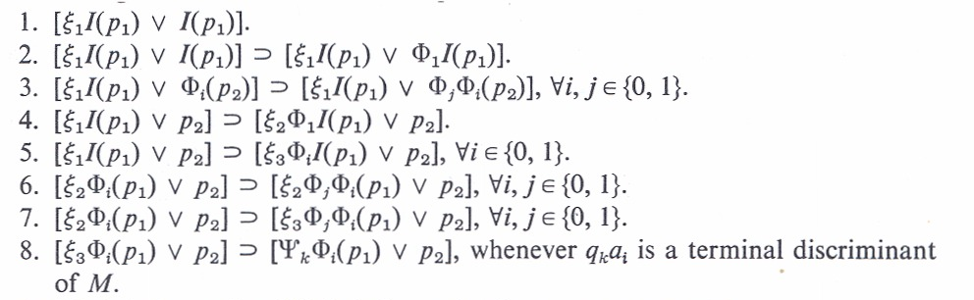
Creating Terminal IDs

Slide 504
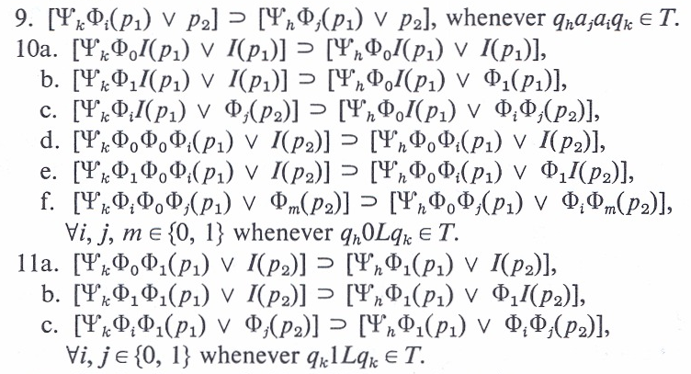
Reversing Print and Left

Slide 505
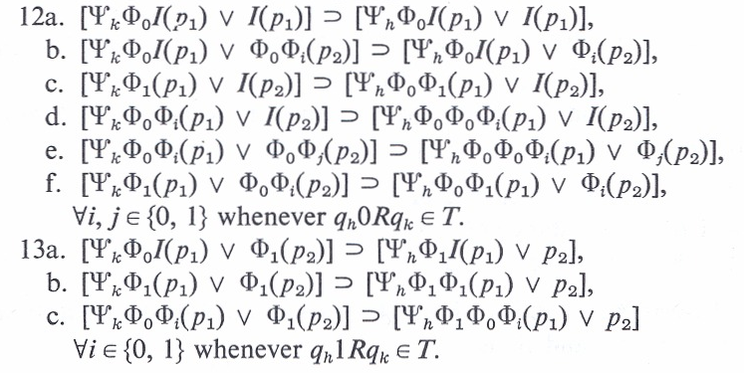
Reversing Right

Slide 506
Exam Prep

Slide 507
Sample Question
Let A and B be re sets. For each of the following, either prove that the set is re, or give a counterexample that results in some known non-re set.
Let A be semi decided by f_{A} and B by f_{B}
  A ∪ B: must be re as it is semi-decided by
  f_{A ∪ B} (x) = ∃t [stp(f_{A}, x, t) || stp(f_{B}, x, t) ]
  A ∩ B: must be re as it is semi-decided by
  f_{A ∩ B} (x) = ∃t [stp(f_{A}, x, t) && stp(f_{B}, x, t) ]
  ~A: can be non-re. If ~A is always re, then all re are recursive as any set that is re and whose complement is re is decidable. However, A = K is a non-rec, re set and so ~A is not re.

Slide 508
Sample Question
Given that the predicate STP and the function VALUE are prf’s, show that we can semi-decide
{ f | ϕ_{f} evaluates to 0 for some input}
This can be shown re by the predicate
{f | ∃<x,t> [stp(f,x,t) && value(f,x,t) = 0] }

Slide 509
Sample Question
Let S be an re (recursively enumerable), non-recursive set, and T be re, non-empty, possibly recursive set. Let E = { z | z = x + y, where x ∈ S and y ∈ T }.
(a) Can E be non re? No as we can let S and T be semi-decided by f_{S} and f_{T}, resp., E is then semi-dec. by
f_{E} (z) = ∃<x,y,t> [stp(f_{S}, x, t) && stp(f_{T}, y, t) &&
(z = value(f_{S}, x, t) + value(f_{T}, y, t)) ]
(b) Can E be re non-recursive? Yes, just let T = {0}, then E = S which is known to be re, non-rec.
(c) Can E be recursive? Yes, let T = ℵ, then
E = { x | x ≥ min (S) } which is a co-finite set and hence rec.

Slide 510
Sample Question
Assuming TOTAL is undecidable, use reduction to show the undecidability of
Incr = { f | ∀x ϕ_{f} (x+1) > ϕ_{f} (x) }
Let f be arb.
Define G_{f} (x) = ϕ_{f} (x) - ϕ_{f} (x) + x
f ∈ TOTAL iff ∀xϕ_{f} (x)↓ iff ∀x G_{f}(x)↓ iff
∀x ϕ_{f} (x) - ϕ_{f} (x) + x = x iff G_{f} ∈ Incr

Slide 511
Sample Question
Let Incr = { f | ∀x, ϕ_{f}(x+1)>ϕ_{f}(x) }.
Let TOTAL = { f | ∀x, ϕ_{f}(x)↓ }.
Prove that Incr ≤_{m} TOTAL.
Let f be arb.
Define G_{f} (x) = ∃t[stp(f,x,t) && stp(f,x+1,t) && (value(f,x+1,t) > value(f,x,t))]
f ∈ Incr iff ∀x ϕ_{f}(x+1)>ϕ_{f}(x) iff
∀x G_{f} (x)↓ iff G_{f} ∈ TOT

Slide 512
Sample Question
Let Incr = { f | ∀x ϕ_{f}(x+1)>ϕ_{f}(x) }.
Use Rice’s theorem to show Incr is not recursive.
Non-Trivial as
C₀(x)=0 ∉ Incr; S(x)=x+1 ∈ Incr
Let f,g be arb. Such that ∀x ϕ_{f}(x)=ϕ_{g}(x)
f ∈ Incr iff ∀x ϕ_{f}(x+1)>ϕ_{f}(x) iff
∀x ϕ_{g}(x+1)>ϕ_{g}(x) iff g ∈ Incr

Slide 513
Sample Question
Let S be a recursive (decidable set), what can we say about the complexity (recursive, re non-recursive, non-re) of T, where T ⊂ S?
Nothing. Just let S = ℵ, then T could be any subset of ℵ. There are an uncountable number of such subsets and some are clearly in each of the categories above.

Slide 514
Sample Question
Let P = { f | ∃ x [ STP(f, x, x) ] }. Why does Rice’s theorem not tell us anything about the undecidability of P?
This is not an I/O property as we can have implementations of C₀ that are efficient and satisfy P and others that do not.

Slide 515
ORDER ANALYSIS

Slide 516

Computability & Complexity Theory
Charles E. Hughes
COT 6410 – Spring 2019
Notes

Slide 517
Notion of “Order”
Throughout the complexity portion of this course, we will be interested in how long an algorithm takes on the instances of some arbitrary "size" n. Recognizing that different times can be recorded for two instance of size n, we only ask about the worst case.
We also understand that different languages, computers, and even skill of the implementer can alter the "running time."

Slide 518
Notion of “Order”
As a result, we really can never know "exactly" how long anything takes.
So, we usually settle for a substitute function, and say the function we are trying to measure is "of the order of" this new substitute function.

Slide 519
Notion of “Order”
"Order" is something we use to describe an upper bound upon something else (in our case, time, but it can apply to almost anything).
For example, let f(n) and g(n) be two functions. We say "f(n) is order g(n)" when there exists constants c and N such that f(n) ≤ cg(n) for all n ≥ N.
What this is saying is that when n is 'large enough,' f(n) is bounded above by a constant multiple of g(n).

Slide 520
Notion of “Order”
This is particularly useful when f(n) is not known precisely, is complicated to compute, and/or difficult to use. We can, by this, replace f(n) by g(n) and know we aren't "off too far."
We say f(n) is "in the order of g(n)" or, simply,
f(n) ∈ O(g(n)).
Usually, g(n) is a simple function, like nlog(n), n³, 2^{n}, etc., that's easy to understand and use.

Slide 521
Notion of “Order”
Order of an Algorithm: The maximum number of steps required to find the answer to any instance of size n, for any arbitrary value of n.
For example, if an algorithm requires at most 6n²+3n–6 steps on any instance of size n, we say it is "order n²" or, simply, O(n²).

Slide 522
Order
Let the order of algorithm X be in O(f_{x}(n)).
Then, for algorithms A and B and their respective order functions, f_{A}(n) and f_{B}(n), consider the limit of f_{A}(n)/f_{B}(n) as n goes to infinity.
If this value is
  0 A is faster than B
  constant A and B are "equally slow/fast"
  infinity A is slower than B.

Slide 523
Order of a Problem
Order of a Problem
The order of the fastest algorithm that can ever solve this problem. (Also known as the "Complexity" of the problem.)
  Often difficult to determine, since this allows for algorithms not yet discovered.

Slide 524
Decision vs Optimization
    Two types of problems are of particular interest:
    Decision Problems ("Yes/No" answers)
    Optimization problems ("best" answers)
    (there are other types)

Slide 525
Vertex Cover (VC)
Suppose we are in charge of a large network (a graph where edges are links between pairs of cities (vertices). Periodically, a line fails. To mend the line, we must call in a repair crew that goes over the line to fix it. To minimize down time, we station a repair crew at one end of every line. How many crews must you have and where should they be stationed?
This is called the Vertex Cover Problem. (Yes, it sounds like it should be called the Edge Cover problem – something else already had that name.)
An interesting problem – it is among the hardest problems, yet is one of the easiest of the hard problems.

Slide 526
VC Decision vs Optimization
As a Decision Problem:
Instances: A graph G and an integer k.
Question: Does G possess a vertex Cover with at most k vertices?
As an Optimization Problem:
Instances: A graph G.
Question: What is the smallest k for which G possesses a vertex cover?

Slide 527
Relation of VC Problems
If we can (easily) solve either one of these problems, we can (easily) solve the other. (To solve the optimization version, just solve the decision version with several different values of k. Use a binary search on k between 1 and n. That is log(n) solutions of the decision problem solves the optimization problem. It's simple to solve the decision version if we can solve the optimization version.
We say their time complexity differs by no more than a multiple of log(n).
If one is polynomial then so is the other.
If one is exponential, then so is the other.
We say they are equally difficult (both poly. or both exponential).

Slide 528
Smallest VC
A "stranger version"
Instances: A graph G and an integer k.
Question: Does the smallest vertex cover of G have exactly k vertices?
This is a decision problem. But, notice that it does not seem to be easy to verify either Yes or No instances!! (We can easily verify No instances for which the VC number is less than k, but not when it is actually greater than k.)
So, it would seem to be in a different category than either of the other two. Yet, it also has the property that if we can easily solve either of the first two versions, we can easily solve this one.

Slide 529
Natural Pairs of Problems
    Interestingly, these usually come in pairs
    a decision problem, and
    an optimization problem.
    Equally easy, or equally difficult, to solve.
    Both can be solved in polynomial time, or both require exponential time.

Slide 530
A Word about Time
An algorithm for a problem is said to be polynomial if there exists integers k and N such that t(n), the maximum number of steps required on any instance of size n, is at most n^{k}, for all n ≥ N.
Otherwise, we say the algorithm is exponential. Usually, this is interpreted to mean t(n) ≥ c^{n} for an infinite set of size n instances, and some constant c > 1 (often, we simply use c = 2).

Slide 531
A Word about “Words”
Normally, when we say a problem is "easy" we mean that it has a polynomial algorithm.
But, when we say a problem is "hard" or “apparently hard" we usually mean no polynomial algorithm is known, and none seems likely.
It is possible a polynomial algorithm exists for "hard" problems, but the evidence seems to indicate otherwise.

Slide 532
A Word about Abstractions
Problems we will discuss are usually "abstractions" of real problems. That is, to the extent possible, non-essential features have been removed, others have been simplified and given variable names, relationships have been replaced with mathematical equations and/or inequalities, etc.
If an abstraction is hard, then the real problem is probably even harder!!

Slide 533
A Word about Toy Problems
This process, Mathematical Modeling, is a field of study in itself, and not our interest here.
On the other hand, we sometimes conjure up artificial problems to put a little "reality" into our work. This results in what some call "toy problems."
Again, if a toy problem is hard, then the real problem is probably harder.

Slide 534
Very Hard Problems
Some problems have no algorithm (e. g., Halting Problem.)
No mechanical/logical procedure will ever solve all instances of any such problem!!
Some problems have only exponential algorithms (provably so – they must take at least order 2^{n} steps) So far, only a few have been proven, but there may be many. We suspect so.

Slide 535
Easy Problems
  Many problems have polynomial algorithms (Fortunately).
  Why fortunately? Because, most exponential algorithms are essentially useless for problem instances with n much larger than 50 or 60. We have algorithms for them, but the best of these will take 100's of years to run, even on much faster computers than we now envision.

Slide 536
Three Classes of Problems
  Problems proven to be in these three groups (classes) are, respectively,
  Undecidable, Exponential, and Polynomial.
  Theoretically, all problems belong to exactly one of these three classes.

Slide 537
Unknown Complexity
Practically, there are a lot of problems (maybe, most) that have not been proven to be in any of the classes (Yet, maybe never will be).
Most currently "lie between" polynomial and exponential – we know of exponential algorithms, but have been unable to prove that exponential algorithms are necessary.
Some may have polynomial algorithms, but we have not yet been clever enough to discover them.

Slide 538
Why do we Care?
If an algorithm is O(n^{k}), increasing the size of an instance by one gives a running time that is O((n+1)^{k})
That’s really not much more.
With an increase of one in an exponential algorithm, O(2^{n}) changes to O(2^{n+1}) = O(2*2^{n}) = 2*O(2^{n}) – that is, it takes about twice as long.

Slide 539
A Word about “Size”
Technically, the size of an instance is the minimum number of bits (information) needed to represent the instance – its "length."
  This comes from early Formal Language researchers who were analyzing the time needed to 'recognize' a string of characters as a function of its length (number of characters).
  When dealing with more general problems there is usually a parameter (number of vertices, processors, variables, etc.) that is polynomially related to the length of the instance. Then, we are justified in using the parameter as a measure of the length (size), since anything polynomially related to one will be polynomially related to the other.

Slide 540
The Subtlety of “Size”
But, be careful.
For instance, if the "value" (magnitude) of n is both the input and the parameter, the 'length' of the input (number of bits) is log₂(n). So, an algorithm that takes n time is running in n = 2^{log2(n)} time, which is exponential in terms of the length, log₂(n), but linear (hence, polynomial) in terms of the "value," or magnitude, of n.
It's a subtle, and usually unimportant difference, but it can bite you.

Slide 541
Subset Sum
Problem – Subset Sum
Instances: A list L of n integer values and an integer B.
Question: Does L have a subset which sums exactly to B?
No one knows of a polynomial (deterministic) solution to this problem.
On the other hand, there is a very simple (dynamic programming) algorithm that runs in O(nB) time.
Why isn't this "polynomial"?
Because, the "length" of an instance is nlog(B) and
nB > (nlog(B))^k for any fixed k.

Slide 542
Why do we Care?
When given a new problem to solve (design an algorithm for), if it's undecidable, or even exponential, you will waste a lot of time trying to write a polynomial solution for it!!
If the problem really is polynomial, it will be worthwhile spending some time and effort to find a polynomial solution.
You should know something about how hard a problem is before you try to solve it.

Slide 543
Research Territory
  Decidable – vs – Undecidable
  (area of Computability Theory)
  Exponential – vs – polynomial
  (area of Computational Complexity)
  Algorithms for any of these
  (area of Algorithm Design/Analysis)

Slide 544
Complexity Theory
Second Part of Course

Slide 545
Models of Computation
NonDeterminism
Since we can't seem to find a model of computation that is more powerful than a TM, can we find one that is 'faster'?
In particular, we want one that takes us from exponential time to polynomial time.
Our candidate will be the NonDeterministic Turing Machine (NDTM).

Slide 546
NDTM's
In the basic Deterministic Turing Machine (DTM) we make one major alteration (and take care of a few repercussions):
  The 'transition functon' in DTM's is allowed to become a 'transition mapping' in NDTM's.
This means that rather than the next action being totally specified (deterministic) by the current state and input character, we now can have many next actions - simultaneously. That is, a NDTM can be in many states at once. (That raises some interesting problems with writing on the tape, just where the tape head is, etc., but those little things can be explained away).

Slide 547
NDTM's
We also require that there be only one halt state - the 'accept' state. That also raises an interesting question - what if we give it an instance that is not 'acceptable'? The answer - it blows up (or goes into an infinite loop).
The solution is that we are only allowed to give it 'acceptable' input. That means
  NDTM's are only defined for decision problems
  and, in particular, only for Yes instances.

Slide 548
NDTM's
We want to determine how long it takes to get to the accept state - that's our only motive!!
So, what is a NDTM doing?
In a normal (deterministic) algorithm, we often have a loop where each time through the loop we are testing a different option to see if that "choice" leads to a correct solution. If one does, fine, we go on to another part of the problem. If one doesn't, we return to the same place and make a different choice, and test it, etc.

Slide 549
NDTM's
If this is a Yes instance, we are guaranteed that an acceptable choice will eventually be found and we go on.
In a NDTM, what we are doing is making, and testing, all of those choices at once by 'spawning' a different NDTM for each of them. Those that don't work out, simply die (or something).
This is kind of like the ultimate in parallel programming.

Slide 550
NDTM's
To allay concerns about not being able to write on the tape, we can allow each spawned NDTM to have its own copy of the tape with a read/write head.
The restriction is that nothing can be reported back except that the accept state was reached.

Slide 551
NDTM's
Another interpretation of nondeterminism:
  From the basic definition, we notice that out of every state having a nondeterministic choice, at least one choice is valid and all the rest sort of die off. That is they really have no reason for being spawned (for this instance - maybe for another). So, we station at each such state, an 'oracle' (an all knowing being) who only allows the correct NDTM to be spawned.
An 'Oracle Machine.'

Slide 552
NDTM's
This is not totally unreasonable. We can look at a non deterministic decision as a deterministic algorithm in which, when an "option" is to be tested, it is very lucky, or clever, to make the correct choice the first time.
In this sense, the two machines would work identically, and we are just asking "How long does a DTM take if it always makes the correct decisions?"

Slide 553
NDTM's
As long as we are talking magic, we might as well talk about a 'super' oracle stationed at the start state (and get rid of the rest of the oracles) whose task is to examine the given instance and simply tell you what sequence of transitions needs to be executed to reach the accept state.
He/she will write them to the left of cell 0 (the instance is to the right).

Slide 554
NDTM's
Now, you simply write a DTM to run back and forth between the left of the tape to get the 'next action' and then go back to the right half to examine the NDTM and instance to verify that the provided transition is a valid next action. As predicted by the oracle, the DTM will see that the NDTM would reach the accept state and can report the number of steps required.

Slide 555
NDTM's
All of this was originally designed with Language Recognition problems in mind. It is not a far stretch to realize the Yes instances of any of our more real word-like decision problems defines a language, and that the same approach can be used to "solve" them.
Rather than the oracle placing the sequence of transitions on the tape, we ask him/her to provide a 'witness' to (a 'proof' of) the correctness of the instance.

Slide 556
NDTM's
For example, in the SubsetSum problem, we ask the oracle to write down the subset of objects whose sum is B (the desired sum). Then we ask "Can we write a deterministic polynomial algorithm to test the given witness."
The answer for SubsetSum is Yes, we can, i.e., the witness is verifiable in deterministic polynomial time.

Slide 557
NDTM's - Witnesses
Just what can we ask and expect of a "witness"?
The witness must be something that
    (1) we can verify to be accurate (for the given problem and instance) and
    (2) we must be able to "finish off" the solution.
    All in polynomial time.

Slide 558
NDTM's - Witnesses
The witness can be nothing!
    Then, we are on our own. We have to "solve the instance in polynomial time."
The witness can be "Yes."
    Duh. We already knew that. We have to now verify the yes instance is a yes instance (same as above).
The witness has to be something other than nothing and Yes.

Slide 559
NDTM's - Witnesses
The information provided must be something we could have come up with ourselves, but probably at an exponential cost. And, it has to be enough so that we can conclude the final answer Yes from it.
Consider a witness for the graph coloring problem:
Given: A graph G = (V, E) and an integer k.
Question: Can the vertices of G be assigned colors so that adjacent vertices have different colors and use at most k colors?

Slide 560
NDTM's - Witnesses
The witness could be nothing, or Yes.
    But that's not good enough - we don't know of a polynomial algorithm for graph coloring.
It could be "vertex 10 is colored Red."
    That's not good enough either. Any single vertex can be colored any color we want.
It could be a color assigned to each vertex.
    That would work, because we can verify its validity in polynomial time, and we can conclude the correct answer of Yes.

Slide 561
NDTM's - Witnesses
What if it was a color for all vertices but one?
    That also is enough. We can verify the correctness of the n-1 given to us, then we can verify that the one uncolored vertex can be colored with a color not on any neighbor, and that the total is not more than k.
What if all but 2, 3, or 20 vertices are colored
    All are valid witnesses.
What if half the vertices are colored?
    Usually, No. There's not enough information. Sure, we can check that what is given to us is properly colored, but we don't know how to "finish it off."

Slide 562
NDTM's - Witnesses
An interesting question: For a given problem, what are the limits to what can be provided that still allows a polynomial verification?

Slide 563
NDTM's
A major question remains: Do we have, in NDTMs, a model of computation that solves all deterministic exponential (DE) problems in polynomial time (nondeterministic polynomial time)??
It definitely solves some problems we think are DE in nondeterministic polynomial time.

Slide 564
NDTM's
But, so far, all problems that have been proven to require deterministic exponential time also require nondeterministic exponential time.
So, the jury is still out. In the meantime, NDTMs are still valuable, because they might identify a larger class of problems than does a deterministic TM - the set of decision problems for which Yes instances can be verified in polynomial time.

Slide 565
Problem Classes
We now begin to discuss several different classes of problems. The first two will be:
NP 'Nondeterministic' Polynomial
P 'Deterministic' Polynomial,
The 'easiest' problems in NP
Their definitions are rooted in the depths of Computability Theory as just described, but it is worth repeating some of it in the next few slides.

Slide 566
Problem Classes
We assume knowledge of Deterministic and Nondeterministic Turing Machines. (DTM's and NDTM's)
The only use in life of a NDTM is to scan a string of characters X and proceed by state transitions until an 'accept' state is entered.
X must be in the language the NDTM is designed to recognize. Otherwise, it blows up!!

Slide 567
Problem Classes
So, what good is it?
We can count the number of transitions on the shortest path (elapsed time) to the accept state!!!
If there is a constant k for which the number of transitions is at most |X|^{k}, then the language is said to be 'nondeterministic polynomial.'

Slide 568
Problem Classes
The subset of YES instances of the set of instances of a decision problem, as we have described them above, is a language.
  When given an instance, we want to know that it is in the subset of Yes instances. (All answers to Yes instances look alike - we don't care which one we get or how it was obtained).
  This begs the question "What about the No instances?"
  The answer is that we will get to them later. (They will actually form another class of problems.)

Slide 569
Problem Classes
This actually defines our first Class, NP, the set of decision problems whose Yes instances can be solved by a Nondeterministic Turing Machine in polynomial time.
That knowledge is not of much use!! We still don't know how to tell (easily) if a problem is in NP. And, that's our goal.
Fortunately, all we are doing with a NDTM is tracing the correct path to the accept state. Since all we are interested in doing is counting its length, if someone just gave us the correct path and we followed it, we could learn the same thing - how long it is.

Slide 570
Problem Classes
It is even simpler than that (all this has been proven mathematically). Consider the following problem:
  You have a big van that can carry 10,000 lbs. You also have a batch of objects with weights w₁, w₂, …, w_{n} lbs. Their total sum is more than 10,000 lbs, so you can't haul all of them.
  Can you load the van with exactly 10,000 lbs?
  (WOW. That's the SubsetSum problem.)

Slide 571
Problem Classes
Now, suppose it is possible (i.e., a Yes instance) and someone tells you exactly what objects to select.
We can add the weights of those selected objects and verify the correctness of the selection.
This is the same as following the correct path in a NDTM. (Well, not just the same, but it can be proven to be equivalent.)
Therefore, all we have to do is count how long it takes to verify that a "correct" answer" is in fact correct.

Slide 572
Class – NP
First Significant Class of Problems:
The Class NP

Slide 573
Class – NP
We have, already, an informal definition for the set NP. We will now try to get a better idea of what NP includes, what it does not include, and give a formal definition.

Slide 574
Class – NP
    Consider two seemingly closely related statements (versions) of a single problem. We show they are actually very different. Let G = (V, E) be a graph.
      Definition: X ⊆ V(G) is a vertex cover if every edge in G has at least one endpoint in X.

Slide 575
Class – NP
    Version 1. Given a graph G and an integer k.
    Does G contain a vertex cover
    with at most k vertices?
    Version 2. Given a graph G and an integer k.
    Does the smallest vertex cover of G
    have exactly k vertices?

Slide 576
Class – NP
    Suppose, for either version, we are given a graph G and an integer k for which the answer is "yes." Someone also gives us a set X of vertices and claims
    "X satisfies the conditions."

Slide 577
Class – NP
    In Version 1, we can fairly easily check that the claim is correct – in polynomial time.
    That is, in polynomial time, we can check that X has k vertices, and that X is a vertex cover.

Slide 578
Class – NP
    In Version 2, we can also easily check that X has exactly k vertices and that X is a vertex cover.
    But, we don't know how to easily check that there is not a smaller vertex cover!!
    That seems to require exponential time.
    These are very similar looking "decision" problems (Yes/No answers), yet they are VERY different in this one important respect.

Slide 579
Class – NP
    In the first: We can verify a correct answer in polynomial time.
    In the second: We apparently can not verify a correct answer in polynomial time.
        (At least, we don't know how to verify one in polynomial time.)

Slide 580
Class – NP
    Could we have asked to be given something that would have allowed us to easily verify that X was the smallest such set?
    No one knows what to ask for!!
    To check all subsets of k or fewer vertices requires exponential time (there can be an exponential number of them).

Slide 581
Class – NP
    Version 1 problems make up the class called NP
    Definition: The Class NP is the set of all decision problems for which answers to Yes instances can be verified in polynomial time.
    {Why not the NO instances? We'll answer that later.}
    For historical reasons, NP means
    "Nondeterministic Polynomial."
    (Specifically, it does not mean "not polynomial").

Slide 582
Class – NP
Version 2 of the Vertex Cover problem is not unique. There are other versions that exhibit this same property. For example,
Version 3: Given: A graph G = (V, E) and an
integer k.
Question: Do all vertex covers of G
have more than k vertices?
What would/could a 'witness' for a Yes instance be?

Slide 583
Class – NP
Again, no one knows except to list all subsets of at most k vertices. Then we would have to check each of the possible exponential number of sets.
Further, this is not isolated to the Vertex Cover problem. Every decision problem has a 'Version 3,' also known as the 'complement' problem (we will discuss these further at a later point).

Slide 584
Class – NP
All problems in NP are decidable.
That means there is an algorithm.
And, the algorithm is no worse than O(2^{n}).

Slide 585
Class – NP
    Version 2 and 3 problems are apparently not in NP.
    So, where are they??
We need more structure! {Again, later.}
First we look inward, within NP.

Slide 586
Class – P
Second Significant Class of Problems: The Class P

Slide 587
Class – P
    Some decision problems in NP can be solved (without knowing the answer in advance) - in polynomial time. That is, not only can we verify a correct answer in polynomial time, but we can actually compute the correct answer in polynomial time - from "scratch."
      These are the problems that make up the class P.
        P is a subset of NP.

Slide 588
Class – P
Problems in P can also have a witness – we just don't need one. But, this line of thought leads to an interesting observation. Consider the problem of searching a list L for a key X.
Given: A list L of n values and a key X.
Question: Is X in L?

Slide 589
Class – P
We know this problem is in P. But, we can also envision a nondeterministic solution. An oracle can, in fact, provide a "witness" for a Yes instance by simply writing down the index of where X is located.
We can verify the correctness with one simple comparison and reporting, Yes the witness is correct.

Slide 590
Class – P
Now, consider the complement (Version 3) of this problem:
Given: A list L of n values and a key X.
Question: Is X not in L?
Here, for any Yes instance, no 'witness' seems to exist, but if the oracle simply writes down "Yes" we can verify the correctness in polynomial time by comparing X with each of the n values and report "Yes, X is not in the list."

Slide 591
Class – P
Therefore, both problems can be verified in polynomial time and, hence, both are in NP.
This is a characteristic of any problem in P - both it and its complement can be verified in polynomial time (of course, they can both be 'solved' in polynomial time, too.)
Therefore, we can again conclude P ⊆ NP.

Slide 592
Class – P
There is a popular conjecture that if any problem and its complement are both in NP, then both are also in P.
This has been the case for several problems that for many years were not known to be in P, but both the problem and its complement were known to be in NP.
For example, Linear Programming (proven to be in P in the 1980's), and Prime Number (proven in 2006 to be in P).
A notable 'holdout' to date is Graph Isomorphism.

Slide 593
Class – P
    There are a lot of problems in NP that we do not know how to solve in polynomial time. Why?
      Because they really don't have polynomial algorithms?
      Or, because we are not yet clever enough to have found a polynomial algorithm for them?

Slide 594
Class – P
    At the moment, no one knows.
    Some believe all problems in NP have polynomial algorithms. Many do not (believe that).
    The fundamental question in theoretical computer science is:
      Does P = NP?
      There is an award of one million dollars for a proof.
      – Either way, True or False.

Slide 595
Other Classes
We now look at other classes of problems.
Hard appearing problems can turn out to be easy to solve. And, easy looking problems can actually be very hard (Graph Theory is rich with such examples).
We must deal with the concept of "as hard as," "no harder than," etc. in a more rigorous way.

Slide 596
"No harder than"
Problem A is said to be 'no harder than' problem B when the smallest class containing A is a subset of the smallest class containing B.
Recall that f_{X}(n) is the order of the smallest complexity class containing problem X.
If, for some constant α,
f_{A}(n) ≤ n^{α} f_{B}(n),
the time to solve A is no more than some polynomial multiple of the time required to solve B, i.e., A is 'no harder than' B.

Slide 597
"No harder than"
The requirement for determining the relative difficulty of two problems A and B requires that we know, at least, the order of the fastest algorithm for problem B and the order of some algorithm for Problem A.
We may not know either!!
In the following we exhibit a technique that can allow us to determine this relationship without knowing anything about an algorithm for either problem.

Slide 598
    The "Key" to
    Complexity Theory
    'Reductions,' 'Reductions,' 'Reductions.'

Slide 599
Reductions
For any problem X, let X(I_{X}, Answer_{X}) represents an algorithm for problem X – even if none is known to exist.
  I_{X} is an arbitrary instance given to the algorithm and Answer_{X} is the returned answer determined by the algorithm.

Slide 600
Reductions
Definition: For problems A and B, a (Polynomial) Turing Reduction is an algorithm A(I_{A}, Answer_{A}) for solving all instances of problem A and satisfies the following:
    (1) Constructs zero or more instances of problem B and invokes algorithm B(I_{B}, Answer_{B}), on each.
    (2) Computes the result, Answer_{A}, for I_{A}.
    (3) Except for the time required to execute algorithm B, the execution time of algorithm A must be polynomial with respect to the size of I_{A}.

Slide 601
Reductions
Proc A(I_{A}, Answer_{A})
  For i = 1 to alpha
        Compute I_{B}
      B(I_{B}, Answer_{B})
  End For
  Compute Answer_{A}
End proc

Slide 602
Reductions
We may assume a 'best' algorithm for problem B without actually knowing it.
If A(I_{A}, Answer_{A}) can be written without algorithm B, then problem A is simply a polynomial problem.

Slide 603
Poly Turing Reductions
The existence of a Turing reduction is often stated as:
    "Problem A reduces to problem B" or, simply,
    "A ≤_{P} B"

Slide 604
PolyTime Reductions
Theorem. If A ≤_{P} B and problem B is polynomial, then problem A is polynomial.
Corollary. If A ≤_{P} B and problem A is exponential, then problem B is exponential.

Slide 605
PT Reductions
The previous theorem and its corollary do not capture the full implication of Turing reductions.
Regardless of the complexity class problem B is in, a Turing reduction implies problem A is in a subclass.
Regardless of the class problem A might be in, problem B is in a super class.

Slide 606
PT Reductions
Theorem. If A ≤_{P} B , then problem A is "no harder than" problem B.
Proof: Let t_{A}(n) and t_{B}(n) be the maximum times for algorithms A and B per the definition. Thus, f_{A}(n) ≤ t_{A}(n). Further, since we assume the best algorithm for B, t_{B}(n) = f_{B}(n). Since A ≤_{P} B, there is a constant k such that t_{A}(n) ≤ n^{k}t_{B}(n). Therefore, f_{A}(n) ≤ t_{A}(n) ≤ n^{k}t_{B}(n) = n^{k}f_{B}(n). That is, A is no harder than B.

Slide 607
PT Reductions
Theorem.
    If A ≤_{P} B and B ≤_{P} C then A ≤_{P} C.
Definition.
    If A ≤_{P} B and B ≤_{P} A, then A and B are polynomially equivalent.

Slide 608
Polynomial Reductions
A ≤_{P} B means:
    'Problem A is no harder within a polynomial factor than problem B,' and
    'Problem B is as hard within a polynomial factor as is problem A.'

Slide 609
An Aside
Without condition (3) of the definition, a simple Reduction results.
If problem B is decidable,
then so is problem A.
Equivalently,
If problem A is undecidable,
then problem B is undecidable.

Slide 610
NP–Complete
Third Significant Class of Problems:
The Class NP–Complete

Slide 611
NP–Complete
    Polynomial Transformations enforce an equivalence relationship on all decision problems, particularly, those in the Class NP. Class P is one of those classes and is the "easiest" class of problems in NP.
    Is there a class in NP that is the hardest class in NP?
    A problem B in NP such that A ≤_{P} B for every A in NP.

Slide 612
NP–Complete
    In 1971, Stephen Cook proved there was. Specifically, a problem called
    Satisfiability (or, SAT).

Slide 613
Satisfiability
U = {u₁, u₂,…, u_{n}}, Boolean variables.
C = {c₁, c₂,…, c_{m}}, "OR clauses"
For example:
c_{i} = (u₄ ∨ u₃₅ ∨ ~u₁₈ ∨ u₃… ∨ ~u₆)

Slide 614
Satisfiability
Can we assign Boolean values to the variables in U so that every clause is TRUE?
There is no known polynomial time algorithm!!

Slide 615
NP–Complete
Cooks Theorem:
1) SAT is in NP
2) For every problem A in NP,
A ≤_{P} SAT
Thus, SAT is as hard as every problem in NP.

Slide 616
NP–Complete
Since SAT is itself in NP, that means SAT is a hardest problem in NP (there can be more than one.).
A hardest problem in a class is called the "completion" of that class.
Therefore, SAT is NP–Complete.

Slide 617
NP–Complete
    Today, there are 1,000’s of problems that have been proven to be NP–Complete. (See Garey and Johnson, Computers and Intractability: A Guide to the Theory of NP–Completeness, for a list of over 300 as of the early 1980's).

Slide 618
P = NP?
If P = NP then all problems in NP are polynomial problems.
If P ≠ NP then all NP–C problems are at least super-polynomial and perhaps exponential. That is, NP-C problems could require sub-exponential super-polynomial time. (Example of super-polynomial, sub-exponential is o(2^{o(n)}), e.g., 2^{∛n}

Slide 619
P = NP?
Why should P equal NP?
There seems to be a huge "gap" between the known problems in P and Exponential. That is, almost all known polynomial problems are no worse than n³ or n⁴.
Where are the O(n⁵⁰) problems?? O(n¹⁰⁰)? Maybe they are the ones in NP–Complete?
It's awfully hard to envision a problem that would require n¹⁰⁰, but surely they exist?
Some of the problems in NP–C just look like we should be able to find a polynomial solution (looks can be deceiving, though).

Slide 620
P ≠ NP?
Why should P not equal NP?
    P = NP would mean, for any problem in NP, that it is just as easy to solve an instance form "scratch," as it is to verify the answer if someone gives it to you. That seems a bit hard to believe.
    There simply are a lot of awfully hard looking problems in NP–Complete (and Co–NP-Complete) and some just don't seem to be solvable in polynomial time.
    Many smart people have tried for a long time to find polynomial algorithms for some of the problems in NP-Complete - with no luck.

Slide 621
NP-Complete; NP-Hard
A decision problem, C, is NP-complete if:
  C is in NP and
  C is NP-hard. That is, every problem in NP is polynomially reducible to C.
D polynomially reduces to C means that there is a deterministic polynomial-time many-one algorithm, f, that transforms each instance x of D into an instance f(x) of C, such that the answer to f(x) is YES if and only if the answer to x is YES.
To prove that an NP problem A is NP-complete, it is sufficient to show that an already known NP-complete problem polynomially reduces to A. By transitivity, this shows that A is NP-hard.
A consequence of this definition is that if we had a polynomial time algorithm for any NP-complete problem C, we could solve all problems in NP in polynomial time. That is, P = NP.
Note that NP-hard does not necessarily mean NP-complete, as a given NP-hard problem could be outside NP.

Slide 622
Returning to SAT
SAT is the problem to decide of an arbitrary Boolean formula (wff in the propositional calculus) whether or not this formula is satisfiable (has a set of variable assignments that evaluate the expression to true).
SAT clearly can be solved in time k2^{n}, where k is the length of the formula and n is the number of variables in the formula.
What we now show is that SAT is NP-complete, providing us our first concrete example of an NP-complete decision problem.

Slide 623
Simulating NDTM
Given a NDTM, M, and an input w, we need to create a formula, ϕ_{M,w}, containing a polynomial number of terms that is satisfiable just in case M accepts w in polynomial time.
The formula must encode within its terms a trace of configurations that includes
  A term for the starting configuration of the TM
  Terms for all accepting configurations of the TM
  Terms that ensure the consistency of each configuration
  Terms that ensure that each configuration after the first follows from the prior configuration by a single move

Slide 624
Tableaus
A tableau is an array of tape alphabet symbols.
  It represents a configuration history of one branch of our NDTM’s nondeterminism.
  If the NDTM runs in n^{k} time, the tableau is an
  (n^{k} × n^{k}) tableau.
    It’s big enough downward because, well, the TM runs in n^{k}.
    …and rightward because the TM can only count to n^{k}.
  We assume that every configuration starts and ends with a # symbol.
  We think of our tableau as looking like this in the “beginning”: the starting configuration across the top, and the other configurations blank.
    (We quote “beginning” because SAT isn’t really a stateful algorithm, but just go with it for now.)
  But we’ve assumed that we can “represent” alphabet symbols. How do we do that, in SAT?
# | q₀ | w₁ | w₂ | … | w_{n} | □ | … | □ | # | ↑n^{k}↓
# |  |  |  |  |  |  |  |  | #
# |  |  |  |  |  |  |  |  | #
# |  |  |  |  |  |  |  |  | #
# |  |  |  |  |  |  |  |  | #
# |  |  |  |  |  |  |  |  | #
# |  |  |  |  |  |  |  |  | #
# |  |  |  |  |  |  |  |  | #
# |  |  |  |  |  |  |  |  | #
# |  |  |  |  |  |  |  |  | #
← n^{k} →

Slide 625
Encoding the Tableau: Basics
Consider a set comprised of:
  The tape alphabet
  The state set
  The separator character
C = Γ ∪ Q ∪ { # }
Consider a cell variable:
x_{i,j,c}
Turning this variable on corresponds to setting cell (i, j) = c, for some c ∈ C.
 | 1 | 2 | 3 | 4 | 5 | 6 | 7 | 8 | 9 | 10
1 | # | q₀ | w₁ | w₂ | … | w_{n} | □ | … | □ | #
2 | # |  |  |  |  |  |  |  |  | #
3 | # |  |  |  |  |  |  |  |  | #
4 | # |  |  |  |  |  |  |  |  | #
5 | # |  |  |  |  |  |  |  |  | #
6 | # |  |  |  |  |  |  |  |  | #
7 | # |  |  |  |  |  |  |  |  | #
8 | # |  |  |  |  |  |  |  |  | #
9 | # |  |  |  |  |  |  |  |  | #
10 | # |  |  |  |  |  |  |  |  | #

Slide 626
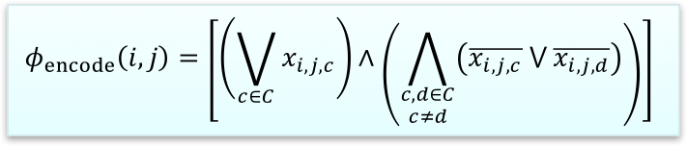
Encoding the Tableau: Cells
Consider our tableau alphabet:
C = Γ ∪ Q ∪ { # }
Consider a cell and corresponding variable:
x_{i,j,c}
Now we need to make sure the tableau is consistently encoded.
  Create a clause for each cell (i, j).
  The left demands x_{i,j,c} be true for some c.
  The right demands x_{i,j,c} be true for only one c.
 | 1 | 2 | 3 | 4 | 5 | 6 | 7 | 8 | 9 | 10
1 | # | q₀ | w₁ | w₂ | … | w_{n} | □ | … | □ | #
2 | # |  |  |  |  |  |  |  |  | #
3 | # |  |  |  |  |  |  |  |  | #
4 | # |  |  |  |  |  |  |  |  | #
5 | # |  |  |  |  |  |  |  |  | #
6 | # |  |  |  |  |  |  |  |  | #
7 | # |  |  |  |  |  |  |  |  | #
8 | # |  |  |  |  |  |  |  |  | #
9 | # |  |  |  |  |  |  |  |  | #
10 | # |  |  |  |  |  |  |  |  | #
$$φ_{encode}\left(i,j\right)=\left[\left(\bigvee_{c∈C}{x_{i,j,c}}\right)∧\left(\bigwedge_{\begin{aligned}c,d∈C \\ c≠d\end{aligned}}{\left(\overline{x_{i,j,c}} ⋁ \overline{x_{i,j,d}}\right)}\right)\right]$$

Slide 627
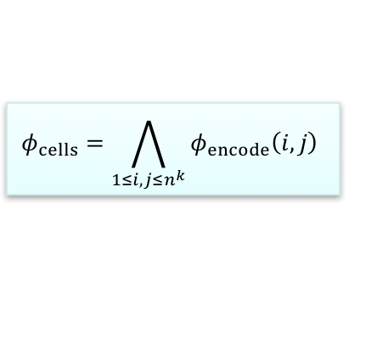

Encoding the Tableau: The Tableau
Tableau alphabet: C = Γ ∪ Q ∪ { # }
Cell variable: x_{i,j,c}
Create an encoding clause for each cell (i, j).
Now repeat the clause across the tableau.
This is our cell formula. It ensures that each cell in the tableau is assigned a single symbol.
 | 1 | 2 | 3 | 4 | 5 | 6 | 7 | 8 | 9 | 10
1 | # | q₀ | w₁ | w₂ | … | w_{n} | □ | … | □ | #
2 | # |  |  |  |  |  |  |  |  | #
3 | # |  |  |  |  |  |  |  |  | #
4 | # |  |  |  |  |  |  |  |  | #
5 | # |  |  |  |  |  |  |  |  | #
6 | # |  |  |  |  |  |  |  |  | #
7 | # |  |  |  |  |  |  |  |  | #
8 | # |  |  |  |  |  |  |  |  | #
9 | # |  |  |  |  |  |  |  |  | #
10 | # |  |  |  |  |  |  |  |  | #
$$φ_{encode}\left(i,j\right)=\left[\left(\bigvee_{c∈C}{x_{i,j,c}}\right)∧\left(\bigwedge_{\begin{aligned}c,d∈C \\ c≠d\end{aligned}}{\left(\overline{x_{i,j,c}} ⋁ \overline{x_{i,j,d}}\right)}\right)\right]$$
$$φ_{cells}=\bigwedge_{1≤i,j≤n^{k}}{φ_{encode}\left(i,j\right)}$$

Slide 628
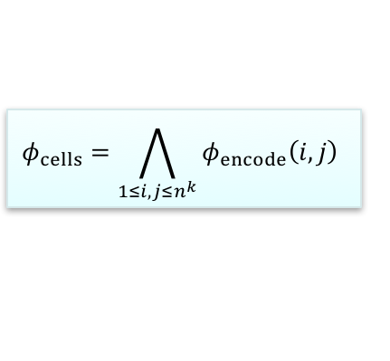
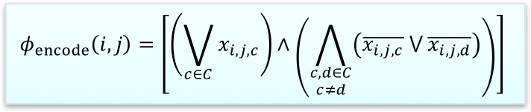
Encoding the Tableau: Complexity
We can create the single-cell encoding formula in polynomial time with a |C|² iteration.
We can create the entire cell formula in polynomial time with an n^{2k} iteration around that.
So we can say that φ_{cells} is satisfied by, and only by, a properly encoded tableau, and is created in polynomial time.
$$φ_{encode}\left(i,j\right)=\left[\left(\bigvee_{c∈C}{x_{i,j,c}}\right)∧\left(\bigwedge_{\begin{aligned}c,d∈C \\ c≠d\end{aligned}}{\left(\overline{x_{i,j,c}} ⋁ \overline{x_{i,j,d}}\right)}\right)\right]$$
 | 1 | 2 | 3 | 4 | 5 | 6 | 7 | 8 | 9 | 10
1 | # | q₀ | w₁ | w₂ | … | w_{n} | □ | … | □ | #
2 | # |  |  |  |  |  |  |  |  | #
3 | # |  |  |  |  |  |  |  |  | #
4 | # |  |  |  |  |  |  |  |  | #
5 | # |  |  |  |  |  |  |  |  | #
6 | # |  |  |  |  |  |  |  |  | #
7 | # |  |  |  |  |  |  |  |  | #
8 | # |  |  |  |  |  |  |  |  | #
9 | # |  |  |  |  |  |  |  |  | #
10 | # |  |  |  |  |  |  |  |  | #
$$φ_{cells}=\bigwedge_{1≤i,j≤n^{k}}{φ_{encode}\left(i,j\right)}$$

Slide 629
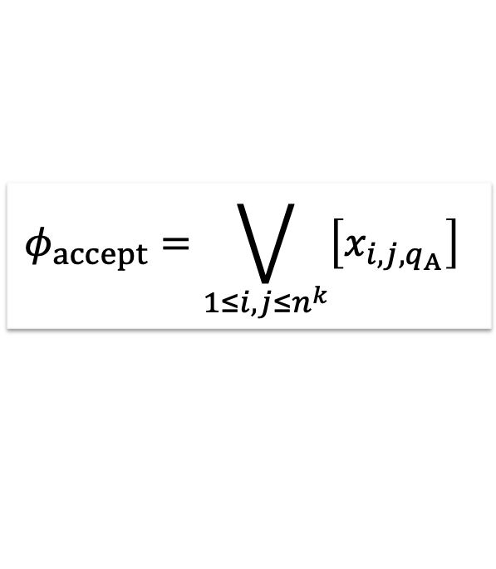
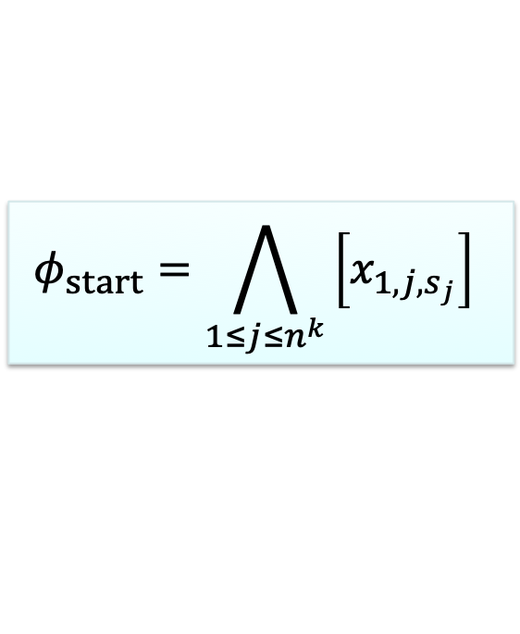
Starting and Accepting
Starting and accepting are (comparatively) easy.
To start, take the start configuration padded to n^{k} length with blanks…
S = #q₀w₁w₂…w_{n}□…□# so that |S| = n^{k}
…and require the first row be equal to the start configuration:
Then to accept, just require an accept state somewhere in the tableau.
 | 1 | 2 | 3 | 4 | 5 | 6 | 7 | 8 | 9 | 10
1 | # | q₀ | w₁ | w₂ | … | w_{n} | □ | … | □ | #
2 | # |  |  |  |  |  |  |  |  | #
3 | # |  |  |  |  |  |  |  |  | #
4 | # |  |  |  |  |  |  |  |  | #
5 | # | w₁ | w₂ | … | q_{A} | … | □ | … | □ | #
6 | # |  |  |  |  |  |  |  |  | #
7 | # |  |  |  |  |  |  |  |  | #
8 | # |  |  |  |  |  |  |  |  | #
9 | # |  |  |  |  |  |  |  |  | #
10 | # |  |  |  |  |  |  |  |  | #
$$φ_{start}=\bigwedge_{1≤j≤n^{k}}{\left[x_{1,j,s_{j}}\right]}$$
$$φ_{accept}=\bigvee_{1≤i,j≤n^{k}}{\left[x_{i,j,q_{A}}\right]}$$

Slide 630
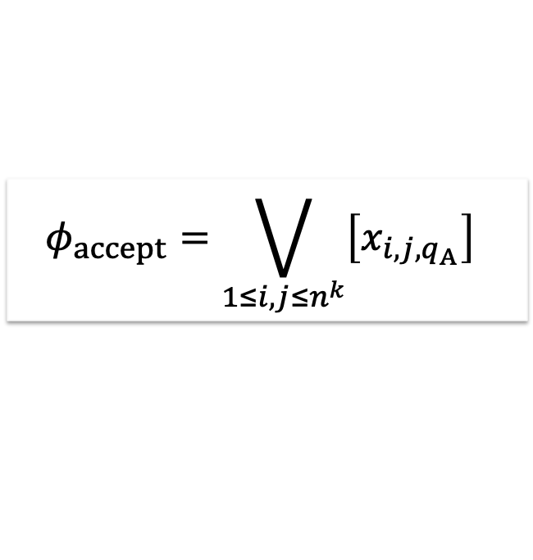
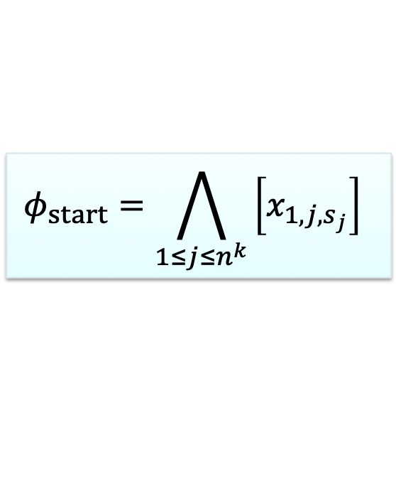
Starting and Accepting
$$φ_{start}=\bigwedge_{1≤j≤n^{k}}{\left[x_{1,j,s_{j}}\right]}$$
$$φ_{accept}=\bigvee_{1≤i,j≤n^{k}}{\left[x_{i,j,q_{A}}\right]}$$
 | 1 | 2 | 3 | 4 | 5 | 6 | 7 | 8 | 9 | 10
1 | # | q₀ | w₁ | w₂ | … | w_{n} | □ | … | □ | #
2 | # |  |  |  |  |  |  |  |  | #
3 | # |  |  |  |  |  |  |  |  | #
4 | # |  |  |  |  |  |  |  |  | #
5 | # | z₁ | z₂ | … | q_{A} | … | □ | … | □ | #
6 | # |  |  |  |  |  |  |  |  | #
7 | # |  |  |  |  |  |  |  |  | #
8 | # |  |  |  |  |  |  |  |  | #
9 | # |  |  |  |  |  |  |  |  | #
10 | # |  |  |  |  |  |  |  |  | #
We can generate the start and accept formulas in n^{k} and (n^{k})² time, both polynomial.
So now we can say that:
φ_{start} is satisfied by, and only by, a tableau with the starting configuration of M on w encoded as its first row, and is created in polynomial time.
…and…
φ_{accept} is satisfied by, and only by, a tableau encoding an accepting configuration as one of its rows, and is created in polynomial time.

Slide 631
Transitions
Now, for transitions. Recall the discussions we had about ID changes being limited to three characters or six, when looking at transitions..
  A given 2x3 window is legal if it does not violate our machine’s transition function.
  Given the linear sets of states and tape symbols, and the finite size of 2x3 windows, we can make a polynomial-sized set of all legal windows.
Let a sequence A = (a₁, …, a₆) be a 2x3 window, with a₁ the top left cell, a₂ the top middle, etc.
  We say that A is legal if it represents a legal window. Here we have q₀ a R q₁
 | 1 | 2 | 3 | 4 | 5 | 6 | 7 | 8 | 9 | 10
1 | # | q₀ | a | b | c | a | □ | □ | □ | #
2 | # | a | q₁ | b | c | a | □ | □ | □ | #
3 | # |  |  |  |  |  |  |  |  | #
4 | # |  |  |  |  |  |  |  |  | #
5 | # |  |  |  |  |  |  |  |  | #
6 | # |  |  |  |  |  |  |  |  | #
7 | # |  |  |  |  |  |  |  |  | #
8 | # |  |  |  |  |  |  |  |  | #
9 | # |  |  |  |  |  |  |  |  | #
10 | # |  |  |  |  |  |  |  |  | #

Slide 632
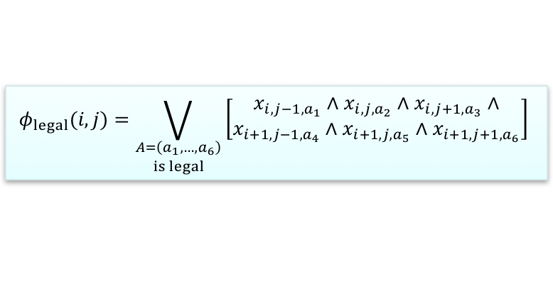
Transitions
  A given 2x3 window is legal if it does not violate our machine’s transition function. We have a polynomial-sized set of all legal windows.
  Let a sequence A = (a₁, …, a₆) be a 2x3 window. A is legal if it represents a legal window.
  Now we can come up with a formula to say that the window top-centered at cell (i, j) is legal.
Don’t be intimidated by this formula!
  It’s just counting off the six cells of the window and demanding that each be equal to the corresponding cell in some legal window.
 | 1 | 2 | 3 | 4 | 5 | 6 | 7 | 8 | 9 | 10
1 | # | q₀ | a | b | c | a | □ | □ | □ | #
2 | # | a | q₁ | b | c | a | □ | □ | □ | #
3 | # |  |  |  |  |  |  |  |  | #
4 | # |  |  |  |  |  |  |  |  | #
5 | # |  |  |  |  |  |  |  |  | #
6 | # |  |  |  |  |  |  |  |  | #
7 | # |  |  |  |  |  |  |  |  | #
8 | # |  |  |  |  |  |  |  |  | #
9 | # |  |  |  |  |  |  |  |  | #
10 | # |  |  |  |  |  |  |  |  | #
$$φ_{legal}(i,j)=\bigvee_{\begin{aligned}A=\left(a_{1},…,a_{6}\right) \\ is legal\end{aligned}}{\left[\begin{aligned}x_{i,j−1,a_{1}}∧x_{i,j,a_{2}}∧x_{i,j+1,a_{3}}∧ \\ x_{i+1,j−1,a_{4}}∧x_{i+1,j,a_{5}}∧x_{i+1,j+1,a_{6}}\end{aligned}\right]}$$

Slide 633
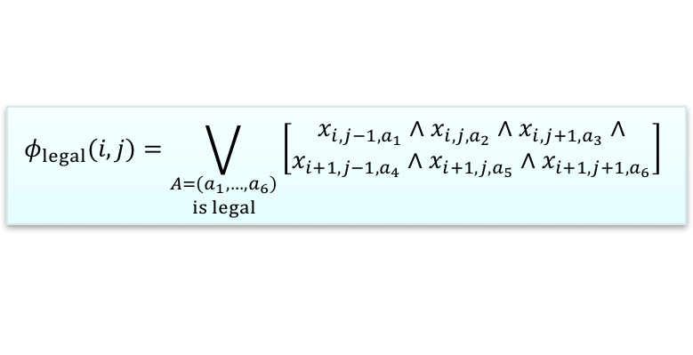
Transitions
A given 2x3 window is legal if it does not violate our machine’s transition function.
We have a polynomial-sized set of all legal windows.
Let a sequence A = (a₁, …, a₆) be a 2x3 window. A is legal if it represents a legal window.
Since we have a polynomial number of legal windows, this formula is also polynomial. So we can say:
φ_{legal} (i, j) is satisfied by, and only by, a tableau whose window top-centered at (i, j) is legal; and is created in polynomial time.
 | 1 | 2 | 3 | 4 | 5 | 6 | 7 | 8 | 9 | 10
1 | # | q₀ | a | b | c | a | □ | □ | □ | #
2 | # | a | q₁ | b | c | a | □ | □ | □ | #
3 | # |  |  |  |  |  |  |  |  | #
4 | # |  |  |  |  |  |  |  |  | #
5 | # |  |  |  |  |  |  |  |  | #
6 | # |  |  |  |  |  |  |  |  | #
7 | # |  |  |  |  |  |  |  |  | #
8 | # |  |  |  |  |  |  |  |  | #
9 | # |  |  |  |  |  |  |  |  | #
10 | # |  |  |  |  |  |  |  |  | #
$$φ_{legal}(i,j)=\bigvee_{\begin{aligned}A=\left(a_{1},…,a_{6}\right) \\ is legal\end{aligned}}{\left[\begin{aligned}x_{i,j−1,a_{1}}∧x_{i,j,a_{2}}∧x_{i,j+1,a_{3}}∧ \\ x_{i+1,j−1,a_{4}}∧x_{i+1,j,a_{5}}∧x_{i+1,j+1,a_{6}}\end{aligned}\right]}$$

Slide 634
Windows and Configurations
Consider any upper and lower configuration in the tableau, so that the lower configuration is the one immediately below – that is, following – the upper.
If all the windows top-centered on cells in the upper configuration are legal, then:
  The legality of the windows that don’t involve the state symbol easily ensures the legality of the configuration below them.
  The window top-centered on the state symbol in the upper configuration is sufficient to ensure that the state symbol in the lower configuration makes a legal move.
The upper configuration yields the lower one if and only if all the windows top-centered on cells in the upper configuration are legal – and that holds all the way down the tableau.
 | 1 | 2 | 3 | 4 | 5 | 6 | 7 | 8 | 9 | 10
1 | # | q₀ | a | b | c | a | □ | □ | □ | #
2 | # | a | q₁ | b | c | a | □ | □ | □ | #
3 | # |  |  |  |  |  |  |  |  | #
4 | # |  |  |  |  |  |  |  |  | #
5 | # |  |  |  |  |  |  |  |  | #
6 | # |  |  |  |  |  |  |  |  | #
7 | # |  |  |  |  |  |  |  |  | #
8 | # |  |  |  |  |  |  |  |  | #
9 | # |  |  |  |  |  |  |  |  | #
10 | # |  |  |  |  |  |  |  |  | #

Slide 635
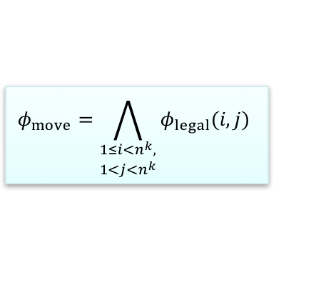

Windows and Configurations
$$φ_{legal}(i,j)=\bigvee_{\begin{aligned}A=\left(a_{1},…,a_{6}\right) \\ is legal\end{aligned}}{\left[\begin{aligned}x_{i,j−1,a_{1}}∧x_{i,j,a_{2}}∧x_{i,j+1,a_{3}}∧ \\ x_{i+1,j−1,a_{4}}∧x_{i+1,j,a_{5}}∧x_{i+1,j+1,a_{6}}\end{aligned}\right]}$$
φ_{legal} (i, j) is satisfied by, and only by, a tableau whose window top-centered at (i, j) is legal; and is created in polynomial time.
An upper configuration yields a lower one iff all the windows top-centered within the upper are legal.
  This holds all the way down the tableau.
Then we have:
And can say φ_{move} is satisfied by, and only by, a tableau that does not violate the machine’s transition function; and is created in polynomial time.
 | 1 | 2 | 3 | 4 | 5 | 6 | 7 | 8 | 9 | 10
1 | # | q₀ | a | b | c | a | □ | □ | □ | #
2 | # | a | q₁ | b | c | a | □ | □ | □ | #
3 | # |  |  |  |  |  |  |  |  | #
4 | # |  |  |  |  |  |  |  |  | #
5 | # |  |  |  |  |  |  |  |  | #
6 | # |  |  |  |  |  |  |  |  | #
7 | # |  |  |  |  |  |  |  |  | #
8 | # |  |  |  |  |  |  |  |  | #
9 | # |  |  |  |  |  |  |  |  | #
10 | # |  |  |  |  |  |  |  |  | #
$$φ_{move}=\bigwedge_{\begin{aligned}1≤i<n^{k}, \\ 1<j<n^{k}\end{aligned}}{φ_{legal}(i,j)}$$

Slide 636
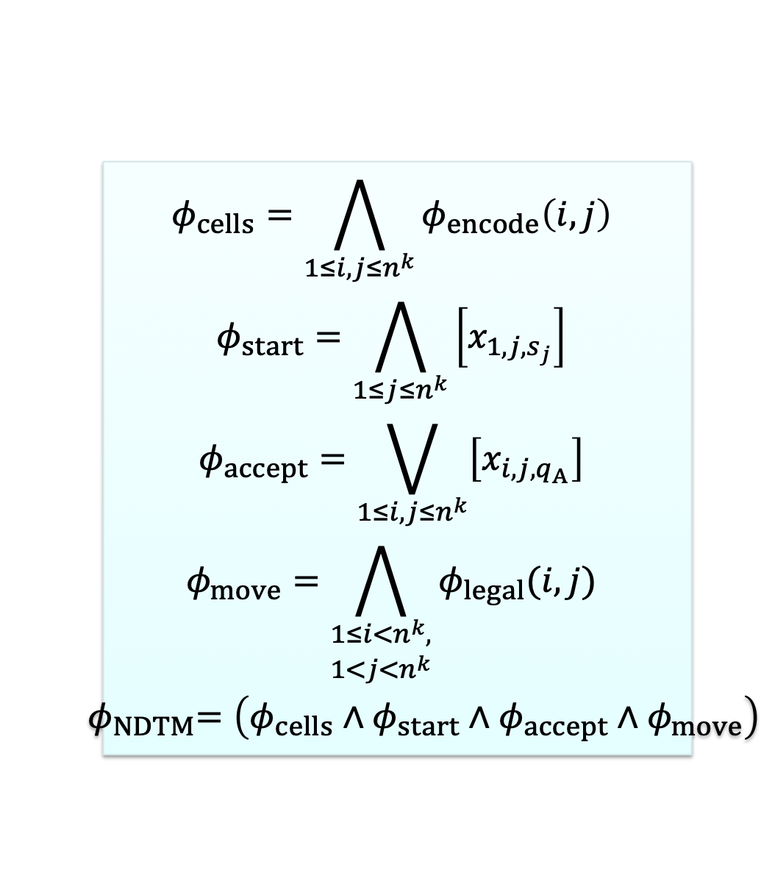
Pulling It Together
$$\begin{matrix}φ_{cells}=\bigwedge_{1≤i,j≤n^{k}}{φ_{encode}\left(i,j\right)} \\ φ_{start}=\bigwedge_{1≤j≤n^{k}}{\left[x_{1,j,s_{j}}\right]} \\ φ_{accept}=\bigvee_{1≤i,j≤n^{k}}{\left[x_{i,j,q_{A}}\right]} \\ φ_{move}=\bigwedge_{\begin{aligned}1≤i<n^{k}, \\ 1<j<n^{k}\end{aligned}}{φ_{legal}(i,j)} \\ { φ}_{NDTM}=\left(φ_{cells}∧φ_{start}∧φ_{accept}∧φ_{move}\right)\end{matrix}$$
We have:
  φ_{cells} is satisfied by, and only by, a properly encoded tableau.
  φ_{start} is satisfied by, and only by, a tableau with the starting configuration of M on w encoded as its first row.
  φ_{accept} is satisfied by, and only by, a tableau encoding an accepting configuration as one of its rows.
  φ_{move} is satisfied by, and only by, a tableau that does not violate the machine’s transition function.
  All are created in polynomial time.
Then φ_{NDTM} is satisfied by, and only by, a tableau encoding an accepting computation history of M on w, and is created in polynomial time.

Slide 637
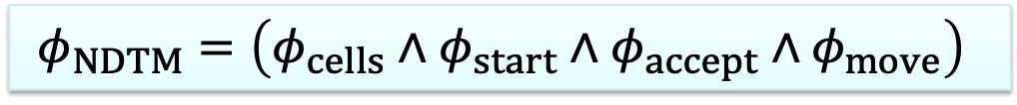
SAT is NP-Complete
$$φ_{NDTM}=\left(φ_{cells}∧φ_{start}∧φ_{accept}∧φ_{move}\right)$$
φ_{NDTM} created from NDTM M and input w is satisfied by, and only by, a tableau encoding an accepting computation history of M on w, and is created in polynomial time.
This means that:
  SAT accepts φ_{NDTM} if and only if such a tableau exists…
  …if and only if the NDTM we are encoding into φ_{NDTM} accepts w.
We’ve just polynomially reduced every possible NP language to SAT.
Let’s convince ourselves of that a bit more.
  By definition, any NP language has an NDTM M that decides it in polynomial time.
We can decide any NP language with a result from SAT using the following algorithm:
On input <M, w>:
  Create φ_{NDTM} from M and w.
  Run the decider for SAT on φ_{NDTM}.
  Accept if SAT accepts, reject if it rejects.
SAT is NP-complete.

Slide 638
Cook’s Theorem
ϕ_{M,w} = φ_{cells} ∧ φ_{start} ∧ φ_{accept} ∧ φ_{move}
See the following for another detailed description and discussion of the four terms that make up this formula.
http://www.cs.tau.ac.il/~safra/Complexity/Cook.ppt

Slide 639
NP–Complete
Within a year, Richard Karp added 22 problems to this special class.
We will focus on:
3-SAT
Integer Linear Programming
SubsetSum
Partition
Vertex Cover
Independent Set
K-Color
Multiprocessor Scheduling

Slide 640
Co-NP
A problem is in co-NP if its complement is in NP – this is like co-RE, wrt RE problems.
An example is the problem to determine if a Boolean expression is a tautology.
  If the answer to the problem "is B in TAUT ?" is NO, then ¬A is in SAT.
A more direct example of a co-NP problem is to determine if a Boolean expression is self-contradictory.
  This is the complement of satisfiability.
Both of the above are co-NP Complete

Slide 641
SAT to 3SAT
3-SAT means that each clause has exactly three terms
If one term, e.g., (p), expand to (p∨p∨p)
If two terms, e.g., (p∨q), expand to (p∨q∨p)
Any clause with three terms is fine
If n > three terms, can reduce to two clauses, one with three terms and one with n-1 terms, e.g., (p1∨p2∨…∨pn) to
(p1∨p2∨z) & (p3∨…∨pn∨~z), where z is a new variable. If n=4, we are done, else apply this approach again with the clause having n-1 terms

Slide 642
Integer Linear Programming
Show for 0-1 integer linear programming by constraining solution space. Start with an instance of SAT (or 3SAT), assuming variables v1,…, vn and clauses c1,…, cm
For each variable vi, have constraint that 0 ≤ vi ≤ 1
For each clause we provide a constraint that it must be satisfied (evaluate to at least 1). For example, if clause cj is v2 ∨ ~v3 ∨ v5 ∨ v6 then add the constraint
v2 + (1-v3) + v5 + v6 ≥ 1
A solution to this set of integer linear constraints implies a solution to the instance of SAT and vice versa

Slide 643
SubsetSum
S = {s₁, s₂, …, s_{n}}
    set of positive integers
    and an integer B.
    Question: Does S have a subset whose values sum to B?
No one knows of a polynomial algorithm.
{No one has proven there isn’t one, either!!}

Slide 644
SubsetSum ≡_{p} Partition
Theorem. SAT ≤_{P} 3SAT
Theorem. 3SAT ≤_{P} SubsetSum
Theorem. SubsetSum ≤_{P} Partition
Theorem. Partition ≤_{P} SubsetSum
Therefore, not only is Satisfiability in NP–Complete, but so is 3SAT, Partition, and SubsetSum.

Slide 645
3SAT ≤_{p} SubsetSum
Assuming a 3SAT expression (a + ~b + c) (~a + b + ~c)
 | a | b | c | a+~b+c | ~a+b+~c
a | 1 | 0 | 0 | 1 | 0
~a | 1 | 0 | 0 | 0 | 1
b | 0 | 1 | 0 | 0 | 1
~b | 0 | 1 | 0 | 1 | 0
c | 0 | 0 | 1 | 1 | 0
~c | 0 | 0 | 1 | 0 | 1
C1 | 0 | 0 | 0 | 1 | 0
C1’ | 0 | 0 | 0 | 1 | 0
C2 | 0 | 0 | 0 | 0 | 1
C2’ | 0 | 0 | 0 | 0 | 1
 | 1 | 1 | 1 | 3 | 3

Slide 646
SubsetSum≡_{p}Partition Details
Partition is polynomial equivalent to SubsetSum
  Let i₁, i₂, .., i_{n} , G be an instance of SubsetSum. This instance has answer “yes” iff
  i₁, i₂, .., i_{n} , 2*Sum(i₁, i₂, .., i_{n} ) – G,Sum(i₁, i₂, .., i_{n} ) + G
  has answer “yes” in Partition. Here we assume that
  G ≤ Sum(i₁, i₂, .., i_{n} ), for, if not, the answer is “no.”
  Let i₁, i₂, .., i_{n} be an instance of Partition. This instance has answer “yes” iff
  i₁, i₂, .., i_{n} , Sum(i₁, i₂, .., i_{n} )/2
  has answer “yes” in SubsetSum

Slide 647
SubsetSum ≡_{p} Partition
[(15, 17, 27, 11, 4, 12, 33, 5, 6, 21, 2), 57]
A solution is 15, 17, 11, 12, 2
Sum of all is 153
Mapping to Partition is
  (15, 17, 27, 11, 4, 12, 33, 5, 6, 21, 2, 306-57, 153+57)
  (15, 17, 27, 11, 4, 12, 33, 5, 6, 21, 2, 249, 210)
  (15+17+11+12+2+249) = 306
  (27+4+33+5+6+21+210) = 306
Going other direction map above to
  [(15, 17, 27, 11, 4, 12, 33, 5, 6, 21, 2, 249, 210), 306]

Slide 648
VERTEX COVERING (VC) Decision Problem is NP-Hard

Slide 649
3SAT to Vertex Cover
Vertex cover seeks a set of vertices that cover every edge in some graph
Let I_{3-SAT} be an arbitrary instance of 3-SAT. For integers n and m,
U = {u₁, u₂, …, u_{n}} and C_{i} = {z_{i1}, z_{i2}, z_{i3}} for 1 ≤ i ≤ m,
where each z_{ij} is either a u_{k} or u_{k}' for some k.
Construct an instance of VC as follows.
For each i, 1 ≤ i ≤ n, construct two vertices, u_{i} and u_{i}' with an edge between them.
For each clause C_{i} = {z_{i1}, z_{i2}, z_{i3}}, 1 ≤ i ≤ m, construct three vertices z_{i1}, z_{i2}, and z_{i3} and form a "triangle on them. Each z_{ij} is one of the Boolean variables u_{k} or its complement u_{k}'. Draw an edge between z_{ij} and the Boolean variable (whichever it is). Each z_{ij} has degree 3. Finally, set k = n+2m.
Theorem. The given instance of 3-SAT is satisfiable if and only if the constructed instance of VC has a vertex cover with at most k vertices.

Slide 650
VC Variable Gadget
X
~X

Slide 651
VC Clause Gadget
b
a
~c
a + b + ~c

Slide 652
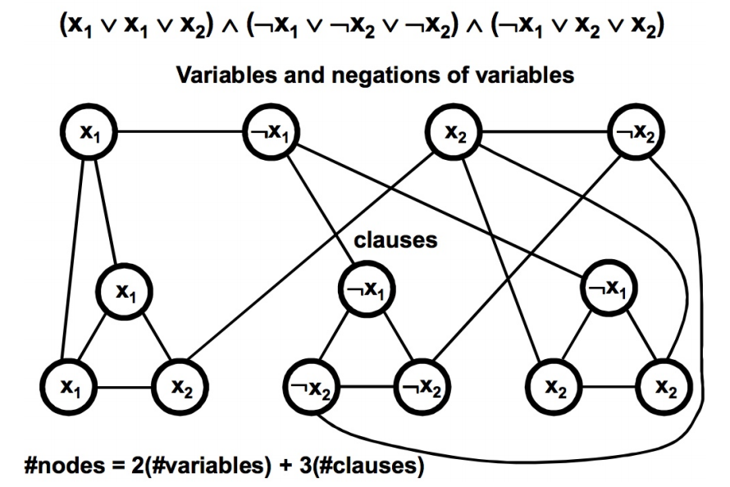
VC Gadgets Combined
© UCF EECS

Slide 653
Independent Set
Independent Set
  Given Graph G = (V, E), a subset S of the vertices is independent if there are no edges between vertices in S
  The k-IS problem is to determine for a k>0 and a graph G, whether or not G has an independent set of k nodes
Note there is a related NP-Hard optimization problem to find a Maximum Independent Set. It is even hard to approximate a solution to the Maximum Independent Set Problem.

Slide 654
IS (VC) Clause Gadget
b
a
~c
a + b + ~c

Slide 655
3SAT to IS
(a + ~b + c) (~a + b + ~c)(a + b + c), k=3 (k=number of clauses, not variables)
b
~b
b
~a
~c
a
c
a
c

Slide 656
K-Color (KC) Decision Problem is NP-Hard

Slide 657
K-Coloring
Given:
A graph G = (V, E) and an integer k.
Question:
Can the vertices of G be assigned colors from a palette of size k, so that adjacent vertices have different colors and use at most k colors?
3Coloring (3C) uses k=3

Slide 658
3C Super Gadget
T
F
B

Slide 659
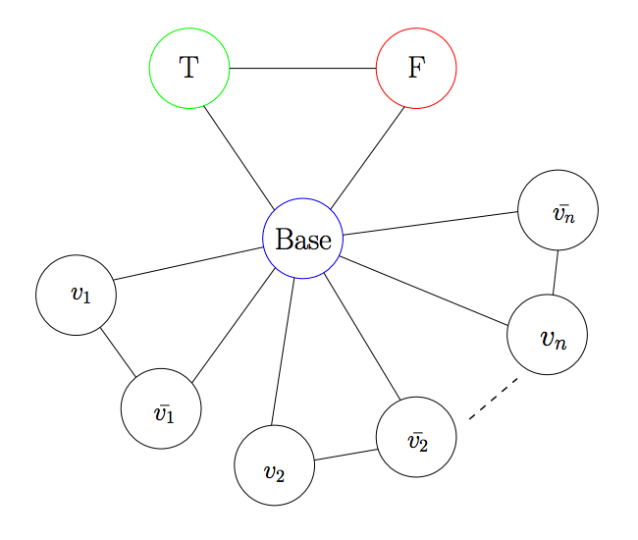
KC Super + Variables Gadget

Slide 660
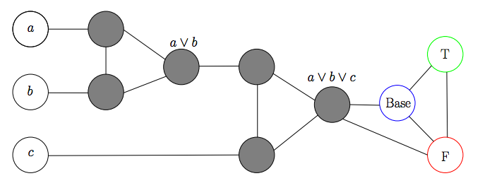
KC Clause Gadget

Slide 661
Consider ~a, ~b, ~c
F but not legal
F
T / B
B / T
F
B
T

Slide 662
Consider a || b, ~c
F/B
F
T
B/F
F
B
T

Slide 663
Consider ~a, ~b, c
F
T, B
B
F
F
B,T
T
F
T

Slide 664
Consider one of a || b, c
F/B
B
T
B/F
T
F
T

Slide 665
Consider a, b, c
T
F/B
B
T
T
B/F
T
F
T

Slide 666
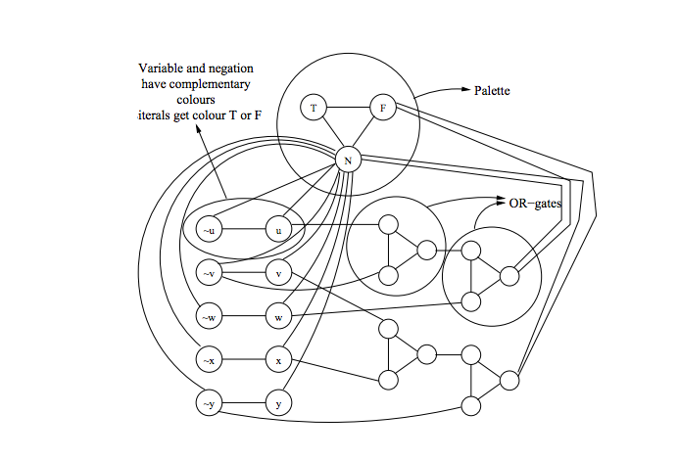
KC Gadgets Combined
(u + ~v + w) (v + x + ~y)
B
K = 3

Slide 667
Register Allocation
Liveness: A variable is live if its current assignment may be used at some future point in a program’s flow
Optimizers often try to keep live variables in registers
If two variables are simultaneously live, they need to be kept in separate registers
Consider the K-coloring problem (can the nodes of a graph be colored with at most K colors under the constraint that adjacent nodes must have different colors?)
Register Allocation reduces to K-coloring by mapping each variable to a node and inserting an edge between variables that are simultaneously live
K-coloring reduces to Register Allocation by interpreting nodes as variables and edges as indicating concurrent liveness
This is a simple mapping because it’s an isomorphism

Slide 668
Processor Scheduling is NP-Hard

Slide 669
Processor Scheduling
A Process Scheduling Problem can be described by
  m processors P₁, P₂, …, P_{m},
  processor timing functions S₁, S₂, …, S_{m}, each describing how the corresponding processor responds to an execution profile,
  additional resources R₁, R₂, …, R_{k}, e.g., memory
  transmission cost matrix C_{ij} (1 ≤ i , j ≤ m), based on proc. data sharing,
  tasks to be executed T₁, T₂, …, T_{n},
  task execution profiles A₁, A₂, …, A_{n},
  a partial order defined on the tasks such that T_{i} < T_{j} means that T_{i} must complete before T_{j} can start execution,
  communication matrix D_{ij} (1 ≤ i , j ≤ n); D_{ij} can be non-zero only if T_{i} < T_{j},
  weights W₁, W₂, …, W_{n} -- cost of deferring execution of task.

Slide 670
Complexity Overview
The intent of a scheduling algorithm is to minimize the sum of the weighted completion times of all tasks, while obeying the constraints of the task system. Weights can be made large to impose deadlines.
The general scheduling problem is quite complex, but even simpler instances, where the processors are uniform, there are no additional resources, there is no data transmission, the execution profile is just processor time and the weights are uniform, are very hard.
In fact, if we just specify the time to complete each task and we have no partial ordering, then finding an optimal schedule on two processors is an NP-complete problem. It is essentially the subset-sum problem.

Slide 671
2 Processor Scheduling
The problem of optimally scheduling n tasks T₁, T₂, …, T_{n} onto 2 processors with an empty partial order < is the same as that of dividing a set of positive whole numbers into two subsets, such that the numbers are as close to evenly divided. So, for example, given the numbers
3, 2, 4, 1
we could try a “greedy” approach as follows:
put 3 in set 1
put 2 in set 2
put 4 in set 2 (total is now 6)
put 1 in set 1 (total is now 4)
This is not the best solution. A better option is to put 3 and 2 in one set and 4 and 1 in the other. Such a solution would have been attained if we did a greedy solution on a sorted version of the original numbers. In general, however, sorting doesn’t work.

Slide 672
2 Processor Nastiness
Try the unsorted list (2-1/m)
7, 7, 6, 6, 5, 4, 4, 5, 4
Greedy (Always in one that is least used)
7, 6, 5, 5 = 23
7, 6, 4, 4, 4 = 25
Optimal
7, 6, 6, 5 = 24
7, 4, 4, 4, 5 = 24
Sort it (non-increasing) (4/3-1/3m) Sort it (non-decreasing) (2-1/m)
7, 7, 6, 6, 5, 5, 4, 4, 4 4, 4, 4, 5, 5, 6, 6, 7, 7
7, 6, 5, 4, 4 = 26 4, 4, 5, 6, 7 = 26
7, 6, 5, 4 = 22 4, 5, 6, 7 = 22
Both sorts are even worse than greedy unsorted !! (not a general result)

Slide 673

Challenge Problem
Consider the simple scheduling problem where we have a set of independent tasks running on a fixed number of processors, and we wish to minimize finishing time.
How would a list (first fit, no preemption) strategy schedule tasks with the following IDs and execution times onto four processors? Answer using Gantt chart.
(T1,4) (T2,1) (T3,3) (T4,6) (T5,2) (T6,1) (T7,4) (T8,5) (T9,7) (T10,3) (T11,4) (2-1/m)
Now show what would happen if the times were sorted non-decreasing. (2-1/m)
Now show what would happen if the times were sorted non-increasing. (4/3-1/3m)

Slide 674
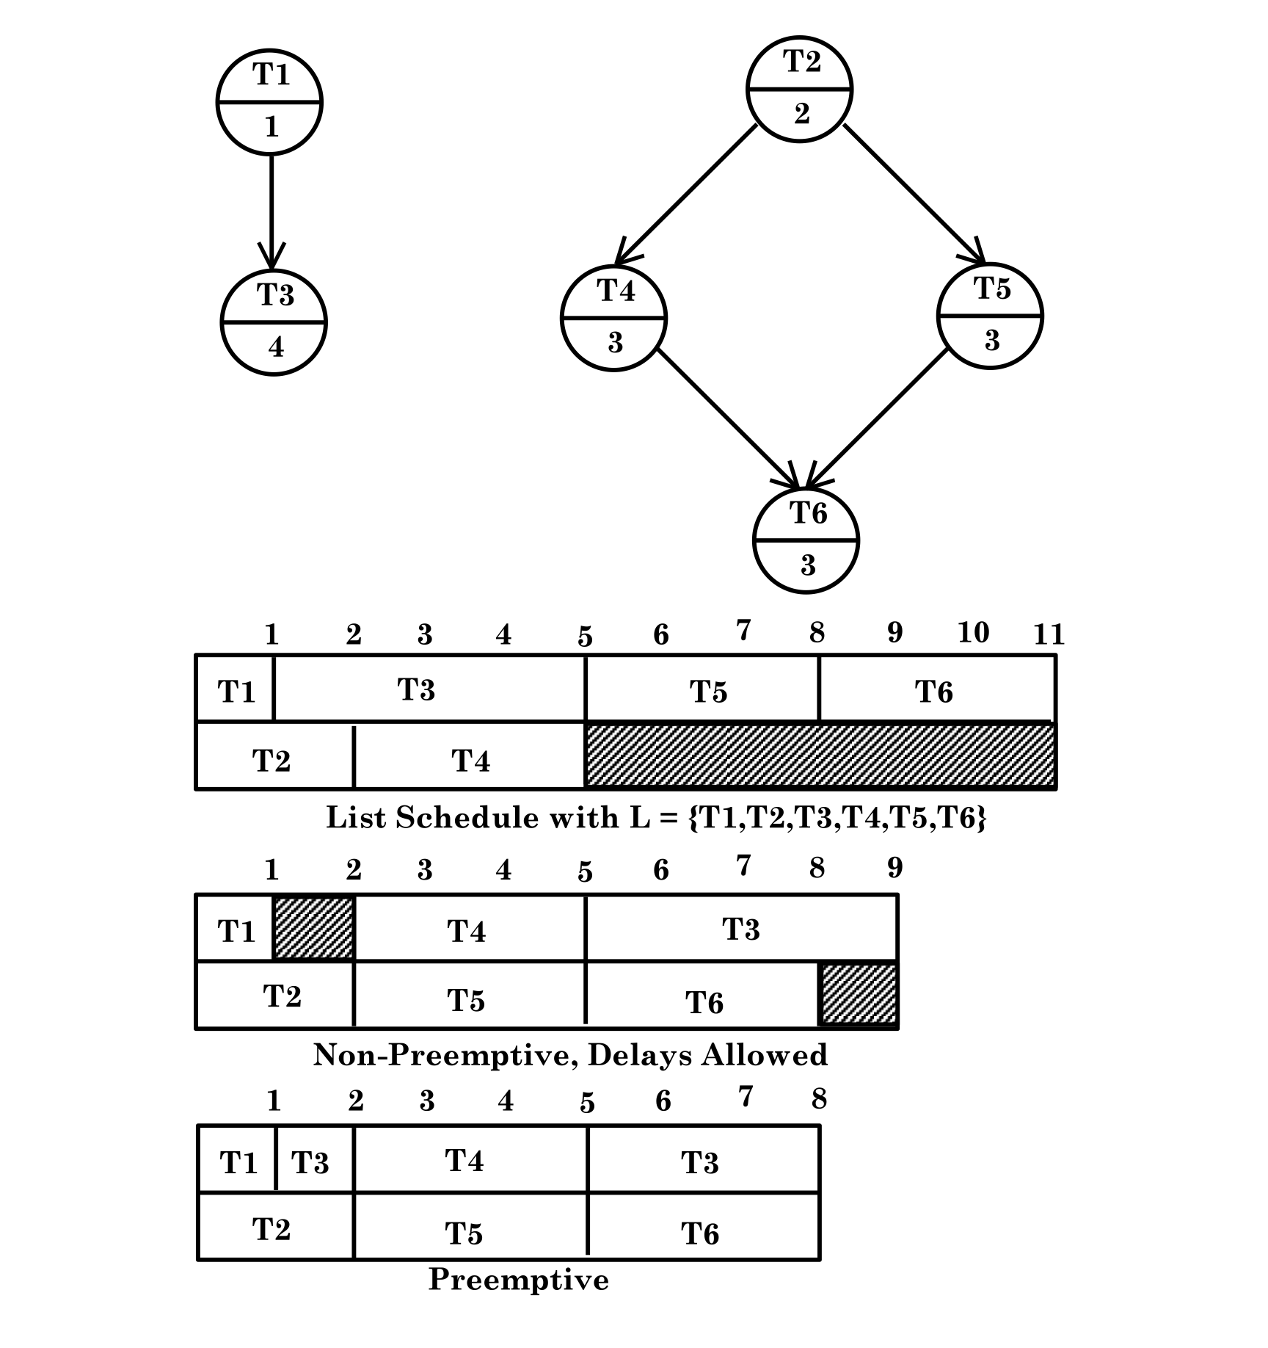
2 Processor with partial order

Slide 675
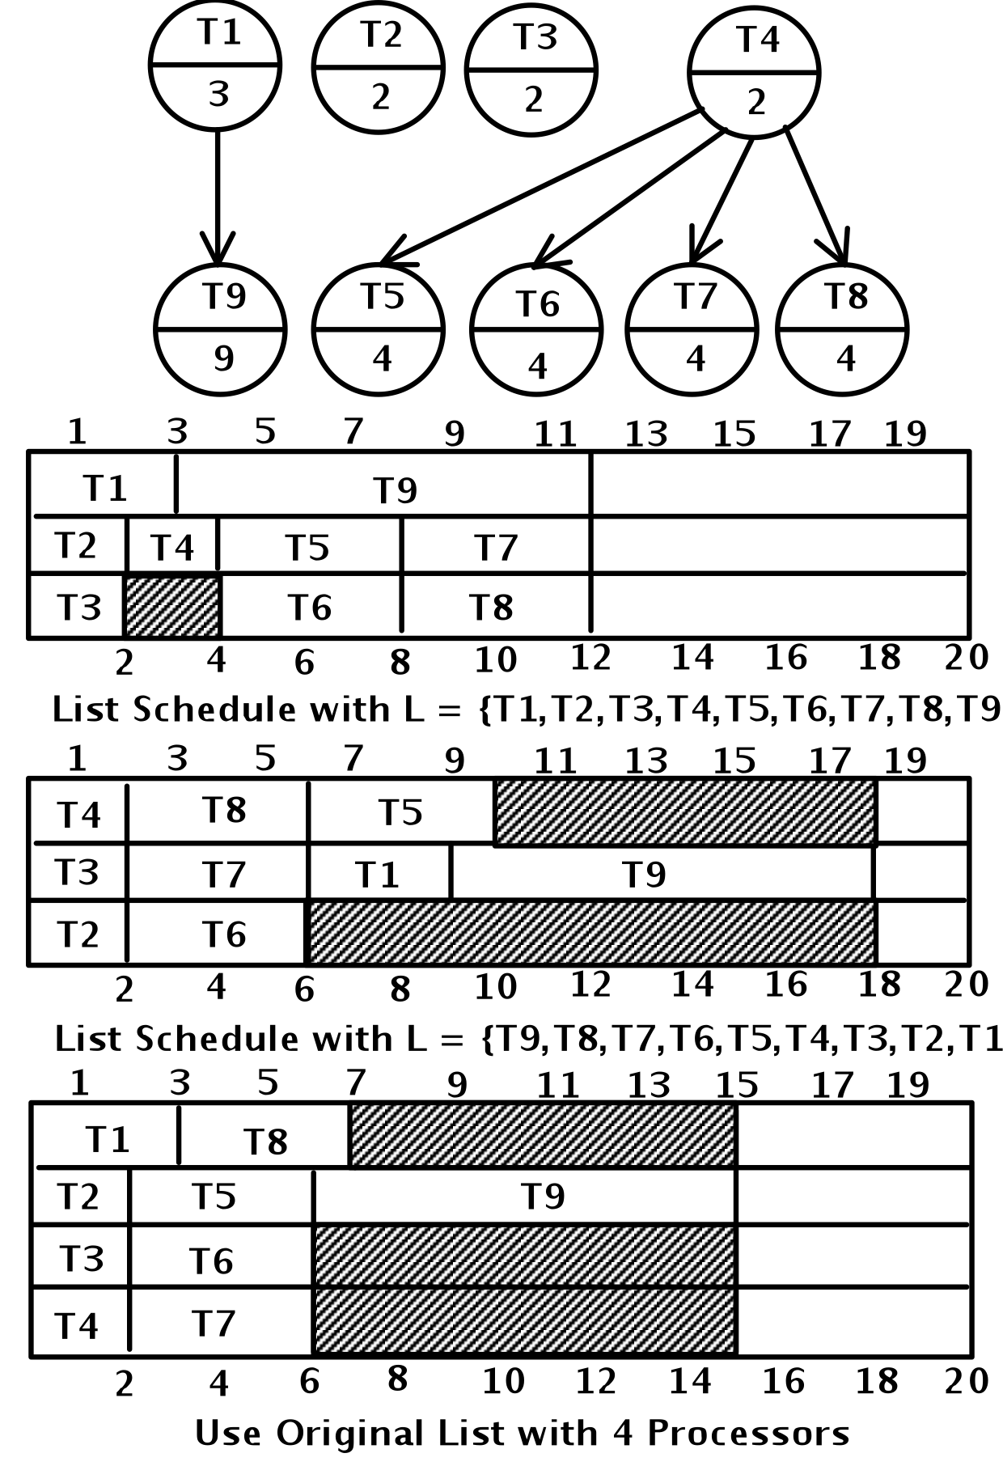
Anomalies everywhere

Slide 676
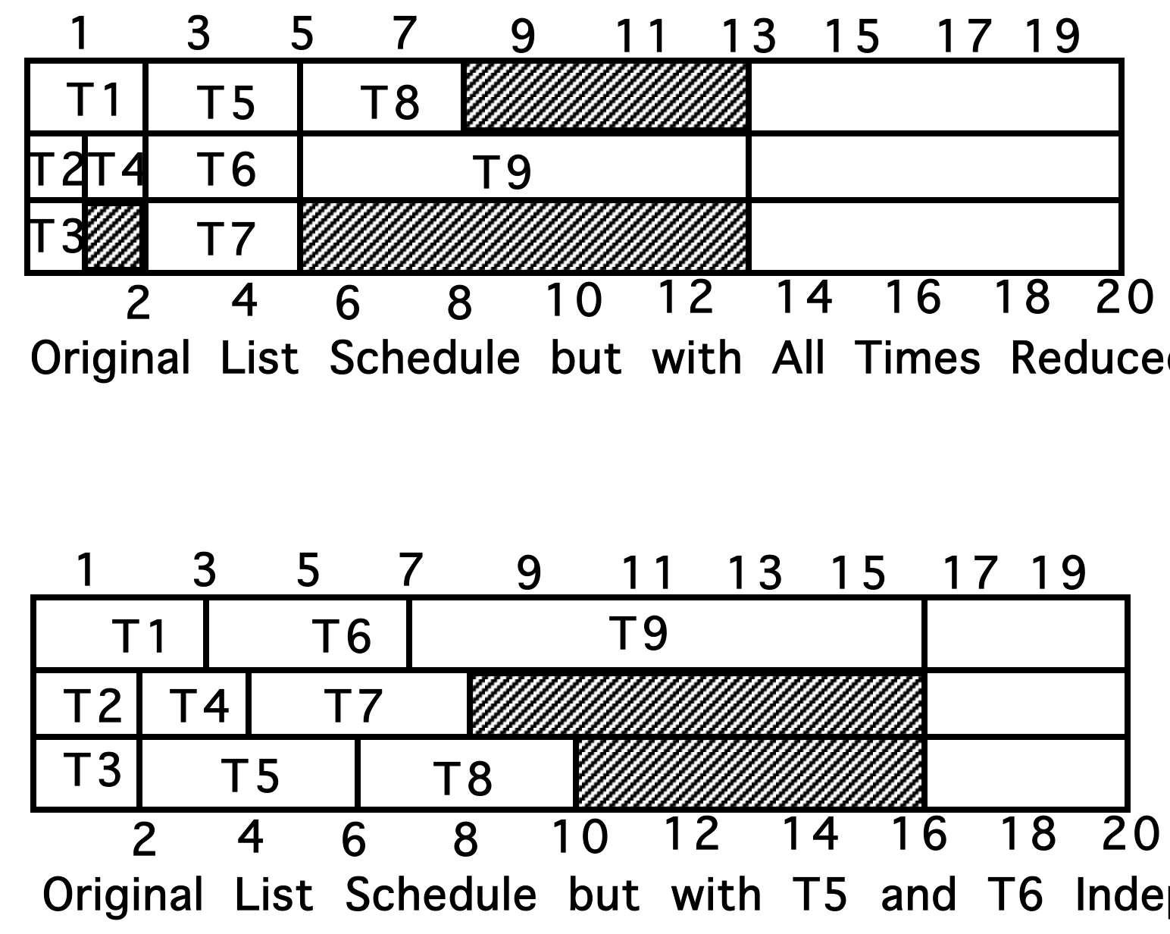
More anomalies

Slide 677
Critical path or level strategy
A UET is a Unit Execution Tree. Our Tree is funny. It has a single leaf by standard graph definitions.
1. Assign L(T) = 1, for the leaf task T
2. Let labels 1, …, k-1 be assigned. If T is a task with lowest numbered immediate successor then define L(T) = k (non-deterministic)
This is an order n labeling algorithm that can easily be implemented using a breadth first search.
Note: This can be used for a forest as well as a tree. Just add a new leaf. Connect all the old leafs to be immediate successors of the new one. Use the above to get priorities, starting at 0, rather than 1. Then delete the new node completely.
Note: This whole thing can also be used for anti-trees. Make a schedule, read it backwards. You cannot just reverse priorities.

Slide 678
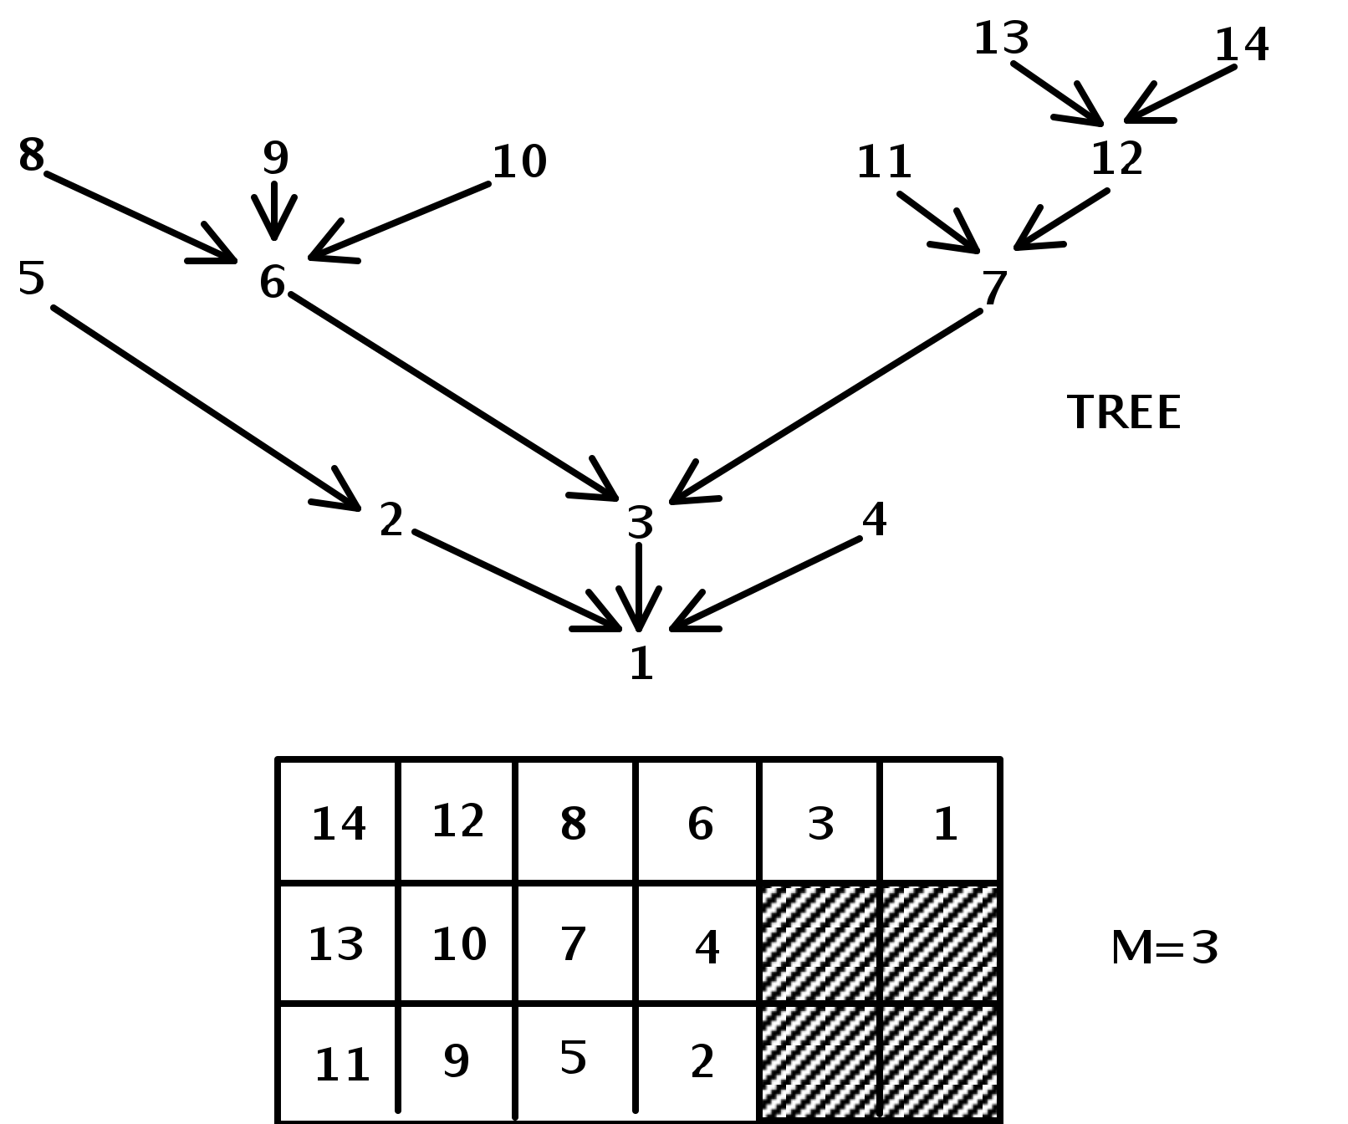
Level strategy and UET
Theorem: Level Strategy is optimal for unit execution, m arbitrary, forest precedence

Slide 679
Level – DAG with unit time
1. Assign L(T) = 1, for an arbitrary leaf task T
2. Let labels 1, …, k-1 be assigned. For each task T such that
{ L(T’) is defined for all T’ in Successor(T) }
Let N(T) be decreasing sequence of set members in
{S(T’) | T’ is in S(T)}
Choose T* with least N(T*).
Define L(T*) = K.
This is an order n² labeling algorithm. Scheduling with it involves n union / find style operations. Such operations have been shown to be implementable in nearly constant time using an “amortization” algorithm.
Theorem: Level Strategy is optimal for unit execution, m=2, dag precedence.

Slide 680
Assignment#5
Looking back at page 678, consider adding two additional tasks numbered 15 and 16 that are siblings of 13 and 14. These four tasks must be completed before 12 is started.
a) Show the Gantt chart that reflects the new schedule associated with this enhanced tree
b) Show the Gantt chart that is associated with the corresponding anti-tree, in which all arcs are turned in the opposite direction. Use the technique of reversing the schedule from (a)
c) Show the Gantt chart associated with the anti-tree of b), where we now use the priorities obtained by treating lower numbered tasks as higher priority ones
d) Comment on the results seen in (b) versus (c), providing insight as to why they are different and why one is better than the other.

Slide 681
UNIVERSE OF SETS
NP-Complete
NP
P
Co-NP

Slide 682
Hamiltonian Circuit (HC) Decision Problem is NP-Hard

Slide 683
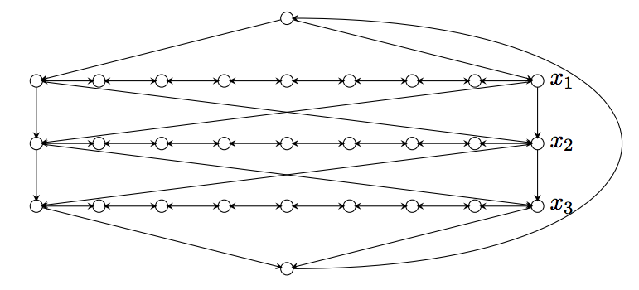
HC Variable Gadget
This has many Hamiltonian Circuits

Slide 684
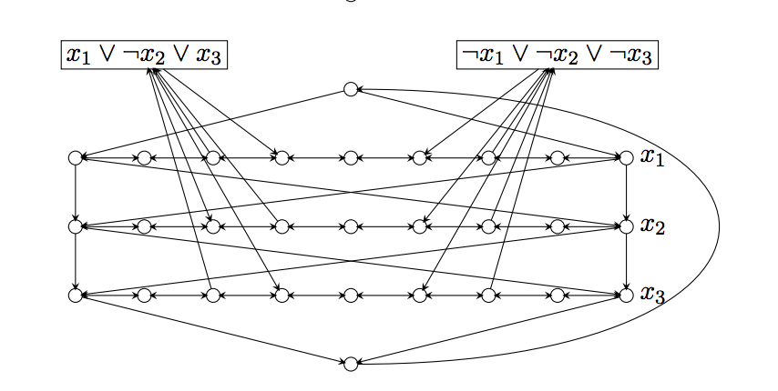
HC Gadgets Combined
We will set convention on x_{i} true to be left to right and x_{i} false to be right to left (can fix for opposite)
This has a Hamiltonian Circuit iff all clauses are satisfied with consistent assignments to each variable

Slide 685
Hamiltonian Path
Note we can split an arbitrary node, v, into two (v’,v’’) – one, v’, has in-edges of v, other, v’’, has out-edges. Path (not cycle) must start at v’’ and end at v’ and goal is still K (the number of vertices).

Slide 686
Travelling Salesman
Start with HC = (V,E), K=|V|
Set edges from HC instance to 1
Add edges between pairs that lack such edges and make those weights 2 (often people make these K+1); this means that the reverse of unidirectional links also get weight 2
Goal weight is K for cycle

Slide 687
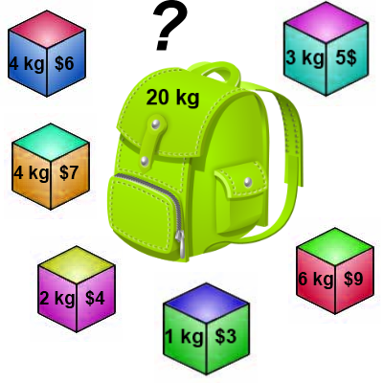
Knapsack 0-1 Problem
The goal is to maximize the value of a knapsack that can hold at most W units (i.e. lbs or kg) worth of goods from a list of items I₀, I₁, … I_{n-1}.
  Each item has 2 attributes:
    Value – let this be v_{i} for item I_{i}
    Weight – let this be w_{i} for item I_{i}
Thanks to Arup Guha

Slide 688
Knapsack 0-1 Problem
The difference between this problem and the fractional knapsack one is that you CANNOT take a fraction of an item.
  You can either take it or not.
  Hence the name Knapsack 0-1 problem.

Slide 689
Knapsack Optimize vs Decide
As stated, the Knapsack problem is an optimization problem.
We can restate as decision problem to determine if there exists a set of items , each with weight < W, that reaches some fixed goal value, W.

Slide 690
Knapsack and SubsetSum
Let v_{i} = w_{i} for each item I_{i}.
By doing so, the value is maximized when the Knapsack is filled as close to capacity.
The related decision problem is to determine if we can attain capacity (W).
Clearly then, given an instance of the SubsetSum problem, we can create an instance of the Knapsack decision problem problem, such that we reach the goal sum, G, iff we can attain a Knapsack value of G.

Slide 691
Knapsack Decision Problem
The reduction from SubsetSum shows that the Knapsack decision problem is at least as hard as SubsetSum, so it is NP-Complete if it is in NP.
Think about whether or not it is in NP.
Now, think about optimization problem.

Slide 692
Related Bin Packing
Have a bin capacity of B.
Have item set S = {s₁, s₂, …, s_{n}}
Use all items in S, minimizing the number of bins, while adhering to the constraint that any such subset must sum to B or less.
This is similar to the processor scheduling problem without constraints, except we optimize on number of processors, not finishing time for all tasks. It is NP-Hard (WHY?)

Slide 693
Knapsack 0-1 Problem
Brute Force
  The naïve way to solve the 0-1 Knapsack problem is to cycle through all 2^{n} subsets of the n items and pick the subset with a legal weight that maximizes the value of the knapsack.
  We can come up with a dynamic programming algorithm that is USUALLY faster than this brute force technique.

Slide 694
Knapsack 0-1 Problem
We are going to solve the problem in terms of sub-problems.
Our first attempt might be to characterize a sub-problem as follows:
  Let S_{k} be the optimal subset of elements from
  {I₀, I₁, …, I_{k}}.
    What we find is that the optimal subset from the elements {I₀, I₁, …, I_{k+1}} may not correspond to the optimal subset of elements from {I₀, I₁, …, I_{k}} in any regular pattern.
  Basically, the solution to the optimization problem for S_{k+1} might NOT contain the optimal solution from problem S_{k}.

Slide 695
Knapsack 0-1 Problem
Let’s illustrate that point with an example:
Item Weight Value
I₀ 3 10
I₁ 8 4
I₂ 9 9
I₃ 8 11
The maximum weight the knapsack can hold is 20.
The best set of items from {I₀, I₁, I₂} is {I₀, I₁, I₂}
BUT the best set of items from {I₀, I₁, I₂, I₃} is {I₀, I₂, I₃}.
  In this example, note that this optimal solution, {I₀, I₂, I₃}, does NOT build upon the previous optimal solution, {I₀, I₁, I₂}.
    (Instead it builds upon the solution, {I₀, I₂}, which is really the optimal subset of {I₀, I₁, I₂} with weight 12 or less.)

Slide 696
Knapsack 0-1 problem
So now we must re-work the way we build upon previous sub-problems…
  Let B[k, w] represent the maximum total value of a subset S_{k} with weight w.
  Our goal is to find B[n, W], where n is the total number of items and W is the maximal weight the knapsack can carry.
So our recursive formula for subproblems:
B[k, w] = B[k - 1,w], if w_{k} > w
= max { B[k - 1,w], B[k - 1,w - w_{k}] + v_{k}}, otherwise
In English, this means that the best subset of S_{k} that has total weight w is:
  The best subset of S_{k-1} that has total weight w, or
  The best subset of S_{k-1} that has total weight w-w_{k} plus the item k

Slide 697
Knapsack 0-1 Problem –
Recursive Formula
B[k, w] = B[k - 1,w], if w_{k} > w
= max { B[k - 1,w], B[k - 1,w - w_{k}] + v_{k}}, otherwise
The best subset of S_{k} that has the total weight w, either contains item k or not.
First case: w_{k} > w
  Item k can’t be part of the solution! If it was the total weight would be > w, which is unacceptable.
Second case: w_{k} ≤ w
  Then the item k can be in the solution, and we choose the case with greater value.

Slide 698
Knapsack 0-1 Algorithm
for w = 0 to W { // Initialize 1st row to 0’s
B[0,w] = 0
}
for i = 1 to n { // Initialize 1st column to 0’s
B[i,0] = 0
}
for i = 1 to n {
for w = 0 to W {
if w_{i} <= w { //item i can be in the solution
if v_{i} + B[i-1,w-w_{i}] > B[i-1,w]
B[i,w] = v_{i} + B[i-1,w- w_{i}]
else
B[i,w] = B[i-1,w]
}
else B[i,w] = B[i-1,w] // w_{i} > w
}
}

Slide 699
Knapsack 0-1 Problem
Let’s run our algorithm on the following data:
  n = 4 (# of elements)
  W = 5 (max weight)
  Elements (weight, value):
  (2,3), (3,4), (4,5), (5,6)

Slide 700
Knapsack 0-1 Example
i / w | 0 | 1 | 2 | 3 | 4 | 5
0 | 0 | 0 | 0 | 0 | 0 | 0
1 | 0
2 | 0
3 | 0
4 | 0
// Initialize the base cases
for w = 0 to W
B[0,w] = 0
for i = 1 to n
B[i,0] = 0

Slide 701
Knapsack 0-1 Example
Items:
1: (2,3)
2: (3,4)
3: (4,5)
4: (5,6)
i / w | 0 | 1 | 2 | 3 | 4 | 5
0 | 0 | 0 | 0 | 0 | 0 | 0
1 | 0
2 | 0
3 | 0
4 | 0
i / w | 0 | 1 | 2 | 3 | 4 | 5
0 | 0 | 0 | 0 | 0 | 0 | 0
1 | 0 | 0
2 | 0
3 | 0
4 | 0
i = 1
v_{i} = 3
w_{i} = 2
w = 1
w-w_{i} = -1
if w_{i} <= w //item i can be in the solution
if v_{i} + B[i-1,w-w_{i}] > B[i-1,w]
B[i,w] = v_{i} + B[i-1,w- w_{i}]
else
B[i,w] = B[i-1,w]
else B[i,w] = B[i-1,w] // w_{i} > w

Slide 702
Knapsack 0-1 Example
Items:
1: (2,3)
2: (3,4)
3: (4,5)
4: (5,6)
i / w | 0 | 1 | 2 | 3 | 4 | 5
0 | 0 | 0 | 0 | 0 | 0 | 0
1 | 0 | 0
2 | 0
3 | 0
4 | 0
i / w | 0 | 1 | 2 | 3 | 4 | 5
0 | 0 | 0 | 0 | 0 | 0 | 0
1 | 0 | 0 | 3
2 | 0
3 | 0
4 | 0
i = 1
v_{i} = 3
w_{i} = 2
w = 2
w-w_{i} = 0
if w_{i} <= w //item i can be in the solution
if v_{i} + B[i-1,w-w_{i}] > B[i-1,w]
B[i,w] = v_{i} + B[i-1,w- w_{i}]
else
B[i,w] = B[i-1,w]
else B[i,w] = B[i-1,w] // w_{i} > w

Slide 703
Knapsack 0-1 Example
Items:
1: (2,3)
2: (3,4)
3: (4,5)
4: (5,6)
i / w | 0 | 1 | 2 | 3 | 4 | 5
0 | 0 | 0 | 0 | 0 | 0 | 0
1 | 0 | 0 | 3
2 | 0
3 | 0
4 | 0
i / w | 0 | 1 | 2 | 3 | 4 | 5
0 | 0 | 0 | 0 | 0 | 0 | 0
1 | 0 | 0 | 3 | 3
2 | 0
3 | 0
4 | 0
i = 1
v_{i} = 3
w_{i} = 2
w = 3
w-w_{i} = 1
if w_{i} <= w //item i can be in the solution
if v_{i} + B[i-1,w-w_{i}] > B[i-1,w]
B[i,w] = v_{i} + B[i-1,w- w_{i}]
else
B[i,w] = B[i-1,w]
else B[i,w] = B[i-1,w] // w_{i} > w

Slide 704
Knapsack 0-1 Example
Items:
1: (2,3)
2: (3,4)
3: (4,5)
4: (5,6)
i / w | 0 | 1 | 2 | 3 | 4 | 5
0 | 0 | 0 | 0 | 0 | 0 | 0
1 | 0 | 0 | 3 | 3
2 | 0
3 | 0
4 | 0
i / w | 0 | 1 | 2 | 3 | 4 | 5
0 | 0 | 0 | 0 | 0 | 0 | 0
1 | 0 | 0 | 3 | 3 | 3
2 | 0
3 | 0
4 | 0
i = 1
v_{i} = 3
w_{i} = 2
w = 4
w-w_{i} = 2
if w_{i} <= w //item i can be in the solution
if v_{i} + B[i-1,w-w_{i}] > B[i-1,w]
B[i,w] = v_{i} + B[i-1,w- w_{i}]
else
B[i,w] = B[i-1,w]
else B[i,w] = B[i-1,w] // w_{i} > w

Slide 705
Knapsack 0-1 Example
Items:
1: (2,3)
2: (3,4)
3: (4,5)
4: (5,6)
i / w | 0 | 1 | 2 | 3 | 4 | 5
0 | 0 | 0 | 0 | 0 | 0 | 0
1 | 0 | 0 | 3 | 3 | 3
2 | 0
3 | 0
4 | 0
i / w | 0 | 1 | 2 | 3 | 4 | 5
0 | 0 | 0 | 0 | 0 | 0 | 0
1 | 0 | 0 | 3 | 3 | 3 | 3
2 | 0
3 | 0
4 | 0
i = 1
v_{i} = 3
w_{i} = 2
w = 5
w-w_{i} = 3
if w_{i} <= w //item i can be in the solution
if v_{i} + B[i-1,w-w_{i}] > B[i-1,w]
B[i,w] = v_{i} + B[i-1,w- w_{i}]
else
B[i,w] = B[i-1,w]
else B[i,w] = B[i-1,w] // w_{i} > w

Slide 706
Knapsack 0-1 Example
Items:
1: (2,3)
2: (3,4)
3: (4,5)
4: (5,6)
i / w | 0 | 1 | 2 | 3 | 4 | 5
0 | 0 | 0 | 0 | 0 | 0 | 0
1 | 0 | 0 | 3 | 3 | 3 | 3
2 | 0
3 | 0
4 | 0
i / w | 0 | 1 | 2 | 3 | 4 | 5
0 | 0 | 0 | 0 | 0 | 0 | 0
1 | 0 | 0 | 3 | 3 | 3 | 3
2 | 0 | 0
3 | 0
4 | 0
i = 2
v_{i} = 4
w_{i} = 3
w = 1
w-w_{i} = -2
if w_{i} <= w //item i can be in the solution
if v_{i} + B[i-1,w-w_{i}] > B[i-1,w]
B[i,w] = v_{i} + B[i-1,w- w_{i}]
else
B[i,w] = B[i-1,w]
else B[i,w] = B[i-1,w] // w_{i} > w

Slide 707
Knapsack 0-1 Example
Items:
1: (2,3)
2: (3,4)
3: (4,5)
4: (5,6)
i / w | 0 | 1 | 2 | 3 | 4 | 5
0 | 0 | 0 | 0 | 0 | 0 | 0
1 | 0 | 0 | 3 | 3 | 3 | 3
2 | 0 | 0
3 | 0
4 | 0
i / w | 0 | 1 | 2 | 3 | 4 | 5
0 | 0 | 0 | 0 | 0 | 0 | 0
1 | 0 | 0 | 3 | 3 | 3 | 3
2 | 0 | 0 | 3
3 | 0
4 | 0
i = 2
v_{i} = 4
w_{i} = 3
w = 2
w-w_{i} = -1
if w_{i} <= w //item i can be in the solution
if v_{i} + B[i-1,w-w_{i}] > B[i-1,w]
B[i,w] = v_{i} + B[i-1,w- w_{i}]
else
B[i,w] = B[i-1,w]
else B[i,w] = B[i-1,w] // w_{i} > w

Slide 708
Knapsack 0-1 Example
Items:
1: (2,3)
2: (3,4)
3: (4,5)
4: (5,6)
i / w | 0 | 1 | 2 | 3 | 4 | 5
0 | 0 | 0 | 0 | 0 | 0 | 0
1 | 0 | 0 | 3 | 3 | 3 | 3
2 | 0 | 0 | 3
3 | 0
4 | 0
i / w | 0 | 1 | 2 | 3 | 4 | 5
0 | 0 | 0 | 0 | 0 | 0 | 0
1 | 0 | 0 | 3 | 3 | 3 | 3
2 | 0 | 0 | 3 | 4
3 | 0
4 | 0
i = 2
v_{i} = 4
w_{i} = 3
w = 3
w-w_{i} = 0
if w_{i} <= w //item i can be in the solution
if v_{i} + B[i-1,w-w_{i}] > B[i-1,w]
B[i,w] = v_{i} + B[i-1,w- w_{i}]
else
B[i,w] = B[i-1,w]
else B[i,w] = B[i-1,w] // w_{i} > w

Slide 709
Knapsack 0-1 Example
Items:
1: (2,3)
2: (3,4)
3: (4,5)
4: (5,6)
i / w | 0 | 1 | 2 | 3 | 4 | 5
0 | 0 | 0 | 0 | 0 | 0 | 0
1 | 0 | 0 | 3 | 3 | 3 | 3
2 | 0 | 0 | 3 | 4
3 | 0
4 | 0
i / w | 0 | 1 | 2 | 3 | 4 | 5
0 | 0 | 0 | 0 | 0 | 0 | 0
1 | 0 | 0 | 3 | 3 | 3 | 3
2 | 0 | 0 | 3 | 4 | 4
3 | 0
4 | 0
i = 2
v_{i} = 4
w_{i} = 3
w = 4
w-w_{i} = 1
if w_{i} <= w //item i can be in the solution
if v_{i} + B[i-1,w-w_{i}] > B[i-1,w]
B[i,w] = v_{i} + B[i-1,w- w_{i}]
else
B[i,w] = B[i-1,w]
else B[i,w] = B[i-1,w] // w_{i} > w

Slide 710
Knapsack 0-1 Example
Items:
1: (2,3)
2: (3,4)
3: (4,5)
4: (5,6)
i / w | 0 | 1 | 2 | 3 | 4 | 5
0 | 0 | 0 | 0 | 0 | 0 | 0
1 | 0 | 0 | 3 | 3 | 3 | 3
2 | 0 | 0 | 3 | 4 | 4
3 | 0
4 | 0
i / w | 0 | 1 | 2 | 3 | 4 | 5
0 | 0 | 0 | 0 | 0 | 0 | 0
1 | 0 | 0 | 3 | 3 | 3 | 3
2 | 0 | 0 | 3 | 4 | 4 | 7
3 | 0
4 | 0
i = 2
v_{i} = 4
w_{i} = 3
w = 5
w-w_{i} = 2
if w_{i} <= w //item i can be in the solution
if v_{i} + B[i-1,w-w_{i}] > B[i-1,w]
B[i,w] = v_{i} + B[i-1,w- w_{i}]
else
B[i,w] = B[i-1,w]
else B[i,w] = B[i-1,w] // w_{i} > w

Slide 711
Knapsack 0-1 Example
Items:
1: (2,3)
2: (3,4)
3: (4,5)
4: (5,6)
i / w | 0 | 1 | 2 | 3 | 4 | 5
0 | 0 | 0 | 0 | 0 | 0 | 0
1 | 0 | 0 | 3 | 3 | 3 | 3
2 | 0 | 0 | 3 | 4 | 4 | 7
3 | 0
4 | 0
i / w | 0 | 1 | 2 | 3 | 4 | 5
0 | 0 | 0 | 0 | 0 | 0 | 0
1 | 0 | 0 | 3 | 3 | 3 | 3
2 | 0 | 0 | 3 | 4 | 4 | 7
3 | 0 | 0 | 3 | 4
4 | 0
i = 3
v_{i} = 5
w_{i} = 4
w = 1..3
w-w_{i} = -3..-1
if w_{i} <= w //item i can be in the solution
if v_{i} + B[i-1,w-w_{i}] > B[i-1,w]
B[i,w] = v_{i} + B[i-1,w- w_{i}]
else
B[i,w] = B[i-1,w]
else B[i,w] = B[i-1,w] // w_{i} > w

Slide 712
Knapsack 0-1 Example
Items:
1: (2,3)
2: (3,4)
3: (4,5)
4: (5,6)
i / w | 0 | 1 | 2 | 3 | 4 | 5
0 | 0 | 0 | 0 | 0 | 0 | 0
1 | 0 | 0 | 3 | 3 | 3 | 3
2 | 0 | 0 | 3 | 4 | 4 | 7
3 | 0 | 0 | 3 | 4
4 | 0
i / w | 0 | 1 | 2 | 3 | 4 | 5
0 | 0 | 0 | 0 | 0 | 0 | 0
1 | 0 | 0 | 3 | 3 | 3 | 3
2 | 0 | 0 | 3 | 4 | 4 | 7
3 | 0 | 0 | 3 | 4 | 5
4 | 0
i = 3
v_{i} = 5
w_{i} = 4
w = 4
w-w_{i} = 0
if w_{i} <= w //item i can be in the solution
if v_{i} + B[i-1,w-w_{i}] > B[i-1,w]
B[i,w] = v_{i} + B[i-1,w- w_{i}]
else
B[i,w] = B[i-1,w]
else B[i,w] = B[i-1,w] // w_{i} > w

Slide 713
Knapsack 0-1 Example
Items:
1: (2,3)
2: (3,4)
3: (4,5)
4: (5,6)
i / w | 0 | 1 | 2 | 3 | 4 | 5
0 | 0 | 0 | 0 | 0 | 0 | 0
1 | 0 | 0 | 3 | 3 | 3 | 3
2 | 0 | 0 | 3 | 4 | 4 | 7
3 | 0 | 0 | 3 | 4 | 5
4 | 0
i / w | 0 | 1 | 2 | 3 | 4 | 5
0 | 0 | 0 | 0 | 0 | 0 | 0
1 | 0 | 0 | 3 | 3 | 3 | 3
2 | 0 | 0 | 3 | 4 | 4 | 7
3 | 0 | 0 | 3 | 4 | 5 | 7
4 | 0
i = 3
v_{i} = 5
w_{i} = 4
w = 5
w-w_{i} = 1
if w_{i} <= w //item i can be in the solution
if v_{i} + B[i-1,w-w_{i}] > B[i-1,w]
B[i,w] = v_{i} + B[i-1,w- w_{i}]
else
B[i,w] = B[i-1,w]
else B[i,w] = B[i-1,w] // w_{i} > w

Slide 714
Knapsack 0-1 Example
Items:
1: (2,3)
2: (3,4)
3: (4,5)
4: (5,6)
i / w | 0 | 1 | 2 | 3 | 4 | 5
0 | 0 | 0 | 0 | 0 | 0 | 0
1 | 0 | 0 | 3 | 3 | 3 | 3
2 | 0 | 0 | 3 | 4 | 4 | 7
3 | 0 | 0 | 3 | 4 | 5 | 7
4 | 0
i / w | 0 | 1 | 2 | 3 | 4 | 5
0 | 0 | 0 | 0 | 0 | 0 | 0
1 | 0 | 0 | 3 | 3 | 3 | 3
2 | 0 | 0 | 3 | 4 | 4 | 7
3 | 0 | 0 | 3 | 4 | 5 | 7
4 | 0 | 0 | 3 | 4 | 5
i = 4
v_{i} = 6
w_{i} = 5
w = 1..4
w-w_{i} = -4..-1
if w_{i} <= w //item i can be in the solution
if v_{i} + B[i-1,w-w_{i}] > B[i-1,w]
B[i,w] = v_{i} + B[i-1,w- w_{i}]
else
B[i,w] = B[i-1,w]
else B[i,w] = B[i-1,w] // w_{i} > w

Slide 715
Knapsack 0-1 Example
Items:
1: (2,3)
2: (3,4)
3: (4,5)
4: (5,6)
i / w | 0 | 1 | 2 | 3 | 4 | 5
0 | 0 | 0 | 0 | 0 | 0 | 0
1 | 0 | 0 | 3 | 3 | 3 | 3
2 | 0 | 0 | 3 | 4 | 4 | 7
3 | 0 | 0 | 3 | 4 | 5 | 7
4 | 0 | 0 | 3 | 4 | 5
i / w | 0 | 1 | 2 | 3 | 4 | 5
0 | 0 | 0 | 0 | 0 | 0 | 0
1 | 0 | 0 | 3 | 3 | 3 | 3
2 | 0 | 0 | 3 | 4 | 4 | 7
3 | 0 | 0 | 3 | 4 | 5 | 7
4 | 0 | 0 | 3 | 4 | 5 | 7
i = 4
v_{i} = 6
w_{i} = 5
w = 5
w-w_{i} = 0
if w_{i} <= w //item i can be in the solution
if v_{i} + B[i-1,w-w_{i}] > B[i-1,w]
B[i,w] = v_{i} + B[i-1,w- w_{i}]
else
B[i,w] = B[i-1,w]
else B[i,w] = B[i-1,w] // w_{i} > w

Slide 716
Knapsack 0-1 Example
Items:
1: (2,3)
2: (3,4)
3: (4,5)
4: (5,6)
i / w | 0 | 1 | 2 | 3 | 4 | 5
0 | 0 | 0 | 0 | 0 | 0 | 0
1 | 0 | 0 | 3 | 3 | 3 | 3
2 | 0 | 0 | 3 | 4 | 4 | 7
3 | 0 | 0 | 3 | 4 | 5 | 7
4 | 0 | 0 | 3 | 4 | 5 | 7
We’re DONE!!
The max possible value that can be carried in this knapsack is $7

Slide 717
Knapsack 0-1 Problem – Run Time
for w = 0 to W
B[0,w] = 0
for i = 1 to n
B[i,0] = 0
for i = 1 to n
for w = 0 to W
< the rest of the code >
What is the running time of this algorithm?
O(n*W) – of course, W can be mighty big
What is an analogy in world of sorting?
Remember that the brute-force algorithm takes: O(2^{n})
O(W)
O(n)
Repeat n times
O(W)

Slide 718
Tiling
Undecidable and NP-Complete
Variants

Slide 719

Basic Idea of Tiling
A single tile has colors on all four sides.
Tiles are often called dominoes as
assembling them follows the rules of
placing dominoes. That is, the color
(or number) of a side must match that
of its adjacent tile, e.g., tile, t2, to right
of a tile, t1, must have same color on
Its left as is on the right side of t1.
This constraint applies to top and as
well as sides. Boundary tiles do not
have constraints on their sides that touch
the boundaries.

Slide 720
Instance of Tiling Problem
A finite set of tile types (a type is determined by the colors of its edges)
Some 2d area (finite or infinite) on which the tiles are to be laid out
An optional starting set of tiles in fixed positions
The goal of tiling the plane following the adjacency constraints and whatever constraints are indicated by the starting configuration.

Slide 721
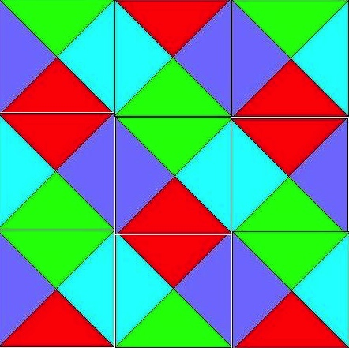
A Valid 3 by 3 Tiling of Tile Types from Previous Slide

Slide 722
Some Variations
Infinite 2d plane (impossible, co-re-non-rec) in general)
  Our two tile types can easily tile the 2d plane
Finite 2d plane (hard in general)
  Our two tile types can easily tile any finite 2d plane
  This is called the Bounded Tiling Problem.
One dimensional space (hmm?)
Infinite 3d space (really impossible – multiple quantifiers, in general)

Slide 723
Tiling the Plane
We will start with a Post Machine, M = (Q, Σ, δ, q₀), with tape alphabet Σ = {B,1} where B is blank and δ maps pairs from Q×Σ to Q×(Σ ∪ {R,L}). M starts in state q₀
  (Turing Machine with each action being L, R or Print)
We will consider the case of M starting with a blank tape
We will constrain our machine to never go to the left of its starting position (semi unbounded tape)
We will mimic the computation steps of M
Termination occurs if in state q reading b and δ(q,b) is not defined
We will use the fact that halting when starting at the left end of a semi unbounded tape in its initial state with a blank tape is undecidable

Slide 724
The Tiling Decision Problem
Given a finite set of tile types and a starting tile in lower left corner of 2d plane, can we tile all places in the plane?
A place is defined by its coordinates (x,y), x≥0, y≥0
The fixed starting tile is at (0,0)

Slide 725
Colors
Given M, define our tile colors as
{X, Y, *, B, 1, YB, Y1} ∪ Q×{B,1} ∪ Q×{YB,Y1} ∪ Q×{R,L}
Simplest tile (represents Blank on X axis)
B
B
B
X

Slide 726
Tiles for Copying Tape Cell
Copy cells not on
left boundary and
not scanned
B
1
*
*
*
*
B
1
YB
Y1
Copy cells on
left boundary
but not scanned
Y
*
Y
*
YB
Y1

Slide 727
Right Move δ(q,a) = (p,R)
a
*
p,R
q,a
p,b
where b∈Σ={B,1}
p,R
*
b
Ya
Y
p,R
q,Ya

Slide 728
Left Move δ(q,a) = (p,L)
p,b
*
p,L
b
a
where b∈Σ={B,1}
p,L
*
q,a
p,Yb
Y
p,L
Yb

Slide 729
Print δ(q,a) = (p,c)
p,c
*
*
q,a
p,Yc
Y
*
q,Ya

Slide 730
Corner Tile and Bottom Row
q₀,YB
Y
B
X
Zero-ed Row is forced to be
q₀,YB
B
B
Y
B
B
B
B
B
………...
X
X
X

Slide 731
First Action Print
As we cannot move left of leftmost character first action is either right or print. Assume for now that δ(q₀,B) = (p,a)
p,Ya
B
B
Y
*
*
*
*
*
………...
q₀,YB
B
B
q₀,YB
B
B
Y
B
B
B
B
B
………...
X
X
X

Slide 732
First Action Right Move
As we cannot move left of leftmost character first action is either right or print. Assume for now that δ(q₀,B) = (p,R)
YB
p,B
B
Y
p,R
p,R
*
*
*
………...
q₀,YB
B
B
q₀,YB
B
B
Y
B
B
B
B
B
………...
X
X
X

Slide 733
The Rest of the Story Part 1
Inductively we can show that, if the i-th row represents an infinite transcription of the Turing configuration after step i then the (i+1)-st represents such a transcription after step i+1. Since we have shown the base case, we have a successful simulation.

Slide 734
The Rest of the Story Part 2
Consider the case where M eventually halts when started on a blank tape in state q₀. In this case we will reach a point where no actions fill the slots above the one representing the current state. That means that we cannot tile the plane.
If M never halts, then we can tile the plane (in the limit).

Slide 735
The Rest of the Story Part 3
The consequences of Parts 1 and 2 are that Tiling the plane is as hard as the complement of the Halting problem which is co-RE Complete.
This is not surprising as this problem involve a universal quantification over all coordinates (x,y) in the plane.

Slide 736
Constraints on M
The starting blank tape is not a real constraint as we can create M so its first actions are to write arguments on its tape.
The semi unbounded tape is not new. If you look back at Standard Turing Computing (STC), we assumed there that we never moved left of the blank preceding our first argument.
If you prefer to consider all computation based on the STC model then we can add to M the simple prologue
(R1)^{x1}R(R1)^{x2}R…(R1)^{xk}R so the actual computation starts with a vector of x1 … xk on the tape and with the scanned square as the blank to right of this vector. The rest of the tape is blank.
Think about how, in the preceding pages, you could actually start the tiling in this configuration.

Slide 737
Bounded Tiling Problem #1
Consider a slight change to our machine M. First, it is non-deterministic, so our transition function maps to sets.
Second, we add two auxiliary states
{q_{a}, q_{r}}, where q_{a} is our only accept state and q_{r} is our only reject state.
We make it so the reject state has no successor states, but the accept state always transitions back to itself rewriting the scanned square unchanged.
We also assume our machine accepts or rejects in at most n^{k} steps, where n is the length of its starting input which is written immediately to the right of the initial scanned square.

Slide 738
Bounded Tiling Problem #2
We limit our rows and column to be of size
n^{k}+1. We change our initial condition of the tape to start with the input to M. Thus, it looks like
Note that there are n^{k} – n of these blank representations at the end. We really only need the first as the tiling constraint will force all the others to be of the same form.
q₀,YB
x₀
x_{n}
B
Y
B
B
B
B
B
B
B
…
…
X
X
X
X

Slide 739
Bounded Tiling Problem #3
The finitely bounded Tiling Problem we just described mimics the operation of any given polynomially-bound non-deterministic Turing machine.
This machine can tile the finite plane of size
(n^{k}+1) * (n^{k}+1) just in case the initial string is accepted in n^{k} or fewer steps on some path (really a trace of at most n^{k}).
If the string is not accepted then we will hit a reject state on all paths and never complete tiling.
This shows that the bounded tiling problem is NP-Hard
Is it in NP? Yes. How? Well, we can be shown a tiling (posed solution takes space polynomial in n) and check it for completeness and consistency (this takes linear time in terms of proposed solution). Thus, we can verify the solution in time polynomial in n.

Slide 740
A Final Comment on Tiling
If you look back at the unbounded version, you can see that we could have simulated a non-deterministic Turing machine there, but it would have had the problem that the plane would be tiled if any of the non-deterministic choices diverged and that is not what we desired.
However, we need to use a non-deterministic machine for the finite case as we made this so it tiled iff some path led to acceptance. If all lead to rejection, we get stalled out on all paths as the reject state can go nowhere.

Slide 741
Tiling Example
Turing Machine Recognizes strings of at least two 1’s in succession.
q0 0 0 q2
q0 1 R q1
q1 0 L q2
q1 1 1 q3
q2 0 0 q2
q2 1 1 q2
No q3 rules so entering here stops tiling

Slide 742
Tile Replication
0
1
*
*
*
*
0
1
Y0
Y1
Y
*
Y
*
Y0
Y1

Slide 743
q0 0 0 q2 q0 1 R q1
q2,0
1
q1,0
*
*
*
q1,R
q1,R
*
q0,0
q0,1
0
q2,Y0
Y1
q1,1
Y
*
Y
q1,R
q1,R
*
q0,Y0
q0,Y1
1

Slide 744
q1 0 L q2 q1 1 1 q3
0
q2,0
q2,1
q3,1
q2,L
*
*
q2,L
*
q2,L
*
*
q1,0
0
1
q1,1
q2,Y0
q2,Y1
q3,Y1
Y
q2,L
Y
q2,L
Y
*
Y0
Y1
q1,Y1

Slide 745
q2 0 0 q2 q2 1 1 q2
q2,0
q2,1
*
*
*
*
q2,0
q2,1
q2,Y0
q2,Y1
Y
*
Y
*
q2,Y0
q2,Y1

Slide 746
Sample Starting Rows
q₀,Y1
0
0
Y
0
0
0
0
0
………...
X
X
X
q₀,Y1
1
0
0
Y
0
0
0
0
0
…
0
0
X
X
X
X

Slide 747
Case 1; Two More Rows
q2,Y1
0
0
0
Y
q2,L
q2,L
*
*
*
…
*
*
Y1
q1,0
0
0
Y1
q1,0
0
0
Y
q1,R
q1,R
*
*
*
…
*
*
q₀,Y1
0
0
0
q₀,Y1
0
0
0
Y
0
0
0
0
0
…
0
0
X
X
X
X

Slide 748
Case 1; Row 3 repeated
q2,Y1
0
0
0
Y
*
*
*
*
*
…
*
*
q2,Y1
0
0
0
q2,Y1
0
0
0
Y
*
*
*
*
*
…
*
*
q2,Y1
0
0
0
q2,Y1
0
0
0
Y
q2,L
q2,L
*
*
*
…
*
*
Y1
q1,0
0
0

Slide 749
Case 2; Only Two More Rows
Y1
q3,1
0
0
Y
*
*
*
*
*
…
*
*
Y1
q1,1
0
0
Y1
q1,1
0
0
Y
q1,R
q1,R
*
*
*
…
*
*
q₀,Y1
1
0
0
q₀,Y1
1
0
0
Y
0
0
0
0
0
…
0
0
X
X
X
X

Slide 750
Comments on Variations
One dimensional space (think about it)
Infinite 3d space (really impossible in general)
  This become a for all, there exists problem
  In fact, one can mimic acceptance on all inputs here, meaning M is an algorithm iff we can tile the 3d space

Slide 751
PCP Revisited
Bounded Post Correspondence

Slide 752
Bounded Variation
Limit correspondence to a length that is polynomial in n, where n is length of initial input string.
Outline of proof we can get for almost free
  Convert halting problem for a Non-deterministic Turing machine to word problem for a Semi-Thue System
  Note: we originally did for deterministic machines but the construction works for non-determinism and maps nicely to Semi-Thue systems which are non-deterministic by definition.
  Recast as an instance of PCP
  Limit the length of word to (n+2)^{k}, where original TM accepts or rejects in n^{k} steps.

Slide 753
Another Approach
There is a tighter bound on Bounded PCP.
Given sequences (x1, x2, …, xn) and (y1, y2, …, yn), and a positive integer
K≤p(max(|x1|+…+|xn|, |y1|+…+|yn|),
where p is some polynomial, is there a solution to this instance involving indices i1, …,ik, k≤K (not necessarily distinct), of integers between 1 and n, such that the corresponding x and y strings are identical.
Follows from Constable, Hunt and Sahni (1974). “On the Computational Complexity of Program Scheme Equivalence,” Siam Journal of Computing 9(2), 396-416.

Slide 754
Co-NP
Fourth Significant Class of Problems

Slide 755
Co–NP
    For any decision problem A in NP, there is a ‘complement’ problem Co–A defined on the same instances as A, but with a question whose answer is the negation of the answer in A. That is, an instance is a "yes" instance for A if and only if it is a "no" instance in Co–A.
    Notice that the complement of the complement of a problem is the original problem.

Slide 756
Co–NP
    Co–NP is the set of all decision problems whose complements are members of NP.
    For example: consider Graph Color GC
      Given: A graph G and an integer k.
      Question: Can G be properly colored with k colors?

Slide 757
Co–NP
    The complement problem of GC
    Co–GC
    Given: A graph G and an integer k.
    Question: Do all proper colorings of G require more than k colors?

Slide 758
Co–NP
    Notice that Co–GC is a problem that does not appear to be in the set NP. That is, we know of no way to check in polynomial time the answer to a "Yes" instance of Co–GC.
    What is the "answer" to a Yes instance that can be verified in polynomial time?

Slide 759
Co–NP
    Not all problems in NP behave this way. For example, if X is a problem in class P, then both "yes" and "no" instances can be solved in polynomial time.
    That is, both "yes" and "no" instances can be verified in polynomial time and hence, X and Co–X are both in NP, in fact, both are in P.
    This implies P = Co–P and, further,
      P = Co–P ⊆ NP ∩ Co–NP.

Slide 760
Co–NP
    This gives rise to a second fundamental question:
      NP = Co–NP?
    If P = NP, then NP = Co–NP.
    This is not "if and only if."
    It is possible that NP = Co–NP and, yet, P ≠ NP.

Slide 761
Co–NP
If A ≤_{P} B and both are in NP, then the same polynomial transformation will reduce Co-A to Co–B. That is,
Co–A ≤_{P} Co–B. Therefore, Co–SAT is 'complete' in
Co–NP.
In fact, corresponding to NP–Complete is the complement set Co–NP–Complete, the set of hardest problems in
Co–NP.

Slide 762
Turing Reductions
Now, return to Turing Reductions.
Recall that Turing reductions include polynomial transformations as a special case. So, we should expect they will be more powerful.

Slide 763
Turing Reductions
    (1) Problems A and B can, but need not, be
    decision problems.
    (2) No restriction placed upon the number
    of instances of B that are constructed.
    (3) Nor, how the result, Answer_{A}, is computed.
    In effect, we use an Oracle for B.

Slide 764
Turing Reductions
Technically, Turing Reductions include Polynomial Transformations, but it is useful to distinguish them.
Polynomial transformations are often the easiest to apply.

Slide 765
NP–Hard
Fifth Significant Class of Problems

Slide 766
NP–Hard
To date, we have concerned ourselves with decision problems. We are now in a position to include additional problems. In particular, optimization problems.
We require one additional tool – the second type of transformation discussed above – Turing reductions.

Slide 767
NP–Hard
    Definition: Problem B is NP–Hard if there is a polynomial time Turing reduction A ≤_{PT} B for some problem A in NP–Complete.
    This implies NP–Hard problems are at least as hard as NP–Complete problems. Therefore, they cannot be solved in polynomial time unless P = NP (and maybe not then).
    This use of an oracle, allows us to reduce co-NP-Complete problems to NP-Complete ones and vice versa.

Slide 768
QSAT
QSAT is the problem to determine if an arbitrary fully quantified Boolean expression is true. Note: SAT only uses existential.
QSAT is NP-Hard but may not be in NP.
QSAT can be solved in polynomial space (PSPACE).

Slide 769
NP–Hard
    Polynomial transformations are Turing reductions.
    Thus, NP–Complete is a subset of NP–Hard.
    Co–NP–Complete also is a subset of NP–Hard.
    NP–Hard contains many other interesting problems.

Slide 770
NP-Easy
NP-Easy is the set of function problems that are solvable in polynomial time by a deterministic Turing machine with an oracle for some decision problem in NP.
That is, given an Oracle for some NP problem Y, if X is Turing reducible to Y in polynomial time then X is NP-Easy.

Slide 771
NP–Easy
Problem X need not be, but often is, NP–Complete.
In fact, X can be any problem in NP or Co–NP.
More to the point, an NP-Easy problem does not even need to be a decision problem – it can be an optimization problem or some other problem seeking a numerical rather than binary (yes/no answer).

Slide 772
NP–Equivalent
Problem B in NP–Hard is NP–Equivalent when B reduces to some problem X in NP, That is, B ≤_{PT} X. This is, when B is also NP-Easy.
Since B is in NP–Hard, we already know there is a problem A in NP–Complete that reduces to B. That is, A ≤_{PT} B.
Since X is in NP, X ≤_{PT} A. Therefore, X ≤_{PT} A ≤_{PT} B ≤_{PT} X.
Thus, X, A, and B are all polynomially equivalent, and we can say
Theorem. Problems in NP–Equivalent are polynomial if and only if P = NP.
Example: Optimization version of Subset-Sum is NP-Equivalent.

Slide 773
NP-Easy and Equivalent
NP-Easy -- these are problems that are polynomial when using an NP oracle (≤pt)
NP-Equivalent is the class of NP-Easy and NP-Hard problems (assuming Turing rather than many-one reductions)
  In essence this is the functional equivalent of NP-Complete but also of
  Co-NP-Complete since can negate answers

Slide 774
SubsetSum Optimization
S = {s₁, s₂, …, s_{n}}
    set of positive integers
    and an integer B.
    Optimization: Find a subset of S whose values sum to the largest
    attainable value ≤B?
    Strategy: Use Oracle for SubsetSum Decision
    Problem but only use it a
    polynomial number of times

Slide 775
Using SubsetSum Oracle
SUBSET-SUM-OPTIMIZATION(A, b)
int best = b;
for i = floor(log₂b) downto 0 do
A = A + { 2^{i} } // add to set
for i = floor(log₂b) downto 0 do
A = A - { 2^{i}} // remove from set
if not SUBSET-SUM(A, best) then
best = best - 2^{i} // reduce best
return best

Slide 776
Example of SubsetSum Opt
Initial Values:
A = {1, 4, 5, 7}, best = b = 15
A = {1, 4, 5, 7, 8, 4, 2, 1}, best = 15
A = {1, 4, 5, 7, 4, 2, 1}, best = 15
A = {1, 4, 5, 7, 2, 1}, best = 15
A = {1, 4, 5, 7, 1}, best = 15-2 = 13
A = {1, 4, 5, 7}, best = 13

Slide 777
Another Example
Initial Values:
A = {1, 4, 5, 7}, best = b = 20
A = {1, 4, 5, 7, 16, 8, 4, 2, 1}, best = 20
A = {1, 4, 5, 7, 8, 4, 2, 1}, best = 20
A = {1, 4, 5, 7, 4, 2, 1}, best = 20
A = {1, 4, 5, 7, 2, 1}, best = 20-2 = 18
A = {1, 4, 5, 7, 1}, best = 20-2 = 18
A = {1, 4, 5, 7}, best = 18-1 = 17

Slide 778
Analysis
Each loop has O(log₂b) iterations, which is linear with respect to the size of b.
Note that if we tried all values less that b, we would have O(b) tries and that is exponential in log₂b, the size of b.
The correct solution takes advantage of the NP-complete power of the oracle.

Slide 779
Minimum Colors for a Graph
We know K-Color is NP Complete
We can reduce KC to Min Color problem just by seeing if Min is ≤ K.
How do we reduce Min Color to KC asking only a log number of questions of the oracle for KC?
Consider, if N nodes, then can easily N-Color
Can we N/2-Color?
  If not, then try N/4
  If so, then try 3N/4
This is a simple binary search for optimal value

Slide 780
PSPACE
PSPACE is set of problems solvable in polynomial space with unlimited time
PSPACE = ∪ SPACE(n^{k})
PSPACE = co-PSPACE = NPSPACE
PSPACE is a strict superset of CSLs
A PSPACE-Complete Problem is, given a regular expression e over Σ, does e denote all strings in Σ*?
Another PSPACE-Complete problem is QSAT

Slide 781
EXPTIME and EXPSPACE
EXPTIME is the set of problems solvable in 2^{p(n)} where is p is some polynomial.
NEXPTIME is the set of problems solvable in 2^{p(n)} on a non-deterministic TM.
EXPSPACE is set of problems solvable in 2^{p(n)} space and unlimited time

Slide 782
Complexity Hierarchy
P ⊆ NP ⊆ PSPACE = NPSPACE ⊆ EXPTIME ⊆ NEXPTIME ⊆ EXPSPACE ⊈ 2-EXPTIME ⊈ 3-EXPTIME ⊈ … ⊈ ELEMENTARY ⊈ PRF ⊈ REC
P ≠ EXPTIME; At least one of these is true
  P ⊈ NP
  NP ⊈ PSPACE
  PSPACE ⊈ EXPTIME
NP ≠ NEXPTIME
  Note that EXPTIME = NEXPTIME iff P=NP
  Note that k-EXPTIME ⊈ (k+1)-EXPTIME, k>0
PSPACE ≠ EXPSPACE; At least one of these is true
  PSPACE ⊈ EXPTIME
  EXPTIME ⊈ EXPSPACE

Slide 783
Alternating TM (ATM)
ATM adds to NDTM notation the notion where, for each state q, q has one of the following properties: (accept, reject, ∨, ∧)
  ∨ means mean accept the string if any final state reached after q is accepting
  ∧ means mean accept the string if all final states reached after q are accepting
AP = PSPACE where AP is class of problems solvable in polynomial time on an ATM

Slide 784
QSAT, Petri Net, Presburger
QSAT is solvable by an alternating TM in polynomial time and polynomial space
As noted before, QSAT is PSPACE-Complete
Petri net reachability is EXPSPACE-hard and requires 2-EXPTIME
Presburger arithmetic is at least in 2-EXPTIME, at most in 3-EXPTIME, and can be solved by an ATM with n alternating quantifiers in doubly exponential time

Slide 785
FP and FNP
FP is functional equivalent to P
R(x,y) in FP if can provide value y for input x via a deterministic polynomial time algorithm
FNP is functional equivalent to NP; R(x,y) in FNP if can verify any pair (x,y) via a deterministic polynomial time algorithm

Slide 786
TFNP
TFNP is the subset of FNP where a solution always exists, i.e., there is a y for each x such that R(x,y).
  Task of a TFNP algorithm is to find a y, given x, such that R(x,y)
  Unlike FNP, the search for a y is always successful
FNP properly contains TFNP contains FP (we don't know if proper)

Slide 787
Prime Factoring
Prime factoring is defined as, given n and k, does n have a prime factor <k?
Factoring is in NP and co-NP
  Given candidate factor can check its primality in poly time and then see if it divides n
  Given candidate set of factors can check their primalities, and see if product equals n; if so, and no candidate < k, then answer is no

Slide 788
Prime Factoring and TFNP
Prime Factoring as a functional problem is in TFNP, but is it in FP?
If TFNP in FP then TFNP = FP since FP contained in TFNP
If that is so, then carrying out Prime Factoring is in FP and its decision problem is in P
  If this is so, we must fear for encryption, most of which depends on difficulty of finding factors of a large number

Slide 789
More TFNP
There is no known recursive enumeration of TFNP but there is of FNP
  This is similar to total versus partially recursive functions (analogies are everywhere)
It appears that TFNP does not have any complete problems!!!
  But there are subclasses of TFNP that do have complete problems!!

Slide 790
Another Possible Analogy
Is P = (NP intersect Co-NP)?
Recall that REC = (RE intersect co-RE)
The analogous result may not hold here

Slide 791
Turing vs m-1 Reductions
  In effect, our normal polynomial reduction (≤p) is a many-one polynomial time reduction as it just asks and then accepts its oracle’s answer
  In contrast, NP-Easy and NP-Equivalent employ a Turing machine polynomial time reduction (≤pt) that uses rather than mimics answers from its oracle

Slide 792
More Examples of NP Complete Problems

Slide 793

TipOver

Slide 794
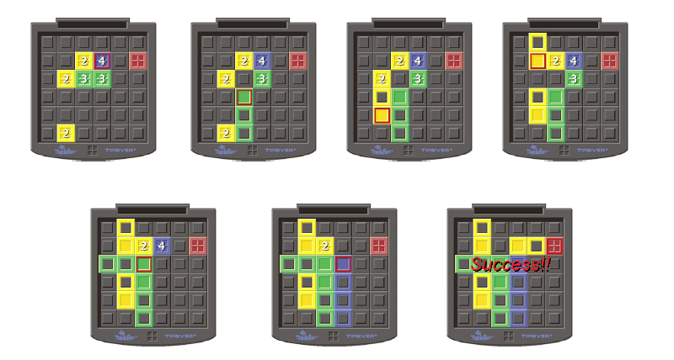
Rules of Game
Numbers are height of crate stack;
If could get 4 high out of way we can attain goal

Slide 795
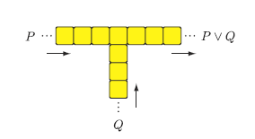
Problematic OR Gadget
Can go out where did not enter

Slide 796

Directional gadget
Single stack is two high;
tipped over stack is one high, two long;
red square is location of person travelling the towers

Slide 797
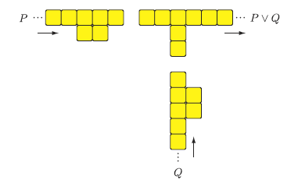
One directional Or gadget

Slide 798
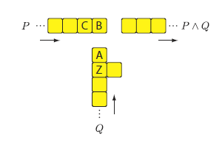
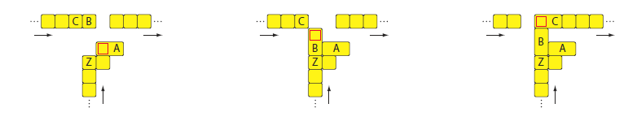
AND Gadget
How AND Works

Slide 799
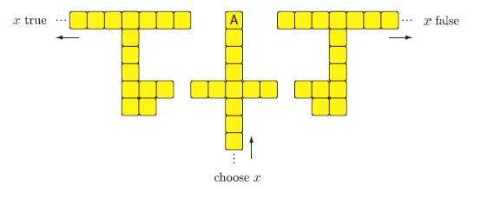
Variable Select Gadget
Tip A left to set x true; right to set x false
Can build bridge to go back but never to change choice

Slide 800
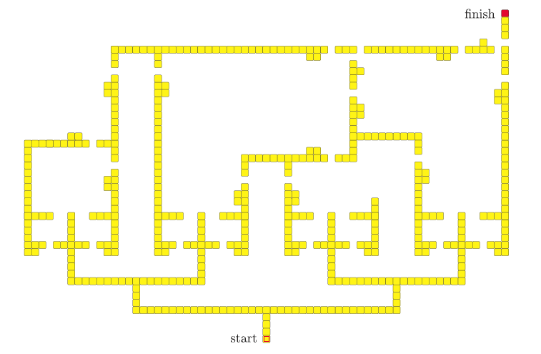
((x∨~x∨y)∧(~y∨z∨w)∧~w)
∧
∧
∨
Bridges back for true paths
∨
∨
∨
x
~x
y
~y
z
~z
w
~w

Slide 801
Win Strategy is NP-Complete
TipOver win strategy is NP-Complete
Minesweeper consistency is NP-Complete
Phutball single move win is NP-Complete
  Do not know complexity of winning strategy
Checkers is really interesting
  Single move to King is in P
  Winning strategy is PSpace-Complete

Slide 802
Finding Triangle Strips
Adapted from presentation by
Ajit Hakke Patil
Spring 2010

Slide 803
Graphics Subsystem
The graphics subsystem (GS) receives graphics commands from the application running on CPU/GPU over a bus, builds the image specified by the commands, and outputs the resulting image to display hardware
Graphics Libraries:
  OpenGL, DirectX.

Slide 804
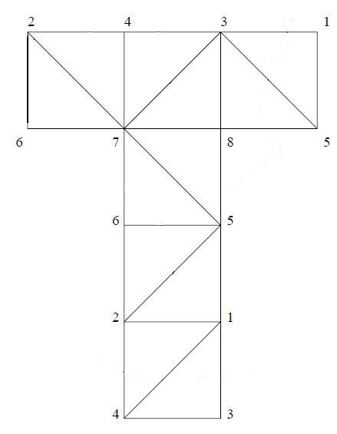

Surface Visualization
As Triangle Mesh
Generated by triangulating the geometry

Slide 805
Triangle List vs Triangle Strip
Triangle List: Arbitrary ordering of triangles.
Triangle Strip: A triangle strip is a sequential ordering of triangles. i.e consecutive triangles share an edge
In case of triangle lists we draw each triangle separately.
So for drawing N triangles you need to call/send 3N vertex drawing commands/data.
However, using a Triangle Strip reduces this requirement from 3N to N + 2, provided a single strip is sufficient.

Slide 806
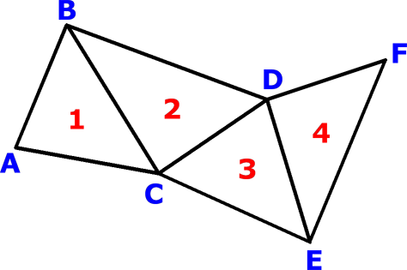
Triangle List vs Triangle Strip
four separate triangles: ABC, CBD, CDE, and EDF
But if we know that it is a triangle strip or if we rearrange the triangles such that it becomes a triangle strip, then we can store it as a sequence of vertices ABCDEF
This sequence would be decoded as a set of triangles ABC, BCD, CDE and DEF
Storage requirement:
  3N => N + 2

Slide 807
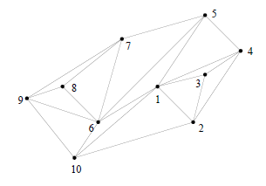
Tri-strips example
Single tri-strip that describes triangles is:
1,2,3,4,1,5,6,7,8,9,6,10,1,2

Slide 808
K-Stripability
Given some positive integer K (less than the number of triangles).
Can we create K tri-strips for some given triangulation – no repeated triangles.

Slide 809
Triangle List vs Triangle Strip
// Draw Triangle List
glBegin(GL_TRIANGLES);
For each Triangle
{
glVertex3f(x1,y1,z1);// vertex 1 glVertex3f(x2,y2,z2);// vertex 2
glVertex3f(x3,y3,z3);// vertex 3
}
glEnd();
// Draw Triangle Strip
glBegin(GL_TRIANGLE_STRIP);
For each Vertex
{
glVertex3f(x,y,z); //vertex
}
glEnd();

Slide 810
Problem Definition
Given a triangulation T = {t₁, t₂, t₃ ,.. t_{n}}. Find the triangle strip (sequential ordering) for it?
Converting this to a decision problem.
Formal Definition:
Given a triangulation T = {t₁, t₂, t₃ ,.. t_{N}}. Does there exists a triangle strip?

Slide 811
NP Proof
Provided a witness of a ‘Yes’ instance of the problem. we can verify it in polynomial time by checking if the sequential triangles are connected.
Cost of checking if the consecutive triangles are connected
  For i to N -1
    Check of i_{th} and i+1_{th} triangle are adjacent (have a common edge)
    Three edge comparisions or six vertex comparisions
  ~ 6N
Hence it is in NP.

Slide 812
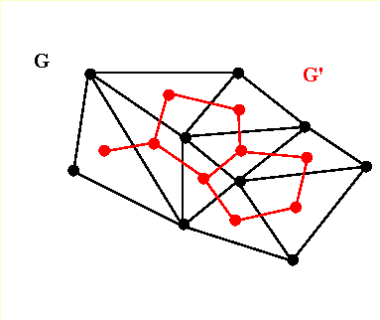
Dual Graph
The dual graph of a triangulation is obtained by defining a vertex for each triangle and drawing an edge between two vertices if their corresponding triangles share an edge
This gives the triangulations edge-adjacency in terms of a graph
Cost of building a Dual Graph
  O(N²)
e.g G’ is a dual graph of G.

Slide 813
NP-Completeness
To prove it’s NP-Complete we reduce a known NP-Complete problem to this one; the Hamiltonian Path Problem.
Hamiltonian Path Problem:
  Given: A Graph G = (V, E). Does G contains a path that visits every vertex exactly once?

Slide 814
NP-Completeness proof by restriction
Accept an Instance of Hamiltonian Path, G = (V, E), we restrict this graph to have max. degree = 3.The problem is still NP-Complete.
Construct an Instance of HasTriangleStrip
  G’ = G
    V’ = V
    E’ = E
  Let this be the dual graph G’ = (V’, E’) of the triangulation T = {t1, t2, t3 ,.. tN}.
    V’ ~ Vertex v_{i} represents triangle t_{i,} i = 1 to N
    E’ ~ An edge represents that two triangles are edge-adjacent (share an edge)
Return HasTriangleStrip(T)

Slide 815
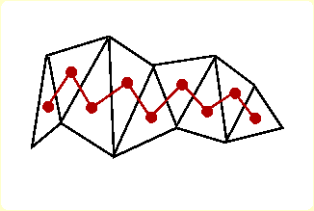
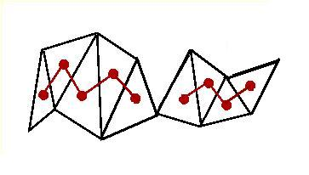
NP-Completeness
G will have a Hamiltonian Path iff G’ has one (they are the same).
G’ has a Hamiltonian Path iff T has a triangle strip of length N – 1.
T will have a triangle strip of length N – 1 iff G (G’) has a Hamiltonian Path.
‘Yes’ instance maps to ‘Yes’ instance. ‘No’ maps to ‘No.’

Slide 816
HP <_{P} HasTriangleStrip
The ‘Yes/No’ instance maps to ‘Yes/No’ instance respectively and the transformation runs in polynomial time.
Polynomial Transformation
Hence finding Triangle Strip in a given triangulation is a NP-Complete Problem

Slide 817
Undecidability of Finite Convergence for Operators on Formal Languages
Relation to Real-Time
(Constant Time) Execution

Slide 818
Simple Operators
Concatenation
  A • B = { xy | x ∈ A & y ∈ B }
Insertion
  A  B = { xyz | y ∈ A, xz ∈ B, x, y, z ∈ Σ*}
  Clearly, since x can be λ, A • B ⊆ A  B

Slide 819
K-insertion
A  ^{[ k ]} B = { x₁y₁x₂y₂ … x_{k}y_{k}x_{k+1} |
y₁y₂ … y_{k} ∈ A,
x₁x₂ … x_{k}x_{k+1} ∈ B,
x_{i}, y_{j} ∈ Σ*}
Clearly, A • B ⊆ A  ^{[ k ]} B , for all k>0

Slide 820
Iterated Insertion
A (1) ^{[ n ]} B = A ^{[ n ]} B
A (k+1) ^{[ n ]} B = A ^{[ n ]} (A (k) ^{[ n ]} B)

Slide 821
Shuffle
Shuffle (product and bounded product)
  A  B = ∪ _{j ≥ 1} A ^{[ j ]} B
  A ^{[ k ]} B = ∪ _{1≤j≤k} A ^{[ j ]} B = A ^{[ k ]} B
One is tempted to define shuffle product as
A  B = A ^{[ k ]} B where
k = μ y [ A ^{[ j ]} B = A ^{[ j+1]} B ]
but such a k may not exist – in fact, we will show the undecidability of determining whether or not k exists

Slide 822

More Shuffles
Iterated shuffle
  A ⁰ B = A
  A ^{k +1} B = (A ^{[ k ]} B)  B
Shuffle closure
  A * B = ∪ _{k ≥ 0} (A ^{[ k ]} B)

Slide 823
Crossover
Unconstrained crossover is defined by
A ⊗_{u} B = { wz, yx | wx∈A and yz∈B}
Constrained crossover is defined by
A ⊗_{c} B = { wz, yx | wx∈A and yz∈B,
|w| = |y|, |x| = |z| }

Slide 824
Who Cares?
People with no real life (me?)
Insertion and a related deletion operation are used in biomolecular computing and dynamical systems
Shuffle is used in analyzing concurrency as the arbitrary interleaving of parallel events
Crossover is used in genetic algorithms

Slide 825
Some Known Results
Regular languages, A and B
  A • B is regular
  A  ^{[ k ]} B is regular, for all k>0
  A  B is regular
  A * B is not necessarily regular
    Deciding whether or not A * B is regular is an open problem

Slide 826
More Known Stuff
CFLs, A and B
  A • B is a CFL
  A  B is a CFL
  A  ^{[ k ]} B is not necessarily a CFL, for k>1
    Consider A=a^{n}b^{n}; B = c^{m}d^{m} and k=2
    Trick is to consider (A  ^{[ 2 ]} B) ∩ a*c*b*d*
  A  B is not necessarily a CFL
  A * B is not necessarily a CFL
    Deciding whether or not A * B is a CFL is an open problem

Slide 827
Immediate Convergence
L = L² ?
L = L L ?
L = L  L ?
L = L * L ?
L = L ⊗_{c} L ?
L = L ⊗_{u} L ?

Slide 828
Finite Convergence
∃k>0 L^{k} = L^{k+1}
∃k≥0 L (k)  L = L (k+1)  L
∃k≥0 L ^{[ k ]} L = L ^{[ k+1 ]} L
∃k≥0 L ^{k} L = L ^{k +1} L
∃k≥0 L (k) ⊗_{c} L = L (k+1) ⊗_{c} L
∃k≥0 L (k) ⊗_{u} L = L (k+1) ⊗_{u} L
∃k≥0 A (k)  B = A (k+1)  B
∃k≥0 A ^{[ k ]} B = A ^{[ k+1 ]} B
∃k≥0 A ^{k} B = A ^{k +1} B
∃k≥0 A (k) ⊗_{c} B = A (k+1) ⊗_{c} B
∃k≥0 A (k) ⊗_{u} B = A (k+1) ⊗_{u} L

Slide 829
Finite Power of CFG
Let G be a context free grammar.
Consider L(G)^{n}
Question1: Is L(G) = L(G)²?
Question2: Is L(G)^{n} = L(G)^{n+1}, for some finite n>0?
These questions are both undecidable.
Think about why question1 is as hard as whether or not L(G) is Σ*.
Question2 requires much more thought.

Slide 830
1981 Results
Theorem 1:
The problem to determine if L = Σ* is Turing reducible to the problem to decide if
L • L ⊆ L, so long as L is selected from a class of languages C over the alphabet Σ for which we can decide if Σ ∪ {λ} ⊆ L.
Corollary 1:
The problem “is L • L = L, for L context free or context sensitive?” is undecidable

Slide 831
Proof #1
Question: Does L • L get us anything new?
  i.e., Is L • L = L?
Membership in a CSL is decidable.
Claim is that L = Σ* iff
  (1) Σ ∪ {λ} ⊆ L ; and
  (2) L • L = L
Clearly, if L = Σ* then (1) and (2) trivially hold.
Conversely, we have Σ* ⊆ L*= ∪ _{n≥0} L^{n} ⊆ L
  first inclusion follows from (1); second from (2)

Slide 832
Subsuming •
Let ⊕ be any operation that subsumes concatenation, that is A • B ⊆ A ⊕ B.
Simple insertion is such an operation, since A • B ⊆ A  B.
Unconstrained crossover also subsumes •,
A ⊗_{c} B = { wz, yx | wx∈A and yz∈B}

Slide 833
L = L ⊕ L ?
Theorem 2:
The problem to determine if L = Σ* is Turing reducible to the problem to decide if L ⊕ L ⊆ L, so long as
L • L ⊆ L ⊕ L and L is selected from a class of languages C over Σ for which we can decide if
Σ ∪ {λ} ⊆ L.

Slide 834
Proof #2
Question: Does L ⊕ L get us anything new?
  i.e., Is L ⊕ L = L?
Membership in a CSL is decidable.
Claim is that L = Σ* iff
  (1) Σ ∪ {λ} ⊆ L ; and
  (2) L ⊕ L = L
Clearly, if L = Σ* then (1) and (2) trivially hold.
Conversely, we have Σ* ⊆ L*= ∪ _{n≥0} L^{n} ⊆ L
  first inclusion follows from (1); second from (1), (2) and the fact that L • L ⊆ L ⊕ L

