Slide 1
3D Printing
Jamir Dirksen
Kyle Strink
COP 4910

Slide 2
Outline
What is 3D Printing?
Materials Used
Where is 3D printing used?
Future applications
3D printing vs. machining
Benefits of 3D printing
3D printing technologies

Slide 3
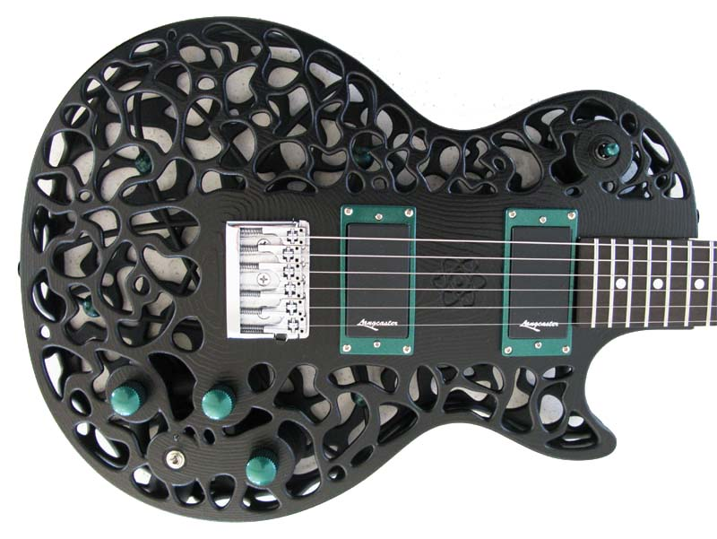
What is 3D Printing
Creates three-dimensional physical objects out of digital data
Uses additive method, printing layers as thin at 10microns.
2D pattern of each layer extrudes the raw material onto a flat platform
Process is repeated until the object if formed
Material is cured, laser-sintered, fused or bound by UV light, lasers or electron beams
Created from 3D modeling or by 3D scanning

Slide 4
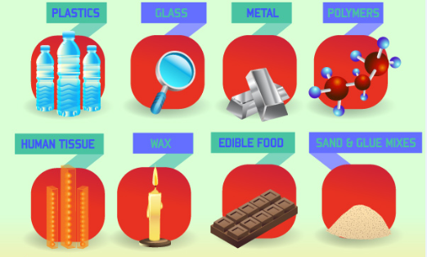
Materials
Plastic
Glass
Metal
Polymers
Human tissue
Wax
Food
Sand & glue mixtures

Slide 5
Software
Computer-aided manufacturing software package (CAM)
Computer-aided design (CAD)
EX: AutoCAD, Autodesk
Once the CAD file is completed it then must be converted into a STL file (stereolithography) to be printed
The STL file then breaks the design into layers of specified depth

Slide 6
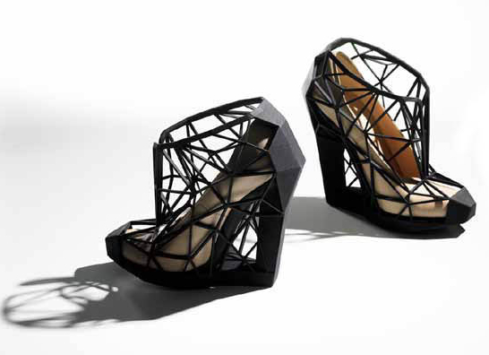
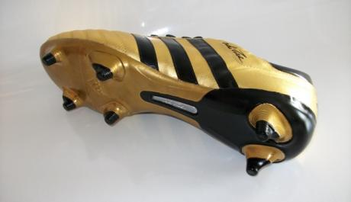
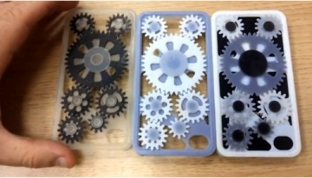
Where is 3D printing Used
Used for design visualization
Architecture – models
Education
Jewelry
Automotive – clay models & concept cars
Healthcare – implants, drug delivery systems, diagnostic equipment
Dental – crowns, bridges, stone models
Fossil Reconstruction
Bone reconstruction in forensic investigations
Consumer use – mugs, cellphone cases, food

Slide 7
Future Applications
3D printing is being studied for use in tissue engineering where organs and body parts are created by applying layers of living cells onto a gel medium and slowly built into a 3D structure

Slide 8
3D printing vs. machining
3D printing is an Additive Manufacturing Technology that builds objects by printing layer by layer. The layers are fused to create the final 3D shape.
Machining uses a subtractive process, where you start with a block of raw material that is removed by drilling, cutting, machining, turning, milling, sawing, etc.

Slide 9
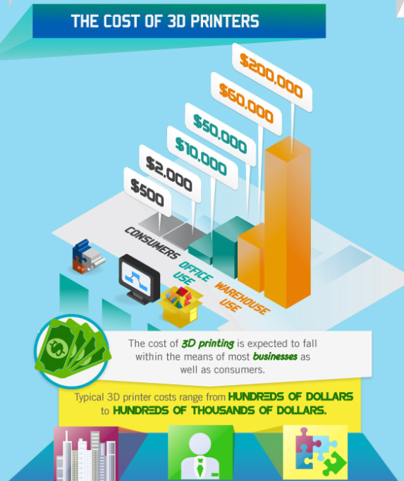
Benefits of 3D printing
Companies can create their own prototypes
Rapid manufacturing
Reduce waste and extra costs associated with traditional subtractive manufacturing.
Subtractive manufacturing can leave up to 90% of expensive raw materials, such as titanium, wasted

Slide 10
3D printing technologies
There are many 3D printing technologies
Examples:
Stereolithography Apparatus (SLA)
Fused Deposition Modeling (FDM)
Selective Laser Sintering (SLS)

Slide 11
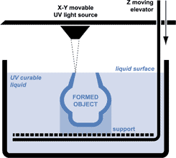
Stereolothography Apparatus
First commercial 3D printer
Invented by Charles Hull in 1984
UV laser beam causes liquid photopolymer to harden
Layers of 1/400 of an inch

Slide 12
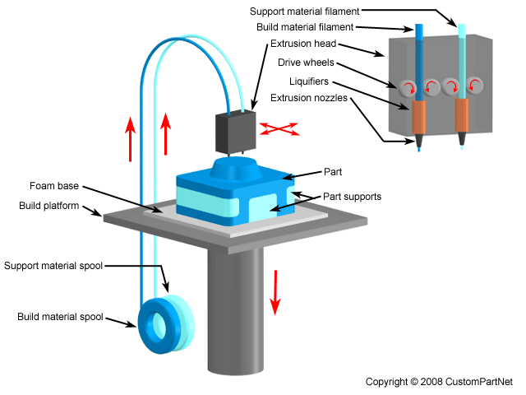
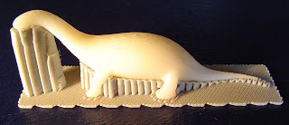
Fused Deposition Modeling
Works like a glue gun
Uses plastic filament or metal wire
Extrudes melted material layer by layer
Layers of 1/200 of an inch

Slide 13
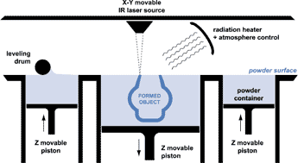
Selective Laser Sintering
Laser fuses powder
Layers of 1/300 of an inch
Various powder materials:
Wax
Nylon
Glass
Stainless steel
Titanium
Aluminum

Slide 14
Summary
3D printing is widely used today in many industries using a variety of materials
There are cost benefits to using 3D printing
There are a variety of printing technologies available
3D printing is still growing and developing

Slide 15
References
http://3dprinting.com/
http://www.dimensionprinting.com/
http://www.mojo3dprinting.com/printers/default.aspx
http://web.ncsu.edu/abstract/technology/3d-printing/
http://createdigitalmusic.com/2012/10/six-3d-printed-musical-instruments-and-what-3d-printing-could-do-for-musicians/
http://www.smartplanet.com/blog/bulletin/dutch-architect-to-build-8216endless-3d-printed-house/10671
Kaur, S. (2012). How is "Internet of the 3D Printed Products" Going to Affect Our Lives?. IETE Technical Review, 29(5), 360-364. http://www.tr.ietejournals.org/article.asp?issn=0256-4602;year=2012;volume=29;issue=5;spage=360;epage=364;aulast=Kaur
Matthews, J. A. (2011). 3D printing breaks out of its mold. Physics Today, 64(10), 25-28. http://www.physicstoday.org/resource/1/phtoad/v64/i10/p25_s1?bypassSSO=1

Slide 16
3D Printing
Jamir Dirksen
Kyle Strink
COP 4910

