Slide 1
Frontiers in Web-based Design and Programming
Corbin Kolehmainen
Chris Marstaller

Slide 2
Overview
The Beginning
HTTP
History of HTML
Future of HTML and HTML 5
Final Remarks

Slide 3
The Beginning
World Wide Web began in the labs at CERN in 1989
It’s inventor was Tim Berners-Lee
He wanted to give researchers the ability to share data from remote sites
This way they could link to the text files and cross-reference from one paper to another

Slide 4
The Beginning
He wanted to have buttons that controlled the access of these different pages
For the linking he decided that a form of hypertext needed to be used
Hypertext has been around for a few decades, mainly used on computers for “filing cards”.
This was only good for the local machine, not for a global use.

Slide 5
HTTP
To use hypertext links on a global scale, there needed to be a new language developed
All majorly developed hypertext languages already packaged were machine specific and couldn’t easily take text from other sources
So Tim developed the HTTP protocol to make use of the information in the links
The text format for HTTP became HTML

Slide 6
HTML
The bulk of HTML was based on SGML
SGML is where many of the common pairs of tags come from
<TITLE></TITLE>, <P></P>, <H1></H1>
What Tim invented and what made HTML different was the use of the <A> anchor element
This is the linking element

Slide 7
HTML 2
Since HTML was so basic that many browsers were starting to add their own parts to the language
This was causing it to become poorly defined
To help this Dan Connolly and others collected all the widely use tags and made a draft that circulated
This became the new HTML 2 standards

Slide 8
HTML 3
HTML 3 faced many problems from the internet community
With it was the addition of style sheets, using the tags <STYLE> and <CLASS>
Also with HTML 3 came the use of tables for organizing the information in the document
This version was never standardized, due to too many extensions made by browsers

Slide 9
HTML 3.2
The use of tables in HTML 3 faced many arguments because SGML already had the CALS format that was used by many organizations
These were later edited to suit the needs
In 1997 the W3C made the final edit to 3 and released the HTML 3.2 standards
With this version was the use of the edited tables, applets, image décor, subscripts, and superscripts

Slide 10
HTML 4.01
With internet growth, the W3C decided to change the standards to make a more international web
With it was the full use of CSS
Also the use of frames for formatting

Slide 11
XHTML 1
The use of XHTML really wasn’t a change in HTML elements but rather a adoption of XML rules for writing the code
This dictated the syntax and structure
No tags left open, nesting of elements, etc.
Using this new standard would ensure that your page would be displayed as written across all browsers

Slide 12
HTML 5
With the internet becoming more and more dynamic, there needed to be a drastic change in HTML
During the development of XHTML 2 the W3C turned their attention toward the future and thus creating HTML 5
This will be the new standard for the next decade at least, and is slowly becoming more developed all the time

Slide 13
Attractiveness of HTML 5
Allows for dynamic web pages with visual effects
Allows for more native support
Less reliance on third-party plugins like Adobe Flash or Apple’s QuickTime
Less likely that customers will come across “black holes”
Better ease of access
Dragging and dropping files to attach
Rapid app replication inside of a browser

Slide 14
Functionalities with HTML 5
New Methods for
Typography
Native Transitions
Audio Integration
The <canvas> tag
WebGL
Music Videos
Data Visualizations

Slide 15
<canvas> Demonstration

Slide 16
Functionalities with HTML 5
Device API
Network Connection
File System Access
Camera Access
App Launcher
Accelerometer
Battery Status
Vibration
Notification API
Desktop and mobile notifications

Slide 17
Future of Web-design
HTML 5 Standards should become “stable” in 2014
Many browsers already support a majority of HTML 5 features
Rapidly being updated
Adobe Flash will still be around for DRM Protected media
Browser notifications for websites
Firefox’s Facebook Messenger
Responsive website design
one website that can react to various screen

Slide 18
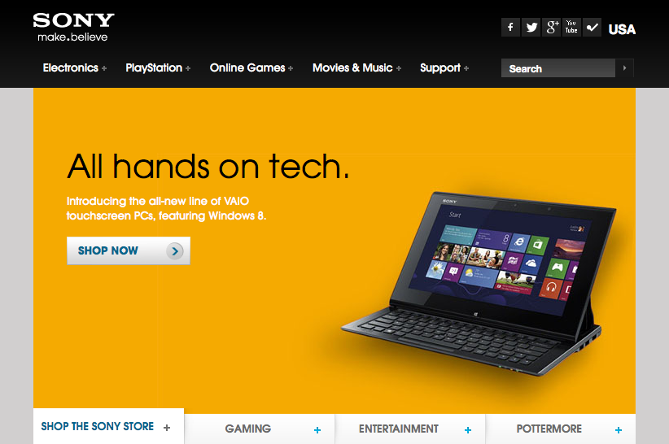
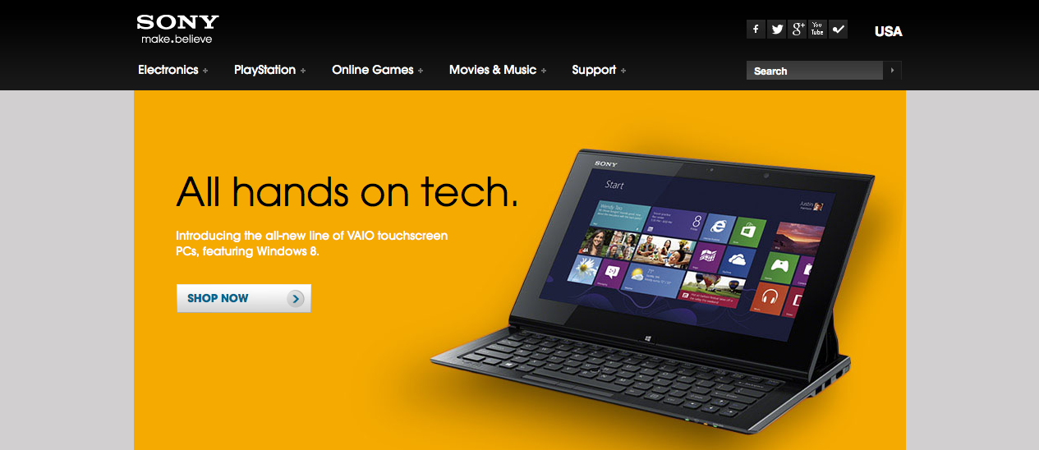
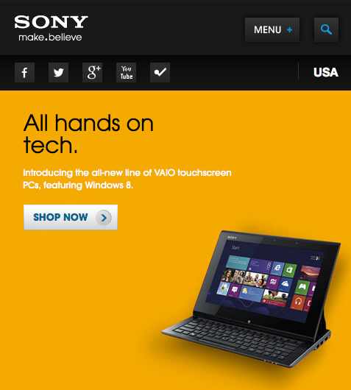
Responsive Design Example

Slide 19
HTML 5 and Beyond
Richer media websites
App-styled website
Chrome App Store
Ubuntu Web Apps
Internet Gaming
Device Integration
Versatile, Beautifully Designed Websites

Slide 20
Final Remarks
HTML has been around since 1990
HTML has since evolved from standard text documents
Today’s Internet is very image and multimedia reliant
The future we will see more dynamic, integrated, and scalable websites
More app-based design and mobile technology

Slide 21
Frontiers in Web-based Design and Programming
Corbin Kolehmainen
Chris Marstaller

