Slide 1
Innovations In Wireless Communication
Travis Heminger
Nikolay Abdrakhmanov

Slide 2
Presentation OverVIEW
Early Mobile Devices - Slides 3 - 4
Current Mobile Networks - Slides 5 - 6
Future Research for Worldwide Cellular Communication - Slide 7
802.11 Standard - Slides 8 - 9
802.11ac Protocol - Slide 10
WiGig (802.11ad) - Slide 11
Concluding Remarks - Slide 12

Slide 3
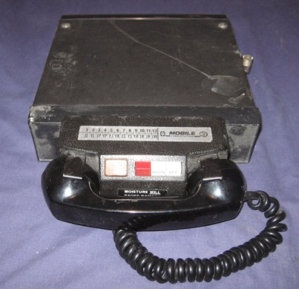
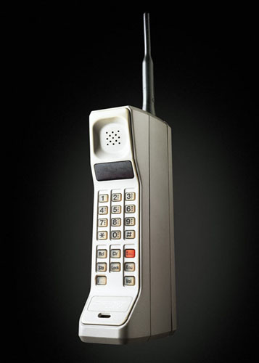
Mobile Communication
MTS (Mobile Telephone Service) Year 1946 (0G)
Developed By Motorola and Bell Systems
AMPS ( Advanced Mobile Phone System) Year 1983 (1G)
Developed By Bell Laboratories(AT&T)

Slide 4
Mobile Communication
GSM (Global System for Mobile Communications) Year 1990 (2G)
Developed by European Telecommunications Standards Institute
IS-95 System Using CDMA (Code Division Multiple Access) Year 1993 (2G)
Developed by Qualcomm Inc
Transition From 1G Networks (Analog) to 2G (Digital) Allowed Exponential Growth in the Number of Users

Slide 5
Mobile Communication
International Mobile Telecommunications-2000 (IMT-2000) (3G)
Must provide at least 200 kbits/s to meet standard
4G Standards – Mobile WIMAX and LTE (Long Term Evolution)
Common speeds of 100 mbps to users

Slide 6
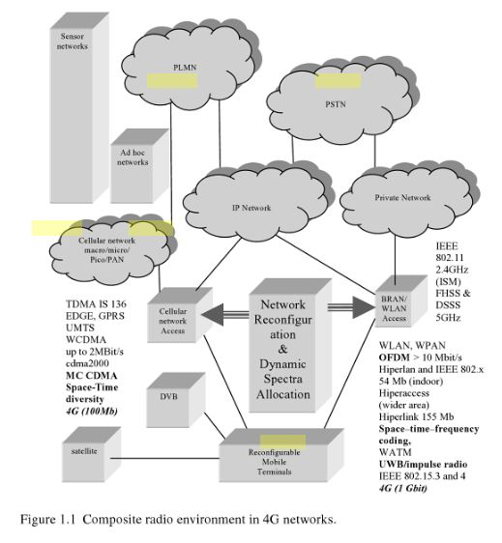
Mobile Communication

Slide 7
Mobile Communication
5th Generation Wireless Systems
Hybrid Pervasive Networks
Dynamic Adhoc Wireless Networks
Main Goal To Create Worldwide Core Network Standard Based on IPv6

Slide 8
802.11 Standard (Wi-Fi)
Set of standards for implementing Wireless Local Area Network technologies
Started with 802.11 (1997)
2.4 Ghz frequency band
Up to 2 Mbits/s
802.11a (1999)
5 Ghz frequency band
Up to 54 Mbits/s
802.11b (1999)
2.4 Ghz frequency band
Up to 11 Mbits/s

Slide 9
802.11 Standard Continued
802.11g (2003)
2.4 Ghz frequency band
Up to 54 Mbits/s
802.11n (2009) – Current Standard
2.4 Ghz and 5Ghz frequency band
Up to 150 Mbits/s per stream

Slide 10
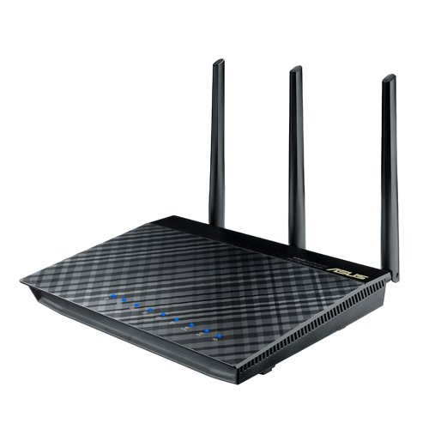
802.11ac
Finalization is currently taking place, expected to finish this year
Current specifications allows 1 Gbit/s throughput at speeds of 500 Mbits/s
Up to 160 Mhz bandwidth compared to Wireless N’s 40 Mhz
Up to 8 simultaneous channels compared to Wireless N’s 4
Currently on the market (ASUS, Buffalo, Belkin, D-Link, Netgear, Linksys)
Expensive – Routers cost $150 and up

Slide 11
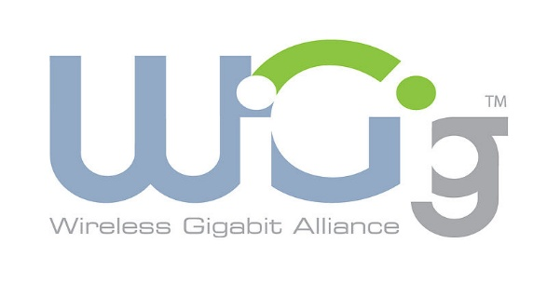
802.11AD WIGIG
Established by the Wireless Gigabit Alliance aka WiGig
Currently under development
Specification establishes a standard to allow the transmission of gigabit wireless speeds
Theoretical speed is 7 Gbits/s
Protocol adaption layers allow expandability into data buses for PC peripherals
WiGig Display Extension
Use of 60Ghz frequency band
Wireless transmission of audio and video signals
Wireless display interfaces like DisplayPort

Slide 12
Concluding Remarks
Evolved from the old phone networks to 4G LTE and WIMAX services
802.11 Standard from A to AD
Wireless is the future!

Slide 13
Resources
Chermack, T. (2011). Scenario planning in organizations. (Vol. 1). Berrett- Koehler Publishers.
Glisic, S. (2006). Advanced wireless networks: 4g technologies. West Sussex: Wiley.
IEEE.org, http://standards.ieee.org/getieee802/download/802.11g-2003.pdf
IEEE.org (2012), http://standards.ieee.org/about/get/802/802.11.html

Slide 14
Innovations In Wireless Communication
Travis Heminger
Nikolay Abdrakhmanov

