Slide 1

Cloud Computing
Roger Fernandez
Yenny Lozada

Slide 2
Table of Content
Cloud computing evolution
Definition and Examples
Three Approaches of Cloud Computing
Types of Cloud
Advantages and Risks
Cloud Providers
Conclusion

Slide 3

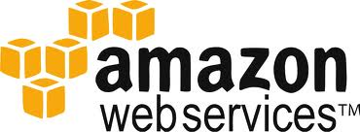
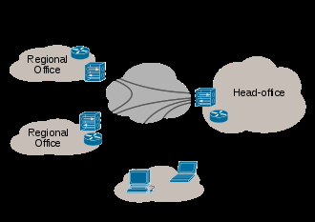
Cloud Computing Evolution
The vision of John McCarthy “Computation may someday be organized as a public utility”.
1990, phone companies began for the first time offering virtual private Network (VPN) services in addition to dedicated point-to-point data circuits which had been the service standard. “Cloud” probably originates with this new “telephony” virtual network which offered a comparable quality of service as the dedicated point-point circuits while being more cost effective.
Early 2000, The online shopping company Amazon, played a major role in the development of cloud computing by redesigning their data centers. Amazon was trying to find a way to use more of their computer network capacity which was about 90% unused and eventually initiated a new product, offering cloud computing for external customers, and launched Amazon web Services (AWS) in 2006.
Google, IBM and a number of universities followed Amazon’s lead and in 2007 started a large and coordinated cloud computing research project. By this point cloud computing was marching forward with some organizations switching away from company-owned hardware and software assets.

Slide 4
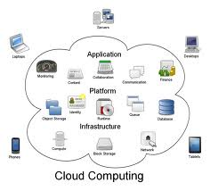


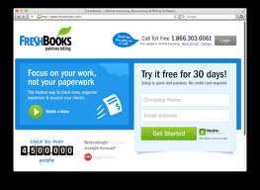
Definition and Cloud computing services
Cloud computing is defined as the practice of using a network of remote server hosted on the internet to store, manage, and process data rather than a local server.
Remote backup services: This service has become much more cost effective and applicable because of affordably increased bandwidth capacity.
www.carbonite.com www.mozy.com
Email services: These email providers store the account holder’s e-mail at their data centers.
Invoicing services: Invoicing services allows companies to offer professional invoicing while maintaining the smallest possible computing infrastructure in order to keep cost down.
www.Freshbooks.com

Slide 5
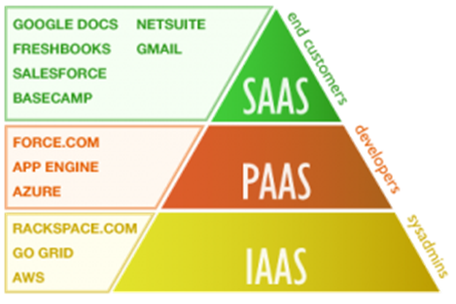
Three approaches to cloud computing:
Software as a service (SAAS)
Includes Email, games, virtual desktop, CRM etc.
The most successful model in respect to cloud computing.
Specific applications for countless numbers of users are accessed through their internet browsers.
Platform as a service (PASS) or MSP (managed Service providers
Includes execution runtime, web server, development tools and database.
MSPs offer various services interfacing with the information technology department, application monitoring, anti-virus scanning and anti Spam filtering.
Infrastructure as a service (IASS)
The basic cloud service model that includes virtual machines, storage, servers, load balancers and networks.
This model transfers even more control and responsibility for security from the cloud provider to the client.
The end user accesses the operating system that supports the visual images, networking and storage.

Slide 6
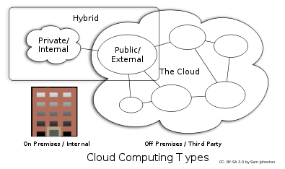
Different levels or types of cloud computing
Public Cloud
Private Cloud
A proprietary network or a data center that supplies hosted services to a limited number of people. (virtualization) (VMware & Citrix)
Hybrid Cloud
A combination of private clouds and public clouds, usually, managed using the same administration and monitoring consoles.
Sells services to anyone on the Internet. (Currently, Amazon Web Services is the largest public cloud provider.)

Slide 7
Advantages of Cloud Computing
Cost Efficient: Cloud computing is probably the most cost efficient method to use, maintain and upgrade. There are many one-time-payment, pay-as-you-go and other scalable options available, which makes it very reasonable for the company in question.
Almost Unlimited Storage: Storing information in the cloud gives you almost unlimited storage capacity.
Backup and Recovery: Since all your data is stored in the cloud, backing it up and restoring the same is relatively much easier than storing the same on a physical device.

Slide 8

Risks involved in Cloud Computing
Technical Issues: Information and data on the cloud can be accessed anytime and from anywhere at all, there are times when this system can have some serious dysfunction.
Security in the Cloud: Before adopting this technology, make absolutely sure that you choose the most reliable service provider, who will keep your information totally secure.

Slide 9
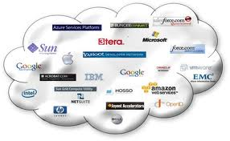



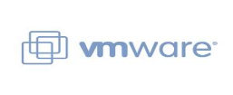
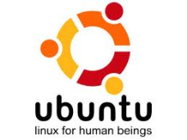

The cloud providers

Slide 10
Conclusion
Cloud computing is rapidly emerging as a viable alternative to traditional approaches agencies. Costs are being significantly reduced, along with personnel time spent on computing issues. Storage availability increases, high automation eliminates worries about keeping applications up to date, and flexibility and mobility are heightened, allowing users to access information anytime, anywhere.

Slide 11
Cloud Computing
Roger Fernandez
Yenny Lozada

