Slide 1
Phishing
By
Aaron Blakeman
Michael Waters

Slide 2
Table of Contents
What is Phishing
Type of attacks
Phishing Today

Slide 3
What is it
Phishing- is the act of attempting to acquire information such as usernames, passwords, or credit card details.
This can be done by masquerading as a trustworthy entity.
This can lead to identity theft or credit card fraud

Slide 4
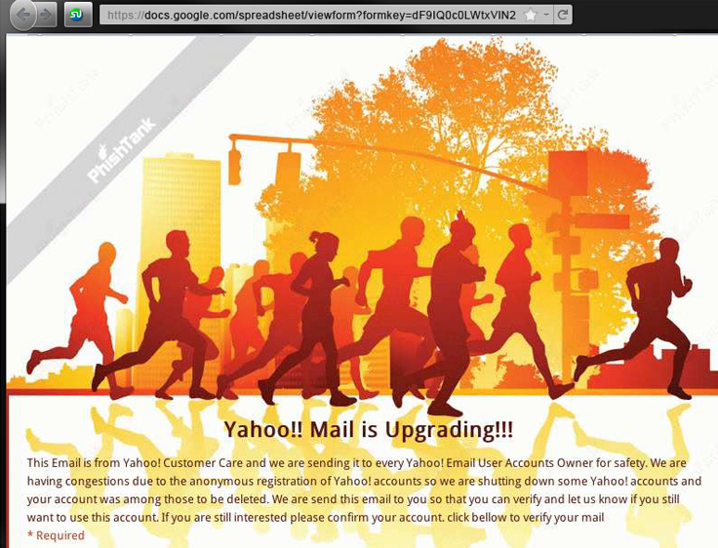

Slide 5
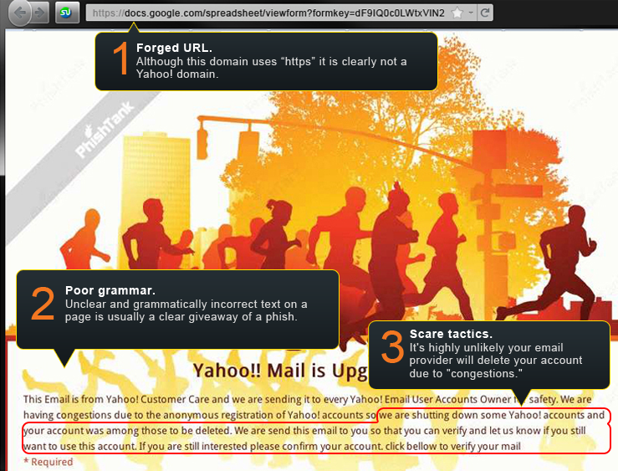

Slide 6
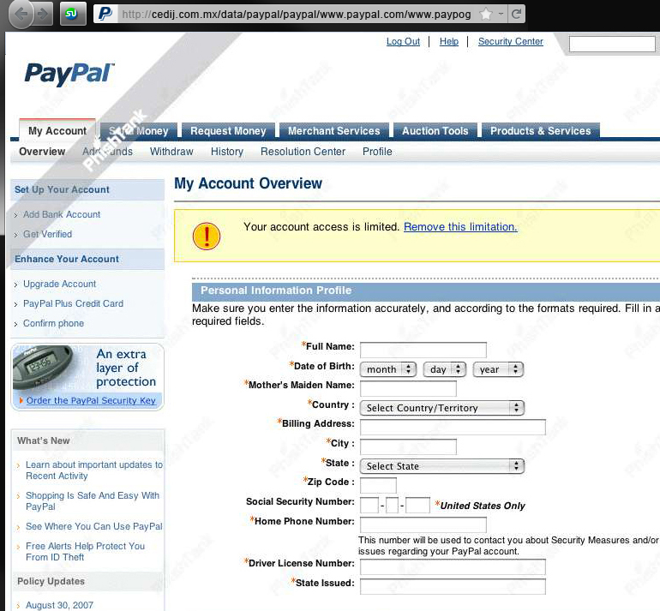

Slide 7
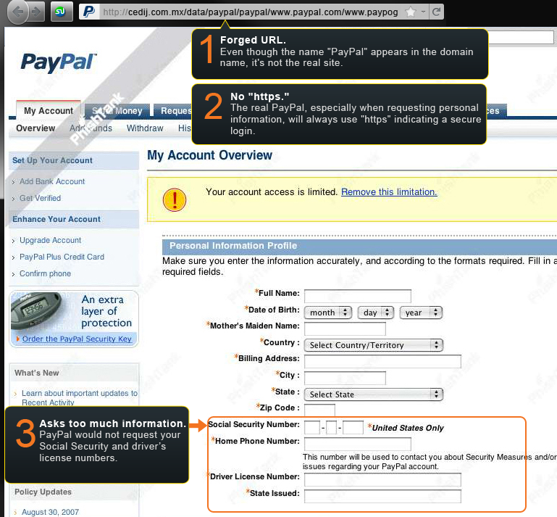

Slide 8
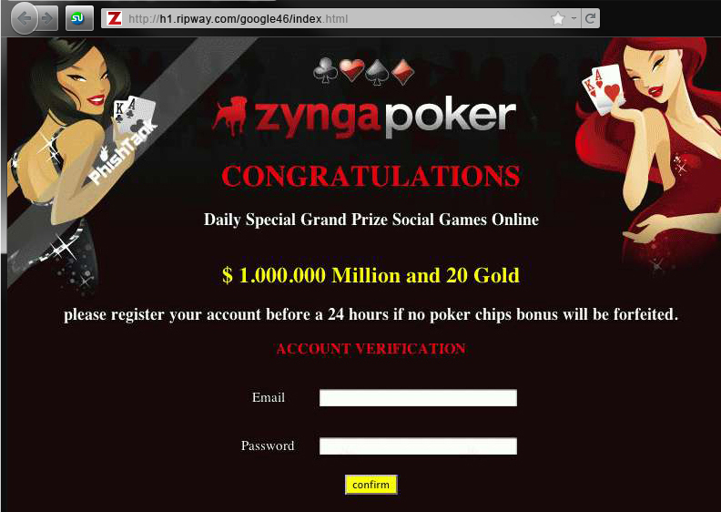

Slide 9
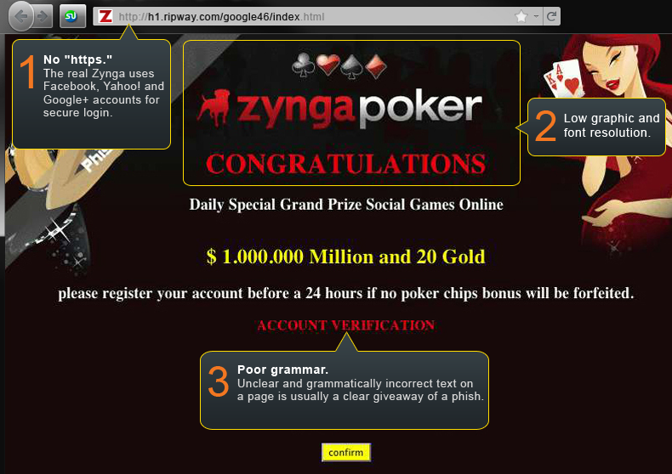

Slide 10
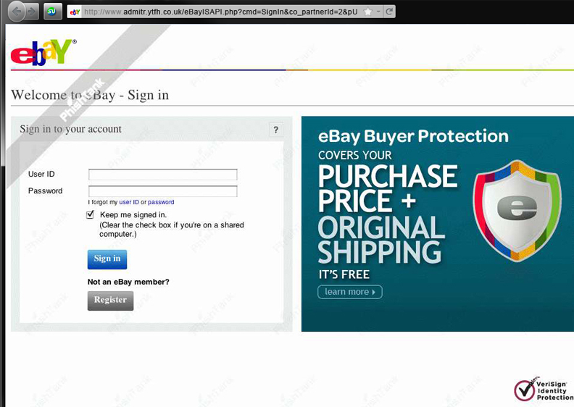

Slide 11
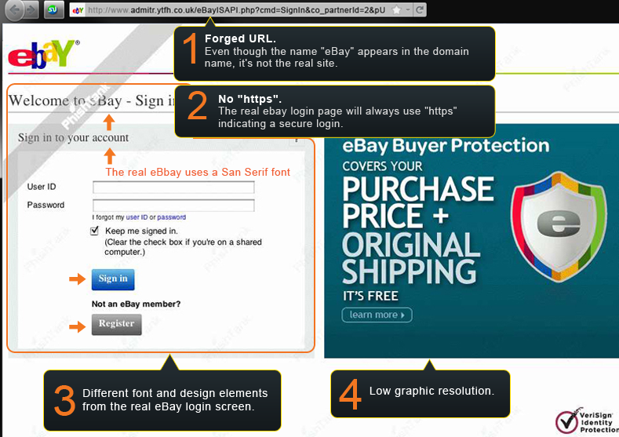

Slide 12
Types of Attacks
Spear Phishing
Clone Phishing
Whaling
Website Forgery
Evil Twins
Notes:
Rakesh Agrawal, CEO of SnapStream, phishing attack on facebook
Fake eBay auction site in Korea stole over 18 million users personal information

Slide 13
DMARK
Free email providers are teaming up with other service providers to create a new system for authenticating e-mail senders.
DMARK = SPF + DKIM
how to handle messages that fail

Slide 14
Closing Remarks
Phishing - any attempt to obtain personal information by masquerading as a trusted entity
It comes in many forms
The best protection is awareness

Slide 15
Works cited
http://www.opendns.com/phishing-quiz
http://computer.howstuffworks.com/phishing.htm
http://www.social-engineer.org/framework/Real_World_Social_Engineering_Examples:_Phishing
https://www.isecpartners.com/media/11961/CSRF_Paper.pdf

Slide 16
Phishing
By
Aaron Blakeman
Michael Waters

