Slide 1
Cross Site Scripting
Khristopher Powell
Maurice Wahba

Slide 2
Overview
Cross Site Scripting (XSS, CSS) is a type of Internet security attack which allows the attacker to obtain data on others who use the website. This kind of attack can be done on many websites and is one of the most prevalent types of attacks.

Slide 3
Outline
Overview of Website Scripting
What is an XSS Attack?
Affected Websites
Method of Attack
Prevalence
Prevention

Slide 4
Website Scripting
Programming for actions/events behind a web page (usually Javascript)
  Dynamic Content based on user input
Examples
  Modification of HTML
  Dynamic content (animations, audio/video)
  Seamless transitions (Ajax)

Slide 5
What is an XSS Attack?
Code that can be inserted into user Browser to perform negative effects.
What are the negative effects?
Private Information
Cookies
False Requests
Malicious Code
XSS Attack is usually a Hyperlink

Slide 6
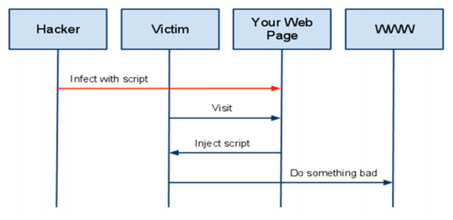
What is an XSS Attack?
Essential Steps:
Malicious attacker injects script that can modify HTML
User accesses website.
Script activates.
Something BAD happens!!

Slide 7
Affected Websites
Are Static or Dynamic HTML Websites affected?
Dynamic Websites through Forms or Dynamic Links
Any website application that displays user input or passes data to a database is vulnerable.
Usually present in Login's, Password Recovery, etc

Slide 8
Affected Websites
Attacker does not need access to Server HTML, only Response Page
Modern Websites are not self contained, they are an amalgamation of data from different sources
This is a potential vulnerability when the hacker doesn't have access to your specific website Markup.

Slide 9
Method of Attack
Injected Code:
JavaScript
VBScript
ActiveX
Flash
Vulnerable HTML Tags:
Code execution (<script> embedded or external, onClick for any element)
Stylesheets (<link>, <style>)
Forms (<form>, <input>)
Layout (<body>, <div>, <span>, <table>)
Multimedia (<img>, <object>, <embed>)

Slide 10
Method of Attack
Types of Attack:
Non-Persistent (Most Common)
  HTML Search Engine
Persistent
  Message Boards
    <script> tags don't show up

Slide 11
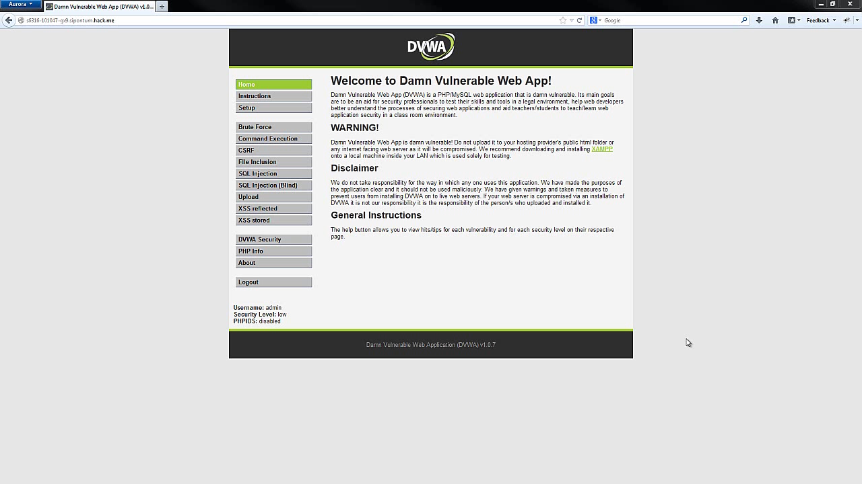
DEMO

Slide 12
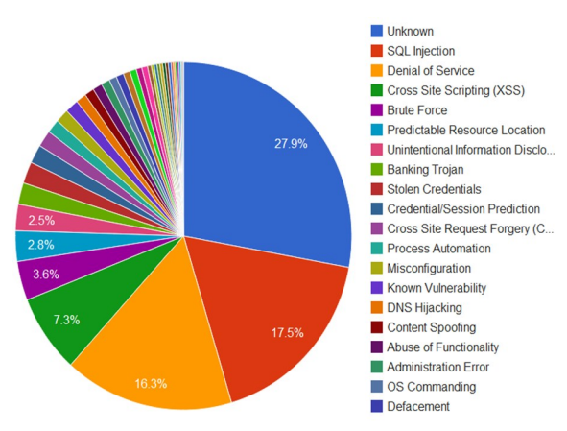
Prevalence
Web Hacking Incident Database (1999 - 2011)
7.3% of all attacks

Slide 13
Prevention
For the website developer
Validate any user input before included in output page
  Safest is letters and numbers only
Convert special characters to HTML
  < becomes "&lt;" and > becomes "&gt;" etc
For the user
Be aware of where you send information
Use tools available for prevention
  NoScript

Slide 14
Final Remarks
Scripting is an integral part of websites
XSS can inject code without your consent
If vulnerable, any information you enter may be compromised
Both web developers and users can take steps to prevent this

Slide 15
References
Oeconomics of Knowledge, Volume 4, issue 3, Q3, Summer of 2012 Knowledge https://sites.google.com/site/oeconomicsofknowledge/v4_i3_3q_2012_fa.pdf?attredirects=0
Acunetx: Web Based Security - Cross Site Scripting Attack http://www.acunetix.com/websitesecurity/cross-site-scripting/
Caught in the Cross-Site Scripting Fire http://www.sciencedirect.com.ezproxy.lib.ucf.edu/science/article/pii/S1353485812700351

Slide 16
Cross Site Scripting
Khristopher Powell
Maurice Wahba

