Slide 1
Past, Present &
Future of DRM
Adrian Kostic
Ron White

Slide 2
Table of Contents
1. What is DRM?
2. DRM of the Past.
3. Present day DRM.
4. Future View of DRM (dystopian)
5. Future View of DRM (elimination)
6. Final Remarks
7. Rerefences

Slide 3
What is DRM
Digital Rights Management
encompasses all forms of delivery and consumption of digital media.
Main goal is to restrict copying & alteration of format.
Delivery
Restricted, encrypted distribution
Consumption
Limited devices, time-based, technology based
Multiple Stakeholders
Manufacturers, publishers, Copyright Holders, and individuals.
Plethora of Technologies
Software, music, videos

Slide 4
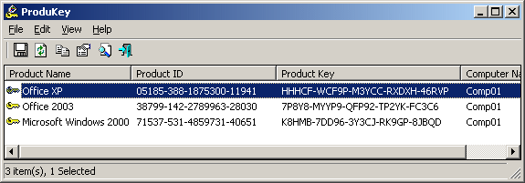
History of DRM
Early Examples
Movies - CSS Encryption
Video Games & Software - CD Keys, Wheel Keys, Manual Search, puzzles
Physical Locks - Lenses & Dongles
Dummy Files, oversized CDs & DVDs
License Agreements

Slide 5
DRM Today
DRM has evolved to become more invasive
Content has shifted from owning to licensing
You no longer own what you buy, you have a temporary license to it
License can be revoked at anytime
Extensive checks
Always Online
Account Based
Limited activation
Valve, Microsoft, Adobe
Account Based
Concurrent checking
Licence revocation

Slide 6
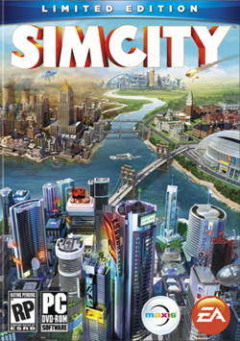
Future of DRM
Separation of Online from Real life
DRM is no longer about the product but about the individual purchasing it
Tracking, monitoring
Invasive DRM
Potentially government backed
Elements of this already exist
UN and other governmental bodies

Slide 7
Future of DRM #2
DRM inhibits customers, and has a tendency to turn honest customers to dishonest.
DRM inhibits growth and technological improvements.
Some companies that have no drm or are dropping drm: GoG, Itunes, LuLu
Witcher 2 sold 1 million copies but had 4 million pirated. CD Projekt saw this as a success.

Slide 8
Final Remarks
DRM has existed since the beginning of the digital era.
Evolved from simple checks to much more pervasive methods
There is demand to have DRM free content, but also demand to protect the created content
Consumer vs. producer or (copyright holder)
It probably will not go away, but we can mitigate the invasiveness.

Slide 9
References
United States Patent 6,330,670 B1
United States Patent 8,082,486 B1
Subramanya, S.R.; Yi, B.K.; , "Digital rights management," Potentials, IEEE , vol.25, no.2, pp. 31- 34, March-April 2006 doi: 10.1109/MP.2006.1649008
Drm. (n.d.). Retrieved from https://www.eff.org/issues/drm

Slide 10
Past, Present &
Future of DRM
Adrian Kostic
Ron White

