Slide 1
Technical Issues of Wireless Power Transmission
By: Jonathan Baliwag
James Negron Rodriguez
Group 19

Slide 2
Table of Contents
Introduction and Background
Wired Power Transmission
Wireless Power Transmission
Current Uses
New Methods
Technical Issues
Conclusion
References

Slide 3
Introduction and Background
What is Wireless Power Transmission?
Nicola Tesla first proposed wireless power in the late 1800s and early 1900s
Didn't immediately take off and wired power has become the main method of power transmission

Slide 4
Wired Power Transmission
An electrical grid is an interconnected network for delivering electricity from suppliers to consumers
Consists of:
Generating stations
High-voltage transmission lines
Demand Centers
Distribution Lines
Customers

Slide 5
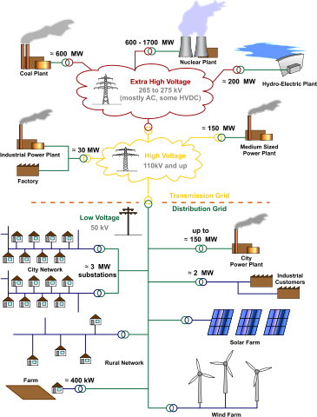

Slide 6
Wireless Power Transmission
Electromagnetic Induction
New methods for long range wireless power transmission
Electromagnetic Radiation
Electrical Conduction

Slide 7
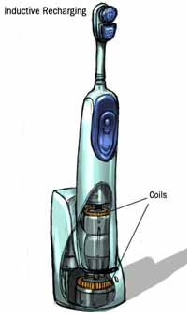
Inductive Coupling

Slide 8
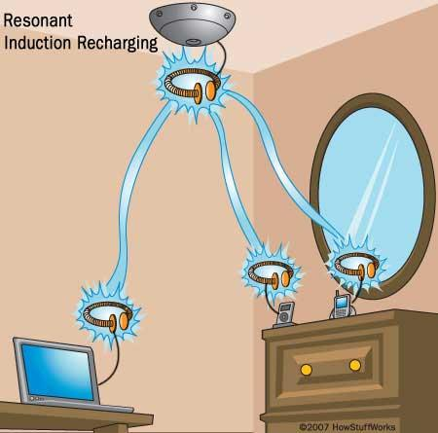
Resonant Induction

Slide 9
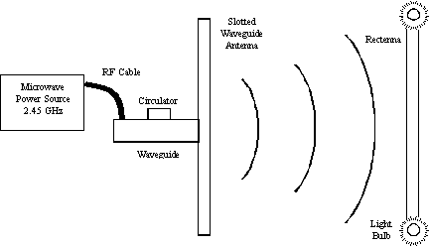
Electromagnetic Radiation - Microwave Method

Slide 10
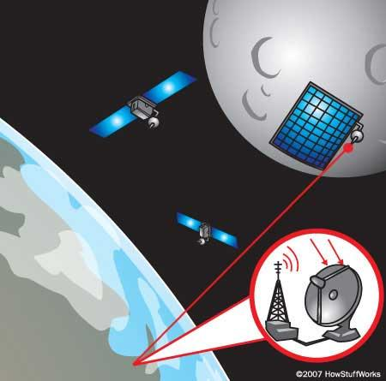
Electromagnetic Radiation - Laser Method

Slide 11
Technical Issues
Conversion efficiency for laser method
Direct line of sight needed for laser and microwave methods
Atmospheric interference
How to meter wireless consumption

Slide 12
Conclusion
Although the idea of wireless power transmission is not a new idea, it was not till today's technology that it could be implemented.
There are several ways to achieve the goal of wireless power and they are gradually improving the technologies capabilities.

Slide 13
References
Ferguson, Will. "Wireless Power May Cut the Cord for Plug-In Devices, Including Cars." National Geographic. National Geographic Society, 28 Dec. 2012. 08 Feb. 2013.
Hadley, Franklin. "Goodbye Wires!" MIT Tech Talk 13 June 2007. MIT's News Office. 08 Feb. 2013.
Wilson, Tracy V.. "How Wireless Power Works" 12 January 2007. HowStuffWorks.com. <http://electronics.howstuffworks.com/everyday-tech/wireless-power.htm> 08 February 2013.

Slide 14
Technical Issues of Wireless Power Transmission
By: Jonathan Baliwag
James Negron Rodriguez
Group 19

