Slide 1
Technical Issues
Group 18
Ross Arena
Bertram Powell

Slide 2
Table of Contents
Introduction
Integrity
  Merging / Branching
  HEAD
  Integrity Tools
Access Control
  User Permissions
Revision Control
  File Sharing
  Lock-Modify-Unlock
  Copy-Modify-Merge
Conclusion
References

Slide 3
Introduction
A Version Control System (VCS) is an application, desktop or web-based system that lets developers keep their source code and binary and resource files stored away along with information about different versions.
Version Control Systems need to properly track revisions of files over time. Proper maintenance will ensure the integrity of files remain intact and access control permissions remain consistent.
However, technical issues will arise and when they do they must be handled with expertise

Slide 4
Integrity - Merge/Branch
Merging and branching. One of the most important feature sets in a good VCS is the ability to create branches and merge files.
Merging failures
  One or more conflicts during merge
Old branches
  Branches with outdated files and/or files that were deleted from the trunk
  Can be fixed by updating current branch or deleting old branches and making new branches.
Corruption to files
  Incorrect file extensions or files incorrectly overwritten by user or the system

Slide 5
Integrity - HEAD
Maintaining the HEAD of the repostority
Corruption to the HEAD of a repository can ruin the repository and prevent backups or rollbacks
  Revision history can become completely lost or corrupted
  Any modification to files after corruption of the HEAD will be saved to a permanently bad HEAD
Issues arise in trying to fix the bad HEAD
  Usually very difficult and time consuming to fix
  Files and/or history may become lost
  Sometimes better to just cut your losses and use an older copy of the repostority when the HEAD was still good

Slide 6
Integrity Tools
Integrity tools like SiberSafe CMS and Perforce perform licensing management and manage file integrity
  SiberSafe
    Supports any JDBC-compliant database (Oracle, SQL, etc.)
    Enables single source publishing to multiple outputs (PDF, HTML, etc.)
    Conflict-free multi-author collaboration
  Perforce
    Huge version control company that manages many different types files

Slide 7
Access Control
Access Control determines who has access to which files and who can edit them. It is the ability to define not only who can update files but also who can label, promote or demote files throughout the development life cycle
Many companies use centralized repository with access control to make it easy to use commits but hard to do anything else
Decentralized version control tools do not provide a viable way to control access to specific files or directories within the repository tree.
Some Distribution of Version control don't even use Access Control. Ex. CVS and Git

Slide 8
User Permissions
Maintaining and setting user permissions correctly ensures that files do not become accidentally modified or overwritten during development
DVCS's such as Git, Hg, Bzr, etc. do not let you set read permissions finer than at the whole-repository level.
  This can be solved by using SVN which allows for you to set fine/grain permissions.
  Splitting the project into separate (mostly self-contained) modules and granting or denying access to each module as a whole.

Slide 9
File Sharing Problem
All version control systems have to solve the same fundamental problem:
How will the system allow users to share information but prevent them from accidentally stepping on each other's feet?

Slide 10
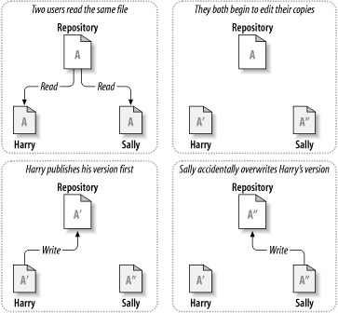
File Sharing Solution

Slide 11
Lock-Modify-Unlock Problem
Many version control systems use a lock-modify-unlock model to address the problem of many authors collaborating each other's work.
The problem with the lock-modify-unlock model is that it is a bit restrictive and often becomes a roadblock for user
  Locking may cause administrative problems.
  Locking may cause unnecessary serialization.
  Locking may create a false sense of security.

Slide 12
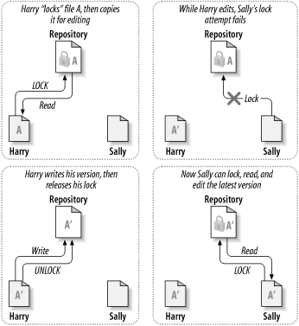
Lock-Modify-Unlock Solution

Slide 13
Copy-Modify-Merge Problem
Subversion, CVS, and many other version control systems use a copy-modify-merge model as an alternative to locking.
In the following model, each user's client contacts the project repository and creates a personal working copy.
  Users then work simultaneously and independently, modifying their private copies.
  Finally, the private copies are merged together into a new, final version.
The version control system often assists with the merging, but ultimately, a human being is responsible for making it happen correctly.

Slide 14
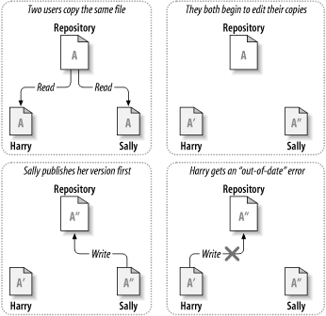
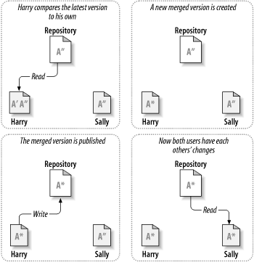
Copy-Modify-Merge Solution

Slide 15
Conclusion
Proper maintenance will ensure that users have proper access to files and the integrity of files remains consistent
Although Version Control Systems do a good job at maintaining file integrity and access control, the users must be aware of any issues that might crop up during development and be able to fix them accordingly.

Slide 16
References
Nagel, W. (2006). Subversion version control: Using the subversion version control system in development projects. (1st ed., pg. 346)
Loeliger, J. (2009). Version control with git: Powerful tools and techniques for collaborative software development. (pp. 45-85).
Rochkind, Marc J. (1975, December). The Source Code Control System. (pp. 365-370).
Grune, Dick. (1986). Concurrent Versions System, A Method for Independent Cooperation. (pg. 5)

Slide 17
Technical Issues
Group 18
Ross Arena
Bertram Powell

