Slide 1
Eye Tracking:
Technical Issues
Amber Luu
Paul Lewis
Team 17

Slide 2
Overview
Brief reintroduction
Eye tracking techniques
Current limitations
The human factor
What's being done
Final remarks

Slide 3
Eye Tracking
The process of measuring the point of gaze.
Allows for a better understanding of how people gather information.
These discoveries are already being utilized in medical research, training simulators, and computer usability.

Slide 4
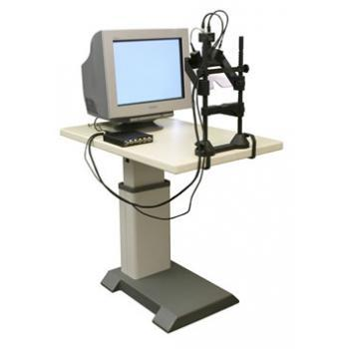
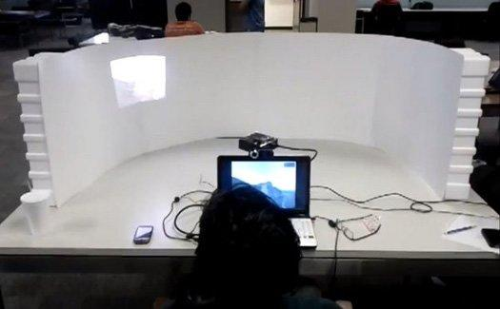
Current Techniques
Most widely used method is video-based.
A camera focuses on one or both eyes and records movement.
Must first be calibrated.

Slide 5
Limiting Factors
Accuracy is impacted by:
How much the subject is moving
The lighting in a room
Varying sample rates:
50/60Hz is common in most video-based trackers
1000/1250Hz is needed for detailed captures of rapid movement

Slide 6
Limiting Factors cont.
The eye is almost never completely still
Difficult to capture tiny and chaotic movement associated with fixations.
Eye tracking is difficult to do outside of the lab.

Slide 7
The Cost
Accuracy has a direct relationship with cost.
Simple systems can use cheap webcams.
Sensitive systems can cost tens of thousands of dollars.
Advances in computer and video technology have led to the development of low cost systems.

Slide 8
Interpreting Results
Results can be greatly impacted by misaligned or badly calibrated systems.
Interpretation of results still requires some level of expertise.

Slide 9
The Human Factor
Visual attention is generally ahead of the eye.
100 to 250ms
Cannot infer specific processes directly from a fixation.
A subject might not be looking where their attention is.
Gender can affect scanpath.

Slide 10
Eye Movement Problems
Oculomotor Dysfunction (OMD)
Both eyes do not move smoothly, accurately, or quickly.
Inability to fixate on a single target.

Slide 11
Final Remarks
Most current systems are video based.
Eye tracking analysis can be costly.
Accuracy is affected and limited by:
Quality of technology
Lighting
Biological impact

Slide 12
References
Untreated Oculomotor Dysfunction. Tassinari, J. T. // Optometry & Vision Development;2007, Vol. 38 Issue 3, p121
Duchowski, Andrew. 2007. Eye Tracking Methodology: Theory and Practice. Springer.
Just, M. A., & Carpenter, P. A. (1976). Eye fixations and cognitive processes. Cognitive Psychology, 8, 441-480.

Slide 13
Eye Tracking:
Technical Issues
Amber Luu
Paul Lewis
Team 17

