Slide 1
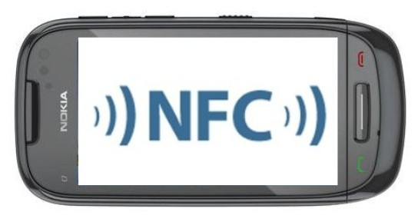
Technical Issues Regarding Near Field Communication
Group 16 Tyler Swofford Matthew Kotan

Slide 2
Outline
How NFC works
Device Examples
Threats
Security
Cryptography
NFC Specific Key Agreement
Hardware implementation
Conclusion
References

Slide 3
How NFC Works
NFC devices use conductors to generate magnetic fields
These fields can then be used to transport data
NFC differs from many radio based technologies by having a very short range
NFC devices can be either active or passive
Active Devices have their own power sources
Passive devices have no power source and rely on “leaching” power from active devices interacting with them

Slide 4
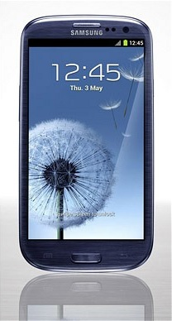
Active and Passive Device Examples
An example of a common active device would be a NFC enabled cell phone
Examples of passive devices would smart posters, and Samsung TecTiles

Slide 5
Threats
Eavesdropping
Short range of NFC typically prevents this attack
Data Corruption
Devices detect can detect and prevent data corruption
Man-in-the-middle Attack
This attack is difficult as the attacker has to block the originators RF field and create a new RF field for the recipient
Theft
Biometric sensors in new smart phones, and password protection

Slide 6
Security - Cryptography
Authentication
Verifying the correct user of the device
Cryptography
Symmetric
Asymmetric
Secure Channel
Best approach for securing NFC technology

Slide 7
Security - NFC Specific Key Agreement
Does not use asymmetric cryptography
Based on Amplitude Shift Keying (ASK)
Synchronizes both devices based on timing of random bits and also on the amplitude of the RF signal
While sending data, device listens to RF field
When devices send different bits, attacker can’t differentiate between sender and receiver
Clusters the transfer of data with random bits and erroneous data

Slide 8
Hardware Implementation
Majority of businesses would have to implement NFC reading hardware
Credit Card companies would have to be on board with the hardware implementation
Hardware would be costly
With hardware being costly, why would you implement this new technology over one that currently works and is paid for

Slide 9
Conclusion
There are multiple threats facing NFC in its current form
There are some proposed solutions to eliminate these threats
Secure Channel
NFC Specific Key Agreement
Widespread adoption could be costly and hinder NFC growth

Slide 10
References
Ok, K., Coskun, V., Aydin, M., & Ozdenizci, B. (2010, November). Current benefits and Future Directions of NFC Services. 2010 International Conference on Education and Management Technology, Cairo, Egypt, 1-5.
Rieback, M., Crispo, B. & Tanenbaum, A. (2006, January). The Evolution of RFID Security. Pervasive Computing, 62-69.
Ok, K., Coskun, V., & Ozdenizci, B. (2012). Near Field Communication From Theory to Practice. (pp. 22-56). West Sussex, United Kingdom: John Wiley and Sons.
W. Diffie, “The First Ten Years of Public-Key Cryptography,” Proc. IEEE, vol. 76, no. 5, 1988, pp. 560-577.

Slide 11
Technical Issues Regarding Near Field Communication
Group 16 Tyler Swofford Matthew Kotan

