Slide 1
3D Printing
Jamir Dirksen
Kyle Strink
Group 15
COP 4910

Slide 2
Outline
3D Printer Adoption
Limitations
Printing Speed
3D Printing Stores
MakerBot Replicator
3D System Cube X
3D Organ Printing
Conclusion
Sources

Slide 3
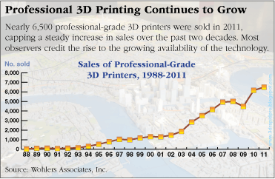
3D Printer Adoption
Revenues from 3D printed products exceeded $17 billion in 2011
Personal 3D Printer sales increased from 5000 in 2010 to 23000 in 2011
Professional 3D Printer sales increased 5 fold the last 10 years

Slide 4
Limitations
Plastic and other materials do not withstand years of use
AD machines cost up to millions
Requires highly skilled operators

Slide 5
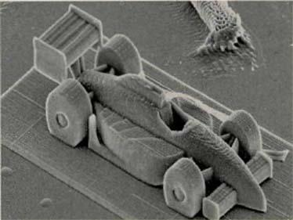
Printing Speed
Traditional SLA methods speeds are measured in millimeters per second.
Vienna University of Technology uses two-photon lithography to print with speeds up to 5 meters per second.
285 micrometer Formula One style racing car.

Slide 6
3D Printing Stores
No need for technical training
Better precision
Wider range of materials
Staples is providing 3D printing services in Netherlands and Belgium, with plans to extend to U.S.

Slide 7
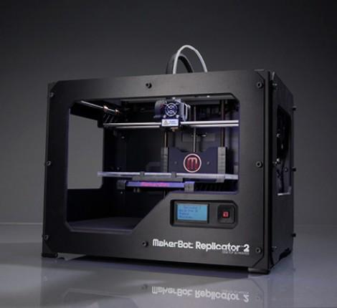
MakerBot Replicator 2
Print Technology: Fused Filament Fabrication
Dimensions:
11.2 L x 6.0 W x 6.1 H in
Print Quality:
100 microns [0.0039 in]
Price: $2199.00
Six colors available, each cartridge
costs $48.00

Slide 8
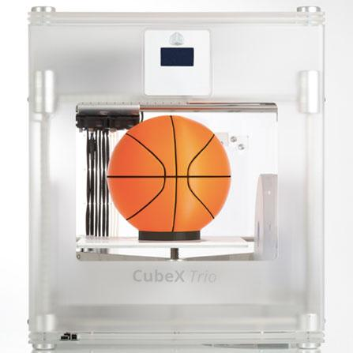
3D Systems CubeX
Print Technology: Thermoplastic Extrusion
Dimensions:
20.25 L x 20.25 H x 23.5 W in
Print Quality:
100 microns [0.0039 in]
pRI
17 Color ABS cartridges or
18 PLA Color cartridges available

Slide 9
3D Organ Printing Today
Can print blood vessel system made of crystallized sugar using a modified RepRap printer
  RepRap is an open-source kit printer capable of printing plastic objects and self replication.
  Liver cells are mixed with hardened sugar and printed
  Tissue-like gel that contains liver cells is poured around the sugar structure
  The sugar is then dissolved in water leaving vascular network, complete with cells
  Current technology has allowed researchers to print bladders, and a golf-ball sized functional heart.

Slide 10
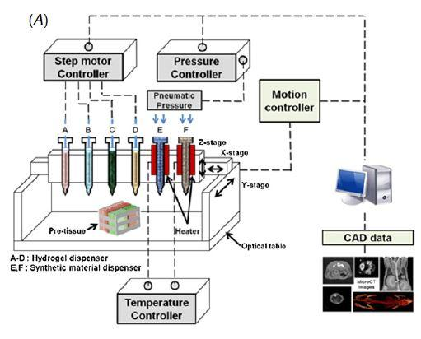
3D Organ Printing Future
Multi-head tissue\organ buligin system (MtoBS) is being developed
  6 dispensing heads
    2 heads are connected to a heating system to melt thermoplastic biomaterials
      molten biomaterials are extruded by pneumatic pressure then rapidly cooled.
    Remaining 4 heads
used to dispense
gel-stage hydrogel that
encapsulates cells

Slide 11
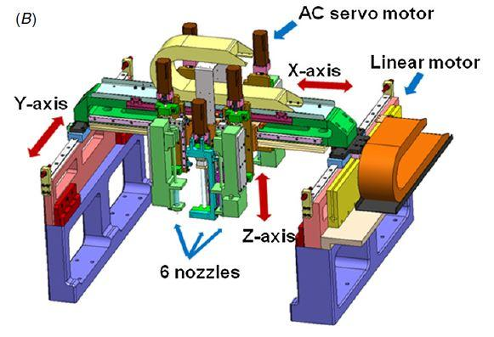
3D Organ Printing Future
  Hydrogel volume is precisely controlled as low at 1 μL
  x & y axes are operated at a max velocity of 500mm with accuracy of
  < ±5.0 μm and repeatability of <±1.0 μm
  z axis used to govern the motion of 6 dispensing heads with an accuracy of <±5.0 μm and repeatability of <±1 μm

Slide 12
Conclusion
3D Printing sales are increasing at a high rate
3D Printing is still a growing technology with limitations
Printing stores are beginning to open allowing for cheaper and more accessible 3D printing
There are many available 3D printers such as MakeBot Replicator 2 & 3D Systems Cube X
3D organ printing is a growing technology that is still developing methods that allow organs to function correctly as well as fabricate blood-vessel-like channels to correctly allow blood and nutrient flow.

Slide 13
Sources
Nano Precision. (2012). Mechanical Engineering, 134(5), 10.
Katel, P. (2012). THE ISSUES. CQ Researcher, 22(43), 1039-1046.
Katel, P. (2012). 3D Printing Pushed Medical Boundaries. CQ Researcher, 22(43), 1042
Berthiaume, F., Morgan, J. (2010). Methods in Bioengineering: 3D Tissue Engineering. Artech House.
3-D Printing Tissues and Organs. (2013). Townsend Letter, (354), 24.

Slide 14
3D Printing
Jamir Dirksen
Kyle Strink
Group 15
COP 4910

