Slide 1
Data Storage Technology Technical Issues
Team 12
Travis Heminger
Nikolay Abdrakhmanov

Slide 2
Presentation Overview
Hard Drive Disk Explanation and Issues – Slides 3-5
Flash Memory Overview – Slides 6-8
NAND Flash Memory and Solid State Drives – Slides 9 -11
Research Technology Issues – Slide 12
Conclusion – Slide 13
References – Slide 14

Slide 3
Hard Drive Disk
Most Commonly Used Storage Device Today
Cost Per Megabyte Greatly Decreased Over the Past Few Decades
Robust and Effective Storage Systems Already in Place that rely on HDDs

Slide 4
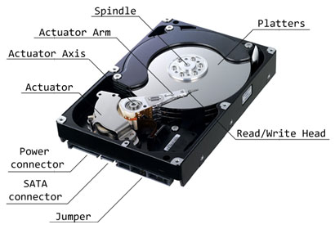
Hard Drive Disk

Slide 5
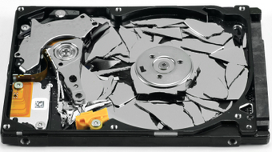
Hard Drive Disk Problems
Mechanical Moving Parts that can fail
Power Consumption Increases Greatly along side the Demand for Data

Slide 6
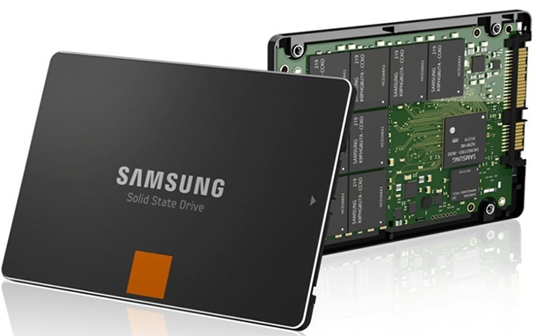
Flash Memory
Non-volatile Memory
Floating Gate Transistor Cell
Implemented in SSD’s,
USB drives, memory cards,
phones, other electronics

Slide 7
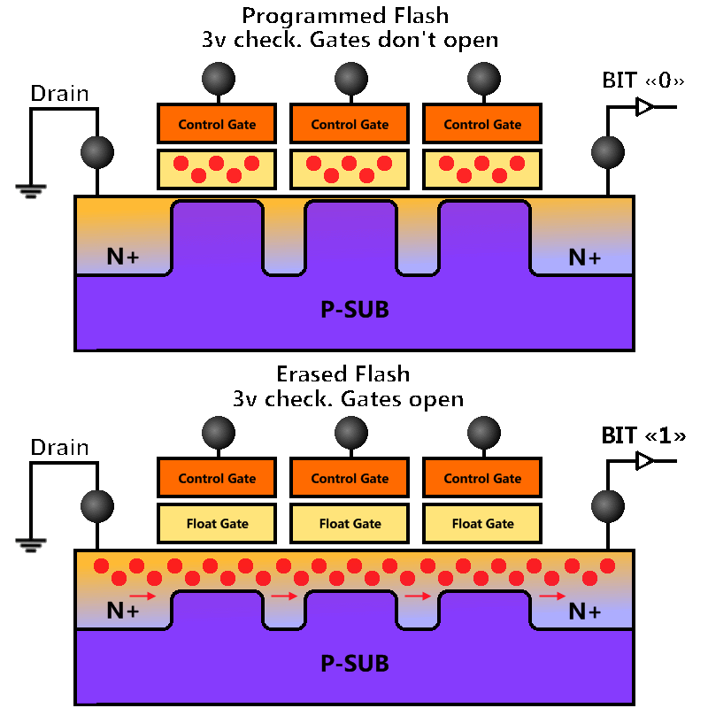
Flash Memory
Floating Gate
Transistor Memory Cell
Diagram

Slide 8
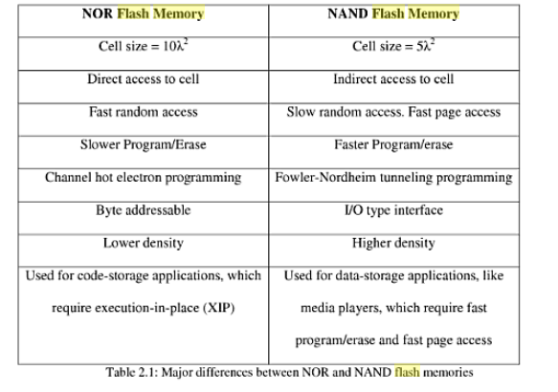
Flash Memory
Uses Either NAND, NOR Logic Gates

Slide 9
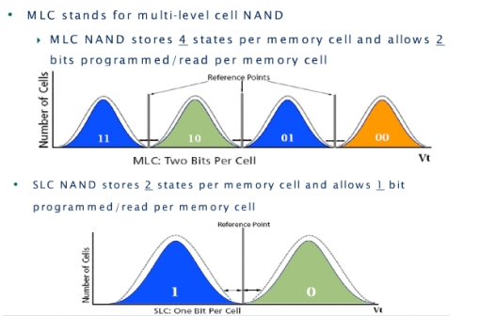
NAND Flash Memory
Used In Solid State Drives
Two Different Implementations Currently in the Market

Slide 10
NAND Flash Memory

Slide 11
NAND Flash Memory Challenges
Adjacent Memory Cell Interference
Increase Program/Erase Cycles Integrity
Continue to Reduce Cost of MB/$

Slide 12
Research Storage Technology
DNA Data Storage Research in Infancy
Cost of Synthesized DNA is Expensive, and will take time to make cost efficient
Storage Capability is 2.2 petabytes in one gram

Slide 13
Conclusion
Scalability of Storing Data is Primary Concern
of Emerging Storage Technology
Reducing Power Consumption
Keeping Up With the Demand for Data Storage

Slide 14
References
Abdullah, A. M. (2007). Hard disk drive: Mechatronics and control. Boca Raton: CRC Group. pp67-103.
Brewer, J. (2011). Nonvolatile memory technologies with emphasis on flash: A comprehensive guide to understanding and using flash memory devices.
Wiley-IEEE Press.
Raghunathan, S. S. ( 2011). Scaled planar floating-gate nand flash memory technology: Challenges and novel solutions. (Doctoral dissertation).
Micheloni, R. (2010). Inside nand flash memories. (1st ed.). New York: Springer. pp34-44.

Slide 15
Data Storage Technology Technical Issues
Team 12
Travis Heminger
Nikolay Abdrakhmanov

