Slide 1
The ZFS File System
Technical Issues
Brian St. Amour
Peter Nguyen
Team 11

Slide 2
Table of Contents
Overview of ZFS
  History
  Pooled Storage
  Redundancy
  Copy-on-Write
  Checksums and self-healing
  Hybrid Storage
Highlight of ZFS' Limitations
  vdevs cannot be shrunk/expanded
  vdevs cannot be removed from a zpool
  zpool versions are not backwards compatible
Conclusion
References

Slide 3
Overview of ZFS
Developed by Sun Microsystems
All-purpose File System
  Pooled Storage
  Large Capacity
  Redundancy
  256-bit Checksums and Self-Healing
  Hybrid Storage using SSDs
  Easy to Administer
Two Separate ZFS Groups
  Oracle (closed proprietary)
  Open ZFS (open source community)

Slide 4
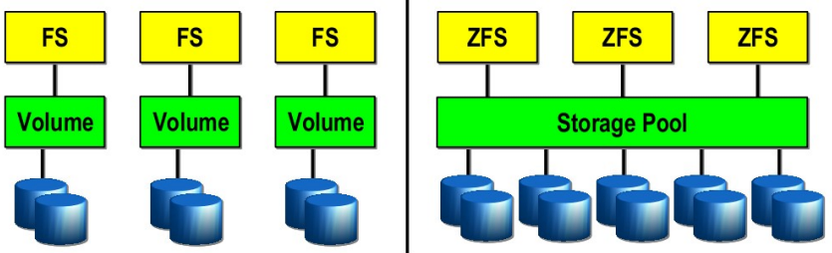
Volume Storage vs Pooled Storage

Slide 5
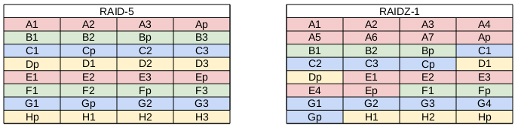
Redundancy - RAID-5 vs RAID-Z

Slide 6
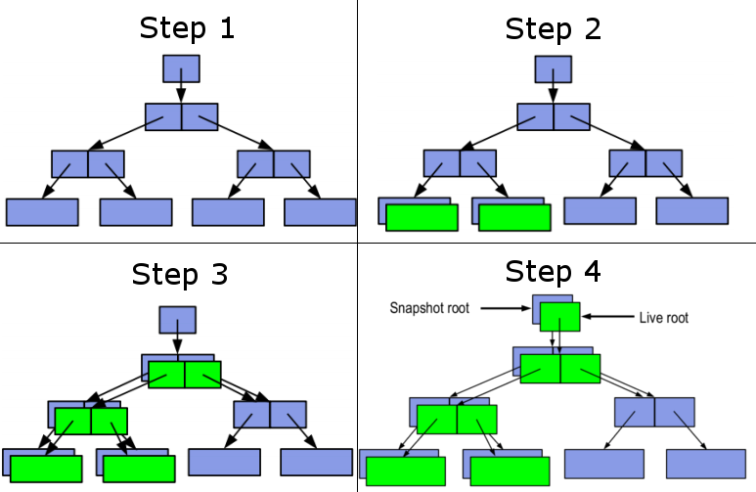
Copy-on-Write

Slide 7
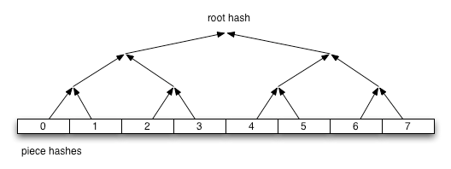
Checksums and Self-Healing
256-bit checksum
Self-validating Merkle tree

Slide 8
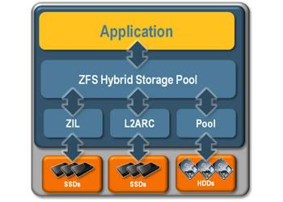
Hybrid Storage using SSDs

Slide 9

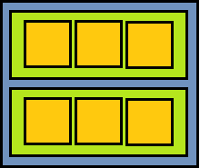

vdevs Cannot be Shrunk/Expanded
What is a vdev?
A single disk, a mirror, a RAID-Z group, or a special type of disk (cache, spare, and etc).
What is RAID-Z?
Software solution to the RAID-5 Write Hole.
Expand RAID-Z? No
Expand Storage? Yes
Cons:
More expensive
zpool with RAID-Z
+
zpool with 2x RAID-Z vdevs

Slide 10


Cannot Remove vdevs from a zpool
What is a zpool?
A single vdev or a set of vdevs.
zpool1 with RAID-1
zpool2 with RAID-Z
zpool with 2x RAID-1

Slide 11
Cannot Remove vdevs from a zpool
What is a zpool?
A single vdev or a set of vdevs.
The solution:
1. Backup zpool
2. Delete zpool
3. Create two new zpools
4. Configure RAID-1 for zpool1
5. Configure RAID-Z for zpool2
6. Have fun
zpool1 with RAID-1
zpool2 with RAID-Z
zpool with 2x RAID-1

Slide 12

zpool Versions not Backwards Compatible
What are zpool versions?
They are used to distinguish which features are offered in a zpool. IE: zpool v30 includes ZFS encryption.
No
Yes
Oracle ZFS Appliance 1
zpool v34
Oracle ZFS Appliance 2
zpool v28
Open ZFS uses Feature Flags to select enable/disable features.

Slide 13
zpool Versions not Backwards Compatible
zpool versions are a one way street
  Cannot downgrade a current zpool
    Workarounds:
      Create a new pool and set that to an older zpool version

Slide 14
Conclusion
While ZFS has many benefits, it still has its limitations:
  vdevs cannot be shrunk/expanded
  vdevs cannot be removed once they're added to a zpool
  zpool versions are not backwards compatible
We hope that this presentation did not steer you away from ZFS. We look forward to talking more about ZFS in our next presentation.

Slide 15
References
Ahren, M. (Presenter). (2012, October 2). ZFS State of the Union [Video
recording]. San Francisco, California, ZFSDAY Conference, 2012.
Hazra, K. S., Sanyal, G., Hamid, T. (2009). A Study of the Zettabyte File
System (ZFS) [Proposal to OpenSolaris Undergraduate Student Research Grant].
Pugh, C., Henderson, P., Silber, K., Carroll, T., & Ying, K. (2009, June 1-5).
Utilizing ZFS for the Storage of Acquired Data. Paper presented at Fusion Engineering, 2009. 23rd IEEE/NPSS Symposium, San Diego, CA, pp. 1-4. doi: 10.1109/FUSION.2009.5226462
Solaris ZFS Administration Guide. (2010). Santa Clara, CA: Sun
Microsystems, Inc.
Peterson, Z. (2002). Data placement for copy-on-write using virtual
contiguity. (p. 4). (Unpublished master's thesis, University of California).
Oracle Corporation. (2010). ZFS pooled storage. Solaris ZFS
Administration Guide, (p 1).

Slide 16
The ZFS File System
Technical Issues
Brian St. Amour
Peter Nguyen
Team 11

