Slide 1
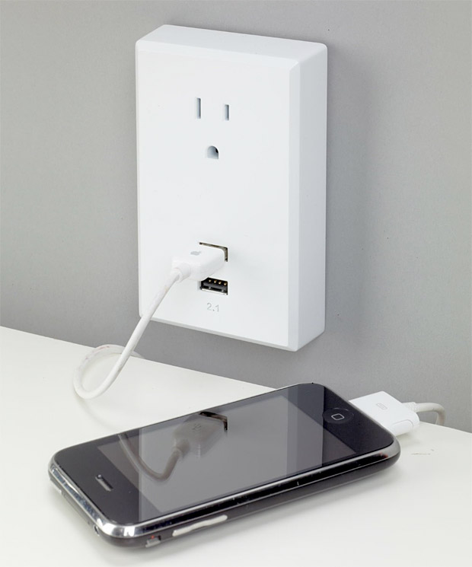
USB 3.0 (Universal Serial Bus)
Cory Koby
Fred Smith Jr.

Slide 2
Table of Contents
Review of USB 1.0/1.1 – 3.0
Developmental Intentions
Technical Benefits and Capabilities
Charging
Issues
Conclusion
References

Slide 3
Why USB ?
Developed due to problems and complications caused by having so many connections for peripheral devices on computer systems.
Too many different types of ports with limited uses
Serial, Parallel, PS/2, Etc
USB solved this limitation by limiting the number of different types of ports needed to connect to a computer. USB is specifically designed to allow easy connection of a wide variety of devices. It is intended to be user friendly.

Slide 4
USB 3.0: Superspeed
Certified under the name ‘SuperSpeed’
New Theoretical Max = 5 Gbits/s
Upgraded from Half-Duplex (1.0/1.1/2.0) to Full-Duplex communication with Peripherals
No longer uses Polling, technology upgraded to packet-routing.
Lower Power Consumption
Reduced by 85%

Slide 5
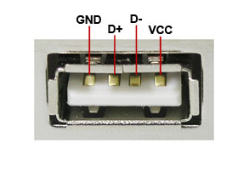
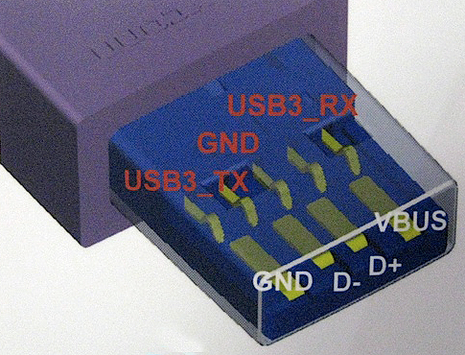
The New Format
2.0 3.0

Slide 6
Potential Intent for 3.0
Offers 900mA of Power
(4.5 Watts constant power)
The possibility of a universal charger for various platforms
Laptops
Printers
Scanners
Cellphones

Slide 7
USB 3.0 Technical Benefits

Slide 8
USB 3.0 Power Ability
USB Power Delivery is the next big step in the USB evolution to provide high bandwidth data and intelligent power over a simple, single, ubiquitous cable.

Slide 9
USB 3.0 Consortium
Intel, HP, Microsoft an ST-Erricson
Together have announced the new USB Power Delivery specification which includes the ability to transfer up to 100 Watts (W) through the familiar socket.

Slide 10
Brad Saunders: USB 3.0 Promoter Group chairman
“USB Power Delivery enables a path to greatly reduce electronic waste by eliminating proprietary, platform-specific chargers.”
“We envision a significant move toward universal charging based on this specification, most notably for charging notebook PCs using standardized USB power bricks or when connected to USB hubs and desktop displays that integrate USB Power Delivery capabilities.”

Slide 11
The new standard will enable convenient charging of laptops and other power-hungry devices.
The new USB 3.0 cables will help eliminate device-specific chargers, and result in less e-waste.

Slide 12
USB 3.0 Charging Specification
There are currently three types of modes for charging.
Host charger: A host charger is a USB 2.0 host that provides up to 500 mA to a downstream port and implements charger detection. A Hi-Speed device may draw only up to 900 mA from the host charger.

Slide 13
USB 3.0 Charging Specification (Continued)
Hub charger: A hub charger is a USB 2.0 hub that provides up to 500 mA to a downstream port and supports charger detection. The charging functionality is very similar to a host charger.
Dedicated charger: A dedicated charger provides power over the USB interface but does not enumerate the device. The charging current is limited to 1.5 A.

Slide 14
Old way of charging

Slide 15
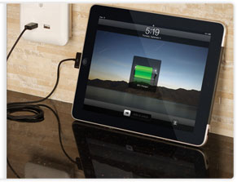
New way of charging USB 3.0 Power sockets

Slide 16
Problems and Issues
Radio frequency Interference
Bluetooth
2.4GHz wireless band devices
Data transfer at 2.0 speeds (480mbps)
Driver compatibility
Cable types

Slide 17
Conclusion
Charging over USB has inherent benefits.
Lower manufacturing cost
Saves the environment
Customers will not have to carry around separate cables for every device.
Saves you money

Slide 18
References
Jia-na Lou; Xiao-Bo Wu; Meng-lian Zhao, "Switch-mode multi-power-supply Li-ion battery charger with power-path management," Solid-State and Integrated Circuit Technology (ICSICT), 2010 10th IEEE International Conference on , vol., no., pp.527,529, 1-4 Nov. 2010 doi: 10.1109/ICSICT.2010.5667349
Lan Dai; Ke-Qing Ning; Yan-Feng Jiang, "Design of a multi-mode and high-stability linear charger for Lithium-ion batteries," Solid-State and Integrated Circuit Technology (ICSICT), 2010 10th IEEE International Conference on , vol., no., pp.345,347, 1-4 Nov. 2010 doi: 10.1109/ICSICT.2010.5667724
White Paper. “USB 3.0* Radio Frequency Interference Impact on 2.4 GHz Wireless Devices” Intel, N.D. pp1-14. Nov 2011.

Slide 19
USB 3.0 (Universal Serial Bus)
Cory Koby
Fred Smith Jr.

