Slide 1
Virtualization: Technical Issues
Matthew Leonard
Troy Matthews
Group #7

Slide 2
Table of Contents
Virtualization Diagram
Benefits
Full-Virtualization
Para-Virtualization
OS-Virtualization
Hardware
Bandwidth
Conclusion
References

Slide 3
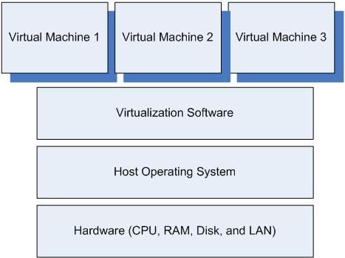
Virtualization Diagram

Slide 4
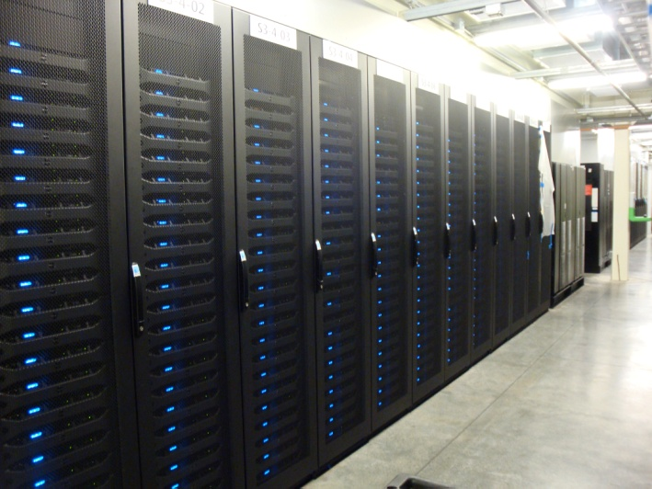
Benefits
Conserves space by consolidation
Allows cost efficient way to practice redundancy
Easier to test new software
More fault tolerance for Legacy Systems

Slide 5
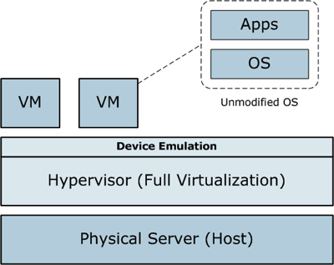
Full-Virtualization
Uses software called hypervisor to interact directly with the hardware
Keeps each virtual server unaware and independent of other virtual servers
Each server has its own OS
The hypervisor delegates
resources to each server as
needed

Slide 6
Para-Virtualization
All virtual servers are aware of the other virtual servers
Each server knows the demands that the other servers will need
The whole system works together sharing and using resources of the hardware
Better for systems using different types of OS

Slide 7
OS-Virtualization
Does not use a hypervisor at all
The virtualization capability is part of the host OS
The host OS performs all the functions of a hypervisor
Servers are independent of one another
Each guest server must run the same OS

Slide 8
Technical Issues - Hardware
Single point of failure
Can take down several virtual servers
Hardware may not support virtualization
Enough RAM?
Enough CPU cores?

Slide 9
Technical Issues - Bandwidth
In a physical server environment, each application runs on a separate box with a dedicated network interface card (NIC)
In a virtual server environment, multiple workloads share a single NIC, and possibly one router or switch
Limited bandwidth availability
Bottleneck effect

Slide 10
Conclusion
Benefits
Conserves space
Redundant
Easier testing
More fault tolerance
Different types
Full-virtualization
Para-virtualization
OS-virtualization
Hardware requirements
Bandwidth concerns

Slide 11
References
Garcia, M. R. (2007, March 8). Virtualization's downsides.Computerworld, Retrieved from http://www.computerworld.com/s/article/9012 599/Virtualization_s_downsides
Golden, B. (2007). Virtualization for dummies. (1st ed.). New York: Wiley Publishing.
Posey, B. (2010, February 5). TechRepublic. Retrieved from http://www.techrepublic.com/blog/10things/10 -issues-to-consider-during-virtualization- planning/1345

Slide 12
Virtualization: Technical Issues
Matthew Leonard
Troy Matthews
Group #7

