Slide 1
Internet Security Technical Issues
Khristopher Powell
Maurice Wahba

Slide 2
Overview
Because of many different holes in the functioning of internet protocols and languages, it leaves users open to different forms of attack
The Internet is (unfortunately) an effective method for remote attacks and makes defense a constant necessity

Slide 3
Outline
  Technical Issues dealing with the prevention of:
  DoS/DDoS Attacks
  Code Injection
  Phishing
Conclusion
References

Slide 4
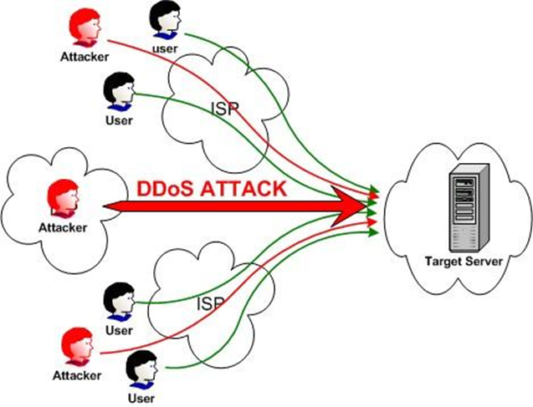
Denial of service
Method of attack - IP Spoofing
Randomize 32bit source address
  Conceals attack source
  Block legitimate access to target
  Attack spoofed address
Targets
Network Bandwidth
Server Processing Power
Server Memory

Slide 5
Denial of service
Types of attack include:
ICMP Attack - Source Address
UDP Attack - Network Bandwidth
TCP Attack - Network Resources
SYN Flood - Initial Connection
Current mitigation methods
Router Based
Host Based

Slide 6
Denial of service
Proposed mitigation methods
Hop Count Filtering (article)
  Use packet data to filter legitimate from spoof
  Use source ip to determine necessary hops
Client Puzzle
  Trusted Bastion puzzle maker
  Communication only on a few channels
  Tokens

Slide 7

Code injection
Binary Code Injection
Inject data in memory
Source Code Injection
Exploits languages that take user input
SELECT password FROM users WHERE email ='<user_input>'

Slide 8
Code injection
Mitigation methods:
Static
Inspection of code without executing program
  Secure Coding Practices
  Lexical Analysis
  Sanitization of Input
Dynamic
Runtime Tainting
Instruction Set Randomization

Slide 9
Phishing
Method of attack: Email, incorrectly typed domain
Email: Format tries to look like an official email, has misleading hyperlinks
Mistyped domain name: Website can either be completely different from intended destination or look almost identical to it

Slide 10
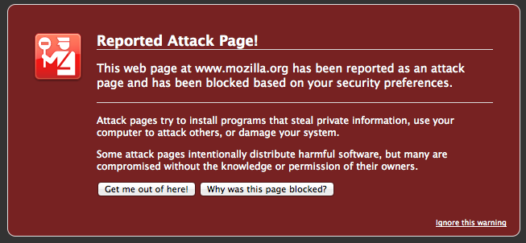
phishing
Mitigation Methods
User
Check URLs on hover, link text may be misleading
Browser
Firefox, Chrome, IE, Safari have phishing protection
  Consistently updated server-side

Slide 11
Conclusion
DDoS, code injection and phishing have the ability to interrupt Internet access or steal a user's information.
These attacks are often untraceable, so it's not possible to locate the source.
Prevention methods are are getting better at detecting and preventing these exploits.

Slide 12
Kiruthika, First N. "A new approach to defend against DDoS" Computer Science & Telecommunications. Vol. 31 Issue 2 (2011): pp93-101. Print
Mitropoulos, Dimitris; Karakoidas, Vassilios; Louridas, Panagiotis; Spinellis, Louridas. "Countering code injection attacks: a unified approach." Information Management & Computer Security Emerald. Vol. 19 Issue 3 (2011): pp177-194. Print
Gemona, Anastasia; Duncan, Ishbel; Allison, Colin;Miller, Alan. "End to end defence against DDoS Attacks" Proceedings Of The IADIS International Conference On WWW/Internet (2004). pp325-333. Print
James, Lance. Phishing Exposed. n.p.: Syngress, 2005. eBook Collection (EBSCOhost). Web. 13 Feb. 2013.
Forouzan, Behrouz. “Cryptography and Network Security”. 1st ed. McGraw Hill, 2008.

Slide 13
Internet Security Technical Issues
Khristopher Powell
Maurice Wahba

