Slide 1
Ultra High Definition Technical Issues
Ron White
Adrian Kostic
Team 3

Slide 2
Table of Contents
Bandwidth Limitations
Production Issues
Content Production
Summary
References

Slide 3
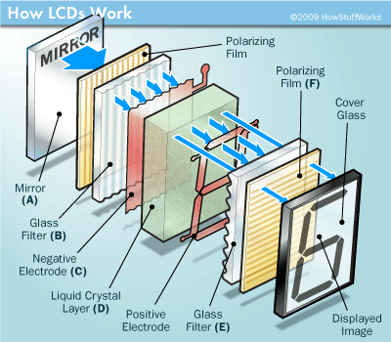
Production Issues
LCDs = Liquid Crystal Display
Built using liquid crystal called nematic liquid crystal pressed between 2 Polarized Glass Panes and 2 electrodes
Every Pixel has 3 transistors, one for each color
At UHD (3840 x 2160) that is 24.9 million transistors!
For building the LCDs it is a balancing act.
The smaller it is, the more densely the transistors and in turn the pixels have to be packed
If to larger, then there are more pixels which have to be put in place to take up the space
There is also the problem with the transmission rates of the crystals
New LCDs are in the works with higher Transmission rates
Sharp IGZO

Slide 4
Production Issues Pt. 2
Monitors will need many new technologies
Higher level medium of transmission
BCM7445
Chip capable of decoding HEVC
New Facilities as well as hardware will need to be created in order to produce new technologies at consumable levels
Also the manpower in order to upkeep and run said facilities and hardware
US will have limited supply of these said panels at the start due to outsourcing constraints

Slide 5
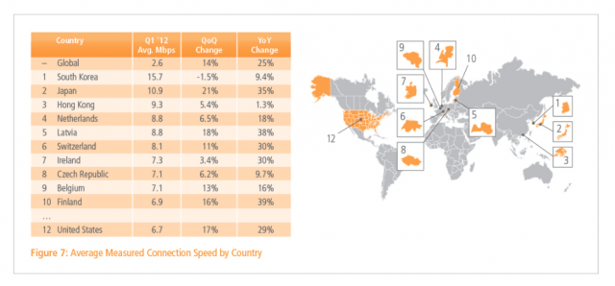
Bandwidth Limitations
Primary research conducted in Japan
Delivering content over fiber optic networks
Over 500Mb/s needed for 4K resolution video (uncompressed)
New methods of video compression needed for our current internet infrastructure
US average internet speed is 6.7Mbps for 2012 (world avg: 2.6):
Upload speed much more lacking, pitiful really.
Internet Price is also a concerning factor

Slide 6
Bandwidth Limitations Pt. 2
Video much more higher bandwidth concern than audio.
Audio is already transmitted efficiently at 7.1 @ lossless quality.
Current compression methods don't deal with higher resolution video
H.265 newest method of compression
Support for 4K and above.
H.264 technically supports 2K-4K resolutions. Compression is more of a concern for the newest method.

Slide 7
Content Production
Analog Limitation
35mm film was the primary means of recording for many years
Advent of DVD and Blu-Ray, conversion from analog to digital
35mm converts to approximately 2K-6K depending on quality
Upscaling current DVD and Blu-ray
Much easier, limitations still exist
Digital Limitations
Limited number of recording hardware both consumer and professional
Red Digital Cinema Camera Company, and other companies have a hanful of hardware that records at native 2K-8K resolution. (Examples Iron Sky, The Hobbit, Louie)

Slide 8
Content Pt. 2
Some new technologies on the horizion that should allow for recording at these native resolutions (primarily video).
Cable Standards (HDMI, DVI, VGA)
VGA supports up to HD, DVI up to 3K and HDMI 1.4 up to 4K
Apple’s Thunderbolt also supports up to 4K, we will need a new cable to support 4K+

Slide 9
Summary
For the production of TVs and monitors, new technologies are rapidly being produced
In order for a solid source of new panels, manufacturing facilities will either need to be created or old facilities will need to be shifted
Internet infrastructure direly needs to be upgraded.
New consumer devices need to be put on the market that are as affordable as the current "HD" devices.

Slide 10
References
Fujii, T. (2009). 4k & 2k multi-resolution video communication with 60 fps over ip networks using jpeg2000. International Symposium on Intelligent Signal Processing and Communication Systems, 2009
Kitamura, M., Shirai, S., Kaneko, K., Murooka, T., Sawabe, T., Fujii, T., & Takahara, A. (2010). Beyond 4k: 8k 60p live video streaming to multiple sites. Future Generation Computer Systems, 27(7), 952-9.
Kadner, N. (2010). Red, the ultimate guide to using the revolutionary camera. (pp. 24-28). Berkeley, CA: Peachpit Press.
PR, N. (2013, February 27). LG Electronics Introduces Industry's First 84-inch Class 'Ultra HD' Digital Signage Monitor. PR Newswire US.
Tarr, G. (2013). LG Expands Smart TV, OLED, 4K For 2013. TWICE: This Week In Consumer Electronics, 28(1), 14-58.

Slide 11
Ultra High Definition Technical Issues
Ron White
Adrian Kostic
Team 3

