Slide 1
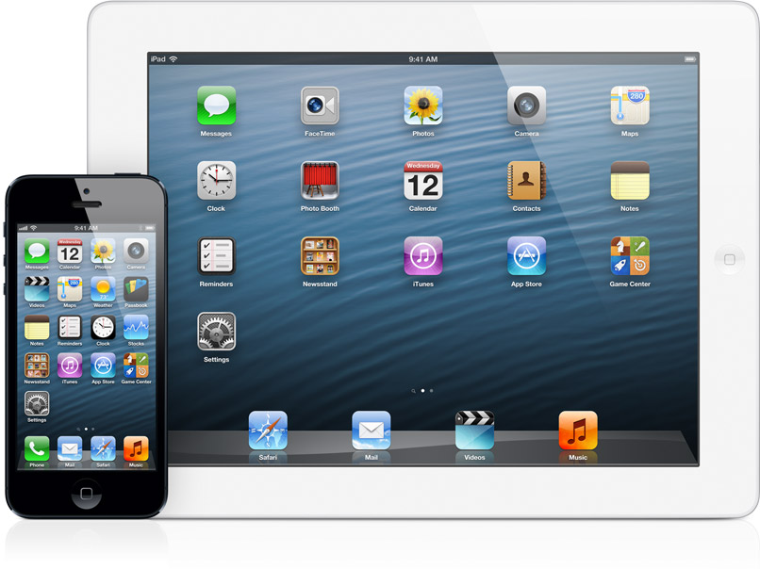
The Future of Apple’s iOS Timeline
Olivier Sassine
Adam Stark
COP4910

Slide 2
Table of Contents
1. Title
2. Table of Contents
3. Recap – iOS Definition
4. Interface Display
5. History of iOS
6. Timeline of iOS
7. Controversies
8. Technical Issues
9. Current State of iOS
10. Our Team Goal
11. Gantt Chart
12. Conclusion
13. References
14. Title (End)

Slide 3
Recap – What is the iOS again?
As we stated in our previous presentation, iOS (previously iPhone OS) in a nutshell is a mobile operating system developed and distributed by Apple Inc. for several product lines currently available.
Since its release in 2007 (initially for the iPhone alone), it has been extended to other Apple technologies including the popular iPad as well as Apple T.V, with plans for implementing iOS on other various devices in the future.

Slide 4
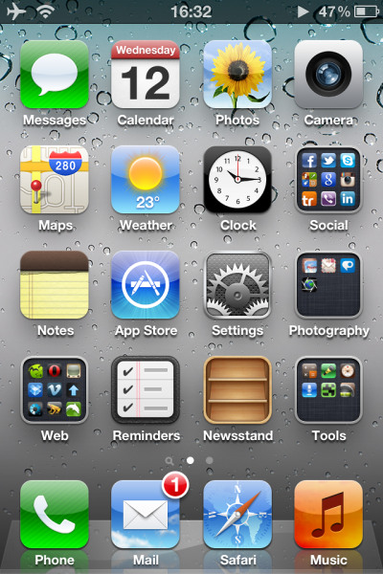
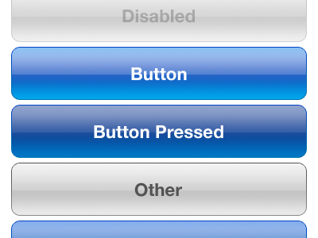
Swiping gesture (VERY important with iOS interaction!)
Various Button Displays
And some more ways of interacting with the interface…sliders / switches
General iOS Home Page Interface

Slide 5
History of the iOS
iOS 1.0 – The iPhone was Born
iOS 2.0 – App Store & Apps
iOS 3.0 – Features
iOS 3.2 – iPad
iOS 4.0 - Multitasking
iOS 5.0 – Siri, iMessage & more
iOS 6.0 – Good Bye Google
iOS 1.0 - Released: June 2007
Until iOS, smartphones either didn't have a touchscreen or used a resistive touchscreen and a stylus
iOS 1.0 introduced a new computing paradigm that broke from smartphone tradition: hiding the filesystem from the user
MobileMe – Apple Cloud Base Services

Slide 6
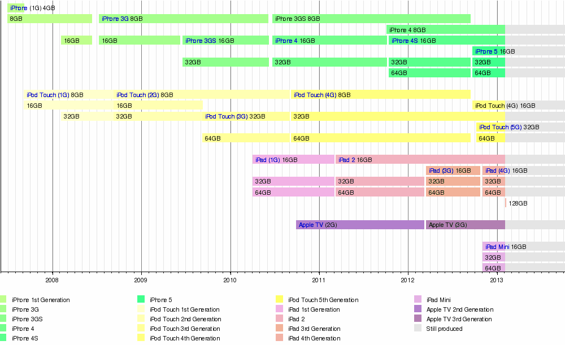

Slide 7
Controversies
ITunes - European Union Controversy
Google Voice Controversy
Antitrust issue with Adobe Flash and iPhone OS controversy
Gizmodo Controversy

Slide 8
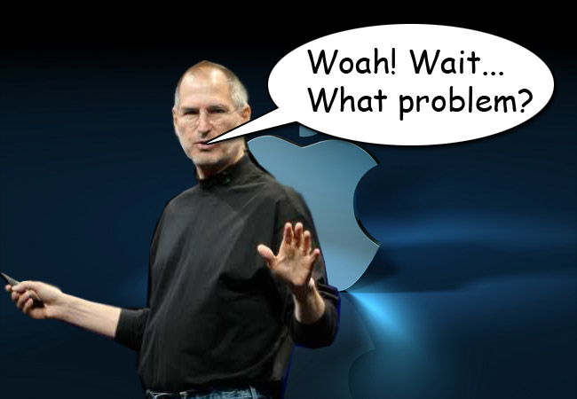
Some iOS Technical Issues
Unusable Wi-Fi
Wi-Fi connectivity loss
Music missing
Short battery life
Changes to iTunes Match
“Incompatible” third party apps
Apple’s iOS 6 apps

Slide 9
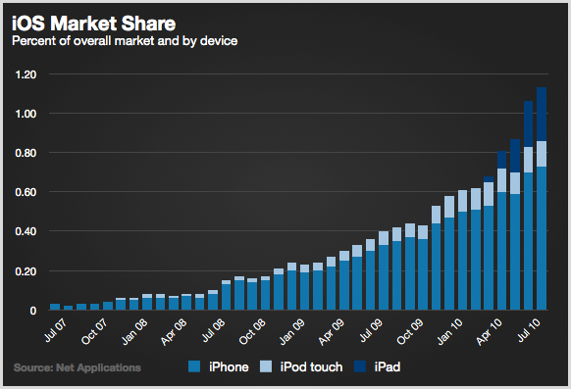
Current State of the iOS
-There are over one million applications available on the App store, a high-capacity megapixel camera / video recorder, MP3 player, and Internet / e-mail services.
-What this offeres to the world in an EFFICIENT manner is essentially a mobile operating system that could fit in your pocket. It is not only the speedy technology that has contributed to the iOS’s success, but also the user-friendliness of the interface.

Slide 10
Our Team Goal
In recent months, Apple (primarily some of its affiliates) has been hinting at several new and innovative technologies for the future of its iOS. The primary expectations regarding this project are to discover as much as possible what these technologies are and how these technologies could potentially benefit or harm the company.
Overall, the goal behind this project is not what the company currently offers, but rather discovering what the company’s potential technologies are. More importantly, how these technologies can improve the overall mobile operating system market is a key focus as well.

Slide 11
Gantt Chart

Slide 12
Conclusion
The researchers wish to study the potential features of the iOS and how these features can greatly benefit its users.
The iOS has had a vast history of success by constantly innovating new technologies to keep its users interested.
The researchers intend on following the schedule (and Gantt chart) strictly. This is to make certain all the necessary research is completed in a timely and effective manner.

Slide 13
References
Baxter, Kyle. 2012. Tight Wind. Tight Wind. [Online] October 30, 2012. [Cited: February 3, 2013.] http://tightwind.net/2012/10/the-future-of-ios/
Sande, Steven. 2012. tuaw. tuaw. [Online] AOL tech, December 4, 2012. [Cited: February 3, 2013.] http://www.tuaw.com/2012/12/04/loren-brichter-and-the-future-of-ios-apps/
Sorrel, Charlie. 2013. Cult of Mac. Cult of Mac. [Online] CultMedia Corp, January 16, 2013. [Cited: February 3, 2013.] http://www.cultofmac.com/210666/write-for-iphone-looks-like-the-future-of-ios-text-editors/.
http://www.theverge.com/2011/12/13/2612736/ios-history-iphone-ipad
http://www.macworld.com/article/2010812/bugs-and-fixes-troubleshooting-ios-6.html

Slide 14
The Future of Apple’s iOS Timeline
Olivier Sassine
Adam Stark
COP4910

