Slide 1
Wireless Power Transmission
By:
Jonathan Baliwag
James Negron Rodriguez

Slide 2
Table of Contents
Introduction
Background and Key Words
Technical Issues
Social Impact
Ethical Issues and Marketing
Management Plan
Conclusion
References

Slide 3
Introduction
Electromagnetic induction
New methods for long range wireless power transmission
Electromagnetic Radiation
Electrical Conduction

Slide 4
Background
First shown at the 1893 World's Columbian Exposition in Chicago.
In 1899 moved research to Colorado Springs to continue research
1902- Wardenclyffe Tower facility was created

Slide 5
Key Words
Resonance
Resonant Frequency
Resonant Inductive Coupling

Slide 6
Technical Issues
Conversion efficiency for laser method
Direct line of sight needed for laser and microwave methods
Atmospheric interference
How to meter wireless consumption

Slide 7
Social Impact
Less wiring/more cost effective
Wireless charging of multiple mobile devices
Wireless charging of electric vehicles

Slide 8
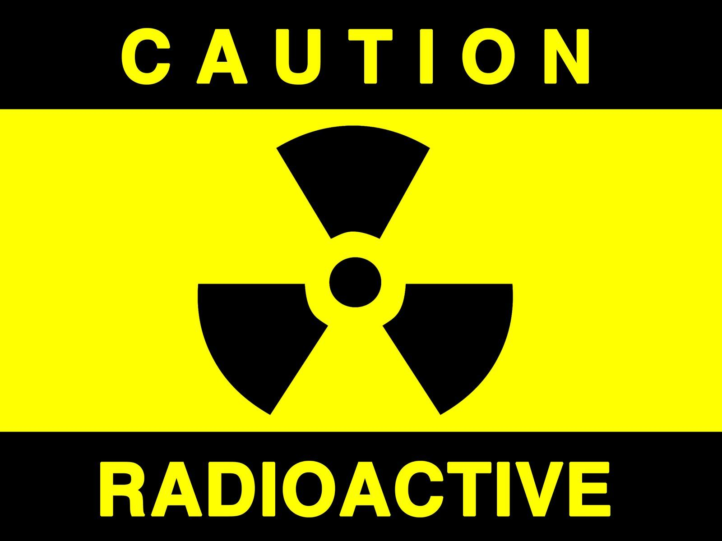
Ethical Issues
Radiation concerns
Electromagnetic field exposure concerns
E-waste

Slide 9
Marketing
How to advertise products to society who are concerned about health issues
How to sell the construction of wireless towers throughout cities

Slide 10
Management Plan

Slide 11
Conclusion
In conclusion we aim to inform you what is wireless energy and some of its technical issues.
We also plan to touch on some of the technical, ethical, and marketing issues, along with the potential social impact of this technology.

Slide 12
References
Ferguson, Will. "Wireless Power May Cut the Cord for Plug-In Devices, Including Cars." National Geographic. National Geographic Society, 28 Dec. 2012. 08 Feb. 2013.
Hadley, Franklin. "Goodbye Wires!" MIT Tech Talk 13 June 2007. MIT's News Office. 08 Feb. 2013.
Wilson, Tracy V.. "How Wireless Power Works" 12 January 2007. HowStuffWorks.com. <http://electronics.howstuffworks.com/everyday-tech/wireless-power.htm> 08 February 2013.

Slide 13
Wireless Power Transfer
By:
Jonathan Baliwag
James Negron Rodriguez

