Slide 1
Near Field Communication
Group 16 Tyler Swofford Matthew Kotan

Slide 2
Outline
What is NFC
History
Usage
Timeline
Issues related to NFC
Technical
Social
Ethical and Marketing
Conclusion
References

Slide 3
What is Near Field Communication(NFC)
NFC is a transmission protocol
Designed for short range communication
Communication is limited to being between two devices
Half duplex communication
Based off of Radio Frequency Identification(RFID)

Slide 4
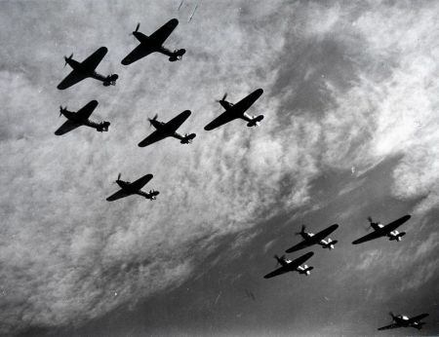
History
RFID was developed in 1940 for the purpose of Identification Friend or Foe(IFF)
IFF was developed by the Allied Forces
Used in conjunction with radar
Led to the development of NFC

Slide 5
Usage
Uses of RFID
SunPass
Inventory Management
Uses of NFC
TecTiles
Marketing and advertising
Peer-to-peer data transfer
Google Wallet
RFID is used in situations where range is necessary whereas NFC is for shorter range consumer applications

Slide 6
Timeline

Slide 7
Technical Issues
Lacked mobile devices that were NFC compliant
Developers refused to create applications without adequate demand due to lack of devices
In 2010 mobile phones began to have NFC technology incorporated into them, the first one being the Nexus S

Slide 8
Social Issues
Risk of people becoming more dependent on technology
Limits social interaction
Has the potential to downsize point of sale employees
Concerns about tracking information such as consumer behavior and purchasing patterns

Slide 9
Ethical and Marketing Issues
People still need to carry a wallet for a drivers license and any spare money
Google Wallet is currently not any faster than paying with a physical credit card
Developers need to uphold data integrity due to the storage of sensitive data
Security issues with wireless transmissions using NFC

Slide 10
Conclusion
NFC is finally seeing devices that can utilize this technology and has the potential for mass adoption in the upcoming years
It has the ability to change advertising and marketing strategies
Security is still a major concern for many aspects of NFC
Financial
Privacy

Slide 11
References
Ok, K., Coskun, V., Aydin, M., & Ozdenizci, B. (2010, November). Current benefits and future directions of nfc services. 2010 International conference on education and management technology, Cairo, Egypt.
E. Haselsteiner, K. Breitfub, "Security in Near Field Communication: Strengths and Weaknesses", Apr. 2006, http://events.iaik.tugraz.at/RFIDSec06/Program/papers/002%20-%20Security%20in%20NFC.pdf.
Molen, B. (2011, June 10). What is nfc and why do we care. Retrieved from http://www.engadget.com/2011/06/10/engadget-primed-what-is-nfc-and-why-do-we-care/

Slide 12
References Continued
Ok, K., Coskun, V., & Ozdenizci, B. (2012). Near field communication from theory to practice. (pp. 22-56). West Sussex, United Kingdom: John Wiley and Sons.
Rieback, M., Crispo, B. & Tanenbaum, A. (2006, January). The evolution of rfid security. Pervasive Computing, 62-69.
Strickland, J. (2012, February 10). How near field communication works. Retrieved from http://electronics.howstuffworks.com/near-field-communication.htm

Slide 13
Near Field Communication
Group 16 Tyler Swofford Matthew Kotan

