Slide 1
3D Printing
The Proposal
Jamir Dirksen
Kyle Strink
Group 15
COP 4910

Slide 2
Outline
Introduction to 3D Printing
Materials Used
Where 3D printing is being used
Technical Aspects
Social Impact
Ethical issues and marketing
Timeline
Conclusion
Sources

Slide 3
Introduction to 3D printing
Creates three-dimensional physical objects from digital file
Objects are designed with 3D modeling software or by 3D scanning
Object is printed in layers as thin as 10microns
process is repeated until the entire object is formed
Currently used primarily for design visualization

Slide 4
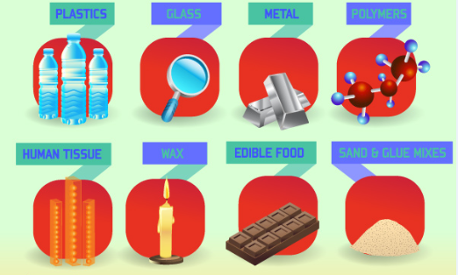
Materials
Plastic
Glass
Metal
Wax
Food
Human tissue

Slide 5
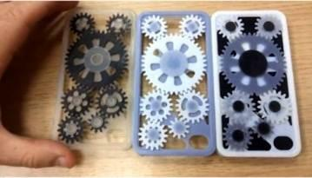
Where 3D printing is being used
Architecture
Automotive
Healthcare
Dental
Fossil Reconstruction
Bone Reconstruction for forensic investivations
Consumer Use

Slide 6
Technical Issues
Printing Methods
Accuracy
Available Printers

Slide 7
Social Impacts
Reviving U.S. manufacturing
Change in shopping
Changes in the medical field

Slide 8
Ethical Issues and Marketing
Piracy and DRM
Printing Organs
Printing Weapons
Printing Drugs

Slide 9
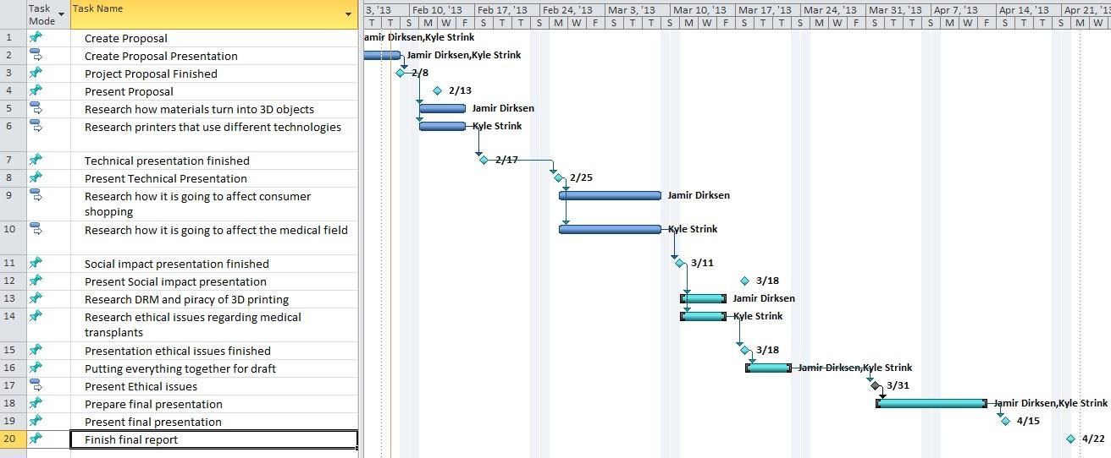
Timeline

Slide 10
Conclusion
There are still some hurdles
Change the way we shop
Will have an impact in the medical field
Will have DRM issues to address

Slide 11
Sources
Dolphin, J. (2012). 3D printing: Piracy or opportunity?. Keeping Good Companies, 64(5), 300.
Kaur, S. (2012). How is "Internet of the 3D Printed Products" Going to Affect Our Lives?. IETE Technical Review, 29(5), 360-364.
Lemu, H. G. (2012). Study of capabilities and limitations of 3D printing technology. AIP Conference Proceedings, 1431(1), 857-865. doi:10.1063/1.4707644
Matthews, J. A. (2011). 3D printing breaks out of its mold. Physics Today, 64(10), 25-28.
Mironov, V, Boland, T, Trusk, T, Forgacs, G & Markwald, R. (2003) Organ printing: computer-aided jet-based 3D tissue engineering. TRENDS in Biotechnology, 21(4), 157
http://3dprinting.com/
http://web.ncsu.edu/abstract/technology/3d-printing

Slide 12
3D Printing
Jamir Dirksen
Kyle Strink
Group 15
COP 4910

