Slide 1
Autonomous cars
Alan reichner
Steven jenzen

Slide 2
Key points
History
Common Components
Safety and Efficiency
Technical Issues
Ethical issues and marketing
Project Plan
Schedule breakdown
Gantt Chart

Slide 3
History
Eureka Prometheus Project (1987-1995)
ISTEA Transportation Authorization Bill (1991)
Carnegie Mellon Navlab Project (1995)
DARPA Grand Challenge (2004-2007)
DARPA Urban Challenge (2007)
Google Cars (2010-Current)

Slide 4
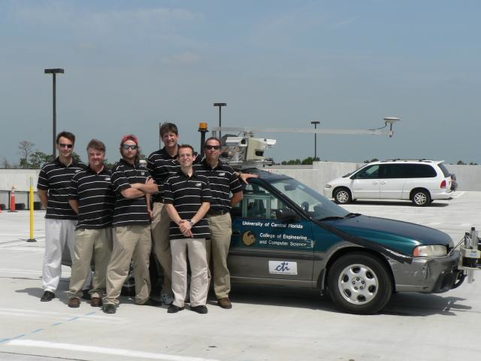
UCF’s Knight rider
UCF competed in the 2007 DARPA Urban Challenge with a 1996 Subaru Outback Legacy named Knight Rider.
Made it to the finals
Went off course - Did not finish

Slide 5
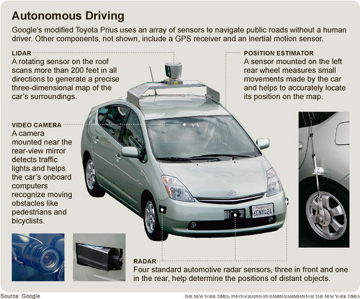
Common Components
Lidar
Video Camera
Position Estimator
Radar

Slide 6
Safety and efficiency
Fewer Accidents
Boost Highway Capacity
Greener

Slide 7
Technical issues
Smarter Recognition of Obstacles
Bugs in Software
Computer Security Issues

Slide 8
Ethical & Marketing issues
Stigmas associated with Artificial intelligence and robots
It wouldn’t take much to frighten consumers
Expensive due to cost of sensors and computers
Liability Issues

Slide 9
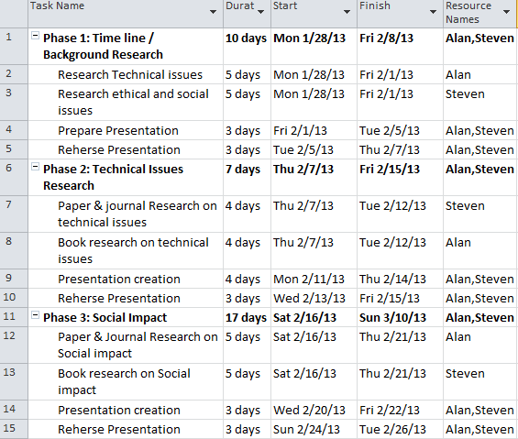
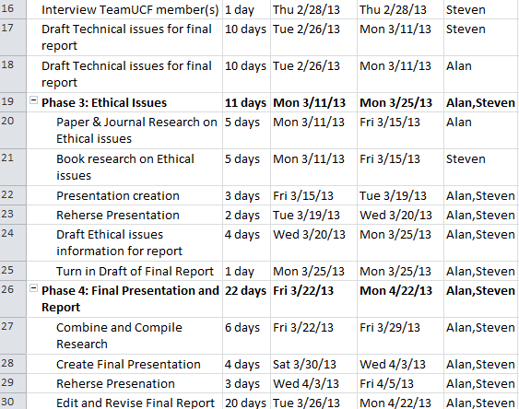
Project Plan

Slide 10
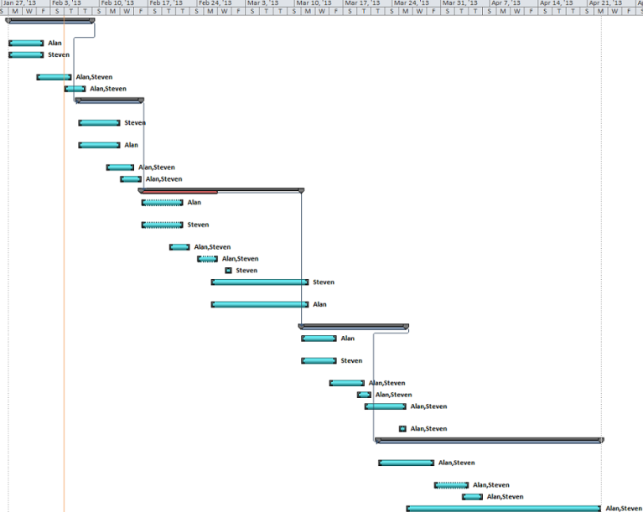
Gantt Chart

Slide 11
Sources
Tientrakool, P. (2011, Sept.). Highway capacity benefits from using vehicle-to-vehicle communication and sensors for collision avoidance. Vehicular technology conference, 2011 ieee.
Patz, B. (2007). Teamucf darpa technical report. Unpublished raw data, Electrical Engineering and Computer Science, University of Central Florida, .
Keyes, B. (n.d.). Driverless world. Retrieved from http://driverlessworld.com/2011/06/a-brief-history-of-driverless-vehicles/
Cohen, A. (2013, January 14). Will self driving cars change the rules of the road. Retrieved from http://ideas.time.com/2013/01/14/will-self-driving-cars-change-the-rules-of-the-road/
DARPA. (2007). Urban Challenge: http://archive.darpa.mil/grandchallenge/

Slide 12
Autonomous cars
Alan reichner
Steven jenzen

