Slide 1
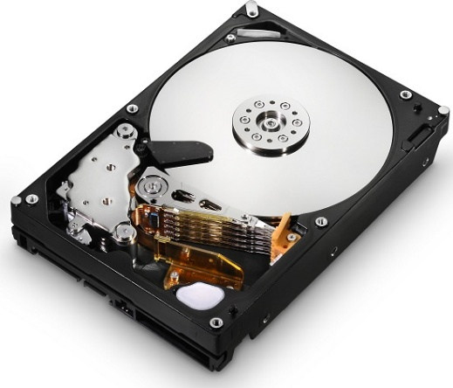
Data Storage Technology
TEAM 12
Travis Heminger
Nikolay Abdrakhmanov

Slide 2
Presentation Overview
Background - Slide 3
History and Early Storage Devices-Slides 4-6
Current Technology- Slides 7-8
Social Impact- Slide 9
Ethical Issues- Slide 10-11
Our Research Timeline - Slide 12
Conclusion - Slide 13
References – Slide 14

Slide 3
Background
Data Storage Device Used to Record and Retain Information
Recording Medium Only Stores Information
Electromagnetic Data Usually Digital or Analog Format

Slide 4
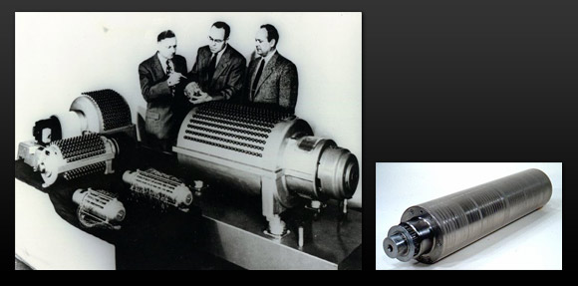
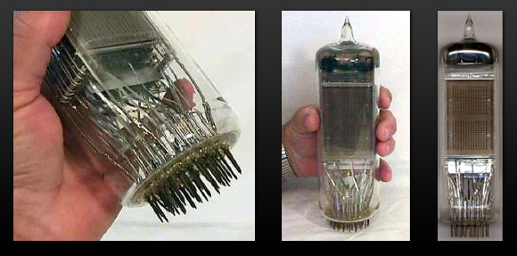
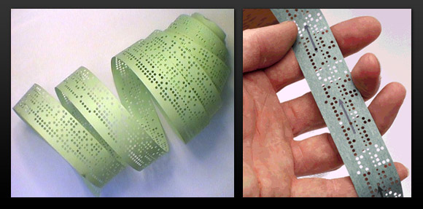
History and Early Storage Devices
Magnetic Drum Memory
Up to 10 kB (1932)
Selectron Tube (1946)
Up to 512 Bytes
Punch Cards (1950)
Variable Length by
physical length

Slide 5
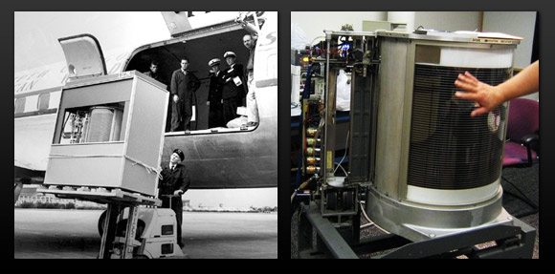
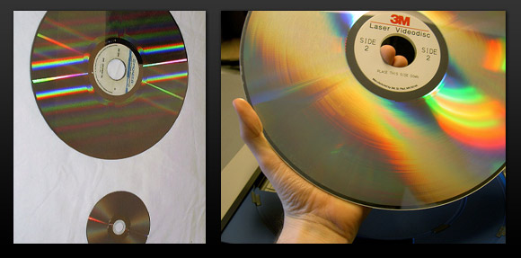
History and Early Storage Devices
Hard Disk Drive (1956)
Developed by IBM
First drive had a capacity of 3.75 MB
Laserdisc (1978)
60 minutes of video per side
Precursor to CD-ROM

Slide 6
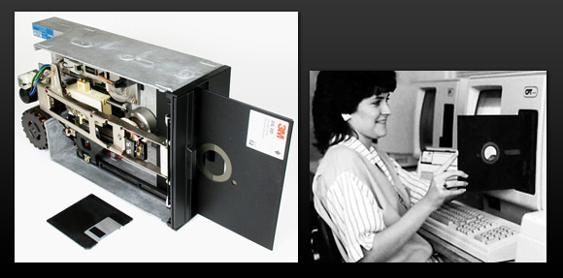
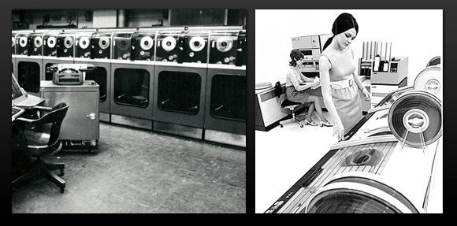
History and Early Storage Devices
Floppy Disk (1971)
First disk had a capacity of 79.7 kB
Read Only
Magnetic Tape (1951)
7,200 characters per second
Typically 1200 feet long

Slide 7
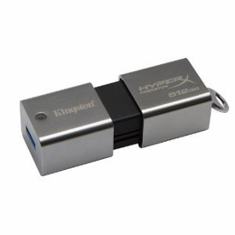
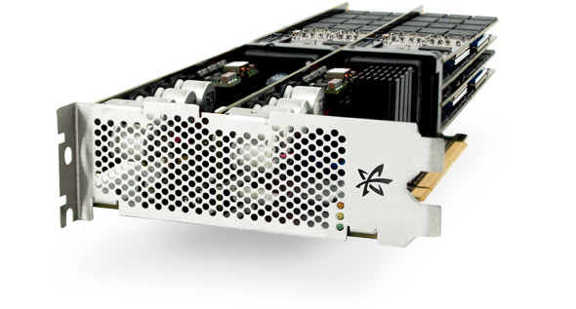
Current Technology (SSD)
1 TB Flash Drive
Designed by Kingston Technology
512 GB version costs $1,750
USB 3.0
10.24 TB SSD
Read 6.7GB/s
Write 3.9GB/s

Slide 8
Current Technology (HDD)
2 TB Platters (Hitachi GST)
Allows 2 TB of storage data per 3.5” disk platter with HAMR technology
Helium Filled HDD (TDK)
Allows cooler operation and the maximum amount of platters to increase from five to seven
Using these two technologies a 14 TB HDD could be manufactured

Slide 9
Social Impact
Demand for Data Storage Always Increasing
Reduce Energy Used to Record and Store Data
Reduce Physical Space by Increasing
Density

Slide 10
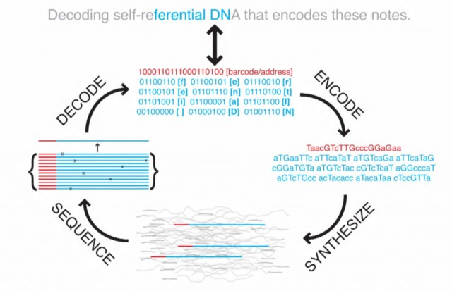
Ethical Issues
Research Stores 5.5 petabits on one gram of DNA

Slide 11
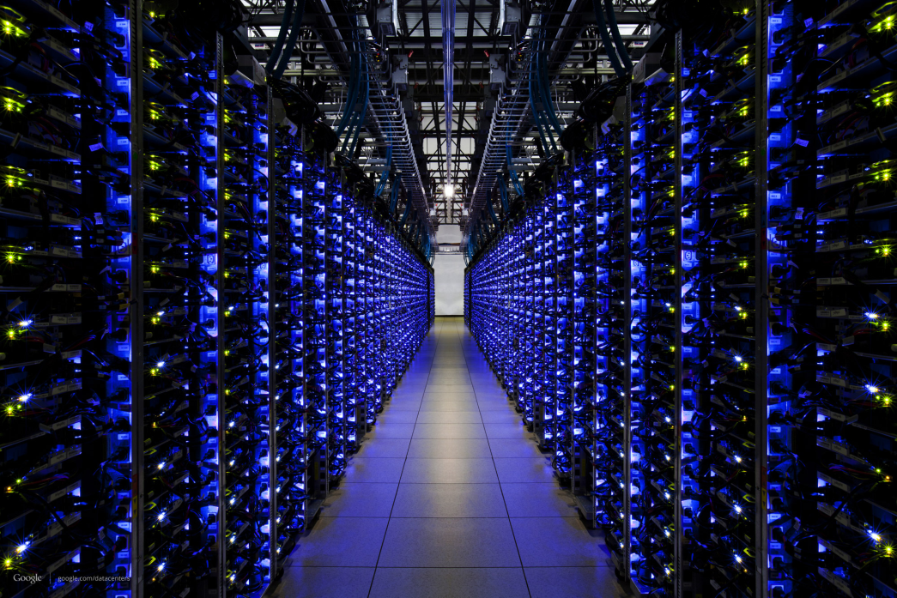
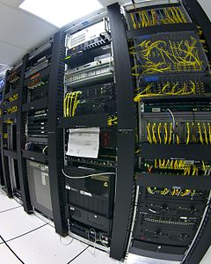
Ethical Issues
Emerging Storage Technologies need to Protect Privacy
Reduce Impact on Environment

Slide 12
Research Timeline

Slide 13
Conclusion
Amount Of Data Always Increasing
Demand for Data Needs More Compact and Efficient Methods
We Will Research and Document these Emerging Storage Technologies

Slide 14
Sources
Brewer, J. (2011). Nonvolatile memory technologies with emphasis on flash: A comprehensive guide to understanding and using flash memory devices.
Wiley-IEEE Press.
Abdullah, A. M. (2007). Hard disk drive: Mechatronics and control. Boca Raton: CRC Group. pp67-103.
National Research Council. , Fuller, S., & Millett, L. (2011). The future of computing performance: Game over or next level?. United States of America: National Academies Press.
Micheloni, R. (2010). Inside nand flash memories. (1st ed.). New York: Springer. pp34-44.
"The History of Computer Data Storage, in Pictures." Royal Pingdom RSS. Pingdom, 8 Apr. 2008. Web. 08 Feb. 2013.

Slide 15
Data Storage Technology
TEAM 12
Travis Heminger
Nikolay Abdrakhmanov

