Slide 1
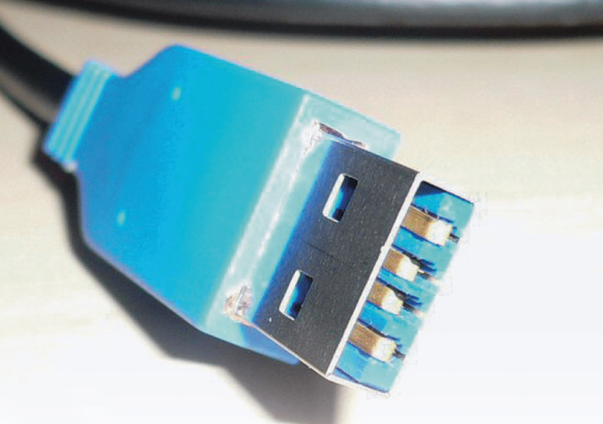
USB 3.0
(Universal Serial Bus)
Cory Koby
Fred Smith Jr.

Slide 2
Table of Contents
Review of USB 1.0/1.1 – 2.0
What is USB 3.0?
USB 3.0 competition
Capability and what it can offer

Slide 3
Why USB ?
  Developed due to problems and complications caused by having so many connections for peripheral devices on computer systems.
  Too many different types of ports with limited uses
    Serial, Parallel, PS/2, Etc
  USB solved this limitation by limiting the number of different types of ports needed to connect to a computer. USB is specifically designed to allow easy connection of a wide variety of devices. It is intended to be user friendly.

Slide 4
USB 1.0/1.1 & 2.0
Increased Speed over 1.0/1.1
USB 1.0/1.1 Max Speed was 12Mbits/s
USB 2.0 Max Speed is 480 Mbit/s
    40x Faster than 1.1
    Decreases number of connectors needed

Slide 5
USB 3.0: Superspeed
Certified under the name ‘SuperSpeed’
  New Theoretical Max = 5 Gbits/s
Upgraded from Half-Duplex (1.0/1.1/2.0) to Full-Duplex communication with Peripherals
  No longer uses Polling, technology upgraded to packet-routing.
Lower Power Consumption
  Reduced by 85%

Slide 6
Backwards Compatible
USB 3 and 2.0 are backwards compatible, though the speed is automatically scaled down to the lower technology.
USB cables are all the same format for connectors.
  However, for extra power, USB 3.0 cables are specially hard-wired for printers and scanners, etc.
New connectors for USB 3.0 are blue.

Slide 7
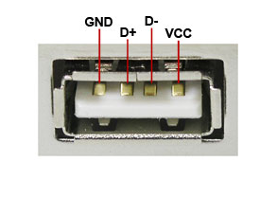
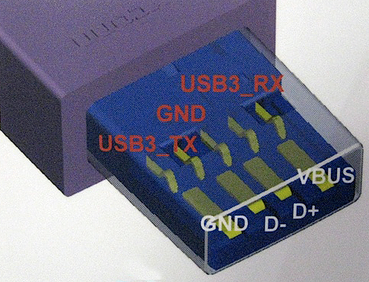
The New Format
2.0 3.0

Slide 8
Time Lines of USB and FireWire
FireWire
400 800 s3200
1995 2001 2010
1.0/1.1 2.0 3.0
USB

Slide 9
Competitors/Comparison
Competitors
USB 3.0
Firewire S3200
  Firewire runs at 3.2 Gbits/s
  Full duplex communication (bi-directional)
eSATA
    Used for External Hard Drives
    Runs at 3.2 Gbits/s
Speed – 4.8 (Actual)
  5 Gbits/s (Theoretical)
Full-Duplex
  Bi-Directional Communication with Peripherals
Packet Routing
  Allows for power saving and faster data transfer.
  All devices can transfer at the same time

Slide 11
Potential Intent for 3.0
Offers 900mA of Power
(4.5 Watts constant power)
The possibility of a universal charger for various platforms
    Laptops
    Printers
    Scanners
    Cellphones

Slide 12
References
Unknown. "Universal Serial Bus (USB *) Specifications.“ Intel.com. Intel, N.D. Web. 21 Jan 2013. http://www.intel.com/technology/usb/spec.htm?iid=Tech_usb+spec2.
Allyn-Feuer, Ari. “Super speed: a brief history of USB 3.0, 2007-2018.” ARSTechnica, Web. 1 Feb 2013. http://arstechnica.com/gadgets/2009/08/super-speed-a-brief-history-of-usb-30/2/.
Viswanath, Somnath. “SuperSpeed USB 3.0: Ubiquitous Interconnect for Next Generation Consumer Applications” Arasan Chip Systems Inc., Web. 2 Feb 2013. http://arasan.com/wp-content/media/Arasan_USB_3_0_Enables_New_Usage.pdf.
White Paper. “USB 3.0* Radio Frequency Interference Impact on 2.4 GHz Wireless Devices” Intel, N.D. Web. 1 Feb 2013. http://www.usb.org/developers/whitepapers/327216.pdf

Slide 13
USB 3.0
(Universal Serial Bus)
Cory Koby
Fred Smith Jr.

