Slide 1
GPU Computing
Aaron Blakeman, Michael Waters

Slide 2
Table of Contents
Introduction to GPU Computing
Brief History of GPU Computing
Technical Issues
Social Impact
Marketing and Ethical Issues
Project Management
Conclusion

Slide 3
Introduction to GPU Computing
A GPU is used to generate output to a screen
Redirect the output of the GPU for general purpose applications
They have a instruction set much like a CPU
Difference in architecture
Notes:
CPU have ALU and registers
GPU have shaders and scalers

Slide 4
Brief History
Research Machines have existed since 1978
NVIDIA introduces GPU in 1999
Mark J. Harris coins the term GPGPU in 2002
NVIDIA introduces CUDA in 2006
Notes:
Ikonas 1st machine for General Purpose GPU Research
Pixel-Planes 5 procedural texturing
SIMD used for UNIX password encryption cracking
Mark Harris Chief Technologist NVIDIAu
GPGPU (general purpose computation on Graphics Processing Units)

Slide 5
Technical Issues
Using CUDA by NVidia all C, C++ and Fortran code can be sent straight to GPU
Few standards among manufacturers
OpenCL takes advantage of the CPUs and GPUs

Slide 6
Social Impact
Identify Hidden Plaque in Arteries
Analyze Air Traffic Flow
Nanoscale Molecular Dynamics (NAMD)
Notes:
NAMD visualizing molecules
Speed Boosted by GPU Computing

Slide 7
Marketing and Ethical Issues
GPUs are capable of high performance at a lower cost than CPUs
This appeals to researchers who have lots of processing to do and a limited budget.
What programs can run on these GPU
Could code execute without the user knowing
Notes:
GPUs provide 20x more computational power and an order of magnitude more performance per dollar

Slide 8
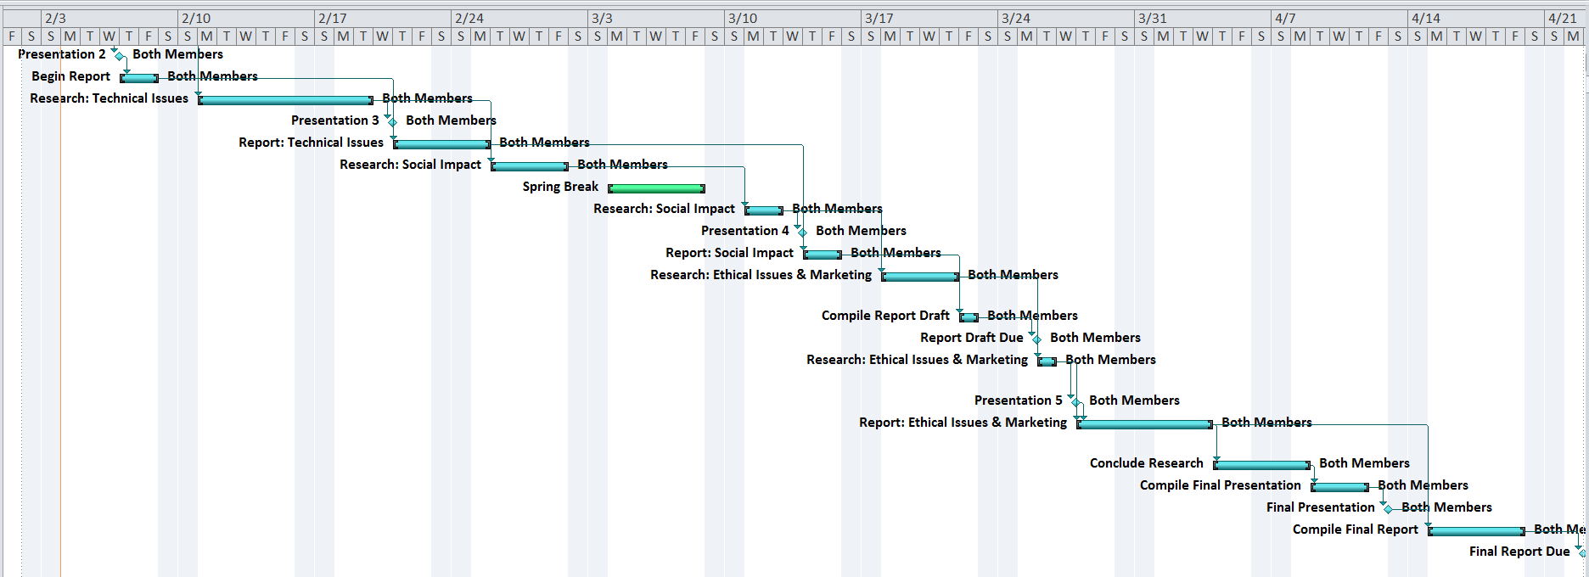
Project Management

Slide 9
Closing Remarks
GPU Computing is a upcoming trend in technology
CUDA and OpenCL are promising developments
More power at a lower cost

Slide 10
Sources
Owens, J. D., Luebke, D., Govindaraju, N., Harris, M., Krüger, J., Lefohn, A. E. and Purcell, T. J. (2007), A Survey of General-Purpose Computation on Graphics Hardware. Computer Graphics Forum
Emmanuel Gallo, N. T. (2004). Efﬁcient 3D Audio Processing with the GPU. Chesnay: Inria.
NVidia (2012). CUDA 5. Feb 5,2013 http://www.nvidia.com/object/cuda_home_new.html

Slide 11
GPU Computing
Aaron Blakeman, Michael Waters

