Slide 1
Internet Security Attacks
Background and Timeline
Group 4
Khristopher Powell
Maurice Wahba

Slide 2
Overview
The history of Internet Security Attacks goes back as far as the initial telephone system. While attempts have been made to certify devices as being secure from intrusion and attacks it ultimately became a futile effort. A multi-pronged approach had to be done.

Slide 3
Outline
Attempts at Certification of devices
  Orange Book
Network Security
History of telecommunication attacks
  70's-00's
Schedule
Conclusion
References

Slide 4
Orange Book
1970's
David Bell and Leonard Padula develop secure computer operations model.
Levels of Gov't classification
  Unclassified
  Confidential
  Secret
  Top Secret
  Various levels of clearances
If clearance at or above classification level, they had access, otherwise no.

Slide 5
Orange Book
1983
Trusted Computing System Evaluation Criteria
(Orange Book)
D - Minimal protection or unrated
C1 - Discretionary Security Protection
C2 - Controlled access protection
B1 - Labeled security protection
B2 - Structured protection
B3 - Security domains
A1 - Verified design

Slide 6
Orange Book
Had to meet functional and assurance requirements.
Took a lot of time and money.
Few systems certified above C2 (Controlled Access Protection)
Technologies obsolete by the time of certification

Slide 7
Orange Book
Models that attempted to improve this:
German Green Book - 1989
Canadian Criteria - 1990
Information Technology Security Evaluation Criteria (ITSEC) - 1991
Federal Criteria (Common Criteria) - 1992
  Current concept of security embodied in this criteria.
  Protection Profiles to cover many environments.
  Tested against profiles and secured accordingly.
  Assurance levels

Slide 8
Network Security
Technology moved too quickly for Certification Programs
Problems increase once computers are networked together. New problems arise and old problems took new forms.
Encryption not enough:
LAN
WAN
High Connection Speeds
More connections
Wire signal radiation
User access from many systems.

Slide 9
Network Security
Different Aspects of Security
Physical Security
Communication Security
  Information in transit
Emission Security
  Wired Signal
Computer Security
  Access to computers
Network Security
  LAN

Slide 10
History of Telecommunication Attacks
1970's
Phone Hacking "Phreaking"
1980's
Beginning of Malware
Brain Virus - 1986
  Changes Boot Sector & Volume Label on Diskettes
Morris Worm - 1988
Kevin Paulson - 1991

Slide 11
History of Telecommunication Attacks
1990's
Beginning of modern Information Security Industry
Melissa Worm, Love Letter
  Flooding E-Mail using MS Word and Outlook
Concept Macro-Virus
  Embed self in Microsoft Word docs in different OS's

Slide 12
History of Telecommunication Attacks
2000's
Malicious activity turns into major criminal enterprise for money
Malware:
  Conducent TimeSink
  Aureate/Radiate
  Comet cursor
Malware becomes self propogating
Phishing becomes mainstream. Targeting banking and social websites.

Slide 13
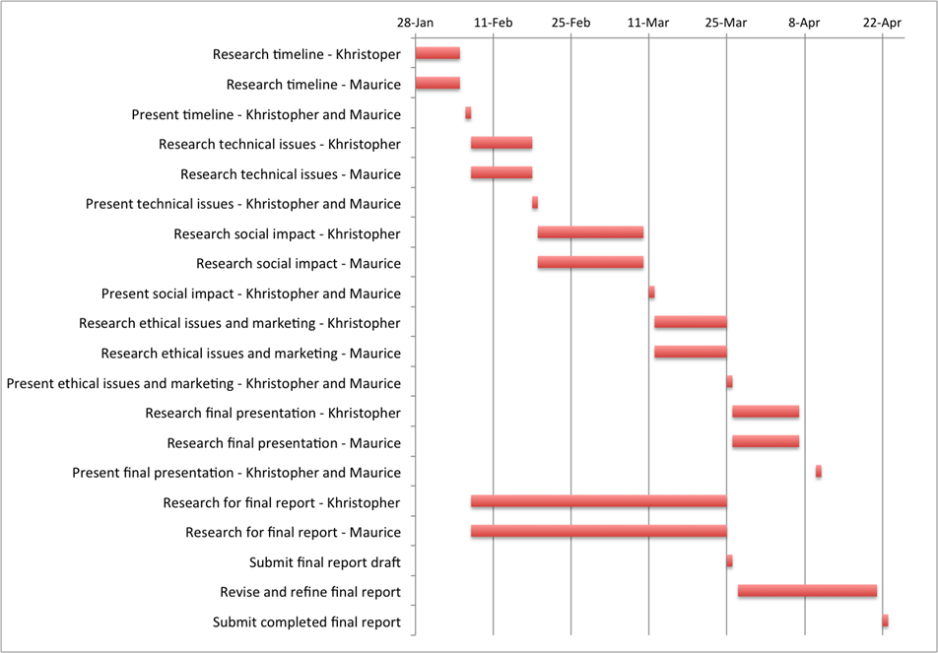
Schedule

Slide 14
Conclusion
Security of our information has become more important as our world becomes more connected
We've had a need for information security even before personal computing
What started as simple hobbyist tinkering has turned into the threat of your information being taken
Social and ethical issues very prominent

Slide 15
References
Maiwald, Eric. "Network Security: A Beginner’s Guide". 2nd ed. In Essential Skills made easy. McGraw-Hill/osborne. 2003
Symantec. "A brief history of internet security". SC Magazine. http://www.scmagazine.com/a-brief-history-of-internet-security/article/149611/
F-Secure. "Virus and Threat Descriptions" http://www.f-secure.com/en/web/labs_global/threats/descriptions

Slide 16
Internet Security Attacks
Background and Timeline
Group 4
Khristopher Powell
Maurice Wahba

