Slide 1
4K Resolution The future of resolutions
Adrian Kostic
Ron White

Slide 2
Table of Contents
1. What is resolution?
2. Common Terms
3. Background & Current Technologies
4. 4K resolution
5. How we are going to research
6. Project Scope
7. Conclusion
8. References
Notes:
Adrian

Slide 3
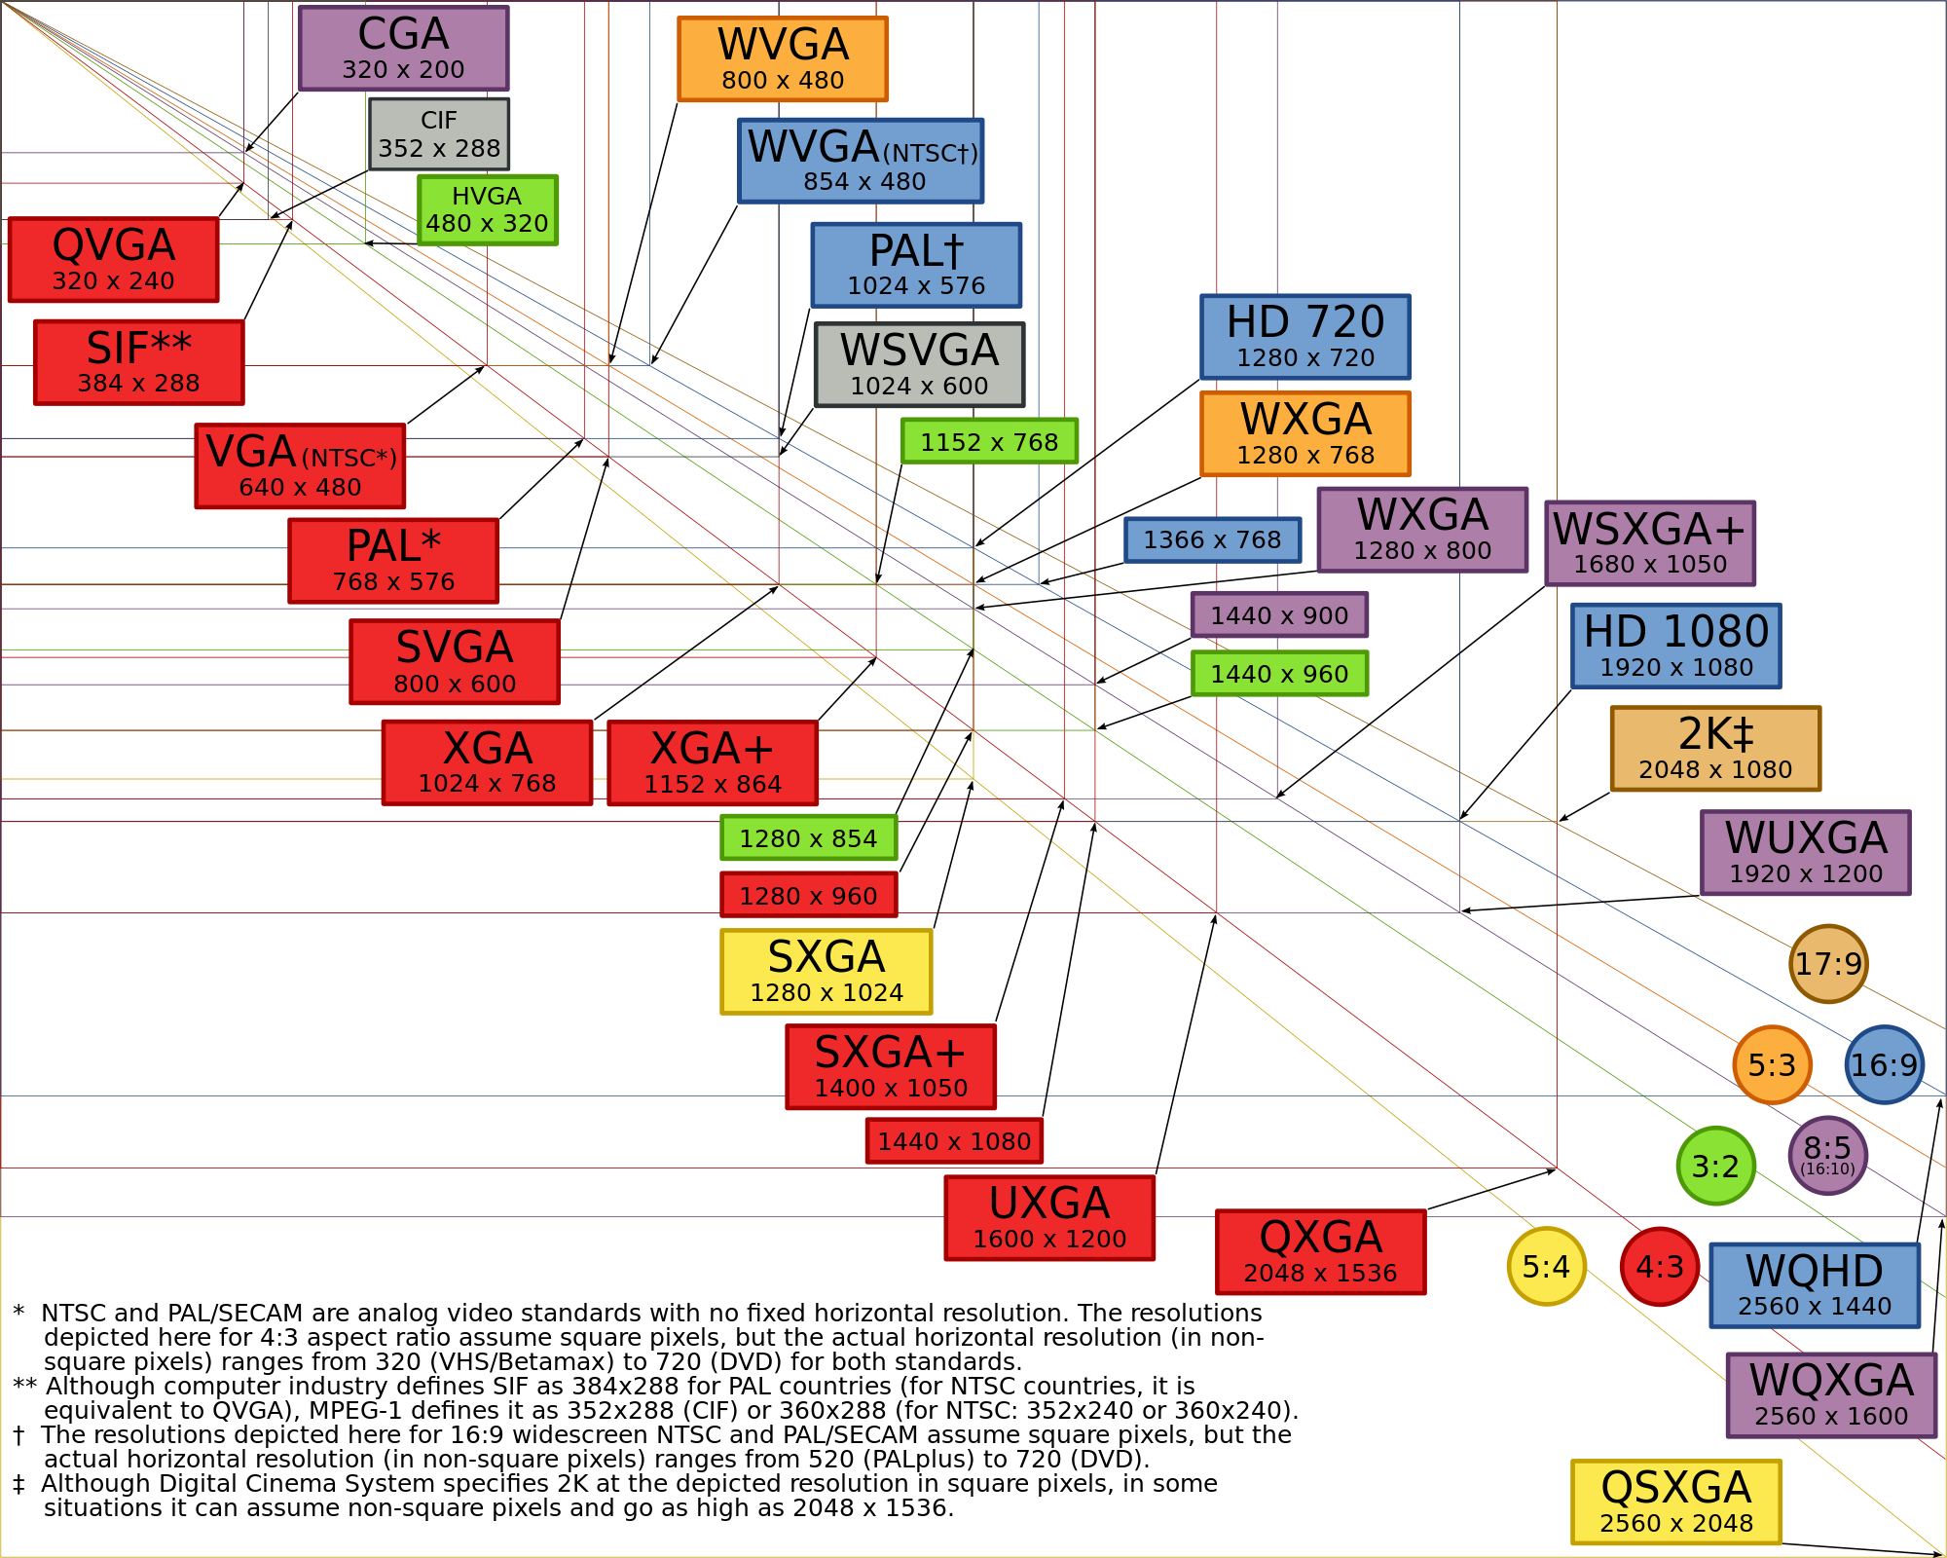
What is resolution?
Resolution is slightly ambiguous term.
Context for this project is Digital Resolution.
Digital Image resolution is usually defined as the pixel count. (Width x Height)
TV: Standard Definition: 486X440 – 640x480 to 852x480
TV: Hi Definition: 1366x768 – 1920x1200
Notes:
Adrian

Slide 4
Common Terms
Refresh Rate
The times per second a display draws the information on screen.
Horizontal vs. Vertical
Common refresh rates on LCDs & TVs – 60Hz to 120Hz
Frames Per Second
Context of Video, the number of Frame changes per second.
24p – Standard Motion Picture (48p in testing)
~30p – Video Game Consoles (PS3, Xbox, Wii, etc)
60p+ - PC Gaming
Aspect Ratio
Ratio between vertical and horizontal pixels
4:3 (1.33:1), 16:9(~1.77:1), 16:10
Response Time
Brightness
Contrast Ratio
Notes:
Adrian

Slide 5
Current Technology
HD Televisions
1336x768 to 1920x1200 @ 60Hz – 240Hz
DVD @ 720x480 @ 24 – 30 FPS
Blu-Ray @ 720x576 – 1920x1080 @ 24-29.97 FPS
Computer & Laptop Monitors
1024x768-2560x1600 @59Hz -120Hz
Connections: HDMI, DVI, VGA, Display Port, Thunderbolt
Notes:
Adrian

Slide 6
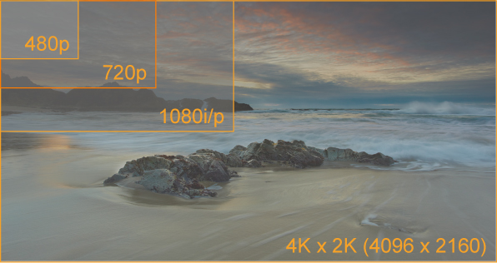
4K Resolution
Defined as Ultra High Definition Television (Ultra HD, UHD, UHDTV)
Standard Has been approved for 4K (3840x2160) & 8K (7680x4320) resolutions
4 and 8 times as many pixels as standard HD.
Better color representation & higher frame rate support (120fps)
Upscaling from lower sources is easier.
Notes:
Adrian

Slide 7
How we are going to research
Journals
Research on transmission, bandwidth limitations & compression
Possible new media formats (H.265)
Applications of 4K resolution media
Consumer Products already Available
Sony, LG currently have 4K televisions available (Very Expensive, Limited Content)
Netflix demo at CES 2013
Notes:
http://www.pocket-lint.com/news/49245/netflix-4k-uhd-video-pictures-hands-on
Ron

Slide 8
Project Scope
3 Phases
Research, Rough Draft & Final Presentation
Nearly the same time scale for each phase, with some room for flexibility
Notes:
Ron

Slide 9
Final Thoughts
2013 will be a defining year for the scope of the technology
The standard is finalized but the production and methods are not.
We are eager to see the bandwidth that will be needed as well as the possible new media formats that will accompany.
Ultra High Def. Movies should look Awesome!
Notes:
Ron

Slide 10
References
Lenidino, J. (2012, November 16). What is ultra hd (4k)?. Retrieved from http://www.pcmag.com/article2/0,2817,2412174,00.asp
Duncan, G. (2012, September 2012). Does your living room need 4k tv?. Retrieved from http://www.digitaltrends.com/home-theater/4k-hd-explainers-sony-lg-content-delivery-availability/
Burnell, I. (2013, January 25). Hd? 3d? no, the future of television is 4k – and it’s brought to you by some very sharp meerkats. Retrieved from http://www.independent.co.uk/arts-entertainment/tv/news/hd-3d-no-the-future-of-television-is-4k--and-its-brought-to-you-by-some-very-sharp-meerkats-8467820.html
Notes:
Ron

Slide 11
4K Resolution The future of resolutions
Adrian Kostic
Ron White

