Slide 1
2D Action Shooter
Tyler Harbin-Giuntoli
Horica Ionescu
Ross Pape
Michael Paulsen
Remo Gutierrez
Adam Stack

Slide 2
Speakers
Intro - Tyler
Project Management Plan - Remo
Requirements - Horica
Testing and Risk - Ross
Design - Mike
Unity and Prototype Demo - Adam

Slide 3
Introduction
Simple top-down action shooter
Retro themed
Currently runs on PC, will run on android mobile devices

Slide 4
Remo’s Project Management Plan

Slide 5
Project Overview
The goal of our project is to create a 2D top down shooting game for Android platforms.
Consists of player with the ability to level up
Feature multiple levels populated with enemies
Scoring system to score player performance
Merchant system for the player to purchase items and upgrades.

Slide 6
Team Organization
Team consists of …
Tyler Harbin-Giuntoli : General Manager/ Dev assistant
In charge of general group organization, has final say in group disputes and assists lead developer.
Remo Gutierrez : Lead Developer
In charge of program organization and standards. Has final say in game design decisions.
Adam Stack : Document manager
Making sure documents are ready and turned in by deadlines.

Slide 7
Team Organization
Team consists of …
Horica Ionescu : Testing and Documentation Assistant
Will assist Document Manager and Testing Lead as well as managing communications and team meetings.
Ross Pape : Developer Assistant
Directly assists lead developer and streamlines code. Responsible for keeping object input/output consistent.
Michael Paulsen : Testing Lead
In charge of of testing and bug reports, has final say on enforcing necessary changes to the code.

Slide 8
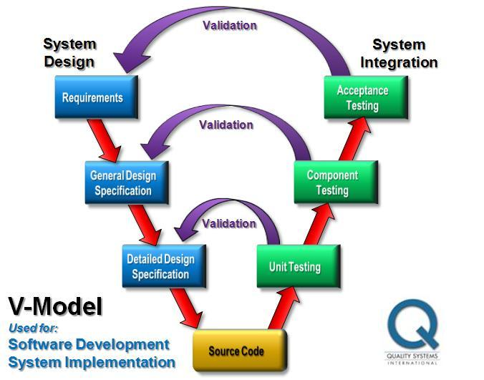
Software Development Model
V-Model

Slide 9
High-Level Activities Table
Step 1: Setting up work environment
Step 2: Basic team software Training
Step 3: Game Prototype
Step 4: Core Game Development
Step 5: Internal Testing
Step 6: Game Polish I
Step 7: Internal/External Testing
Step 8: Game Polish II
Step 9: Launch

Slide 10
Specific Requirements
Character leveling
Player inventory
Merchant
Character selection
Game levels
Scoring system

Slide 11
Specific Requirements
Interface Requirements
Touchscreen
Physical Requirements
Android platform
Documentation Requirements
Tutorial

Slide 12
Test Plan
Overview
Test for fatal, mechanical, and cosmetic errors
Test at various points during development
Test Environment
Android emulator and actual Android devices
Notes:
Ross

Slide 13
Test Plan - Stopping Criteria
Test each feature alone for errors
Test related features together
Test whole game
Once each step can pass tests 4 times w/o any fatal or mechanical errors, testing can stop
Notes:
Ross

Slide 14
Test Plan - Example Test Cases
Character Leveling
Combat System
Saving
Character selection and customization
Notes:
Ross

Slide 15
Design Details
The world
Multiple levels
Merchants
Scoring
The Player
Character Select
Weapons & Equipment
Experience Progression

Slide 16
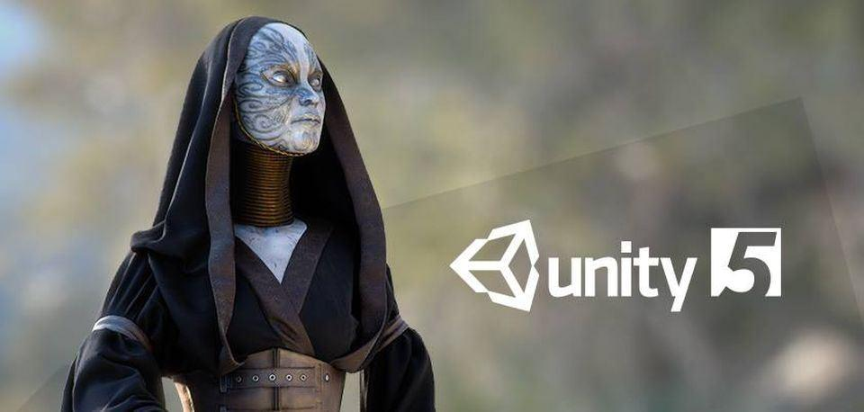
Unity Demo

