Slide 1
The Miranda Programming Language
Presented by Sean Kauffman
D. A. Turner An Overview of Miranda, SIGPLAN Notices 21(12):158-166, December 1986. PDF [139K]

Slide 2
Designer
Developed in 1985 by David Turner
Professor in the School of Computer Science and Engineering at California State University
Currently teaching Game Programming CSE 441

Slide 3
Language Developed
It was produced by Research Software Ltd. of England and was the first purely functional language to be commercially supported. Miranda was first released in 1985, as a fast interpreter in C for Unix-flavor operating systems, with subsequent releases in 1987 and 1989.
The later Haskell programming language is similar in many ways to Miranda.

Slide 4
Historical Background
Miranda is a modern functional programming language designed by David Turner of the University of Kent, with lazy evaluation, polymorphic strong typing, and a powerful module system.
A program written in Miranda is typically 5 to 15 times shorter than the corresponding program in C or Java.

Slide 5
Types of Applications
Non-Strict functional Language : Program works under the concept of lazy evaluation. (pass equation till need it the do “work”)
Advantage? Can pass large data structures
Purely Functional : Excludes destructive modifications.
Why is this desired? Think Space saving
Thesaurus: instead of copy for every person you can make a custom sub list for each person on their own modifications and still have them access the main thesaurus.

Slide 6
Features
Purely Functional - no side effects
Higher Order - supports functional data
Lazy - supports non strict functions and infinite data objects
List Comprehensions
Polymorphic Strong Typing
Abstract Data Types and Modules

Slide 7
Features: Higher Order
Ability for it’s functions to do one of the following.
Take 1 or more functions as input
Output a function

Slide 8
Features: List Comprehensions
Syntactic construct available for creating a list based on existing lists.
[n * n | n <- [1..100] ]

Slide 9
Features: Polymorphic Strong Typing
That is, every expression and every sub expression has a type, which can be deduced at compile time, and any inconsistency in the type structure of a script results in a compile time error message.
Primitive types - Number, Boolean, and Char.

Slide 10
Features: Abstract Data Types and Modules
Miranda permits the definition of abstract types, whose implementation is "hidden" from the rest of the program.
To show how this works we give the standard example of defining stack as an abstract data type :
abstype stack *
with empty :: stack *
isempty :: stack * -> bool
push :: * -> stack * -> stack *
pop :: stack * -> stack *
top :: stack * -> *
stack * == [*]
empty = []
isempty x = (x=[])
push a x = (a:x)
pop (a:x) = x
top (a:x) = a

Slide 11
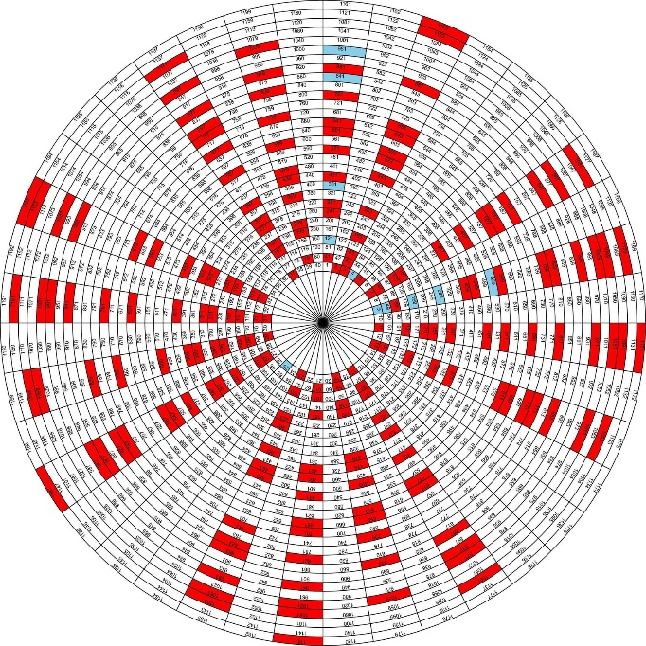
Examples 1 : Primes
Primes = Sieve [2..]
Sieve (p:x) = p : Sieve [n | n <- x; n mod p ~= 0]

Slide 12
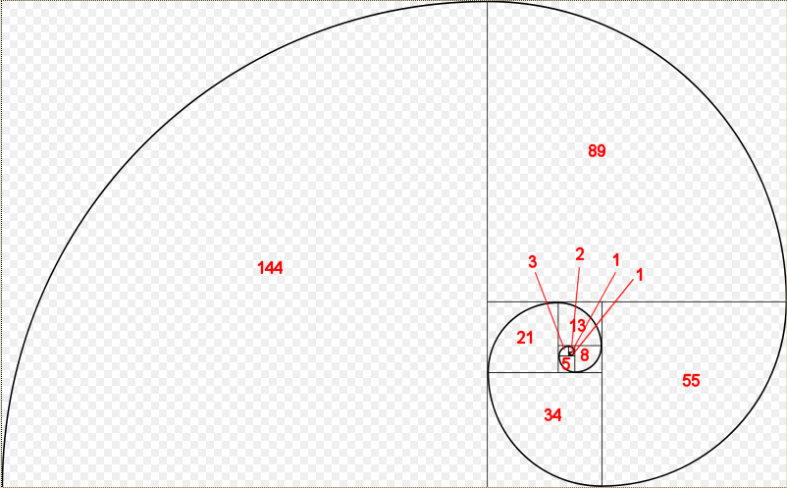
Example 2 : Fibonacci
Fibs = map fib [0..]
Fib 0 = 0
Fib 1 = 1
Fib (n + 2) = Fibs! (n + 1) + Fibs! N
Test = layn (map shownum Fibs)

Slide 13
Language Basics : List
Week_days = [“Mon”, “Tue”, “Wed”, “Thur”, “Fri”]
Days = Week_days ++ [“Sat”, “Sun”]
[“Mon”, “Tue”, “Wed”, “Thur”, “Fri”] -- [“Mon”, “Wed”] is [“Tue”, “Thur”, “Fri”]

Slide 14
Language Basics: Guard
Gcd a b = gcd (a-b) b, if a > b
= gcd a (b-a), if a < b
= a, if a = b
The last guard in such a series of alternatives can be written "otherwise", instead of "if condition", to indicate a default case(*).

Slide 15
Language Basics: Currying
answer = twice twice suc suc twice suc 0
twice f x = f (f x)
suc x = x + 1

Slide 16
Language Basics: Tuples
A sequence of elements of mixed type is called a Tuple.
Store = (“Starbucks”, False, True, 20)
Employee = (“Timmy”, True, True, 40)
Accessing the elements of a tuple is also done by pattern matching. You can create definitions such as…
Fst (a, b) = a
Snd (a. b) = b

Slide 17
Compiler Part 1

Slide 18
Compiler Part 2

Slide 19
Compiler Part 3

Slide 20
Compiler Part 4
Fibs = map fib [0..]
Fib 0 = 0
Fib 1 = 1
Fib (n + 2) = Fibs! (n + 1) + Fibs! N
Test = layn (map shownum Fibs)

Slide 21
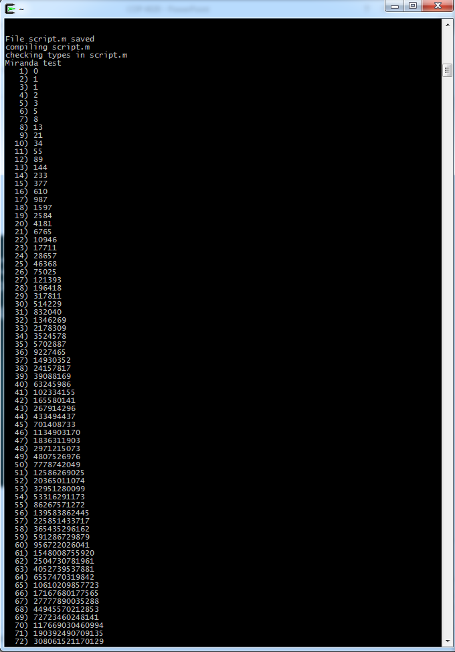
Compiler Part 5

Slide 22
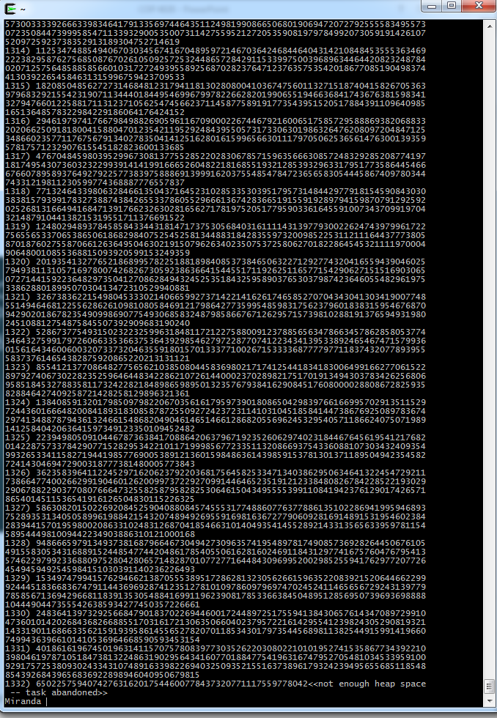
Compiler Part 6 1332

Slide 23
Compiler Part 7

Slide 24
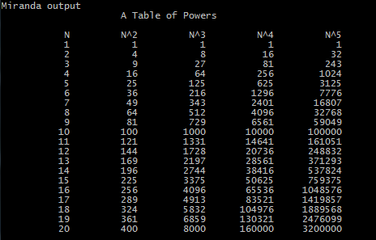
Compiler Part 8

Slide 25
Current State
Last update: 22 December 2010
Last release in 2008

Slide 26
Summery
Designed and excels at fast prototyping.
If you are interested in working with tuples I would recommend that you take a look at this language on a curiosity standpoint.
It is mainly implemented on Unix systems.

