Slide 1
Occam
A Concurrent Programming Language
By: Justin Barnes
Steven Garcia
Esteban Guzman
Stefan Rivas

Slide 2
Table of Contents
Introduction
  Computing before concurrent programming
Occam’s History
  Creator
  Occam versions
Occam Evolution
  Occam Versions and specifications
Uses & Benefits
  Type of Programming Language
Transputer Microprocessors
Structure/Syntax
  The Occam Language
  Precedence
  Declaring Variables
  Constructors and SEQ
  PAR
  IF and WHILE
  ALT
  PROC
Examples
  Time Delay
  Producer/Consumer
  Fibonacci Sequence
Conclusion
References

Slide 3
Introduction
Named after philosopher William of Ockham, England and his law (later) named Occam’s razor
Processing was done through serial communication (byte-by-byte decoding)
One CPU used to perform sequential operations needing to be executed in order
Parallel/Concurrent processing requires a breakdown of a problem, requiring more resources

Slide 4


Occam’s History
David May was the lead architect working with an INMOS team
  Computer Scientist
  Worked in Bristol as Architect of the INMOS Transputer
Inspired and motivated by Tony (C.A.R.) Hoare

Slide 5
Occam Evolution
Occam 1
  Created May 1983
  Conjunction between the first Transputer and Tony Hoare’s ideas of CSP
  One Dimensional
Occam 2
  Developed in 1987
  Types and type checking

Slide 6
Occam Evolution
Occam 2.1*
  Introduced record types
  Allows naming of arrays for abstract use
  New constructs supported named and structured data types
Occam-π**
  A derivation of the occam versions
  The best features of Tony Hoare’s CSP combined with π-calculus developed by Robin Milner
  Non-deterministic choice over communication channels
  *Reference (3)
  **Reference (2)

Slide 7
Uses & Benefits
Occam is an imperative procedural language
Meaning it’s structured to take statements sequentially (one after another) and also has the ability to store procedures (or functions) that may be called at any time
Viewed as the assembly language for the Transputer
Examples to come

Slide 8
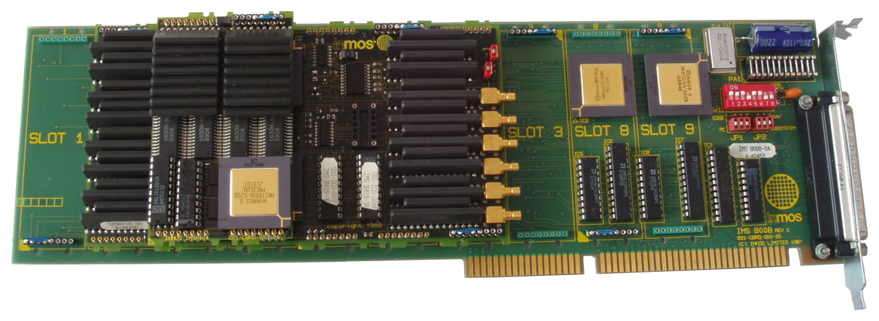
Transputer Microprocessors*
Transputer is a 32-bit microprocessor (20 MHz clock)
The T414 was the original Transputer released in 1985
Had four bi-directional serial channels to allow concurrent message passing to other Transputers
Essentially created to support David May and his team’s concurrency model, the Occam language
*Reference (1)

Slide 9
The Occam Language
There are 5 primitive actions in Occam:
  *PRIMITIVE SYNTAX EXAMPLE
  assignment <variable> := <expression> x := y + 1
  receive <channel> ? <variable> Ch ? x
  send <channel> ! <expression> Ch ! y + 1
  SKIP SKIP SKIP
  STOP STOP STOP
  Assignment – assigns the variable the value of the expression
  Receive – receives a value from a channel
  Send – sends expression value on a channel
  SKIP – do nothing and terminate the statement (no operation)
  STOP – do nothing and never terminate the statement (never get to the next statement) (Hyde, 1995)
The “!” and “?” symbols come straight from the notation used in Hoare’s CSP
*Reference (1)

Slide 10
Precedence
In Occam, there is no operator precedence
  Parenthesis must be used to specify the order of operation
  x := 2 * y + 1 -- this is illegal
  x := (2 * y) + 1 -- proper implementation

Slide 11
Declaring Variables
Declarations are in the form:
    <type> <one or more identifiers separated by commas> :
Available variable types are:
  INT – for integers
  BOOL – for Booleans
  BYTE – for character
  REAL32 – for 32-bit reals
  REAL64 – for 64-bit reals
  CHAN for channels
Examples:
    INT x, y:
    CHAN q:
The only data structure available in Occam are arrays:
    VAL n IS 100: -- declaring n as a constant
  [n][n] INT a: -- 2D int array a

Slide 12
Constructors and SEQ
In Occam, constructors are a set of keywords applied to a set of statements, similar to the BEGIN-END keywords used in Pascal
SEQ is a constructor that executes a set of statements in a sequential order:
    SEQ
    a := 3
    b := a + 5
    c := a – 5
The nested structure of constructors are indicated by indenting the code 2 spaces

Slide 13
PAR
PAR, short for parallel, is used to execute several statements or processes concurrently
PAR
INT x:
ch1 ? x -- receive from channel ch1
INT y:
ch2 ? y -- receive from channel ch2
The whole construct terminates when all processes terminate

Slide 14
IF and WHILE
IF
a > b
c := 3
a < b
c := 4
TRUE
SKIP
Selects the first true Boolean expression and executes the statement
Programmers should always include the TRUE SKIP as the last case to keep the program from stopping
WHILE i < 10
i := i + 1
Standard while loop, very simple and relatable to more modern high-level programming languages

Slide 15
ALT
ALT, short for alternative, is Occam’s implementation of Dijkstra’s guard commands
  ALT
  ch1 ? x
  A[1] := x
  ch2 ? x
  A[2] := x
  time ? AFTER begin.time + (10 * sec)
  SKIP
Randomly selects one true guard and executes its statement. If no guards are true, then it will wait for one to become true

Slide 16
PROC
PROC, short for process, names one process and allows variables to be passed in by value or by reference. No recursion is allowed.
  PROC buff(CHAN OF BYTE in, out)
  WHILE TRUE
  BYTE x:
  SEQ
  in ? x
  out ! x
  : -- end of buff
  CHAN OF BYTE comms, buffer.in, buffer.out:
  PAR
  buff(buffer.in, comms)
  buff(comms, buffer.out)

Slide 17
Example: Time Delay
This is a simple procedure that implements a time delay
PROC delay(VAL INT us)
TIMER Tim:
INT t:
SEQ
Tim ? t
t := t PLUS us
Tim ? AFTER t
:

Slide 18
Example: Producer/Consumer
A simple Producer/Consumer implementation
PROC producer (CHAN INT out!)
INT x:
SEQ
x := 0
WHILE TRUE
SEQ
out ! x
x := x + 1
:
PROC consumer (CHAN INT in?)
WHILE TRUE
INT v:
SEQ
in ? v
-- do something with `v'
:
PROC network ()
CHAN INT c:
PAR
producer (c!)
consumer (c?)
:

Slide 19
Example: Fibonacci Sequence
This is an iterative implementation of the Fibonacci sequence
PROC Fibonacci(VAL INT num, CHAN BYTE scr!)
INT prev:
INT curr:
INT i:
INT temp:
SEQ
prev := 0
curr := 1s
SEQ i = 0 FOR num
out.int(prev, 0, scr)
out.string(“ “, 0, scr)
temp := prev + curr
prev := curr
curr := temp
:

Slide 20
Conclusion
Occam helped innovate and pioneer the implementation of concurrent programming
Provided a fundamental and simple approach to parallel processing
Simple structure (inspired by previous languages) helped make it easy to grasp

Slide 21
References
1. Hyde, Daniel C. “Introduction to the Programming Language Occam. (20 Mar. 1995). Bucknell University. Web. 5 Nov. 2012. <http://www.eg.bucknell.edu/~cs366/occam.pdf>.
2. Christian L. Jacobsen , Matthew C. Jadud, Towards concrete concurrency: occam- pi on the LEGO mindstorms, Proceedings of the 36th SIGCSE technical symposium on Computer science education. (February 23-27, 2005). St. Louis, Missouri, USA [doi>10.1145/1047344.1047485]
3. SGS-THOMSON, occam 2.1 REFERENCE MANUAL, (1988). SGS-THOMSON Microelectronics Limited 1995. Web. 5 Nov. 2012. <http://www.wotug.org/occam/documentation/oc21refman.pdf>.

Slide 22
Occam
A Concurrent Programming Language
By: Justin Barnes
Steven Garcia
Esteban Guzman
Stefan Rivas

