Slide 1
Synthetic Reality Laboratory Charlie Hughes ceh@cs.ucf.edu

Slide 2
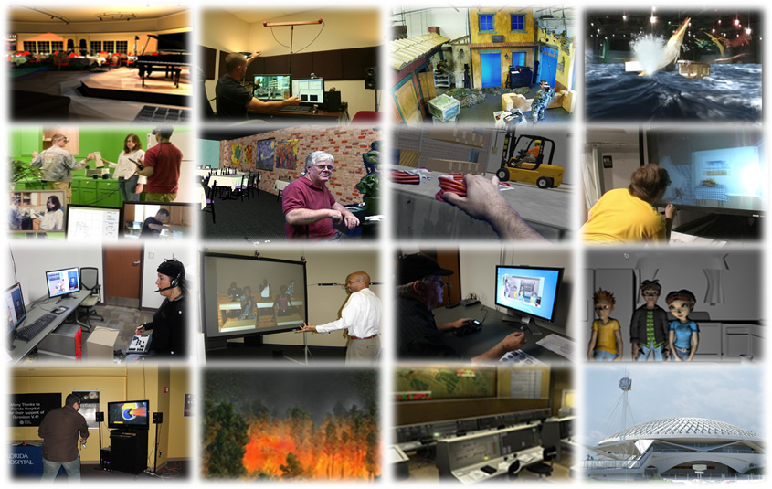

Slide 3
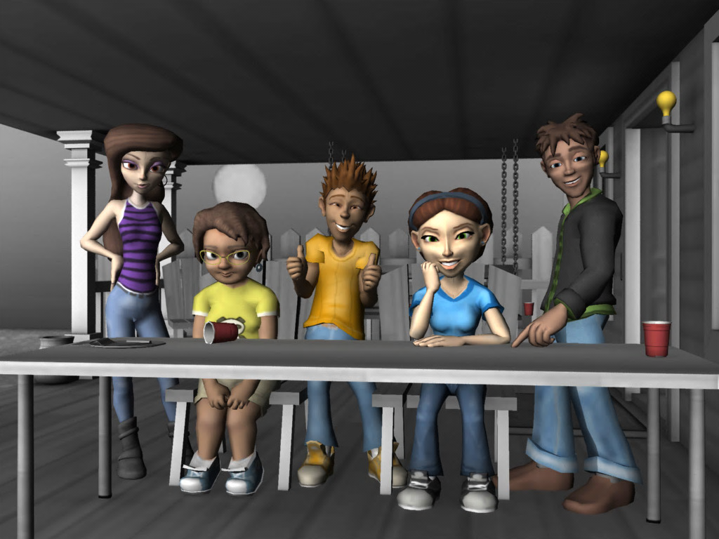
Resist/Avoid Strategies

Slide 4
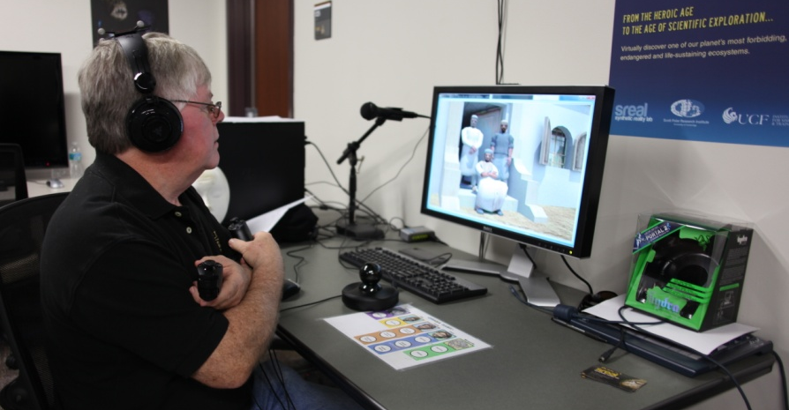
Exposure Therapy with VA

Slide 5
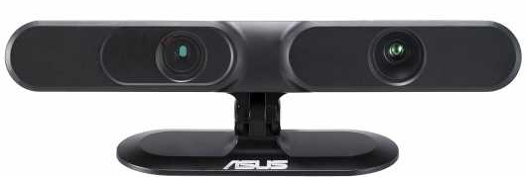
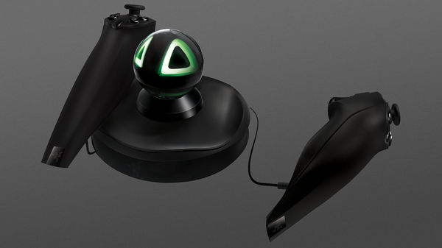
Tech Cost is not the Issue

Slide 6
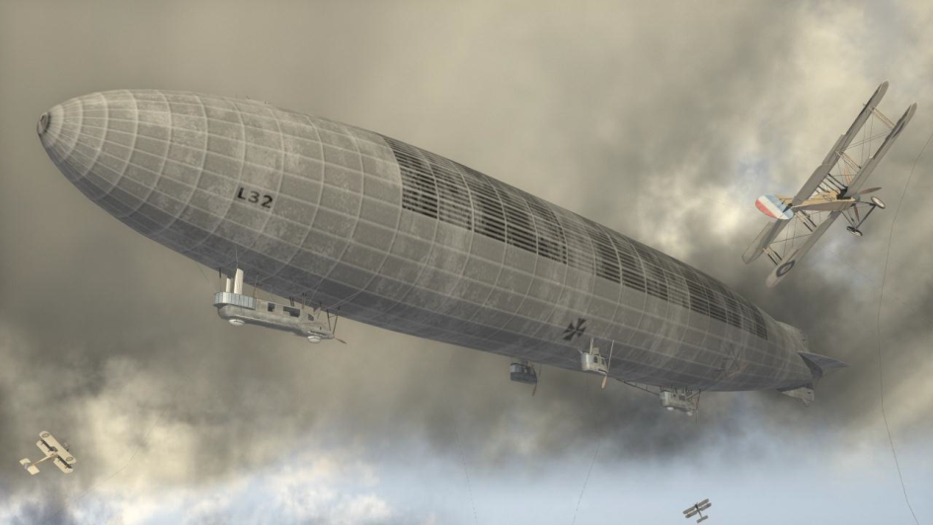
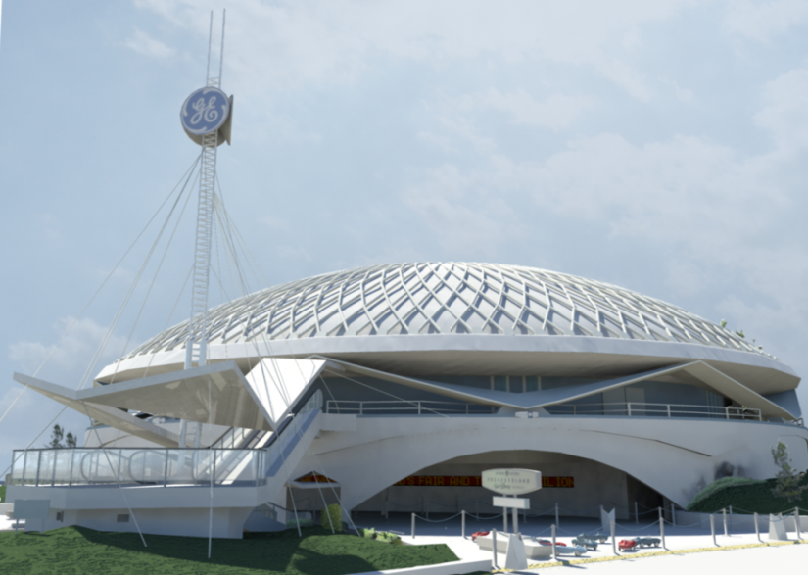
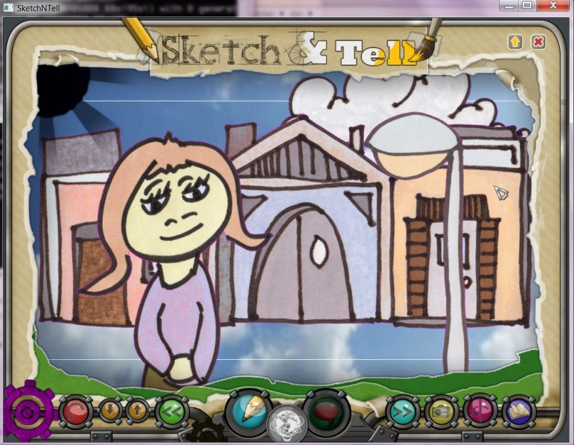
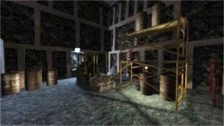
Cultural Heritage and STEM

Slide 7
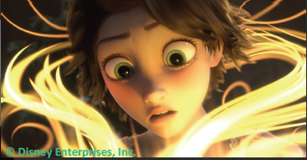
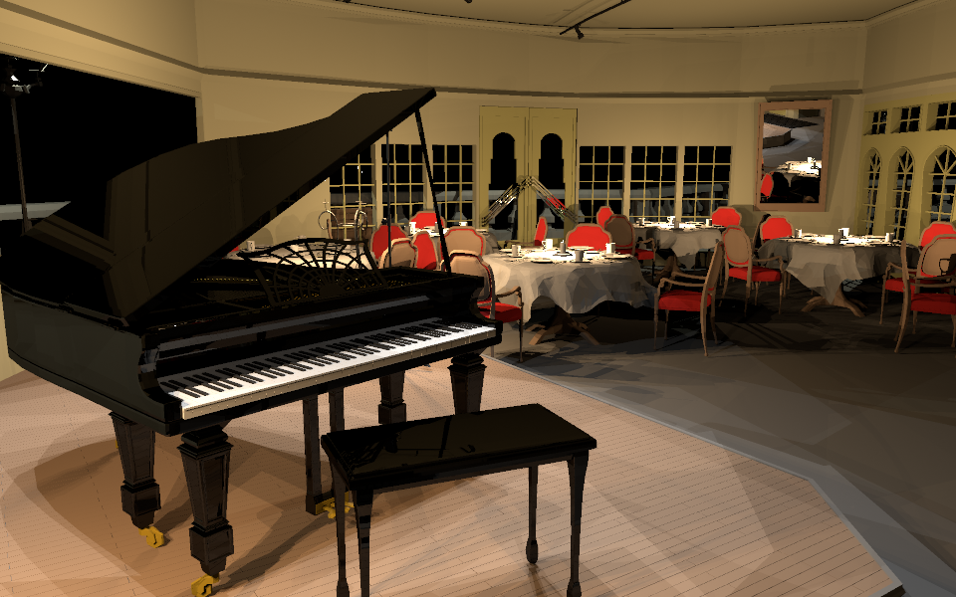
Graphics Research

Slide 8
Active Grants
NSF:
Efficient control and transmission of digital puppetry
Collaborative Research: Reducing Alcohol Use among College Students Using Digital Puppetry
Metaphor-Based Learning of Physics Concepts through Whole-Body Interaction in a Mixed Reality Science Center Exhibit
Interconnections: Revisiting the Future
NIH:
Reality to Build Peer Resistance Skills in Latina Middle Schoolers
Gates
TeachLIVE
NEH
Journey beyond the Fairs

Slide 9
The Team
Academic Faculty
Charlie Hughes, Mike Moshell, Greg Welch
Research Faculty
Darin Hughes, Dan Mapes, Lori Walters
Affiliated Faculty
Lisa Dieker (Educ), Hassan Foroosh (CS), Mike Hynes (Educ), Jun Kim (DM), Joe LaViola (CS), Robb Lindgren (DM), Tom McPeek (Arch), Anne Norris (Nusring), Sumanta Pattanaik (CS), Lisa Rutstrom (Econ, Georgia State), Tracy St. Benoit (Anthro), Natalie Underburg (DM), Jichen Zhu (DM, Drexel)
Post Doctoral Associates
Arjun Nagendran
Students
Pavel Amelishko, Nick Beato, Amy Bolling (Cog Sci), Steven Braeger, Miko Charbonneau, David Crossmier, Elena Erbiceanu, Jennifer Graham, Michael Hopper, Jared Johnson, Sarah Loewy, Juliet Norton, Aleshia Panbamrung (M&S), Neel Patel (high school), Remo Pillat, Ben Shaia, Nick Stanley (CMU), Peter Tonner, Kelly Vandegeer (DM), Lucy Xiong, Alice Yin
3D Artists
Alex Furer, Eric Imperiale, Chip Lundell, Julian Orrego, Alex Zelenin

