Slide 1
COP3503H
Projects
Fall 2011

Slide 2
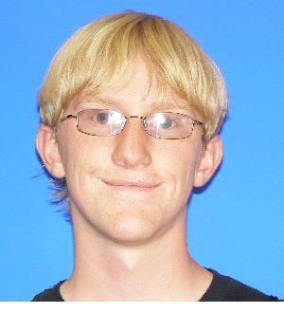
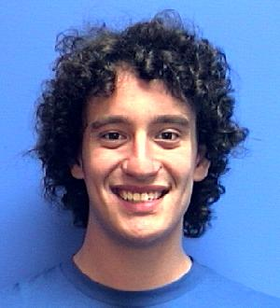
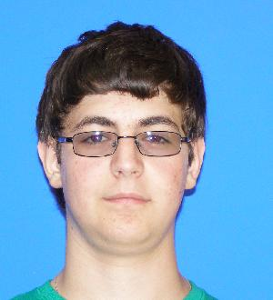
Lindenmayer Systems
11:30
Skyler Goodell
TJ Horwath
Daniel Wasserman

Slide 3
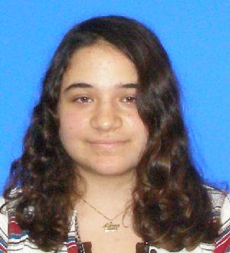
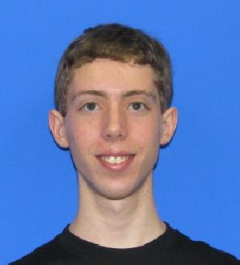
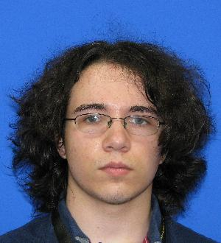
Pathfinders
11:39
Jennifer Graham
Kevin Joslyn
Andre Miereles

Slide 4
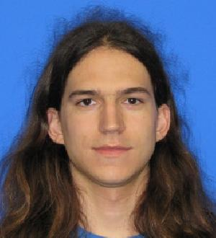
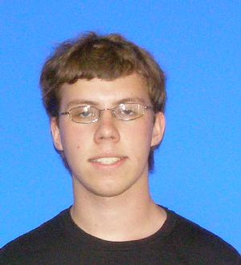
Textcraft
11:48
William Ellett
Nick Phillips

Slide 5
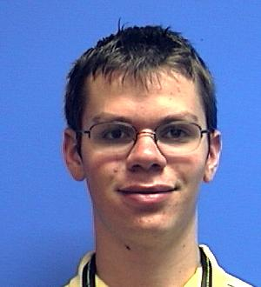
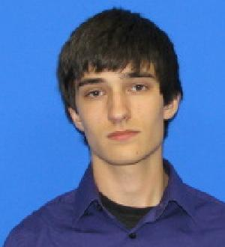
Tree of Life
11:56
Paul Ang
Toby Tobkin

Slide 6
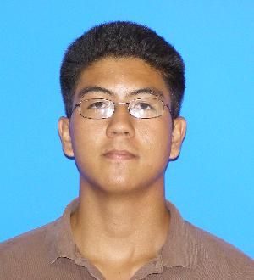
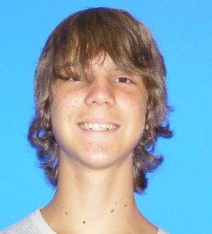
CSIRO Facial Recognition
12:04
Tony Aguilar
Tim Unrue

Slide 7
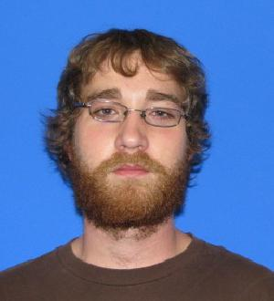
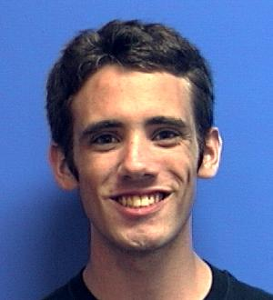
Neural Networks
12:12
Bradley Maier
Kyle Burnett

